Slide 1
Interview Example: nknw964.sas
Y = rating of a job applicant
Factor A represents 5 different personnel officers (interviewers)
n = 4

Slide 2
Interview Example: Input
data interview;
infile ‘H:\My Documents\Stat 512\CH25TA01.DAT';
input rating officer;
proc print data=interview; run;
Obs | rating | officer
1 | 76 | 1
2 | 65 | 1
3 | 85 | 1
4 | 74 | 1
5 | 59 | 2
6 | 75 | 2
7 | 81 | 2
8 | 67 | 2
9 | 49 | 3
10 | 63 | 3
11 | 61 | 3
12 | 46 | 3
⁞ | ⁞ | ⁞

Slide 3
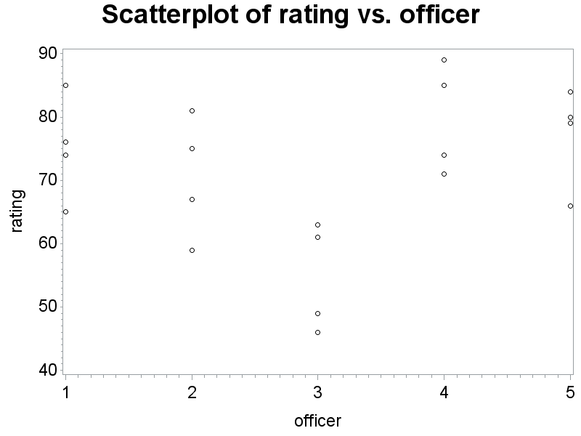
Interview Example: Scatterplot
axis2 label=(angle=90);
symbol1 v=circle i=none c=black;
proc gplot data=interview;
plot rating*officer/vaxis=axis2;
run;
title1 h=3 'Scatterplot
of rating vs.
officer';
goptions htext=2;

Slide 4
Interview Example: Means plot
proc means data=interview;
output out=a2 mean=avrate;
var rating;
by officer;
run;
title1 h=3 'Plot of the means of rating vs. officer';
symbol1 v=circle i=join c=black;
proc gplot data=a2;
plot avrate*officer/vaxis=axis2;
run;

Slide 5
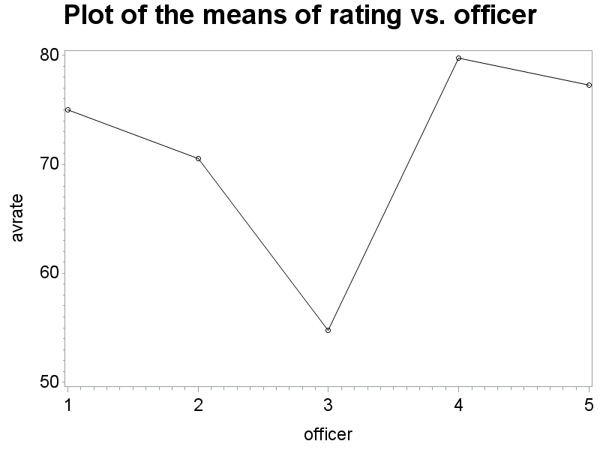
Interview Example: Means plot (cont)

Slide 6
Interview Example: random ANOVA
proc glm data=interview;
class officer;
model rating=officer;
random officer;
run;

Slide 7
Interview Example: random ANOVA (cont)
Source | DF | Sum of Squares | Mean Square | F Value | Pr > F
Model | 4 | 1579.700000 | 394.925000 | 5.39 | 0.0068
Error | 15 | 1099.250000 | 73.283333
Corrected Total | 19 | 2678.950000
R-Square | Coeff Var | Root MSE | rating Mean
0.589671 | 11.98120 | 8.560569 | 71.45000
Source | DF | Type III SS | Mean Square | F Value | Pr > F
officer | 4 | 1579.700000 | 394.925000 | 5.39 | 0.0068
Source | Type III Expected Mean Square
officer | Var(Error) + 4 Var(officer)

Slide 8
Interview Example: Variances
proc varcomp data=interview;
class officer;
model rating=officer;
run;
MIVQUE(0) Estimates
Variance Component | rating
Var(officer) | 80.41042
Var(Error) | 73.28333

Slide 9
Interview Example: ANOVA random (mixed)
proc mixed data=interview cl;
class officer;
model rating=;
random officer/vcorr;
run;

Slide 10
Interview Example: ANOVA random (mixed) (cont)
The Mixed Procedure
Covariance Parameter Estimates
Cov Parm | Estimate | Alpha | Lower | Upper
officer | 80.4104 | 0.05 | 24.4572 | 1498.97
Residual | 73.2833 | 0.05 | 39.9896 | 175.54
Estimated V Correlation Matrix for Subject 1
Row | Col1 | Col2 | Col3 | Col4
1 | 1.0000 | 0.5232 | 0.5232 | 0.5232
2 | 0.5232 | 1.0000 | 0.5232 | 0.5232
3 | 0.5232 | 0.5232 | 1.0000 | 0.5232
4 | 0.5232 | 0.5232 | 0.5232 | 1.0000

Slide 11
Efficiency Example: nknw976.sas
Y = fuel efficiency in mpg
Factor A = 4 drivers
Factor B = 5 cars
n = 4

Slide 12
Efficiency Example: Input
goptions htext=2;
data efficiency;
infile ‘H:\My Documents\Stat 512\CH25PR15.DAT';
input mpg driver car;
proc print data=efficiency;
run;
Obs | mpg | driver | car
1 | 25.3 | 1 | 1
2 | 25.2 | 1 | 1
3 | 28.9 | 1 | 2
4 | 30.0 | 1 | 2
5 | 24.8 | 1 | 3
6 | 25.1 | 1 | 3
7 | 28.4 | 1 | 4
8 | 27.9 | 1 | 4
9 | 27.1 | 1 | 5
10 | 26.6 | 1 | 5
⁞ | ⁞ | ⁞ | ⁞

Slide 13
Efficiency Example: Scatterplot
data efficiency;
set efficiency;
dc = driver*10 + car;
title1 h=3 'Scatterplot';
axis2 label=(angle=90);
symbol1 v=circle i=none c=blue;
proc gplot data=efficiency;
plot mpg*dc/vaxis=axis2;
run;

Slide 14
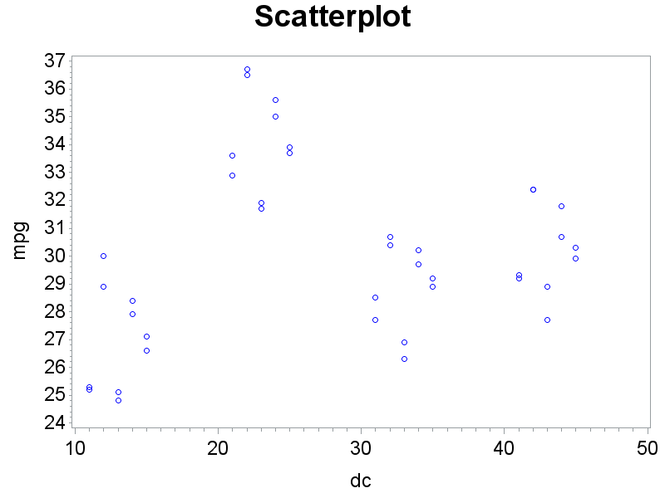
Efficiency Example: Scatterplot (cont)

Slide 15
Efficiency Example: Interaction Plot
proc means data=efficiency;
output out=effout mean=avmpg;
var mpg;
by driver car;
title1 h=3 'Interaction Plot';
symbol1 v='A' i=join c=black h=1.5;
symbol2 v='B' i=join c=red h=1.5;
symbol3 v='C' i=join c=green h=1.5;
symbol4 v='D' i=join c=blue h=1.5;
symbol5 v='E' i=join c=orange h=1.5;
proc gplot data=effout;
plot avmpg*driver=car/vaxis=axis2;
run;

Slide 16
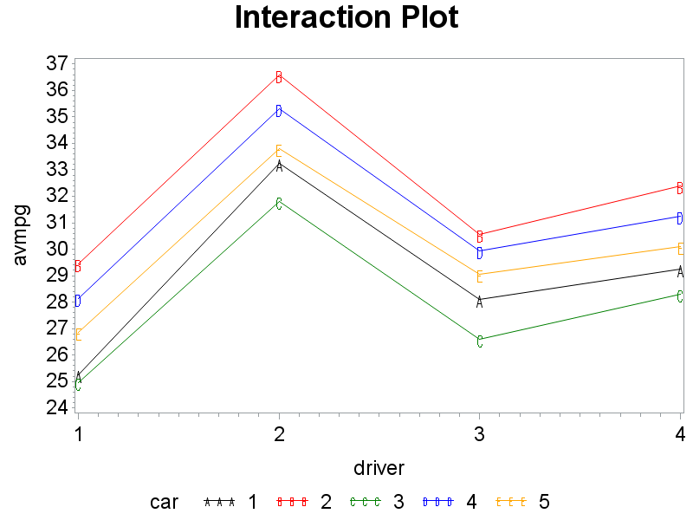
Efficiency Example: Interaction Plot (cont)

Slide 17
Efficiency Example: ANOVA
proc glm data=efficiency;
class driver car;
model mpg=driver car driver*car;
random driver car driver*car/test;
run;
Source | DF | Sum of Squares | Mean Square | F Value | Pr > F
Model | 19 | 377.4447500 | 19.8655132 | 113.03 | <.0001
Error | 20 | 3.5150000 | 0.1757500
Corrected Total | 39 | 380.9597500
Source | DF | Type III SS | Mean Square | F Value | Pr > F
driver | 3 | 280.2847500 | 93.4282500 | 531.60 | <.0001
car | 4 | 94.7135000 | 23.6783750 | 134.73 | <.0001
driver*car | 12 | 2.4465000 | 0.2038750 | 1.16 | 0.3715

Slide 18
Efficiency Example: ANOVA (cont)
Source | Type III Expected Mean Square
driver | Var(Error) + 2 Var(driver*car) + 10 Var(driver)
car | Var(Error) + 2 Var(driver*car) + 8 Var(car)
driver*car | Var(Error) + 2 Var(driver*car)

Slide 19
Efficiency Example: ANOVA (cont)
Tests of Hypotheses for Random Model Analysis of Variance
Dependent Variable: mpg
Source | DF | Type III SS | Mean Square | F Value | Pr > F
driver | 3 | 280.284750 | 93.428250 | 458.26 | <.0001
car | 4 | 94.713500 | 23.678375 | 116.14 | <.0001
Error | 12 | 2.446500 | 0.203875
Error: MS(driver*car)
Source | DF | Type III SS | Mean Square | F Value | Pr > F
driver*car | 12 | 2.446500 | 0.203875 | 1.16 | 0.3715
Error: MS(Error) | 20 | 3.515000 | 0.175750

Slide 20
Efficiency Example: variances
proc varcomp data=efficiency;
class driver car;
model mpg=driver car driver*car;
run;
MIVQUE(0) Estimates
Variance Component | mpg
Var(driver) | 9.32244
Var(car) | 2.93431
Var(driver*car) | 0.01406
Var(Error) | 0.17575

Slide 21
Efficiency Example: ANOVA
proc mixed data=efficiency cl;
class car driver;
model mpg=;
random car driver car*driver/vcorr;
run;
Covariance Parameter Estimates
Cov Parm | Estimate | Alpha | Lower | Upper
car | 2.9343 | 0.05 | 1.0464 | 24.9038
driver | 9.3224 | 0.05 | 2.9864 | 130.79
car*driver | 0.01406 | 0.05 | 0.001345 | 3.592E17
Residual | 0.1757 | 0.05 | 0.1029 | 0.3665

Slide 22
Efficiency Example: Interaction Plot (cont)

Slide 23
Service Example: 25.16 (nknw1005.sas)
Y = service time for disk drives
A = make of drive (3)
fixed
B = technician performing the service (3)
random
n = 5

Slide 24
Service Example: input
data service;
infile 'H:\My Documents\Stat 512\CH19PR16.DAT';
input time tech make k;
mt = make*10+tech;
proc print data=service;
run;
title1 'Proc glm with tech, make*tech random';
proc glm data=service;
class make tech;
model time = make tech make*tech;
random tech make*tech/test;
run;

Slide 25
Service Example: ANOVA
Source | DF | Sum of Squares | Mean Square | F Value | Pr > F
Model | 8 | 1268.177778 | 158.522222 | 3.05 | 0.0101
Error | 36 | 1872.400000 | 52.011111
Corrected Total | 44 | 3140.577778
Source | DF | Type III SS | Mean Square | F Value | Pr > F
make | 2 | 28.311111 | 14.155556 | 0.27 | 0.7633
tech | 2 | 24.577778 | 12.288889 | 0.24 | 0.7908
make*tech | 4 | 1215.288889 | 303.822222 | 5.84 | 0.0010
Source | Type III Expected Mean Square
make | Var(Error) + 5 Var(make*tech) + Q(make)
tech | Var(Error) + 5 Var(make*tech) + 15 Var(tech)
make*tech | Var(Error) + 5 Var(make*tech)

Slide 26
Service Example: /test
Tests of Hypotheses for Mixed Model Analysis of Variance
Dependent Variable: time
Source | DF | Type III SS | Mean Square | F Value | Pr > F
make | 2 | 28.311111 | 14.155556 | 0.05 | 0.9550
tech | 2 | 24.577778 | 12.288889 | 0.04 | 0.9607
Error: MS(make*tech) | 4 | 1215.288889 | 303.822222
Source | DF | Type III SS | Mean Square | F Value | Pr > F
make*tech | 4 | 1215.288889 | 303.822222 | 5.84 | 0.0010
Error: MS(Error) | 36 | 1872.400000 | 52.011111

