Slide 1
Hormone Example: nknw892.sas
Y = change in growth rate after treatment
Factor A = gender (male, female)
Factor B = bone development level (severely depressed, moderately depressed, mildly depressed)
n_{ij}
 |  | j
 |  | 1:severely | 2:moderately | 3:mildly
i | 1: male | 3 | 2 | 2
 | 2: female | 1 | 3 | 3

Slide 2
Hormone Example: Input
data hormone;
infile ‘H:\My Documents\Stat 512\CH23TA01.DAT';
input growth gender bone;
proc print data=hormone;
run;
Obs | growth | gender | bone
1 | 1.4 | 1 | 1
2 | 2.4 | 1 | 1
3 | 2.2 | 1 | 1
4 | 2.1 | 1 | 2
5 | 1.7 | 1 | 2
6 | 0.7 | 1 | 3
7 | 1.1 | 1 | 3
8 | 2.4 | 2 | 1
9 | 2.5 | 2 | 2
10 | 1.8 | 2 | 2
11 | 2.0 | 2 | 2
12 | 0.5 | 2 | 3
13 | 0.9 | 2 | 3
14 | 1.3 | 2 | 3

Slide 3
Hormone Example: Scatterplot
data hormone; set hormone;
if (gender eq 1)*(bone eq 1) then gb='1_Msev ';
if (gender eq 1)*(bone eq 2) then gb='2_Mmod ';
if (gender eq 1)*(bone eq 3) then gb='3_Mmild';
if (gender eq 2)*(bone eq 1) then gb='4_Fsev ';
if (gender eq 2)*(bone eq 2) then gb='5_Fmod ';
if (gender eq 2)*(bone eq 3) then gb='6_Fmild';
run;
title1 h=3 'Scatterplot Hormone Example';
axis1 label=(h=2);
axis2 label=(h=2 angle=90);
symbol1 v=circle i=none c=blue;
proc gplot data=hormone;
plot growth*gb/haxis=axis1 vaxis=axis2;
run;

Slide 4
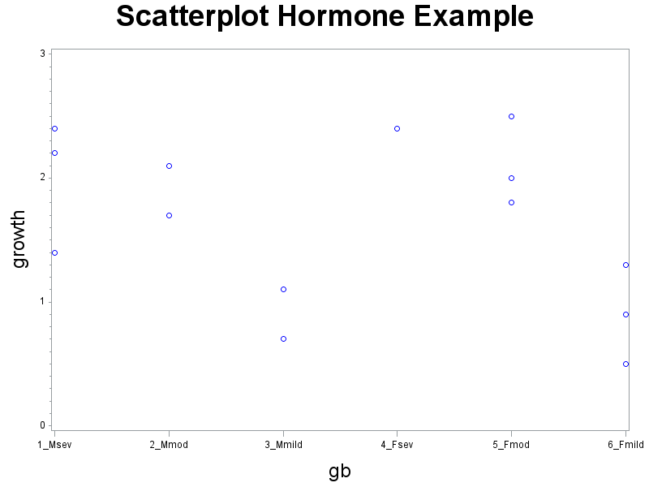
Hormone Example: Scatterplot (cont)

Slide 5
Hormone Example: Means/Interaction
proc means data=hormone;
output out=means mean=avgrowth;
by gender bone;
title1 h=3 'Plot of the means';
symbol1 v='M' i=join c=black h=1.5;
symbol2 v='F' i=join c=purple h=1.5;
proc gplot data=means;
plot avgrowth*bone=gender/haxis=axis1 vaxis=axis2;
run;
symbol1 v='S' i=join c=black h=1.5;
symbol2 v='M' i=join c=red h=1.5;
symbol3 v='L' i=join c=blue h=1.5;
proc gplot data=means;
plot avgrowth*gender=bone/haxis=axis1 vaxis=axis2;
run;

Slide 6
Hormone Example: Means (cont)
gender=1 bone=2
gender=1 bone=3
gender=2 bone=1
gender=2 bone=2
gender=2 bone=3
Analysis Variable : growth
N | Mean | Std Dev | Minimum | Maximum
gender=1 bone=1
3 | 2.0000000 | 0.5291503 | 1.4000000 | 2.4000000
2 | 1.9000000 | 0.2828427 | 1.7000000 | 2.1000000
2 | 0.9000000 | 0.2828427 | 0.7000000 | 1.1000000
1 | 2.4000000 | . | 2.4000000 | 2.4000000
3 | 2.1000000 | 0.3605551 | 1.8000000 | 2.5000000
3 | 0.9000000 | 0.4000000 | 0.5000000 | 1.3000000

Slide 7
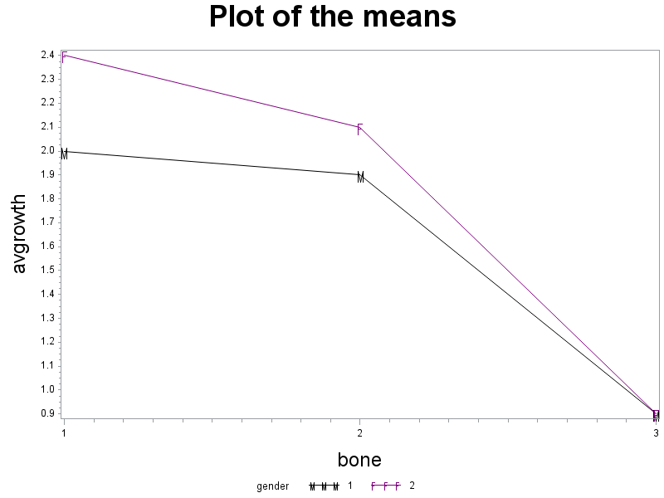
Hormone Example: Interaction (cont)

Slide 8
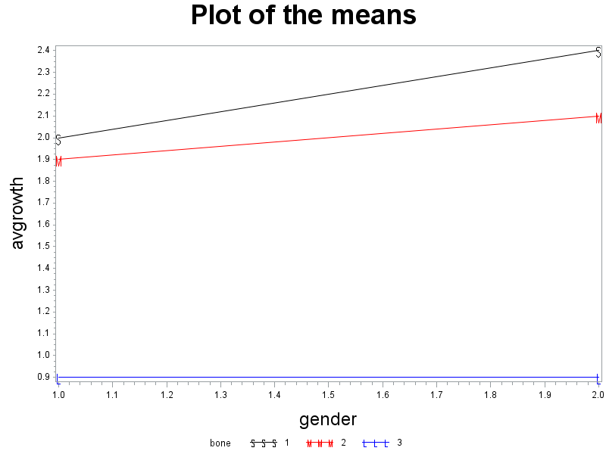
Hormone Example: Interaction (cont)

Slide 9
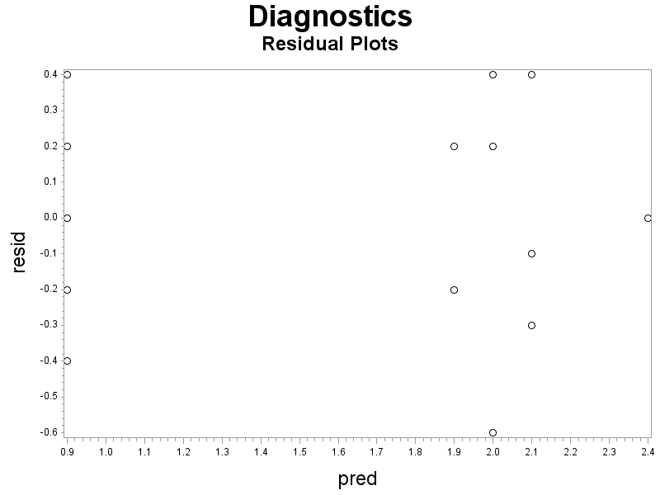
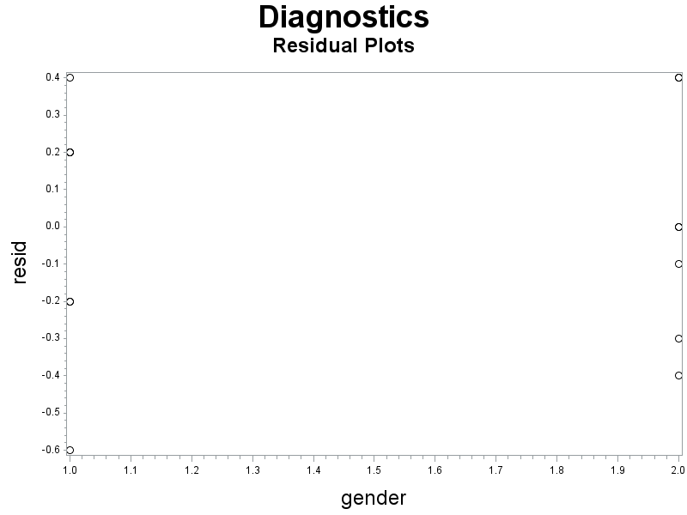
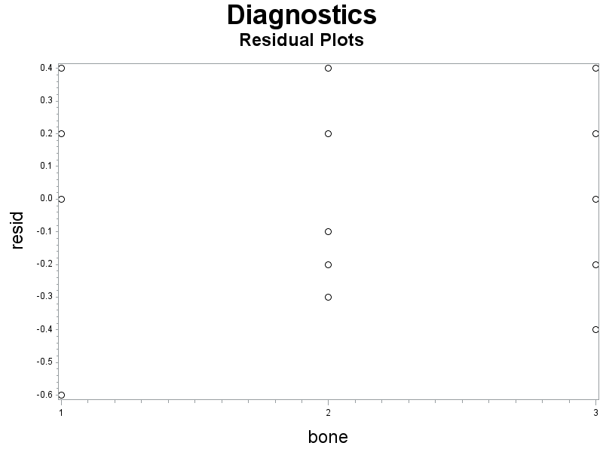
Hormone Example: Residual Plots

Slide 10
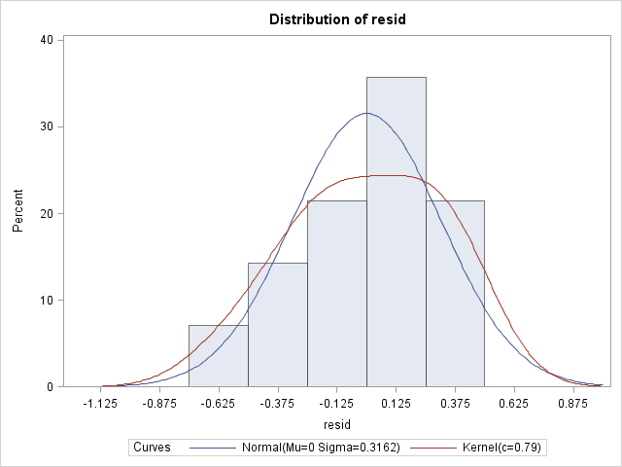
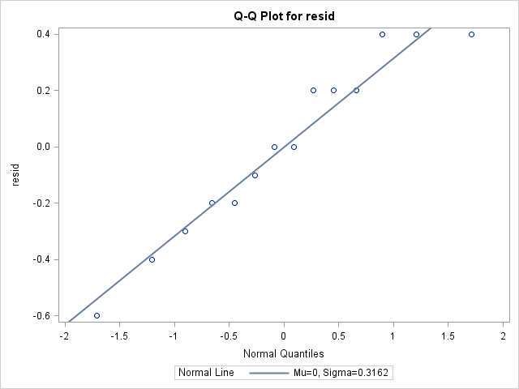
Hormone Example: Normality plots

Slide 11
Hormone Example: ANOVA
proc glm data=hormone;
class gender bone;
model growth=gender|bone/solution;
means gender*bone;
Source | DF | Sum of Squares | Mean Square | F Value | Pr > F
Model | 5 | 4.47428571 | 0.89485714 | 5.51 | 0.0172
Error | 8 | 1.30000000 | 0.16250000
Corrected Total | 13 | 5.77428571
R-Square | Coeff Var | Root MSE | growth Mean
0.774864 | 24.53731 | 0.403113 | 1.642857

Slide 12
Hormone Example: cell means
Level of gender | Level of bone | N | growth
 |  |  | Mean | Std Dev
1 | 1 | 3 | 2.00000000 | 0.52915026
1 | 2 | 2 | 1.90000000 | 0.28284271
1 | 3 | 2 | 0.90000000 | 0.28284271
2 | 1 | 1 | 2.40000000 | .
2 | 2 | 3 | 2.10000000 | 0.36055513
2 | 3 | 3 | 0.90000000 | 0.40000000

Slide 13
Hormone Example: Factor Effects
Parameter | Estimate |  | Standard Error | t Value | Pr > |t|
Intercept | 0.900000000 | B | 0.23273733 | 3.87 | 0.0048
gender 1 | -0.000000000 | B | 0.36799004 | -0.00 | 1.0000
gender 2 | 0.000000000 | B | . | . | .
bone 1 | 1.500000000 | B | 0.46547467 | 3.22 | 0.0122
bone 2 | 1.200000000 | B | 0.32914029 | 3.65 | 0.0065
bone 3 | 0.000000000 | B | . | . | .
gender*bone 1 1 | -0.400000000 | B | 0.59336610 | -0.67 | 0.5192
gender*bone 1 2 | -0.200000000 | B | 0.52041650 | -0.38 | 0.7108
gender*bone 1 3 | 0.000000000 | B | . | . | .
gender*bone 2 1 | 0.000000000 | B | . | . | .
gender*bone 2 2 | 0.000000000 | B | . | . | .
gender*bone 2 3 | 0.000000000 | B | . | . | .

Slide 14
Hormone Example: SS
Source | DF | Type I SS | Mean Square | F Value | Pr > F
gender | 1 | 0.00285714 | 0.00285714 | 0.02 | 0.8978
bone | 2 | 4.39600000 | 2.19800000 | 13.53 | 0.0027
gender*bone | 2 | 0.07542857 | 0.03771429 | 0.23 | 0.7980
Source | DF | Type III SS | Mean Square | F Value | Pr > F
gender | 1 | 0.12000000 | 0.12000000 | 0.74 | 0.4152
bone | 2 | 4.18971429 | 2.09485714 | 12.89 | 0.0031
gender*bone | 2 | 0.07542857 | 0.03771429 | 0.23 | 0.7980

Slide 15
Hormone Example: Contrast gender*bone
contrast 'gender*bone Type I and III'
gender*bone 1 -1 0 -1 1 0,
gender*bone 0 1 -1 0 -1 1;
Contrast | DF | Contrast SS | Mean Square | F Value | Pr > F
gender*bone Type I and III | 2 | 0.07542857 | 0.03771429 | 0.23 | 0.7980
Source | DF | Type I SS | Mean Square | F Value | Pr > F
gender*bone | 2 | 0.07542857 | 0.03771429 | 0.23 | 0.7980
Source | DF | Type III SS | Mean Square | F Value | Pr > F
gender*bone | 2 | 0.07542857 | 0.03771429 | 0.23 | 0.7980

Slide 16
Hormone Example: Contrast gender Type III
contrast 'gender Type III'
gender 3 -3
gender*bone 1 1 1 -1 -1 -1;
estimate 'gender Type III'
gender 3 -3
gender*bone 1 1 1 -1 -1 -1;
Contrast | DF | Contrast SS | Mean Square | F Value | Pr > F
gender Type III | 1 | 0.12000000 | 0.12000000 | 0.74 | 0.4152
Parameter | Estimate | Standard Error | t Value | Pr > |t|
gender Type III | -0.60000000 | 0.69821200 | -0.86 | 0.4152
Source | DF | Type III SS | Mean Square | F Value | Pr > F
gender | 1 | 0.12000000 | 0.12000000 | 0.74 | 0.4152

Slide 17
Hormone Example: Contrast gender Type I
contrast 'gender Type I'
gender 7 -7
bone 2 -1 -1
gender*bone 3 2 2 -1 -3 -3;
estimate 'gender Type I'
gender 7 -7
bone 2 -1 -1
gender*bone 3 2 2 -1 -3 -3;
Contrast | DF | Contrast SS | Mean Square | F Value | Pr > F
gender Type I | 1 | 0.00285714 | 0.00285714 | 0.02 | 0.8978
Parameter | Estimate | Standard Error | t Value | Pr > |t|
gender Type I | 0.20000000 | 1.50831031 | 0.13 | 0.8978
Source | DF | Type I SS | Mean Square | F Value | Pr > F
gender | 1 | 0.00285714 | 0.00285714 | 0.02 | 0.8978

Slide 18
Hormone Example: Contrast Bone III
contrast 'bone Type III'
bone 2 -2 0
gender*bone 1 -1 0 1 -1 0,
bone 0 2 -2
gender*bone 0 1 -1 0 1 -1;
Contrast | DF | Contrast SS | Mean Square | F Value | Pr > F
bone Type III | 2 | 4.18971429 | 2.09485714 | 12.89 | 0.0031
Source | DF | Type III SS | Mean Square | F Value | Pr > F
bone | 2 | 4.18971429 | 2.09485714 | 12.89 | 0.0031

Slide 19
Hormone Example: Contrast Bone I
contrast 'bone Type I'
gender 7 -7
bone 20 -20 0
gender*bone 15 -8 0 5 -12 0,
bone 0 5 -5
gender*bone 0 2 -2 0 3 -3;
Contrast | DF | Contrast SS | Mean Square | F Value | Pr > F
bone Type I | 2 | 4.30628571 | 2.15314286 | 13.25 | 0.0029
Source | DF | Type I SS | Mean Square | F Value | Pr > F
bone | 2 | 4.39600000 | 2.19800000 | 13.53 | 0.0027
bone first | 2 | 4.30628571 | 2.15314286 | 13.25 | 0.0029

Slide 20
Hormone Example: SS
Source | DF | Type I SS | Mean Square | F Value | Pr > F
gender | 1 | 0.00285714 | 0.00285714 | 0.02 | 0.8978
bone | 2 | 4.39600000 | 2.19800000 | 13.53 | 0.0027
gender*bone | 2 | 0.07542857 | 0.03771429 | 0.23 | 0.7980
Source | DF | Type III SS | Mean Square | F Value | Pr > F
gender | 1 | 0.12000000 | 0.12000000 | 0.74 | 0.4152
bone | 2 | 4.18971429 | 2.09485714 | 12.89 | 0.0031
gender*bone | 2 | 0.07542857 | 0.03771429 | 0.23 | 0.7980

Slide 21
Hormone Example: Interaction (cont)

Slide 22
Hormone Example: with pooling
proc glm data=hormone;
class gender bone;
model growth=gender bone/solution;
means gender bone/ tukey lines;
run;

Slide 23
Hormone Example: with pooling (cont)
Source | DF | Sum of Squares | Mean Square | F Value | Pr > F
Model | 3 | 4.39885714 | 1.46628571 | 10.66 | 0.0019
Error | 10 | 1.37542857 | 0.13754286
Corrected Total | 13 | 5.77428571
R-Square | Coeff Var | Root MSE | growth Mean
0.761801 | 22.57456 | 0.370868 | 1.642857
Source | DF | Type I SS | Mean Square | F Value | Pr > F
gender | 1 | 0.00285714 | 0.00285714 | 0.02 | 0.8883
bone | 2 | 4.39600000 | 2.19800000 | 15.98 | 0.0008
Source | DF | Type III SS | Mean Square | F Value | Pr > F
gender | 1 | 0.09257143 | 0.09257143 | 0.67 | 0.4311
bone | 2 | 4.39600000 | 2.19800000 | 15.98 | 0.0008

Slide 24
Hormone Example: with pooling (cont)
Parameter | Estimate |  | Standard Error | t Value | Pr > |t|
Intercept | 0.968571429 | B | 0.18572796 | 5.22 | 0.0004
gender 1 | -0.171428571 | B | 0.20896028 | -0.82 | 0.4311
gender 2 | 0.000000000 | B | . | . | .
bone 1 | 1.260000000 | B | 0.25931289 | 4.86 | 0.0007
bone 2 | 1.120000000 | B | 0.23455733 | 4.77 | 0.0008
bone 3 | 0.000000000 | B | . | . | .

Slide 25
Hormone Example: multiple comparisons
Note: | Cell sizes are not equal.
Means with the same letter are not significantly different.
Tukey Grouping | Mean | N | bone
A | 2.1000 | 4 | 1
A
A | 2.0200 | 5 | 2
B | 0.9000 | 5 | 3

Slide 26
Interaction plot

Slide 27
3-way ANOVA Table

Slide 28
Test Statistics for 3-way ANOVA

Slide 29
Exercise Example: nknw943.sas
Y = exercise tolerance
Factor A = gender (male, female)
Factor B = percent body fat (low, high)
Factor C = smoking history (light, heavy)
n = 3

Slide 30
Exercise Example: input
goptions htext=2;
data exercise;
infile H:\My Documents\Stat 512\CH24TA04.DAT';
input extol gender fat smoke;
data exercise;
set exercise;
gfs = 100*gender + 10*fat + smoke;
proc print data=exercise;
run;

Slide 31
Exercise Example: input (cont)
Obs | extol | gender | fat | smoke | gfs
1 | 24.1 | 1 | 1 | 1 | 111
2 | 29.2 | 1 | 1 | 1 | 111
3 | 24.6 | 1 | 1 | 1 | 111
4 | 20.0 | 2 | 1 | 1 | 211
5 | 21.9 | 2 | 1 | 1 | 211
6 | 17.6 | 2 | 1 | 1 | 211
7 | 14.6 | 1 | 2 | 1 | 121
8 | 15.3 | 1 | 2 | 1 | 121
9 | 12.3 | 1 | 2 | 1 | 121
10 | 16.1 | 2 | 2 | 1 | 221
11 | 9.3 | 2 | 2 | 1 | 221
12 | 10.8 | 2 | 2 | 1 | 221
13 | 17.6 | 1 | 1 | 2 | 112
14 | 18.8 | 1 | 1 | 2 | 112
15 | 23.2 | 1 | 1 | 2 | 112
16 | 14.8 | 2 | 1 | 2 | 212
17 | 10.3 | 2 | 1 | 2 | 212
18 | 11.3 | 2 | 1 | 2 | 212
19 | 14.9 | 1 | 2 | 2 | 122
20 | 20.4 | 1 | 2 | 2 | 122
21 | 12.8 | 1 | 2 | 2 | 122
22 | 10.1 | 2 | 2 | 2 | 222
23 | 14.4 | 2 | 2 | 2 | 222
24 | 6.1 | 2 | 2 | 2 | 222

Slide 32
Exercise Example: Scatterplot
proc sort data=exercise;
by gfs;
run;
title1 h=3 'Scatterplot';
axis2 label=(h=2 angle=90);
symbol1 v=circle i=none c=blue;
proc gplot data=exercise;
plot extol*gfs/ haxis = 111 112 121 122 211 212 221 222
vaxis=axis2;
run;

Slide 33
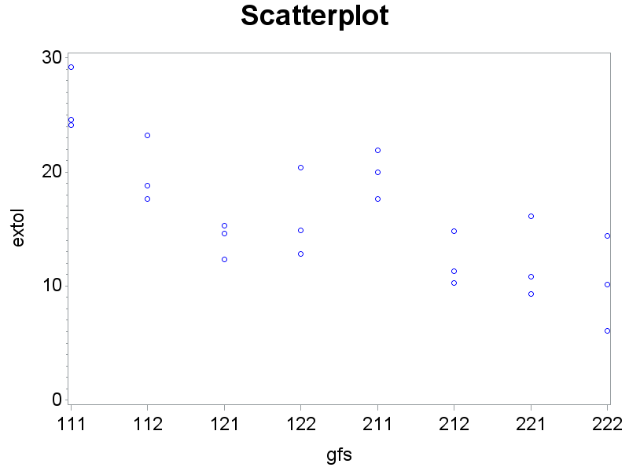
Exercise Example: Scatterplot (cont)

Slide 34
Exercise Example: Interaction Plot
proc sort data=exercise;
by gender fat smoke;
proc means data=exercise;
output out=exer2 mean=avextol;
by gender fat smoke;
data exer2;
set exer2;
fs = fat*10 + smoke;
proc print data=exer2;
run;
Obs | gender | fat | smoke | _TYPE_ | _FREQ_ | avextol | fs
1 | 1 | 1 | 1 | 0 | 3 | 25.9667 | 11
2 | 1 | 1 | 2 | 0 | 3 | 19.8667 | 12
3 | 1 | 2 | 1 | 0 | 3 | 14.0667 | 21
4 | 1 | 2 | 2 | 0 | 3 | 16.0333 | 22
5 | 2 | 1 | 1 | 0 | 3 | 19.8333 | 11
6 | 2 | 1 | 2 | 0 | 3 | 12.1333 | 12
7 | 2 | 2 | 1 | 0 | 3 | 12.0667 | 21
8 | 2 | 2 | 2 | 0 | 3 | 10.2000 | 22

Slide 35
Exercise Example: Interaction Plot (cont)
title1 h=3 'Interaction Plot';
proc sort data=exer2; by fs;
symbol1 v='M' i=join c=blue height=1.5;
symbol2 v='F' i=join c=purple height=1.5;
proc gplot data=exer2;
plot avextol*fs=gender / haxis = 11 12 21 22
vaxis=axis2;
run;

Slide 36
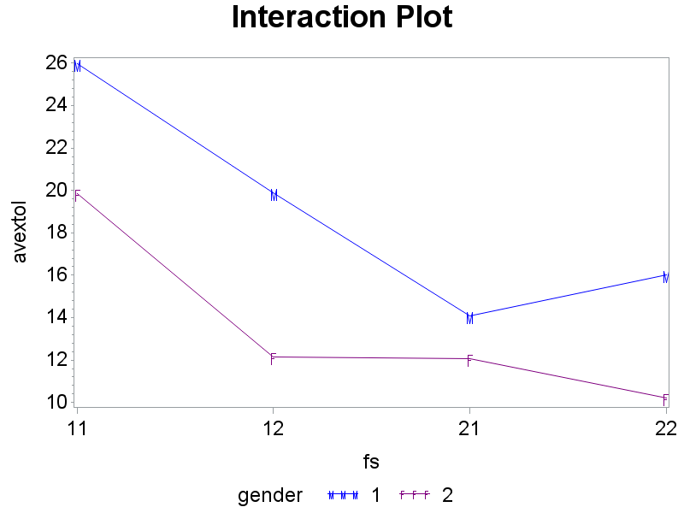
Exercise Example: Interaction Plot (cont)

Slide 37
Exercise Example: ANOVA – full model
proc glm data=exercise;
class gender fat smoke;
model extol=gender|fat|smoke / solution;
means gender*fat*smoke;
output out=diag r = resid p = pred;
run;

Slide 38
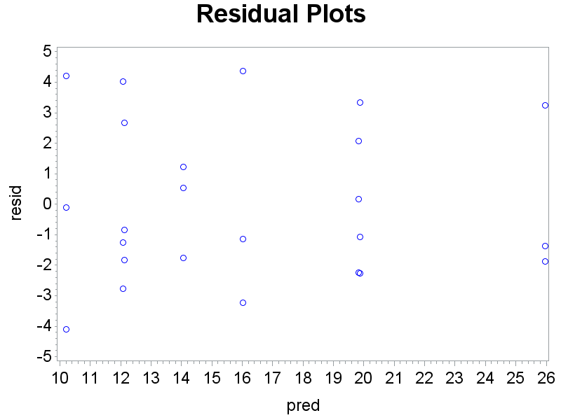
Exercise Example: Residual Plots

Slide 39
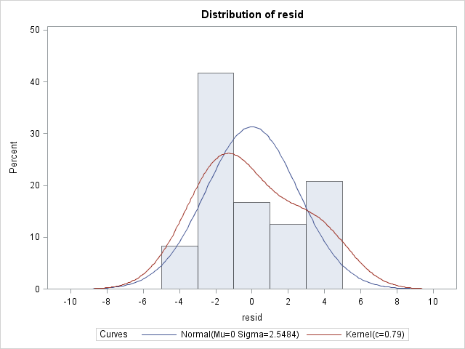
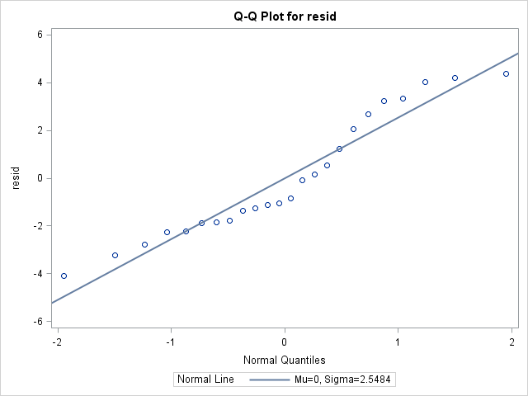
Exercise Example: Normality Plots

Slide 40
Exercise Example: ANOVA table
Source | DF | Sum of Squares | Mean Square | F Value | Pr > F
Model | 7 | 588.5829167 | 84.0832738 | 9.01 | 0.0002
Error | 16 | 149.3666667 | 9.3354167
Corrected Total | 23 | 737.9495833
R-Square | Coeff Var | Root MSE | extol Mean
0.797592 | 18.77833 | 3.055391 | 16.27083
Source | DF | Type III SS | Mean Square | F Value | Pr > F
gender | 1 | 176.5837500 | 176.5837500 | 18.92 | 0.0005
fat | 1 | 242.5704167 | 242.5704167 | 25.98 | 0.0001
gender*fat | 1 | 13.6504167 | 13.6504167 | 1.46 | 0.2441
smoke | 1 | 70.3837500 | 70.3837500 | 7.54 | 0.0144
gender*smoke | 1 | 11.0704167 | 11.0704167 | 1.19 | 0.2923
fat*smoke | 1 | 72.4537500 | 72.4537500 | 7.76 | 0.0132
gender*fat*smoke | 1 | 1.8704167 | 1.8704167 | 0.20 | 0.6604

Slide 41
Exercise Example: Cell Means
Level of gender | Level of fat | Level of smoke | N | extol
 |  |  |  | Mean | Std Dev
1 | 1 | 1 | 3 | 25.9666667 | 2.81128678
1 | 1 | 2 | 3 | 19.8666667 | 2.94844592
1 | 2 | 1 | 3 | 14.0666667 | 1.56950098
1 | 2 | 2 | 3 | 16.0333333 | 3.92470806
2 | 1 | 1 | 3 | 19.8333333 | 2.15483951
2 | 1 | 2 | 3 | 12.1333333 | 2.36290781
2 | 2 | 1 | 3 | 12.0666667 | 3.57258077
2 | 2 | 2 | 3 | 10.2000000 | 4.15090352

Slide 42
Exercise Example: Factor Effects Model
Parameter | Estimate |  | Standard Error | t Value | Pr > |t|
Intercept | 10.20000000 | B | 1.76403105 | 5.78 | <.0001
gender 1 | 5.83333333 | B | 2.49471664 | 2.34 | 0.0327
gender 2 | 0.00000000 | B | . | . | .
fat 1 | 1.93333333 | B | 2.49471664 | 0.77 | 0.4497
fat 2 | 0.00000000 | B | . | . | .
gender*fat 1 1 | 1.90000000 | B | 3.52806211 | 0.54 | 0.5976
gender*fat 1 2 | 0.00000000 | B | . | . | .
gender*fat 2 1 | 0.00000000 | B | . | . | .
gender*fat 2 2 | 0.00000000 | B | . | . | .
smoke 1 | 1.86666667 | B | 2.49471664 | 0.75 | 0.4652
smoke 2 | 0.00000000 | B | . | . | .
gender*smoke 1 1 | -3.83333333 | B | 3.52806211 | -1.09 | 0.2933
gender*smoke 1 2 | 0.00000000 | B | . | . | .
gender*smoke 2 1 | 0.00000000 | B | . | . | .
gender*smoke 2 2 | 0.00000000 | B | . | . | .
fat*smoke 1 1 | 5.83333333 | B | 3.52806211 | 1.65 | 0.1177
fat*smoke 1 2 | 0.00000000 | B | . | . | .
fat*smoke 2 1 | 0.00000000 | B | . | . | .
fat*smoke 2 2 | 0.00000000 | B | . | . | .
gender*fat*smoke 1 1 1 | 2.23333333 | B | 4.98943328 | 0.45 | 0.6604
gender*fat*smoke 1 1 2 | 0.00000000 | B | . | . | .
gender*fat*smoke 1 2 1 | 0.00000000 | B | . | . | .
gender*fat*smoke 1 2 2 | 0.00000000 | B | . | . | .
gender*fat*smoke 2 1 1 | 0.00000000 | B | . | . | .
gender*fat*smoke 2 1 2 | 0.00000000 | B | . | . | .
gender*fat*smoke 2 2 1 | 0.00000000 | B | . | . | .
gender*fat*smoke 2 2 2 | 0.00000000 | B | . | . | .

Slide 43
Exercise Example: Factor Effects Model – conceptual constraints
Obs | gender | fat | smoke | μ | α | β | γ
1 | 1 | 1 | 1 | 16.2708 | 2.7125 | 3.17917 | 1.7125
4 | 1 | 1 | 2 | 16.2708 | 2.7125 | 3.17917 | -1.7125
7 | 1 | 2 | 1 | 16.2708 | 2.7125 | -3.17917 | 1.7125
10 | 1 | 2 | 2 | 16.2708 | 2.7125 | -3.17917 | -1.7125
13 | 2 | 1 | 1 | 16.2708 | -2.7125 | 3.17917 | 1.7125
16 | 2 | 1 | 2 | 16.2708 | -2.7125 | 3.17917 | -1.7125
19 | 2 | 2 | 1 | 16.2708 | -2.7125 | -3.17917 | 1.7125
22 | 2 | 2 | 2 | 16.2708 | -2.7125 | -3.17917 | -1.7125
Obs | gender | fat | smoke | αβ | αγ | βγ | αβγ
1 | 1 | 1 | 1 | 0.75417 | -0.67917 | 1.7375 | 0.27917
4 | 1 | 1 | 2 | 0.75417 | 0.67917 | -1.7375 | -0.27917
7 | 1 | 2 | 1 | -0.75417 | -0.67917 | -1.7375 | -0.27917
10 | 1 | 2 | 2 | -0.75417 | 0.67917 | 1.7375 | 0.27917
13 | 2 | 1 | 1 | -0.75417 | 0.67917 | 1.7375 | -0.27917
16 | 2 | 1 | 2 | -0.75417 | -0.67917 | -1.7375 | 0.27917
19 | 2 | 2 | 1 | 0.75417 | 0.67917 | -1.7375 | 0.27917
22 | 2 | 2 | 2 | 0.75417 | -0.67917 | 1.7375 | -0.27917

Slide 44
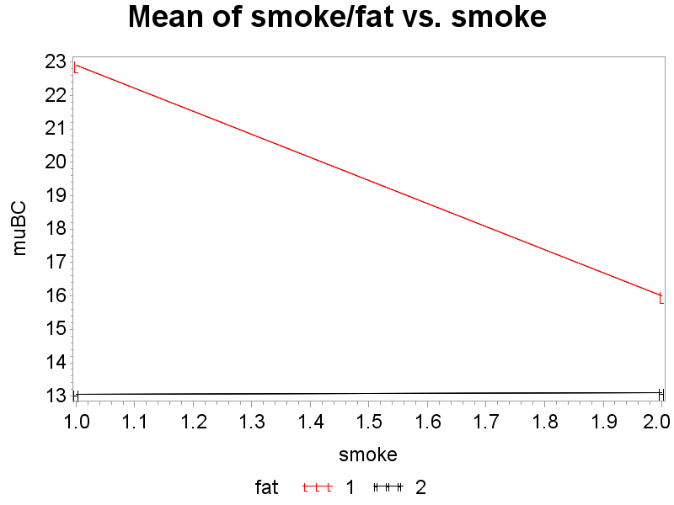
Exercise Example: interaction plot of smoke vs. body fat
title1 h=3 'Mean of smoke/fat vs. smoke';
symbol1 v=L i=join c=red;
symbol2 v=H i=join c=black;
proc gplot data=BCdat;
plot muBC*smoke=fat
/vaxis=axis2;
run;

Slide 45
Exercise Example: Interaction Plot (cont)

Slide 46
Exercise Example: Reduced model
data exercise; set exercise;
fs = 10*fat + smoke;
run;
proc glm data=exercise;
class gender fs;
model extol=gender fs;
means gender fs/tukey;
run;

Slide 47
Exercise Example: Reduced model (cont)
Source | DF | Sum of Squares | Mean Square | F Value | Pr > F
Model | 4 | 561.9916667 | 140.4979167 | 15.17 | <.0001
Error | 19 | 175.9579167 | 9.2609430
Corrected Total | 23 | 737.9495833
R-Square | Coeff Var | Root MSE | extol Mean
0.761558 | 18.70328 | 3.043180 | 16.27083
Source | DF | Type III SS | Mean Square | F Value | Pr > F
gender | 1 | 176.5837500 | 176.5837500 | 19.07 | 0.0003
fs | 3 | 385.4079167 | 128.4693056 | 13.87 | <.0001

Slide 48
Exercise Example: Reduced model (cont)
Means with the same letter are not significantly different.
Tukey Grouping | Mean | N | gender
A | 18.983 | 12 | 1
B | 13.558 | 12 | 2
Means with the same letter are not significantly different.
Tukey Grouping | Mean | N | fs
A | 22.900 | 6 | 11
B | 16.000 | 6 | 12
B
B | 13.117 | 6 | 22
B
B | 13.067 | 6 | 21

