Slide 1
Bread Example: nknw817.sas
Y = number of cases of bread sold (sales)
Factor A = height of shelf display (bottom, middle, top)
Factor B = width of shelf display (regular, wide)
n = 2 (n_{T} = 12)

Slide 2
Bread Example: input
data bread;
infile 'I:\My Documents\Stat 512\CH19TA07.DAT';
input sales height width;
proc print data=bread;
run;
title1 h=3 'Bread Sales';
axis1 label=(h=2);
axis2 label=(h=2 angle=90);
Obs | sales | height | width
1 | 47 | 1 | 1
2 | 43 | 1 | 1
3 | 46 | 1 | 2
4 | 40 | 1 | 2
5 | 62 | 2 | 1
6 | 68 | 2 | 1
7 | 67 | 2 | 2
8 | 71 | 2 | 2
9 | 41 | 3 | 1
10 | 39 | 3 | 1
11 | 42 | 3 | 2
12 | 46 | 3 | 2

Slide 3
Bread Example: input scatterplot
data bread;
set bread;
if height eq 1 and width eq 1 then hw='1_BR';
if height eq 1 and width eq 2 then hw='2_BW';
if height eq 2 and width eq 1 then hw='3_MR';
if height eq 2 and width eq 2 then hw='4_MW';
if height eq 3 and width eq 1 then hw='5_TR';
if height eq 3 and width eq 2 then hw='6_TW';
title2 h=2 'Sales vs. treatment';
symbol1 v=circle i=none c=blue;
proc gplot data=bread;
plot sales*hw/haxis=axis1 vaxis=axis2;
run;

Slide 4
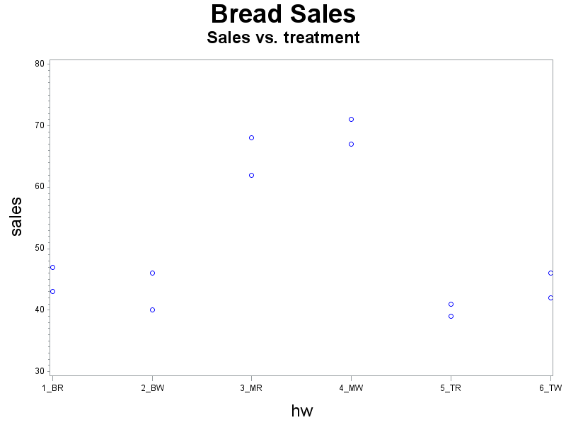
Bread Example: Scatterplot

Slide 5
Bread Example: ANOVA
proc glm data=bread;
class height width;
model sales=height width height*width;
means height width height*width;
output out=diag r=resid p=pred;
run;
Class Level Information
Class | Levels | Values
height | 3 | 1 2 3
width | 2 | 1 2
Number of Observations Read | 12
Number of Observations Used | 12

Slide 6
Bread Example: ANOVA means
Level of height | N | sales
 |  | Mean | Std Dev
1 | 4 | 44.0000000 | 3.16227766
2 | 4 | 67.0000000 | 3.74165739
3 | 4 | 42.0000000 | 2.94392029
Level of width | N | sales
 |  | Mean | Std Dev
1 | 6 | 50.0000000 | 12.0664825
2 | 6 | 52.0000000 | 13.4313067
Level of height | Level of width | N | sales
 |  |  | Mean | Std Dev
1 | 1 | 2 | 45.0000000 | 2.82842712
1 | 2 | 2 | 43.0000000 | 4.24264069
2 | 1 | 2 | 65.0000000 | 4.24264069
2 | 2 | 2 | 69.0000000 | 2.82842712
3 | 1 | 2 | 40.0000000 | 1.41421356
3 | 2 | 2 | 44.0000000 | 2.82842712

Slide 7
Bread Example: Means
proc means data=bread;
var sales;
by height width;
output out=avbread mean=avsales;
proc print data=avbread;
run;
Obs | height | width | _TYPE_ | _FREQ_ | avsales
1 | 1 | 1 | 0 | 2 | 45
2 | 1 | 2 | 0 | 2 | 43
3 | 2 | 1 | 0 | 2 | 65
4 | 2 | 2 | 0 | 2 | 69
5 | 3 | 1 | 0 | 2 | 40
6 | 3 | 2 | 0 | 2 | 44

Slide 8
ANOVA Table – One Way
Source of Variation | df | SS | MS
Model (Regression) | r – 1
Error | n_{T} – r
Total | n_{T} – 1

Slide 9
ANOVA Table – Two Way
Source of Variation | df | SS | MS
Factor A | a – 1
Factor B | b – 1
Interaction (AB) | (a–1)(b–1)
Error | ab(n – 1)
Total | nab – 1

Slide 10
Bread Example: Scatterplot

Slide 11
Bread Example: diagnostics
proc glm data=bread;
class height width;
model sales=height width height*width;
means height width height*width;
output out=diag r=resid p=pred
run;
title2 h=2 'residual plots';
proc gplot data=diag;
plot resid * (pred height width)/vref=0
haxis=axis1 vaxis=axis2;
run;
title2 'normality';
proc univariate data=diag noprint;
histogram resid/normal kernel;
qqplot resid/normal (mu=est sigma=est);
run;

Slide 12
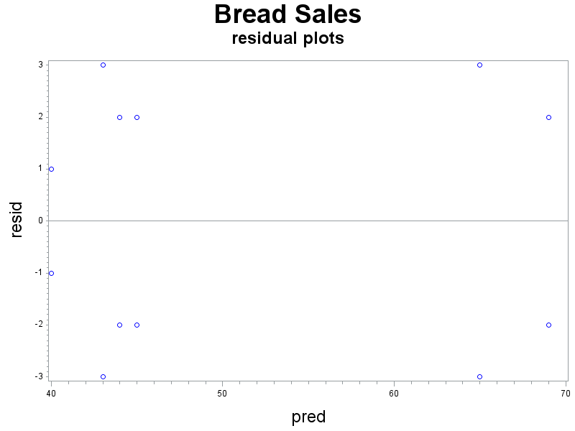
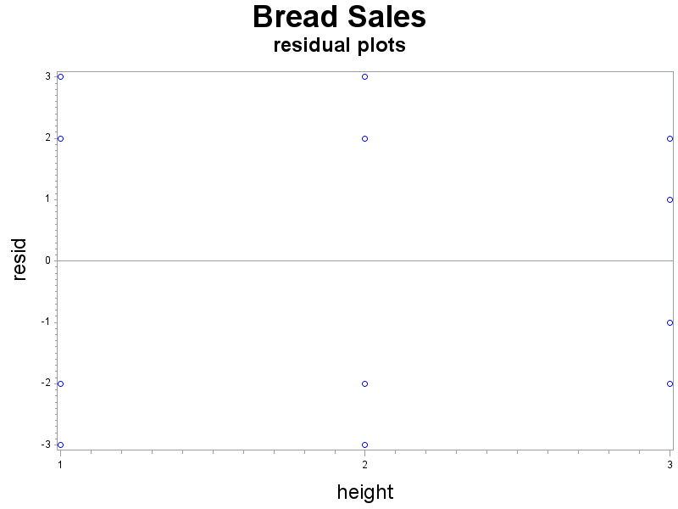
Bread Example: Residual Plots

Slide 13
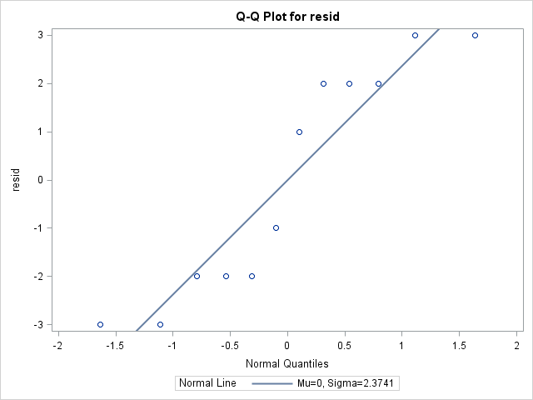
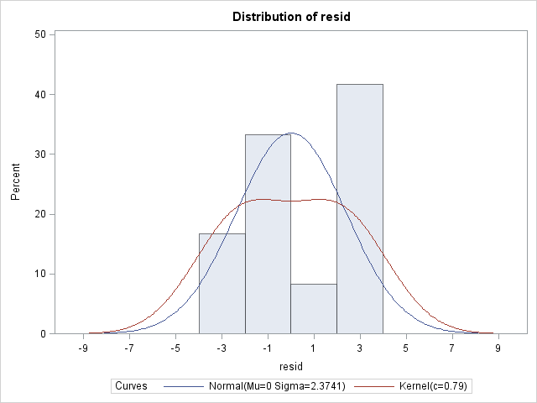
Bread Example: Normality

Slide 14
ANOVA Table – Two Way
Source of Variation | df | SS | MS | F
Model | ab - 1 | SSM | SSM/df_{M} | MSM/MSE
Error | ab(n – 1) | SSE | SSE/df_{E}
Total | nab – 1 | SST
Factor A | a – 1 | SSA | SSA/df_{A} | MSA/MSE
Factor B | b – 1 | SSB | SSB/df_{B} | MSB/MSE
Interaction (AB) | (a–1)(b–1) | SSAB | SSAB/df_{AB} | MSAB/MSE

Slide 15
Strategy for Analysis

Slide 16
Bread Example: nknw817.sas
Y = number of cases of bread sold (sales)
Factor A = height of shelf display (bottom, middle, top)
Factor B = width of shelf display (regular, wide)
n = 2 (n_{T} = 12)
Questions:
Does the height of the display affect sales?
Does the width of the display affect sales?
Does the effect on height on sales depend on width?
Does the effect of the width depend on height?

Slide 17
Bread Example: Interaction Plots
title2 'Interaction Plot';
symbol1 v=square i=join c=black;
symbol2 v=diamond i=join c=red;
symbol3 v=circle i=join c=blue;
proc gplot data=avbread;
plot avsales*height=width/haxis=axis1 vaxis=axis2;
plot avsales*width=height/haxis=axis1 vaxis=axis2;
run;

Slide 18
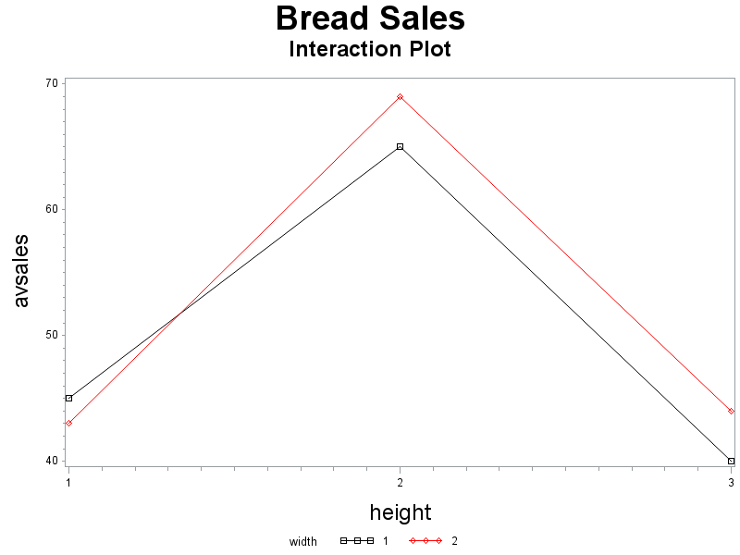
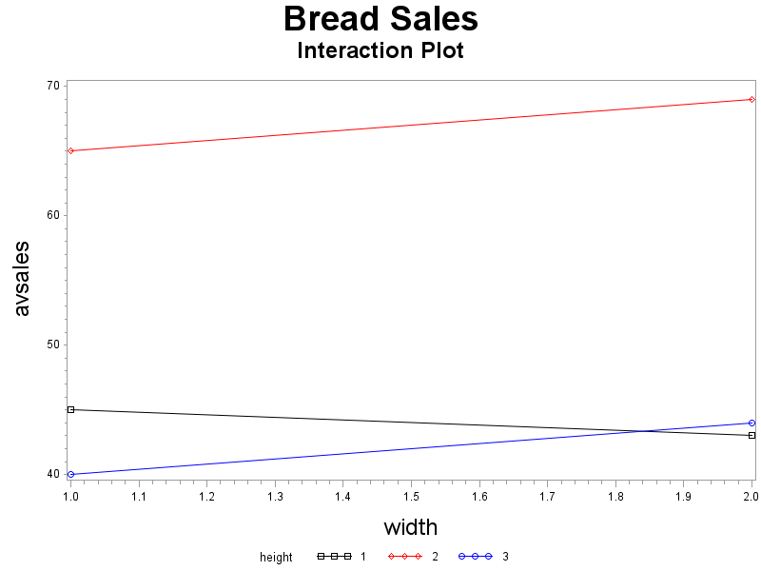
Bread Example: Interaction Plots (cont)

Slide 19
Bread Example: ANOVA table
proc glm data=bread;
class height width;
model sales=height width height*width;
means height width height*width;
output out=diag r=resid p=pred;
run;
Source | DF | Sum of Squares | Mean Square | F Value | Pr > F
Model | 5 | 1580.000000 | 316.000000 | 30.58 | 0.0003
Error | 6 | 62.000000 | 10.333333
Corrected Total | 11 | 1642.000000

Slide 20
Bread Example: ANOVA table
Source | DF | Type I SS | Mean Square | F Value | Pr > F
height | 2 | 1544.000000 | 772.000000 | 74.71 | <.0001
width | 1 | 12.000000 | 12.000000 | 1.16 | 0.3226
height*width | 2 | 24.000000 | 12.000000 | 1.16 | 0.3747
Source | DF | Type III SS | Mean Square | F Value | Pr > F
height | 2 | 1544.000000 | 772.000000 | 74.71 | <.0001
width | 1 | 12.000000 | 12.000000 | 1.16 | 0.3226
height*width | 2 | 24.000000 | 12.000000 | 1.16 | 0.3747
R-Square | Coeff Var | Root MSE | sales Mean
0.962241 | 6.303040 | 3.214550 | 51.00000

Slide 21
Bread Example: Interaction Plots (cont)

Slide 22
Bread Example: cell means model (MSE)
proc glm data=bread;
class height width;
model sales=height width height*width;
means height width height*width;
output out=diag r=resid p=pred;
run;
Source | DF | Sum of Squares | Mean Square | F Value | Pr > F
Model | 5 | 1580.000000 | 316.000000 | 30.58 | 0.0003
Error | 6 | 62.000000 | 10.333333
Corrected Total | 11 | 1642.000000

Slide 23
Bread Example: cell means model
proc glm data=bread;
class height width;
model sales=height width height*width;
means height width height*width;
output out=diag r=resid p=pred;
run;
Level of height | Level of width | N | sales
 |  |  | Mean | Std Dev
1 | 1 | 2 | 45.0000000 | 2.82842712
1 | 2 | 2 | 43.0000000 | 4.24264069
2 | 1 | 2 | 65.0000000 | 4.24264069
2 | 2 | 2 | 69.0000000 | 2.82842712
3 | 1 | 2 | 40.0000000 | 1.41421356
3 | 2 | 2 | 44.0000000 | 2.82842712

Slide 24
Bread Example: factor effects model (overall mean)
Source | DF | Type I SS | Mean Square | F Value | Pr > F
height | 2 | 1544.000000 | 772.000000 | 74.71 | <.0001
width | 1 | 12.000000 | 12.000000 | 1.16 | 0.3226
height*width | 2 | 24.000000 | 12.000000 | 1.16 | 0.3747
Source | DF | Type III SS | Mean Square | F Value | Pr > F
height | 2 | 1544.000000 | 772.000000 | 74.71 | <.0001
width | 1 | 12.000000 | 12.000000 | 1.16 | 0.3226
height*width | 2 | 24.000000 | 12.000000 | 1.16 | 0.3747
R-Square | Coeff Var | Root MSE | sales Mean
0.962241 | 6.303040 | 3.214550 | 51.00000

Slide 25
Bread Example: factor effects model (overall mean) (cont)
proc glm data=bread;
class height width;
model sales=;
output out=pmu p=muhat;
proc print data=pmu;run;
Obs | sales | height | width | hw | muhat
1 | 47 | 1 | 1 | 1_BR | 51
2 | 43 | 1 | 1 | 1_BR | 51
3 | 46 | 1 | 2 | 2_BW | 51
4 | 40 | 1 | 2 | 2_BW | 51
5 | 62 | 2 | 1 | 3_MR | 51
6 | 68 | 2 | 1 | 3_MR | 51
7 | 67 | 2 | 2 | 4_MW | 51
8 | 71 | 2 | 2 | 4_MW | 51
9 | 41 | 3 | 1 | 5_TR | 51
10 | 39 | 3 | 1 | 5_TR | 51
11 | 42 | 3 | 2 | 6_TW | 51
12 | 46 | 3 | 2 | 6_TW | 51

Slide 26
Bread Example: ANOVA means A (height)
Level of height | N | sales
 |  | Mean | Std Dev
1 | 4 | 44.0000000 | 3.16227766
2 | 4 | 67.0000000 | 3.74165739
3 | 4 | 42.0000000 | 2.94392029

Slide 27
Bread Example: means A (cont)
proc glm data=bread;
class height width;
model sales=height;
output out=pA p=Amean;
proc print data = pA; run;
Obs | sales | height | width | hw | Amean
1 | 47 | 1 | 1 | 1_BR | 44
2 | 43 | 1 | 1 | 1_BR | 44
3 | 46 | 1 | 2 | 2_BW | 44
4 | 40 | 1 | 2 | 2_BW | 44
5 | 62 | 2 | 1 | 3_MR | 67
6 | 68 | 2 | 1 | 3_MR | 67
7 | 67 | 2 | 2 | 4_MW | 67
8 | 71 | 2 | 2 | 4_MW | 67
9 | 41 | 3 | 1 | 5_TR | 42
10 | 39 | 3 | 1 | 5_TR | 42
11 | 42 | 3 | 2 | 6_TW | 42
12 | 46 | 3 | 2 | 6_TW | 42

Slide 28
Bread Example: ANOVA means B (width)
Level of width | N | sales
 |  | Mean | Std Dev
1 | 6 | 50.0000000 | 12.0664825
2 | 6 | 52.0000000 | 13.4313067

Slide 29
Bread Example: ANOVA means
Level of height | N | sales
 |  | Mean | Std Dev
1 | 4 | 44.0000000 | 3.16227766
2 | 4 | 67.0000000 | 3.74165739
3 | 4 | 42.0000000 | 2.94392029
Level of width | N | sales
 |  | Mean | Std Dev
1 | 6 | 50.0000000 | 12.0664825
2 | 6 | 52.0000000 | 13.4313067
Level of height | Level of width | N | sales
 |  |  | Mean | Std Dev
1 | 1 | 2 | 45.0000000 | 2.82842712
1 | 2 | 2 | 43.0000000 | 4.24264069
2 | 1 | 2 | 65.0000000 | 4.24264069
2 | 2 | 2 | 69.0000000 | 2.82842712
3 | 1 | 2 | 40.0000000 | 1.41421356
3 | 2 | 2 | 44.0000000 | 2.82842712

Slide 30
Bread Example: Factor Effects Model (zero-sum constraints)
title2 'overall mean';
proc glm data=bread;
class height width;
model sales=;
output out=pmu p=muhat;
proc print data=pmu; run;
title2 'mean for height';
proc glm data=bread;
class height width;
model sales=height;
output out=pA p=Amean;
proc print data = pA; run;
title2 'mean for width';
proc glm data=bread;
class height width;
model sales=width;
output out=pB p=Bmean;
run;
title2 'mean height/ width';
proc glm data=bread;
class height width;
model sales=height*width;
output out=pAB p=ABmean;
run;
data parmest;
merge bread pmu pA pB pAB;
alpha=Amean-muhat;
beta=Bmean-muhat;
alphabeta=ABmean-(muhat+alpha+beta);
run;
proc print;run;

Slide 31
Bread Example: Factor Effects Model (zero-sum constraints) (cont)
Obs | sales | height | width | hw | muhat | Amean | Bmean | ABmean | α | β | αβ
1 | 47 | 1 | 1 | 1_BR | 51 | 44 | 50 | 45 | -7 | -1 | 2
2 | 43 | 1 | 1 | 1_BR | 51 | 44 | 50 | 45 | -7 | -1 | 2
3 | 46 | 1 | 2 | 2_BW | 51 | 44 | 52 | 43 | -7 | 1 | -2
4 | 40 | 1 | 2 | 2_BW | 51 | 44 | 52 | 43 | -7 | 1 | -2
5 | 62 | 2 | 1 | 3_MR | 51 | 67 | 50 | 65 | 16 | -1 | -1
6 | 68 | 2 | 1 | 3_MR | 51 | 67 | 50 | 65 | 16 | -1 | -1
7 | 67 | 2 | 2 | 4_MW | 51 | 67 | 52 | 69 | 16 | 1 | 1
8 | 71 | 2 | 2 | 4_MW | 51 | 67 | 52 | 69 | 16 | 1 | 1
9 | 41 | 3 | 1 | 5_TR | 51 | 42 | 50 | 40 | -9 | -1 | -1
10 | 39 | 3 | 1 | 5_TR | 51 | 42 | 50 | 40 | -9 | -1 | -1
11 | 42 | 3 | 2 | 6_TW | 51 | 42 | 52 | 44 | -9 | 1 | 1
12 | 46 | 3 | 2 | 6_TW | 51 | 42 | 52 | 44 | -9 | 1 | 1

Slide 32
Bread Example: nknw817b.sas
Y = number of cases of bread sold (sales)
Factor A = height of shelf display (bottom, middle, top)
Factor B = width of shelf display (regular, wide)
n = 2 (n_{T} = 12 = 3 x 2)

Slide 33
Bread Example: SAS constraints
proc glm data=bread;
class height width;
model sales=height width height*width/solution;
means height*width;
run;

Slide 34
Bread Example: SAS constraints (cont)
Parameter | Estimate |  | Standard Error | t Value | Pr > |t|
Intercept | 44.00000000 | B | 2.27303028 | 19.36 | <.0001
height 1 | -1.00000000 | B | 3.21455025 | -0.31 | 0.7663
height 2 | 25.00000000 | B | 3.21455025 | 7.78 | 0.0002
height 3 | 0.00000000 | B | . | . | .
width 1 | -4.00000000 | B | 3.21455025 | -1.24 | 0.2598
width 2 | 0.00000000 | B | . | . | .
height*width 1 1 | 6.00000000 | B | 4.54606057 | 1.32 | 0.2350
height*width 1 2 | 0.00000000 | B | . | . | .
height*width 2 1 | -0.00000000 | B | 4.54606057 | -0.00 | 1.0000
height*width 2 2 | 0.00000000 | B | . | . | .
height*width 3 1 | 0.00000000 | B | . | . | .
height*width 3 2 | 0.00000000 | B | . | . | .

Slide 35
Bread Example: Means
Level of height | Level of width | N | sales
 |  |  | Mean | Std Dev
1 | 1 | 2 | 45.0000000 | 2.82842712
1 | 2 | 2 | 43.0000000 | 4.24264069
2 | 1 | 2 | 65.0000000 | 4.24264069
2 | 2 | 2 | 69.0000000 | 2.82842712
3 | 1 | 2 | 40.0000000 | 1.41421356
3 | 2 | 2 | 44.0000000 | 2.82842712

Slide 36
Bread Example: nknw817b.sas
Y = number of cases of bread sold (sales)
Factor A = height of shelf display (bottom, middle, top)
Factor B = width of shelf display (regular, wide)
n = 2 (n_{T} = 12 = 3 x 2)

Slide 37
Bread Example: Pooling
*factor effects model, SAS constraints, without pooling;
proc glm data=bread;
class height width;
model sales=height width height*width;
means height/tukey lines;
run;
*with pooling;
proc glm data=bread;
class height width;
model sales=height width;
means height / tukey lines;
run;

Slide 38
Bread Example: Pooling (cont)
Source | DF | Sum of Squares | Mean Square | F Value | Pr > F
Model | 5 | 1580.000000 | 316.000000 | 30.58 | 0.0003
Error | 6 | 62.000000 | 10.333333
Corrected Total | 11 | 1642.000000
Source | DF | Type I SS | Mean Square | F Value | Pr > F
height | 2 | 1544.000000 | 772.000000 | 74.71 | <.0001
width | 1 | 12.000000 | 12.000000 | 1.16 | 0.3226
height*width | 2 | 24.000000 | 12.000000 | 1.16 | 0.3747
Source | DF | Sum of Squares | Mean Square | F Value | Pr > F
Model | 3 | 1556.000000 | 518.666667 | 48.25 | <.0001
Error | 8 | 86.000000 | 10.750000
Corrected Total | 11 | 1642.000000
Source | DF | Type I SS | Mean Square | F Value | Pr > F
height | 2 | 1544.000000 | 772.000000 | 71.81 | <.0001
width | 1 | 12.000000 | 12.000000 | 1.12 | 0.3216

Slide 39
Bread Example: Pooling (cont)
Means with the same letter are not significantly different.
Tukey Grouping | Mean | N | height
A | 67.000 | 4 | 2
B | 44.000 | 4 | 1
B
B | 42.000 | 4 | 3
Means with the same letter are not significantly different.
Tukey Grouping | Mean | N | height
A | 67.000 | 4 | 2
B | 44.000 | 4 | 1
B
B | 42.000 | 4 | 3

Slide 40
Bread Example: ANOVA table/Means
Source | DF | Sum of Squares | Mean Square | F Value | Pr > F
Model | 5 | 1580.000000 | 316.000000 | 30.58 | 0.0003
Error | 6 | 62.000000 | 10.333333
Corrected Total | 11 | 1642.000000
Level of height | Level of width | N | sales
 |  |  | Mean | Std Dev
1 | 1 | 2 | 45.0000000 | 2.82842712
1 | 2 | 2 | 43.0000000 | 4.24264069
2 | 1 | 2 | 65.0000000 | 4.24264069
2 | 2 | 2 | 69.0000000 | 2.82842712
3 | 1 | 2 | 40.0000000 | 1.41421356
3 | 2 | 2 | 44.0000000 | 2.82842712
Level of height | N | sales
 |  | Mean | Std Dev
1 | 4 | 44.0000000 | 3.16227766
2 | 4 | 67.0000000 | 3.74165739
3 | 4 | 42.0000000 | 2.94392029

Slide 41
Bread Example (nknw864.sas): contrasts and estimates
proc glm data=bread;
class height width;
model sales=height width height*width;
contrast 'middle vs others' height -.5 1 -.5
height*width -.25 -.25 .5 .5 -.25 -.25;
estimate 'middle vs others' height -.5 1 -.5
height*width -.25 -.25 .5 .5 -.25 -.25;
means height*width;
run;
Contrast | DF | Contrast SS | Mean Square | F Value | Pr > F
middle vs others | 1 | 1536.000000 | 1536.000000 | 148.65 | <.0001
Parameter | Estimate | Standard Error | t Value | Pr > |t|
middle vs others | 24.0000000 | 1.96850197 | 12.19 | <.0001

Slide 42
Bread Example (nknw864.sas): contrasts and estimates (cont)
Level of height | Level of width | N | sales
 |  |  | Mean | Std Dev
1 | 1 | 2 | 45.0000000 | 2.82842712
1 | 2 | 2 | 43.0000000 | 4.24264069
2 | 1 | 2 | 65.0000000 | 4.24264069
2 | 2 | 2 | 69.0000000 | 2.82842712
3 | 1 | 2 | 40.0000000 | 1.41421356
3 | 2 | 2 | 44.0000000 | 2.82842712

Slide 43
ANOVA Table – Two Way, n = 1
Source of Variation | df | SS | MS | F
Factor A | a – 1 | SSA | SSA/df_{A} | MSA/MSE
Factor B | b – 1 | SSB | SSB/df_{B} | MSB/MSE
Error | (a – 1)(b – 1) | SSE | SSE/df_{E}
Total | ab – 1 | SST

Slide 44
Car Insurance Example: (nknw878.sas)
Y = 3-month premium for car insurance
Factor A = size of the city
small, medium, large
Factor B = geographic region
east, west

Slide 45
Car Insurance: input
data carins;
infile 'I:\My Documents\Stat 512\CH20TA02.DAT';
input premium size region;
if size=1 then sizea='1_small ';
if size=2 then sizea='2_medium';
if size=3 then sizea='3_large ';
proc print data=carins;
run;
Obs | premium | size | region | sizea
1 | 140 | 1 | 1 | 1_small
2 | 100 | 1 | 2 | 1_small
3 | 210 | 2 | 1 | 2_medium
4 | 180 | 2 | 2 | 2_medium
5 | 220 | 3 | 1 | 3_large
6 | 200 | 3 | 2 | 3_large

Slide 46
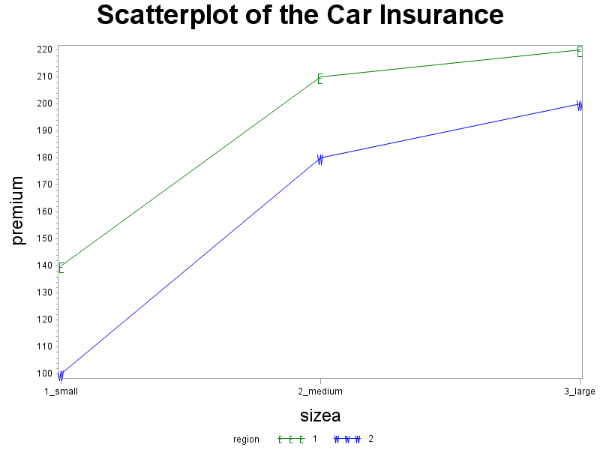
Car Insurance: Scatterplot
symbol1 v='E' i=join c=green height=1.5;
symbol2 v='W' i=join c=blue height=1.5;
title1 h=3 'Scatterplot of the Car Insurance';
proc gplot data=carins;
plot premium*sizea=region/haxis=axis1 vaxis=axis2;
run;

Slide 47
Car Insurance: ANOVA
proc glm data=carins;
class sizea region;
model premium=sizea region/solution;
means sizea region / tukey;
output out=preds p=muhat;
run;
proc print data=preds;
run;
Class Level Information
Class | Levels | Values
sizea | 3 | 1_small 2_medium 3_large
region | 2 | 1 2
Number of Observations Read | 6
Number of Observations Used | 6

Slide 48
Car Insurance: ANOVA (cont)
Source | DF | Sum of Squares | Mean Square | F Value | Pr > F
Model | 3 | 10650.00000 | 3550.00000 | 71.00 | 0.0139
Error | 2 | 100.00000 | 50.00000
Corrected Total | 5 | 10750.00000
R-Square | Coeff Var | Root MSE | premium Mean
0.990698 | 4.040610 | 7.071068 | 175.0000
Source | DF | Type I SS | Mean Square | F Value | Pr > F
sizea | 2 | 9300.000000 | 4650.000000 | 93.00 | 0.0106
region | 1 | 1350.000000 | 1350.000000 | 27.00 | 0.0351

Slide 49
Car Insurance: ANOVA (cont)
Parameter | Estimate |  | Standard Error | t Value | Pr > |t|
Intercept | 195.0000000 | B | 5.77350269 | 33.77 | 0.0009
sizea 1_small | -90.0000000 | B | 7.07106781 | -12.73 | 0.0061
sizea 2_medium | -15.0000000 | B | 7.07106781 | -2.12 | 0.1679
sizea 3_large | 0.0000000 | B | . | . | .
region 1 | 30.0000000 | B | 5.77350269 | 5.20 | 0.0351
region 2 | 0.0000000 | B | . | . | .
Obs | premium | size | region | sizea | muhat
1 | 140 | 1 | 1 | 1_small | 135
2 | 100 | 1 | 2 | 1_small | 105
3 | 210 | 2 | 1 | 2_medium | 210
4 | 180 | 2 | 2 | 2_medium | 180
5 | 220 | 3 | 1 | 3_large | 225
6 | 200 | 3 | 2 | 3_large | 195

Slide 50
Car Insurance: ANOVA (cont)
Means with the same letter are not significantly different.
Tukey Grouping | Mean | N | sizea
A | 210.000 | 2 | 3_large
A
A | 195.000 | 2 | 2_medium
B | 120.000 | 2 | 1_small
Means with the same letter are not significantly different.
Tukey Grouping | Mean | N | region
A | 190.000 | 3 | 1
B | 160.000 | 3 | 2

Slide 51
Car Insurance: Plots
symbol1 v='E' i=join c=green size=1.5;
symbol2 v='W' i=join c=blue size=1.5;
title1 h=3 'Plot of the model estimates';
proc gplot data=preds;
plot muhat*sizea=region/haxis=axis1 vaxis=axis2;
run;

Slide 52
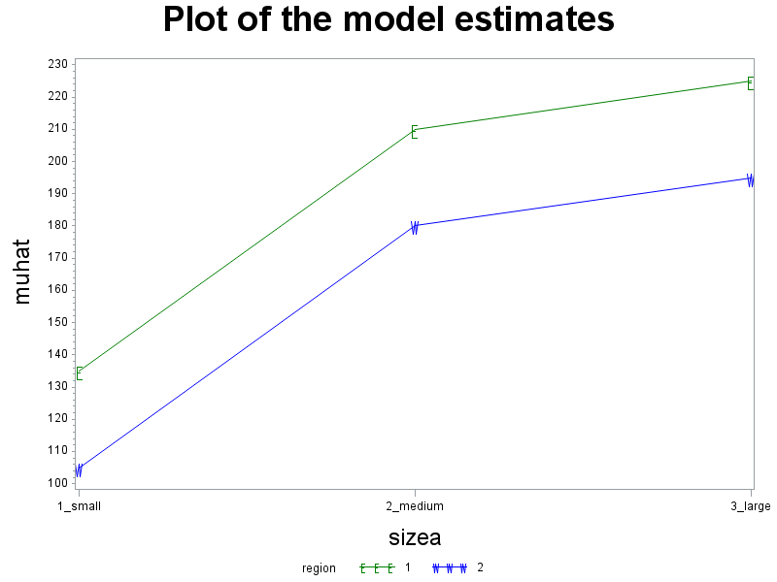
Car Insurance: plots (cont)

Slide 53
Car Insurance Example: (nknw884.sas)
Y = 3-month premium for car insurance
Factor A = size of the city
small, medium, large
Factor B = geographic region
east, west

Slide 54
Car Insurance: Overall mean
proc glm data=carins;
model premium=;
output out=overall p=muhat;
proc print data=overall;
Obs | premium | size | region | muhat
1 | 140 | 1 | 1 | 175
2 | 100 | 1 | 2 | 175
3 | 210 | 2 | 1 | 175
4 | 180 | 2 | 2 | 175
5 | 220 | 3 | 1 | 175
6 | 200 | 3 | 2 | 175

Slide 55
Car Insurance: Factor A treatment means
proc glm data=carins;
class size;
model premium=size;
output out=meanA p=muhatA;
proc print data=meanA;
run;
Obs | premium | size | region | muhatA
1 | 140 | 1 | 1 | 120
2 | 100 | 1 | 2 | 120
3 | 210 | 2 | 1 | 195
4 | 180 | 2 | 2 | 195
5 | 220 | 3 | 1 | 210
6 | 200 | 3 | 2 | 210

Slide 56
Car Insurance: Factor B treatment means
proc glm data=carins;
class region;
model premium=region;
output out=meanB p=muhatB;
proc print data=meanB;
run;
Obs | premium | size | region | muhatB
1 | 140 | 1 | 1 | 190
2 | 100 | 1 | 2 | 160
3 | 210 | 2 | 1 | 190
4 | 180 | 2 | 2 | 160
5 | 220 | 3 | 1 | 190
6 | 200 | 3 | 2 | 160

Slide 57
Car Insurance: Combine files
data estimates;
merge overall meanA meanB;
alpha = muhatA - muhat;
beta = muhatB - muhat;
atimesb = alpha*beta;
proc print data=estimates;
var size region alpha beta atimesb;
run;
Obs | size | region | alpha | beta | atimesb
1 | 1 | 1 | -55 | 15 | -825
2 | 1 | 2 | -55 | -15 | 825
3 | 2 | 1 | 20 | 15 | 300
4 | 2 | 2 | 20 | -15 | -300
5 | 3 | 1 | 35 | 15 | 525
6 | 3 | 2 | 35 | -15 | -525

Slide 58
Car Insurance: Tukey test for additivity
proc glm data=estimates;
class size region;
model premium=size region atimesb/solution;
run;
Source | DF | Sum of Squares | Mean Square | F Value | Pr > F
Model | 4 | 10737.09677 | 2684.27419 | 208.03 | 0.0519
Error | 1 | 12.90323 | 12.90323
Corrected Total | 5 | 10750.00000
R-Square | Coeff Var | Root MSE | premium Mean
0.998800 | 2.052632 | 3.592106 | 175.0000
Source | DF | Type I SS | Mean Square | F Value | Pr > F
size | 2 | 9300.000000 | 4650.000000 | 360.37 | 0.0372
region | 1 | 1350.000000 | 1350.000000 | 104.62 | 0.0620
atimesb | 1 | 87.096774 | 87.096774 | 6.75 | 0.2339

Slide 59
Car Insurance: Tukey test for additivity
Source | DF | Sum of Squares | Mean Square | F Value | Pr > F
Model | 3 | 10650.00000 | 3550.00000 | 71.00 | 0.0139
Error | 2 | 100.00000 | 50.00000
Corrected Total | 5 | 10750.00000
Source | DF | Type I SS | Mean Square | F Value | Pr > F
sizea | 2 | 9300.000000 | 4650.000000 | 93.00 | 0.0106
region | 1 | 1350.000000 | 1350.000000 | 27.00 | 0.0351
Source | DF | Sum of Squares | Mean Square | F Value | Pr > F
Model | 4 | 10737.09677 | 2684.27419 | 208.03 | 0.0519
Error | 1 | 12.90323 | 12.90323
Corrected Total | 5 | 10750.00000
Source | DF | Type I SS | Mean Square | F Value | Pr > F
size | 2 | 9300.000000 | 4650.000000 | 360.37 | 0.0372
region | 1 | 1350.000000 | 1350.000000 | 104.62 | 0.0620
atimesb | 1 | 87.096774 | 87.096774 | 6.75 | 0.2339

Slide 60
Car Insurance: Tukey test for additivity
Parameter | Estimate |  | Standard Error | t Value | Pr > |t|
Intercept | 195.0000000 | B | 5.77350269 | 33.77 | 0.0009
sizea 1_small | -90.0000000 | B | 7.07106781 | -12.73 | 0.0061
sizea 2_medium | -15.0000000 | B | 7.07106781 | -2.12 | 0.1679
sizea 3_large | 0.0000000 | B | . | . | .
region 1 | 30.0000000 | B | 5.77350269 | 5.20 | 0.0351
region 2 | 0.0000000 | B | . | . | .
Parameter | Estimate |  | Standard Error | t Value | Pr > |t|
Intercept | 195.0000000 | B | 2.93294230 | 66.49 | 0.0096
size 1 | -90.0000000 | B | 3.59210604 | -25.05 | 0.0254
size 2 | -15.0000000 | B | 3.59210604 | -4.18 | 0.1496
size 3 | 0.0000000 | B | . | . | .
region 1 | 30.0000000 | B | 2.93294230 | 10.23 | 0.0620
region 2 | 0.0000000 | B | . | . | .
atimesb | -0.0064516 |  | 0.00248323 | -2.60 | 0.2339

