Slide 1
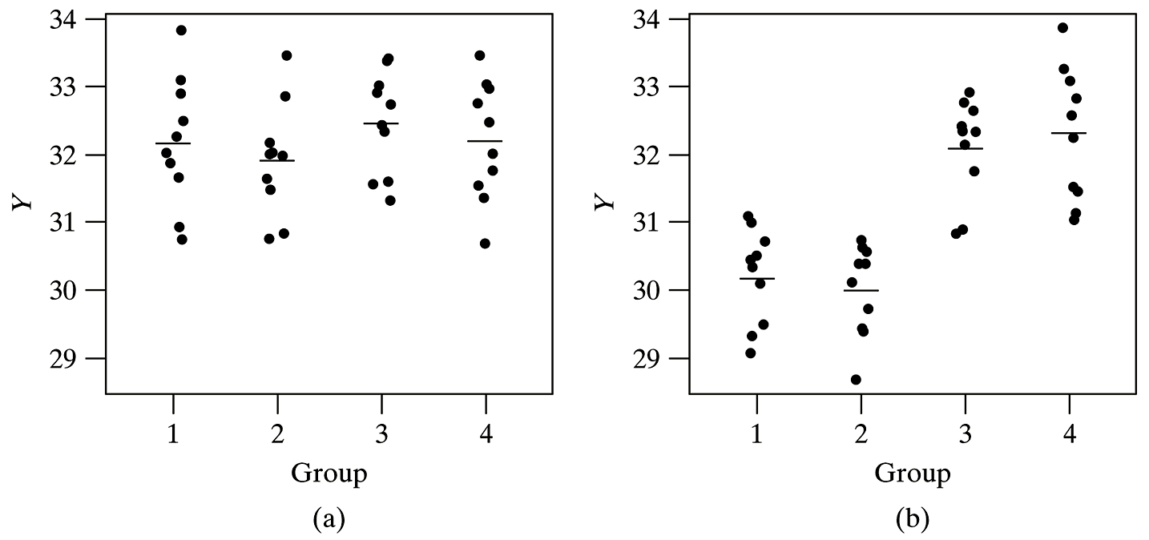
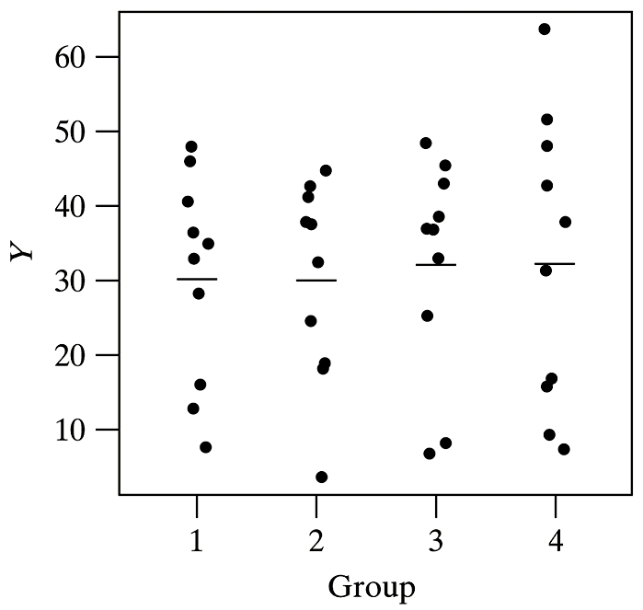
ANOVA: Graphical

Slide 2
Cereal Example: nknw677.sas
Y = number of cases of cereal sold (CASES)
X = design of the cereal package (PKGDES)
r = 4 (there were 4 designs tested)
n_{i} = 5, 5, 4, 5 (one store had a fire)
n_{T} = 19

Slide 3
Cereal Example: input
data cereal;
infile ‘H:\My Documents\Stat 512\CH16TA01.DAT';
input cases pkgdes store;
proc print data=cereal;
run;
Obs | cases | pkgdes | store | Obs | cases | pkgdes | store
1 | 11 | 1 | 1 | 11 | 23 | 3 | 1
2 | 17 | 1 | 2 | 12 | 20 | 3 | 2
3 | 16 | 1 | 3 | 13 | 18 | 3 | 3
4 | 14 | 1 | 4 | 14 | 17 | 3 | 4
5 | 15 | 1 | 5 | 15 | 27 | 4 | 1
6 | 12 | 2 | 1 | 16 | 33 | 4 | 2
7 | 10 | 2 | 2 | 17 | 22 | 4 | 3
8 | 15 | 2 | 3 | 18 | 26 | 4 | 4
9 | 19 | 2 | 4 | 19 | 28 | 4 | 5
10 | 11 | 2 | 5

Slide 4
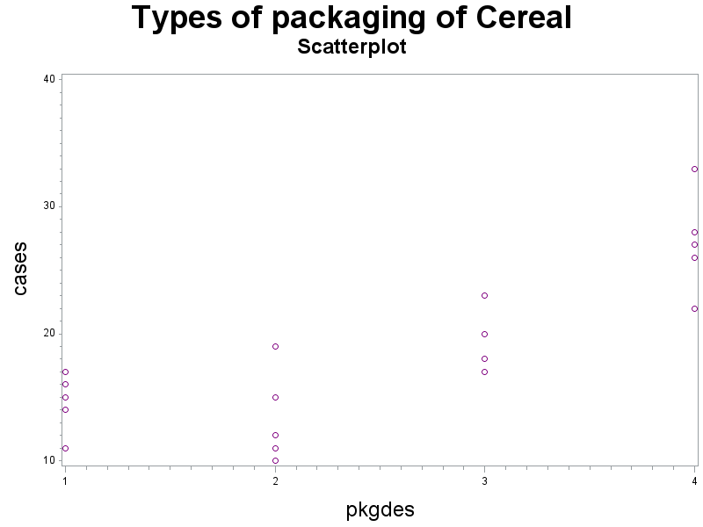
Cereal Example: Scatterplot
title1 h=3 'Types of packaging of Cereal';
title2 h=2 'Scatterplot';
axis1 label=(h=2);
axis2 label=(h=2 angle=90);
symbol1 v=circle i=none c=purple;
proc gplot data=cereal;
plot cases*pkgdes
/haxis=axis1 vaxis=axis2;
run;

Slide 5
Cereal Example: ANOVA
proc glm data=cereal;
class pkgdes;
model cases=pkgdes/xpx inverse solution;
means pkgdes;
run;
Class Level Information
Class | Levels | Values
pkgdes | 4 | 1 2 3 4
Level of pkgdes | N | cases
 |  | Mean | Std Dev
1 | 5 | 14.6000000 | 2.30217289
2 | 5 | 13.4000000 | 3.64691651
3 | 4 | 19.5000000 | 2.64575131
4 | 5 | 27.2000000 | 3.96232255

Slide 6
Cereal Example: Means
proc means data=cereal;
var cases; by pkgdes;
output out=cerealmeans mean=avcases;
proc print data=cerealmeans; run;
title2 h=2 'plot of means';
symbol1 v=circle i=join;
proc gplot data=cerealmeans;
plot avcases*pkgdes/haxis=axis1 vaxis=axis2;
run;
Types of packaging of Cereal
plot of means
Obs | pkgdes | _TYPE_ | _FREQ_ | avcases
1 | 1 | 0 | 5 | 14.6
2 | 2 | 0 | 5 | 13.4
3 | 3 | 0 | 4 | 19.5
4 | 4 | 0 | 5 | 27.2

Slide 7
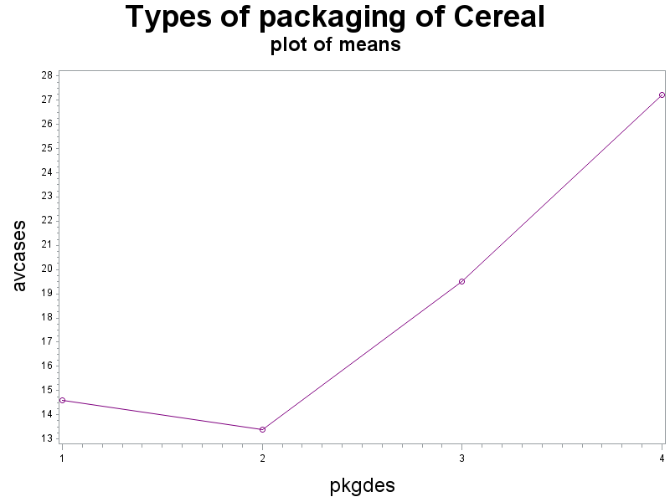
Cereal Example: Means (cont)

Slide 8
ANOVA Table
Source of Variation | df | SS | MS
Model (Regression) | r – 1
Error | n_{T} – r
Total | n_{T} – 1

Slide 9
ANOVA test

Slide 10
Cereal Example: ANOVA table
proc glm data=cereal;
class pkgdes;
model cases=pkgdes;
run;
Source | DF | Sum of Squares | Mean Square | F Value | Pr > F
Model | 3 | 588.2210526 | 196.0736842 | 18.59 | <.0001
Error | 15 | 158.2000000 | 10.5466667
Corrected Total | 18 | 746.4210526
R-Square | Coeff Var | Root MSE | cases Mean
0.788055 | 17.43042 | 3.247563 | 18.63158

Slide 11
Cereal Example: Design Matrix

Slide 12
Cereal Example: Inverse
proc glm data=cereal;
class pkgdes;
model cases=pkgdes/ xpx inverse solution;
means pkgdes;
run;

Slide 13
Cereal Example: /xpx
The X'X Matrix
 | Intercept | pkgdes 1 | pkgdes 2 | pkgdes 3 | pkgdes 4 | cases
Intercept | 19 | 5 | 5 | 4 | 5 | 354
pkgdes 1 | 5 | 5 | 0 | 0 | 0 | 73
pkgdes 2 | 5 | 0 | 5 | 0 | 0 | 67
pkgdes 3 | 4 | 0 | 0 | 4 | 0 | 78
pkgdes 4 | 5 | 0 | 0 | 0 | 5 | 136
cases | 354 | 73 | 67 | 78 | 136 | 7342

Slide 14
Cereal Example: /inverse
X'X Generalized Inverse (g2)
 | Intercept | pkgdes 1 | pkgdes 2 | pkgdes 3 | pkgdes 4 | cases
Intercept | 0.2 | -0.2 | -0.2 | -0.2 | 0 | 27.2
pkgdes 1 | -0.2 | 0.4 | 0.2 | 0.2 | 0 | -12.6
pkgdes 2 | -0.2 | 0.2 | 0.4 | 0.2 | 0 | -13.8
pkgdes 3 | -0.2 | 0.2 | 0.2 | 0.45 | 0 | -7.7
pkgdes 4 | 0 | 0 | 0 | 0 | 0 | 0
cases | 27.2 | -12.6 | -13.8 | -7.7 | 0 | 158.2

Slide 15
Cereal Example: /solution
Parameter | Estimate |  | Standard Error | t Value | Pr > |t|
Intercept | 27.20000000 | B | 1.45235441 | 18.73 | <.0001
pkgdes 1 | -12.60000000 | B | 2.05393930 | -6.13 | <.0001
pkgdes 2 | -13.80000000 | B | 2.05393930 | -6.72 | <.0001
pkgdes 3 | -7.70000000 | B | 2.17853162 | -3.53 | 0.0030
pkgdes 4 | 0.00000000 | B | . | . | .
Note: | The X'X matrix has been found to be singular, and a generalized inverse was used to solve the normal equations. Terms whose estimates are followed by the letter 'B' are not uniquely estimable.

Slide 16
Cereal Example: ANOVA
Level of pkgdes | N | cases
 |  | Mean | Std Dev
1 | 5 | 14.6000000 | 2.30217289
2 | 5 | 13.4000000 | 3.64691651
3 | 4 | 19.5000000 | 2.64575131
4 | 5 | 27.2000000 | 3.96232255

Slide 17
Cereal Example: Means (nknw698.sas)
proc means data=cereal printalltypes;
class pkgdes;
var cases;
output out=cerealmeans mean=mclass;
run;
The MEANS Procedure
Analysis Variable : cases
N Obs | N | Mean | Std Dev | Minimum | Maximum
19 | 19 | 18.6315789 | 6.4395525 | 10.0000000 | 33.0000000
Analysis Variable : cases
pkgdes | N Obs | N | Mean | Std Dev | Minimum | Maximum
1 | 5 | 5 | 14.6000000 | 2.3021729 | 11.0000000 | 17.0000000
2 | 5 | 5 | 13.4000000 | 3.6469165 | 10.0000000 | 19.0000000
3 | 4 | 4 | 19.5000000 | 2.6457513 | 17.0000000 | 23.0000000
4 | 5 | 5 | 27.2000000 | 3.9623226 | 22.0000000 | 33.0000000

Slide 18
Cereal Example: Means (cont)
proc print data=cerealmeans;
run;
Obs | pkgdes | _TYPE_ | _FREQ_ | mclass
1 | . | 0 | 19 | 18.6316
2 | 1 | 1 | 5 | 14.6000
3 | 2 | 1 | 5 | 13.4000
4 | 3 | 1 | 4 | 19.5000
5 | 4 | 1 | 5 | 27.2000

Slide 19
Cereal Example: Explanatory Variables
data cereal; set cereal;
x1=(pkgdes eq 1)-(pkgdes eq 4);
x2=(pkgdes eq 2)-(pkgdes eq 4);
x3=(pkgdes eq 3)-(pkgdes eq 4);
proc print data=cereal; run;

Slide 20
Cereal Example: Explanatory Variables (cont)
Obs | cases | pkgdes | store | x1 | x2 | x3
1 | 11 | 1 | 1 | 1 | 0 | 0
2 | 17 | 1 | 2 | 1 | 0 | 0
3 | 16 | 1 | 3 | 1 | 0 | 0
4 | 14 | 1 | 4 | 1 | 0 | 0
5 | 15 | 1 | 5 | 1 | 0 | 0
6 | 12 | 2 | 1 | 0 | 1 | 0
7 | 10 | 2 | 2 | 0 | 1 | 0
8 | 15 | 2 | 3 | 0 | 1 | 0
9 | 19 | 2 | 4 | 0 | 1 | 0
10 | 11 | 2 | 5 | 0 | 1 | 0
11 | 23 | 3 | 1 | 0 | 0 | 1
12 | 20 | 3 | 2 | 0 | 0 | 1
13 | 18 | 3 | 3 | 0 | 0 | 1
14 | 17 | 3 | 4 | 0 | 0 | 1
15 | 27 | 4 | 1 | -1 | -1 | -1
16 | 33 | 4 | 2 | -1 | -1 | -1
17 | 22 | 4 | 3 | -1 | -1 | -1
18 | 26 | 4 | 4 | -1 | -1 | -1
19 | 28 | 4 | 5 | -1 | -1 | -1

Slide 21
Cereal Example: Regression
proc reg data=cereal;
model cases=x1 x2 x3;
run;

Slide 22
Cereal Example: Regression (cont)
Analysis of Variance
Source | DF | Sum of Squares | Mean Square | F Value | Pr > F
Model | 3 | 588.22105 | 196.07368 | 18.59 | <.0001
Error | 15 | 158.20000 | 10.54667
Corrected Total | 18 | 746.42105
Root MSE | 3.24756 | R-Square | 0.7881
Dependent Mean | 18.63158 | Adj R-Sq | 0.7457
Coeff Var | 17.43042
Parameter Estimates
Variable | DF | Parameter Estimate | Standard Error | t Value | Pr > |t|
Intercept | 1 | 18.67500 | 0.74853 | 24.95 | <.0001
x1 | 1 | -4.07500 | 1.27081 | -3.21 | 0.0059
x2 | 1 | -5.27500 | 1.27081 | -4.15 | 0.0009
x3 | 1 | 0.82500 | 1.37063 | 0.60 | 0.5562

Slide 23
Cereal Example: ANOVA
proc glm data=cereal;
class pkgdes;
model cases=pkgdes;
run;
Source | DF | Sum of Squares | Mean Square | F Value | Pr > F
Model | 3 | 588.2210526 | 196.0736842 | 18.59 | <.0001
Error | 15 | 158.2000000 | 10.5466667
Corrected Total | 18 | 746.4210526
R-Square | Coeff Var | Root MSE | cases Mean
0.788055 | 17.43042 | 3.247563 | 18.63158

Slide 24
Cereal Example: Comparison
Regression
ANOVA
Analysis of Variance
Source | DF | Sum of Squares | Mean Square | F Value | Pr > F
Model | 3 | 588.22105 | 196.07368 | 18.59 | <.0001
Error | 15 | 158.20000 | 10.54667
Corrected Total | 18 | 746.42105
Root MSE | 3.24756 | R-Square | 0.7881
Dependent Mean | 18.63158 | Adj R-Sq | 0.7457
Coeff Var | 17.43042
Source | DF | Sum of Squares | Mean Square | F Value | Pr > F
Model | 3 | 588.2210526 | 196.0736842 | 18.59 | <.0001
Error | 15 | 158.2000000 | 10.5466667
Corrected Total | 18 | 746.4210526
R-Square | Coeff Var | Root MSE | cases Mean
0.788055 | 17.43042 | 3.247563 | 18.63158

Slide 25
Cereal Example: Regression (cont)
Analysis of Variance
Source | DF | Sum of Squares | Mean Square | F Value | Pr > F
Model | 3 | 588.22105 | 196.07368 | 18.59 | <.0001
Error | 15 | 158.20000 | 10.54667
Corrected Total | 18 | 746.42105
Root MSE | 3.24756 | R-Square | 0.7881
Dependent Mean | 18.63158 | Adj R-Sq | 0.7457
Coeff Var | 17.43042
Parameter Estimates
Variable | DF | Parameter Estimate | Standard Error | t Value | Pr > |t|
Intercept | 1 | 18.67500 | 0.74853 | 24.95 | <.0001
x1 | 1 | -4.07500 | 1.27081 | -3.21 | 0.0059
x2 | 1 | -5.27500 | 1.27081 | -4.15 | 0.0009
x3 | 1 | 0.82500 | 1.37063 | 0.60 | 0.5562

Slide 26
Cereal Example: Means
proc means data=cereal printalltypes;
class pkgdes;
var cases;
output out=cerealmeans mean=mclass;
run;
The MEANS Procedure
Analysis Variable : cases
N Obs | N | Mean | Std Dev | Minimum | Maximum
19 | 19 | 18.6315789 | 6.4395525 | 10.0000000 | 33.0000000
Analysis Variable : cases
pkgdes | N Obs | N | Mean | Std Dev | Minimum | Maximum
1 | 5 | 5 | 14.6000000 | 2.3021729 | 11.0000000 | 17.0000000
2 | 5 | 5 | 13.4000000 | 3.6469165 | 10.0000000 | 19.0000000
3 | 4 | 4 | 19.5000000 | 2.6457513 | 17.0000000 | 23.0000000
4 | 5 | 5 | 27.2000000 | 3.9623226 | 22.0000000 | 33.0000000

Slide 27
Cereal Example: nknw677a.sas
Y = number of cases of cereal sold (CASES)
X = design of the cereal package (PKGDES)
r = 4 (there were 4 designs tested)
n_{i} = 5, 5, 4, 5 (one store had a fire)
n_{T} = 19

Slide 28
Cereal Example: Plotting Means
title1 h=3 'Types of packaging of Cereal';
proc glm data=cereal;
class pkgdes;
model cases=pkgdes;
output out=cerealmeans p=means;
run;
title2 h=2 'plot of means';
axis1 label=(h=2);
axis2 label=(h=2 angle=90);
symbol1 v=circle i=none c=blue;
symbol2 v=none i=join c=red;
proc gplot data=cerealmeans;
plot cases*pkgdes means*pkgdes/overlay haxis=axis1 vaxis=axis2;
run;

Slide 29
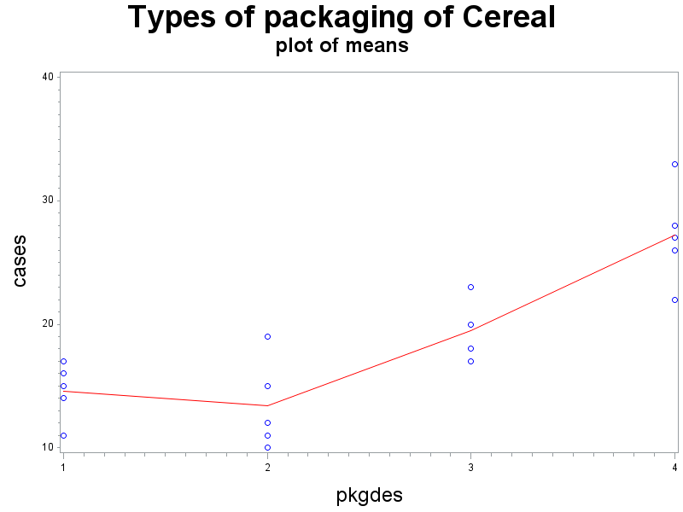
Cereal Example: Means (cont)

Slide 30
Cereal Example: CI (1) (nknw711.sas)
proc means data=cereal mean std stderr clm maxdec=2;
class pkgdes;
var cases;
run;
The MEANS Procedure
Analysis Variable : cases
pkgdes | N Obs | Mean | Std Dev | Std Error | Lower 95% CL for Mean | Upper 95% CL for Mean
1 | 5 | 14.60 | 2.30 | 1.03 | 11.74 | 17.46
2 | 5 | 13.40 | 3.65 | 1.63 | 8.87 | 17.93
3 | 4 | 19.50 | 2.65 | 1.32 | 15.29 | 23.71
4 | 5 | 27.20 | 3.96 | 1.77 | 22.28 | 32.12

Slide 31
Cereal Example: CI (2)
proc glm data=cereal;
class pkgdes;
model cases=pkgdes;
means pkgdes/t clm;
run;
The GLM Procedure
t Confidence Intervals for cases
Alpha | 0.05
Error Degrees of Freedom | 15
Error Mean Square | 10.54667
Critical Value of t | 2.13145
pkgdes | N | Mean | 95% Confidence Limits
4 | 5 | 27.200 | 24.104 | 30.296
3 | 4 | 19.500 | 16.039 | 22.961
1 | 5 | 14.600 | 11.504 | 17.696
2 | 5 | 13.400 | 10.304 | 16.496

Slide 32
Cereal Example: CI
pkdges | Mean | Std Error | CI (means) | CI (glm)
1 | 14.6 | 1.03 | (11.74, 17.46) | (11.504, 17.696)
2 | 13.4 | 1.63 | (8.87, 17.93) | (10.304, 16.496)
3 | 19.5 | 1.32 | (15.29, 23.71) | (16.039, 22.961)
4 | 27.2 | 1.77 | (22.28, 32.12) | (24.104, 30.296)

Slide 33
Cereal Example: CI Bonferroni Correction
proc glm data=cereal;
class pkgdes;
model cases=pkgdes;
means pkgdes/bon clm;
run;
The GLM Procedure
Bonferroni t Confidence Intervals for cases
Alpha | 0.05
Error Degrees of Freedom | 15
Error Mean Square | 10.54667
Critical Value of t | 2.83663
pkgdes | N | Mean | Simultaneous 95% Confidence Limits
4 | 5 | 27.200 | 23.080 | 31.320
3 | 4 | 19.500 | 14.894 | 24.106
1 | 5 | 14.600 | 10.480 | 18.720
2 | 5 | 13.400 | 9.280 | 17.520

Slide 34
Cereal Example: CI – Bonferroni Correction
pkdges | Mean | CI | CI (Bonferroni)
4 | 27.2 | (24.104, 30.296) | (23.080, 31.320)
3 | 19.5 | (16.039, 22.961) | (14.894, 24.106)
1 | 14.6 | (11.504, 17.696) | (10.480, 18.720)
2 | 13.4 | (10.304, 16.496) | (9.280, 17.520)

Slide 35
Cereal Example: Significance Test
proc means data=cereal mean std stderr t probt maxdec=2;
class pkgdes;
var cases;
run;
Analysis Variable : cases
pkgdes | N Obs | Mean | Std Dev | Std Error | t Value | Pr > |t|
1 | 5 | 14.60 | 2.30 | 1.03 | 14.18 | 0.0001
2 | 5 | 13.40 | 3.65 | 1.63 | 8.22 | 0.0012
3 | 4 | 19.50 | 2.65 | 1.32 | 14.74 | 0.0007
4 | 5 | 27.20 | 3.96 | 1.77 | 15.35 | 0.0001

Slide 36
Cereal Example: CI for μ_{i} - μ_{j}
proc glm data=cereal;
class pkgdes;
model cases=pkgdes;
means pkgdes/cldiff lsd tukey bon scheffe dunnett("2");
means pkgdes/lines tukey;
run;

Slide 37
Cereal Example: CI for μ_{i} - μ_{j} - LSD
t Tests (LSD) for cases
Note: | This test controls the Type I comparisonwise error rate, not the experimentwise error rate.
Alpha | 0.05
Error Degrees of Freedom | 15
Error Mean Square | 10.54667
Critical Value of t | 2.13145

Slide 38
Cereal Example: CI for μ_{i} - μ_{j} – LSD (cont)
Comparisons significant at the 0.05 level are indicated by ***.
pkgdes Comparison | Difference Between Means | 95% Confidence Limits
4 - 3 | 7.700 | 3.057 | 12.343 | ***
4 - 1 | 12.600 | 8.222 | 16.978 | ***
4 - 2 | 13.800 | 9.422 | 18.178 | ***
3 - 4 | -7.700 | -12.343 | -3.057 | ***
3 - 1 | 4.900 | 0.257 | 9.543 | ***
3 - 2 | 6.100 | 1.457 | 10.743 | ***
1 - 4 | -12.600 | -16.978 | -8.222 | ***
1 - 3 | -4.900 | -9.543 | -0.257 | ***
1 - 2 | 1.200 | -3.178 | 5.578
2 - 4 | -13.800 | -18.178 | -9.422 | ***
2 - 3 | -6.100 | -10.743 | -1.457 | ***
2 - 1 | -1.200 | -5.578 | 3.178

Slide 39
Cereal Example: CI for μ_{i} - μ_{j} - Tukey
Tukey's Studentized Range (HSD) Test for cases
Note: | This test controls the Type I experimentwise error rate.
Critical Value of Studentized Range | 4.07588
Comparisons significant at the 0.05 level are indicated by ***.
pkgdes Comparison | Difference Between Means | Simultaneous 95% Confidence Limits
4 - 3 | 7.700 | 1.421 | 13.979 | ***
4 - 1 | 12.600 | 6.680 | 18.520 | ***
4 - 2 | 13.800 | 7.880 | 19.720 | ***
3 - 4 | -7.700 | -13.979 | -1.421 | ***
3 - 1 | 4.900 | -1.379 | 11.179
3 - 2 | 6.100 | -0.179 | 12.379
1 - 4 | -12.600 | -18.520 | -6.680 | ***
1 - 3 | -4.900 | -11.179 | 1.379
1 - 2 | 1.200 | -4.720 | 7.120
2 - 4 | -13.800 | -19.720 | -7.880 | ***
2 - 3 | -6.100 | -12.379 | 0.179
2 - 1 | -1.200 | -7.120 | 4.720

Slide 40
Cereal Example: CI for μ_{i} - μ_{j} - Scheffé
Scheffe's Test for cases
Note: | This test controls the Type I experimentwise error rate, but it generally has a higher Type II error rate than Tukey's for all pairwise comparisons.
Critical Value of F | 3.28738
Comparisons significant at the 0.05 level are indicated by ***.
pkgdes Comparison | Difference Between Means | Simultaneous 95% Confidence Limits
4 - 3 | 7.700 | 0.859 | 14.541 | ***
4 - 1 | 12.600 | 6.150 | 19.050 | ***
4 - 2 | 13.800 | 7.350 | 20.250 | ***
3 - 4 | -7.700 | -14.541 | -0.859 | ***
3 - 1 | 4.900 | -1.941 | 11.741
3 - 2 | 6.100 | -0.741 | 12.941
1 - 4 | -12.600 | -19.050 | -6.150 | ***
1 - 3 | -4.900 | -11.741 | 1.941
1 - 2 | 1.200 | -5.250 | 7.650
2 - 4 | -13.800 | -20.250 | -7.350 | ***
2 - 3 | -6.100 | -12.941 | 0.741
2 - 1 | -1.200 | -7.650 | 5.250

Slide 41
Cereal Example: CI for μ_{i} - μ_{j} - Bonferroni
Bonferroni (Dunn) t Tests for cases
Note: | This test controls the Type I experimentwise error rate, but it generally has a higher Type II error rate than Tukey's for all pairwise comparisons.
Critical Value of t | 3.03628
Comparisons significant at the 0.05 level are indicated by ***.
pkgdes Comparison | Difference Between Means | Simultaneous 95% Confidence Limits
4 - 3 | 7.700 | 1.085 | 14.315 | ***
4 - 1 | 12.600 | 6.364 | 18.836 | ***
4 - 2 | 13.800 | 7.564 | 20.036 | ***
3 - 4 | -7.700 | -14.315 | -1.085 | ***
3 - 1 | 4.900 | -1.715 | 11.515
3 - 2 | 6.100 | -0.515 | 12.715
1 - 4 | -12.600 | -18.836 | -6.364 | ***
1 - 3 | -4.900 | -11.515 | 1.715
1 - 2 | 1.200 | -5.036 | 7.436
2 - 4 | -13.800 | -20.036 | -7.564 | ***
2 - 3 | -6.100 | -12.715 | 0.515
2 - 1 | -1.200 | -7.436 | 5.036

Slide 42
Cereal Example: CI for μ_{i} - μ_{j} - Dunnett
Dunnett's t Tests for cases
Note: | This test controls the Type I experimentwise error for comparisons of all treatments against a control.
Alpha | 0.05
Error Degrees of Freedom | 15
Error Mean Square | 10.54667
Critical Value of Dunnett's t | 2.61481
Comparisons significant at the 0.05 level are indicated by ***.
pkgdes Comparison | Difference Between Means | Simultaneous 95% Confidence Limits
4 - 2 | 13.800 | 8.429 | 19.171 | ***
3 - 2 | 6.100 | 0.404 | 11.796 | ***
1 - 2 | 1.200 | -4.171 | 6.571

Slide 43
Cereal Example: CI for μ_{i} - μ_{j} – Tukey (lines)
Critical Value of Studentized Range | 4.07588
Minimum Significant Difference | 6.1018
Harmonic Mean of Cell Sizes | 4.705882
Note: | Cell sizes are not equal.
Means with the same letter are not significantly different.
Tukey Grouping | Mean | N | pkgdes
A | 27.200 | 5 | 4
B | 19.500 | 4 | 3
B
B | 14.600 | 5 | 1
B
B | 13.400 | 5 | 2

Slide 44
Cereal Example: Contrasts
proc glm data=cereal;
class pkgdes;
model cases = pkgdes;
contrast '(u1+u2)/2-(u3+u4)/2' pkgdes .5 .5 -.5 -.5;
estimate '(u1+u2)/2-(u3+u4)/2' pkgdes .5 .5 -.5 -.5;
run;
Contrast | DF | Contrast SS | Mean Square | F Value | Pr > F
(u1+u2)/2-(u3+u4)/2 | 1 | 411.4000000 | 411.4000000 | 39.01 | <.0001
Parameter | Estimate | Standard Error | t Value | Pr > |t|
(u1+u2)/2-(u3+u4)/2 | -9.35000000 | 1.49705266 | -6.25 | <.0001

Slide 45
Cereal Example: Multiple Contrasts
proc glm data=cereal;
class pkgdes;
model cases = pkgdes;
contrast 'u1-(u2+u3+u4)/3' pkgdes 1-.3333-.3333-.3333;
estimate 'u1-(u2+u3+u4)/3' pkgdes 3 -1 -1 -1/divisor=3;
contrast 'u2=u3=u4' pkgdes 0 1 -1 0, pkgdes 0 0 1 -1;
run;
Contrast | DF | Contrast SS | Mean Square | F Value | Pr > F
u1-(u2+u3+u4)/3 | 1 | 108.4739502 | 108.4739502 | 10.29 | 0.0059
u2=u3=u4 | 2 | 477.9285714 | 238.9642857 | 22.66 | <.0001
Parameter | Estimate | Standard Error | t Value | Pr > |t|
u1-(u2+u3+u4)/3 | -5.43333333 | 1.69441348 | -3.21 | 0.0059

Slide 46
Training Example: (nknw742.sas)
Y = number of acceptable pieces
X = hours of training (6 hrs, 8 hrs, 10 hrs, 12 hrs)
n = 7

Slide 47
Training Example: input
data training;
infile 'I:\My Documents\STAT 512\CH17TA06.DAT';
input product trainhrs;
proc print data=training; run;
data training; set training;
hrs=2*trainhrs+4;
hrs2=hrs*hrs;
proc print data=training; run;
Obs | product | trainhrs | hrs | hrs2
1 | 40 | 1 | 6 | 36
⁞ | ⁞ | ⁞ | ⁞ | ⁞
8 | 53 | 2 | 8 | 64
⁞ | ⁞ | ⁞ | ⁞ | ⁞
15 | 53 | 3 | 10 | 100
⁞ | ⁞ | ⁞ | ⁞ | ⁞
22 | 63 | 4 | 12 | 144
⁞ | ⁞ | ⁞ | ⁞ | ⁞

Slide 48
Training Example: ANOVA
proc glm data=training;
class trainhrs;
model product=hrs trainhrs / solution;
run;
Parameter | Estimate |  | Standard Error | t Value | Pr > |t|
Intercept | 32.28571429 | B | 6.09421494 | 5.30 | <.0001
hrs | 2.42857143 | B | 0.55174430 | 4.40 | 0.0002
trainhrs 1 | -6.85714286 | B | 2.91955639 | -2.35 | 0.0274
trainhrs 2 | -1.85714286 | B | 1.91129831 | -0.97 | 0.3409
trainhrs 3 | 0.00000000 | B | . | . | .
trainhrs 4 | 0.00000000 | B | . | . | .

Slide 49
Training Example: ANOVA (cont)
Source | DF | Sum of Squares | Mean Square | F Value | Pr > F
Model | 3 | 1808.678571 | 602.892857 | 141.46 | <.0001
Error | 24 | 102.285714 | 4.261905
Corrected Total | 27 | 1910.964286
R-Square | Coeff Var | Root MSE | product Mean
0.946474 | 3.972802 | 2.064438 | 51.96429
Source | DF | Type I SS | Mean Square | F Value | Pr > F
hrs | 1 | 1764.350000 | 1764.350000 | 413.98 | <.0001
trainhrs | 2 | 44.328571 | 22.164286 | 5.20 | 0.0133

Slide 50
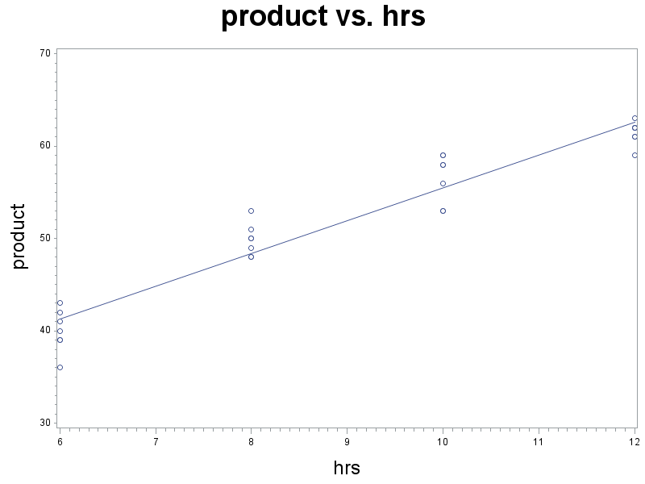
Training Example: Scatterplot
Title1 h=3 'product vs. hrs';
axis1 label=(h=2);
axis2 label=(h=2 angle=90);
symbol1 v = circle i = rl;
proc gplot data=training;
plot product*hrs/haxis=axis1 vaxis=axis2;
run;

Slide 51
Training Example: Quadratic
proc glm data=training;
class trainhrs;
model product=hrs hrs2 trainhrs;
run;
Source | DF | Sum of Squares | Mean Square | F Value | Pr > F
Model | 3 | 1808.678571 | 602.892857 | 141.46 | <.0001
Error | 24 | 102.285714 | 4.261905
Corrected Total | 27 | 1910.964286
R-Square | Coeff Var | Root MSE | product Mean
0.946474 | 3.972802 | 2.064438 | 51.96429
Source | DF | Type I SS | Mean Square | F Value | Pr > F
hrs | 1 | 1764.350000 | 1764.350000 | 413.98 | <.0001
hrs2 | 1 | 43.750000 | 43.750000 | 10.27 | 0.0038
trainhrs | 1 | 0.578571 | 0.578571 | 0.14 | 0.7158

Slide 52
Rust Example: (nknw712.sas)
Y = effectiveness of the rust inhibitors
coded score, the higher means less rust
X has 4 levels, the brands are A, B, C, D
n = 10

Slide 53
Rust Example: input
data rust;
infile 'H:\My Documents\Stat 512\CH17TA02.DAT';
input eff brand$;
proc print data=rust; run;
data rust; set rust;
if brand eq 1 then abrand='A';
if brand eq 2 then abrand='B';
if brand eq 3 then abrand='C';
if brand eq 4 then abrand='D';
proc print data=rust; run;
proc glm data=rust;
class abrand;
model eff = abrand;
output out=rustout r=resid p=pred;
run;

Slide 54
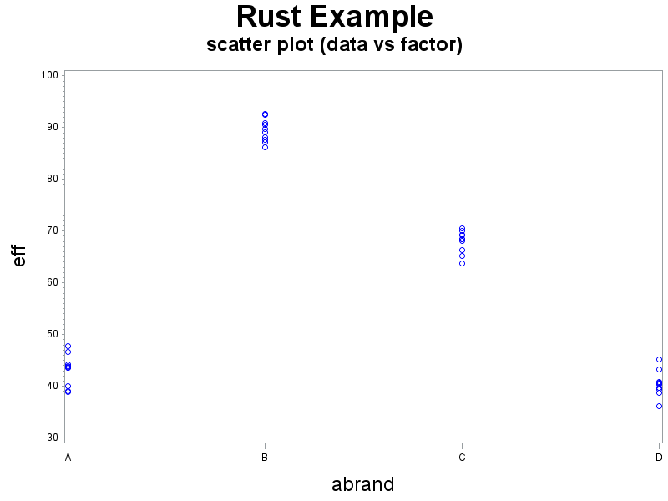
Rust Example: data vs. factor
title1 h=3 'Rust Example';
title2 h=2 'scatter plot (data vs factor)';
axis1 label=(h=2);
axis2 label=(h=2 angle=90);
symbol1 v=circle i=none c=blue;
proc gplot data=rustout;
plot eff*abrand/haxis=axis1 vaxis=axis2;
run;

Slide 55
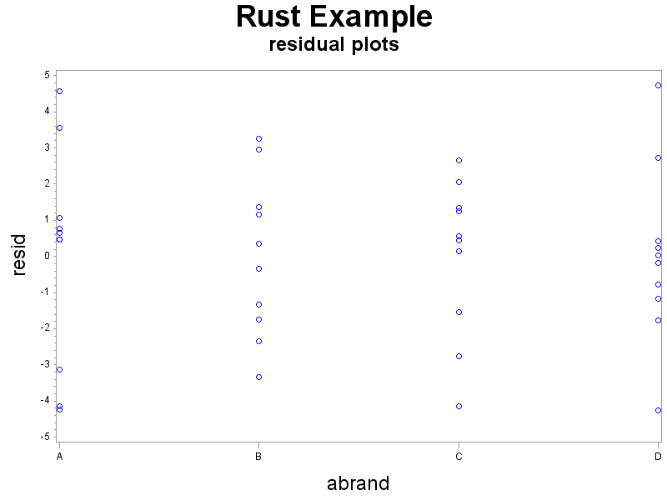
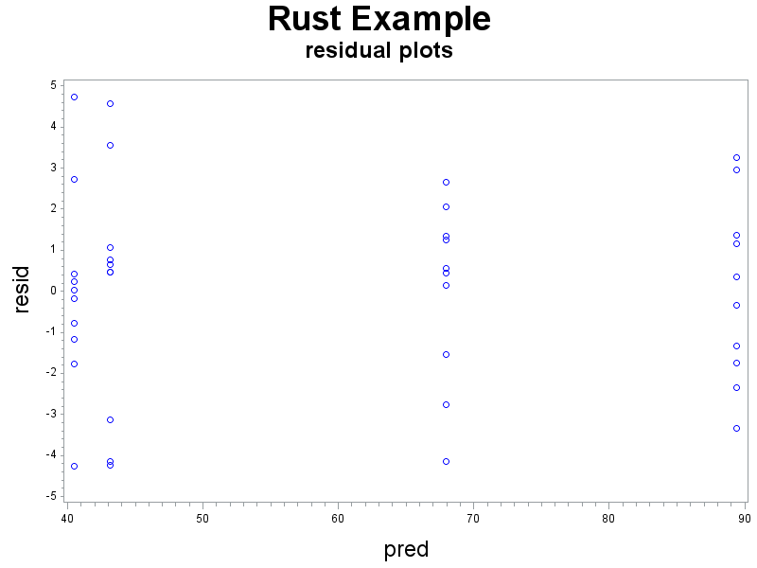
Rust Example: residuals vs. factor, predictor
title2 h=2 'residual plots';
proc gplot data=rustout;
plot resid*(pred abrand)/haxis=axis1 vaxis=axis2;
run;
brand
predicted value

Slide 56
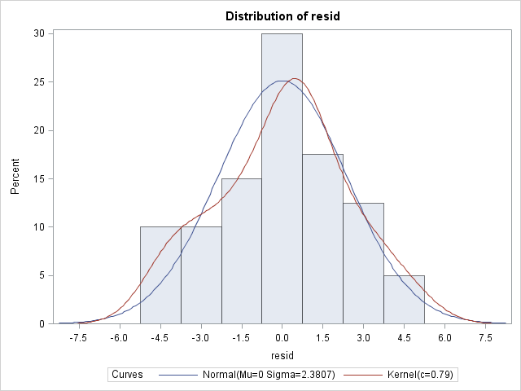
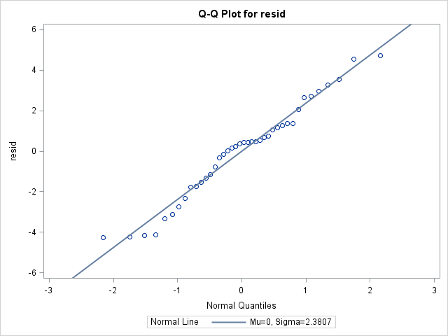
Rust Example: Normality
title2 'normality plots';
proc univariate data = rustout;
histogram resid/normal kernel;
qqplot resid / normal (mu=est sigma=est);
run;

Slide 57
Solder Example (nknw768.sas)
Y = strength of joint
X = type of solder flux (there are 5 types in the study)
n = 8

Slide 58
Solder Example: input/diagnostics
data solder;
infile 'I:\My Documents\Stat 512\CH18TA02.DAT';
input strength type;
proc print data=solder;
run;
title1 h=3 'Solder Example';
title2 h=2 'scatterplot';
axis1 label=(h=2);
axis2 label=(h=2 angle=90);
symbol1 v=circle i=none c=red;
proc gplot data=solder;
plot strength*type/haxis=axis1 vaxis=axis2;
run;

Slide 59
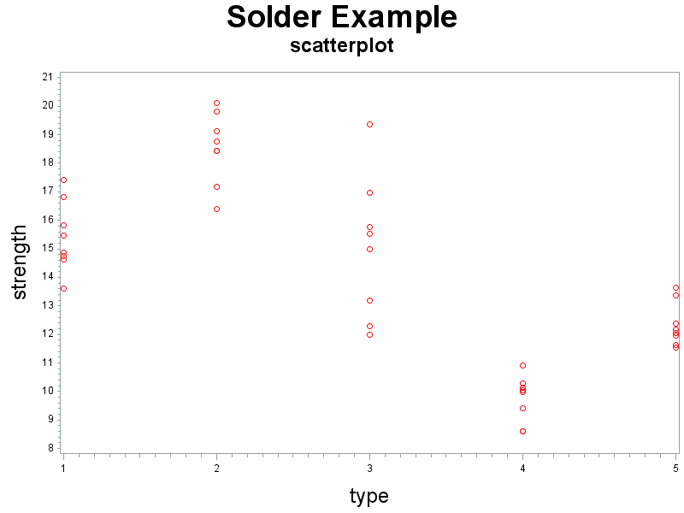
Solder Example: scatterplot

Slide 60
Solder Example: Modified Levene
proc glm data=solder;
class type;
model strength=type;
means type/hovtest=levene(type=square);
run;

Slide 61
Solder Example: Modified Levene (cont)
Source | DF | Sum of Squares | Mean Square | F Value | Pr > F
Model | 4 | 353.6120850 | 88.4030212 | 41.93 | <.0001
Error | 35 | 73.7988250 | 2.1085379
Corrected Total | 39 | 427.4109100
R-Square | Coeff Var | Root MSE | strength Mean
0.827335 | 10.22124 | 1.452081 | 14.20650
Source | DF | Type I SS | Mean Square | F Value | Pr > F
type | 4 | 353.6120850 | 88.4030212 | 41.93 | <.0001
Levene's Test for Homogeneity of strength Variance ANOVA of Squared Deviations from Group Means
Source | DF | Sum of Squares | Mean Square | F Value | Pr > F
type | 4 | 132.3 | 33.0858 | 3.57 | 0.0153
Error | 35 | 324.6 | 9.2751

Slide 62
Solder Example: Modified Levene (cont)
Level of type | N | strength
 |  | Mean | Std Dev
1 | 8 | 15.4200000 | 1.23713956
2 | 8 | 18.5275000 | 1.25297076
3 | 8 | 15.0037500 | 2.48664397
4 | 8 | 9.7412500 | 0.81660337
5 | 8 | 12.3400000 | 0.76941536

Slide 63
Solder Example: Weighted Least Squares
proc means data=solder;
var strength;
by type;
output out=weights var=s2;
run;
data weights;
set weights;
wt=1/s2;

Slide 64
Solder Example: Weighted Least Squares (cont)
data wsolder;
merge solder weights;
by type;
proc print;run;
proc glm data=wsolder;
class type;
model strength=type;
weight wt;
output out = weighted r = resid p = predict;
run;

Slide 65
Solder Example: Weighted Least Squares (cont)
Dependent Variable: strength
Weight: wt
From before: F = 41.93, R² = 0.827335
Source | DF | Sum of Squares | Mean Square | F Value | Pr > F
Model | 4 | 324.2130988 | 81.0532747 | 81.05 | <.0001
Error | 35 | 35.0000000 | 1.0000000
Corrected Total | 39 | 359.2130988
R-Square | Coeff Var | Root MSE | strength Mean
0.902565 | 7.766410 | 1.00000 | 12.87596

Slide 66
Solder Example: Weighted Least Squares (cont)
data residplot;
set weighted;
resid1 = sqrt(wt)*resid;
title2 h=2 'Weighted data - residual plot';
symbol1 v=circle i=none;
proc gplot data=residplot;
plot resid1*(predict type)/vref=0 haxis=axis1 vaxis=axis2;
run;

Slide 67
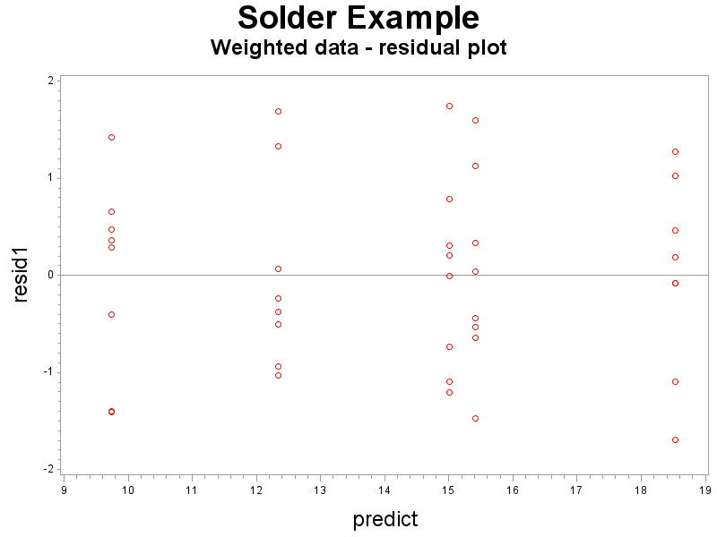
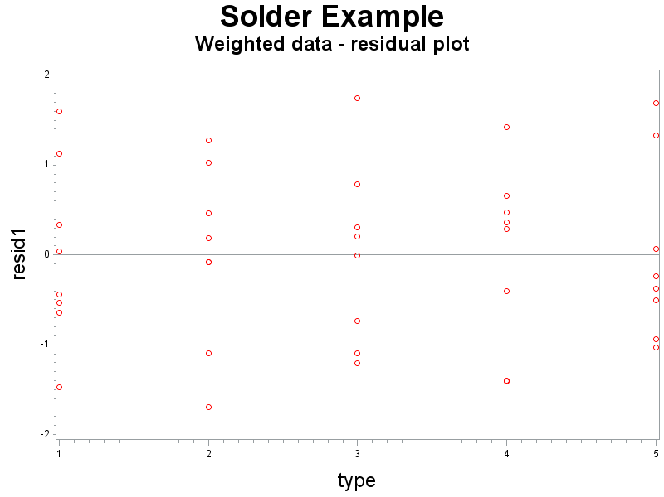
Solder Example: Weighted Least Squares (cont)

