Slide 1
Partial Regression Plots

Slide 2
Life Insurance Example: (nknw364.sas)
Y = the amount of life insurance for the 18 managers (in $1000)
X₁ = average annual income (in $1000)
X₂ = risk aversion score (0 – 10)

Slide 3
Life Insurance: Input, diagnostics
title1 h=3 'Insurance';
data insurance;
infile 'I:\My Documents\Stat 512\CH10TA01.DAT';
input income risk amount;
run;
proc print data=insurance; run;
*diagnostics;
title2 h=2 'residual plots';
symbol1 v=circle c=black;
proc reg data=insurance;
model amount = income risk/r p;
plot r.*(p. income risk);
run;

Slide 4
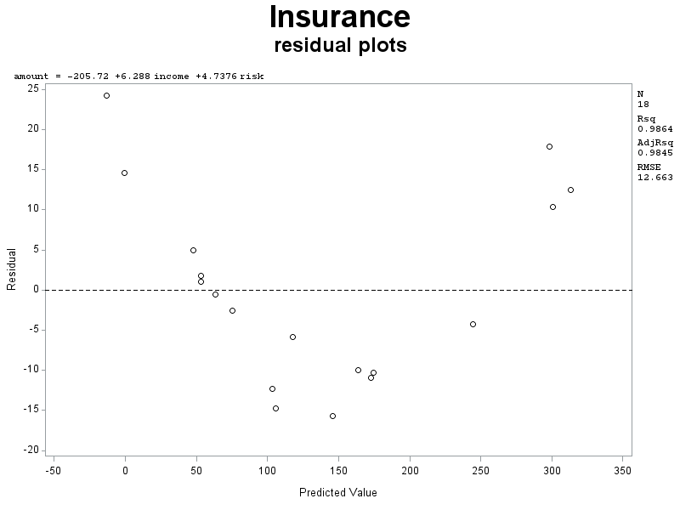
Life Insurance: output, diagnostics

Slide 5
Life Insurance: Initial Regression
Analysis of Variance
Source | DF | Sum of Squares | Mean Square | F Value | Pr > F
Model | 2 | 173919 | 86960 | 542.33 | <.0001
Error | 15 | 2405.14763 | 160.34318
Corrected Total | 17 | 176324
Root MSE | 12.66267 | R-Square | 0.9864
Dependent Mean | 134.44444 | Adj R-Sq | 0.9845
Coeff Var | 9.41851
Parameter Estimates
Variable | DF | Parameter Estimate | Standard Error | t Value | Pr > |t|
Intercept | 1 | -205.71866 | 11.39268 | -18.06 | <.0001
income | 1 | 6.28803 | 0.20415 | 30.80 | <.0001
risk | 1 | 4.73760 | 1.37808 | 3.44 | 0.0037

Slide 6
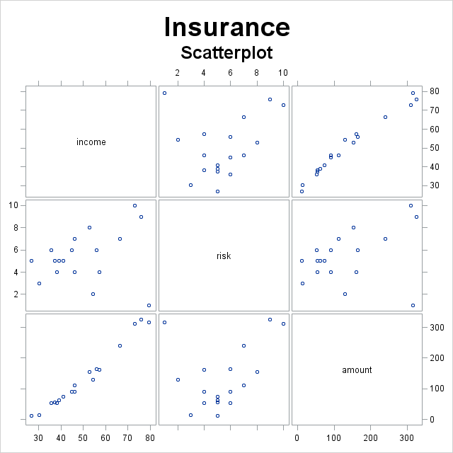
Life Insurance: Scatter plot
title2 h=2 'Scatterplot';
proc sgscatter data=insurance;
matrix income risk amount;
run;

Slide 7
Life Insurance – Residual Plots

Slide 8
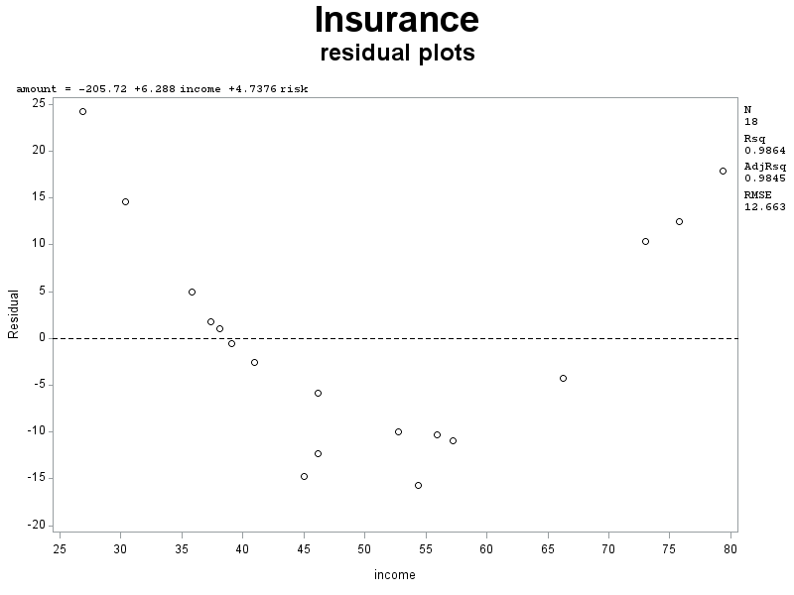
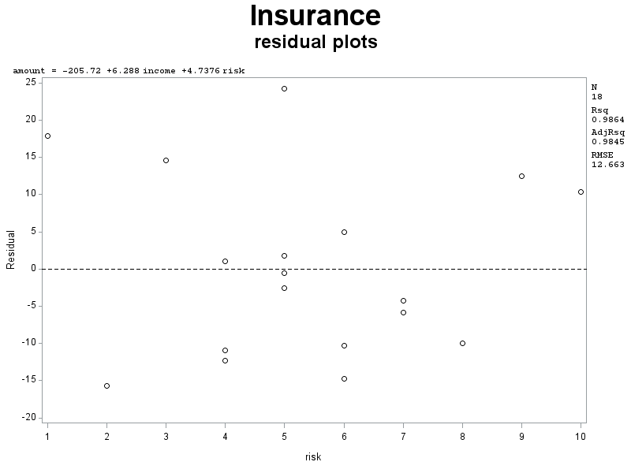
Life Insurance – Residual Plots (cont)

Slide 9
Life Insurance: Partial Regression Plots (1)
proc reg data=insurance;
model amount=income risk/partial;
run;

Slide 10
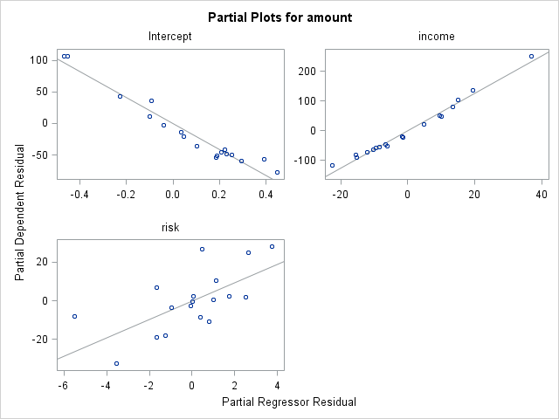
Life Insurance: Partial Regression Plots (1)

Slide 11
Life Insurance: Partial Regression Plots (2) risk
title1 h=3 'Partial residual plot';
title2 h=2 'for risk';
symbol1 v=circle i=rl;
axis1 label=(h=2 'Risk Aversion Score');
axis2 label=(h=2 angle=90 'Amount of Insurance');
proc reg data=insurance;
model amount risk = income;
output out=partialrisk r=resamt resrisk;
proc gplot data=partialrisk;
plot resamt*resrisk / haxis=axis1 vaxis=axis2 vref = 0;
run;

Slide 12
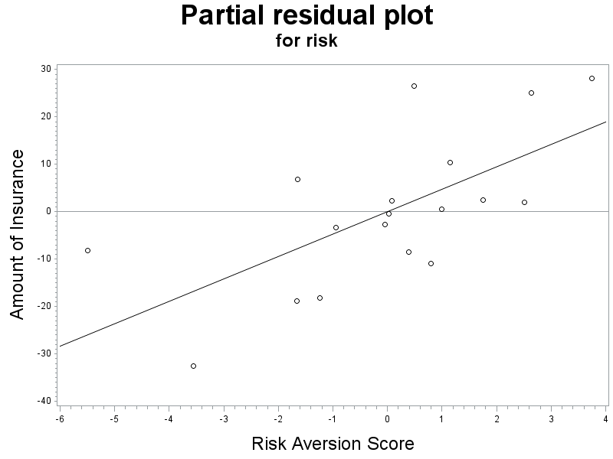
Life Insurance: Partial Regression Plots (2) risk (cont)

Slide 13
Life Insurance: Partial Regression Plots (2) income
axis3 label=(h=2 'Income');
title2 h=2 'for income';
proc reg data=insurance;
model amount income = risk;
output out=partialincome r=resamt resinc;
proc gplot data=partialincome;
plot resamt*resinc / haxis=axis3 vaxis=axis2 vref = 0;
run;

Slide 14
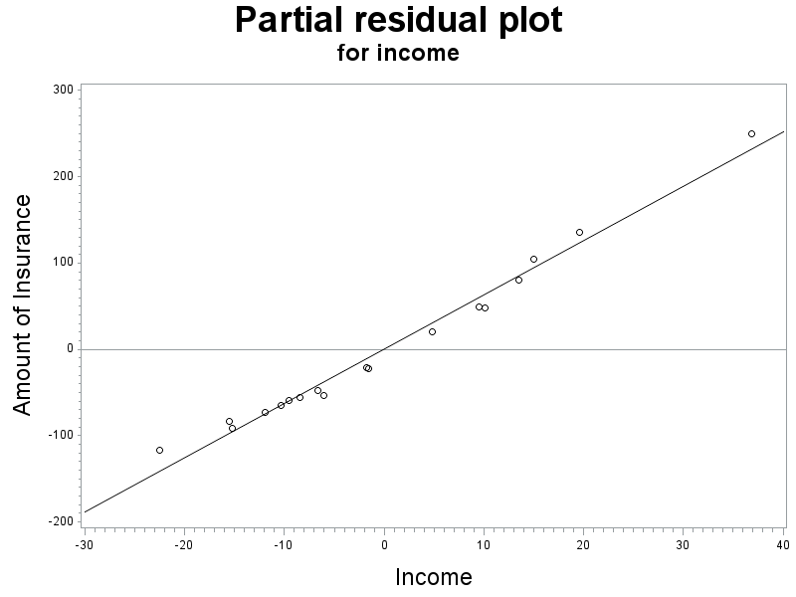
Life Insurance: Partial Regression Plots (2) income (cont)

Slide 15
Life Insurance: Quadratic
title1 'Quadratic model';
title2 '';
data quad;
set insurance;
sinc = income;
proc standard data=quad out=quad mean=0;
var sinc;
data quad;
set quad;
incomesq = sinc*sinc;
proc corr data=quad;
var amount risk income incomesq;
run;
proc reg data=quad;
model amount = income risk incomesq;
run;

Slide 16
Life Insurance: Quadratic (regression)
Analysis of Variance
Source | DF | Sum of Squares | Mean Square | F Value | Pr > F
Model | 3 | 176249 | 58750 | 10958.0 | <.0001
Error | 14 | 75.05895 | 5.36135
Corrected Total | 17 | 176324
Root MSE | 2.31546 | R-Square | 0.9996
Dependent Mean | 134.44444 | Adj R-Sq | 0.9995
Coeff Var | 1.72224
Parameter Estimates
Variable | DF | Parameter Estimate | Standard Error | t Value | Pr > |t|
Intercept | 1 | -200.81134 | 2.09649 | -95.78 | <.0001
income | 1 | 5.88625 | 0.04201 | 140.11 | <.0001
risk | 1 | 5.40039 | 0.25399 | 21.26 | <.0001
incomesq | 1 | 0.05087 | 0.00244 | 20.85 | <.0001

Slide 17
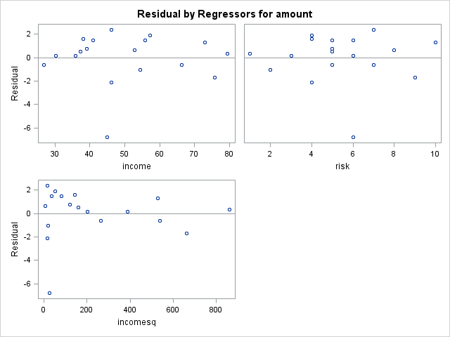
Life Insurance: Quadratic (residual plots)

Slide 18
Life Insurance: normality
Original Model
With Quadratic Term

Slide 19
Types of Outliers

Slide 20
Life Insurance: Studentized Residuals (nknw364.sas)
proc reg data=quad;
model amount=income risk incomesq/r;
output out = diag r=resid student=student;
run;
proc print data=diag; run;

Slide 21
Life Insurance: Studentized Residuals (cont)
Output Statistics
Obs | Dependent Variable | Predicted Value | Std Error Mean Predict | Residual | Std Error Residual | Student Residual | -2-1 0 1 2
1 | 91.0000 | 97.8164 | 0.7181 | -6.8164 | 2.201 | -3.097 | |******| |
2 | 162.0000 | 160.1201 | 0.9577 | 1.8799 | 2.108 | 0.892 | | |* |
3 | 11.0000 | 11.5901 | 1.5574 | -0.5901 | 1.713 | -0.344 | | | |
4 | 240.0000 | 240.6278 | 0.8580 | -0.6278 | 2.151 | -0.292 | | | |
5 | 73.0000 | 71.5019 | 0.6656 | 1.4981 | 2.218 | 0.675 | | |* |
6 | 311.0000 | 309.6777 | 1.4363 | 1.3223 | 1.816 | 0.728 | | |* |
7 | 316.0000 | 315.6359 | 2.0100 | 0.3641 | 1.150 | 0.317 | | | |
8 | 154.0000 | 153.3645 | 0.9829 | 0.6355 | 2.096 | 0.303 | | | |
9 | 164.0000 | 162.4847 | 0.8211 | 1.5153 | 2.165 | 0.700 | | |* |
10 | 54.0000 | 52.4068 | 0.7346 | 1.5932 | 2.196 | 0.726 | | |* |
11 | 53.0000 | 52.8060 | 0.8340 | 0.1940 | 2.160 | 0.0898 | | | |
12 | 326.0000 | 327.6975 | 1.4378 | -1.6975 | 1.815 | -0.935 | | *| |
13 | 55.0000 | 54.4957 | 0.7142 | 0.5043 | 2.203 | 0.229 | | | |
14 | 130.0000 | 131.0179 | 1.2720 | -1.0179 | 1.935 | -0.526 | | *| |
15 | 112.0000 | 109.6080 | 0.8185 | 2.3920 | 2.166 | 1.104 | | |** |
16 | 91.0000 | 93.0992 | 0.8093 | -2.0992 | 2.169 | -0.968 | | *| |
17 | 14.0000 | 13.8135 | 1.2042 | 0.1865 | 1.978 | 0.0943 | | | |
18 | 63.0000 | 62.2363 | 0.6776 | 0.7637 | 2.214 | 0.345 | | | |

Slide 22
Life Insurance: Studentized Residuals (cont)
Obs | income | risk | amount | sinc | incomesq | resid | student
1 | 45.010 | 6 | 91 | -5.0268 | 25.268 | -6.81637 | -3.09652
2 | 57.204 | 4 | 162 | 7.1672 | 51.369 | 1.87988 | 0.89174
3 | 26.852 | 5 | 11 | -23.1848 | 537.534 | -0.59009 | -0.34440
4 | 66.290 | 7 | 240 | 16.2532 | 264.167 | -0.62783 | -0.29193
5 | 40.964 | 5 | 73 | -9.0728 | 82.315 | 1.49807 | 0.67550
6 | 72.996 | 10 | 311 | 22.9592 | 527.126 | 1.32229 | 0.72806
7 | 79.380 | 1 | 316 | 29.3432 | 861.025 | 0.36407 | 0.31672
8 | 52.766 | 8 | 154 | 2.7292 | 7.449 | 0.63552 | 0.30314
9 | 55.916 | 6 | 164 | 5.8792 | 34.565 | 1.51532 | 0.69992
10 | 38.122 | 4 | 54 | -11.9148 | 141.962 | 1.59323 | 0.72557
11 | 35.840 | 6 | 53 | -14.1968 | 201.548 | 0.19397 | 0.08980
12 | 75.796 | 9 | 326 | 25.7592 | 663.538 | -1.69746 | -0.93525
13 | 37.408 | 5 | 55 | -12.6288 | 159.486 | 0.50425 | 0.22894
14 | 54.376 | 2 | 130 | 4.3392 | 18.829 | -1.01786 | -0.52609
15 | 46.186 | 7 | 112 | -3.8508 | 14.828 | 2.39205 | 1.10437
16 | 46.130 | 4 | 91 | -3.9068 | 15.263 | -2.09925 | -0.96765
17 | 30.366 | 3 | 14 | -19.6708 | 386.939 | 0.18647 | 0.09429
18 | 39.060 | 5 | 63 | -10.9768 | 120.490 | 0.76374 | 0.34494

Slide 23
Life Insurance: Studentized Deleted Residuals
proc reg data=quad;
model amount=income risk incomesq/r influence;
output out = diag1 r=resid rstudent=rstudent;
run;
proc print data=diag1; run;

Slide 24
Studentized Deleted Residuals (cont)
Obs | Dependent Variable | Predicted Value | RStudent | Hat Diag H
1 | 91.0000 | 97.8164 | -5.3155 | 0.0962
2 | 162.0000 | 160.1201 | 0.8848 | 0.1711
3 | 11.0000 | 11.5901 | -0.3333 | 0.4524
4 | 240.0000 | 240.6278 | -0.2822 | 0.1373
5 | 73.0000 | 71.5019 | 0.6618 | 0.0826
6 | 311.0000 | 309.6777 | 0.7153 | 0.3848
7 | 316.0000 | 315.6359 | 0.3063 | 0.7535
8 | 154.0000 | 153.3645 | 0.2931 | 0.1802
9 | 164.0000 | 162.4847 | 0.6866 | 0.1258
10 | 54.0000 | 52.4068 | 0.7127 | 0.1006
11 | 53.0000 | 52.8060 | 0.0866 | 0.1297
12 | 326.0000 | 327.6975 | -0.9308 | 0.3856
13 | 55.0000 | 54.4957 | 0.2210 | 0.0951
14 | 130.0000 | 131.0179 | -0.5120 | 0.3018
15 | 112.0000 | 109.6080 | 1.1138 | 0.1249
16 | 91.0000 | 93.0992 | -0.9653 | 0.1222
17 | 14.0000 | 13.8135 | 0.0909 | 0.2705
18 | 63.0000 | 62.2363 | 0.3338 | 0.0856

Slide 25
Studentized Deleted Residuals (cont)
Sum of Residuals | 0
Sum of Squared Residuals | 75.05895
Predicted Residual SS (PRESS) | 103.99525

Slide 26
Studentized Deleted Residuals (cont)
Obs | income | risk | amount | sinc | incomesq | resid | rstudent
1 | 45.010 | 6 | 91 | -5.0268 | 25.268 | -6.81637 | -5.31555
2 | 57.204 | 4 | 162 | 7.1672 | 51.369 | 1.87988 | 0.88480
3 | 26.852 | 5 | 11 | -23.1848 | 537.534 | -0.59009 | -0.33328
4 | 66.290 | 7 | 240 | 16.2532 | 264.167 | -0.62783 | -0.28217
5 | 40.964 | 5 | 73 | -9.0728 | 82.315 | 1.49807 | 0.66180
6 | 72.996 | 10 | 311 | 22.9592 | 527.126 | 1.32229 | 0.71525
7 | 79.380 | 1 | 316 | 29.3432 | 861.025 | 0.36407 | 0.30630
8 | 52.766 | 8 | 154 | 2.7292 | 7.449 | 0.63552 | 0.29307
9 | 55.916 | 6 | 164 | 5.8792 | 34.565 | 1.51532 | 0.68658
10 | 38.122 | 4 | 54 | -11.9148 | 141.962 | 1.59323 | 0.71270
11 | 35.840 | 6 | 53 | -14.1968 | 201.548 | 0.19397 | 0.08656
12 | 75.796 | 9 | 326 | 25.7592 | 663.538 | -1.69746 | -0.93078
13 | 37.408 | 5 | 55 | -12.6288 | 159.486 | 0.50425 | 0.22103
14 | 54.376 | 2 | 130 | 4.3392 | 18.829 | -1.01786 | -0.51204
15 | 46.186 | 7 | 112 | -3.8508 | 14.828 | 2.39205 | 1.11382
16 | 46.130 | 4 | 91 | -3.9068 | 15.263 | -2.09925 | -0.96529
17 | 30.366 | 3 | 14 | -19.6708 | 386.939 | 0.18647 | 0.09089
18 | 39.060 | 5 | 63 | -10.9768 | 120.490 | 0.76374 | 0.33381

Slide 27
Studentized Deleted Residuals: w/o square
Obs | Dependent Variable | Predicted Value | RStudent | Hat Diag H
1 | 91.0000 | 105.7311 | -1.2259 | 0.0693
2 | 162.0000 | 172.9321 | -0.9048 | 0.1006
3 | 11.0000 | -13.1845 | 2.4487 | 0.1890
4 | 240.0000 | 244.2780 | -0.3518 | 0.1316
5 | 73.0000 | 75.5522 | -0.2028 | 0.0756
6 | 311.0000 | 300.6583 | 1.0138 | 0.3499
7 | 316.0000 | 298.1627 | 2.7483 | 0.6225
8 | 154.0000 | 163.9763 | -0.8371 | 0.1319
9 | 164.0000 | 174.3084 | -0.8336 | 0.0658
10 | 54.0000 | 52.9440 | 0.0850 | 0.1005
11 | 53.0000 | 48.0699 | 0.4033 | 0.1201
12 | 326.0000 | 313.5272 | 1.1933 | 0.2994
13 | 55.0000 | 53.1919 | 0.1451 | 0.0944
14 | 130.0000 | 145.6744 | -1.4415 | 0.2096
15 | 112.0000 | 117.8634 | -0.4742 | 0.0957
16 | 91.0000 | 103.2985 | -1.0120 | 0.0775
17 | 14.0000 | -0.5636 | 1.3004 | 0.1818
18 | 63.0000 | 63.5798 | -0.0462 | 0.0849

Slide 28
/r vs. /influence
/r keyword
/influence keyword
Obs | Dependent Variable | Predicted Value | Std Error Mean Predict | Residual | Std Error Residual | Student Residual | bar graph | Cook's D
Obs | Residual | RStudent | Hat Diag H | Cov Ratio | DFFITS | DFBETAS
 |  |  |  |  |  | all parameters

Slide 29
Hat Matrix Diagnosis, DFFITS
Obs | Residual | RStudent | Hat Diag H | Cov Ratio | DFFITS
1 | -6.8164 | -5.3155 | 0.0962 | 0.0147 | -1.7339
2 | 1.8799 | 0.8848 | 0.1711 | 1.2842 | 0.4020
3 | -0.5901 | -0.3333 | 0.4524 | 2.3742 | -0.3029
4 | -0.6278 | -0.2822 | 0.1373 | 1.5215 | -0.1126
5 | 1.4981 | 0.6618 | 0.0826 | 1.2842 | 0.1986
6 | 1.3223 | 0.7153 | 0.3848 | 1.8735 | 0.5656
7 | 0.3641 | 0.3063 | 0.7535 | 5.3027 | 0.5356
8 | 0.6355 | 0.2931 | 0.1802 | 1.5981 | 0.1374
9 | 1.5153 | 0.6866 | 0.1258 | 1.3342 | 0.2604
10 | 1.5932 | 0.7127 | 0.1006 | 1.2830 | 0.2384
11 | 0.1940 | 0.0866 | 0.1297 | 1.5420 | 0.0334
12 | -1.6975 | -0.9308 | 0.3856 | 1.6912 | -0.7373
13 | 0.5043 | 0.2210 | 0.0951 | 1.4643 | 0.0717
14 | -1.0179 | -0.5120 | 0.3018 | 1.7786 | -0.3366
15 | 2.3920 | 1.1138 | 0.1249 | 1.0675 | 0.4209
16 | -2.0992 | -0.9653 | 0.1222 | 1.1616 | -0.3601
17 | 0.1865 | 0.0909 | 0.2705 | 1.8390 | 0.0553
18 | 0.7637 | 0.3338 | 0.0856 | 1.4216 | 0.1022

Slide 30
Cook’s Distance, DFBetas, Cov Ratio
Obs | Cook's D | Cov Ratio | DFFITS | DFBETAS
 |  |  |  | Intercept | income | risk | incomesq
1 | 0.255 | 0.0147 | -1.7339 | -0.4126 | 0.0662 | -0.3686 | 0.9168
2 | 0.041 | 1.2842 | 0.4020 | 0.0110 | 0.2513 | -0.2064 | -0.2579
3 | 0.025 | 2.3742 | -0.3029 | -0.1839 | 0.2513 | -0.0525 | -0.2312
4 | 0.003 | 1.5215 | -0.1126 | 0.0642 | -0.0692 | -0.0299 | 0.0230
5 | 0.010 | 1.2842 | 0.1986 | 0.1216 | -0.0566 | -0.0108 | -0.0580
6 | 0.083 | 1.8735 | 0.5656 | -0.3627 | 0.1183 | 0.3901 | 0.1704
7 | 0.077 | 5.3027 | 0.5356 | -0.0249 | 0.2235 | -0.3381 | 0.2233
8 | 0.005 | 1.5981 | 0.1374 | -0.0372 | 0.0245 | 0.0788 | -0.0712
9 | 0.018 | 1.3342 | 0.2604 | -0.0462 | 0.1333 | 0.0084 | -0.1799
10 | 0.015 | 1.2830 | 0.2384 | 0.1978 | -0.0988 | -0.0773 | -0.0084
11 | 0.000 | 1.5420 | 0.0334 | 0.0195 | -0.0244 | 0.0126 | 0.0091
12 | 0.137 | 1.6912 | -0.7373 | 0.4425 | -0.1728 | -0.3821 | -0.3486
13 | 0.001 | 1.4643 | 0.0717 | 0.0535 | -0.0427 | 0.0030 | 0.0063
14 | 0.030 | 1.7786 | -0.3366 | -0.0807 | -0.1746 | 0.2583 | 0.1861
15 | 0.044 | 1.0675 | 0.4209 | 0.0160 | -0.0195 | 0.2003 | -0.2036
16 | 0.033 | 1.1616 | -0.3601 | -0.1515 | -0.0774 | 0.1654 | 0.2177
17 | 0.001 | 1.8390 | 0.0553 | 0.0462 | -0.0383 | -0.0150 | 0.0317
18 | 0.003 | 1.4216 | 0.1022 | 0.0714 | -0.0471 | -0.0003 | -0.0097

Slide 31
Life Insurance: Multicollinearity
proc reg data=quad;
model amount=income risk incomesq/tol vif;
run;
Parameter Estimates
Variable | DF | Parameter Estimate | Standard Error | t Value | Pr > |t| | Tolerance | Variance Inflation
Intercept | 1 | -200.81134 | 2.09649 | -95.78 | <.0001 | . | 0
income | 1 | 5.88625 | 0.04201 | 140.11 | <.0001 | 0.73842 | 1.35424
risk | 1 | 5.40039 | 0.25399 | 21.26 | <.0001 | 0.92058 | 1.08627
incomesq | 1 | 0.05087 | 0.00244 | 20.85 | <.0001 | 0.78954 | 1.26657

Slide 32
Body Fat: Multicollinearity (nknw260b.sas)
data bodyfat;
infile 'I:\My Documents\Stat 512\CH07TA01.DAT';
input skinfold thigh midarm fat;
proc print data=bodyfat; run;
proc reg data=bodyfat;
model fat=skinfold thigh midarm/vif tol;
run;
Parameter Estimates
Variable | DF | Parameter Estimate | Standard Error | t Value | Pr > |t| | Tolerance | Variance Inflation
Intercept | 1 | 117.08469 | 99.78240 | 1.17 | 0.2578 | . | 0
skinfold | 1 | 4.33409 | 3.01551 | 1.44 | 0.1699 | 0.00141 | 708.84291
thigh | 1 | -2.85685 | 2.58202 | -1.11 | 0.2849 | 0.00177 | 564.34339
midarm | 1 | -2.18606 | 1.59550 | -1.37 | 0.1896 | 0.00956 | 104.60601

Slide 33
Blood Pressure Example: Background (nknw406.sas)
Researching the relationship between blood pressure in healthy women ages 20 – 60.
Y = diastolic blood pressure (diast)
X = age
n = 54

Slide 34
Blood Pressure: input
data pressure;
infile ‘H:\My Documents\Stat 512\CH11TA01.DAT';
input age diast;
proc print data=pressure; run;
title1 h=3 'Blood Pressure';
title2 h=2 'Scatter plot';
symbol1 v=circle i=sm70 c=purple;
axis1 label=(h=2);
axis2 label=(h=2 angle=90);
proc sort data=pressure;
by age;
proc gplot data=pressure;
plot diast*age;
run;

Slide 35
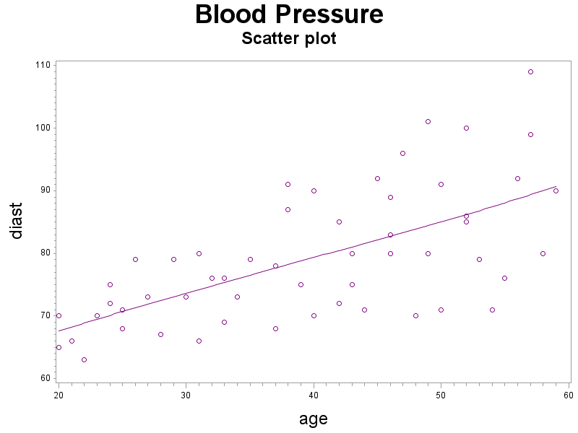
Blood Pressure: Scatterplot

Slide 36
Blood Pressure: regression (unweighted)
proc reg data=pressure;
model diast=age / clb;
output out=diag r=resid;
run;
Analysis of Variance
Source | DF | Sum of Squares | Mean Square | F Value | Pr > F
Model | 1 | 2374.96833 | 2374.96833 | 35.79 | <.0001
Error | 52 | 3450.36501 | 66.35317
Corrected Total | 53 | 5825.33333
Root MSE | 8.14575 | R-Square | 0.4077
Dependent Mean | 79.11111 | Adj R-Sq | 0.3963
Parameter Estimates
Variable | DF | Parameter Estimate | Standard Error | t Value | Pr > |t| | 95% Confidence Limits
Intercept | 1 | 56.15693 | 3.99367 | 14.06 | <.0001 | 48.14304 | 64.17082
age | 1 | 0.58003 | 0.09695 | 5.98 | <.0001 | 0.38548 | 0.77458

Slide 37
Blood Pressure: Residual Plots
data diag;
set diag;
absr=abs(resid);
sqrr=resid*resid;
title2 h=2 'residual abs(resid) squared residual plots vs. age';
proc gplot data=diag;
plot (resid absr sqrr)*age/haxis=axis1
vaxis=axis2;
run;

Slide 38
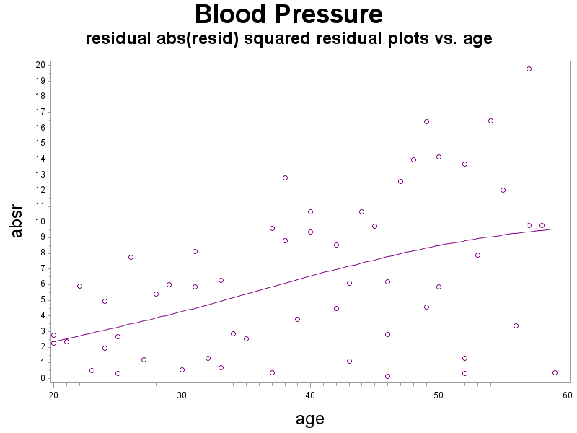
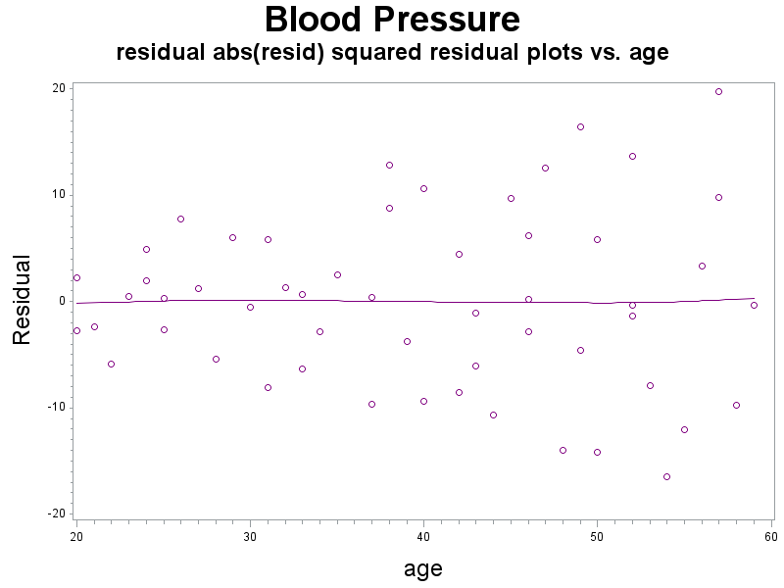
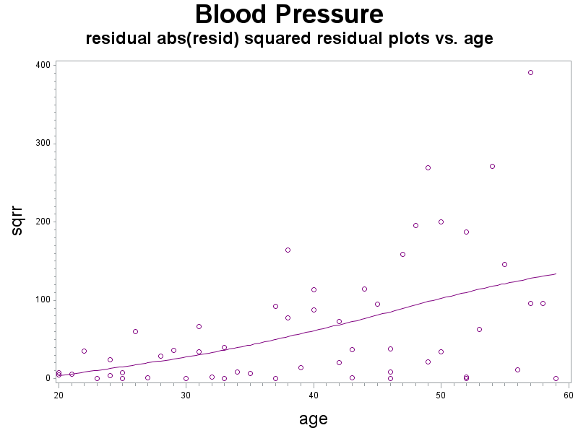
Blood Pressure: Residual Plots (cont)

Slide 39
Blood Pressure: computing weights
proc reg data=diag;
model absr=age;
output out=findweights p=shat;
data findweights;
set findweights;
wt=1/(shat*shat);

Slide 40
Blood Pressure: computing weights if using resid²
proc reg data=diag;
model sqrr=age;
output out=findweights p=shat2;
data findweights;
set findweights;
wt=1/shat2;

Slide 41
Blood Pressure: weighted regression
proc reg data=findweights;
model diast=age / clb p;
weight wt;
output out = weighted r = resid p = predict;
run;
Analysis of Variance
Source | DF | Sum of Squares | Mean Square | F Value | Pr > F
Model | 1 | 83.34082 | 83.34082 | 56.64 | <.0001
Error | 52 | 76.51351 | 1.47141
Corrected Total | 53 | 159.85432
Root MSE | 1.21302 | R-Square | 0.5214
Dependent Mean | 73.55134 | Adj R-Sq | 0.5122
Parameter Estimates
Variable | DF | Parameter Estimate | Standard Error | t Value | Pr > |t| | 95% Confidence Limits
Intercept | 1 | 55.56577 | 2.52092 | 22.04 | <.0001 | 50.50718 | 60.62436
age | 1 | 0.59634 | 0.07924 | 7.53 | <.0001 | 0.43734 | 0.75534

Slide 42
Blood pressure: Comparison
Normal Regression
Weighted Regression
Parameter Estimates
Variable | DF | Parameter Estimate | Standard Error | t Value | Pr > |t| | 95% Confidence Limits
Intercept | 1 | 56.15693 | 3.99367 | 14.06 | <.0001 | 48.14304 | 64.17082
age | 1 | 0.58003 | 0.09695 | 5.98 | <.0001 | 0.38548 | 0.77458
Parameter Estimates
Variable | DF | Parameter Estimate | Standard Error | t Value | Pr > |t| | 95% Confidence Limits
Intercept | 1 | 55.56577 | 2.52092 | 22.04 | <.0001 | 50.50718 | 60.62436
age | 1 | 0.59634 | 0.07924 | 7.53 | <.0001 | 0.43734 | 0.75534

Slide 43
Blood Pressure: new residuals
data graphtest;
set weighted;
resid1 = sqrt(wt)*resid;
title2 h=2 'Weighted data - residual plot';
symbol1 v=circle i=none color=red;
proc gplot data=graphtest;
plot resid1*predict/vref=0 haxis=axis1 vaxis=axis2;
run;

Slide 44
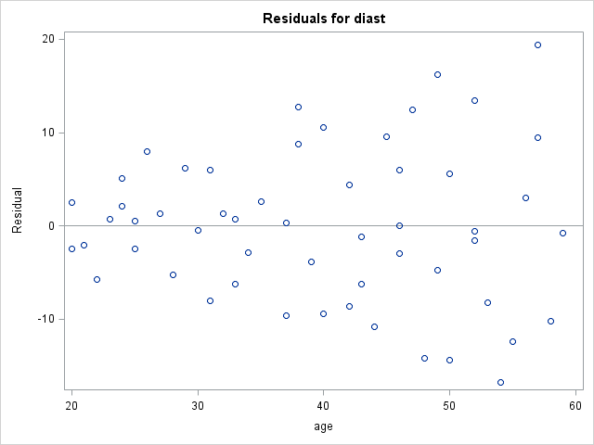
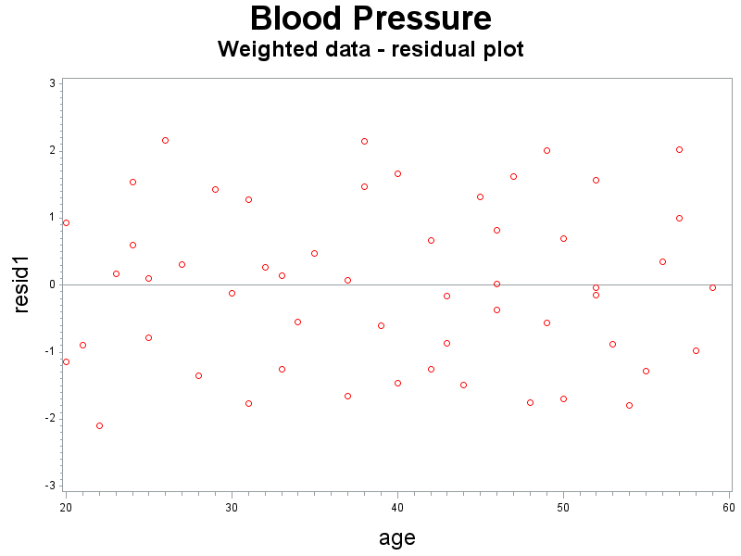
Blood Pressure: new residuals

Slide 45
Biased vs. Unbiased Estimators

Slide 46
Body Fat Example (ridge.sas)
n = 20 healthy female subjects ages of 25 – 34
Y = body fat (fat)
X₁ = triceps skinfold thickness (skinfold)
X₂ = thigh circumference (thigh)
X₃ = midarm circumference (midarm)
Previous Conclusion:
Problem with multicollinearity
Good model with a) thigh only or with b) midarm and skinfold only

Slide 47
Body Fat Example: Regression (input)
data bodyfat;
infile 'I:\My Documents\Stat 512\CH07TA01.DAT';
input skinfold thigh midarm fat;
proc print data=bodyfat;
run;
proc reg data=bodyfat;
model fat=skinfold thigh midarm;
run;

Slide 48
Body Fat Example: Regression (output)
Analysis of Variance
Source | DF | Sum of Squares | Mean Square | F Value | Pr > F
Model | 3 | 396.98461 | 132.32820 | 21.52 | <.0001
Error | 16 | 98.40489 | 6.15031
Corrected Total | 19 | 495.38950
Root MSE | 2.47998 | R-Square | 0.8014
Dependent Mean | 20.19500 | Adj R-Sq | 0.7641
Coeff Var | 12.28017
Parameter Estimates
Variable | DF | Parameter Estimate | Standard Error | t Value | Pr > |t|
Intercept | 1 | 117.08469 | 99.78240 | 1.17 | 0.2578
skinfold | 1 | 4.33409 | 3.01551 | 1.44 | 0.1699
thigh | 1 | -2.85685 | 2.58202 | -1.11 | 0.2849
midarm | 1 | -2.18606 | 1.59550 | -1.37 | 0.1896

Slide 49
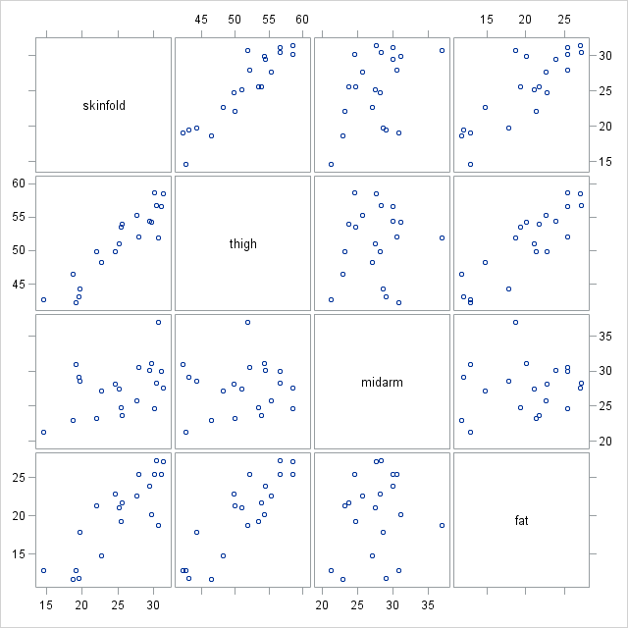
Body Fat Example: Scatter plot

Slide 50
Body Fat Example: Correlation
proc corr data=bodyfat noprob;run;
Pearson Correlation Coefficients, N = 20
 | skinfold | thigh | midarm | fat
skinfold | 1.00000 | 0.92384 | 0.45778 | 0.84327
thigh | 0.92384 | 1.00000 | 0.08467 | 0.87809
midarm | 0.45778 | 0.08467 | 1.00000 | 0.14244
fat | 0.84327 | 0.87809 | 0.14244 | 1.00000

Slide 51
Body Fat Example: Ridge trace
title1 h=3 'Ridge Trace';
title2 h=2 'Body Fat Example';
axis1 label=(h=2);
axis2 label= (h=2 angle=90);
symbol1 v = S i = none c = black;
symbol2 v = T i = none c = red;
symbol3 v = M i = none c = green;
proc reg data = bodyfat outvif
outest = bfout ridge = 0 to .1 by 0.002;
model fat = skinfold thigh midarm / noprint;
plot / ridgeplot nomodel nostat;
run;

Slide 52
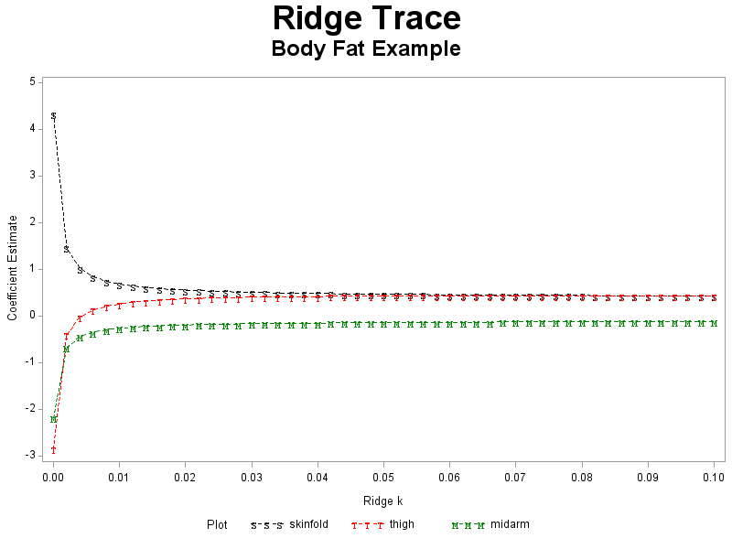
Body Fat Example: Ridge trace (cont)

Slide 53
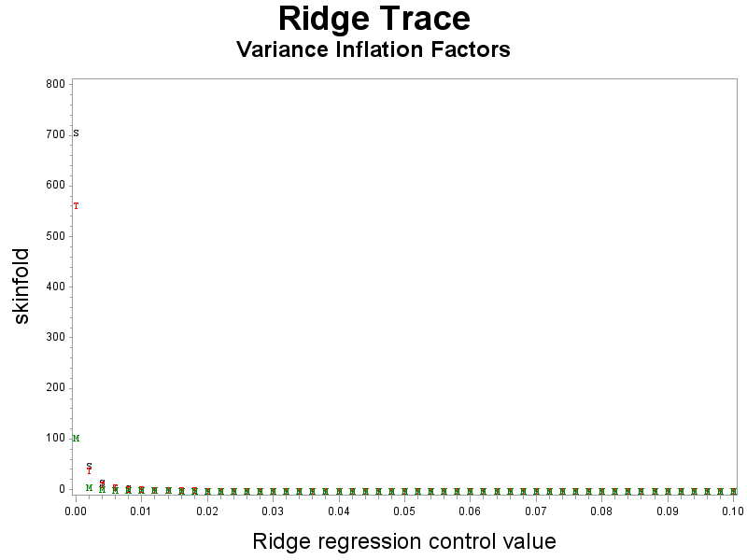
Body Fat Example: VIF factors
title2 h=2 'Variance Inflation Factors';
proc gplot data = bfout;
plot (skinfold thigh midarm)* _RIDGE_ / overlay haxis=axis1 vaxis=axis2;
where _TYPE_ = 'RIDGEVIF';
run;

Slide 54
Body Fat Example: VIF factors (cont)
proc print data = bfout;
var _RIDGE_ skinfold thigh midarm;
where _TYPE_ = 'RIDGEVIF';
Obs | _RIDGE_ | skinfold | thigh | midarm
2 | 0.000 | 708.843 | 564.343 | 104.606
4 | 0.002 | 50.559 | 40.448 | 8.280
6 | 0.004 | 16.982 | 13.725 | 3.363
8 | 0.006 | 8.503 | 6.976 | 2.119
10 | 0.008 | 5.147 | 4.305 | 1.624
12 | 0.010 | 3.486 | 2.981 | 1.377
14 | 0.012 | 2.543 | 2.231 | 1.236
16 | 0.014 | 1.958 | 1.764 | 1.146
18 | 0.016 | 1.570 | 1.454 | 1.086
20 | 0.018 | 1.299 | 1.238 | 1.043
22 | 0.020 | 1.103 | 1.081 | 1.011
24 | 0.022 | 0.956 | 0.963 | 0.986
26 | 0.024 | 0.843 | 0.872 | 0.966
28 | 0.026 | 0.754 | 0.801 | 0.949
30 | 0.028 | 0.683 | 0.744 | 0.935

Slide 55
Body Fat Example: Parameters
title2 'Parameter Estimates';
proc print data = bfout;
var _RIDGE_ _RMSE_ Intercept skinfold thigh midarm;
where _TYPE_ = 'RIDGE';
run;
Obs | _RIDGE_ | _RMSE_ | Intercept | skinfold | thigh | midarm
3 | 0.000 | 2.47998 | 117.085 | 4.33409 | -2.85685 | -2.18606
5 | 0.002 | 2.54921 | 22.277 | 1.46445 | -0.40119 | -0.67381
7 | 0.004 | 2.57173 | 7.725 | 1.02294 | -0.02423 | -0.44083
9 | 0.006 | 2.58174 | 1.842 | 0.84372 | 0.12820 | -0.34604
11 | 0.008 | 2.58739 | -1.331 | 0.74645 | 0.21047 | -0.29443
13 | 0.010 | 2.59104 | -3.312 | 0.68530 | 0.26183 | -0.26185
15 | 0.012 | 2.59360 | -4.661 | 0.64324 | 0.29685 | -0.23934
17 | 0.014 | 2.59551 | -5.637 | 0.61249 | 0.32218 | -0.22278
19 | 0.016 | 2.59701 | -6.373 | 0.58899 | 0.34131 | -0.21004
21 | 0.018 | 2.59822 | -6.946 | 0.57042 | 0.35623 | -0.19991
23 | 0.020 | 2.59924 | -7.403 | 0.55535 | 0.36814 | -0.19163
25 | 0.022 | 2.60011 | -7.776 | 0.54287 | 0.37786 | -0.18470
27 | 0.024 | 2.60087 | -8.083 | 0.53233 | 0.38590 | -0.17881
29 | 0.026 | 2.60156 | -8.341 | 0.52331 | 0.39265 | -0.17372
31 | 0.028 | 2.60218 | -8.559 | 0.51549 | 0.39837 | -0.16926

