Slide 1
CS Example: General Linear Test (cs2.sas)
proc reg data=cs;
model gpa=satm satv hsm hss hse;
* test H0: beta1 = beta2 = 0;
sat: test satm, satv;
* test H0: beta3=beta4=beta5=0;
hs: test hsm, hss, hse;
run;

Slide 2
CS Example: General Linear Test
Test sat Results for Dependent Variable gpa
Source | DF | Mean Square | F Value | Pr > F
Numerator | 2 | 0.46566 | 0.95 | 0.3882
Denominator | 218 | 0.49000
Test hs Results for Dependent Variable gpa
Source | DF | Mean Square | F Value | Pr > F
Numerator | 3 | 6.68660 | 13.65 | <.0001
Denominator | 218 | 0.49000

Slide 3
CS Example: General Linear Test
proc reg data=cs;
model gpa=satm hsm hss hse;
* test H0: beta1 = beta2 = 0;
sat: test satm;
* test H0: beta3=beta4=beta5=0;
hs: test hsm, hss, hse;
run;

Slide 4
Body Fat Example (nknw260.sas)
For 20 healthy female subjects between 25 – 30
Y = amount of body fat (fat)
X₁ = tricepts skinfold thickness (skinfold)
X₂ = thigh circumference (thigh)
X₃ = midarm circumference (midarm)

Slide 5
Body Fat Example: Regression (input)
data bodyfat;
infile 'I:\My Documents\Stat 512\CH07TA01.DAT';
input skinfold thigh midarm fat;
proc print data=bodyfat;
run;
proc reg data=bodyfat;
model fat=skinfold thigh midarm;
run;

Slide 6
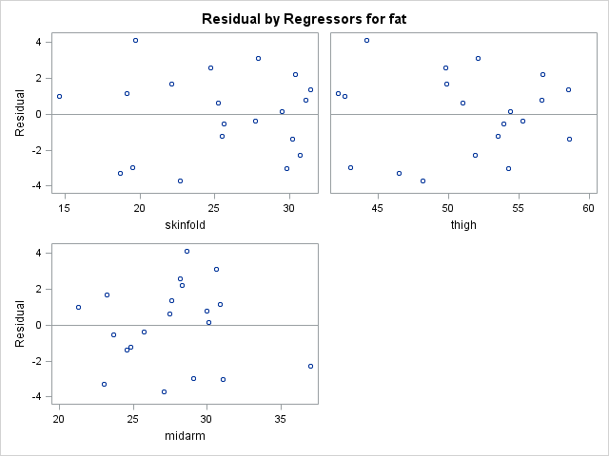
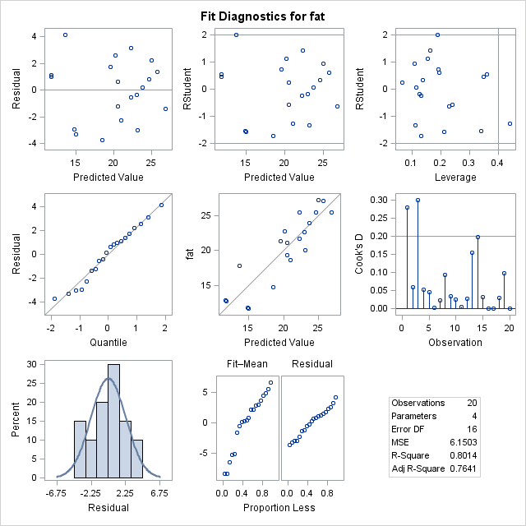
Body Fat Example: Diagnostics (output)

Slide 7
Body Fat Example: Diagnostics (output)

Slide 8
Body Fat Example: Regression (output)
Analysis of Variance
Source | DF | Sum of Squares | Mean Square | F Value | Pr > F
Model | 3 | 396.98461 | 132.32820 | 21.52 | <.0001
Error | 16 | 98.40489 | 6.15031
Corrected Total | 19 | 495.38950
Root MSE | 2.47998 | R-Square | 0.8014
Dependent Mean | 20.19500 | Adj R-Sq | 0.7641
Coeff Var | 12.28017
Parameter Estimates
Variable | DF | Parameter Estimate | Standard Error | t Value | Pr > |t|
Intercept | 1 | 117.08469 | 99.78240 | 1.17 | 0.2578
skinfold | 1 | 4.33409 | 3.01551 | 1.44 | 0.1699
thigh | 1 | -2.85685 | 2.58202 | -1.11 | 0.2849
midarm | 1 | -2.18606 | 1.59550 | -1.37 | 0.1896

Slide 9
Body Fat Example: Extra SS
proc reg data=bodyfat;
model fat=skinfold thigh midarm /ss1 ss2;
run;
Parameter Estimates
Variable | DF | Parameter Estimate | Standard Error | t Value | Pr > |t| | Type I SS | Type II SS
Intercept | 1 | 117.08469 | 99.78240 | 1.17 | 0.2578 | 8156.76050 | 8.46816
skinfold | 1 | 4.33409 | 3.01551 | 1.44 | 0.1699 | 352.26980 | 12.70489
thigh | 1 | -2.85685 | 2.58202 | -1.11 | 0.2849 | 33.16891 | 7.52928
midarm | 1 | -2.18606 | 1.59550 | -1.37 | 0.1896 | 11.54590 | 11.54590
Analysis of Variance
Source | DF | Sum of Squares | Mean Square | F Value | Pr > F
Model | 3 | 396.98461 | 132.32820 | 21.52 | <.0001
Error | 16 | 98.40489 | 6.15031
Corrected Total | 19 | 495.38950

Slide 10
Body Fat Example: Regression (output)
Analysis of Variance
Source | DF | Sum of Squares | Mean Square | F Value | Pr > F
Model | 3 | 396.98461 | 132.32820 | 21.52 | <.0001
Error | 16 | 98.40489 | 6.15031
Corrected Total | 19 | 495.38950
Root MSE | 2.47998 | R-Square | 0.8014
Dependent Mean | 20.19500 | Adj R-Sq | 0.7641
Coeff Var | 12.28017
Parameter Estimates
Variable | DF | Parameter Estimate | Standard Error | t Value | Pr > |t|
Intercept | 1 | 117.08469 | 99.78240 | 1.17 | 0.2578
skinfold | 1 | 4.33409 | 3.01551 | 1.44 | 0.1699
thigh | 1 | -2.85685 | 2.58202 | -1.11 | 0.2849
midarm | 1 | -2.18606 | 1.59550 | -1.37 | 0.1896

Slide 11
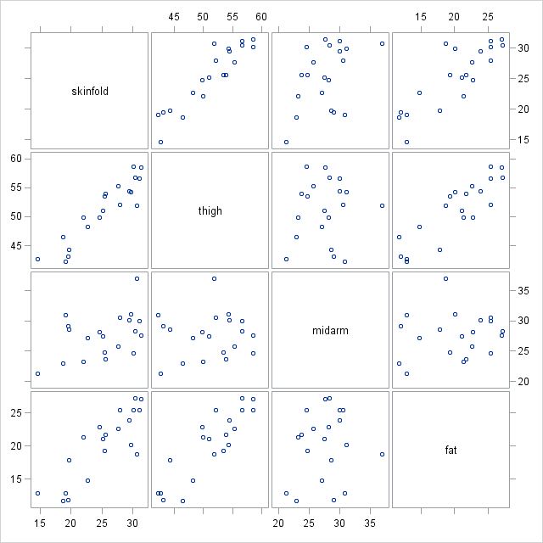
Body Fat Example: Scatter plot

Slide 12
Body Fat Example: Correlation
proc corr data=bodyfat noprob;run;
Pearson Correlation Coefficients, N = 20
 | skinfold | thigh | midarm | fat
skinfold | 1.00000 | 0.92384 | 0.45778 | 0.84327
thigh | 0.92384 | 1.00000 | 0.08467 | 0.87809
midarm | 0.45778 | 0.08467 | 1.00000 | 0.14244
fat | 0.84327 | 0.87809 | 0.14244 | 1.00000

Slide 13
Body Fat Example: Single X_{i}’s (input)
proc reg data=bodyfat;
model fat = skinfold;
model fat = thigh;
model fat = midarm;
run;

Slide 14
Body Fat Example: Single X_{i}’s (output)
Parameter Estimates
Variable | DF | Parameter Estimate | Standard Error | t Value | Pr > |t|
Intercept | 1 | -1.49610 | 3.31923 | -0.45 | 0.6576
skinfold | 1 | 0.85719 | 0.12878 | 6.66 | <.0001
Root MSE | 2.81977
R-Square | 0.7111
Adj R-Sq | 0.6950
Parameter Estimates
Variable | DF | Parameter Estimate | Standard Error | t Value | Pr > |t|
Intercept | 1 | -23.63449 | 5.65741 | -4.18 | 0.0006
thigh | 1 | 0.85655 | 0.11002 | 7.79 | <.0001
Root MSE | 2.51024
R-Square | 0.7710
Adj R-Sq | 0.7583
Parameter Estimates
Variable | DF | Parameter Estimate | Standard Error | t Value | Pr > |t|
Intercept | 1 | 14.68678 | 9.09593 | 1.61 | 0.1238
midarm | 1 | 0.19943 | 0.32663 | 0.61 | 0.5491
Root MSE | 5.19261
R-Square | 0.0203
Adj R-Sq | -0.0341

Slide 15
Body Fat Example: General Linear Test (input)
proc reg data=bodyfat;
model fat=skinfold thigh midarm;
thighmid: test thigh, midarm;
skinmid: test skinfold, midarm;
thigh: test thigh;
skin: test skinfold;
run;

Slide 16
Body Fat Example: General Linear Test (out)
Test thighmid Results for Dependent Variable fat
Source | DF | Mean Square | F Value | Pr > F
Numerator | 2 | 22.35741 | 3.64 | 0.0500
Denominator | 16 | 6.15031
Test skinmid Results for Dependent Variable fat
Source | DF | Mean Square | F Value | Pr > F
Numerator | 2 | 7.50940 | 1.22 | 0.3210
Denominator | 16 | 6.15031
Test thigh Results for Dependent Variable fat
Source | DF | Mean Square | F Value | Pr > F
Numerator | 1 | 7.52928 | 1.22 | 0.2849
Denominator | 16 | 6.15031

Slide 17
Body Fat Example: Model Selection
Parameter Estimates
Variable | DF | Parameter Estimate | Standard Error | t Value | Pr > |t|
Intercept | 1 | 117.08469 | 99.78240 | 1.17 | 0.2578
skinfold | 1 | 4.33409 | 3.01551 | 1.44 | 0.1699
thigh | 1 | -2.85685 | 2.58202 | -1.11 | 0.2849
midarm | 1 | -2.18606 | 1.59550 | -1.37 | 0.1896
Root MSE | 2.47998
R-Square | 0.8014
Adj R-Sq | 0.7641
Parameter Estimates
Variable | DF | Parameter Estimate | Standard Error | t Value | Pr > |t|
Intercept | 1 | 6.79163 | 4.48829 | 1.51 | 0.1486
skinfold | 1 | 1.00058 | 0.12823 | 7.80 | <.0001
midarm | 1 | -0.43144 | 0.17662 | -2.44 | 0.0258
Root MSE | 2.49628
R-Square | 0.7862
Adj R-Sq | 0.7610
Parameter Estimates
Variable | DF | Parameter Estimate | Standard Error | t Value | Pr > |t|
Intercept | 1 | -23.63449 | 5.65741 | -4.18 | 0.0006
thigh | 1 | 0.85655 | 0.11002 | 7.79 | <.0001
Root MSE | 2.51024
R-Square | 0.7710
Adj R-Sq | 0.7583

Slide 18
Coefficients of Partial Determination

Slide 19
Body Fat Example: Partial Correlation
proc reg data=bodyfat;
model fat=skinfold thigh midarm / pcorr1 pcorr2;
run;
Parameter Estimates
Variable | DF | Parameter Estimate | Standard Error | t Value | Pr > |t| | Squared Partial Corr Type I | Squared Partial Corr Type II
Intercept | 1 | 117.08469 | 99.78240 | 1.17 | 0.2578 | . | .
skinfold | 1 | 4.33409 | 3.01551 | 1.44 | 0.1699 | 0.71110 | 0.11435
thigh | 1 | -2.85685 | 2.58202 | -1.11 | 0.2849 | 0.23176 | 0.07108
midarm | 1 | -2.18606 | 1.59550 | -1.37 | 0.1896 | 0.10501 | 0.10501

Slide 20
Body Fat Example: Correlation (nknw260a.sas)
data bodyfat;
infile 'I:\My Documents\Stat 512\CH07TA01.DAT';
input skinfold thigh midarm fat;
proc print data=bodyfat;
run;
data corbodyfat;
set bodyfat;
thmid = thigh + midarm;
proc reg data=corbodyfat;
model fat = thmid thigh midarm;
run;

Slide 21
Body Fat Example: Correlation
Analysis of Variance
Source | DF | Sum of Squares | Mean Square | F Value | Pr > F
Model | 2 | 384.27972 | 192.13986 | 29.40 | <.0001
Error | 17 | 111.10978 | 6.53587
Corrected Total | 19 | 495.38950

Slide 22
Body Fat Example: Correlation
Note: | Model is not full rank. Least-squares solutions for the parameters are not unique. Some statistics will be misleading. A reported DF of 0 or B means that the estimate is biased.
Note: | The following parameters have been set to 0, since the variables are a linear combination of other variables as shown.
midarm = | thmid - thigh
Parameter Estimates
Variable | DF | Parameter Estimate | Standard Error | t Value | Pr > |t|
Intercept | 1 | -25.99695 | 6.99732 | -3.72 | 0.0017
thmid | B | 0.09603 | 0.16139 | 0.60 | 0.5597
thigh | B | 0.75485 | 0.20437 | 3.69 | 0.0018
midarm | 0 | 0 | . | . | .

Slide 23
Body Fat Example: Effects of Correlation
Variables in model | b₁ | b₂ | s{b₁} | s{b₂}
X₁ | 0.8572 |  | 0.1288
X₂ |  | 0.8565 |  | 0.1100
X₁, X₂ | 0.2224 | 0.6594 | 0.3034 | 0.2912
X₁, X₂, X₃ | 4.334 | -2.857 | 3.013 | 2.582

Slide 24
Body Fat Example: Correlation (nknw260.sas)
proc corr data=bodyfat noprob;run;
Pearson Correlation Coefficients, N = 20
 | skinfold | thigh | midarm | fat
skinfold | 1.00000 | 0.92384 | 0.45778 | 0.84327
thigh | 0.92384 | 1.00000 | 0.08467 | 0.87809
midarm | 0.45778 | 0.08467 | 1.00000 | 0.14244
fat | 0.84327 | 0.87809 | 0.14244 | 1.00000

Slide 25
Body Fat Example: Pairwise correlation
proc reg data=bodyfat corr;
model fat=skinfold thigh midarm;
model midarm = skinfold thigh;
model skinfold = thigh midarm;
model thigh = skinfold midarm;
run;
Model | R²
fat=skinfold thigh midarm | 0.8014
midarm = skinfold thigh | 0.9904
skinfold = thigh midarm | 0.9986
thigh = skinfold midarm | 0.9982

Slide 26
Power Cell Example: (nknw302.sas)
Y: cycles until discharge – cycles
X₁: charge rate (3 levels) – chrate
X₂: temperature (3 levels) – temp
data powercell;
infile 'I:\My Documents\Stat 512\CH07TA09.DAT';
input cycles chrate temp;
proc print data=powercell; run;
Obs | cycles | chrate | temp
1 | 150 | 0.6 | 10
2 | 86 | 1.0 | 10
3 | 49 | 1.4 | 10
4 | 288 | 0.6 | 20
⁞ | ⁞ | ⁞ | ⁞

Slide 27
Power Cell Example: Multiple Regression
data powercell; set powercell;
chrate2=chrate*chrate;
temp2=temp*temp;
ct=chrate*temp;
proc reg data=powercell;
model cycles=chrate temp chrate2 temp2 ct / ss1 ss2;
run;

Slide 28
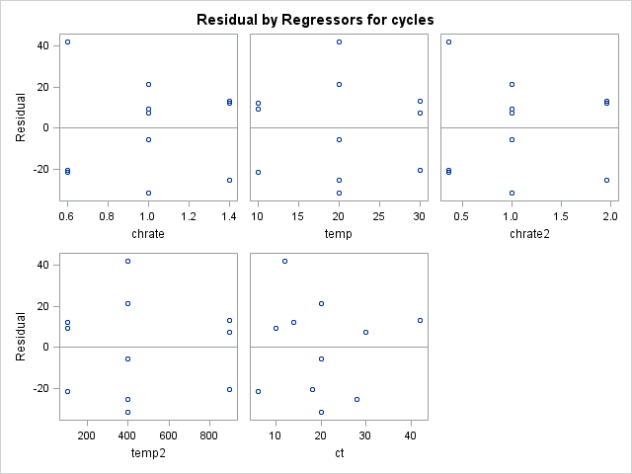
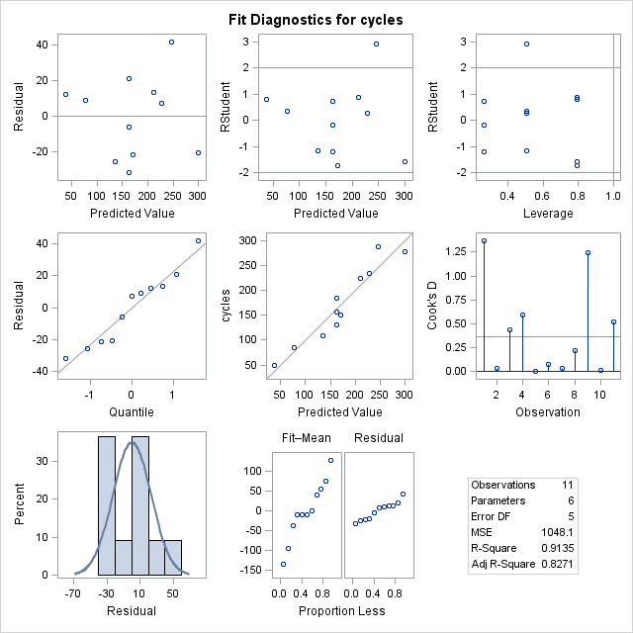
Power Cell Example: Diagnostics

Slide 29
Power Cell Example: Diagnostics

Slide 30
Power Cell Example: Multiple Regression (cont)
Analysis of Variance
Source | DF | Sum of Squares | Mean Square | F Value | Pr > F
Model | 5 | 55366 | 11073 | 10.57 | 0.0109
Error | 5 | 5240.43860 | 1048.08772
Corrected Total | 10 | 60606
Root MSE | 32.37418 | R-Square | 0.9135
Dependent Mean | 172.00000 | Adj R-Sq | 0.8271
Coeff Var | 18.82220

Slide 31
Power Cell Example: Multiple Regression (cont)
Parameter Estimates
Variable | DF | Parameter Estimate | Standard Error | t Value | Pr > |t|
Intercept | 1 | 337.72149 | 149.96163 | 2.25 | 0.0741
chrate | 1 | -539.51754 | 268.86033 | -2.01 | 0.1011
temp | 1 | 8.91711 | 9.18249 | 0.97 | 0.3761
chrate2 | 1 | 171.21711 | 127.12550 | 1.35 | 0.2359
temp2 | 1 | -0.10605 | 0.20340 | -0.52 | 0.6244
ct | 1 | 2.87500 | 4.04677 | 0.71 | 0.5092

Slide 32
Power Cell Example: Multiple Regression (cont)
Parameter Estimates
Variable | DF | Parameter Estimate | Standard Error | t Value | Pr > |t| | Type I SS | Type II SS
Intercept | 1 | 337.72149 | 149.96163 | 2.25 | 0.0741 | 325424 | 5315.62944
chrate | 1 | -539.51754 | 268.86033 | -2.01 | 0.1011 | 18704 | 4220.41673
temp | 1 | 8.91711 | 9.18249 | 0.97 | 0.3761 | 34202 | 988.38036
chrate2 | 1 | 171.21711 | 127.12550 | 1.35 | 0.2359 | 1645.96667 | 1901.19474
temp2 | 1 | -0.10605 | 0.20340 | -0.52 | 0.6244 | 284.92807 | 284.92807
ct | 1 | 2.87500 | 4.04677 | 0.71 | 0.5092 | 529.00000 | 529.00000

Slide 33
Power Cell Example: Correlations
proc corr data=powercell noprob;
var chrate temp chrate2 temp2 ct;
run;
Pearson Correlation Coefficients, N = 11
 | chrate | temp | chrate2 | temp2 | ct
chrate | 1.00000 | 0.00000 | 0.99103 | 0.00000 | 0.60532
temp | 0.00000 | 1.00000 | 0.00000 | 0.98609 | 0.75665
chrate2 | 0.99103 | 0.00000 | 1.00000 | 0.00592 | 0.59989
temp2 | 0.00000 | 0.98609 | 0.00592 | 1.00000 | 0.74613
ct | 0.60532 | 0.75665 | 0.59989 | 0.74613 | 1.00000

Slide 34
Power Cell Example: Centering
data copy; set powercell;
schrate=chrate; stemp=temp;
drop chrate2 temp2 ct;
proc standard data=copy out=std mean=0;
var schrate stemp;
* schrate and stemp now have mean 0;
proc print data=std;
run;
Obs | cycles | chrate | temp | schrate | stemp
1 | 150 | 0.6 | 10 | -0.4 | -10
2 | 86 | 1.0 | 10 | 0.0 | -10
3 | 49 | 1.4 | 10 | 0.4 | -10
4 | 288 | 0.6 | 20 | -0.4 | 0
⁞ | ⁞ | ⁞ | ⁞ | ⁞ | ⁞

Slide 35
Power Cell Example: Centered Variables
data std; set std;
schrate2=schrate*schrate;
stemp2=stemp*stemp;
sct=schrate*stemp;
proc reg data=std;
model cycles= chrate temp schrate2 stemp2 sct / ss1 ss2;

Slide 36
Power Cell Example: Centered Variables (cont)
Parameter Estimates
Variable | DF | Parameter Estimate | Standard Error | t Value | Pr > |t|
Intercept | 1 | 151.42544 | 45.45653 | 3.33 | 0.0208
chrate | 1 | -139.58333 | 33.04176 | -4.22 | 0.0083
temp | 1 | 7.55000 | 1.32167 | 5.71 | 0.0023
schrate2 | 1 | 171.21711 | 127.12550 | 1.35 | 0.2359
stemp2 | 1 | -0.10605 | 0.20340 | -0.52 | 0.6244
sct | 1 | 2.87500 | 4.04677 | 0.71 | 0.5092

Slide 37
Power Cell Example: Centered Variables (cont)
Parameter Estimates
Variable | DF | Parameter Estimate | Standard Error | t Value | Pr > |t| | Type I SS | Type II SS
Intercept | 1 | 151.42544 | 45.45653 | 3.33 | 0.0208 | 325424 | 11631
chrate | 1 | -139.58333 | 33.04176 | -4.22 | 0.0083 | 18704 | 18704
temp | 1 | 7.55000 | 1.32167 | 5.71 | 0.0023 | 34202 | 34202
schrate2 | 1 | 171.21711 | 127.12550 | 1.35 | 0.2359 | 1645.96667 | 1901.19474
stemp2 | 1 | -0.10605 | 0.20340 | -0.52 | 0.6244 | 284.92807 | 284.92807
sct | 1 | 2.87500 | 4.04677 | 0.71 | 0.5092 | 529.00000 | 529.00000

Slide 38
Power Cell Example: Centered Variables (cont)
proc corr data=std noprob;
var chrate temp schrate2 stemp2 sct;
run;
Pearson Correlation Coefficients, N = 11
 | chrate | temp | schrate2 | stemp2 | sct
chrate | 1.00000 | 0.00000 | 0.00000 | 0.00000 | 0.00000
temp | 0.00000 | 1.00000 | 0.00000 | 0.00000 | 0.00000
schrate2 | 0.00000 | 0.00000 | 1.00000 | 0.26667 | 0.00000
stemp2 | 0.00000 | 0.00000 | 0.26667 | 1.00000 | 0.00000
sct | 0.00000 | 0.00000 | 0.00000 | 0.00000 | 1.00000

Slide 39
Power Cell Example: Second Order
proc reg data=std;
model cycles= chrate temp schrate2 stemp2 sct / ss1 ss2;
second: test schrate2, stemp2, sct;
run;
Test second Results for Dependent Variable cycles
Source | DF | Mean Square | F Value | Pr > F
Numerator | 3 | 819.96491 | 0.78 | 0.5527
Denominator | 5 | 1048.08772

Slide 40
Meaning of Coefficients for Qualitative Variables

Slide 41
Insurance Example: Background (nknw459.sas)
Y: number of months for an insurance company to adopt an innovation
X₁: size of the firm
X₂: Type of firm
X₂ = 0 → mutual fund firm
X₂ = 1 → stock firm
Questions
1) Do stock firms adopt innovation faster?
2) Does the size of the firm have an effect on 1)?

Slide 42
Insurance Example: Input
data insurance;
infile 'I:\My Documents\Stat 512\CH11TA01.DAT';
input months size stock;
proc print data=insurance;
run;
Obs | months | size | stock
1 | 17 | 151 | 0
2 | 26 | 92 | 0
⁞ | ⁞ | ⁞ | ⁞
19 | 30 | 124 | 1
20 | 14 | 246 | 1

Slide 43
Insurance Example: Scatterplot
symbol1 v=M i=sm70 c=black l=1;
symbol2 v=S i=sm70 c=red l=3;
title1 h=3 'Insurance Innovation';
axis1 label=(h=2);
axis2 label=(h=2 angle=90);
proc sort data=insurance;
by stock size;
title2 h=2 'with smoothed lines';
proc gplot data=insurance;
plot months*size=stock/haxis=axis1 vaxis=axis2;
run;

Slide 44
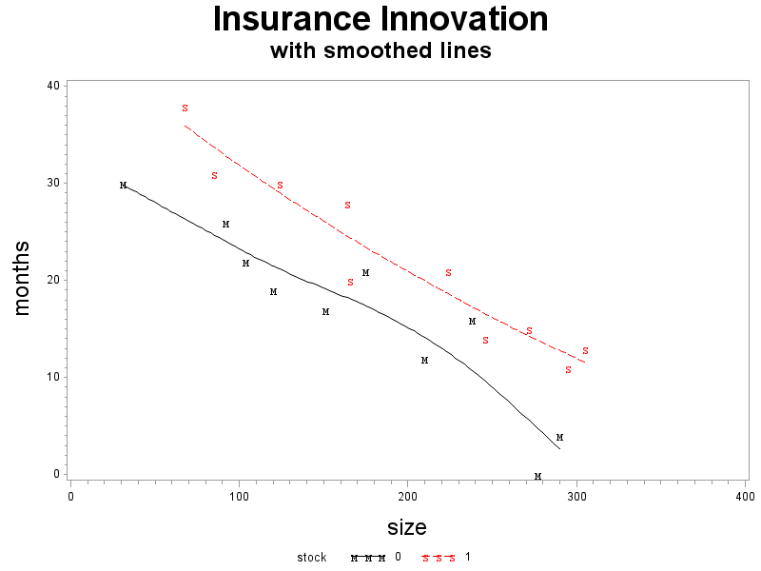
Insurance Example: Scatterplot (cont)

Slide 45
Insurance Example: Regression
data insurance;
set insurance;
sizestock=size*stock;
run;
proc reg data=insurance;
model months = size stock sizestock;
sameline: test stock, sizestock;
run;

Slide 46
Insurance Example: Regression (cont)
Analysis of Variance
Source | DF | Sum of Squares | Mean Square | F Value | Pr > F
Model | 3 | 1504.41904 | 501.47301 | 45.49 | <.0001
Error | 16 | 176.38096 | 11.02381
Corrected Total | 19 | 1680.80000
Root MSE | 3.32021 | R-Square | 0.8951
Dependent Mean | 19.40000 | Adj R-Sq | 0.8754
Test sameline Results for Dependent Variable months
Source | DF | Mean Square | F Value | Pr > F
Numerator | 2 | 158.12584 | 14.34 | 0.0003
Denominator | 16 | 11.02381

Slide 47
Insurance Example: Regression (cont)
Parameter Estimates
Variable | DF | Parameter Estimate | Standard Error | t Value | Pr > |t|
Intercept | 1 | 33.83837 | 2.44065 | 13.86 | <.0001
size | 1 | -0.10153 | 0.01305 | -7.78 | <.0001
stock | 1 | 8.13125 | 3.65405 | 2.23 | 0.0408
sizestock | 1 | -0.00041714 | 0.01833 | -0.02 | 0.9821

Slide 48
Insurance Example: Regression 2
proc reg data=insurance;
model months = size stock;
run;
Analysis of Variance
Source | DF | Sum of Squares | Mean Square | F Value | Pr > F
Model | 2 | 1504.41333 | 752.20667 | 72.50 | <.0001
Error | 17 | 176.38667 | 10.37569
Corrected Total | 19 | 1680.80000
Root MSE | 3.22113 | R-Square | 0.8951
Dependent Mean | 19.40000 | Adj R-Sq | 0.8827
Parameter Estimates
Variable | DF | Parameter Estimate | Standard Error | t Value | Pr > |t|
Intercept | 1 | 33.87407 | 1.81386 | 18.68 | <.0001
size | 1 | -0.10174 | 0.00889 | -11.44 | <.0001
stock | 1 | 8.05547 | 1.45911 | 5.52 | <.0001

Slide 49
Insurance Example: Comparison
interaction | Ŷ | R² | adj R²
yes | Mut: 33.84 – 0.102 size | 0.8951 | 0.8754
 | Stock: 41.97 – 0.102 size
no | Mut: 33.87 – 0.102 size | 0.8951 | 0.8827
 | Stock: 41.93 – 0.102 size

Slide 50
Insurance Example: Regression 2
proc reg data=insurance;
model months = size stock;
run;
Analysis of Variance
Source | DF | Sum of Squares | Mean Square | F Value | Pr > F
Model | 2 | 1504.41333 | 752.20667 | 72.50 | <.0001
Error | 17 | 176.38667 | 10.37569
Corrected Total | 19 | 1680.80000
Root MSE | 3.22113 | R-Square | 0.8951
Dependent Mean | 19.40000 | Adj R-Sq | 0.8827
Parameter Estimates
Variable | DF | Parameter Estimate | Standard Error | t Value | Pr > |t|
Intercept | 1 | 33.87407 | 1.81386 | 18.68 | <.0001
size | 1 | -0.10174 | 0.00889 | -11.44 | <.0001
stock | 1 | 8.05547 | 1.45911 | 5.52 | <.0001

Slide 51
Insurance Example: Regression Lines
title2 h=2 'with straight lines';
symbol1 v=M i=rl c=black;
symbol2 v=S i=rl c=red;
proc gplot data=insurance;
plot months*size=stock/haxis=axis1 vaxis=axis2;
run;

Slide 52
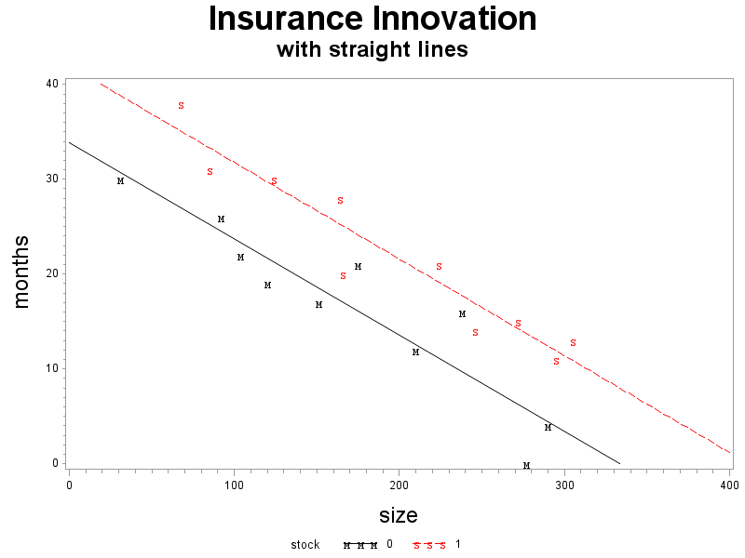
Insurance Example: Regression Lines (cont)

Slide 53
Strategy for Building a Regression Model

Slide 54
Strategy for Building a Regression Model (cont)

Slide 55
Surgical Example (nknw334.sas)
Surgical unit wants to predict survival in patients undergoing a specific liver operation.
n = 54
Y = post-operation survival time
Explanatory Variables
X₁: blood clotting score (blood)
X₂: prognostic index (prog)
X₃: enzyme function test score (enz)
X₄: liver function test score (liver)

Slide 56
Surgical Example: input
data surgical;
infile 'I:\My Documents\Stat 512\CH09TA01.txt' delimiter='09'x;
input blood prog enz liver age gender alcmod alcheavy surv logsurv;
run;
proc print data=surgical;
run;
title1 h=3 'Original model';
title2 h=2 'Matrix Scatterplot';
proc sgscatter data=surgical;
matrix surv blood prog enz liver;
run;

Slide 57
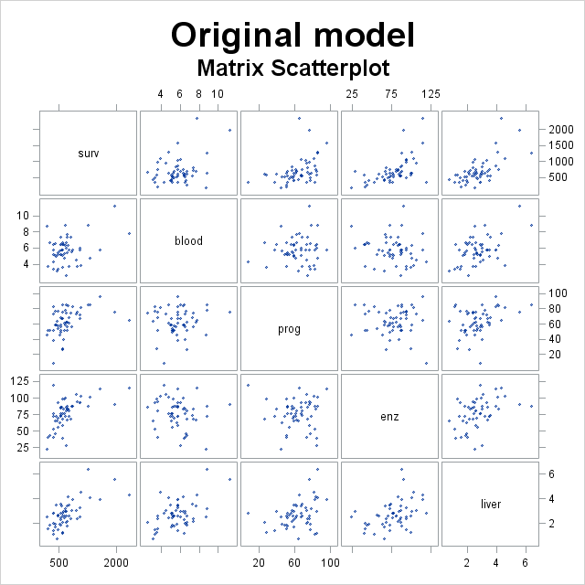
Surgical Example: Scatterplot

Slide 58
Surgical Example: Diagnostics
proc reg data=surgical;
model surv = blood prog enz liver;
output out=diag r=resid p=pred;
run;
title1 h=3 'Original model';
title2 h=2 'Residual plot vs predicted value';
axis1 label=(h=2);
axis2 label=(h=2 angle=90);
symbol1 v=circle;
proc gplot data=diag;
plot resid*pred/vref=0 haxis=axis1 vaxis=axis2;
run;
title2 'Normal plot for residuals';
proc univariate data=diag noprint;
histogram resid/normal kernel;
qqplot resid/normal (sigma=est mu=est);
run;

Slide 59
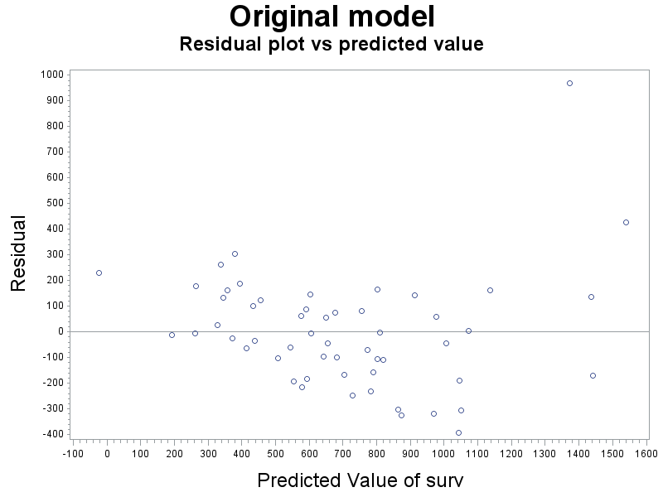
Surgical Example: Diagnostics (cont)

Slide 60
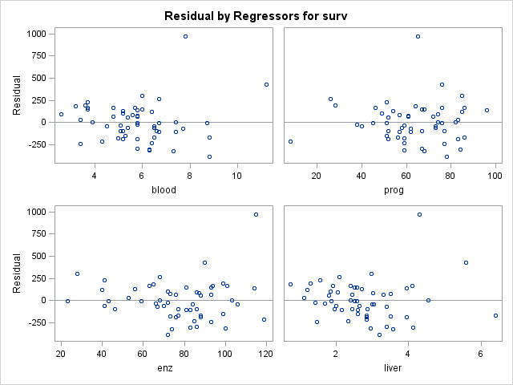
Surgical Example: Diagnostics (cont)

Slide 61
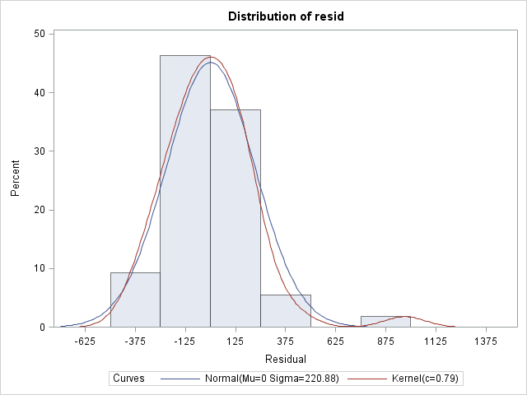
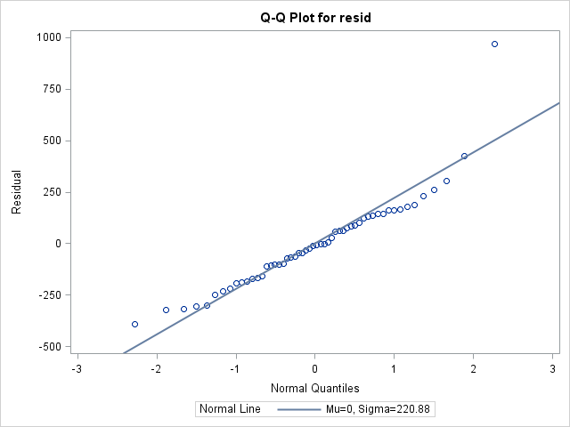
Surgical Example: Diagnostics (cont)

Slide 62
Surgical Example: Y transformation
proc transreg data=surgical;
model boxcox(surv/lambda=-1 to 1 by 0.1) =
identity (blood) identity (prog) identity (enz)
identity (liver);
run;

Slide 63
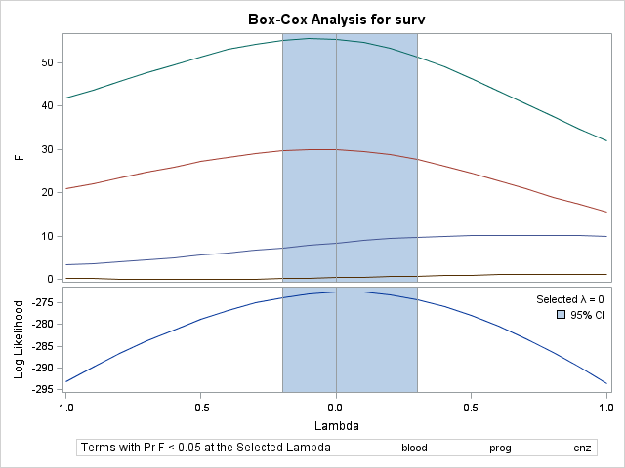
Surgical Example: Y transformation (cont)

Slide 64
Surgical Example: Y transformation (cont)
Box-Cox Transformation Information for surv
Lambda R-Square Log Like
-0.7 0.69 -283.837
-0.6 0.70 -281.203
-0.5 0.72 -278.846
-0.4 0.73 -276.805
-0.3 0.74 -275.119
-0.2 0.75 -273.828 *
-0.1 0.75 -272.971 *
0.0 + 0.76 -272.579 <
0.1 0.76 -272.675 *
0.2 0.76 -273.269 *
0.3 0.76 -274.360 *
0.4 0.75 -275.933
0.5 0.75 -277.961
0.6 0.74 -280.409
0.7 0.73 -283.238
< - Best Lambda * - 95% Confidence Interval
+ - Convenient Lambda
X

Slide 65
Surgical Example: Diagnostics 2
data surgical;
set surgical;
lsurv=log(surv);
proc reg data=surgical;
model lsurv=liver blood prog enz /ss1 ss2;
output out=diagtr r=residtr p=predtr;
title1 h=3 'Transformed model with ln Y';
title2 h=2 'Residual plot vs predicted value';
symbol1 v=circle;
proc gplot data=diagtr;
plot residtr*predtr/vref=0;
run;
title2 'Normal plot for residuals';
proc univariate data=diagtr noprint;
histogram residtr/normal kernel;
qqplot residtr/normal (sigma=est mu=est);

Slide 66
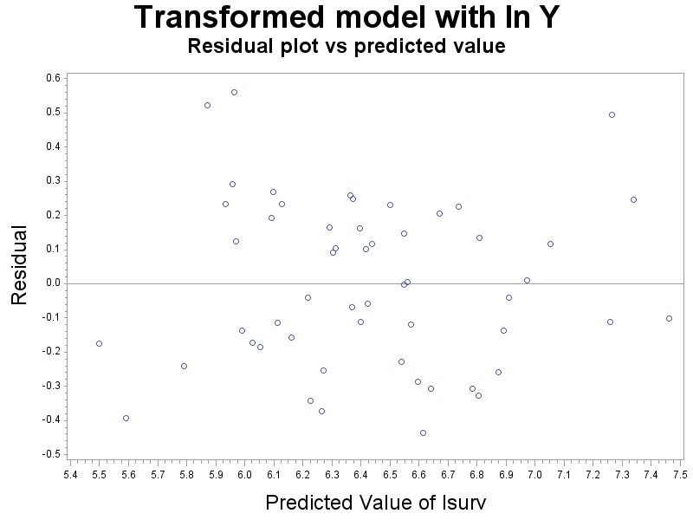
Surgical Example: Diagnostics 2 (cont)

Slide 67
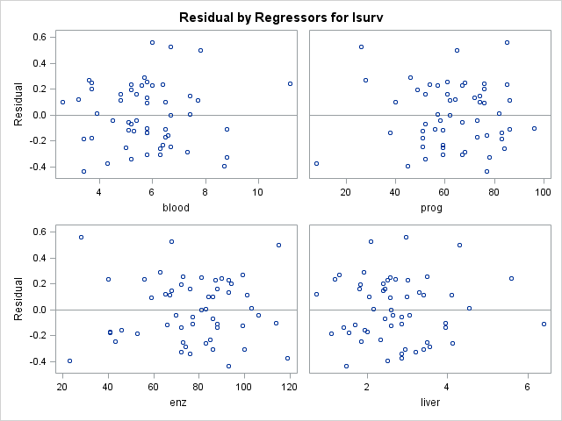
Surgical Example: Diagnostics 2 (cont)

Slide 68
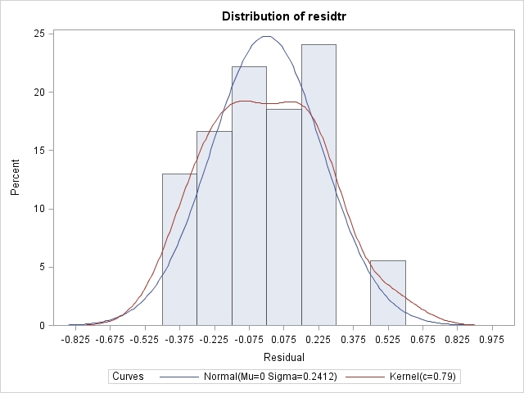
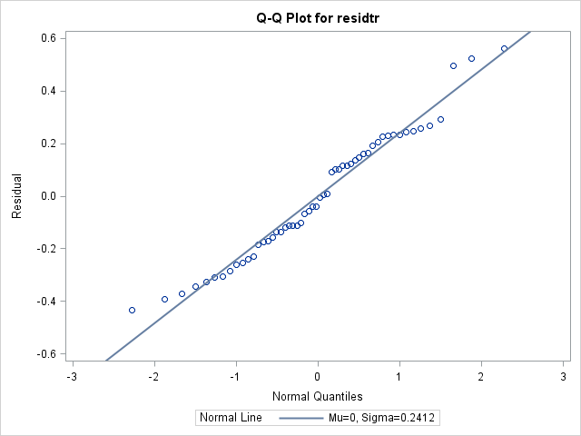
Surgical Example: Diagnostics 2 (cont)

Slide 69
Surgical Example: Scatterplot transformed
title2 h=2 'Matrix Scatterplot';
proc sgscatter data=surgical;
matrix lsurv blood prog enz liver;
run;

Slide 70
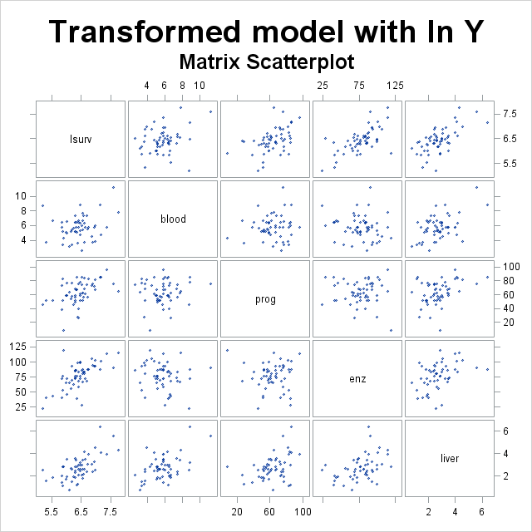
Surgical Example: Scatterplot transformed

Slide 71
Surgical Example: Correlation
proc corr data=surgical noprob;
var lsurv blood prog enz liver;
run;
Pearson Correlation Coefficients, N = 54
 | lsurv | blood | prog | enz | liver
lsurv | 1.00000 | 0.24633 | 0.47015 | 0.65365 | 0.64920
blood | 0.24633 | 1.00000 | 0.09012 | -0.14963 | 0.50242
prog | 0.47015 | 0.09012 | 1.00000 | -0.02361 | 0.36903
enz | 0.65365 | -0.14963 | -0.02361 | 1.00000 | 0.41642
liver | 0.64920 | 0.50242 | 0.36903 | 0.41642 | 1.00000

Slide 72
Surgical Example: Model Selection – data for the current model
proc reg data=surgical outtest=mparam;
model lsurv=blood prog enz liver/
rsquare adjrsq cp press aic sbc;
run;
proc print data=mparam; run;
Obs | _MODEL_ | _TYPE_ | _DEPVAR_ | _RMSE_ | _PRESS_
1 | MODEL1 | PARMS | lsurv | 0.25088 | 4.06875
Obs | Intercept | blood | prog | enz | liver | lsurv
1 | 3.85193 | 0.083739 | 0.012671 | 0.015627 | 0.032056 | -1
Obs | _IN_ | _P_ | _EDF_ | _RSQ_ | _ADJRSQ_ | _CP_ | _AIC_ | _SBC_
1 | 4 | 5 | 49 | 0.75914 | 0.73948 | 5 | -144.587 | -134.642

Slide 73
Surgical Example: Model Selection – all subset selection
proc reg data=surgical;
model lsurv=blood prog enz liver/
selection=rsquare adjrsq cp b best=3;
run;

Slide 74
Surgical Example: Model Selection – all subset selection (cont)

Slide 75
Surgical Example: Model Selection – all subset selection (cont)
proc reg data=surgical;
model lsurv=blood prog enz liver/
selection=rsquare adjrsq cp best=3;
run;
Number in Model | R-Square | Adjusted R-Square | C(p) | Variables in Model
1 | 0.4273 | 0.4162 | 66.5181 | enz
1 | 0.4215 | 0.4103 | 67.6959 | liver
1 | 0.2210 | 0.2061 | 108.4692 | prog
2 | 0.6632 | 0.6500 | 20.5228 | prog enz
2 | 0.5992 | 0.5835 | 33.5362 | enz liver
2 | 0.5484 | 0.5307 | 43.8729 | blood enz
3 | 0.7572 | 0.7427 | 3.3879 | blood prog enz
3 | 0.7177 | 0.7007 | 11.4343 | prog enz liver
3 | 0.6119 | 0.5886 | 32.9601 | blood enz liver
4 | 0.7591 | 0.7395 | 5.0000 | blood prog enz liver

Slide 76
Surgical Example: Type II SS
proc reg data=surgical;
model lsurv=blood prog enz liver/ss1 ss2;
output out=diagtr r=residtr p=predtr;
run;

Slide 77
Surgical Example: Model Selection - automatic
proc reg data=surgical;
model lsurv=blood prog enz liver / selection=stepwise;
run;
All variables left in the model are significant at the 0.1500 level.
No other variable met the 0.1500 significance level for entry into the model.

Slide 78
Surgical Example: Model Selection – backward elimination
Bounds on condition number: 1.0308, 9.1864
All variables left in the model are significant at the 0.1000 level.

