Slide 1
Matrix
A matrix is a rectangular array of elements arranged in rows and columns
Dimension of a matrix is r x c
r = c ⇒ square matrix
r = 1 ⇒ (row) vector
c = 1 ⇒ column vector

Slide 2
Matrix (cont)
elements are either numbers or symbols
each element is designated by the row and column that it is in, a_{ij}
rows are indicated by an i subscript
columns are indicated by a j subscript

Slide 3
Matrix Equality
two matrices are said to be equal if they have the same dimensions and all of the corresponding elements are equal

Slide 4
Equality: Example
Are the following matrices equal?
a)
b)

Slide 5
Matrix Operations - Transpose
A transposition is performed by switching the rows and columns, indicated by a ‘
A’ = B if a_{ij} = b_{ji}
Note: if A is r x c then B will be c x r
The transpose of a column vector is a row vector.

Slide 6
Matrix Operations – Addition/Subtraction
To add or subtract two matrices, they must have the same dimensions
The addition or subtraction is done on an element by element bases

Slide 7
Matrix Operations - Multiplication
by a scalar (number)
every element of the matrix is multiplied by that number
In addition, a matrix can be factored
if A = [a_{ij}], k is a number then kA = Ak = [ka_{ij}]

Slide 8
Matrix Operations - Multiplication
by another matrix
C = A B
columns of A must equal rows of B
Resulting matrix has dimension
rows of A x columns of B

Slide 9
Special Types of Matrices: Symmetric
if A = A’, then A is said to be symmetric
a symmetric matrix has to be a square matrix

Slide 10
Special Types of Matrices: Diagonal
Square matrix with off-diagonal elements equal to 0.

Slide 11
Special Types of Matrices: Diagonal (cont)
Identity
also called the unit matrix, designated by I
a diagonal matrix where the diagonal elements are 1
It is called the identity matrix because for any matrix A
AI = IA = A

Slide 12
Linear Dependence
Think of the columns of a matrix as column vectors
if it can be found that not all of k₁ to k_{c} are 0 in the following equation then the c columns are linearly dependent.
k₁C₁ + k₂C₂ + ⋅⋅⋅ + k_{c}C_{c} = 0
In the example -2C₁ + 0C₂ + 1C₃ = 0
if they all 0, then they are linearly independent.

Slide 13
Rank of a Matrix
The rank of a matrix is the maximum number of linearly independent columns.
This is a unique number for every matrix
rank of the matrix cannot exceed min(r,c)
Full Rank – all columns are linearly independent
Example: Rank = 2

Slide 14
Inverse of a Matrix
Inverse in algebra:
reciprocal
Inverse for a matrix
A A⁻¹ = A⁻¹ A = I
A must be square and full rank

Slide 15
Inverse of a Matrix: Calculation
Diagonal Matrix

Slide 16
Inverse of a Matrix: Calculation (cont)
2 x 2 Matrix
Calculate the Determinant: D = ad – bc
If D = 0, then the matrix doesn’t have full rank (singular) and does not have an inverse.
A⁻¹: switch a and d, make b and c negative, divide by D.
3 x 3 Matrix: in the book

Slide 17
Inverse of a Matrix: Uses
In algebra, we use the inverse to solve algebraic equations.
In matrix algebra, we use the inverse of a matrix to solve matrix algebraic equations:
A X = C
A⁻¹A X = A⁻¹C
X = A⁻¹ C

Slide 18
Basic Matrix Operations
A + B = B + A
(A + B) + C = A + (B + C)
k(A + B) = k A + kB
(A’)’ = A
(A + B)’ = A’ + B’
(AB)’ = B’ A’
(ABC)’ = C’B’ A’
(AB)C = A(BC)
C(A + B) = C A + CB
(A⁻¹)⁻¹ = A
(A’)⁻¹ = (A⁻¹)’
(AB)⁻¹ = B⁻¹ A ⁻¹
(ABC)⁻¹ = C⁻¹B⁻¹A⁻¹

Slide 19
Matrix parameters

Slide 20
Matrix parameters (cont)

Slide 21
Matrix parameters (cont)

Slide 22
Matrix parameters (cont)

Slide 23
Fitted Values

Slide 24
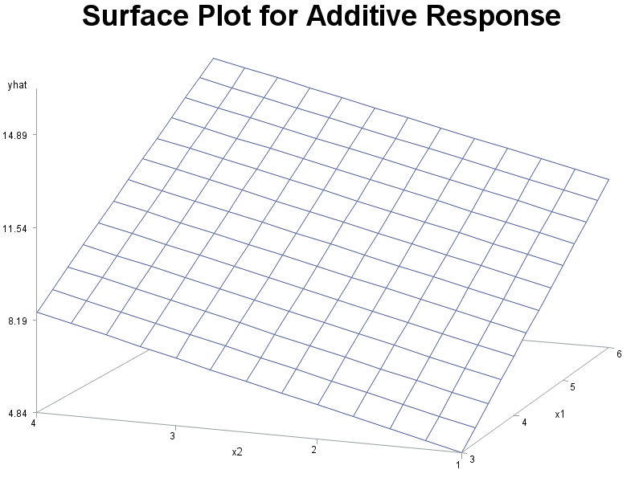
Response Vector: additive (Surface.sas)
Ŷ_{i} = -2.79 + 2.14 X_{i,1} + 1.21 X_{i,2}

Slide 25
SAS code: MLR
proc reg data = a1;
model y = x1 x2 x3;
run;

Slide 26
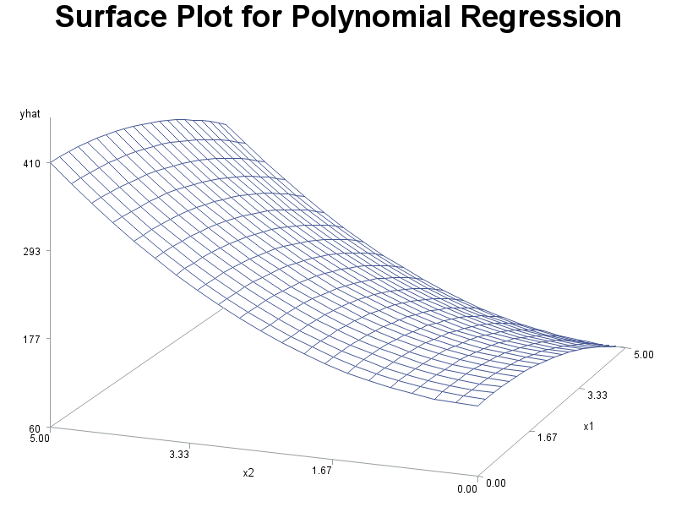
Response Vector: polynomial (Surface.sas)
Ŷ_{i} = 150+ 2.14 X_{i,1} – 4.02 X²_{i,1} + 1.21 X_{i,2} + 10.14 X²_{i,2}

Slide 27
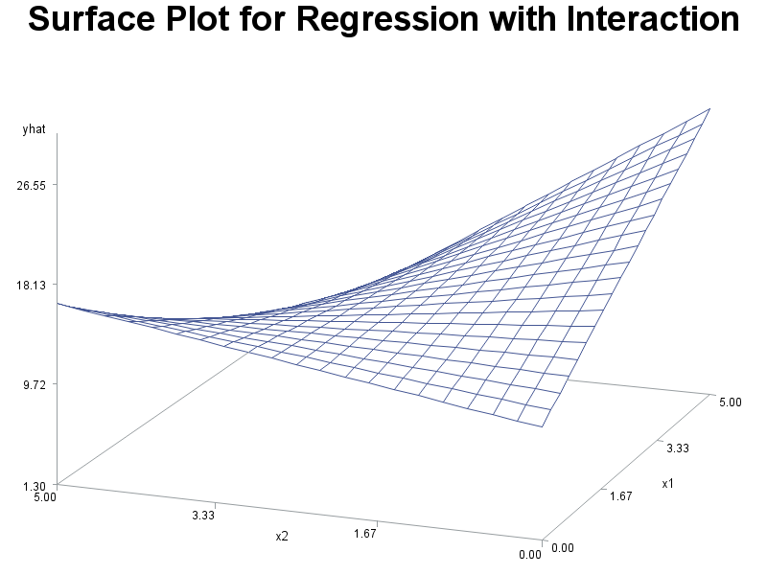
Response Vector: Interaction(Surface.sas)
Ŷ_{i} = 10.5 + 3.21 X_{i,1} + 1.2 X_{i,2} – 1.24 X_{i,1} X_{i,2}

Slide 28
SAS code: MLR
data a2;
set a1;
xsq = x*x;
x12 = x1*x2;
proc reg data=a2;
model y = x xsq x1 x2 x12;
run;

Slide 29
CS Example: all predictors (output)
Analysis of Variance
Source | DF | Sum of Squares | Mean Square | F Value | Pr > F
Model | 5 | 28.64364 | 5.72873 | 11.69 | <.0001
Error | 218 | 106.81914 | 0.49000
Corrected Total | 223 | 135.46279
Root MSE | 0.70000 | R-Square | 0.2115
Dependent Mean | 2.63522 | Adj R-Sq | 0.1934
Coeff Var | 26.56311
Parameter Estimates
Variable | DF | Parameter Estimate | Standard Error | t Value | Pr > |t|
Intercept | 1 | 0.32672 | 0.40000 | 0.82 | 0.4149
hsm | 1 | 0.14596 | 0.03926 | 3.72 | 0.0003
hss | 1 | 0.03591 | 0.03780 | 0.95 | 0.3432
hse | 1 | 0.05529 | 0.03957 | 1.40 | 0.1637
satm | 1 | 0.00094359 | 0.00068566 | 1.38 | 0.1702
satv | 1 | -0.00040785 | 0.00059189 | -0.69 | 0.4915

Slide 30
ANOVA table for MLR
Source | df | SS | MS | F | p
Model (Regression) | p – 1 | Σ(Ŷ_{i} - Y̅)² |  |  | p
Error | n – p | Σ(Y_{i} - Ŷ_{i})²
Total | n - 1 | Σ(Y_{i} - Y̅)²

Slide 31
CS Example: all predictors (output)
Analysis of Variance
Source | DF | Sum of Squares | Mean Square | F Value | Pr > F
Model | 5 | 28.64364 | 5.72873 | 11.69 | <.0001
Error | 218 | 106.81914 | 0.49000
Corrected Total | 223 | 135.46279
Root MSE | 0.70000 | R-Square | 0.2115
Dependent Mean | 2.63522 | Adj R-Sq | 0.1934
Coeff Var | 26.56311
Parameter Estimates
Variable | DF | Parameter Estimate | Standard Error | t Value | Pr > |t|
Intercept | 1 | 0.32672 | 0.40000 | 0.82 | 0.4149
hsm | 1 | 0.14596 | 0.03926 | 3.72 | 0.0003
hss | 1 | 0.03591 | 0.03780 | 0.95 | 0.3432
hse | 1 | 0.05529 | 0.03957 | 1.40 | 0.1637
satm | 1 | 0.00094359 | 0.00068566 | 1.38 | 0.1702
satv | 1 | -0.00040785 | 0.00059189 | -0.69 | 0.4915

Slide 32
CS Example: (cs.sas)
Y_{i}: GPA after 3 semesters
X₁: High school math grades (HSM)
X₂: High school science grades (HSS)
X₃: High school English grades (HSE)
X₄: SAT Math (SATM)
X₅: SAT Verbal (SATV)
Gender: (1 = male, 2 = female)
n = 224

Slide 33
CS Example: Input (cs.sas)
data cs;
infile 'I:\My Documents\Stat 512\csdata.dat';
input id gpa hsm hss hse satm satv genderm1;
proc print data=cs; run;

Slide 34
CS Example: all predictors (input)
proc reg data=cs;
model gpa=hsm hss hse satm satv;
run;

Slide 35
CS Example: all predictors (output)
Analysis of Variance
Source | DF | Sum of Squares | Mean Square | F Value | Pr > F
Model | 5 | 28.64364 | 5.72873 | 11.69 | <.0001
Error | 218 | 106.81914 | 0.49000
Corrected Total | 223 | 135.46279
Root MSE | 0.70000 | R-Square | 0.2115
Dependent Mean | 2.63522 | Adj R-Sq | 0.1934
Coeff Var | 26.56311
Parameter Estimates
Variable | DF | Parameter Estimate | Standard Error | t Value | Pr > |t|
Intercept | 1 | 0.32672 | 0.40000 | 0.82 | 0.4149
hsm | 1 | 0.14596 | 0.03926 | 3.72 | 0.0003
hss | 1 | 0.03591 | 0.03780 | 0.95 | 0.3432
hse | 1 | 0.05529 | 0.03957 | 1.40 | 0.1637
satm | 1 | 0.00094359 | 0.00068566 | 1.38 | 0.1702
satv | 1 | -0.00040785 | 0.00059189 | -0.69 | 0.4915

Slide 36
CS Example: HS grades
proc reg data=cs;
model gpa=hsm hss hse;
run;
Root MSE | 0.69984 | R-Square | 0.2046
Dependent Mean | 2.63522 | Adj R-Sq | 0.1937
Parameter Estimates
Variable | DF | Parameter Estimate | Standard Error | t Value | Pr > |t|
Intercept | 1 | 0.58988 | 0.29424 | 2.00 | 0.0462
hsm | 1 | 0.16857 | 0.03549 | 4.75 | <.0001
hss | 1 | 0.03432 | 0.03756 | 0.91 | 0.3619
hse | 1 | 0.04510 | 0.03870 | 1.17 | 0.2451

Slide 37
CS Example: hsm, hse
proc reg data=cs;
model gpa=hsm hse;
run;
Root MSE | 0.69958 | R-Square | 0.2016
Dependent Mean | 2.63522 | Adj R-Sq | 0.1943
Parameter Estimates
Variable | DF | Parameter Estimate | Standard Error | t Value | Pr > |t|
Intercept | 1 | 0.62423 | 0.29172 | 2.14 | 0.0335
hsm | 1 | 0.18265 | 0.03196 | 5.72 | <.0001
hse | 1 | 0.06067 | 0.03473 | 1.75 | 0.0820

Slide 38
CS Example: hsm
proc reg data=cs;
model gpa=hsm;
run;
Root MSE | 0.70280 | R-Square | 0.1905
Dependent Mean | 2.63522 | Adj R-Sq | 0.1869
Parameter Estimates
Variable | DF | Parameter Estimate | Standard Error | t Value | Pr > |t|
Intercept | 1 | 0.90768 | 0.24355 | 3.73 | 0.0002
hsm | 1 | 0.20760 | 0.02872 | 7.23 | <.0001

Slide 39
CS Example: SAT
proc reg data=cs;
model gpa=satm satv;
run;
Root MSE | 0.75770 | R-Square | 0.0634
Dependent Mean | 2.63522 | Adj R-Sq | 0.0549
Parameter Estimates
Variable | DF | Parameter Estimate | Standard Error | t Value | Pr > |t|
Intercept | 1 | 1.28868 | 0.37604 | 3.43 | 0.0007
satm | 1 | 0.00228 | 0.00066291 | 3.44 | 0.0007
satv | 1 | -0.00002456 | 0.00061847 | -0.04 | 0.9684

Slide 40
CS Example: satm
proc reg data=cs;
model gpa=satm;
run;
Root MSE | 0.75600 | R-Square | 0.0634
Dependent Mean | 2.63522 | Adj R-Sq | 0.0591
Parameter Estimates
Variable | DF | Parameter Estimate | Standard Error | t Value | Pr > |t|
Intercept | 1 | 1.28356 | 0.35243 | 3.64 | 0.0003
satm | 1 | 0.00227 | 0.00058593 | 3.88 | 0.0001

Slide 41
CS Example: hsm, satm
proc reg data=cs;
model gpa=hsm satm/clb;
run;
Root MSE | 0.70281 | R-Square | 0.1942
Dependent Mean | 2.63522 | Adj R-Sq | 0.1869
Parameter Estimates
Variable | DF | Parameter Estimate | Standard Error | t Value | Pr > |t| | 95% Confidence Limits
Intercept | 1 | 0.66574 | 0.34349 | 1.94 | 0.0539 | -0.01120 | 1.34268
hsm | 1 | 0.19300 | 0.03222 | 5.99 | <.0001 | 0.12950 | 0.25651
satm | 1 | 0.00061047 | 0.00061117 | 1.00 | 0.3190 | -0.00059400 | 0.00181

Slide 42
Studio Example: (nknw241.sas)
Y: Sales
X₁: Number of people younger than 16 (young)
X₂: disposable personal income (income)
n = 21

Slide 43
Studio Example: input (nknw241.sas)
data a1;
infile 'I:/My Documents/Stat 512/CH06FI05.DAT';
input young income sales;
proc print data=a1;
run;
Obs | young | income | sales
1 | 68.5 | 16.7 | 174.4
2 | 45.2 | 16.8 | 164.4
3 | 91.3 | 18.2 | 244.2
4 | 47.8 | 16.3 | 154.6
⁞ | ⁞ | ⁞ | ⁞

Slide 44
Studio Example: Regression, CI
proc reg data=a1;
model sales=young income/clb;
run;

Slide 45
Studio Example: Regression, CI
Analysis of Variance
Source | DF | Sum of Squares | Mean Square | F Value | Pr > F
Model | 2 | 24015 | 12008 | 99.10 | <.0001
Error | 18 | 2180.92741 | 121.16263
Corrected Total | 20 | 26196
Root MSE | 11.00739 | R-Square | 0.9167
Dependent Mean | 181.90476 | Adj R-Sq | 0.9075
Coeff Var | 6.05118
Parameter Estimates
Variable | DF | Parameter Estimate | Standard Error | t Value | Pr > |t| | 95% Confidence Limits
Intercept | 1 | -68.85707 | 60.01695 | -1.15 | 0.2663 | -194.94801 | 57.23387
young | 1 | 1.45456 | 0.21178 | 6.87 | <.0001 | 1.00962 | 1.89950
income | 1 | 9.36550 | 4.06396 | 2.30 | 0.0333 | 0.82744 | 17.90356

Slide 46
Studio Example: CI for the mean
The MEANS Procedure
proc reg data=a1;
model sales=young income/clm;
id young income;
run;
Output Statistics
Obs | young | income | Dependent Variable | Predicted Value | Std Error Mean Predict | 95% CL Mean |  | Residual
1 | 68.5 | 16.7 | 174.4000 | 187.1841 | 3.8409 | 179.1146 | 195.2536 | -12.7841
2 | 45.2 | 16.8 | 164.4000 | 154.2294 | 3.5558 | 146.7591 | 161.6998 | 10.1706
3 | 91.3 | 18.2 | 244.2000 | 234.3963 | 4.5882 | 224.7569 | 244.0358 | 9.8037
4 | 47.8 | 16.3 | 154.6000 | 153.3285 | 3.2331 | 146.5361 | 160.1210 | 1.2715
 |  |  | «

Slide 47
Studio Example: CI for predicted values
proc reg data=a1;
model sales=young income/cli;
id young income;
run;
Output Statistics
Obs | young | income | Dependent Variable | Predicted Value | Std Error Mean Predict | 95% CL Predict |  | Residual
1 | 68.5 | 16.7 | 174.4000 | 187.1841 | 3.8409 | 162.6910 | 211.6772 | -12.7841
2 | 45.2 | 16.8 | 164.4000 | 154.2294 | 3.5558 | 129.9271 | 178.5317 | 10.1706
3 | 91.3 | 18.2 | 244.2000 | 234.3963 | 4.5882 | 209.3421 | 259.4506 | 9.8037
4 | 47.8 | 16.3 | 154.6000 | 153.3285 | 3.2331 | 129.2260 | 177.4311 | 1.2715
 |  |  | «

Slide 48
CS Example: Descriptive Statistics (cs.sas) proc means
proc means data=cs maxdec=2;
var gpa hsm hss hse satm satv;
run;
Variable | N | Mean | Std Dev | Minimum | Maximum
gpa | 224 | 2.64 | 0.78 | 0.12 | 4.00
hsm | 224 | 8.32 | 1.64 | 2.00 | 10.00
hss | 224 | 8.09 | 1.70 | 3.00 | 10.00
hse | 224 | 8.09 | 1.51 | 3.00 | 10.00
satm | 224 | 595.29 | 86.40 | 300.00 | 800.00
satv | 224 | 504.55 | 92.61 | 285.00 | 760.00

Slide 49
CS Example: Descriptive Statistics proc univariate
proc univariate data=cs noprint;
var gpa hsm hss hse satm satv;
histogram gpa hsm hss hse satm satv /normal kernel;
run;

Slide 50
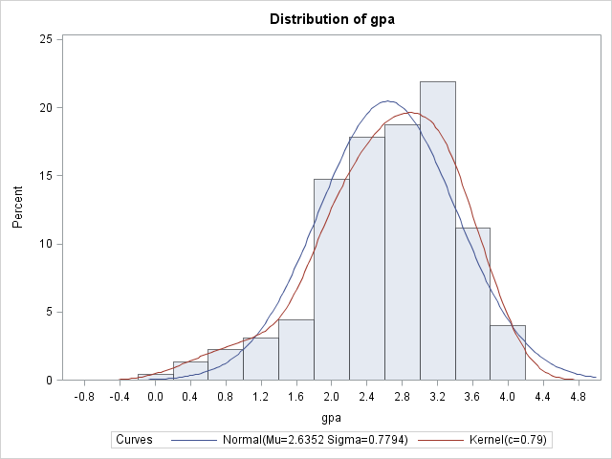
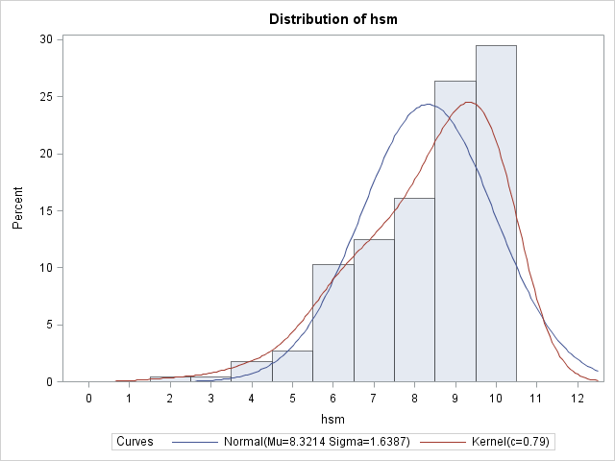
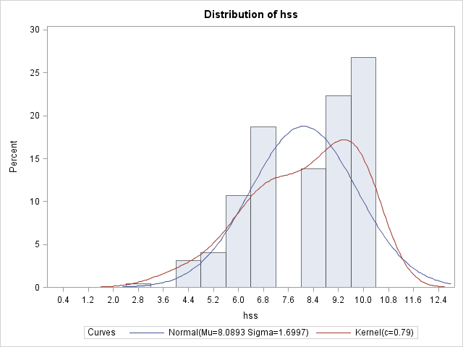
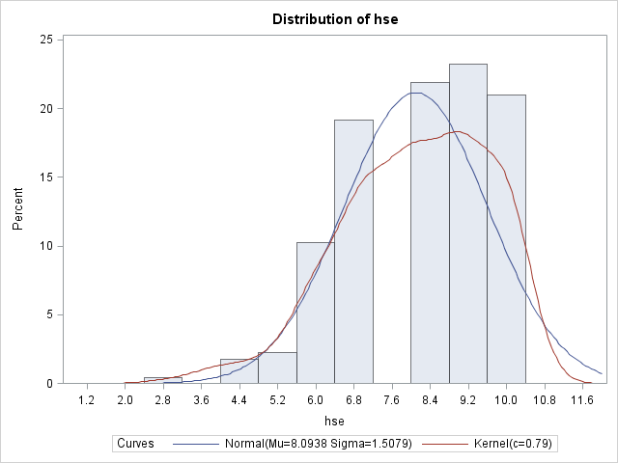
CS Example: Descriptive Statistics (cont) proc univariate
gpa
hsm
hss
hse

Slide 51
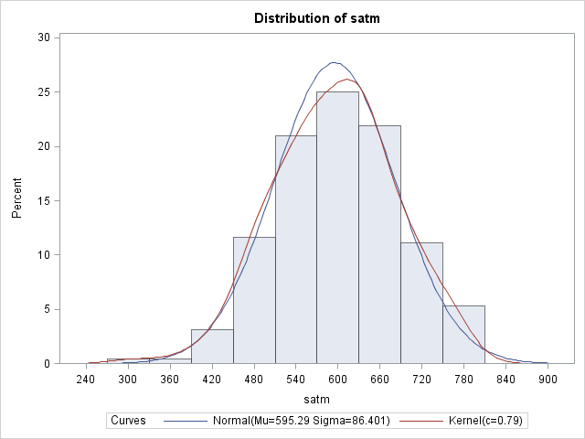
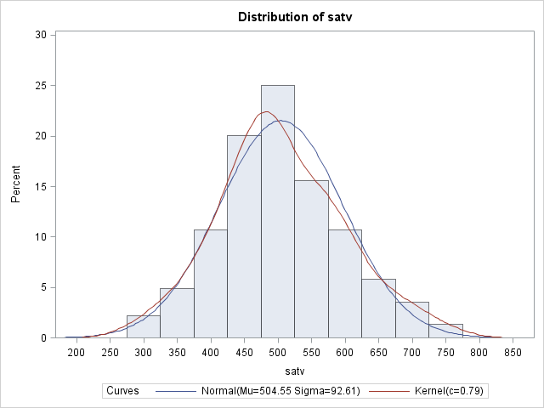
CS Example: Descriptive Statistics (cont) proc univariate
satm
satv

Slide 52
Interactive Data Analysis
Read in the data set as usual.
Solutions --> analysis --> interactive data analysis
To read in the correct data set
Open library work
Click on data set CS
Click on open
Select the variables that you want, use <cntrl> to select more than one
Go to the menu analyze
Choose option Scatter Plot (Y X)

Slide 53
CS Example: Interactive Scatterplot

Slide 54
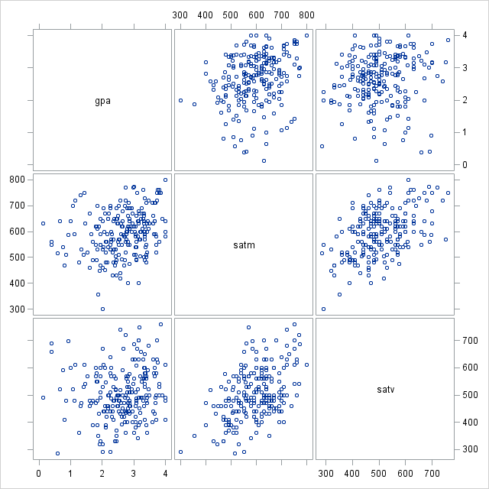
CS Example: Scatterplot
proc sgscatter data=cs;
matrix gpa satm satv;
run;

Slide 55
CS Example: Correlation
proc corr data=cs;
var hsm hss hse;
Pearson Correlation Coefficients, N = 224 Prob > |r| under H0: Rho=0
 | hsm | hss | hse
hsm | 1.00000 | 0.57569 | 0.44689
 |  | <.0001 | <.0001
hss | 0.57569 | 1.00000 | 0.57937
 | <.0001 |  | <.0001
hse | 0.44689 | 0.57937 | 1.00000
 | <.0001 | <.0001

Slide 56
CS Example: Correlation (cont)
proc corr data=cs noprob;
var satm satv;
Pearson Correlation Coefficients, N = 224
 | satm | satv
satm | 1.00000 | 0.46394
satv | 0.46394 | 1.00000

Slide 57
CS Example: Correlation (cont)
proc corr data=cs noprob;
var hsm hss hse;
with satm satv;
Pearson Correlation Coefficients, N = 224
 | hsm | hss | hse
satm | 0.45351 | 0.24048 | 0.10828
satv | 0.22112 | 0.26170 | 0.24371

Slide 58
CS Example: Correlation (cont)
proc corr data=cs noprob;
var hsm hss hse satm satv;
with gpa;
Pearson Correlation Coefficients, N = 224
 | hsm | hss | hse | satm | satv
gpa | 0.43650 | 0.32943 | 0.28900 | 0.25171 | 0.11449

Slide 59
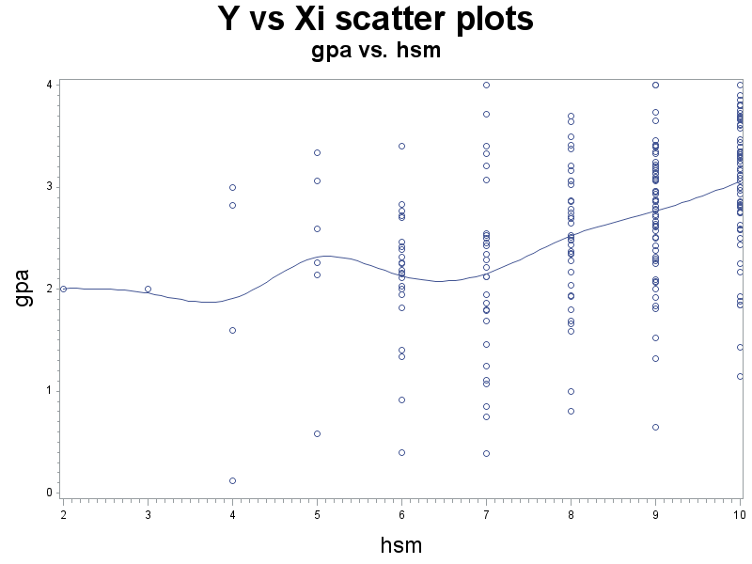
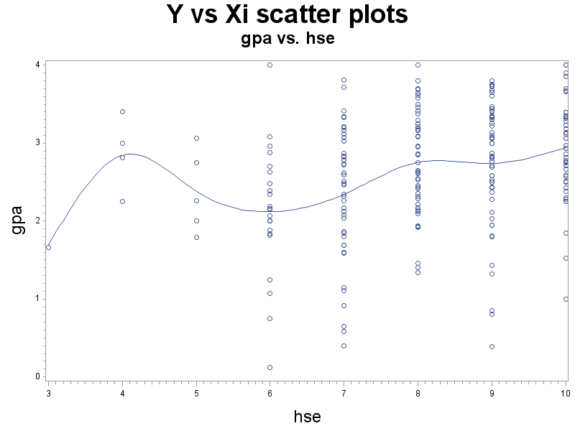
CS Example: Scatter plots (cs1.sas)

Slide 60
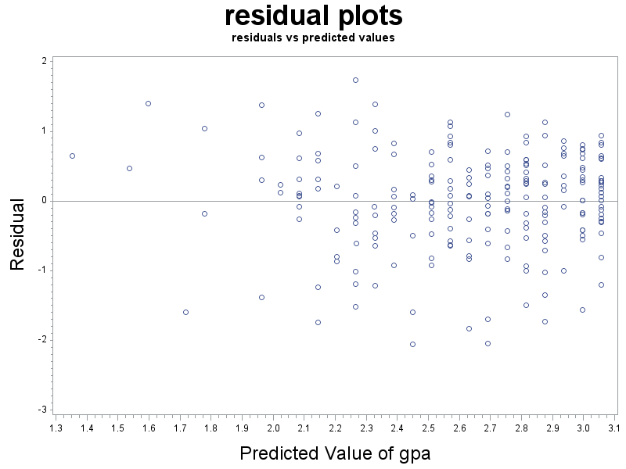
CS Example: residuals vs. Ŷ

Slide 61
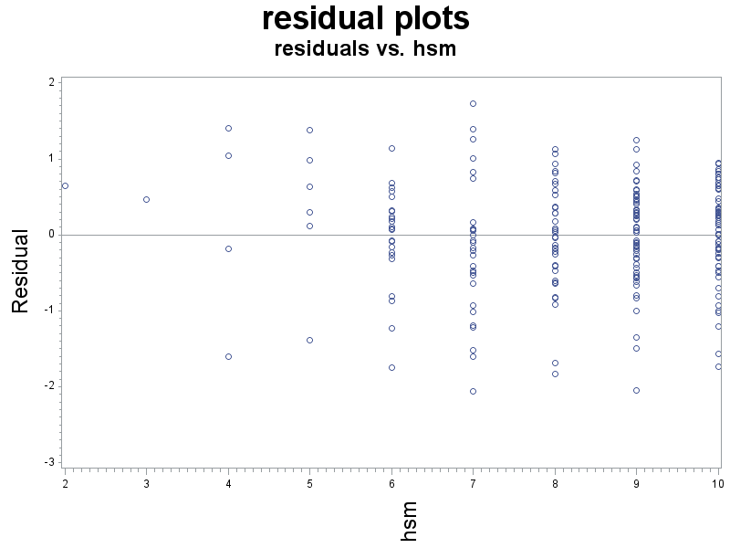
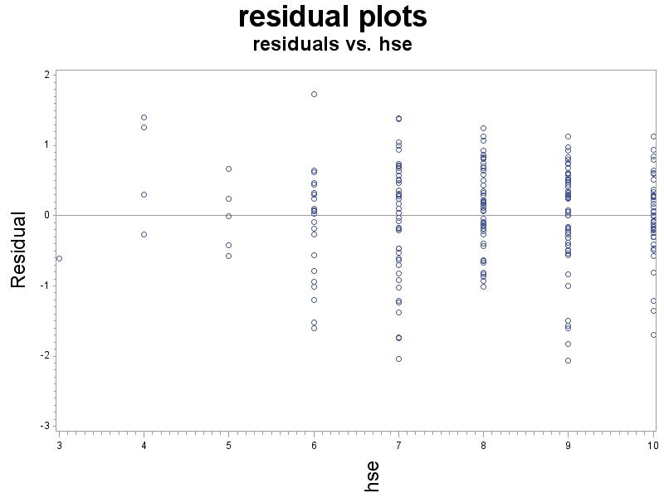
CS Example: Residuals vs X_{i}’s

Slide 62
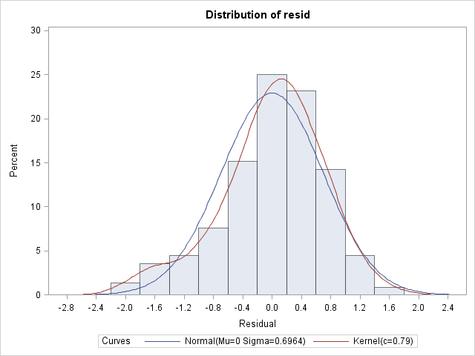
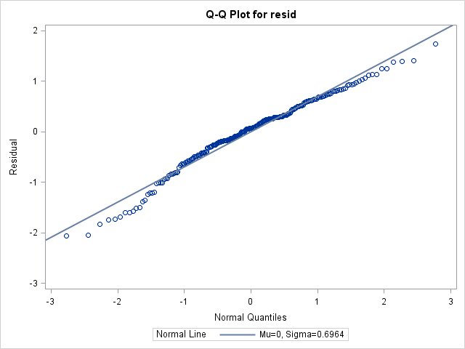
CS Example: Normality of Residuals

