Slide 1
Distribution of X: (nknw096)
data toluca;
infile 'H:\CH01TA01.DAT';
input lotsize workhrs;
seq=_n_;
proc print data=toluca;
run;
Obs | lotsize | workhrs | seq
1 | 80 | 399 | 1
2 | 30 | 121 | 2
3 | 50 | 221 | 3
4 | 90 | 376 | 4
5 | 70 | 361 | 5
⁞ | ⁞ | ⁞ | ⁞

Slide 2
Distribution of X: Descriptive
proc univariate data=toluca plot;
var lotsize workhrs;
run;

Slide 3
Distribution of X: Descriptive (1)
Moments
N | 25 | Sum Weights | 25
Mean | 70 | Sum Observations | 1750
Std Deviation | 28.7228132 | Variance | 825
Skewness | -0.1032081 | Kurtosis | -1.0794107
Uncorrected SS | 142300 | Corrected SS | 19800
Coeff Variation | 41.0325903 | Std Error Mean | 5.74456265
Basic Statistical Measures
Location |  | Variability
Mean | 70.00000 | Std Deviation | 28.72281
Median | 70.00000 | Variance | 825.00000
Mode | 90.00000 | Range | 100.00000
 |  | Interquartile Range | 40.00000

Slide 4
Distribution of X: Descriptive (2)
Tests for Location: Mu0=0
Test | Statistic |  | p Value
Student's t | t | 12.18544 | Pr > |t| | <.0001
Sign | M | 12.5 | Pr >= |M| | <.0001
Signed Rank | S | 162.5 | Pr >= |S| | <.0001
Quantiles (Definition 5)
Quantile | Estimate | Quantile | Estimate
100% Max | 120 | 5% | 30
99% | 120 | 1% | 20
95% | 110 | 0% Min | 20
90% | 110
75% Q3 | 90
50% Median | 70
25% Q1 | 50
10% | 30

Slide 5
Distribution of X: Descriptive (3)
Extreme Observations
Lowest |  | Highest
Value | Obs | Value | Obs
20 | 14 | 100 | 9
30 | 21 | 100 | 16
30 | 17 | 110 | 15
30 | 2 | 110 | 20
40 | 23 | 120 | 7

Slide 6
Distribution of X: Descriptive (4)
Stem Leaf # Boxplot
12 0 1 |
11 00 2 |
10 00 2 |
9 0000 4 +-----+
8 000 3 | |
7 000 3 *--+--*
6 0 1 | |
5 000 3 +-----+
4 00 2 |
3 000 3 |
2 0 1 |
----+----+----+----+
Multiply Stem.Leaf by 10**+1

Slide 7
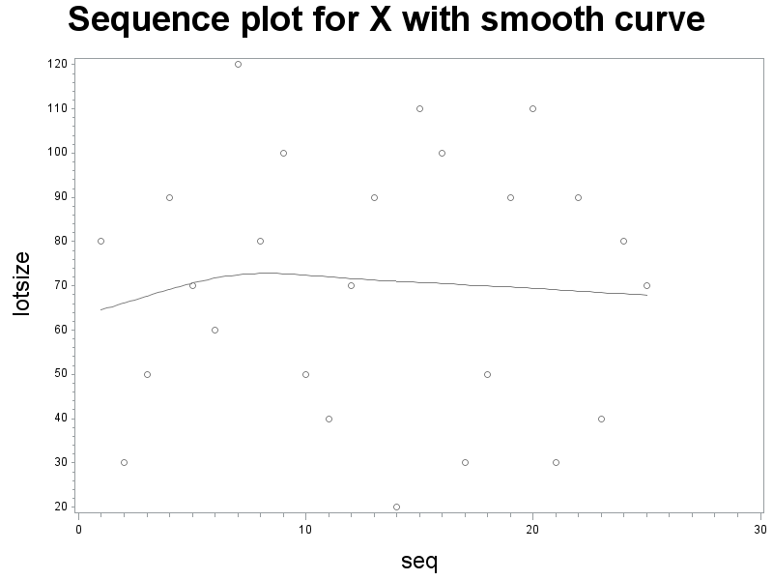
Distribution of X: Sequence plot
title1 h=3 'Sequence plot for X with smooth curve';
symbol1 v=circle i=sm70;
axis1 label=(h=2);
axis2 label=(h=2 angle=90);
proc gplot data=toluca;
plot lotsize*seq/haxis=axis1 vaxis=axis2;
run;

Slide 8
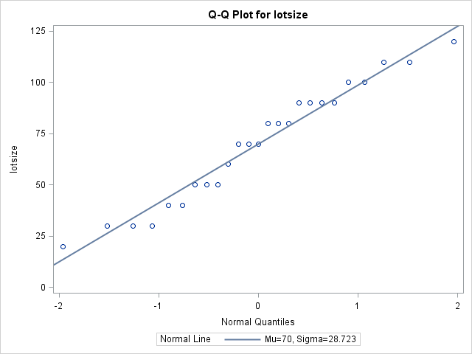
Distribution of X: QQPlot
title1 'QQPlot (normal probability plot)';
proc univariate data=toluca noprint;
qqplot lotsize workhrs / normal (L=1 mu=est sigma=est);
run;

Slide 9
Quadratic: (nknw100quad.sas)
title1 h=3 'Quadratic relationship';
data quad;
do x=1 to 30;
y=x*x-10*x+30+25*normal(0);
output;
end;
proc reg data=quad;
model y=x;
output out=diagquad r=resid;
run;
Analysis of Variance
Source | DF | Sum of Squares | Mean Square | F Value | Pr > F
Model | 1 | 953739 | 953739 | 156.15 | <.0001
Error | 28 | 171018 | 6107.77487
Corrected Total | 29 | 1124757
Root MSE | 78.15225 | R-Square | 0.8480

Slide 10
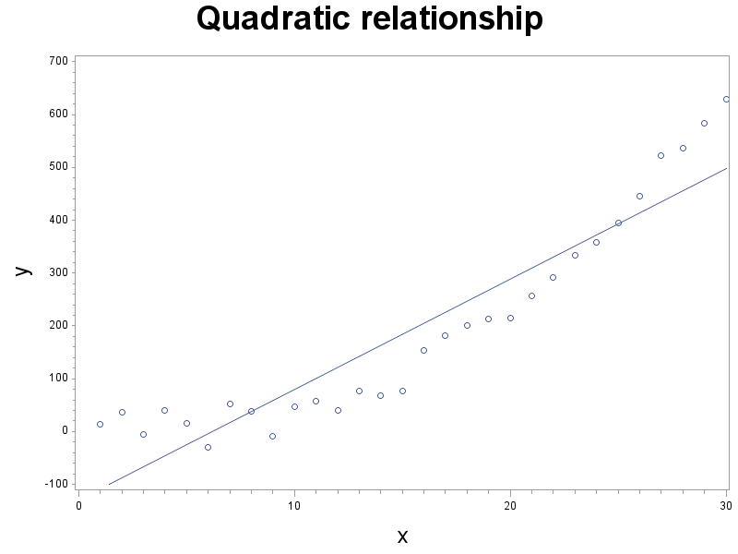
Quadratic: Example (cont)
symbol1 v=circle i=rl;
axis1 label=(h=2);
axis2 label=(h=2 angle=90);
proc gplot data=quad;
plot y*x/haxis=axis1 vaxis=axis2;
run;

Slide 11
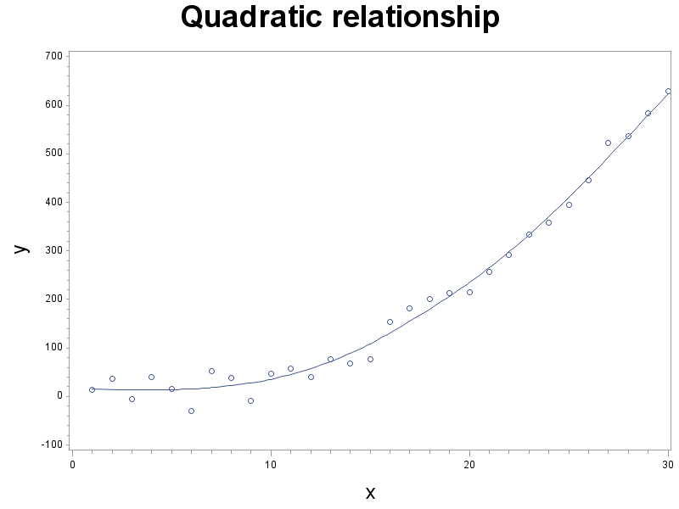
Quadratic: Example (cont)
symbol1 v=circle i=sm60;
proc gplot data=quad;
plot y*x/haxis=axis1 vaxis=axis2;
run;

Slide 12
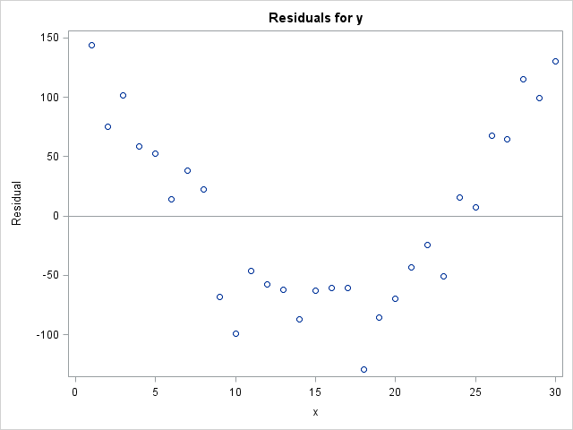
Quadratic: Example (cont)

Slide 13
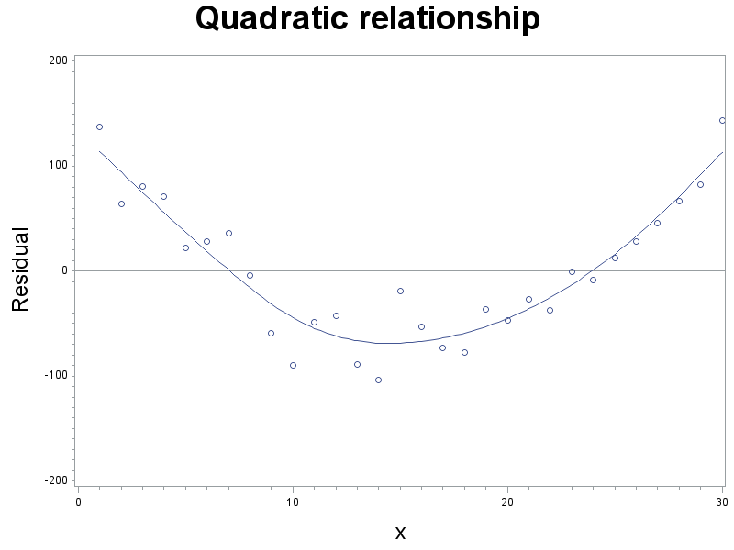
Quadratic: Example (cont)
proc gplot data=diagquad;
plot resid*x/ vref=0 haxis=axis1 vaxis=axis2;
run;

Slide 14
Quadratic: Example (cont)

Slide 15
Heteroscediastic: (nknw100het.sas)
title1 h=3 'Heteroscedastic';
axis1 label=(h=2);
axis2 label=(h=2 angle=90);
Data het;
do x=1 to 100;
y=100*x+30+10*x*normal(0);
output;
end;
proc reg data=het;
model y=x;
run;
Analysis of Variance
Source | DF | Sum of Squares | Mean Square | F Value | Pr > F
Model | 1 | 859078406 | 859078406 | 3170.20 | <.0001
Error | 98 | 26556547 | 270985
Corrected Total | 99 | 885634953
Root MSE | 520.56236 | R-Square | 0.9700

Slide 16
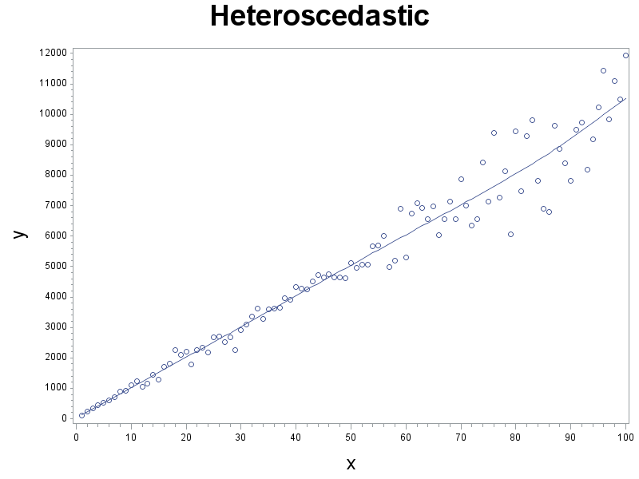
Heteroscediastic: Example (cont)
symbol1 v=circle i=sm60;
proc gplot data=het;
plot y*x/haxis=axis1 vaxis=axis2;
run;

Slide 17
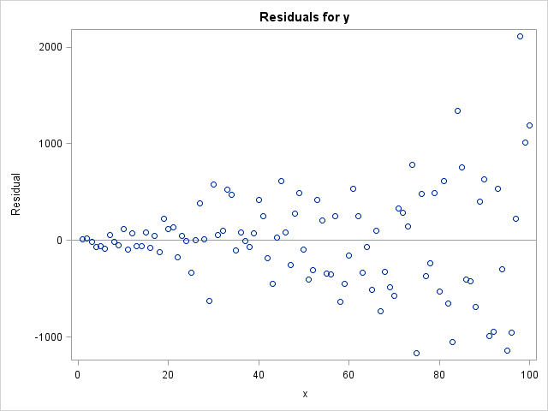
Heteroscediastic: Example (cont)

Slide 18
Heteroscediastic: Example (cont)

Slide 19
Outlier: Example1 (nknw100out.sas)
title1 h=3 'Outlier at x=50';
axis1 label=(h=2);
axis2 label=(h=2 angle=90);
data outlier50;
do x=1 to 100 by 5;
y=30+50*x+200*normal(0);
output;
end;
x=50; y=30+50*50 +10000;
d='out'; output;
proc print data=outlier50; run;

Slide 20
Outlier: Example1 (cont)
Obs | x | y | d
1 | 1 | 121.66
2 | 6 | 508.77
3 | 11 | 564.25
4 | 16 | 615.79
⁞ | ⁞ | ⁞ | ⁞
20 | 96 | 4820.94
21 | 50 | 12530.00 | out

Slide 21
Outlier: Example1 (cont)
Code:
Without outlier: With outlier:
proc reg data=outlier50; proc reg data=outlier50;
model y=x; model y=x;
where d ne 'out';
Parameter Estimates (without outlier)
Variable | DF | Parameter Estimate | Standard Error | t Value | Pr > |t|
Intercept | 1 | 8.62373 | 79.41493 | 0.11 | 0.9147
x | 1 | 49.64446 | 1.40750 | 35.27 | <.0001
Root MSE | 181.48075 | R-Square | 0.9857
Parameter Estimates (with outlier)
Variable | DF | Parameter Estimate | Standard Error | t Value | Pr > |t|
Intercept | 1 | 444.78363 | 981.40205 | 0.45 | 0.6555
x | 1 | 50.50701 | 17.48341 | 2.89 | 0.0094
Root MSE | 2254.42015 | R-Square | 0.3052

Slide 22
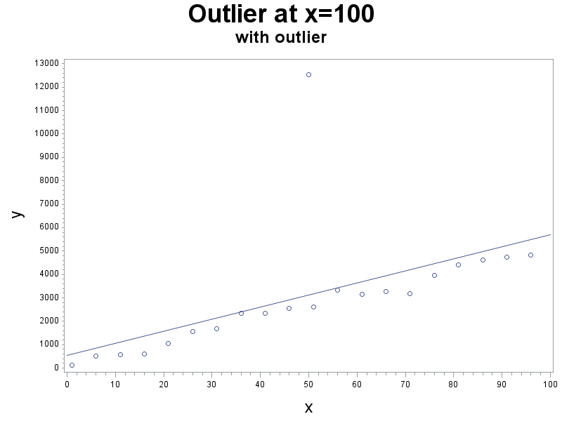
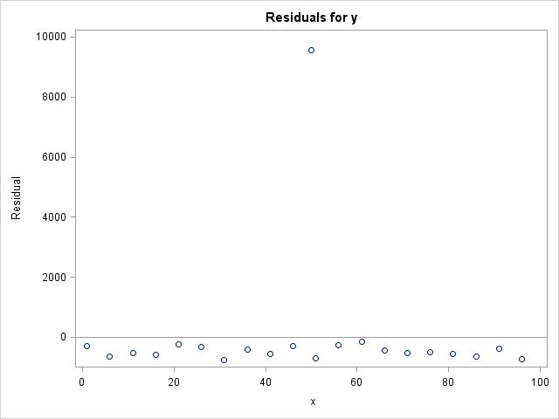
Outlier: Example1 (cont)
symbol1 v=circle i=rl;
proc gplot data=outlier50;
plot y*x/haxis=axis1 vaxis=axis2;
run;

Slide 23
Outlier: Example2 (nknw100out.sas)
title1 h=3 'Outlier at x=100';
data outlier100;
do x=1 to 100 by 5;
y=30+50*x+200*normal(0);
output;
end;
x=100; y=30+50*100 -10000;
d='out'; output;
proc print data=outlier100; run;

Slide 24
Outlier: Example2 (cont)
Code:
Without outlier: With outlier:
proc reg data=outlier100; proc reg data=outlier100;
model y=x; model y=x;
where d ne 'out';
Parameter Estimates (without outlier)
Variable | DF | Parameter Estimate | Standard Error | t Value | Pr > |t|
Intercept | 1 | 23.42072 | 72.90582 | 0.32 | 0.7517
x | 1 | 51.57987 | 1.29214 | 39.92 | <.0001
Root MSE | 166.60598 | R-Square | 0.9888
Parameter Estimates (with outlier)
Variable | DF | Parameter Estimate | Standard Error | t Value | Pr > |t|
Intercept | 1 | 864.72272 | 908.97235 | 0.95 | 0.3534
x | 1 | 25.58104 | 15.34670 | 1.67 | 0.1119
Root MSE | 2123.78315 | R-Square | 0.1276

Slide 25
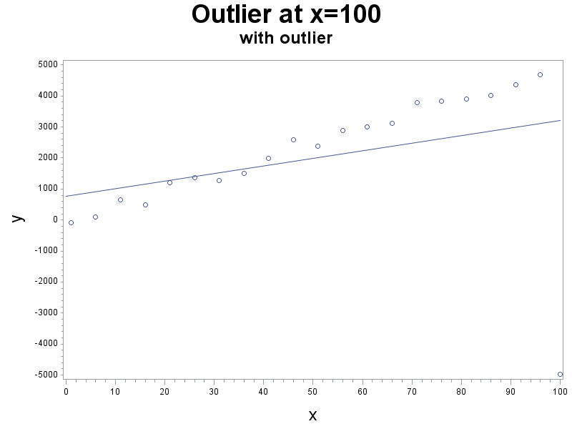
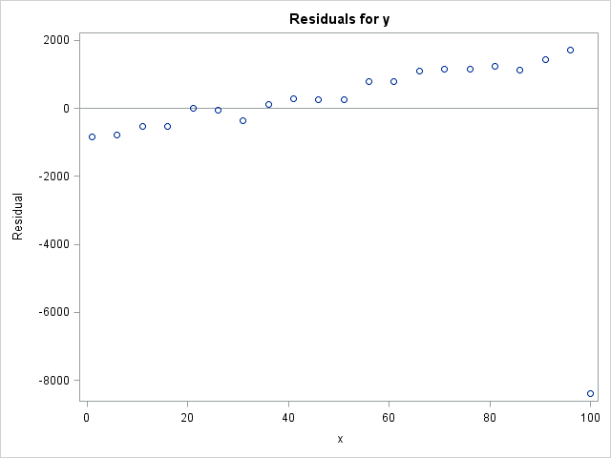
Outlier: Example2 (cont)
symbol1 v=circle i=rl;
proc gplot data=outlier100;
plot y*x/haxis=axis1 vaxis=axis2;
run;

Slide 26
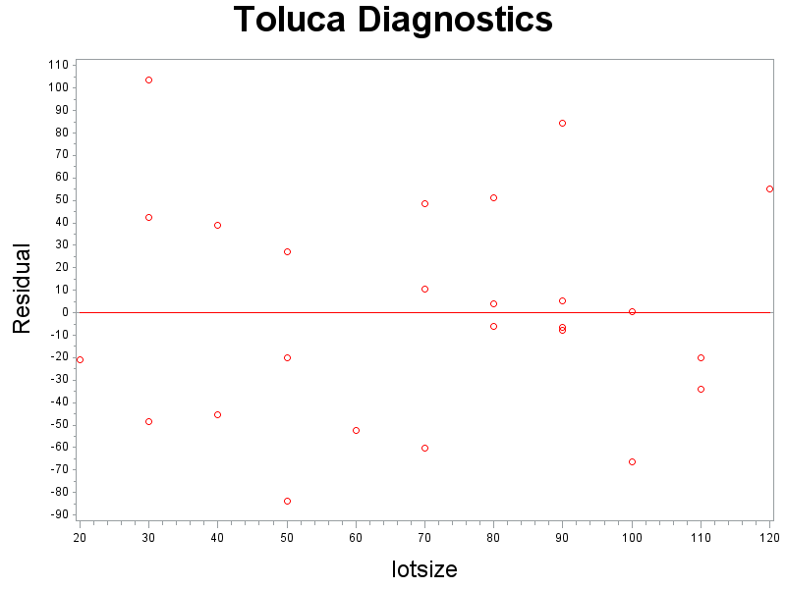
Toluca: Residual Plot (nknw106a.sas)
title1 h=3 'Toluca Diagnostics';
data toluca;
infile 'H:\My Documents\Stat 512\CH01TA01.DAT';
input lotsize workhrs;
proc reg data=toluca;
model workhrs=lotsize;
output out=diag r=resid;
run;
symbol1 v=circle cv = red;
axis1 label=(h=2);
axis2 label=(h=2 angle=90);
proc gplot data=diag;
plot resid*lotsize/ vref=0 haxis=axis1 vaxis=axis2;
run;
quit;

Slide 27
Normality: Toluca (nknw106b.sas)
title1 h=3 'Toluca Diagnostics';
data toluca;
infile 'H:\My Documents\Stat 512\CH01TA01.DAT';
input lotsize workhrs;
proc print data=toluca; run;
proc reg data=toluca;
model workhrs=lotsize;
output out=diag r=resid;
run;
proc univariate data=diag plot normal;
var resid;
histogram resid / normal kernel;
qqplot resid / normal (mu=est sigma=est);
run;

Slide 28
Normality: Toluca (cont)

Slide 29
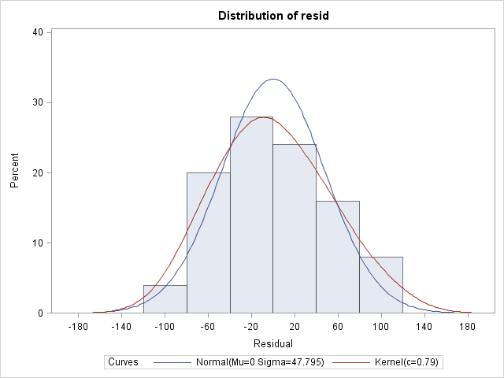
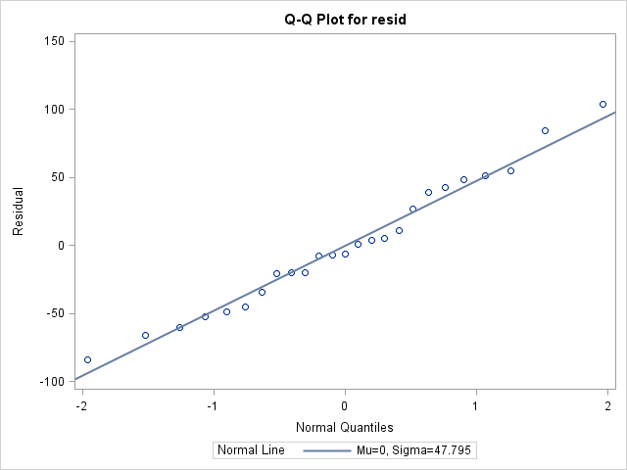
Normality: Toluca (cont)

Slide 30
Normal: (nknw100norm.sas)
%let mu = 0;
%let sigma=10;
title1 'Normal Distribution mu='&mu' sigma='&sigma;
data norm;
do x=1 to 100;
y=100*x+30+rand('normal',&mu,&sigma); output;
end;
proc reg data=norm;
model y=x;
output out=diagnorm r=resid;
run;
symbol1 v=circle i=none;
proc univariate data=diagnorm plot normal;
var resid;
histogram resid / normal kernel;
qqplot resid / normal (mu=est sigma=est);
run;

Slide 31
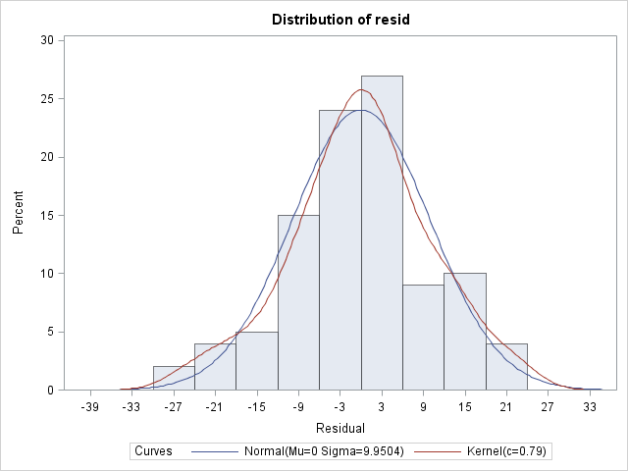
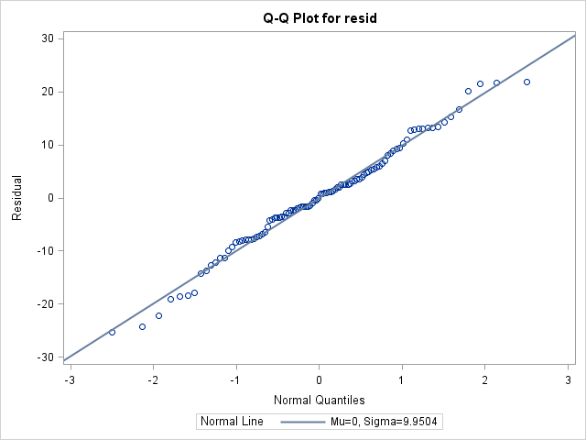
Normal: (cont)
Normal Distribution mu=0 sigma=10

Slide 32
Normality: failure (nknw100nnorm.sas)
title1 'Right Skewed distribution';
data expo;
do x=1 to 100;
y=100*x+30+exp(2)*rand('exponential'); output;
end;
proc reg data=expo;
model y=x;
output out=diagexpo r=resid;
run;
symbol1 v=circle i=none;
proc univariate data=diagexpo plot normal;
var resid;
histogram resid / normal kernel;
qqplot resid / normal (mu=est sigma=est);
run;

Slide 33
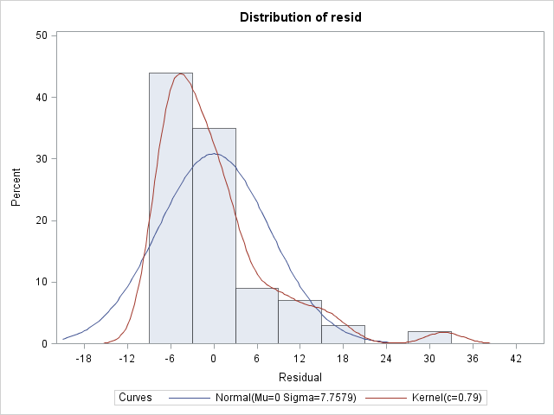
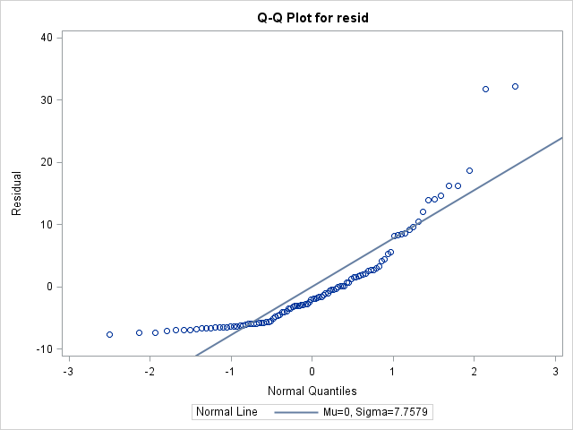
Normality: right skewed (cont)

Slide 34
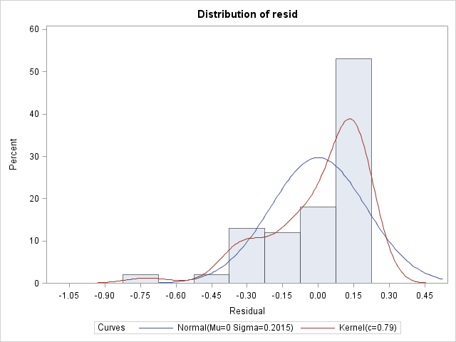
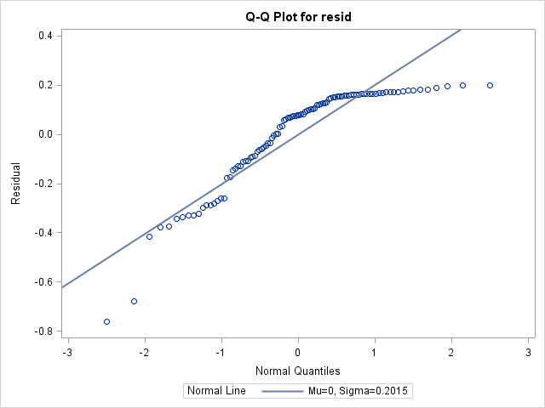
Normality: left skewed (cont)

Slide 35
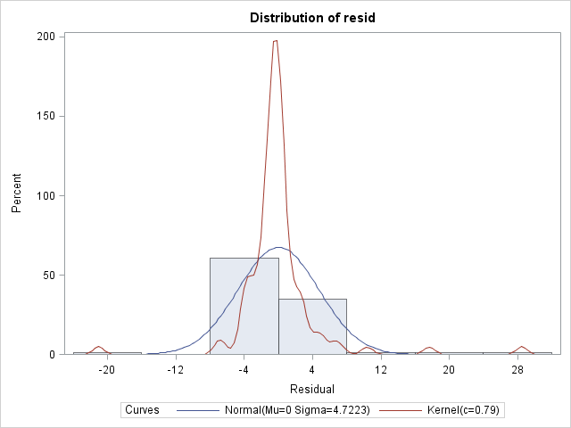
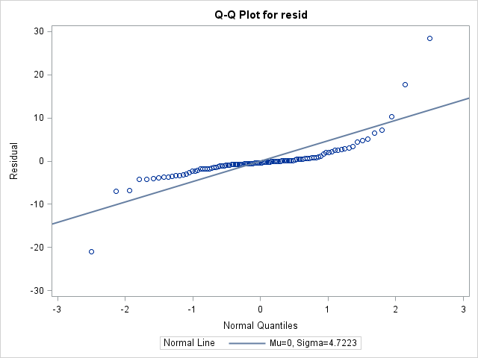
Normality: long tailed (cont)

Slide 36
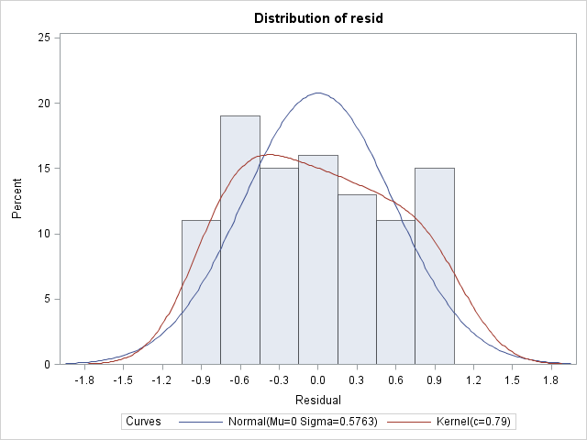
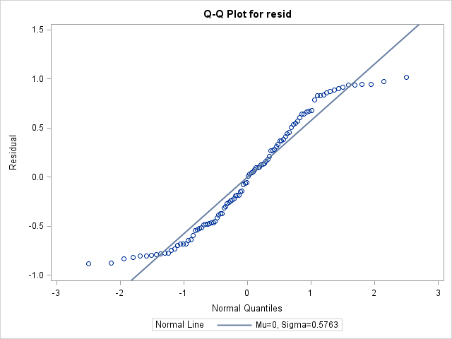
Normality: short tailed (cont)

Slide 37
Normality: nongraphical
proc univariate data=diagy normal;
var resid;
run;
Toluca:
Tests for Normality
Test | Statistic |  | p Value
Shapiro-Wilk | W | 0.978904 | Pr < W | 0.8626
Kolmogorov-Smirnov | D | 0.09572 | Pr > D | >0.1500
Cramer-von Mises | W-Sq | 0.033263 | Pr > W-Sq | >0.2500
Anderson-Darling | A-Sq | 0.207142 | Pr > A-Sq | >0.2500

Slide 38
Normality (nongraphical) cont.
 | Toluca |  | right skewed |  | left skewed |  | long tailed |  | short tailed
Test | stat | P | stat | P | stat | P | stat | P | stat | P
Shapiro-Wilk | 0.98 | 0.86 | 0.83 | <0.01 | 0.87 | <0.01 | 0.68 | <0.01 | 0.94 | <0.01
Kolmogorov-Smirnov | 0.10 | >0.15 | 0.19 | <0.01 | 0.15 | <0.01 | 0.23 | <0.01 | 0.09 | 0.04
Cramer- von Mises | 0.03 | >0.25 | 0.84 | <0.01 | 0.75 | <0.01 | 1.68 | <0.01 | 0.20 | <0.01
Anderson-Darling | 0.21 | >0.25 | 5.42 | <0.01 | 4.42 | <0.01 | 8.96 | <0.01 | 1.51 | <0.01

Slide 39
Normality (nongraphical): Right Skewed
Tests for Normality
Test | Statistic |  | p Value
Shapiro-Wilk | W | 0.803961 | Pr < W | <0.0001
Kolmogorov-Smirnov | D | 0.163439 | Pr > D | <0.0100
Cramer-von Mises | W-Sq | 0.882205 | Pr > W-Sq | <0.0050
Anderson-Darling | A-Sq | 5.208245 | Pr > A-Sq | <0.0050

Slide 40
Normality (nongraphical): Left Skewed
Tests for Normality
Test | Statistic |  | p Value
Shapiro-Wilk | W | 0.833257 | Pr < W | <0.0001
Kolmogorov-Smirnov | D | 0.194715 | Pr > D | <0.0100
Cramer-von Mises | W-Sq | 0.941091 | Pr > W-Sq | <0.0050
Anderson-Darling | A-Sq | 5.420772 | Pr > A-Sq | <0.0050

Slide 41
Normality (nongraphical): Long Tailed
Tests for Normality
Test | Statistic |  | p Value
Shapiro-Wilk | W | 0.67559 | Pr < W | <0.0001
Kolmogorov-Smirnov | D | 0.227803 | Pr > D | <0.0100
Cramer-von Mises | W-Sq | 1.679374 | Pr > W-Sq | <0.0050
Anderson-Darling | A-Sq | 8.959049 | Pr > A-Sq | <0.0050

Slide 42
Normality (nongraphical): Short Tailed
Tests for Normality
Test | Statistic |  | p Value
Shapiro-Wilk | W | 0.940814 | Pr < W | 0.0002
Kolmogorov-Smirnov | D | 0.091643 | Pr > D | 0.0382
Cramer-von Mises | W-Sq | 0.198963 | Pr > W-Sq | 0.0052
Anderson-Darling | A-Sq | 1.505363 | Pr > A-Sq | <0.0050

Slide 43
Transformations (X)

Slide 44
Transformations (Y)
Y’ = Y’ = log₁₀ Y Y’ = 1/Y
Note: a simultaneous transformation on X may also be helpful or necessary.

Slide 45
Equations for Box-Cox Procedure
where

Slide 46
Box-Cox: Plasma (boxcox.sas)
Y = Plasma level of polyamine
X = Age of healthy children
n = 25

Slide 47
Box-Cox: Example (Input)
data orig; input age plasma @@;
cards;
0 13.44 0 12.84 0 11.91 0 20.09 0 15.60
1 10.11 1 11.38 1 10.28 1 8.96 1 8.59
2 9.83 2 9.00 2 8.65 2 7.85 2 8.88
3 7.94 3 6.01 3 5.14 3 6.90 3 6.77
4 4.86 4 5.10 4 5.67 4 5.75 4 6.23
;
proc print data=orig; run;
Obs | age | plasma
1 | 0 | 13.44
2 | 0 | 12.84
3 | 0 | 11.91
4 | 0 | 20.09
5 | 0 | 15.60
6 | 1 | 10.11
⁞ | ⁞ | ⁞

Slide 48
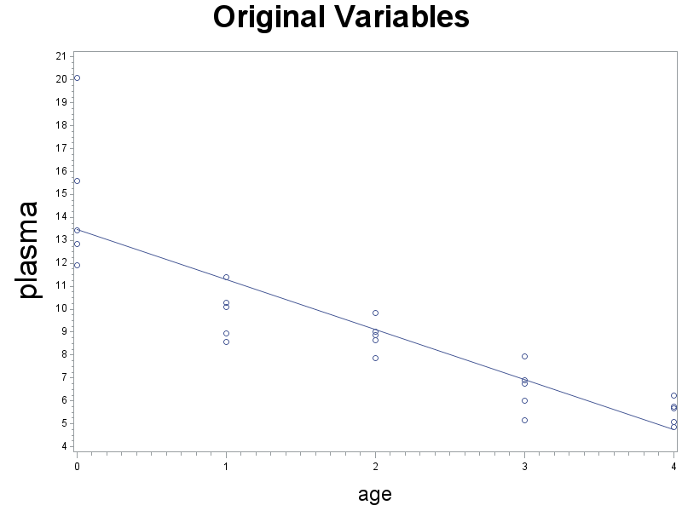
Box-Cox: Example (Y vs. X)
title1 h=3'Original Variables';
axis1 label=(h=2);
axis2 label=(h=3 angle=90);
symbol1 v=circle i=rl;
proc gplot data=orig;
plot plasma*age/haxis=axis1 vaxis=axis2;
run;

Slide 49
Box-Cox: Example (regression)
proc reg data=orig;
model plasma=age;
output out = notrans r = resid;
run;
Analysis of Variance
Source | DF | Sum of Squares | Mean Square | F Value | Pr > F
Model | 1 | 238.05620 | 238.05620 | 70.21 | <.0001
Error | 23 | 77.98306 | 3.39057
Corrected Total | 24 | 316.03926
Root MSE | 1.84135 | R-Square | 0.7532

Slide 50
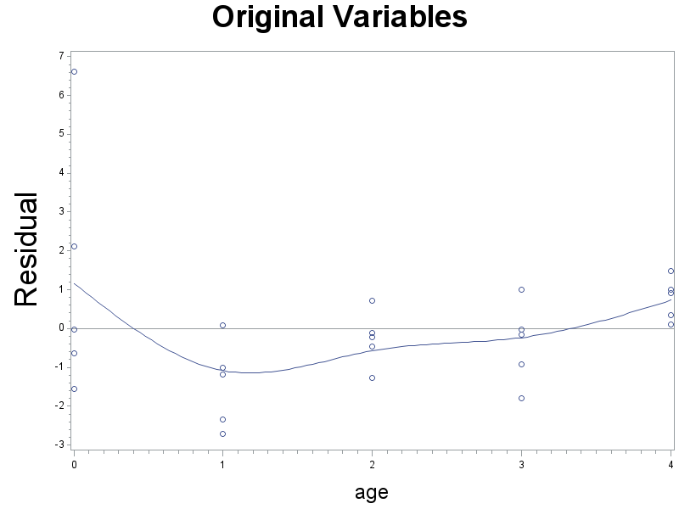
Box-Cox: Example (resid vs. X)
symbol1 i=sm70;
proc gplot data = notrans;
plot resid*age / vref = 0 haxis=axis1 vaxis=axis2;

Slide 51
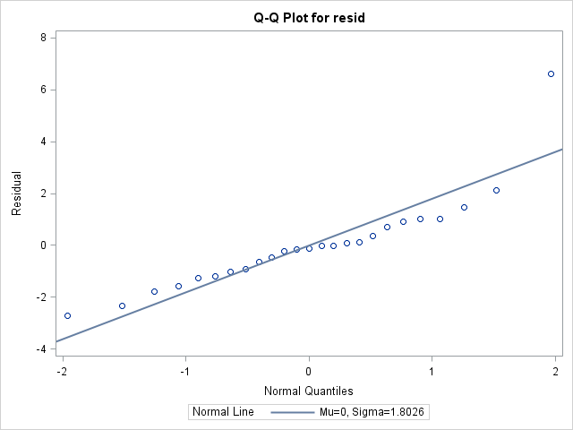
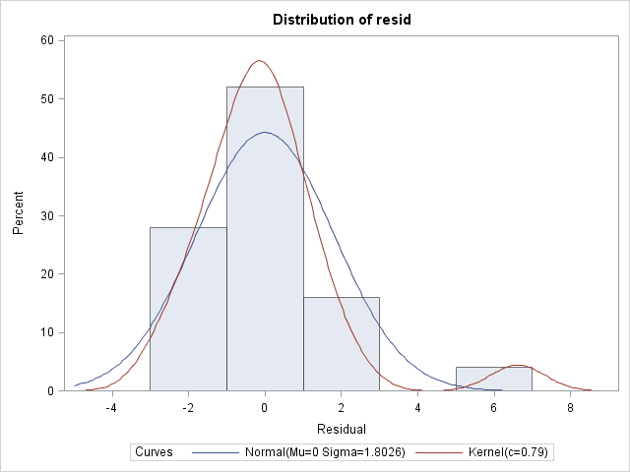
Box-Cox: Example (QQPlot)
proc univariate data=notrans noprint;
var resid;
histogram resid/normal kernel;
qqplot resid/normal (mu = est sigma=est);
run;

Slide 52
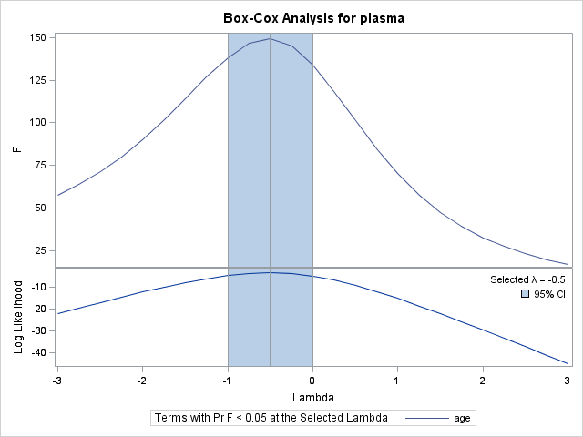
Box-Cox: Example (find transformation)
proc transreg data = orig;
model boxcox(plasma)=identity(age);
run;

Slide 53
Box-Cox: Example (calc transformation)
title1 'Transformed Variables';
data trans; set orig;
logplasma = log(plasma);
rsplasma = plasma**(-0.5);
proc print data = trans;
run;

Slide 54
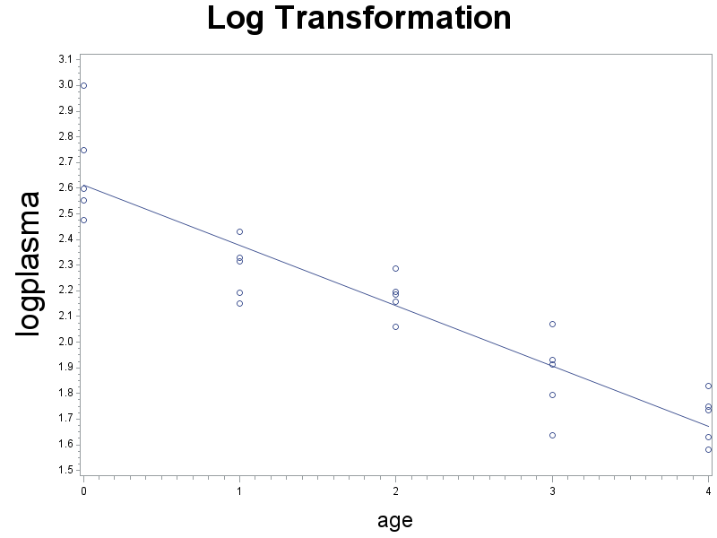
Box-Cox: Log (Y vs. X)
symbol1 i=rl;
proc gplot data = logtrans;
plot logplasma * age/haxis=axis1 vaxis=axis2;
run;

Slide 55
Box-Cox: Log (regression)
proc reg data = trans;
model logplasma = age;
output out = logtrans r = logresid;
run;
Analysis of Variance
Source | DF | Sum of Squares | Mean Square | F Value | Pr > F
Model | 1 | 2.77339 | 2.77339 | 134.02 | <.0001
Error | 23 | 0.47595 | 0.02069
Corrected Total | 24 | 3.24933
Root MSE | 0.14385 | R-Square | 0.8535

Slide 56
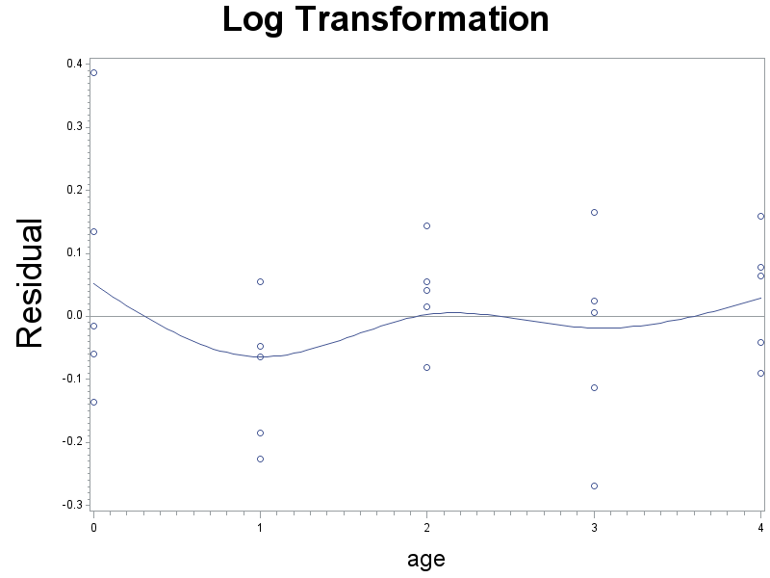
Box-Cox: Log(resid vs. X)
symbol1 i=sm70;
proc gplot data = logtrans;
plot logresid * age / vref = 0 haxis=axis1 vaxis=axis2;

Slide 57
Box-Cox: Log(QQPlot)
proc univariate data=logtrans noprint;
var logresid;
histogram logresid/normal kernel;
qqplot logresid/normal (L=1 mu = est sigma = est);
run;

Slide 58
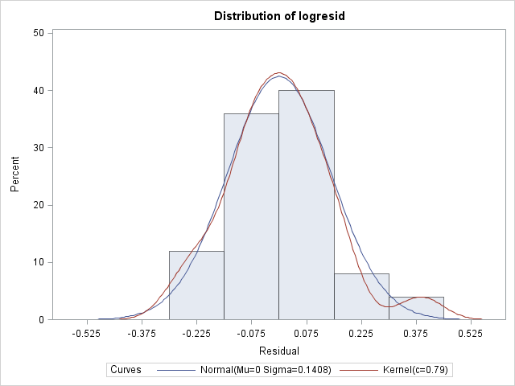
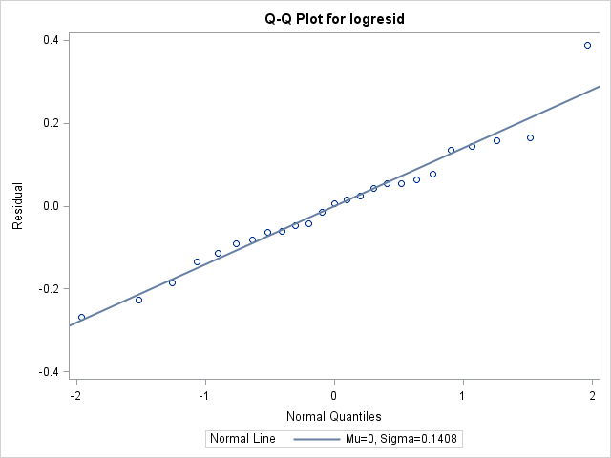
Box-Cox: Log(QQPlot (cont))

Slide 59
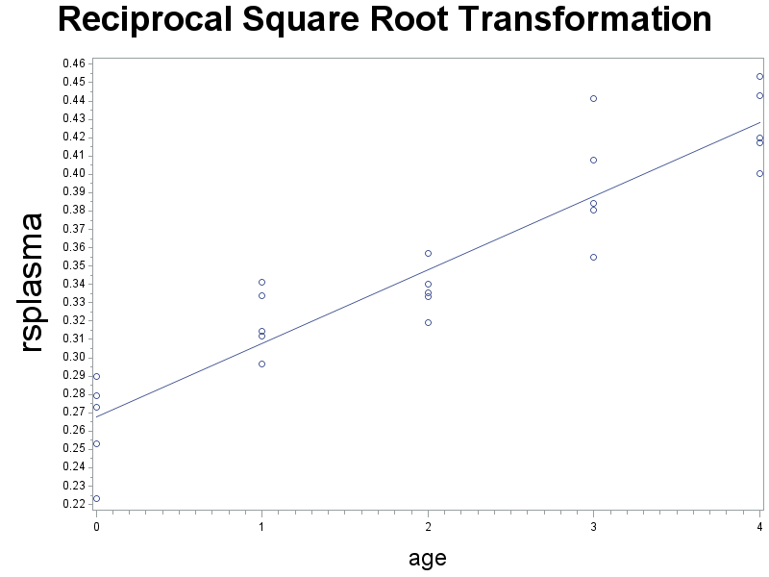
Box-Cox: Reciprocal Sq. Rt. (Y vs. X)
title1 h=3 'Reciprocal Square Root Transformation';
symbol1 i=rl;
proc gplot data = trans;
plot rsplasma * age/haxis=axis1 vaxis=axis2;
run;

Slide 60
Box-Cox: Reciprocal Sq. Rt. (regression)
proc reg data = trans;
model rsplasma = age;
output out = rstrans r = rsresid;
run;
Analysis of Variance
Source | DF | Sum of Squares | Mean Square | F Value | Pr > F
Model | 1 | 0.08025 | 0.08025 | 149.22 | <.0001
Error | 23 | 0.01237 | 0.00053778
Corrected Total | 24 | 0.09262
Root MSE | 0.02319 | R-Square | 0.8665

Slide 61
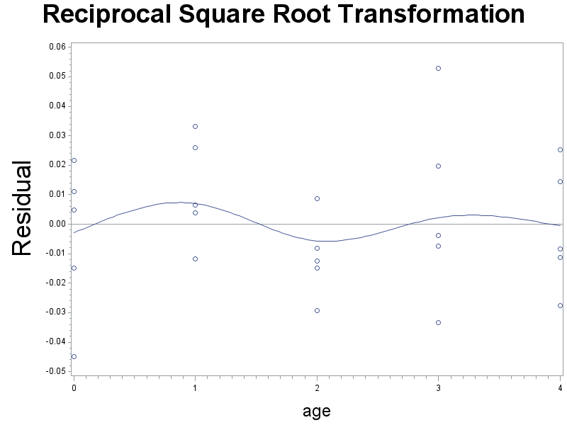
Box-Cox: Reciprocal Sq. Rt. (resid vs. X)
symbol1 i=sm70;
proc gplot data = rstrans;
plot rsresid * age /
vref = 0 haxis=axis1 vaxis=axis2;

Slide 62
Box-Cox: Reciprocal Sq. Rt. (QQPlot)
proc univariate data=rstrans noprint;
var rsresid;
histogram rsresid/normal kernel;
qqplot/normal (L=1 mu = est sigma = est);
run;

Slide 63
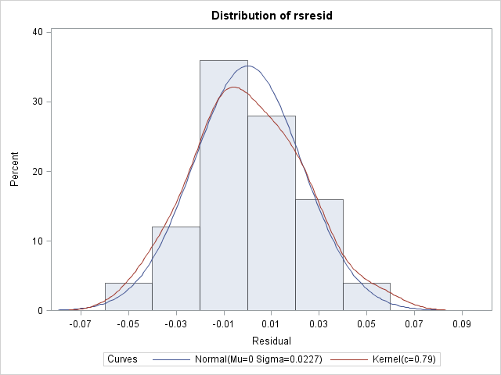
Box-Cox: Reciprocal Sq. Rt. (QQPlot, cont)

Slide 64
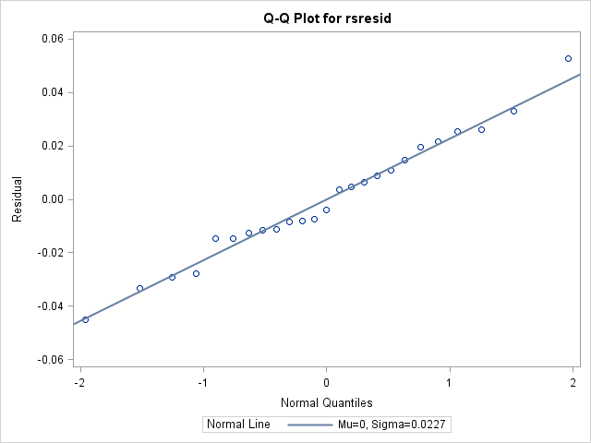
Box-Cox: Reciprocal Sq. Rt. (QQPlot, cont)

Slide 65
Calculation of t_{c}: (knnl155.sas)
data tcrit;
alpha = 0.05; n = 25; g = 2;
percentile = 1 - alpha/g/2; df = n - 2;
tcrit = tinv(percentile,df);
run;
proc print data=tcrit; run;
Obs | alpha | n | g | percentile | df | tcrit
1 | 0.05 | 25 | 2 | 0.9875 | 23 | 2.39788

Slide 66
Calculation of S: (knnl155.sas)
data Scheffe;
alpha = 0.05; n = 25; g = 2;
percentile = 1 - alpha; dfn = g; dfd = n - 2;
S = sqrt(2*Finv(percentile,dfn,dfd));
proc print data=Scheffe; run;
Obs | alpha | n | g | percentile | dfn | dfd | S
1 | 0.05 | 25 | 2 | 0.95 | 2 | 23 | 2.61615

