Slide 1
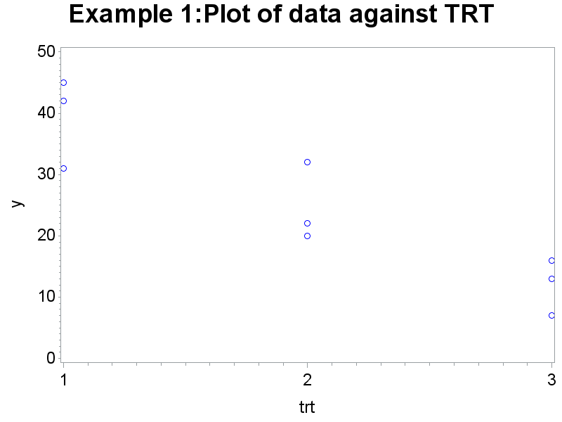
Example 1 (knnl917.sas)
Y = months survival
Treatment (3 levels)

Slide 2
Example 1: ANOVA
Source | DF | Sum of Squares | Mean Square | F Value | Pr > F
Model | 2 | 1122.666667 | 561.333333 | 14.43 | 0.0051
Error | 6 | 233.333333 | 38.888889
Corrected Total | 8 | 1356.000000
Means with the same letter are not significantly different.
Tukey Grouping |  | Mean | N | trt
 | A | 39.333 | 3 | 1
 | A
B | A | 24.667 | 3 | 2
B
B |  | 12.000 | 3 | 3

Slide 3
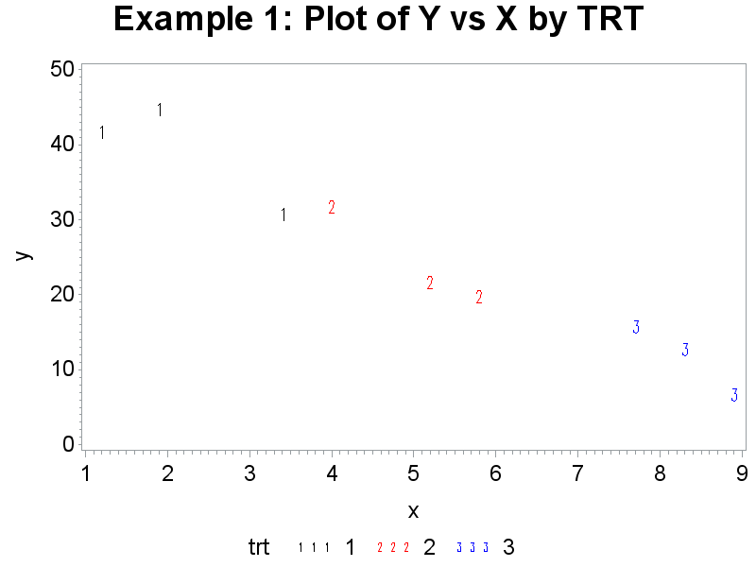
Example 1: Including the covariate

Slide 4
Example 1: ANCOVA
Source | DF | Sum of Squares | Mean Square | F Value | Pr > F
Model | 3 | 1322.369193 | 440.789731 | 65.53 | 0.0002
Error | 5 | 33.630807 | 6.726161
Corrected Total | 8 | 1356.000000
Source | DF | Type I SS | Mean Square | F Value | Pr > F
x | 1 | 1297.234815 | 1297.234815 | 192.86 | <.0001
trt | 2 | 25.134378 | 12.567189 | 1.87 | 0.2478
Source | DF | Type III SS | Mean Square | F Value | Pr > F
x | 1 | 199.7025259 | 199.7025259 | 29.69 | 0.0028
trt | 2 | 25.1343781 | 12.5671890 | 1.87 | 0.2478

Slide 5
Example 1: ANCOVA (cont)
trt | y LSMEAN | LSMEAN Number
1 | 20.3039393 | 1
2 | 23.6762893 | 2
3 | 32.0197715 | 3
Least Squares Means for Effect trt t for H0: LSMean(i)=LSMean(j) / Pr > |t| Dependent Variable: y
i/j | 1 | 2 | 3
1 |  | -0.85813 | -1.56781
 |  | 0.4300 | 0.1777
2 | 0.858127 |  | -1.89665
 | 0.4300 |  | 0.1164
3 | 1.567807 | 1.89665
 | 0.1777 | 0.1164

Slide 6
Example 1: ANCOVA comparison
Means with the same letter are not significantly different.
Tukey Grouping |  | Mean | N | trt
 | A | 39.333 | 3 | 1
 | A
B | A | 24.667 | 3 | 2
B
B |  | 12.000 | 3 | 3
trt | y LSMEAN | LSMEAN Number
1 | 20.3039393 | 1
2 | 23.6762893 | 2
3 | 32.0197715 | 3

Slide 7
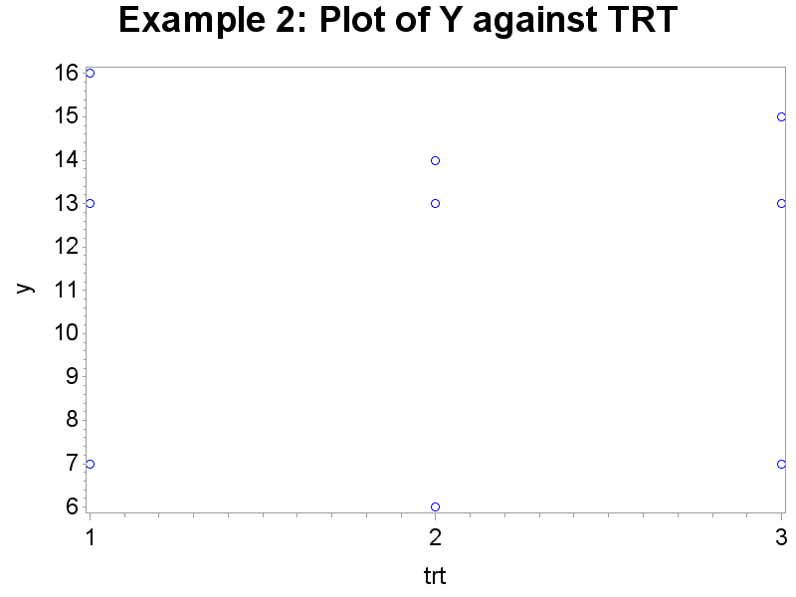
Example 2
Y = months survival
Treatment (3 levels)

Slide 8
Example 2: ANOVA
Source | DF | Sum of Squares | Mean Square | F Value | Pr > F
Model | 2 | 1.5555556 | 0.7777778 | 0.04 | 0.9604
Error | 6 | 114.6666667 | 19.1111111
Corrected Total | 8 | 116.2222222

Slide 9
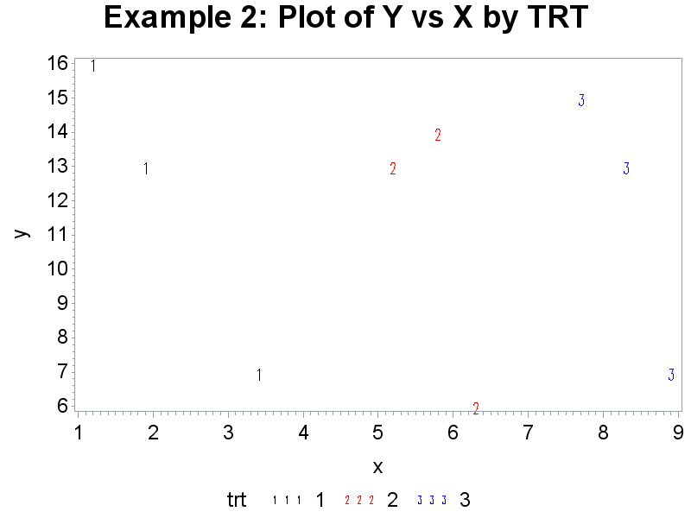
Example 2: Including the covariate

Slide 10
Example 2: ANCOVA
 | DF | Sum of Squares | Mean Square | F Value | Pr > F
Model | 3 | 93.2787389 | 31.0929130 | 6.78 | 0.0327
Error | 5 | 22.9434833 | 4.5886967
Corrected Total | 8 | 116.2222222
Source | DF | Type I SS | Mean Square | F Value | Pr > F
x | 1 | 8.50985643 | 8.50985643 | 1.85 | 0.2314
trt | 2 | 84.76888251 | 42.38444126 | 9.24 | 0.0209
Source | DF | Type III SS | Mean Square | F Value | Pr > F
x | 1 | 91.72318339 | 91.72318339 | 19.99 | 0.0066
trt | 2 | 84.76888251 | 42.38444126 | 9.24 | 0.0209

Slide 11
Example 2: ANCOVA (cont)
trt | y LSMEAN | LSMEAN Number
1 | -3.8292964 | 1
2 | 12.7347174 | 2
3 | 25.7612457 | 3
Least Squares Means for Effect trt t for H0: LSMean(i)=LSMean(j) / Pr > |t| Dependent Variable: y
i/j | 1 | 2 | 3
1 |  | -3.85185 | -4.27746
 |  | 0.0120 | 0.0079
2 | 3.851847 |  | -3.98202
 | 0.0120 |  | 0.0105
3 | 4.277456 | 3.982016
 | 0.0079 | 0.0105

Slide 12
Crackers Example: nknw1020.sas
Y = number of cases sold during promotion
Factor: promotion type
1: sampling of crackers in the store
2: additional shelf space
3: shelf space at the end of the aisles
n = 5
X = cases sold before the promotion

Slide 13
Crackers Example: Input
data crackers;
infile ‘H:\My Documents\Stat 512\CH22TA01.DAT';
input cases last treat store;
proc print data=crackers;
Obs | cases | last | treat | store
1 | 38 | 21 | 1 | 1
2 | 39 | 26 | 1 | 2
3 | 36 | 22 | 1 | 3
4 | 45 | 28 | 1 | 4
5 | 33 | 19 | 1 | 5
6 | 43 | 34 | 2 | 1
7 | 38 | 26 | 2 | 2
8 | 38 | 29 | 2 | 3
9 | 27 | 18 | 2 | 4
10 | 34 | 25 | 2 | 5
11 | 24 | 23 | 3 | 1
12 | 32 | 29 | 3 | 2
13 | 31 | 30 | 3 | 3
14 | 21 | 16 | 3 | 4
15 | 28 | 29 | 3 | 5

Slide 14
Crackers Example: Interaction Plot 1
title1 h=3 'Interaction plot without lines';
axis2 label=(angle=90);
symbol1 v='1' i=none c=black h=1.5;
symbol2 v='2' i=none c=red h=1.5;
symbol3 v='3' i=none c=blue h=1.5;
proc gplot data=crackers;
plot cases*last=treat/vaxis=axis2;
run;

Slide 15
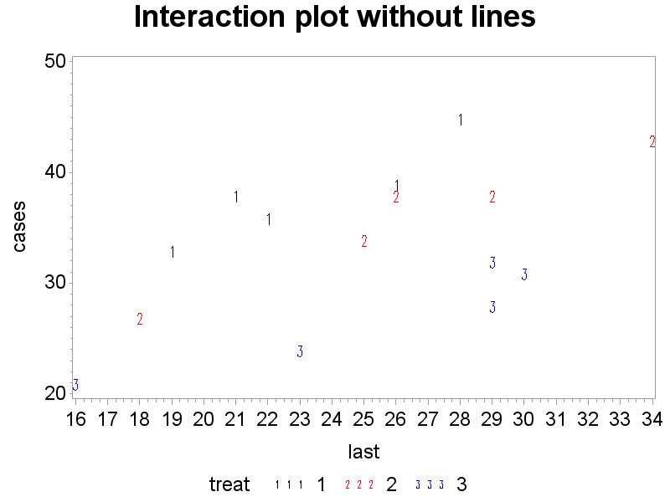
Crackers Example: Interaction Plot 1 (cont)

Slide 16
Crackers Example: Interaction Plot 2
title1 h=3 'Interaction plot with lines';
symbol1 v='1' i=rl c=black h=1.5;
symbol2 v='2' i=rl c=red h=1.5;
symbol3 v='3' i=rl c=blue h=1.5;
proc gplot data=crackers;
plot cases*last=treat/vaxis=axis2;
run;

Slide 17
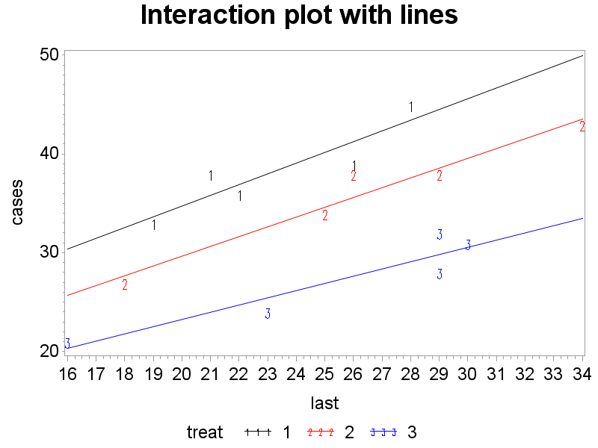
Crackers Example: Interaction Plot 2 (cont)

Slide 18
Crackers Example: ANOVA
proc glm data=crackers;
class treat;
model cases=last treat/solution clparm;
run;
Source | DF | Sum of Squares | Mean Square | F Value | Pr > F
Model | 3 | 607.8286915 | 202.6095638 | 57.78 | <.0001
Error | 11 | 38.5713085 | 3.5064826
Corrected Total | 14 | 646.4000000
R-Square | Coeff Var | Root MSE | cases Mean
0.940329 | 5.540120 | 1.872560 | 33.80000

Slide 19
Crackers Example: ANOVA (cont)
Source | DF | Type I SS | Mean Square | F Value | Pr > F
last | 1 | 190.6777778 | 190.6777778 | 54.38 | <.0001
treat | 2 | 417.1509137 | 208.5754568 | 59.48 | <.0001
Source | DF | Type III SS | Mean Square | F Value | Pr > F
last | 1 | 269.0286915 | 269.0286915 | 76.72 | <.0001
treat | 2 | 417.1509137 | 208.5754568 | 59.48 | <.0001

Slide 20
Crackers Example: ANOVA (cont)
Parameter | Estimate |  | Standard Error | t Value | Pr > |t|
Intercept | 4.37659064 | B | 2.73692149 | 1.60 | 0.1381
last | 0.89855942 |  | 0.10258488 | 8.76 | <.0001
treat 1 | 12.97683073 | B | 1.20562330 | 10.76 | <.0001
treat 2 | 7.90144058 | B | 1.18874585 | 6.65 | <.0001
treat 3 | 0.00000000 | B | . | . | .
Parameter | Estimate |  | 95% Confidence Limits
Intercept | 4.37659064 | B | -1.64733294 | 10.40051421
last | 0.89855942 |  | 0.67277163 | 1.12434722
treat 1 | 12.97683073 | B | 10.32327174 | 15.63038972
treat 2 | 7.90144058 | B | 5.28502860 | 10.51785255
treat 3 | 0.00000000 | B | . | .

Slide 21
Crackers Example: LSMEANS
proc glm data=crackers;
class treat;
model cases=last treat;
lsmeans treat/stderr tdiff pdiff cl;
run;

Slide 22
Crackers Example: LSMEANS (cont)
treat | cases LSMEAN | Standard Error | Pr > |t| | LSMEAN Number
1 | 39.8174070 | 0.8575507 | <.0001 | 1
2 | 34.7420168 | 0.8496605 | <.0001 | 2
3 | 26.8405762 | 0.8384392 | <.0001 | 3
Least Squares Means for Effect treat t for H0: LSMean(i)=LSMean(j) / Pr > |t| Dependent Variable: cases
i/j | 1 | 2 | 3
1 |  | 4.129808 | 10.76359
 |  | 0.0017 | <.0001
2 | -4.12981 |  | 6.646871
 | 0.0017 |  | <.0001
3 | -10.7636 | -6.64687
 | <.0001 | <.0001

Slide 23
Crackers Example: LSMEANS (cont)
treat | cases LSMEAN | 95% Confidence Limits
1 | 39.817407 | 37.929951 | 41.704863
2 | 34.742017 | 32.871927 | 36.612107
3 | 26.840576 | 24.995184 | 28.685968
Least Squares Means for Effect treat
i | j | Difference Between Means | 95% Confidence Limits for LSMean(i)-LSMean(j)
1 | 2 | 5.075390 | 2.370456 | 7.780324
1 | 3 | 12.976831 | 10.323272 | 15.630390
2 | 3 | 7.901441 | 5.285029 | 10.517853
Note: To ensure overall protection level, only probabilities associated with pre-planned comparisons should be used.

Slide 24
Crackers Example: Plot with model
proc glm data=crackers;
class treat;
model cases=last treat;
output out=crackerpred p=pred;
data crackerplot; set crackerpred;
drop cases pred;
if treat eq 1 then do
cases1=cases;
pred1=pred;
output; end;
if treat eq 2 then do
cases2=cases;
pred2=pred;
output; end;
if treat eq 3 then do
cases3=cases;
pred3=pred;
output; end;
X

Slide 25
Crackers Example: Plot with model (cont)
proc print data=crackerplot;
run;
Obs | last | treat | store | cases1 | pred1 | cases2 | pred2 | cases3 | pred3
1 | 21 | 1 | 1 | 38 | 36.2232 | . | . | . | .
2 | 26 | 1 | 2 | 39 | 40.7160 | . | . | . | .
3 | 22 | 1 | 3 | 36 | 37.1217 | . | . | . | .
4 | 28 | 1 | 4 | 45 | 42.5131 | . | . | . | .
5 | 19 | 1 | 5 | 33 | 34.4261 | . | . | . | .
6 | 34 | 2 | 1 | . | . | 43 | 42.8291 | . | .
7 | 26 | 2 | 2 | . | . | 38 | 35.6406 | . | .
8 | 29 | 2 | 3 | . | . | 38 | 38.3363 | . | .
9 | 18 | 2 | 4 | . | . | 27 | 28.4521 | . | .
10 | 25 | 2 | 5 | . | . | 34 | 34.7420 | . | .
11 | 23 | 3 | 1 | . | . | . | . | 24 | 25.0435
12 | 29 | 3 | 2 | . | . | . | . | 32 | 30.4348
13 | 30 | 3 | 3 | . | . | . | . | 31 | 31.3334
14 | 16 | 3 | 4 | . | . | . | . | 21 | 18.7535
15 | 29 | 3 | 5 | . | . | . | . | 28 | 30.4348

Slide 26
Crackers Example: Plot with model (cont)
symbol1 v='1' i=none c=blue;
symbol2 v='2' i=none c=red;
symbol3 v='3' i=none c=green;
symbol4 v=none i=rl c=blue;
symbol5 v=none i=rl c=red;
symbol6 v=none i=rl c=green;
proc gplot data=crackerplot;
plot (cases1 cases2 cases3 pred1 pred2 pred3)*last
/overlay vaxis=axis2;
run;
X

Slide 27
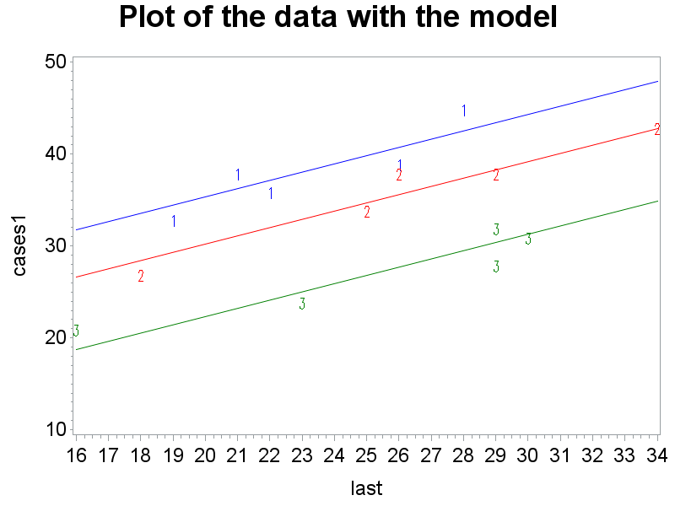
Crackers Example: Plot with model (cont)
X

Slide 28
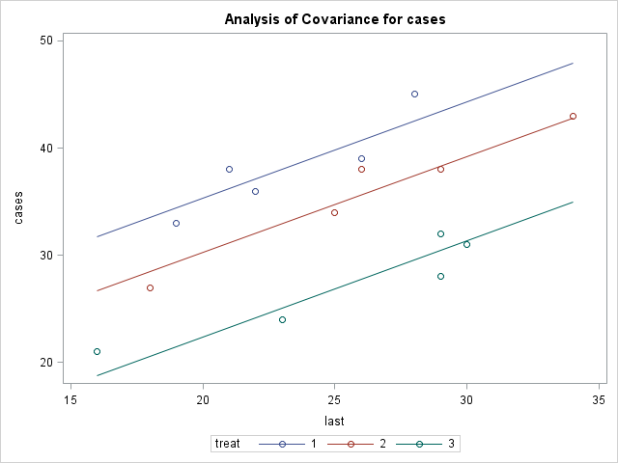
Crackers Example: Plot with model (cont)

Slide 29
Crackers Example: Plot without covariate
title1 h=3 'No covariate';
proc glm data=crackers;
class treat;
model cases=treat;
output out=nocov p=pred;
run;
symbol1 v=circle i=none c=blue;
symbol2 v=none i=join c=blue;
proc gplot data=nocov;
plot (cases pred)*treat/overlay vaxis=axis2;
run;

Slide 30
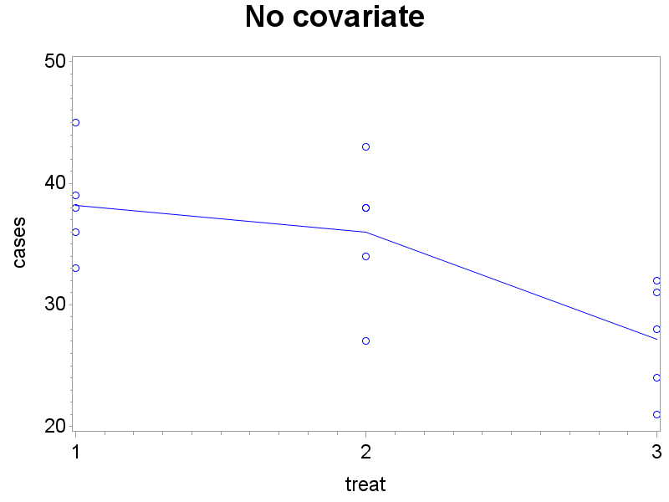
Crackers Example: Plot without covariate (cont)

Slide 31
Crackers Example: Non-constant slope
title1 'Check for equal slopes';
proc glm data=crackers;
class treat;
model cases=last treat last*treat;
run;

Slide 32
Crackers Example: slope (cont)
Source | DF | Sum of Squares | Mean Square | F Value | Pr > F
Model | 5 | 614.8791646 | 122.9758329 | 35.11 | <.0001
Error | 9 | 31.5208354 | 3.5023150
Corrected Total | 14 | 646.4000000
R-Square | Coeff Var | Root MSE | cases Mean
0.951236 | 5.536826 | 1.871447 | 33.80000
Source | DF | Type I SS | Mean Square | F Value | Pr > F
last | 1 | 190.6777778 | 190.6777778 | 54.44 | <.0001
treat | 2 | 417.1509137 | 208.5754568 | 59.55 | <.0001
last*treat | 2 | 7.0504731 | 3.5252366 | 1.01 | 0.4032
Source | DF | Type III SS | Mean Square | F Value | Pr > F
last | 1 | 243.1412380 | 243.1412380 | 69.42 | <.0001
treat | 2 | 1.2632832 | 0.6316416 | 0.18 | 0.8379
last*treat | 2 | 7.0504731 | 3.5252366 | 1.01 | 0.4032

Slide 33
Crackers Example: Y’
data crackerdiff;
set crackers;
casediff = cases - last;
proc glm data=crackerdiff;
class treat;
model casediff = treat;
means treat / tukey;
run;

Slide 34
Crackers Example: Y’ (cont)
Source | DF | Sum of Squares | Mean Square | F Value | Pr > F
Model | 2 | 440.4000000 | 220.2000000 | 62.91 | <.0001
Error | 12 | 42.0000000 | 3.5000000
Corrected Total | 14 | 482.4000000
R-Square | Coeff Var | Root MSE | casediff Mean
0.912935 | 21.25942 | 1.870829 | 8.800000
Means with the same letter are not significantly different.
Tukey Grouping | Mean | N | treat
A | 15.000 | 5 | 1
B | 9.600 | 5 | 2
C | 1.800 | 5 | 3

Slide 35
Crackers Example: Comparison of Y and Y’
treat | cases LSMEAN | Standard Error | Pr > |t| | LSMEAN Number
1 | 39.8174070 | 0.8575507 | <.0001 | 1
2 | 34.7420168 | 0.8496605 | <.0001 | 2
3 | 26.8405762 | 0.8384392 | <.0001 | 3
Means with the same letter are not significantly different.
Tukey Grouping | Mean | N | treat
A | 15.000 | 5 | 1
B | 9.600 | 5 | 2
C | 1.800 | 5 | 3

Slide 36
Cash Example: Problem 22.15, nknw1038.sas
Y = offer made by a dealer on a used car (units $100)
used car was ONE medium-priced, six-year old car
Factor A = age of person selling the car
(young, middle, elderly)
Factor B = gender of person selling the car
(male, female)
n = 6
X = overall sales volume for the dealer

Slide 37
Cash Example: Input
data cash;
infile ‘H:\My Documents\Stat 512\CH22PR15.DAT';
input offer age gender rep sales;
proc print;run;
Obs | offer | age | gender | rep | sales
1 | 21 | 1 | 1 | 1 | 3.0
2 | 23 | 1 | 1 | 2 | 5.1
3 | 19 | 1 | 1 | 3 | 1.0
4 | 22 | 1 | 1 | 4 | 4.4
5 | 22 | 1 | 1 | 5 | 2.7
6 | 23 | 1 | 1 | 6 | 4.9
7 | 21 | 1 | 2 | 1 | 3.5
8 | 22 | 1 | 2 | 2 | 4.2
9 | 20 | 1 | 2 | 3 | 2.2
⁞ | ⁞ | ⁞ | ⁞ | ⁞ | ⁞

Slide 38
Cash Example: scatterplot (without covariate)
data cashplot; set cash;
if age=1 and gender=1 then factor = '1_youngmale';
if age=2 and gender=1 then factor = '2_midmale';
if age=3 and gender=1 then factor = '3_eldmale';
if age=1 and gender=2 then factor = '4_youngfemale';
if age=2 and gender=2 then factor = '5_midfemale';
if age=3 and gender=2 then factor = '6_eldfemale';
title1 h=3 'Plot of Offers against Factor Combinations w/o Covariate';
axis1 label=(h=2);
axis2 label=(h=2 angle=90);
proc gplot data=cashplot;
plot offer*factor/haxis=axis1 vaxis=axis2;
run;

Slide 39
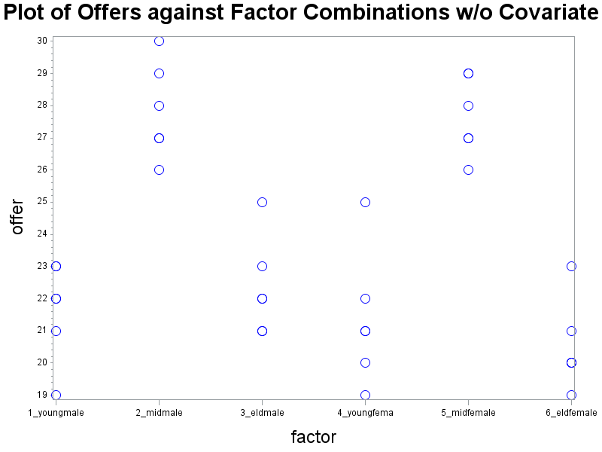
Cash Example: scatterplot (without covariate) (cont)

Slide 40
Cash Example: ANOVA (without covariate)
proc glm data=cash;
class age gender;
model offer = age|gender;
means age gender /tukey;
run;

Slide 41
Cash Example: ANOVA (without covariate) (cont)
Source | DF | Sum of Squares | Mean Square | F Value | Pr > F
Model | 5 | 327.2222222 | 65.4444444 | 27.40 | <.0001
Error | 30 | 71.6666667 | 2.3888889
Corrected Total | 35 | 398.8888889
R-Square | Coeff Var | Root MSE | offer Mean
0.820334 | 6.561523 | 1.545603 | 23.55556
Source | DF | Type III SS | Mean Square | F Value | Pr > F
age | 2 | 316.7222222 | 158.3611111 | 66.29 | <.0001
gender | 1 | 5.4444444 | 5.4444444 | 2.28 | 0.1416
age*gender | 2 | 5.0555556 | 2.5277778 | 1.06 | 0.3597

Slide 42
Cash Example: ANOVA (without covariate) (cont)
Means with the same letter are not significantly different.
Tukey Grouping | Mean | N | age
A | 27.7500 | 12 | 2
B | 21.5000 | 12 | 1
B
B | 21.4167 | 12 | 3

Slide 43
Cash Example: scatterplot (with covariate)
symbol1 v=A h=1.5 c=black;
symbol2 v=B h=1.5 c=red;
symbol3 v=C h=1.5 c=blue;
symbol4 v=D h=1.5 c=green;
symbol5 v=E h=1.5 c=purple;
symbol6 v=F h=1.5 c=orange;
title 'Plot of Offers vs Sales by Factor';
proc gplot data=cashplot;
plot offer*sales=factor/haxis=axis1 vaxis=axis2;
run;

Slide 44
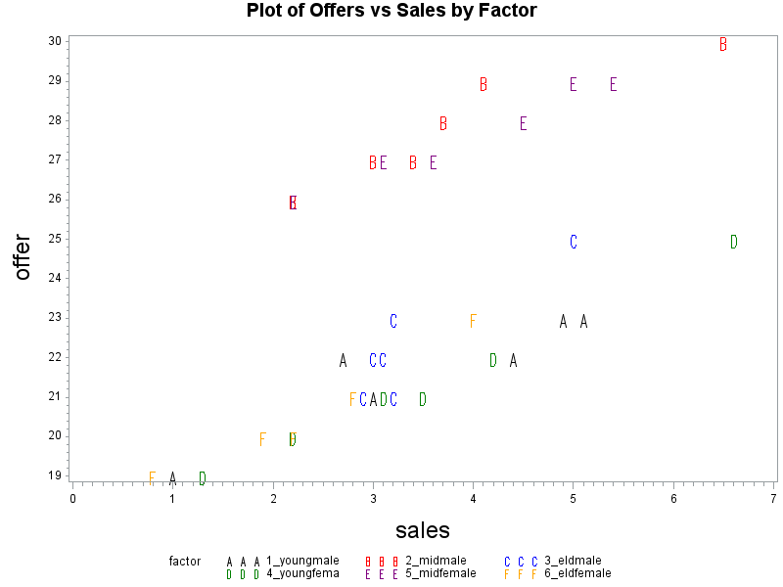
Cash Example: scatterplot (with covariate) (cont)

Slide 45
Cash Example: ANCOVA (with covariate)
proc glm data=cash;
class age gender;
model offer=sales age|gender;
lsmeans age gender /tdiff pdiff cl adjust=tukey;
run;

Slide 46
Cash Example: ANOVA (with covariate) (cont)
Source | DF | Sum of Squares | Mean Square | F Value | Pr > F
Model | 6 | 390.5947948 | 65.0991325 | 227.62 | <.0001
Error | 29 | 8.2940941 | 0.2860032
Corrected Total | 35 | 398.8888889
R-Square | Coeff Var | Root MSE | offer Mean
0.979207 | 2.270346 | 0.534793 | 23.55556

Slide 47
Cash Example: ANOVA (with covariate) (cont)
 | DF | Type I SS | Mean Square | F Value | Pr > F
sales | 1 | 157.3659042 | 157.3659042 | 550.22 | <.0001
age | 2 | 231.5192596 | 115.7596298 | 404.75 | <.0001
gender | 1 | 1.5148664 | 1.5148664 | 5.30 | 0.0287
age*gender | 2 | 0.1947646 | 0.0973823 | 0.34 | 0.7142
Source | DF | Type III SS | Mean Square | F Value | Pr > F
sales | 1 | 63.3725725 | 63.3725725 | 221.58 | <.0001
age | 2 | 232.4894513 | 116.2447257 | 406.45 | <.0001
gender | 1 | 1.5452006 | 1.5452006 | 5.40 | 0.0273
age*gender | 2 | 0.1947646 | 0.0973823 | 0.34 | 0.7142

Slide 48
Cash Example: ANOVA (with covariate) (cont)
age | offer LSMEAN | LSMEAN Number
1 | 21.4027214 | 1
2 | 27.2370766 | 2
3 | 22.0268687 | 3
Least Squares Means for Effect age t for H0: LSMean(i)=LSMean(j) / Pr > |t| Dependent Variable: offer
i/j | 1 | 2 | 3
1 |  | -26.507 | -2.79334
 |  | <.0001 | 0.0241
2 | 26.50696 |  | 22.55522
 | <.0001 |  | <.0001
3 | 2.793336 | -22.5552
 | 0.0241 | <.0001

Slide 49
Cash Example: ANOVA (with covariate) (cont)
gender | offer LSMEAN | H0:LSMean1=LSMean2
 |  | t Value | Pr > |t|
1 | 23.7646265 | 2.32 | 0.0273
2 | 23.3464846
gender | offer LSMEAN | 95% Confidence Limits
1 | 23.764626 | 23.505640 | 24.023613
2 | 23.346485 | 23.087499 | 23.605471
Least Squares Means for Effect gender
i | j | Difference Between Means | Simultaneous 95% Confidence Limits for LSMean(i)-LSMean(j)
1 | 2 | 0.418142 | 0.050220 | 0.786063

