Slide 1
Example: Price Analysis for Diamond Rings in Singapore
Variables
Response Variable: Price in Singapore dollars (Y)
Explanatory Variable: Weight of diamond in carats (X)
Goals
Create a scatterplot
Fit a regression line
Predict the price of a sale for a 0.43 carat diamond ring

Slide 2
diamond.sas (input)
ods html close;
ods html;
data diamonds; input weight price @@;
cards;
.17 355 .16 328 .17 350 .18 325 .25 642 .16 342 .15 322 .19 485
.21 483 .15 323 .18 462 .28 823 .16 336 .20 498 .23 595 .29 860
.12 223 .26 663 .25 750 .27 720 .18 468 .16 345 .17 352 .16 332
.17 353 .18 438 .17 318 .18 419 .17 346 .15 315 .17 350 .32 918
.32 919 .15 298 .16 339 .16 338 .23 595 .23 553 .17 345 .33 945
.25 655 .35 1086 .18 443 .25 678 .25 675 .15 287 .26 693 .15 316
.43 .
;
data diamonds1;
set diamonds;
if price ne .;

Slide 3
diamonds.sas (print out)
proc print data=diamonds;
run;
Obs | weight | price
1 | 0.17 | 355
2 | 0.16 | 328
3 | 0.17 | 350
4 | 0.18 | 325
47 | 0.26 | 693
48 | 0.15 | 316
49 | 0.43 | .

Slide 4
diamonds.sas (scatterplot)
proc sort data=diamonds1; by weight;
symbol1 v=circle i=sm70;
title1 'Diamond Ring Price Study';
title2 'Scatter plot of Price vs. Weight with Smoothing Curve';
axis1 label=('Weight (Carats)');
axis2 label=(angle=90 'Price (Singapore $$)');
proc gplot data=diamonds1;
plot price*weight / haxis=axis1 vaxis=axis2;
run;

Slide 5
diamonds.sas (scatterplot, cont)

Slide 6
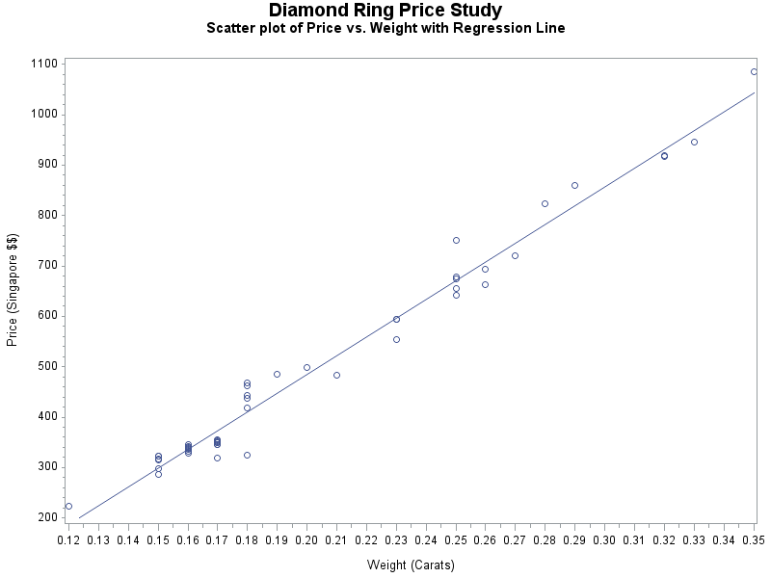
diamonds.sas (linear regression line)
symbol1 v=circle i=rl;
title2 'Scatter plot of Price vs. Weight with Regression Line';
proc gplot data=diamonds1;
plot price*weight / haxis=axis1 vaxis=axis2;
run;

Slide 7
diamonds.sas (linear regression)
proc reg data=diamonds;
model price=weight/clb p r;
output out=diag p=pred r=resid;
id weight;
run;

Slide 8
diamonds.sas (linear regression, cont)
Analysis of Variance
Source | DF | Sum of Squares | Mean Square | F Value | Pr > F
Model | 1 | 2098596 | 2098596 | 2069.99 | <.0001
Error | 46 | 46636 | 1013.81886
Corrected Total | 47 | 2145232
Root MSE | 31.84052 | R-Square | 0.9783
Dependent Mean | 500.08333 | Adj R-Sq | 0.9778
Coeff Var | 6.36704
Parameter Estimates
Variable | DF | Parameter Estimate | Standard Error | t Value | Pr > |t| | 95% Confidence Limits
Intercept | 1 | -259.62591 | 17.31886 | -14.99 | <.0001 | -294.48696 | -224.76486
weight | 1 | 3721.02485 | 81.78588 | 45.50 | <.0001 | 3556.39841 | 3885.65129

Slide 9
diamonds.sas (linear regression, cont)
proc print data=diag;
run;
Output Statistics
Obs | weight | Dependent Variable | Predicted Value | Std Error Mean Predict | Residual | Std Error Residual | Student Residual
1 | 0.17 | 355.0000 | 372.9483 | 5.3786 | -17.9483 | 31.383 | -0.572
2 | 0.16 | 328.0000 | 335.7381 | 5.8454 | -7.7381 | 31.299 | -0.247
3 | 0.17 | 350.0000 | 372.9483 | 5.3786 | -22.9483 | 31.383 | -0.731
4 | 0.18 | 325.0000 | 410.1586 | 5.0028 | -85.1586 | 31.445 | -2.708
5 | 0.25 | 642.0000 | 670.6303 | 5.9307 | -28.6303 | 31.283 | -0.915
46 | 0.15 | 287.0000 | 298.5278 | 6.3833 | -11.5278 | 31.194 | -0.370
47 | 0.26 | 693.0000 | 707.8406 | 6.4787 | -14.8406 | 31.174 | -0.476
48 | 0.15 | 316.0000 | 298.5278 | 6.3833 | 17.4722 | 31.194 | 0.560
49 | 0.43 | . | 1340 | 19.0332 | . | . | .

Slide 10
diamonds.sas (linear regression)
proc reg data=diamonds;
model price=weight/clb p r;
output out=diag p=pred r=resid;
id weight;
run;

Slide 11
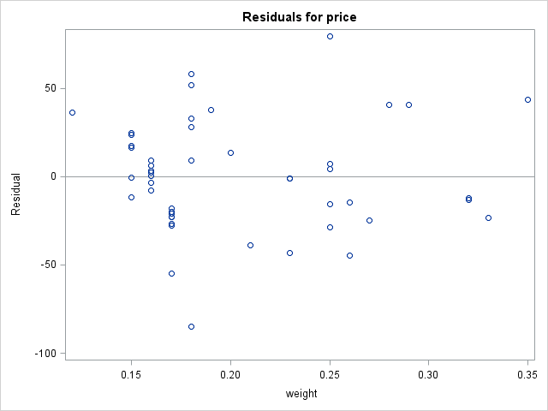
diamond.sas (Residual plot - automatic)

Slide 12
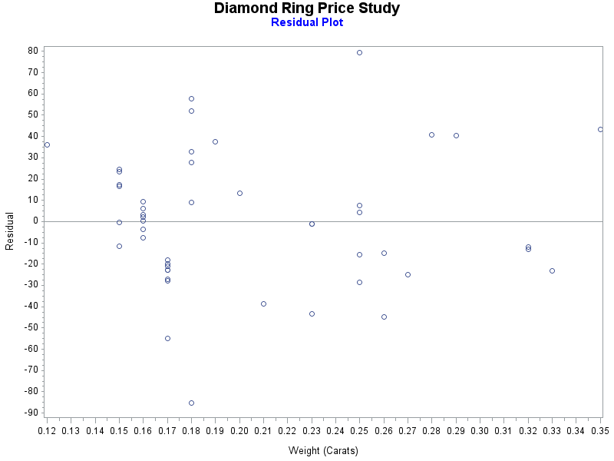
diamond.sas (Residual plot)
symbol1 v=circle i=NONE;
title2 color=blue 'Residual Plot';
axis2 label=(angle=90 'Residual');
proc gplot data=diag; plot resid*weight / haxis=axis1
vaxis=axis2 vref=0;
where price ne .;
run;

Slide 13
Least Squares Solutions
b₀ = Y̅ - b₁X̅

Slide 14
Estimation of σ²

Slide 15
Maximum Likelihood Method
Y_{i} ~ N(β₀ + β₁X_{i}, σ²)
L = f₁ x f₂ x … x f_{n} – likelihood function

Slide 16
diamonds.sas (linear regression, cont)
Analysis of Variance
Source | DF | Sum of Squares | Mean Square | F Value | Pr > F
Model | 1 | 2098596 | 2098596 | 2069.99 | <.0001
Error | 46 | 46636 | 1013.81886
Corrected Total | 47 | 2145232
Root MSE | 31.84052 | R-Square | 0.9783
Dependent Mean | 500.08333 | Adj R-Sq | 0.9778
Coeff Var | 6.36704
Parameter Estimates
Variable | DF | Parameter Estimate | Standard Error | t Value | Pr > |t| | 95% Confidence Limits
Intercept | 1 | -259.62591 | 17.31886 | -14.99 | <.0001 | -294.48696 | -224.76486
weight | 1 | 3721.02485 | 81.78588 | 45.50 | <.0001 | 3556.39841 | 3885.65129

Slide 17
Parameter Estimates (SAS)
proc reg data=diamonds;
model price=weight/clb;
Parameter Estimates
Variable | DF | Parameter Estimate | Standard Error | t Value | Pr > |t| | 95% Confidence Limits
Intercept | 1 | -259.62591 | 17.31886 | -14.99 | <.0001 | -294.48696 | -224.76486
weight | 1 | 3721.02485 | 81.78588 | 45.50 | <.0001 | 3556.39841 | 3885.65129

Slide 18
Summary of Inference
Y_{i} = β₀ + β₁X_{i} + ε_{I}
ε_{I} ~ N(0,σ²) are independent, random errors
Parameter Estimators:
β₀: b₀ = Y̅ - b₁X̅

Slide 19
Summary of Inference (cont)
 | β₁ | β₀
Confidence Intervals | b₁ ± t_{c}s{b₁} | b₀ ± t_{c}s{b₀}
 | t_{c} = t_{n-2}(1 - α/2) with df = n - 2
Significance Tests | H₀: β₁ = 0 H_{a}: β₁ ≠ 0 | H₀: β₀ = 0 H_{a}: β₀ ≠ 0
Reject H₀ if the p-value is small (≤ α (0.05))

Slide 20
Power: Example (nknw055.sas)
Toluca Company (details of study: section 1.6),
Response variable: Work hours
Explanatory variable: Lot size
Assume:
σ² = 2500 n = 25 SS_{XX} = 19800
Calculate power when β₁ = 1.5

Slide 21
Power: Example (SAS)
data a1;
n=25; sig2=2500; ssx=19800; alpha=.05;
sig2b1=sig2/ssx; df=n-2;
beta1=1.5;
delta=abs(beta1)/sqrt(sig2b1);
tstar=tinv(1-alpha/2,df);
power=1-probt(tstar,df,delta)+probt(-tstar,df,delta);
output;
proc print data=a1;run;
Obs | n | sig2 | ssx | alpha | sig2b1 | df | beta1 | delta | tstar | power
1 | 25 | 2500 | 19800 | 0.05 | 0.12626 | 23 | 1.5 | 4.22137 | 2.06866 | 0.98121

Slide 22
Power: Example (SAS, cont)
data a2;
n=25; sig2=2500; ssx=19800; alpha=.05;
sig2b1=sig2/ssx; df=n-2;
do beta1=-2.0 to 2.0 by .05;
delta=abs(beta1)/sqrt(sig2b1);
tstar=tinv(1-alpha/2,df);
power=1-probt(tstar,df,delta)
+probt(-tstar,df,delta);
output;
end;
proc print data=a2;run;
title1 'Power for the slope in simple linear regression';
symbol1 v=none i=join;
proc gplot data=a2;
plot power*beta1;
run;

Slide 23
Power: Example (SAS, cont)

Slide 24
σ²{Ŷ_{h}} – distance from X̅

Slide 25
Estimation of E{Y_{h}}: (nknw060.sas)
data a1;
infile 'I:\My Documents\Stat 512\CH01TA01.DAT';
input size hours;
run;
data a2; size=65; output;
size=100; output;
data a3; set a1 a2;
proc print data=a3; run;
proc reg data=a3;
model hours=size/clm;
id size;
run;
quit;

Slide 26
Estimation of E{Y_{h}}: Example (cont)
Output Statistics
Obs | size | Dependent Variable | Predicted Value | Std Error Mean Predict | 95% CL Mean |  | Residual
25 | 70 | 323.0000 | 312.2800 | 9.7647 | 292.0803 | 332.4797 | 10.7200
26 | 65 | . | 294.4290 | 9.9176 | 273.9129 | 314.9451 | .
27 | 100 | . | 419.3861 | 14.2723 | 389.8615 | 448.9106 | .

Slide 27
Estimation of E{Y_{h(new)}}: (nknw065.sas)
data a1;
infile 'H:/Stat512/Datasets/CH01TA01.DAT';
input size hours;
data a2; size=65; output;
size=100; output;
data a3; set a1 a2;
proc reg data=a3;
model hours=size/cli;
id size;
run;

Slide 28
Estimation of E{Y_{h(new)}}: Example (cont)
Output Statistics
Obs | size | Dependent Variable | Predicted Value | Std Error Mean Predict | 95% CL Predict |  | Residual
25 | 70 | 323.0000 | 312.2800 | 9.7647 | 209.2811 | 415.2789 | 10.7200
26 | 65 | . | 294.4290 | 9.9176 | 191.3676 | 397.4904 | .
27 | 100 | . | 419.3861 | 14.2723 | 314.1604 | 524.6117 | .

Slide 29
Confidence Band (nknw065x.sas)
data a1;
infile 'H:/My Documents/Stat 512/CH01TA01.DAT';
input size hours;
data a2; size=65; output;
size=100; output;
data a3; set a1 a2;
proc reg data=a3 alpha=0.10;
model hours=size;
run;
quit;

Slide 30
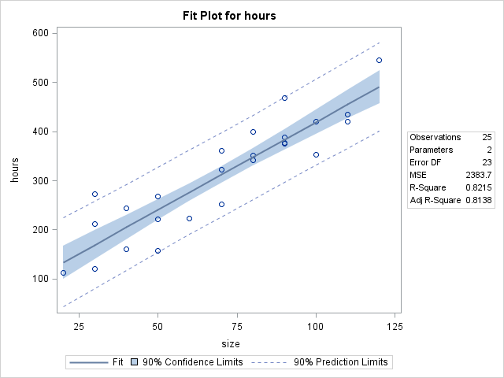
Confidence Band and Prediction Band

Slide 31
Confidence Band (nknw067.sas): Example (find t)
data a1; n=25; alpha=.10; dfn=2; dfd=n-2;
w2=2*finv(1-alpha,dfn,dfd);
w=sqrt(w2); alphat=2*(1-probt(w,dfd));
tstar=tinv(1-alphat/2, dfd); CL = 1 - alphat;
output;
proc print data=a1;run;
Obs | n | alpha | dfn | dfd | w2 | w | alphat | tstar | CL
1 | 25 | 0.1 | 2 | 23 | 5.09858 | 2.25800 | 0.033740 | 2.25800 | 0.96626

Slide 32
Confidence Band: Example (cont)
data a2;
infile ‘H:/STAT 512/CH01TA01.DAT';
input size hours;
title1 '90% Confidence Band';
symbol1 v=circle i=rlclm97;
proc gplot data=a2;
plot hours*size;
run;

Slide 33
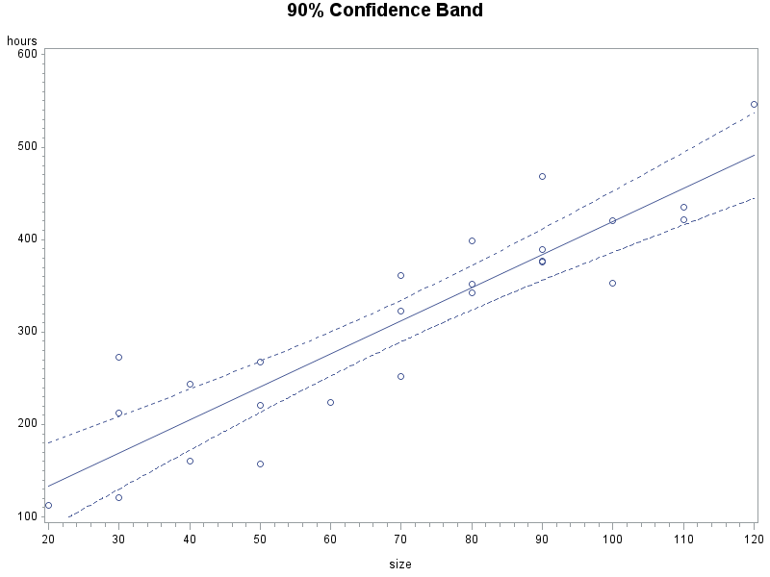
Confidence Band: Example (cont)

Slide 34
Estimation of E(Y_{h}) vs. Prediction of Y_{y}

Slide 35
Confidence Band and Prediction Band

Slide 36
CI vs. Prediction: (still nknw067.sas)
*rlclm is for the mean or confidence band (blue) and rlcli is for the individual plots or prediction band (red);
title1 '90% Confidence Band and prediction band';
title2 'Confidence band is in blue and prediction band is in red';
symbol1 v=circle i=rlclm97 c=blue;
symbol2 v=none i=rlcli97 ci=red;
proc gplot data=a1;
plot hours*size hours*size/overlay;
run;
/*The above code is equivalent to
proc gplot data=a1;
plot hours*size;
plot2 hours*size;
run; */

Slide 37
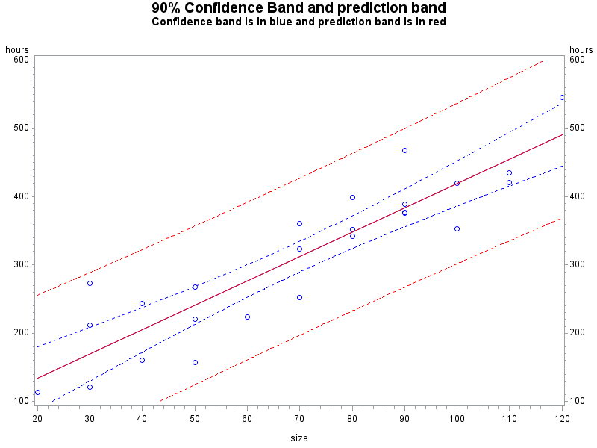
CI vs. Prediction: Example (cont)

Slide 38
ANOVA table for SLR
Source | df | SS | MS
Model (Regression) | 1 | Σ(Ŷ_{i} - Y̅)²
Error | n – 2 | Σ(Y_{i} - Ŷ_{i})²
Total | n - 1 | Σ(Y_{i} - Y̅)²

Slide 39
ANOVA table for SLR (cont)
Source | df | SS | MS | F | p
Model (Regression) | 1 | Σ(Ŷ_{i} - Y̅)² |  |  | p
Error | n – 2 | Σ(Y_{i} - Ŷ_{i})²
Total | n - 1 | Σ(Y_{i} - Y̅)²

Slide 40
ANOVA table: nknw065.sas (modified)
data a1;
infile 'H:/My Documents/Stat 512/CH01TA01.DAT';
input size hours;
proc reg data=a1;
model hours=size;
run;
Analysis of Variance
Source | DF | Sum of Squares | Mean Square | F Value | Pr > F
Model | 1 | 252378 | 252378 | 105.88 | <.0001
Error | 23 | 54825 | 2383.71562
Corrected Total | 24 | 307203
Parameter Estimates
Variable | DF | Parameter Estimate | Standard Error | t Value | Pr > |t|
Intercept | 1 | 62.36586 | 26.17743 | 2.38 | 0.0259
size | 1 | 3.57020 | 0.34697 | 10.29 | <.0001

Slide 41
Correlation: nknw065.sas
Analysis of Variance
Source | DF | Sum of Squares | Mean Square | F Value | Pr > F
Model | 1 | 252378 | 252378 | 105.88 | <.0001
Error | 23 | 54825 | 2383.71562
Corrected Total | 24 | 307203
Root MSE | 48.82331 | R-Square | 0.8215
Dependent Mean | 312.28000 | Adj R-Sq | 0.8138
Coeff Var | 15.63447

Slide 42
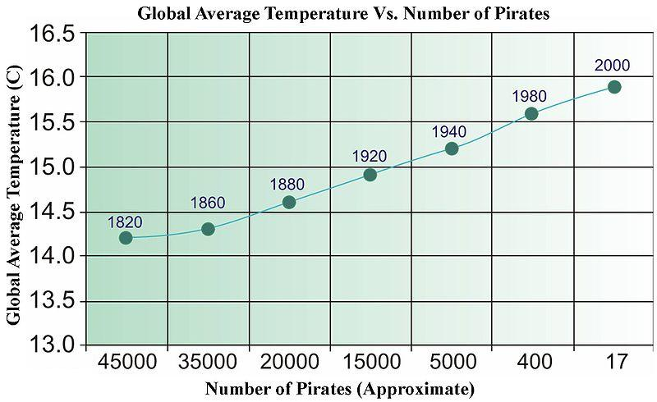
Regression and Causality
http://stats.stackexchange.com/questions/10687/does-simple-linear-regression-imply-causation

