Slide 1


9
Inferences Based on Two Samples
Copyright © Cengage Learning. All rights reserved.
http://www.zazzle.com/mean+boss+cards

Slide 2
Two-sample z tests: Assumptions
X₁, …, X_{n1} is a random sample from a distribution with mean μ₁ and standard deviation σ₁.
Y₁, …, Y_{n2} is a random sample from a distribution with mean μ₂ and standard deviation σ₂.
X and Y are independent of each other.

Slide 3
2-Sample z-test; known variances: Summary
Null hypothesis: H₀: μ₁ – μ₂ = Δ₀
Test statistic:
P-values are calculated as before for z tests.
 | Alternative Hypothesis | Rejection Region for Level α Test
upper-tailed | H_{a}: μ₁ – μ₂ > Δ₀ | z ≥ z_{α}
lower-tailed | H_{a}: μ₁ – μ₂ < Δ₀ | z ≤ -z_{α}
two-tailed | H_{a}: μ₁ – μ₂ ≠ Δ₀ | z ≥ z_{α/2} OR z ≤ -z_{α/2}

Slide 4
β(Δ’) Summary

Slide 5
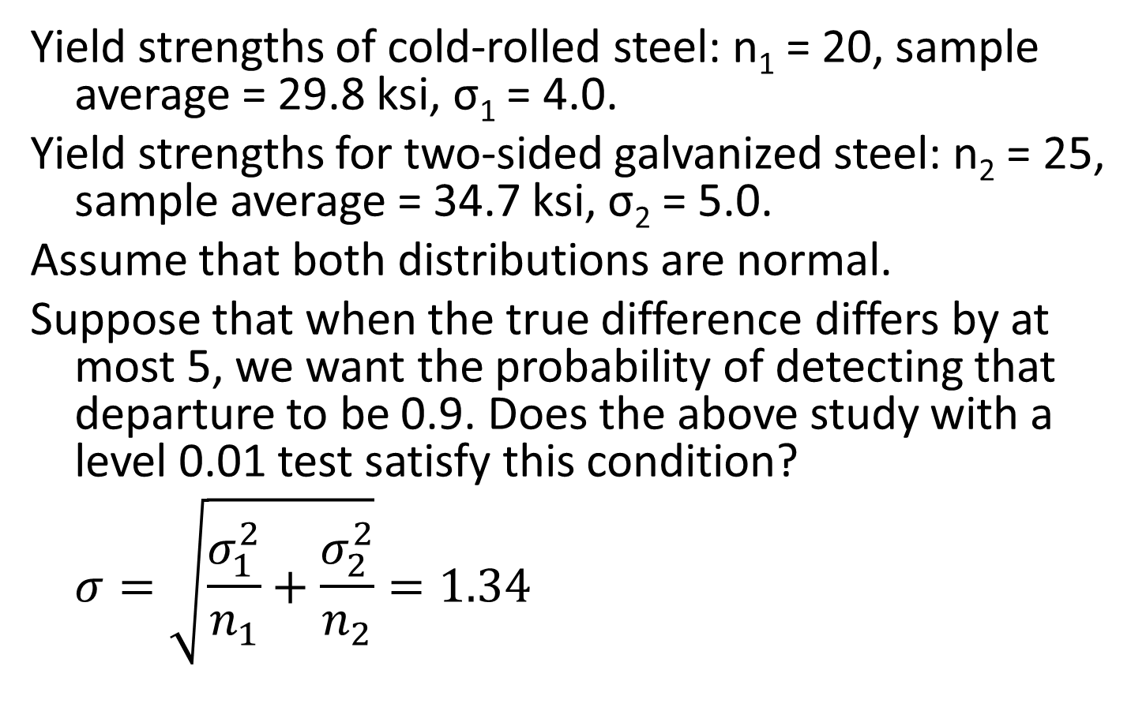
Example 9.3: Difference, z-test, known σ
Yield strengths of cold-rolled steel: n₁ = 20, sample average = 29.8 ksi, σ₁ = 4.0.
Yield strengths for two-sided galvanized steel: n₂ = 25, sample average = 34.7 ksi, σ₂ = 5.0.
Assume that both distributions are normal.
Suppose that when the true difference differs by at most 5, we want the probability of detecting that departure to be 0.9. Does the above study with a level 0.01 test satisfy this condition?
$$σ=\sqrt{\frac{σ_{1}^{2}}{n_{1}}+\frac{σ_{2}^{2}}{n_{2}}}=1.34$$

Slide 6
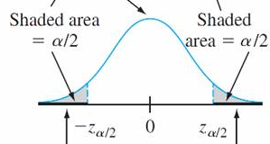
β calculation (cont)

Slide 7
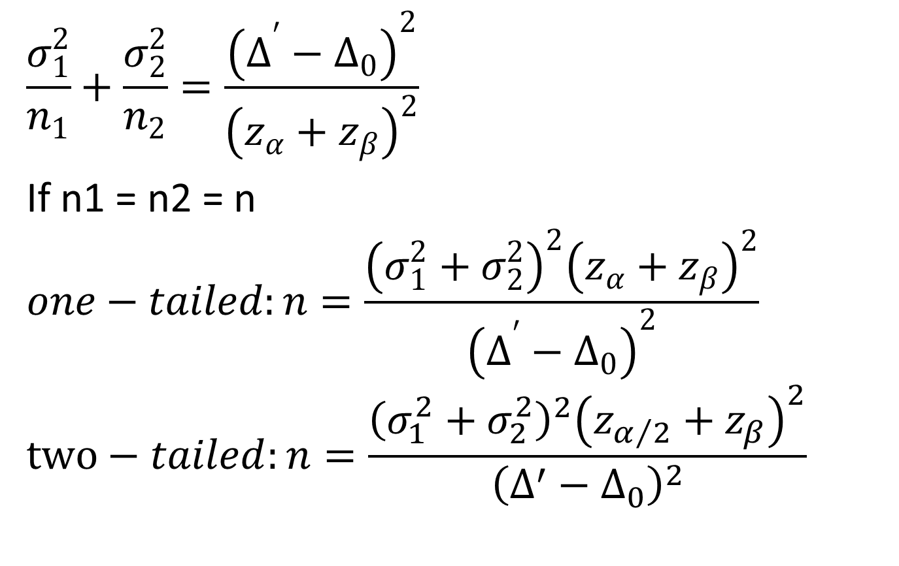
Calculation of n
$$\frac{σ_{1}^{2}}{n_{1}}+\frac{σ_{2}^{2}}{n_{2}}=\frac{{\left(Δ^{′}−Δ_{0}\right)}^{2}}{{\left(z_{α}+z_{β}\right)}^{2}}$$
If n1 = n2 = n
$$one−tailed:n=\frac{{\left(σ_{1}^{2}+σ_{2}^{2}\right)}^{2}{\left(z_{α}+z_{β}\right)}^{2}}{{\left(Δ^{′}−Δ_{0}\right)}^{2}}$$
$$two−tailed:n=\frac{{\left(σ_{1}^{2}+σ_{2}^{2}\right)}^{2}{\left(z_{α/2}+z_{β}\right)}^{2}}{{\left(Δ^{′}−Δ_{0}\right)}^{2}}$$

Slide 8
Two-sample t tests: Assumptions
X₁, …, X_{n1} is a normal random sample from a distribution with mean μ₁ and standard deviation σ₁.
Y₁, …, Y_{n2} is a normal random sample from a distribution with mean μ₂ and standard deviation σ₂.
X and Y are independent of each other.

Slide 9
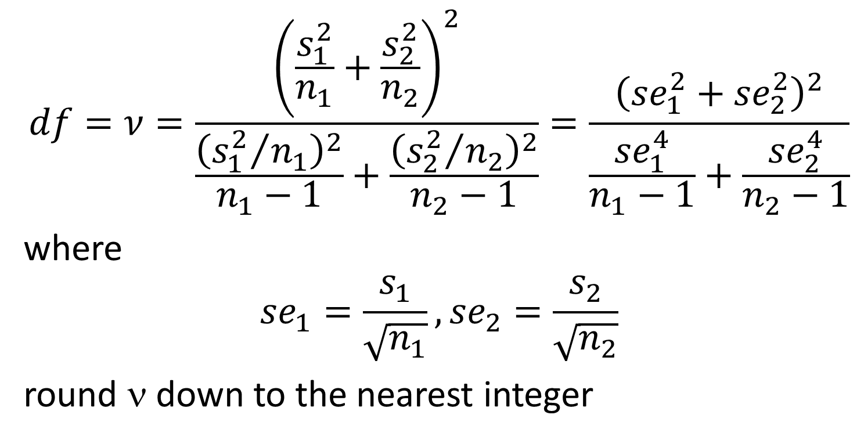
Two-sample t-test: df
$$df=ν=\frac{{\left(\frac{s_{1}^{2}}{n_{1}}+\frac{s_{2}^{2}}{n_{2}}\right)}^{2}}{\frac{{\left({s_{1}^{2}}/{n_{1}}\right)}^{2}}{n_{1}−1}+\frac{{\left({s_{2}^{2}}/{n_{2}}\right)}^{2}}{n_{2}−1}}=\frac{{\left({se}_{1}^{2}+{se}_{2}^{2}\right)}^{2}}{\frac{{se}_{1}^{4}}{n_{1}−1}+\frac{{se}_{2}^{4}}{n_{2}−1}}$$
where
$${se}_{1}=\frac{s_{1}}{\sqrt{n_{1}}}, {se}_{2}=\frac{s_{2}}{\sqrt{n_{2}}}$$
round ν down to the nearest integer

Slide 10
2-Sample t-test: Summary
Null hypothesis: H₀: μ₁ – μ₂ = Δ₀
Test statistic:
P-values are calculated as before for t tests.
 | Alternative Hypothesis | Rejection Region for Level α Test
upper-tailed | H_{a}: μ₁ – μ₂ > Δ₀ | t ≥ t_{α,ν}
lower-tailed | H_{a}: μ₁ – μ₂ < Δ₀ | t ≤ -t_{α,ν}
two-tailed | H_{a}: μ₁ – μ₂ ≠ Δ₀ | t ≥ t_{α/2,ν} OR t ≤ -t_{α/2,ν}

Slide 11
Example: Difference, t-test, CI
A group of 15 college seniors are selected to participate in a manual dexterity skill test against a group of 20 industrial workers. Skills are assessed by scores obtained on a test taken by both groups. The data is shown in the following table:
a) Conduct a hypothesis test to determine whether the industrial workers had better manual dexterity skills than the students at the 0.05 significance level.
b) Also construct a 95% confidence interval for this situation.
c) What is the appropriate bound?
Group | n | x̄ | s
Students | 15 | 35.12 | 4.31
Workers | 20 | 37.32 | 3.83

Slide 12
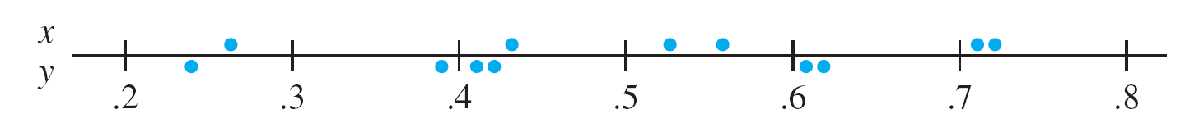
Paired t-test
Example 9.8. Trace metals in drinking water affect the flavor, and unusually high concentrations can pose a health hazard. The following is the results of a study in which six river locations were selected and the zinc concentrations in (mg/L) determined for both surface water and bottom water at each location. The six pairs of observations are displayed graphically below.

Slide 13
Paired two-sample t tests: Assumptions
The data consists of n independent pairs (X₁, Y₁), …, (X_{n}, Y_{n}) with E(X₁) = μ₁ and E(X₂) = μ₂
The differences of each of the pairs is called D. That is D_{i} = X_{i} – Y_{i}.
Assume that D is normally distributed with mean μ_{D} and standard deviation σ_{D}.

Slide 14
Paired t-test: Summary
Null hypothesis: H₀: μ_{D} = Δ₀
Test statistic:
P-values are calculated as before for t tests.
 | Alternative Hypothesis | Rejection Region for Level α Test
upper-tailed | H_{a}: μ_{D} > Δ₀ | t ≥ t_{α,n-1}
lower-tailed | H_{a}: μ_{D} < Δ₀ | t ≤ -t_{α,n-1}
two-tailed | H_{a}: μ_{D} ≠ Δ₀ | t ≥ t_{α/2,n-1} OR t ≤ -t_{α/2,n-1}

Slide 15
Example: Paired t test
In an effort to determine whether sensitivity training for nurses would improve the quality of nursing provided at an area hospital, the following study was conducted. Eight different nurses were selected and their nursing skills were given a score from 1 to 10. After this initial screening, a training program was administered, and then the same nurses were rated again. On the next slide is a table of their pre- and post-training scores.

Slide 16
Individual | Pre-Training | Post-Training | Pre - Post
1 | 2.56 | 4.54 | -1.98
2 | 3.22 | 5.33 | -2.11
3 | 3.45 | 4.32 | -0.87
4 | 5.55 | 7.45 | -1.90
5 | 5.63 | 7.00 | -1.37
6 | 7.89 | 9.80 | -1.91
7 | 7.66 | 5.33 | 2.33
8 | 6.20 | 6.80 | -0.60
mean | 5.27 | 6.32 | -1.05
stdev | 2.02 | 1.82 | 1.47

Slide 17
Example: Paired t-test
Conduct a test to determine whether the training could on average improve the quality of nursing provided in the population at a significance level of 0.05.
What is the appropriate 95% confidence interval or bound of the population mean difference in nursing scores?
What is the 95% confidence interval of the population mean difference in nursing scores?

Slide 18
Paired vs. Unpaired
If there is great heterogeneity between experimental units and a large correlation within paired units then a paired experiment is preferable.
If the experimental units are relatively homogeneous and the correlation within pairs is not large, then unpaired experiments should be used.

Slide 19
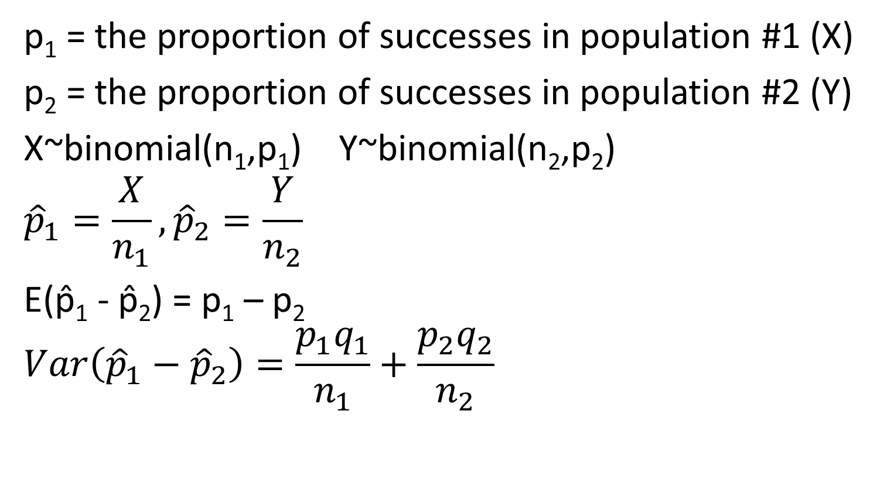
2-Sample z test: large sample size
p₁ = the proportion of successes in population #1 (X)
p₂ = the proportion of successes in population #2 (Y)
X~binomial(n₁,p₁) Y~binomial(n₂,p₂)
$${\hat{p}}_{1}=\frac{X}{n_{1}}, {\hat{p}}_{2}=\frac{Y}{n_{2}}$$
E(p̂₁ - p̂₂) = p₁ – p₂
$$Var\left({\hat{p}}_{1}−{\hat{p}}_{2}\right)=\frac{p_{1}q_{1}}{n_{1}}+\frac{p_{2}q_{2}}{n_{2}}$$

Slide 20
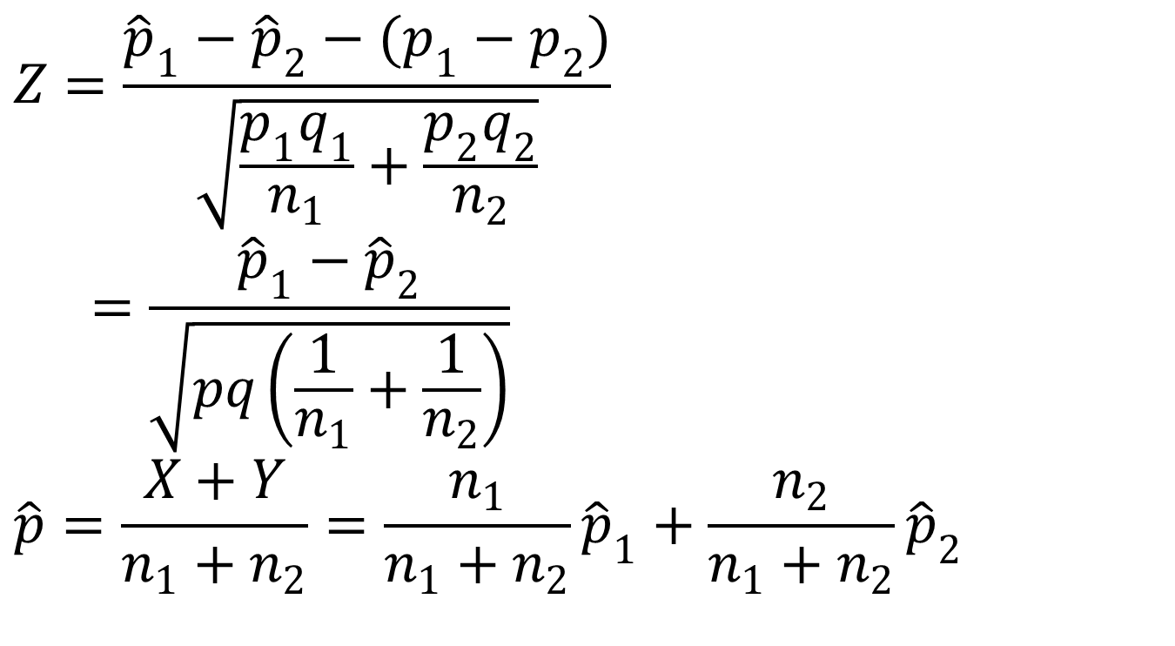
2-Sample z test: large sample size
$$Z=\frac{{\hat{p}}_{1}−{\hat{p}}_{2}−(p_{1}−p_{2})}{\sqrt{\frac{p_{1}q_{1}}{n_{1}}+\frac{p_{2}q_{2}}{n_{2}}}}$$
$$=\frac{{\hat{p}}_{1}−{\hat{p}}_{2}}{\sqrt{pq\left(\frac{1}{n_{1}}+\frac{1}{n_{2}}\right)}}$$
$$\hat{p}=\frac{X+Y}{n_{1}+n_{2}}=\frac{n_{1}}{n_{1}+n_{2}}{\hat{p}}_{1}+\frac{n_{2}}{n_{1}+n_{2}}{\hat{p}}_{2}$$

Slide 21
2-Sample z-test; large sample, proportions: Summary
Null hypothesis: H₀: p₁ – p₂ = 0
Test statistic:
P-values are calculated as before for z tests.
 | Alternative Hypothesis | Rejection Region for Level α Test
upper-tailed | H_{a}: p₁ – p₂ > 0 | z ≥ z_{α}
lower-tailed | H_{a}: p₁ – p₂ < 0 | z ≤ -z_{α}
two-tailed | H_{a}: p₁ – p₂ ≠ 0 | z ≥ z_{α/2} OR z ≤ -z_{α/2}

Slide 22
Example: Large Sample Proportion Test
Two TV commercials are developed for marketing a new product. A volunteer test sample of 200 people is randomly split into two groups of 100 each. In a controlled setting, Group A watches commercial A and Group B watches commercial B. In Group A, 25 say they would buy the product, in Group B, 20 say they would buy the product.
a) The marketing manager who devised this experiment concludes that commercial A is better. Do you agree or disagree with the marketing manager at a significance level of 0.05?

Slide 23
β(p₁,p₂) Summary

Slide 24
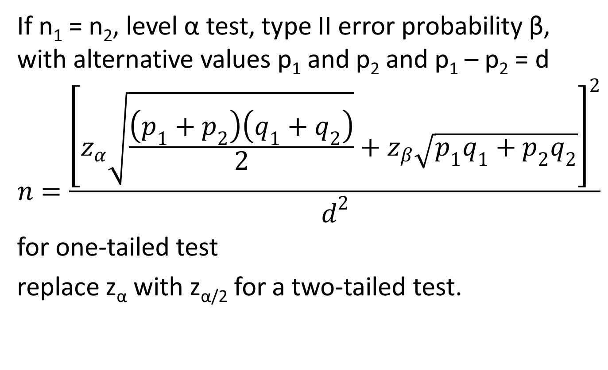
n for large sample proportions
If n₁ = n₂, level α test, type II error probability β, with alternative values p₁ and p₂ and p₁ – p₂ = d
$$n=\frac{{\left[z_{α}\sqrt{\frac{\left(p_{1}+p_{2}\right)\left(q_{1}+q_{2}\right)}{2}}+z_{β}\sqrt{p_{1}q_{1}+p_{2}q_{2}}\right]}^{2}}{d^{2}}$$
for one-tailed test
replace z_{α} with z_{α/2} for a two-tailed test.

Slide 25
Example: Large Sample Proportion Test
Two TV commercials are developed for marketing a new product. A volunteer test sample of 200 people is randomly split into two groups of 100 each. In a controlled setting, Group A watches commercial A and Group B watches commercial B. In Group A, 25 say they would buy the product, in Group B, 20 say they would buy the product.
b) What is the 95% confidence interval for the buying of the product for Group A and Group B?

Slide 26
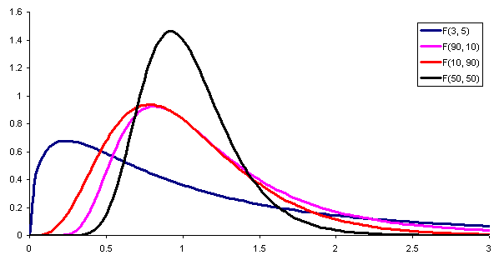
F distribution
http://www.vosesoftware.com/ModelRiskHelp/index.htm#Distributions/Continuous_distributions/F_distribution.htm
X

Slide 27
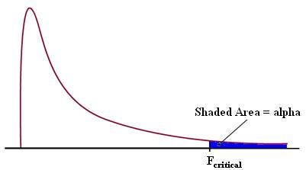
F curve and critical value
http://controls.engin.umich.edu/wiki/index.php/Factor_analysis_and_ANOVA
X

Slide 28
Table A.8 Critical Values for the F Distribution
X

