Slide 1


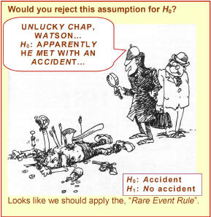
Tests of Hypotheses Based on a Single Sample
8
Copyright © Cengage Learning. All rights reserved.
http://www.rmower.com/statistics/Stat_HW/0801HW_sol.htm

Slide 2
Statistical Hypothesis
A statistical hypothesis is a claim either about the value of a single parameter (population characteristic or characteristic of a probability distribution), about the values of several parameters, or about the form of an entire probability distribution.
A test of hypotheses is a method for using sample data to decide whether the null hypothesis should be rejected.

Slide 3
Test Procedure
A test procedure is a rule, based on sample data, for deciding whether to reject H₀.
This procedure has the following:
A test statistic, a function of the sample data on which the decision (reject H₀ or do not reject H₀) is to be based
A rejection region, the set of all test statistic values for which H₀ will be rejected
      Decision rule: The null hypothesis will be rejected if and only if the observed or computed test statistic value falls in the rejection region

Slide 4
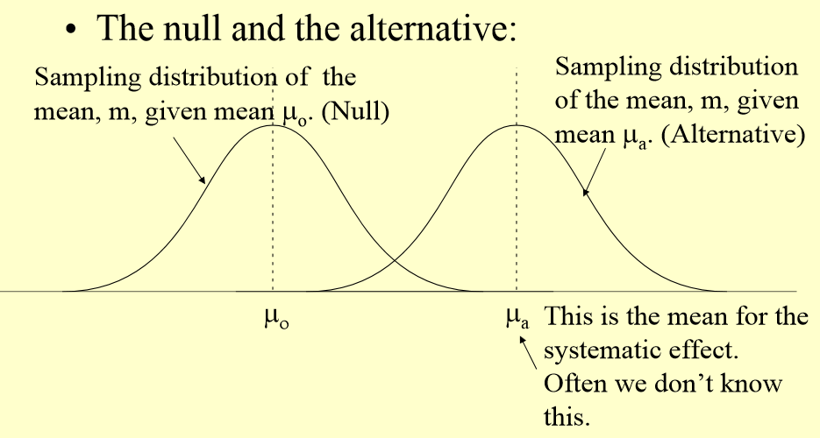
Type I vs. Type II errors (1)

Slide 5
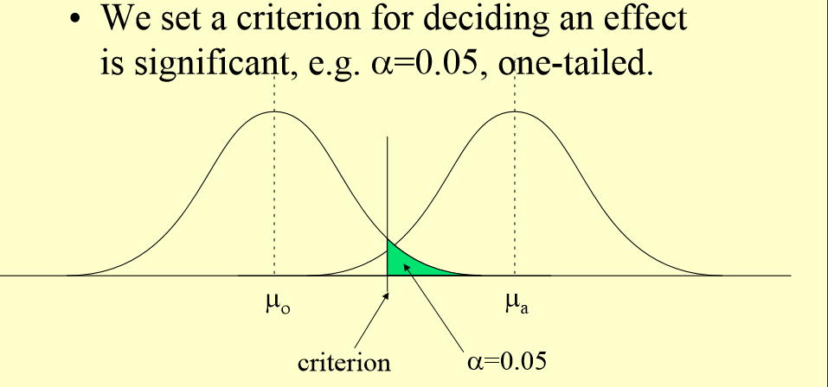
Type I vs. Type II errors (2)

Slide 6
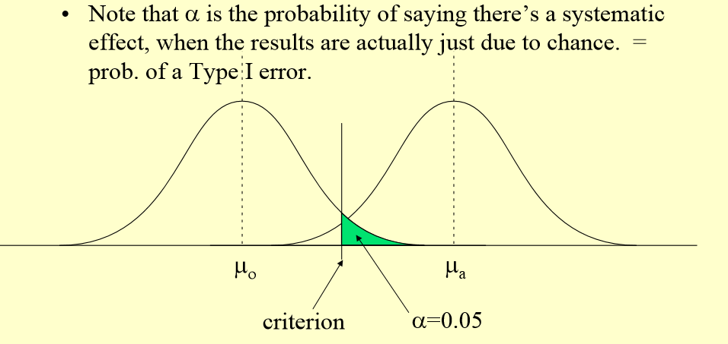
Type I vs. Type II errors (3)

Slide 7
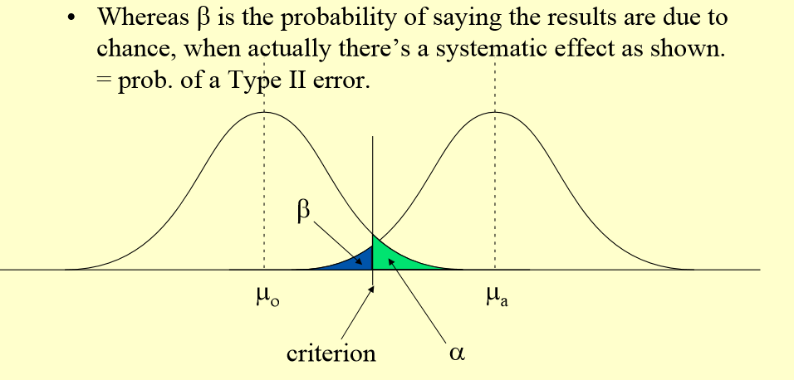
Type I vs. Type II errors (4)

Slide 8
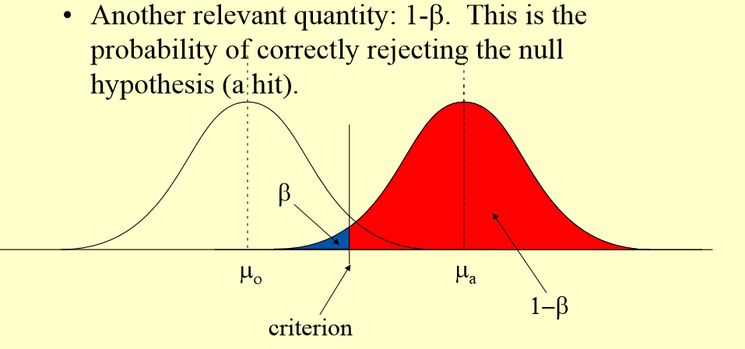
Type I vs. Type II errors (5)

Slide 9
Type I and Type II errors
X

Slide 10
Example 8.2: Type I/II Errors
The drying time of paint under a specified test conditions is known to be normally distributed with mean value 75 min and standard deviation 9 min. Chemists have proposed a new additive designed to decrease average drying time. It is believed that the new drying time will still be normally distributed with the same σ = 9 min.
a) What are the null and alternative hypotheses?
b) If the sample size is 25 and the rejection region is average mean ≤ 70.8, what is α?
c) What is β if μ = 72? If μ = 70?

Slide 11
Type I and Type II errors

Slide 12
Example 8.2: Type I/II Errors
The drying time of paint under a specified test conditions is known to be normally distributed with mean value 75 min and standard deviation 9 min. Chemists have proposed a new additive designed to decrease average drying time. It is believed that the new drying time will still be normally distributed with the same σ = 9 min.
a) What are the null and alternative hypotheses?
b) If the sample size is 25 and the rejection region is average mean ≤ 70.8, what is α?
c) What is β if μ = 72 if μ = 70?
d) What are α, β(72), β(70) if c = 72?

Slide 13
Type I vs. Type II errors (4)

Slide 14
Hypothesis Testing about a Parameter: Procedure
To be done BEFORE analyzing the data.
Identify the parameter of interest and describe it in the context of the problem situation.
Determine the null value and state the null hypothesis (2 in the book) and alternative hypothesis (3 in the book).
Select the significance level α.

Slide 15
Hypothesis Testing about a Parameter: Procedure (cont)
To be done AFTER obtaining the data.
Give the formula for the computed value of the test statistic (4 in the book) and substitute in the values (6 in the book).
Determine the rejection region.
Decide whether H₀ should be rejected (7 in the book) and why.

Slide 16
Hypothesis Testing about a Parameter: Procedure (cont)
State this conclusion in the problem context. (7 in the book).
The data does [not] give strong support to the claim that the [statement of H_{a} in words].

Slide 17
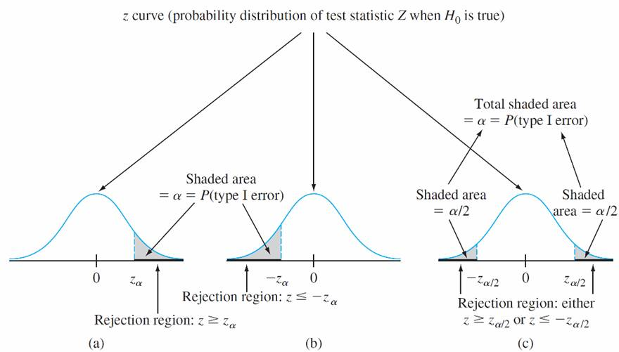
Rejection Regions:

Slide 18
Case I Summary (cont)

Slide 19
Case I: Summary
Null hypothesis: H₀: μ = μ₀
Test statistic:
 | Alternative Hypothesis | Rejection Region for Level α Test
upper-tailed | H_{a}: μ > μ₀ | z ≥ z_{α}
lower-tailed | H_{a}: μ < μ₀ | z ≤ -z_{α}
two-tailed | H_{a}: μ ≠ μ₀ | z ≥ z_{α/2} OR z ≤ -z_{α/2}

Slide 20
Example 8.6: Hypothesis test, known σ
A manufacturer of sprinkler systems used for fire protection in office buildings claims that the true average system-activation temperature is 130ºF. A sample of 9 systems, when tested, yields a sample average activation temperature of 131.08ºF.
If the distribution of activation times is normal with standard deviation 1.5ºF, does the data contradict the manufacturer’s claim at a significance level of α = 0.01?

Slide 21
Example 8.6*: Hypothesis test, known σ
Let’s assume that the fire inspectors state that the sprinkler system is acceptable only if it will go off if the temperature is less than 130ºF. Using the same data as before, n = 9, sample average activation temperature of 131.08ºF, normal distribution and standard deviation 1.5ºF, is this sprinkler system acceptable at a significance level of α = 0.01?
If the required temperature is 129ºF?
If the required temperature is 132ºF?

Slide 22
β(μ’) Summary

Slide 23
Example 8.6*: Hypothesis test, known σ
A manufacturer of sprinkler systems claims that the true average system-activation temperature is 130ºF. Using the same data as before, n = 9, sample average activation temperature of 131.08ºF, normal distribution and standard deviation 1.5ºF, significance level of α = 0.01.
What is β(132)?
What value of n would also have β(132) = 0.01?

Slide 24
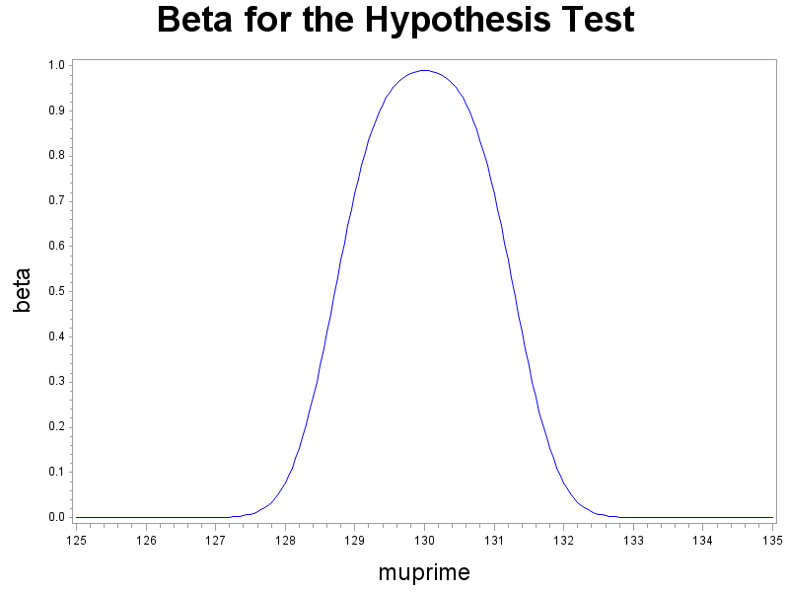
β Curve

Slide 25
Case III: Summary
Null hypothesis: H₀: μ = μ₀
Test statistic:
 | Alternative Hypothesis | Rejection Region for Level α Test
upper-tailed | H_{a}: μ > μ₀ | T ≥ t_{α,n-1}
lower-tailed | H_{a}: μ < μ₀ | T ≤ -t_{α,n-1}
two-tailed | H_{a}: μ ≠ μ₀ | T ≥ t_{α/2,n-1} OR t ≤ -t_{α/2,n-1}

Slide 26
Example: Case III
The average diameter of ball bearings of a certain type is supposed to be 0.5 in. A new machine may result in a change of the average diameter. Also suppose that the diameters follow a normal distribution. A sample size of 9 yields: x̄ = 0.57, s=0.1. If we have a significance level of 0.05, did the average diameter change?
Is the average diameter greater than 0.5 at the same significance level?
If a sample size of 10,000 yields the same sample average and standard deviation. Is the average diameter greater than 0.5 at the same significance level?

Slide 27
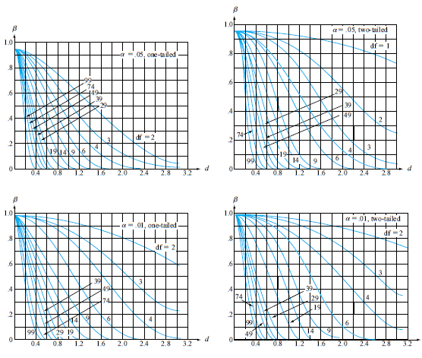
β curves for t-tests

Slide 28
Hypothesis Testing: What procedure to use?
The thickness of some metal plate follows a normal distribution; average thickness is believed to be 2 mm. When checking 25 plates’ thickness, we get: x̄ = 2.4, s=1.0. Using a significance level of 0.05, test whether the average thickness is indeed 2 mm. [fail to reject H₀]
2. The thickness of some metal plate follows a normal distribution, average thickness is believed to be 2 mm and the standard deviation of this normal distribution is believed to be 1.0. When checking 25 plates’ thickness, we get: x̄ = 2.4. Using a significance level of 0.05, test whether the average thickness is indeed 2 mm. [reject H₀]

Slide 29
Hypothesis Testing: What procedure to use?
3. The thickness of some metal plate follows an unknown distribution; average thickness is believed to be 2 mm. When checking 25 plates’ thickness, we get: x̄ = 2.4, s = 1.0. Using a significance level of 0.05, test whether the average thickness is greater than 2 mm. [reject H₀]

Slide 30
Hypothesis Testing about a Parameter: Procedure
To be done BEFORE analyzing the data.
Identify the parameter of interest and describe it in the context of the problem situation.
Determine the null value and state the null (2 in the book) and alternative (3 in the book) hypothesis.
  Normality assumption?
Select the significance level α.

Slide 31
Hypothesis Testing about a Parameter: Procedure (cont)
To be done AFTER obtaining the data.
Give the formula for the computed value of the test statistic (4 in the book) and substitute in the values (6 in the book).
Determine the rejection region.
Decide whether H₀ should be rejected (7 in the book) and why.
State this conclusion in the problem context.

Slide 32
Population Proportion-Large Sample Tests: Summary
Null hypothesis: H₀: p = p₀
Test statistic:
(np₀ ≥ 10 and n(1 – p₀) ≥ 10)
 | Alternative Hypothesis | Rejection Region for Level α Test
upper-tailed | H_{a}: p > p₀ | z ≥ z_{α}
lower-tailed | H_{a}: p < p₀ | z ≤ -z_{α}
two-tailed | H_{a}: p ≠ p₀ | z ≥ z_{α/2} OR z ≤ -z_{α/2}

Slide 33
Example: Large Sample Proportion
A machine in a certain factory must be repaired if it produces more than 10% defectives among the large lot of items it produces in a day. A random sample of 100 items from the day’s production contains 15 defectives, and the foreman says that the machine must be repaired. Does the sample evidence support his decision at the 0.01 significance level?

Slide 34
β(p’) Summary

Slide 35
Table A.1 (abbreviated)
X

Slide 36
Example: Small Sample Tests
We believe that the ratio that some machine components last over 10 hours is 30%. We will randomly select 10 of the components. Let X be the number of machine components that last over 10 hours.
a) Using a significance level of 0.1 and assuming that we determined that X = 1, do we need to change the manufacturing process? That is do less than 30% last over 10 hours?
b) Using a significance level of 0.1 and assuming that we determined that X = 5, do we want to lengthen the time of the warranty? That is do more than 30% last over 10 hours?
X

Slide 37
Table A.1 (abbreviated)
X

Slide 38
Example: Small Sample Tests
We believe that the ratio that some machine components last over 10 hours is 30%. We will randomly select 10 of the components. Let X be the number of machine components that last over 10 hours.
c) Using a significance level of 0.1 and assuming that we determined that X = 5, is the manufacturers claim correct? That is, is percentage that last over 10 hours 30%?
X

Slide 39
Table A.1 (abbreviated)
X

Slide 40
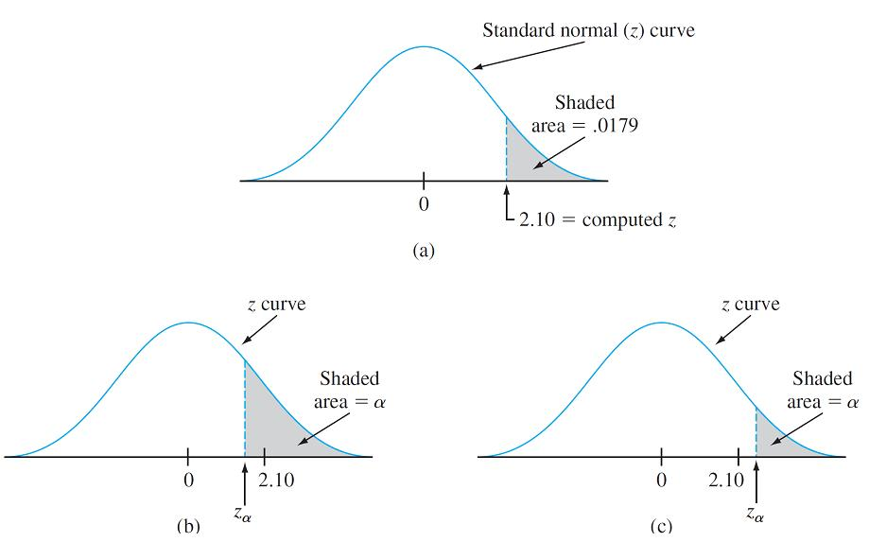
P-Values: Justification
α | Rejection Region | Conclusion
0.05 | z ≥ 1.645 | Reject H₀
0.025 | z ≥ 1.960 | Reject H₀
0.01 | z ≥ 2.326 | Do not reject H₀
0.005 | z ≥ 2.576 | Do not reject H₀
z = 2.10

Slide 41
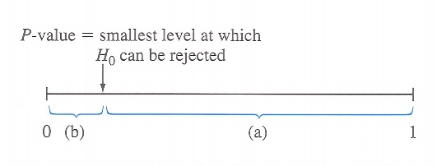
Definition: P-value
The P-value is the probability, calculated assuming that the null hypothesis is true, of obtaining a value of the test statistic at least as contradictory to H₀ as the value calculated from the available sample.

Slide 42
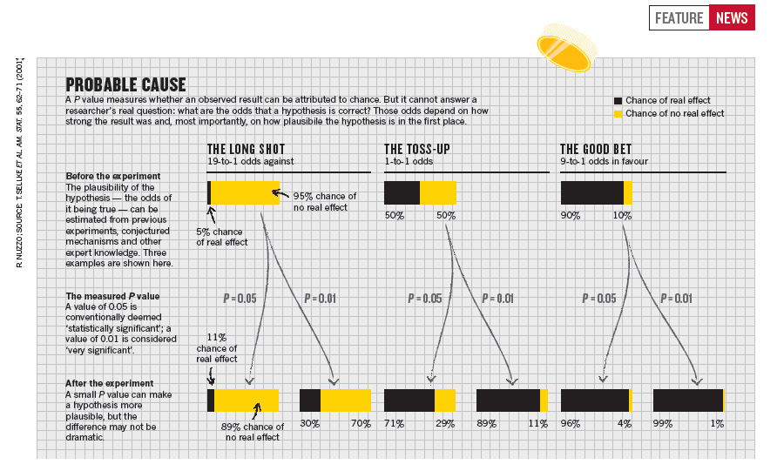
P-Value Interpretation

Slide 43
Hypothesis Testing (P-value): Procedure
To be done BEFORE looking at the data
Identify the parameter of interest and describe it in the context of the problem situation (1 in the book). (no change)
2. Determine the null value and state the null (2 in the book) and alternative (3 in the book) hypothesis. (no change)
State the appropriate alternative hypothesis. (no change)

Slide 44
Hypothesis Testing (P-value): Procedure (cont)
To be done AFTER looking at the data.
Give the formula for the computed value of the test statistic (4 in the book) and substitute in the values (5 in the book) and calculate P (6 in the book).
Determine the rejection region. (changed in using P)
Decide whether H₀ should be rejected (7 in the book) and why. (changed in using P)
State the conclusion in the problem context (7 in the book). (changed using P)

Slide 45
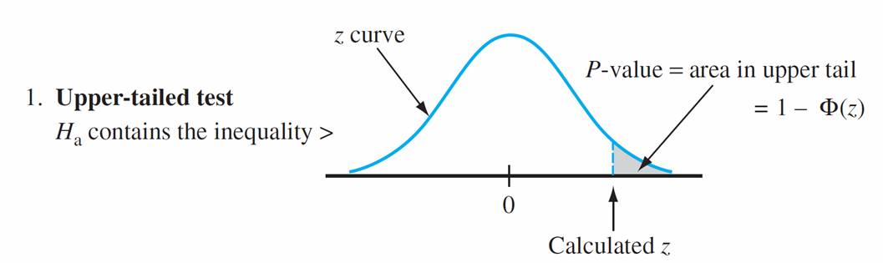
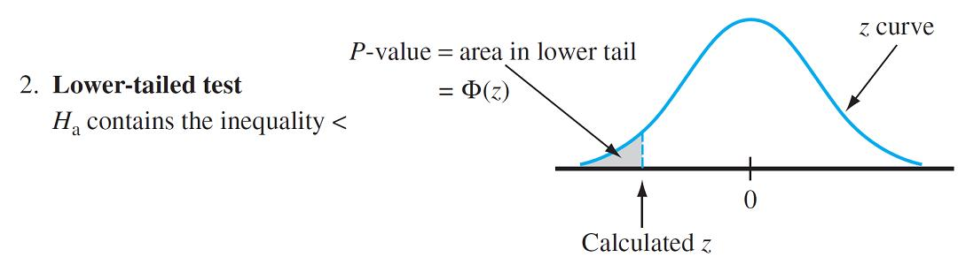
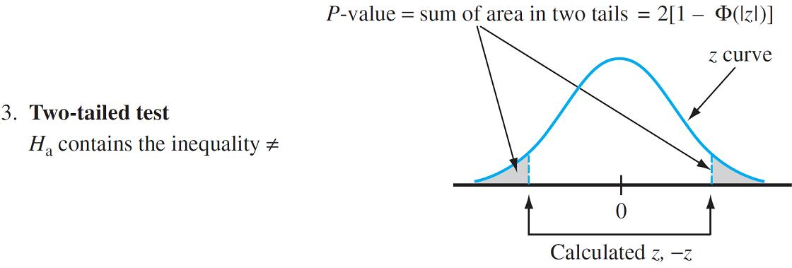
P-values for z tests

Slide 46
Example 8.6: Hypothesis test, known σ
P-value method
A manufacturer of sprinkler systems used for fire protection in office buildings claims that the true average system-activation temperature is 130ºF. A sample of 9 systems, when tested, yields a sample average activation temperature of 131.08ºF. If the distribution of activation times is normal with standard deviation 1.5ºF, does the data contradict the manufacturer’s claim at a significance level of α = 0.01?

Slide 47
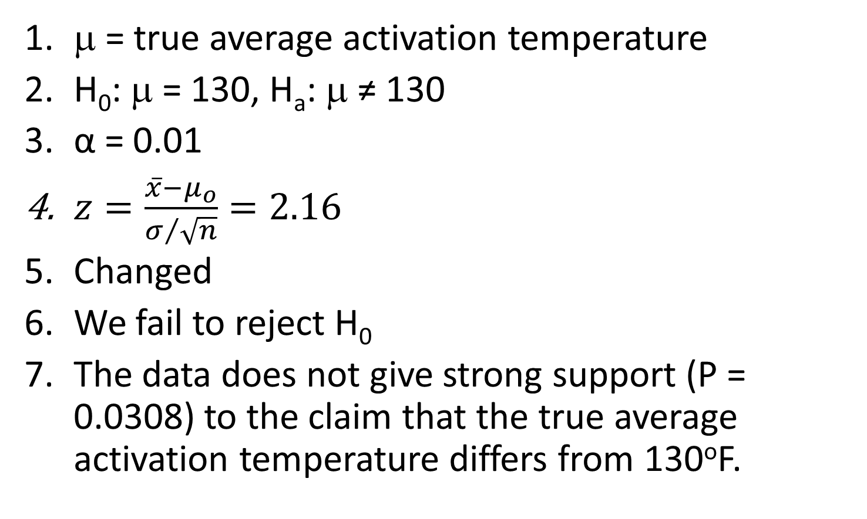
Example 8.6: Hypothesis test, known σ
P-value method (cont.)
μ = true average activation temperature
H₀: μ = 130, H_{a}: μ ≠ 130
α = 0.01
$z=\frac{\overline{x}−μ_{o}}{σ/{\sqrt{n}}}=2.16$
Changed
We fail to reject H₀
The data does not give strong support (P = 0.0308) to the claim that the true average activation temperature differs from 130ºF.

Slide 48
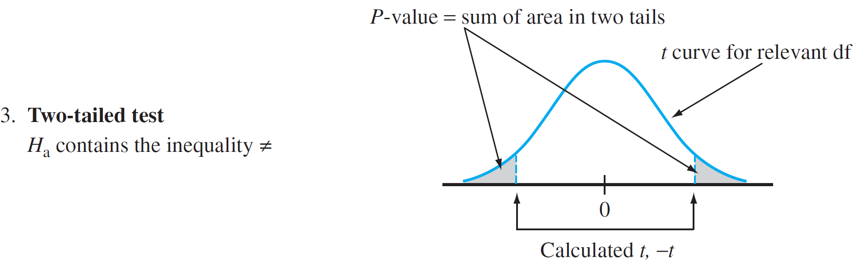
P-values for t tests

Slide 49
Table A.8

Slide 50
Table A.8 (cont)

Slide 51
Example: Case III, P-value method
The average diameter of ball bearings of a certain type is supposed to be 0.5 in. A new machine may result in a change of the average diameter. Also suppose that the diameters follow a normal distribution. A sample size of 9 yields: sample average = 0.57, s = 0.1. If we have a significance level of 0.05, did the average diameter change?
Is the average diameter greater than 0.5 at the same significance level?

Slide 52
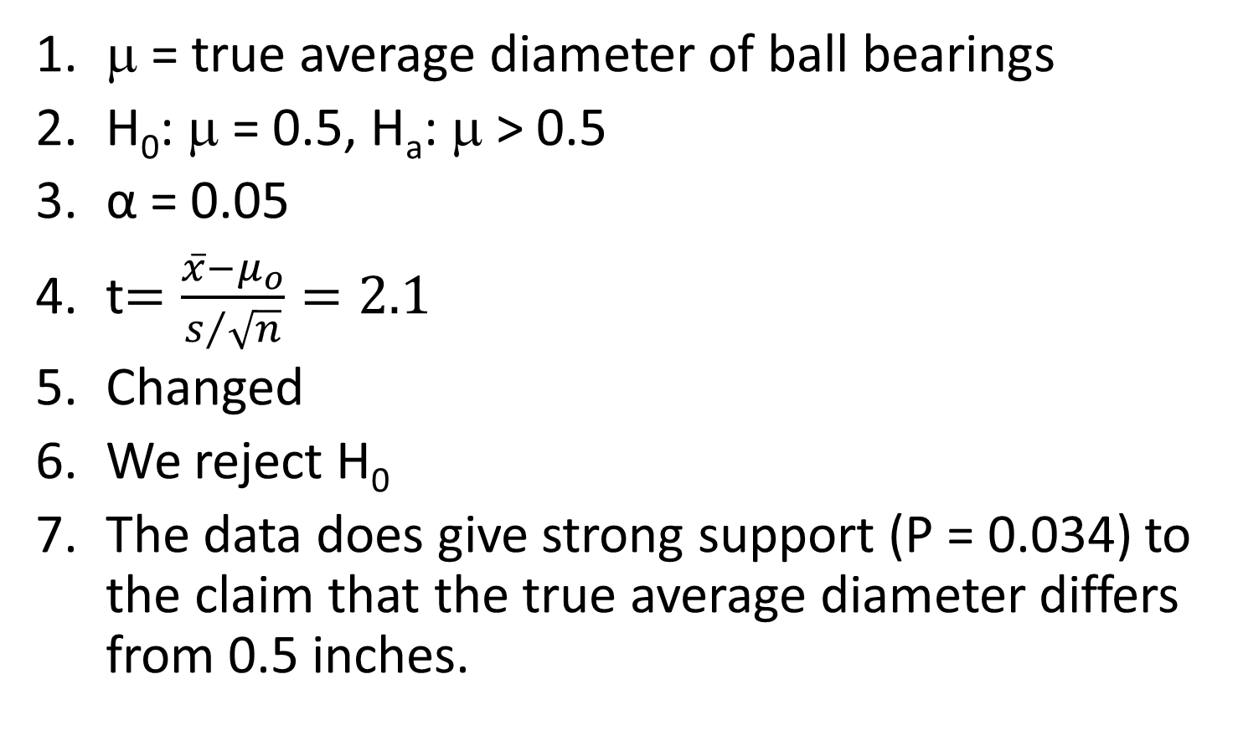
Example: Case III, P-value method (cont)
μ = true average diameter of ball bearings
H₀: μ = 0.5, H_{a}: μ > 0.5
α = 0.05
t$=\frac{\overline{x}−μ_{o}}{s/{\sqrt{n}}}=2.1$
Changed
We reject H₀
The data does give strong support (P = 0.034) to the claim that the true average diameter differs from 0.5 inches.

Slide 53
Example: HT vs. CI (2-tailed)
You are in charge of quality control in your food company. You sample randomly four packs of cherry tomatoes, each labeled 1/2 lb. (227 g). The average weight from your four boxes is 222 g. The packaging process has a known standard deviation of 5 g.
a) Perform the appropriate significance test at a 0.05 significance level to determine if the calibrating machine that sorts cherry tomatoes needs to be recalibrated.
b) Determine the 95% CI for the same situation.
c) How do the results of part a) and b) compare?

Slide 54
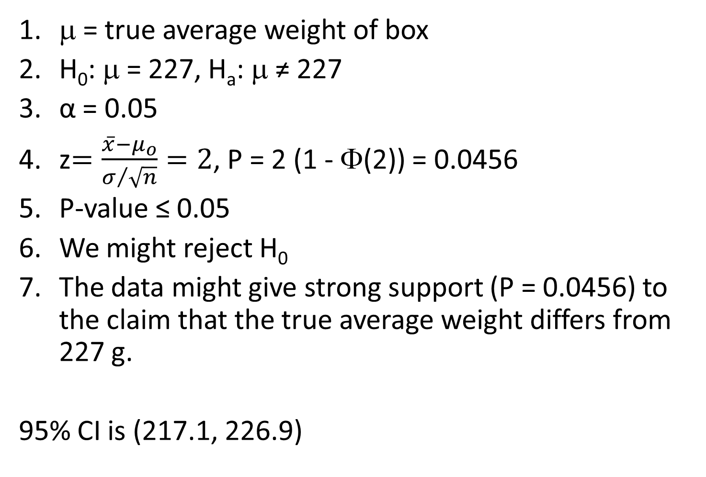
Example: HT vs. CI (2-tailed) (cont)
μ = true average weight of box
H₀: μ = 227, H_{a}: μ ≠ 227
α = 0.05
z$=\frac{\overline{x}−μ_{o}}{σ/{\sqrt{n}}}=2$, P = 2 (1 - Φ(2)) = 0.0456
P-value ≤ 0.05
We might reject H₀
The data might give strong support (P = 0.0456) to the claim that the true average weight differs from 227 g.
95% CI is (217.1, 226.9)

Slide 55
Example: HT vs. CI (2)
Suppose we are interested in how many credit cards that people own. Let’s obtain a SRS of 100 people who own credit cards. In this sample, the sample mean is 4 and the population standard deviation is 2. If someone claims that he thinks that μ > 2, is that person correct?
a) Perform an appropriate hypothesis test with significance level of 0.01.
b) Construct the appropriate bound for μ.
c) How do the results of part a) and b) compare?

Slide 56
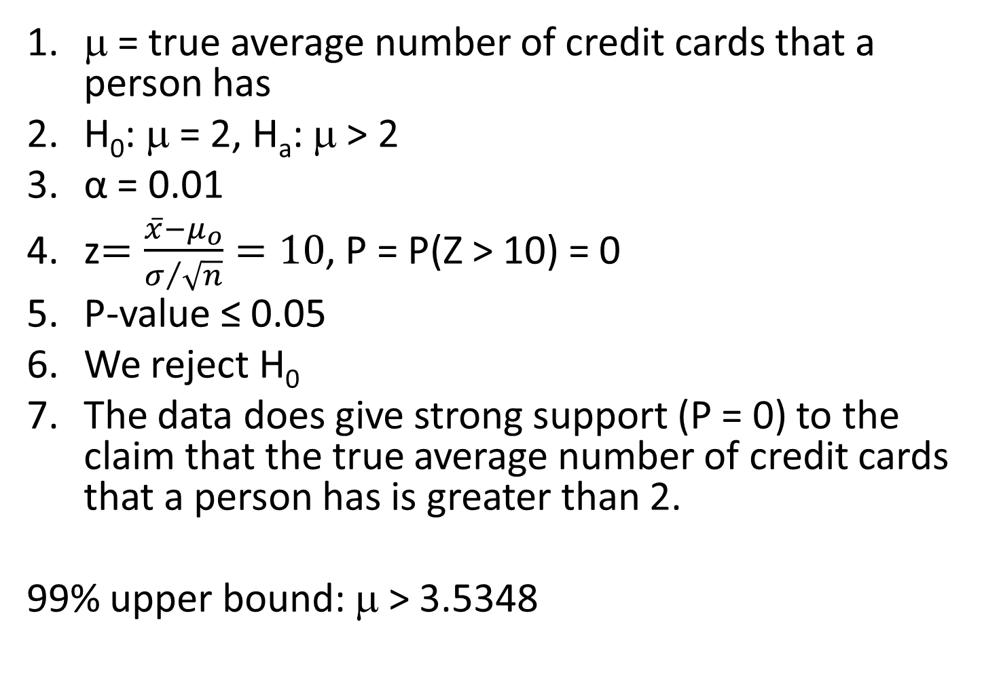
Example: HT vs. CI ( upper tailed) (cont)
μ = true average number of credit cards that a person has
H₀: μ = 2, H_{a}: μ > 2
α = 0.01
z$=\frac{\overline{x}−μ_{o}}{σ/{\sqrt{n}}}=10$, P = P(Z > 10) = 0
P-value ≤ 0.05
We reject H₀
The data does give strong support (P = 0) to the claim that the true average number of credit cards that a person has is greater than 2.
99% upper bound: μ > 3.5348

Slide 57
General Procedure for Selecting a Test
Determine the question.
Determine the data collection method.
Determine the test.
  Specify the test statistic
  Decide on the general form of the rejection region.
  Specify the critical values.

Slide 58
Questions about Determining a Test
1. What are the practical implications and consequences of choosing a particular level of significance once the other aspects of a test have been determined?
2. Does there exist a general principle, not dependent just on intuition, that can be used to obtain best or good test procedures?
3. When two or more tests are appropriate in a given situation, how can the tests be compared to decide which should be used?

Slide 59
Questions about Determining a Test
4. If a test is derived under specific assumptions about the distribution of population being sampled, how will the test perform when the assumptions are violated?

Slide 60
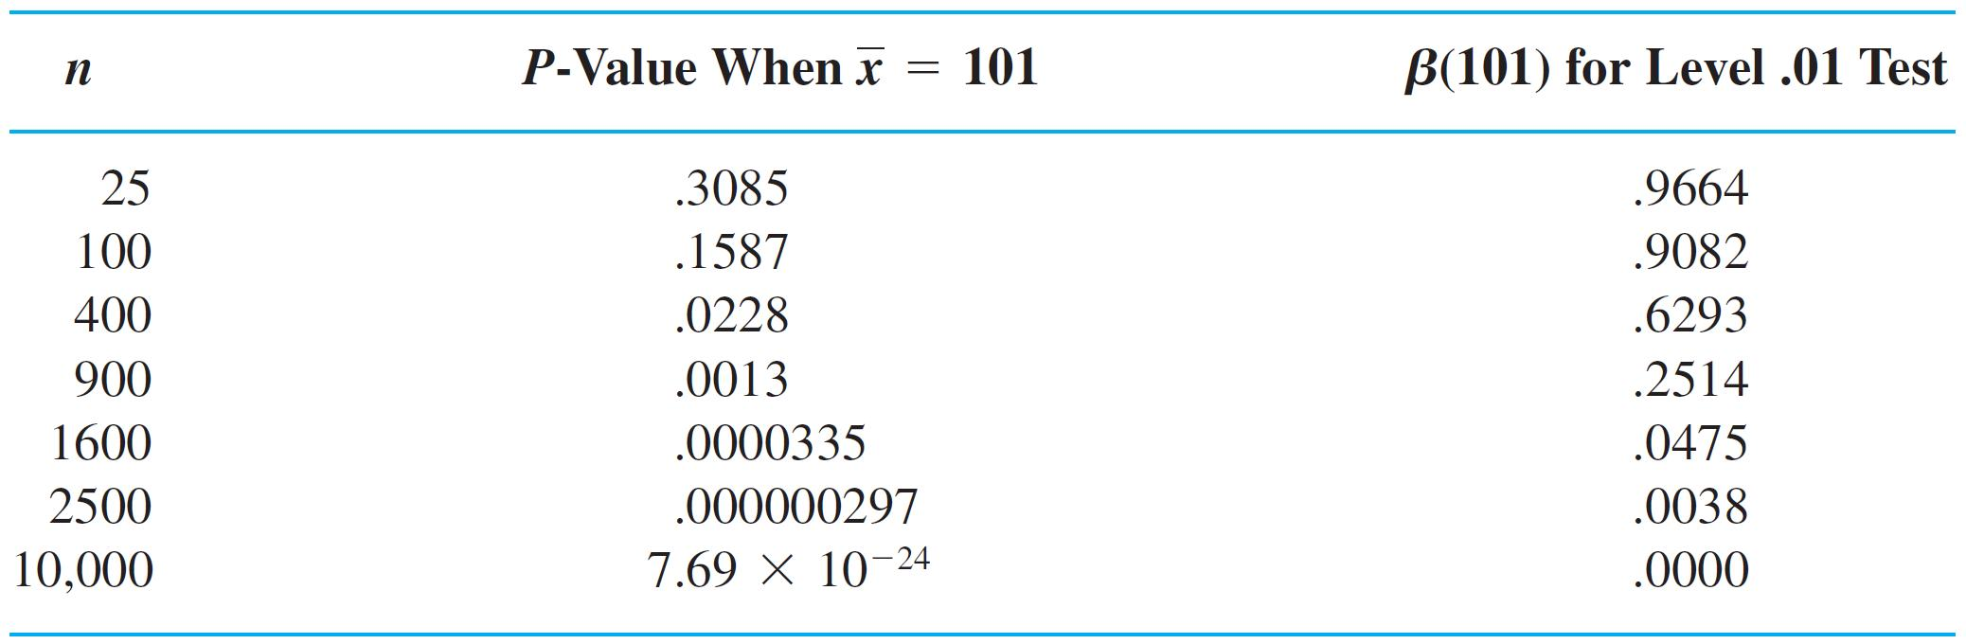
Statistical vs. Practical Significance
Table 8.1
An Illustration of the Effect of Sample Size on P-values and β

