Slide 1


Statistical Intervals Based on a Single Sample
7
Copyright © Cengage Learning. All rights reserved.
http://pballew.blogspot.com/2011/03/100-confidence-interval.html

Slide 2
Example 7.1: CI
Industrial engineers who specialize in ergonomics are concerned with designing workspace and devices operated by workers to achieve high productivity and comfort. This is a report on a study of preferred height of an experimental keyboard with large forearm-wrist support. A sample of 31 trained typists was selected, and the preferred keyboard height was determined for each typist. The resulting sample average preferred height was 80.0 cm.
Assuming that the preferred height is normally distributed with σ = 2.0 cm, obtain a 95% CI for μ, the true average preferred height for the population of all experienced typists.

Slide 3
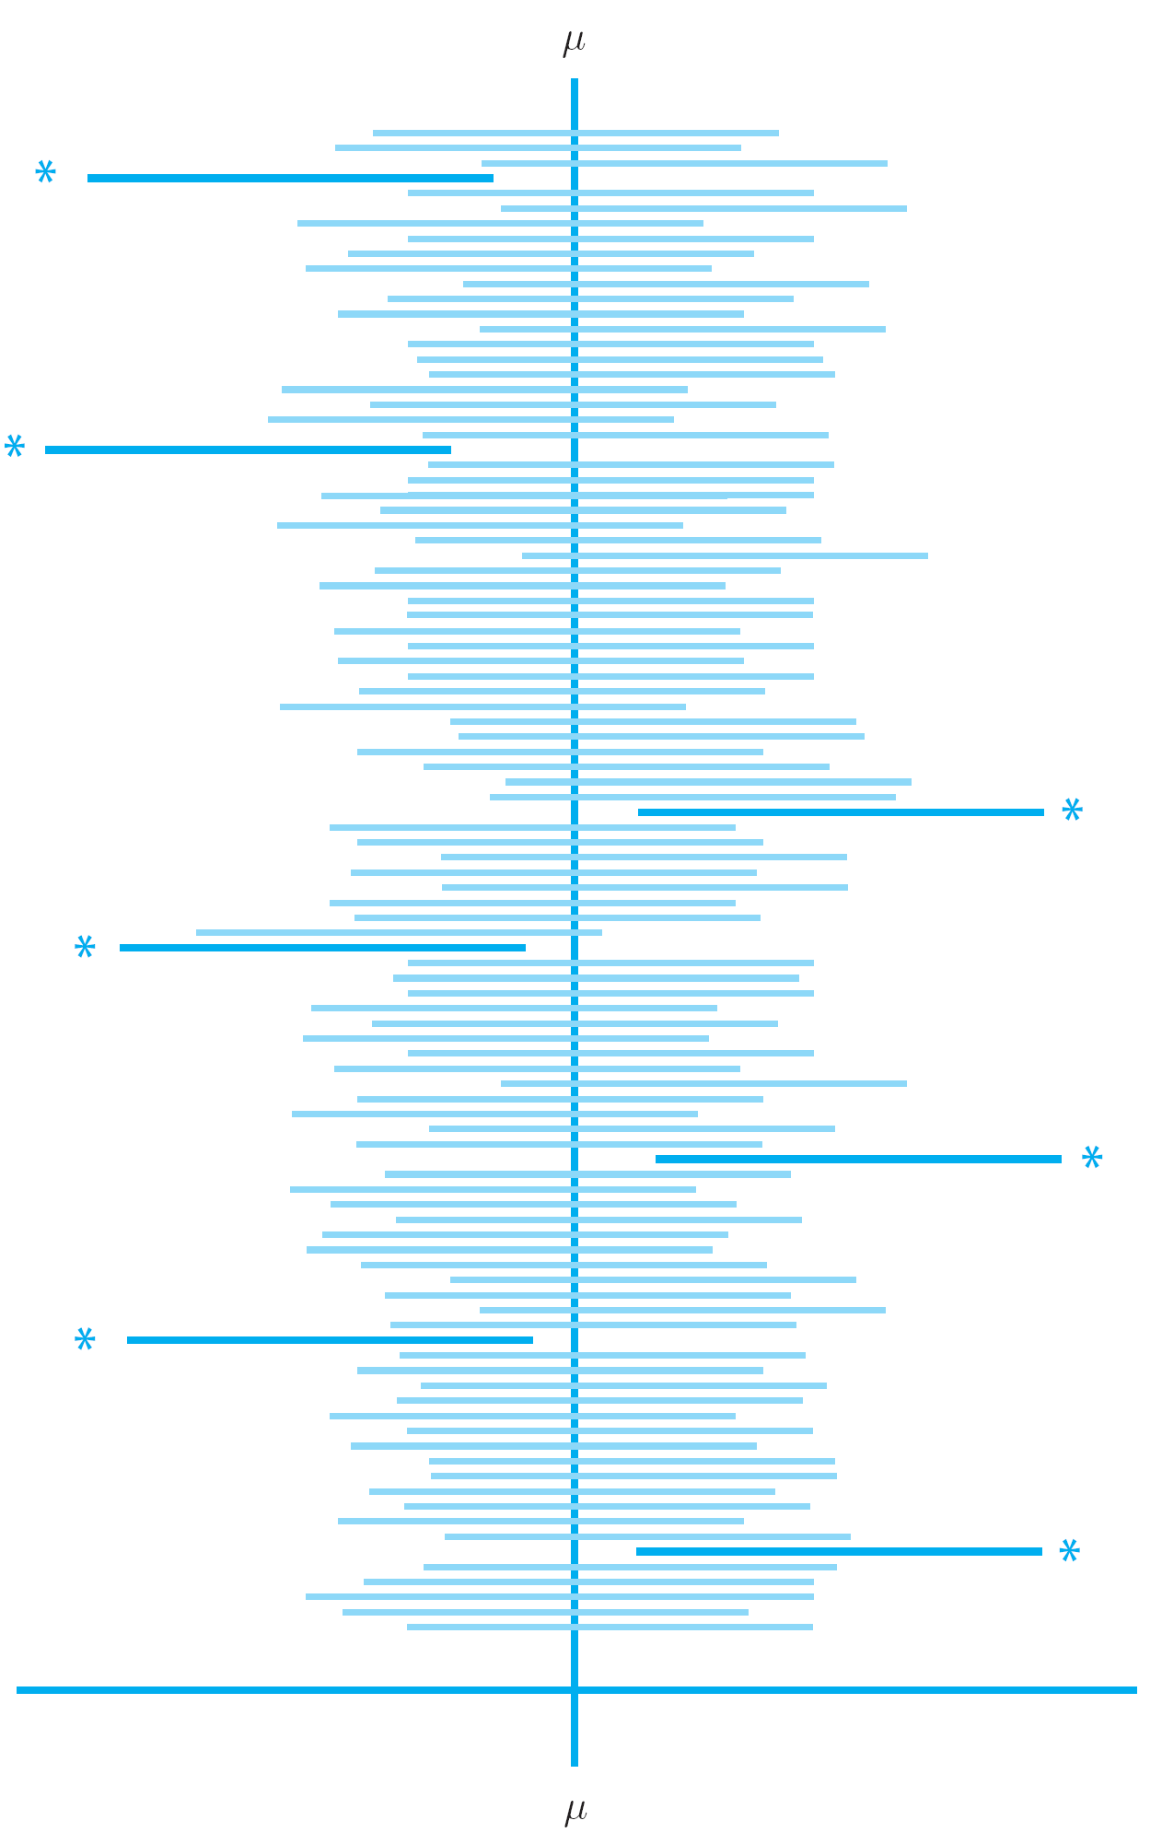
Interpretation of CI

Slide 4
Other Levels of Confidence
P(–z_{α/2} ≤ Z < z_{α/2}) = 1 – α
Figure 7.4

Slide 5
Example 7.3*: CI
A production process for engine control housing units of a particular type has recently been modified. Prior to this modification, the data suggested that the standard deviation of the hole diameters was 0.100 mm. It is believed that the modification did not change the standard deviation, but the value of the mean diameter may have changed. A sample of 40 housing units is selected and the hole diameter is determined for each one, resulting in a sample mean diameter of 5.426 mm.
What is the 99% CI of the new hole diameter?

Slide 6
Example: Confidence Level & Precision
Assuming a normal population with unknown mean μ and has a standard deviation σ = 2.0. Using a sample size of 25, we obtain x̄ = 1.0
What are the 100%, 99%, 95%, 90% C.I. for μ.
Suppose that a sample size of 100 also yields x̄ = 1.0. What is the 99% C.I?
Which of these intervals is the narrowest?

Slide 7
Example: Confidence Level & Precision
Assuming a normal population with unknown μ, the 90% and 95% C.I.’s give (-0.30, 6.30) and (-0.82, 6.82). Which one is the 95% C.I.?

Slide 8
Example 7.4: Calculating n
Extensive monitoring of a computer time-sharing system has suggested that response time to a particular editing command is normally distributed with standard deviation of 25 msec. A new operating system has been installed, and we wish to estimate the true average respond time μ for the new environment. Assuming that the response time is still normally distributed with σ = 25, what sample size is necessary to ensure that the resulting 95% CI has a width of (at most) 10?

Slide 9
Example: CI with large n
An experimenter is measuring the lifetime of a battery. The distribution of the lifetimes is positively skewed similar to an exponential with unknown mean μ and standard deviation σ. A sample of size 196 produces = 2.268 and s = 1.935. For a 95% confidence level, find the C.I.
X
X

Slide 10
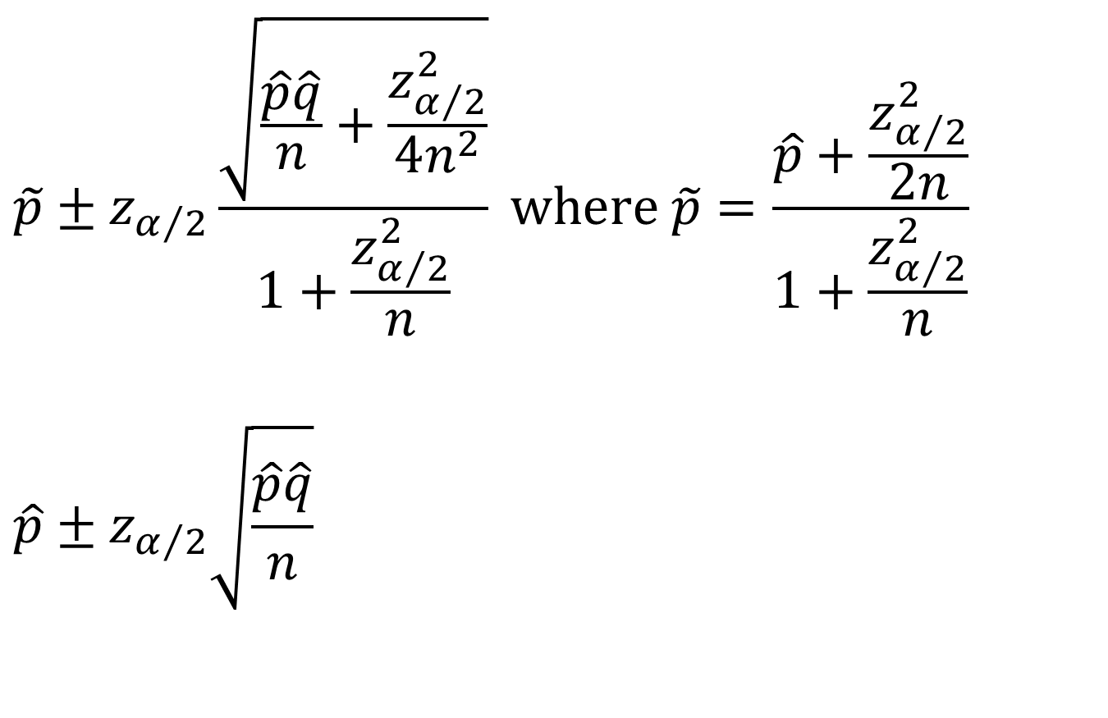
CI for population proportion
$$\tilde{p}±z_{α/2}\frac{\sqrt{\frac{\hat{p}\hat{q}}{n}+\frac{z_{α/2}^{2}}{4n^{2}}}}{1+\frac{z_{α/2}^{2}}{n}} where \tilde{p}=\frac{\hat{p}+\frac{z_{α/2}^{2}}{2n}}{1+\frac{z_{α/2}^{2}}{n}}$$
$$\hat{p}±z_{α/2}\sqrt{\frac{\hat{p}\hat{q}}{n}}$$

Slide 11
Example: CI for proportions
Among 1000 cats in Indiana, 20% are found to be long-hairs.
What is the 95% CI for the proportion of long-hair cats in Indiana?
What sample size should be used if we want an interval width of 0.01?
What sample size should be used if we want an interval width of 0.01 if the proportion was unknown?

Slide 12
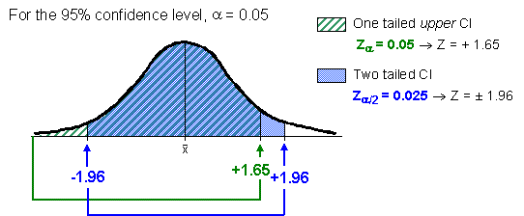
CI: one-sided vs. two-sided
http://labs.geog.uvic.ca/geog226/frLab4.html

Slide 13
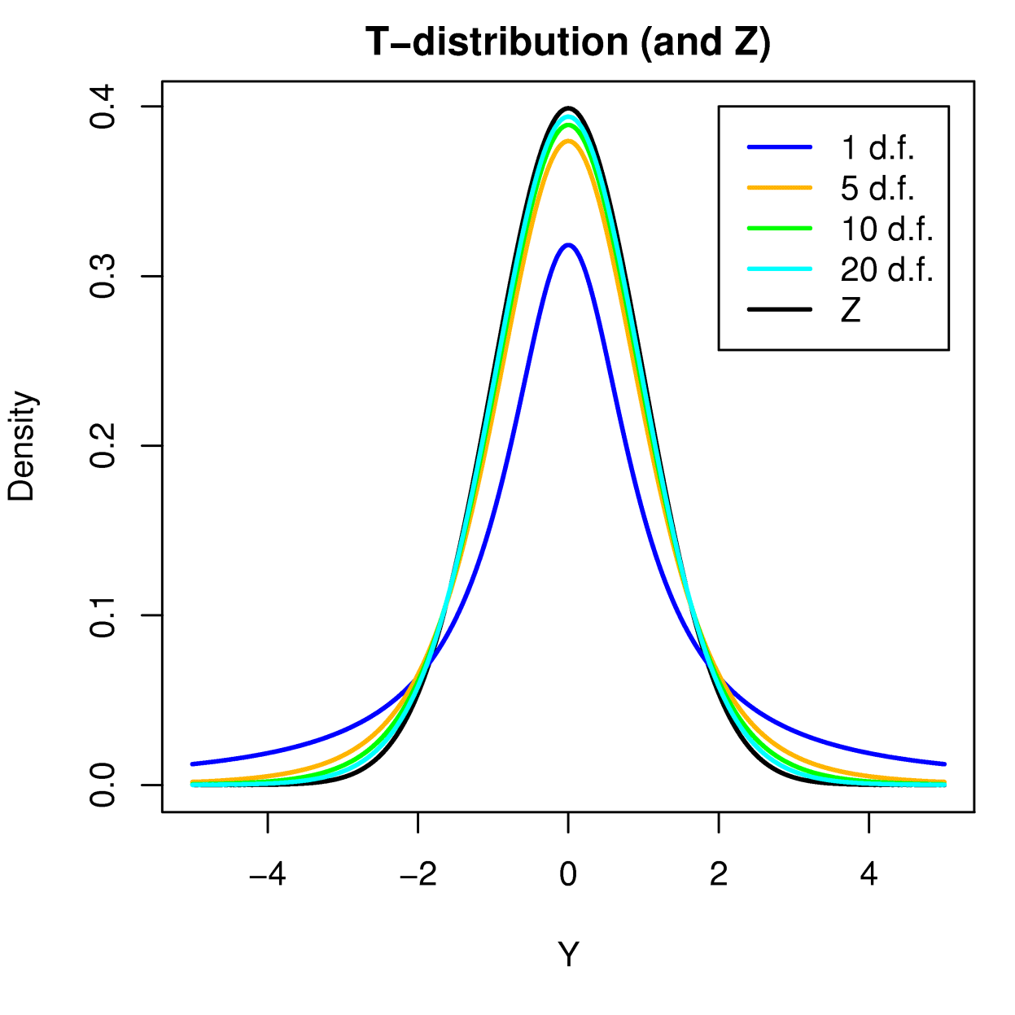
Shape of t-distribution

Slide 14
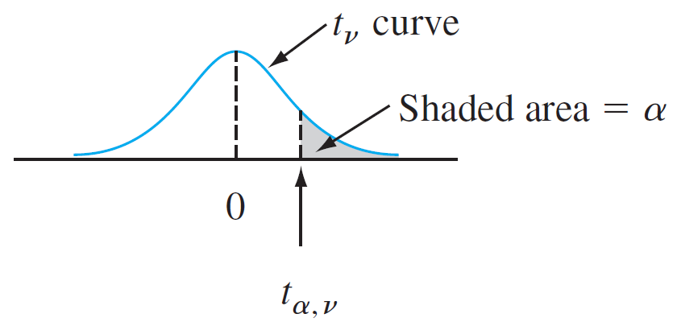
Definition of t critical value
Illustration of a t critical value
Figure 7.8

Slide 15
t-distribution
(text book)

Slide 16
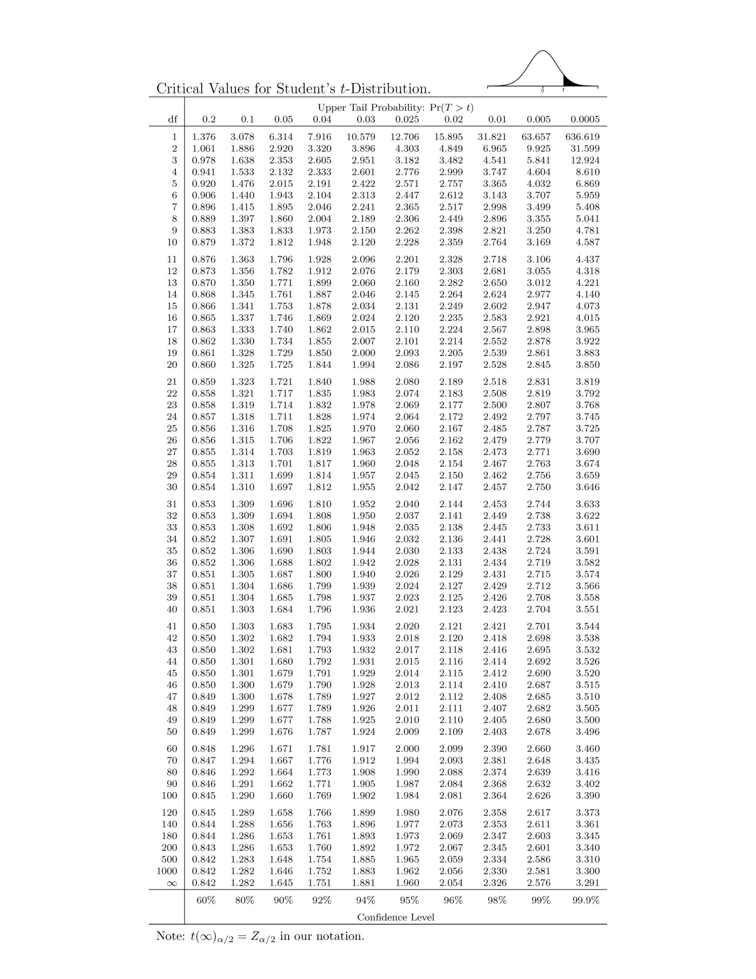
t-distribution
(web site)
X
X

Slide 17
Definition of t critical value
Illustration of a t critical value
Figure 7.8

Slide 18
Shape of t-distribution

Slide 19
Examples: t-table
Find t_{0.1,10}
Find t_{0.005,30}
Find t_{0.5,120}
Determine the t critical value that will capture the desired t curve when
  the central area is 0.95, df = 16.
  lower tail area is 0.1, df = 16
For an r.v. T which follows a t distribution, with df = n-1, what is P(-t_{α/2,n-1} <T < t_{α/2,n-1})?
X

Slide 20
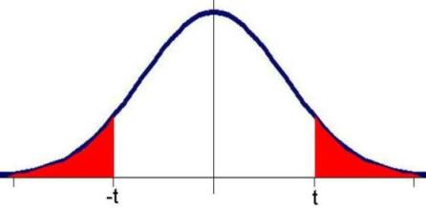
Examples: t-table
-t_{α/2,n-1}
t_{α/2,n-1}
http://www.jurgott.org/linkage/util.htm

Slide 21
Example: One-Sample t CI
In a particular car, when the brake is applied at 62 mph, the following data give stopping distance (in feet) for 10 random trials on a dry surface. (http://www.nhtsa.dot.gov/cars/testing/brakds/b.pdf.)
a) Can we say that the data are approximately normally distributed?
b) Find a 95% confidence interval for the population mean stopping distance, μ
146.9 | 148.4 | 149.4 | 148.6 | 150.3
147.5 | 147.5 | 149.3 | 148.4 | 145.5

Slide 22
Example: One-Sample t CI (cont)
In a particular car, when the brake is applied at 62 mph, the following data give stopping distance (in feet) for 10 random trials on a dry surface. (http://www.nhtsa.dot.gov/cars/testing/brakds/b.pdf.)
a) Can we say that the data are approximately normally distributed?

Slide 23
Example: One-Sample t CI
In a particular car, when the brake is applied at 62 mph, the following data give stopping distance (in feet) for 10 random trials on a dry surface. (http://www.nhtsa.dot.gov/cars/testing/brakds/b.pdf.)
a) Can we say that the data are approximately normally distributed?
b) Find a 95% confidence interval for the population mean stopping distance, μ
146.9 | 148.4 | 149.4 | 148.6 | 150.3
147.5 | 147.5 | 149.3 | 148.4 | 145.5

Slide 24
Example: One-Sample t CI – One side.
In a particular car, when the brake is applied at 62 mph, the following data give stopping distance (in feet) for 10 random trials on a dry surface. (http://www.nhtsa.dot.gov/cars/testing/brakds/b.pdf.)
c) Find a 95% confidence interval for the upper bound of the population mean stopping distance, μ.
d) What sample size is necessary to ensure that the resulting 95% CI has a width of (at most) 1.5 ft?
146.9 | 148.4 | 149.4 | 148.6 | 150.3
147.5 | 147.5 | 149.3 | 148.4 | 145.5

Slide 25
Example: P.I.
Ten independent observations are taken on bottles coming off a machine designed to fill them to 16 ounces. They have a sample average = 16.1 ounces and s = 0.1 ounce. Assume that the filling volume has a normal distribution. Given that t_{0.025,9} = 2.262, find
95% C.I. for the population mean, μ.
How do you interpret the C.I.?
b) 95% P.I. for the amount filled in the next bottle.
How do you interpret the P.I.?
X
X

Slide 26
Tolerance
Critical Values
X

Slide 27
Example: T.I.
Ten independent observations are taken on bottles coming off a machine designed to fill them to 16 ounces. They have a sample average = 16.1 ounces and s = 0.1 ounce. Assume that the filling volume has a normal distribution. Find
a 95% tolerance level of capturing at least 90% of the filling volumes.
X

Slide 28
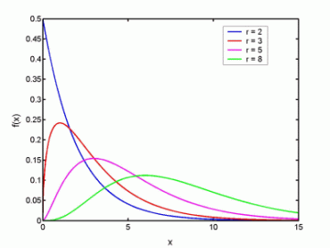
Shapes of χ² Distribution
http://cnx.org/content/m13129/latest/chi_sq.gif
X

Slide 29
Chi-squared critical value
X

Slide 30
Critical Values for χ² Distribution
X

Slide 31
Example: One-Sample CI – Variance.
In a particular car, when the brake is applied at 62 mph, the following data give stopping distance (in feet) for 10 random trials on a dry surface. (http://www.nhtsa.dot.gov/cars/testing/brakds/b.pdf.)
Find a 95% confidence interval for the normal variance σ² and the standard deviation, σ.
146.9 | 148.4 | 149.4 | 148.6 | 150.3
147.5 | 147.5 | 149.3 | 148.4 | 145.5
X

