Slide 1

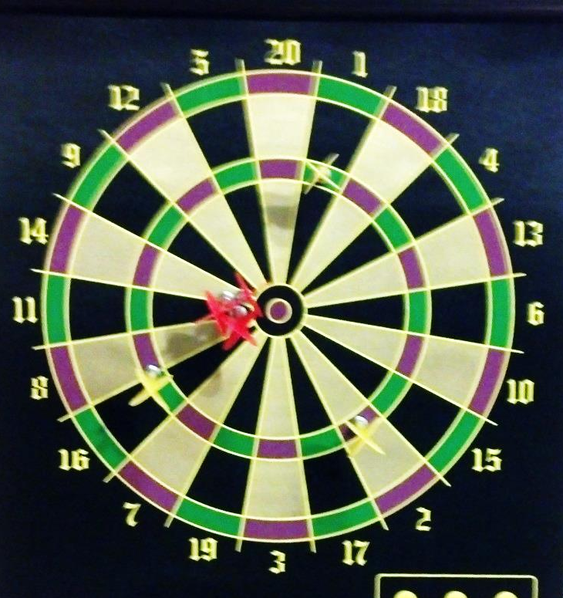
6
Point Estimation
Copyright © Cengage Learning. All rights reserved.

Slide 2
Example: Point Estimation
Suppose that we want to find the proportion, p, of bolts that are substandard in a large manufacturing plant. To test the bolt, you destroy the bolt so you do not want to check all of the bolts to see if they fail.
What is a good point estimator of p, p̂?

Slide 3
Procedure: Point Estimation
Define the r.v. and determine its distribution (random sample).
For the parameter of interest, determine the appropriate statistic and its formula (estimator),
Calculate the statistic from the data (estimate).
Suppose that bolt numbers 5, 13, 24 are substandard out of 25 bolts, what is the value of p̂?

Slide 4
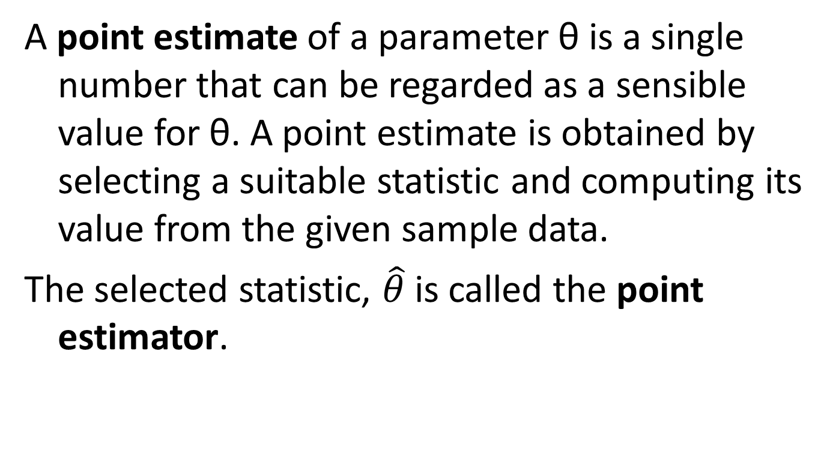
Definition: Point Estimation
A point estimate of a parameter θ is a single number that can be regarded as a sensible value for θ. A point estimate is obtained by selecting a suitable statistic and computing its value from the given sample data.
The selected statistic, $\hat{θ}$ is called the point estimator.

Slide 5
Example 6.2: Point Estimation
Assume the dielectric breakdown voltage for pieces of epoxy resin is normally distributed. We want to estimate the mean μ of the breakdown voltage. We randomly check 20 breakdown voltages (below).
Which point estimators could be used to estimate μ?
24.46 | 25.61 | 26.25 | 26.42 | 26.66
27.15 | 27.31 | 27.54 | 27.74 | 27.94
27.98 | 28.04 | 28.28 | 28.49 | 28.50
28.87 | 29.11 | 29.13 | 29.50 | 30.88

Slide 6
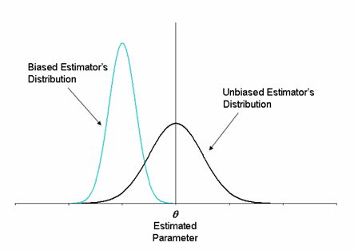
Unbiased Estimators
http://www.weibull.com/DOEWeb/unbiased_and_biased_estimators.htm

Slide 7
Unbiased estimator
The pdf’s of a biased estimator and an unbiased estimator for a parameter θ
Figure 6.1

Slide 8
Examples: Point Estimation
For a binomial distribution with parameters n and p with p unknown,
Is the estimator of the sample proportion , an unbiased estimator of p?
For normal distribution with mean μ and variance σ², given a random sample of size n, X₁, …., X_{n}.
Is the sample mean , an unbiased estimator of μ?

Slide 9
Example 6.4: Point Estimation
Suppose that X, the reaction time to a certain stimulus, has a uniform distribution on the interval from 0 to an unknown upper limit, θ (so the density function of X is rectangular in shape, with height 1/θ for 0 ≤ x ≤ θ). It is desired to estimate θ on the basis of a random sample X₁, …., X_{n} of reaction times.
Is max(X₁, …., X_{n}) an unbiased estimator?
X

Slide 10
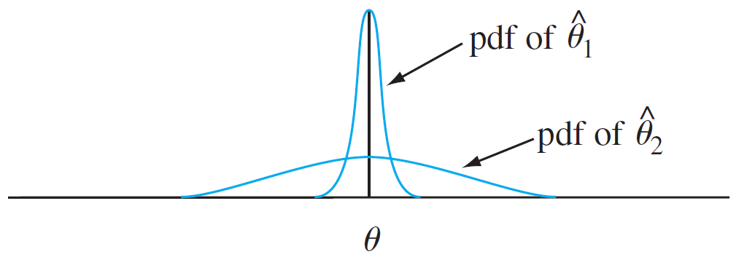
Estimators with Minimum Variance
Graphs of the pdf’s of two different unbiased estimators
Figure 6.3

Slide 11

Principal of Minimum Variance Unbiased Estimation
        Among all estimators of θ that are unbiased, choose the one that has minimum variance. The resulting $\hat{θ}$ is called the minimum variance unbiased estimator (MVUE) of θ.

Slide 12
Estimators with Minimum Variance
Is a biased estimator always the best estimator?

Slide 13
Best Estimators for μ
Distr | cdf |  | Best Estimator
Normal |  | -∞ < x < ∞
Cauchy |  | -∞ < x < ∞
Uniform |  | -c ≤ x – μ ≤ c
 | 0 | else

Slide 14
Example 6.9( 6.2): Estimate of error
Assume the dielectric breakdown voltage for pieces of epoxy resin is normally distributed. Here s = 1.462, n = 20.
What is the standard error of the best estimator of μ?

Slide 15
Example 6.12: Moment Estimates
Let X₁, …, X_{n} represent a random sample of service times of n customers at a certain facility, where the underlying distribution is assumed exponential with parameter λ.
Estimate λ.
X

Slide 16
Example: Moment Estimates
Let X₁, …., X₁₀ represent a random sample of measurement errors of size 10 where the underlying distribution is assumed to be normal. If the observed values of the random sample are
Find the moment estimates of μ and σ.
3.92 | 3.76 | 4.01 | 3.67 | 3.89
3.62 | 4.09 | 4.15 | 3.58 | 3.75
X

Slide 17
Example: Moment Estimates
Let X_{1, ….,} X₅ represent a random sample of bus wait times of size 5 where the underlying distribution is assumed to be uniform. The
observed values give , ,
.
Find the moment estimates of a and b.
X

Slide 18
Example 6.15: MLE
A sample of ten new bike helmets manufactured by a certain company is obtained. Let X_{i} = 1 if the ith helmet is flawed, X_{i} = 0 if the ith helmet is not flawed. Assume that X_{i}’s are independent.
p = P(a helmet is flawed) = P(X_{i} = 1).
The observed values of x = {1,0,1,0,0,0,0,0,0,1}
What is an estimate of p?
X

Slide 19
Example 6.16: MLE
Let X₁, …, X_{n} be a random sample from an exponential distribution with parameter λ. You are given the observed values x₁, …, x_{n}.
Find the maximum likelihood estimate of λ
X

Slide 20
Example 6.17: MLE
Let X₁, …, X_{n} be a random sample from a normal distribution with mean μ and variance σ². You are given the observed values of x₁, …, x_{n}.
Find the maximum likelihood estimate of μ and σ².
X

Slide 21
Example 6.18*: MLE
Suppose that an ecologist selects 5 nonoverlapping regions and counts the number of plants of a certain species found in each region. Assume that all of the regions have the same area and we will set that to be ‘1’ in some units. This is a random sample of size 5 from a Poisson distribution with parameter λ.
The observed number of plants are 2, 4, 6, 9 ,9.
Find the MLE of λ.
X

Slide 22
Example 6.20: Estimating Functions of Parameters
In the normal case, the MLE’s of μ and σ² are
and .
What is the MLE of the standard deviation, σ?
X

