Slide 1

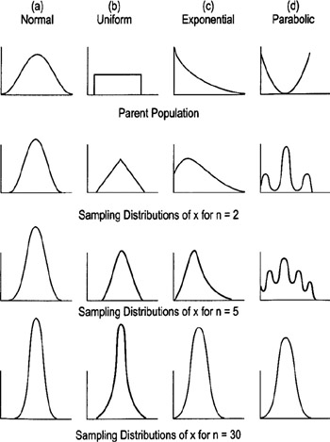
Joint Probability Distributions and
Random Samples
5
Copyright © Cengage Learning. All rights reserved.
http://flylib.com/books/en/2.528.1.68/1/

Slide 2
Example: Joint pmf (discrete)
The National Highway Traffic Safety Administration is interested in the effect of seat belt use on saving lives of children under 5. In this study, there were 7,060 accidents where there was at least one fatality in the years between 1985 to 1989 (3015 children were involved). Let X denote whether the child survived or not and let Y denote the type of seat belt that the child wore (if any). The joint pmf of (X,Y) is given on the next slide.

Slide 3
Example: Joint pmf (discrete) (cont)
 |  | Y
 | p(x,y) | Survivors (0) | Fatalities (1)
X | no belt (0) | 0.37 | 0.17
 | Adult belt (1) | 0.14 | 0.02
 | Child Seat (2) | 0.24 | 0.05
What is P(X = 1, Y = 0)? What is P(X ≥ 1, Y = 1)?
What is P(X = Y)?

Slide 4
Example: Joint pmf (discrete) (cont)
 |  | Y
 | p(x,y) | Survivors (0) | Fatalities (1) | p(x)
X | no belt (0) | 0.37 | 0.17 | 0.54
 | Adult belt (1) | 0.14 | 0.02 | 0.16
 | Child Seat (2) | 0.24 | 0.05 | 0.29
 | p(y) | 0.75 | 0.24 | 0.99
What is P(X = 2)? What is P(Y = 1)?

Slide 5
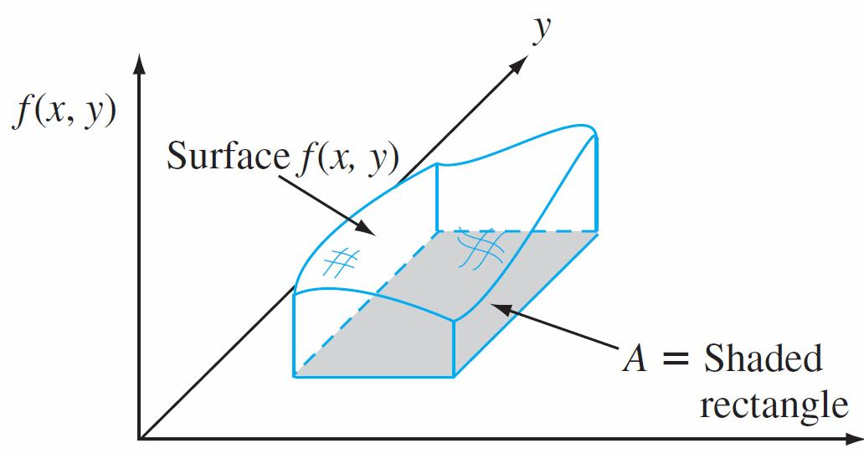
P(X,Y)∈A

Slide 6
Example: Continuous r.v.
Let X and Y denote the proportions of time, out of one workweek, that two employees spend performing their assigned tasks. This can be modeled by the following joint pdf:
Verify that this is a legitimate pdf.
What is the probability that both people work more than 50% of the time?

Slide 7
Example: Continuous r.v. (cont)
Let X and Y denote the proportions of time, out of one workweek, that two employees spend performing their assigned tasks. This can be modeled by the following joint pdf:
What is the marginal probability density function of X and Y?

Slide 8
Example: non-rectangular A
Let A denote the interior of a triangle with vertices (0,0), (2,0), and (2,1). Suppose that the joint pdf is below.
Verify that this is a valid pdf.
What are the marginal pdfs of X and Y?

Slide 9
Example: Continuous r.v. (cont)
Let X and Y denote the proportions of time, out of one workweek, that two employees spend performing their assigned tasks. This can be modeled by the following joint pdf:
f_{X}(x) = x + 0.5, f_{Y}(y) = y + 0.5
Are X and Y independent?

Slide 10
Example: Independence - discrete
 |  | Y
 | p(x,y) | Survivors (0) | Fatalities (1) | p(x)
X | no belt (0) | 0.37 | 0.17 | 0.54
 | Adult belt (1) | 0.14 | 0.02 | 0.16
 | Child Seat (2) | 0.24 | 0.05 | 0.29
 | p(y) | 0.75 | 0.24 | 0.99
Are X and Y independent?

Slide 11
Example: Independence - discrete
 |  | y
 | p(x,y) | 0 | 1 | 2 | 3 | p(x)
x | 0 | 0.04 | 0.03 | 0.01 | 0.02 | 0.1
 | 1 | 0.08 | 0.06 | 0.02 | 0.04 | 0.2
 | 2 | 0.16 | 0.12 | 0.04 | 0.08 | 0.4
 | 3 | 0.04 | 0.03 | 0.01 | 0.02 | 0.1
 | 4 | 0.08 | 0.06 | 0.02 | 0.04 | 0.2
 | p(y) | 0.4 | 0.3 | 0.1 | 0.2 | 1.00
Are X and Y independent?

Slide 12
Example: Independence
X follows an exponential distribution with λ = 2; Y follows an exponential distribution with λ = 3. Assume that X and Y are independent. What is f(x,y)?

Slide 13
Example: Independence
Toss a fair coin and roll a fair 4-sided die. Let X = 1 if the coin is head and X = 0 if it tails. Let Y be the outcome of the die. Assume X and Y are independent.
Find p(x,y)
Find the probability that the outcome of the die is greater than 2 and the coin is a head.
X

Slide 14
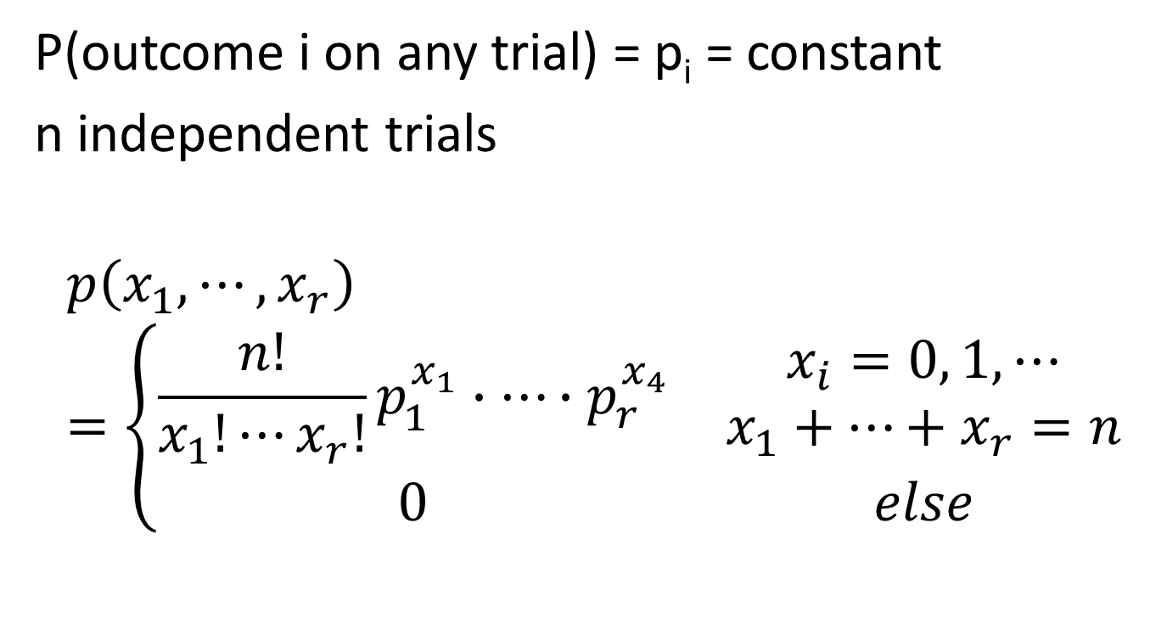
Multinomial Distribution
P(outcome i on any trial) = p_{i} = constant
n independent trials
$$p\left(x_{1},⋯,x_{r}\right)=\left\{\begin{matrix}\frac{n!}{x_{1}!⋯x_{r}!}p_{1}^{x_{1}}∙⋯∙p_{r}^{x_{4}} & \begin{aligned}x_{i}=0, 1, ⋯ \\ x_{1}+⋯+x_{r}=n\end{aligned} \\ 0 & else\end{matrix}\right.$$

Slide 15
Multinomial Distribution: Example
In a certain state, 5% of the bridges are closed, 10% of the bridges are open but have restricted access, 15% of the bridges are in fair condition and the rest of the bridges (70%) are in good condition.
What is the probability that if 6 of the bridges in the state are selected at random, none of the bridges are closed, 1 of the bridges has restricted access, 2 of the bridges are in fair condition and the rest are in good condition?

Slide 16
Example: Conditional pmf
 |  | Y
 | p(x,y) | Survivors (0) | Fatalities (1) | p(x)
X | no belt (0) | 0.37 | 0.17 | 0.54
 | Adult belt (1) | 0.14 | 0.02 | 0.16
 | Child Seat (2) | 0.24 | 0.05 | 0.29
 | p(y) | 0.75 | 0.24 | 0.99
What is the conditional pmf of Y, given X = 1?

Slide 17
Example: Conditional pdf
Let X and Y denote the proportions of time, out of one workweek, that two employees spend performing their assigned tasks. This can be modeled by the following joint pdf:
f_{X}(x) = x + 0.5, f_{Y}(y) = y + 0.5
What is the conditional pdf of Y given X = 0.7?
What is the probability that the proportion of time worked for employee Y is at least 0.7 given X = 0.7?

Slide 18
Example: Conditional pdf
Let X and Y denote the proportions of time, out of one workweek, that two employees spend performing their assigned tasks. This can be modeled by the following joint pdf:
f_{X}(x) = x + 0.5, f_{Y}(y) = y + 0.5
c) What is the expected value of the proportion of time worked for the second employee given X = 0.7?

Slide 19

Expected value of a function
$$E\left[h\left(X,Y\right)\right]=\left\{\begin{matrix}\sum_{x}{\sum_{y}{h(x,y)∙p(x,y)}} & X,Y discrete \\ \int_{−∞}^{∞}{\int_{−∞}^{∞}{h\left(x,y\right)∙f\left(x,y\right)dxdy}} & X,Y continous\end{matrix}\right.$$

Slide 20
Example: Expectation - discrete
The joint pmf for the fatalities for children is:
What is E(XY)?
What is E[max(X,Y)]?
 |  | Y
 | p(x,y) | Survivors (0) | Fatalities (1) | p(x)
X | no belt (0) | 0.37 | 0.17 | 0.54
 | Adult belt (1) | 0.14 | 0.02 | 0.16
 | Child Seat (2) | 0.24 | 0.05 | 0.29
 | p(y) | 0.75 | 0.24 | 0.99

Slide 21
Example: Expectation - continuous
The joint pdf of X and Y is
What is E(XY)?

Slide 22
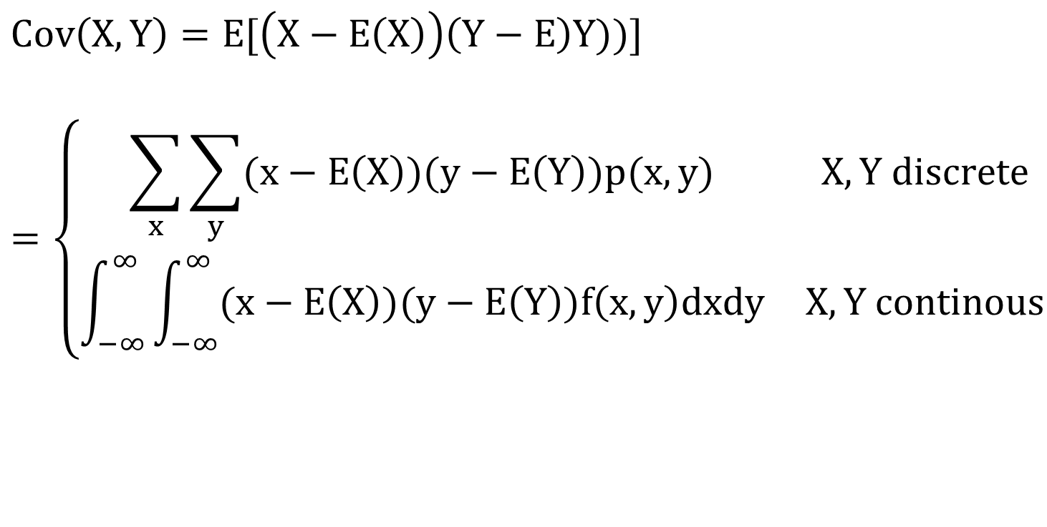
Covariance
$$Cov\left(X,Y\right)=E[\left(X−E\left(X\right)\right)\left(Y−E\right)Y))]$$
$$=\left\{\begin{matrix}\sum_{x}{\sum_{y}{(x−E\left(X\right))(y−E\left(Y\right))p(x,y)}} & X,Y discrete \\ \int_{−∞}^{∞}{\int_{−∞}^{∞}{(x−E\left(X\right))(y−E\left(Y\right))f\left(x,y\right)dxdy}} & X,Y continous\end{matrix}\right.$$

Slide 23
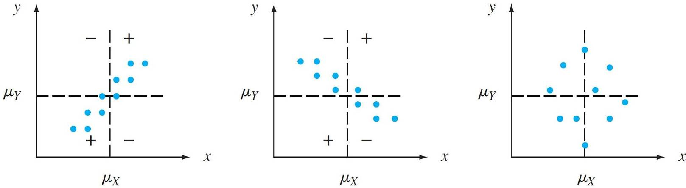
Covariance

Slide 24
Covariance: Properties
Cov(X,Y) = E[(X – E(X))(Y – E(Y))]
Cov(X,X) = Var(X)
Cov(X,Y) = Cov(Y,X)
Cov(aX + b,cY + d) = acCov(X,Y)
Cov(X,Y) = E(XY) – E(X)E(Y)

Slide 25
Example: Example: Covariance - discrete
The joint pmf for the fatalities for children is:
E(XY) = 0.12
What is Cov(X,Y)?
 |  | Y
 | p(x,y) | Survivors (0) | Fatalities (1) | p(x)
X | no belt (0) | 0.37 | 0.17 | 0.54
 | Adult belt (1) | 0.14 | 0.02 | 0.16
 | Child Seat (2) | 0.24 | 0.05 | 0.29
 | p(y) | 0.75 | 0.24 | 0.99

Slide 26
Example: Covariance – discrete (2)
Given the pmf below, what is Cov(X,Y)
p(x,y) |  | y
 |  | 1 | 2 | p_{X}(x)
x | 1 | 0.04 | 0.36 | 0.40
 | 2 | 0.06 | 0.54 | 0.60
 | p_{Y}(y) | 0.10 | 0.90 | 1.00

Slide 27

Example: Covariance - continuous
The joint pdf of X and Y is
$$E\left(XY\right)=\frac{4}{9}$$
What is Cov(X,Y)?

Slide 28
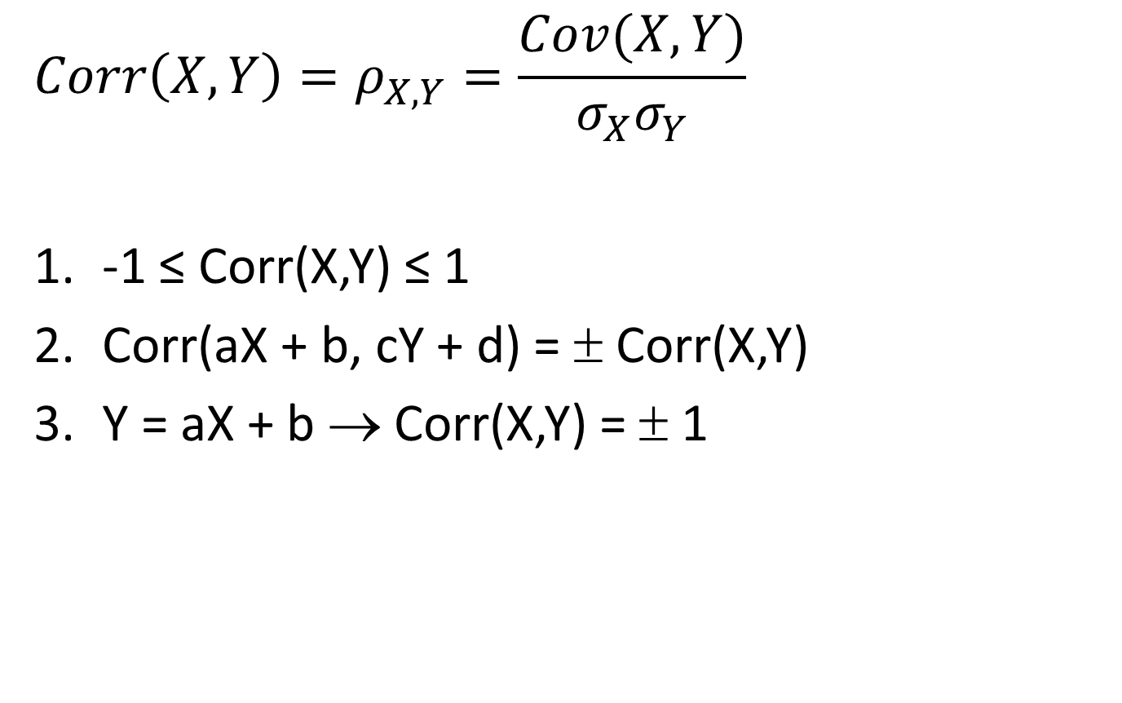
Correlation
$$Corr\left(X,Y\right)=ρ_{X,Y}=\frac{Cov(X,Y)}{σ_{X}σ_{Y}}$$
-1 ≤ Corr(X,Y) ≤ 1
Corr(aX + b, cY + d) = ± Corr(X,Y)
Y = aX + b → Corr(X,Y) = ± 1

Slide 29
Correlation
|ρ| > 0.8 | strongly correlated
0.5 < |ρ| < 0.8 | moderately correlated
0 < |ρ| < 0.5 | weakly correlated
|ρ| = 0 | uncorrelated

Slide 30
Example: Correlation - discrete
The joint pmf for the fatalities for children is:
Cov(X,Y) = -0.0576, E(X) = 0.74, E(Y) = 0.24
What is ρ(X,Y)?
 |  | Y
 | p(x,y) | Survivors (0) | Fatalities (1) | p(x)
X | no belt (0) | 0.37 | 0.17 | 0.54
 | Adult belt (1) | 0.14 | 0.02 | 0.16
 | Child Seat (2) | 0.24 | 0.05 | 0.29
 | p(y) | 0.75 | 0.24 | 0.99

Slide 31
Example: Correlation - continuous
The joint pdf of X and Y is
Cov(X,Y) = 0, E(X) = E(Y) = 2/3
What is Corr(X,Y)?

Slide 32
Example: Correlation
Calculate the covariance for the following joint pmf on the curve Y = X² where f(x,y) = c on the curve and 0 else.

Slide 33
Example (5.18): Correlation - discrete
Calculate the covariance for the following joint pmf
X
x

Slide 34
Sampling Distribution – Example 5.20
A certain brand of MP3 player comes in three configurations: a model with 2 GB of memory, costing $80, a 4 GB model priced at $100, and an 8 GB version with a price tag of $120.
20% of all purchasers choose the 2 GB model, 30% choose the 4 GB model, and 50% choose the 8 GB model. Let X₁ and X₂ be the revenues from the first two sales of the MP3 players.
Find the distribution of and
.

Slide 35
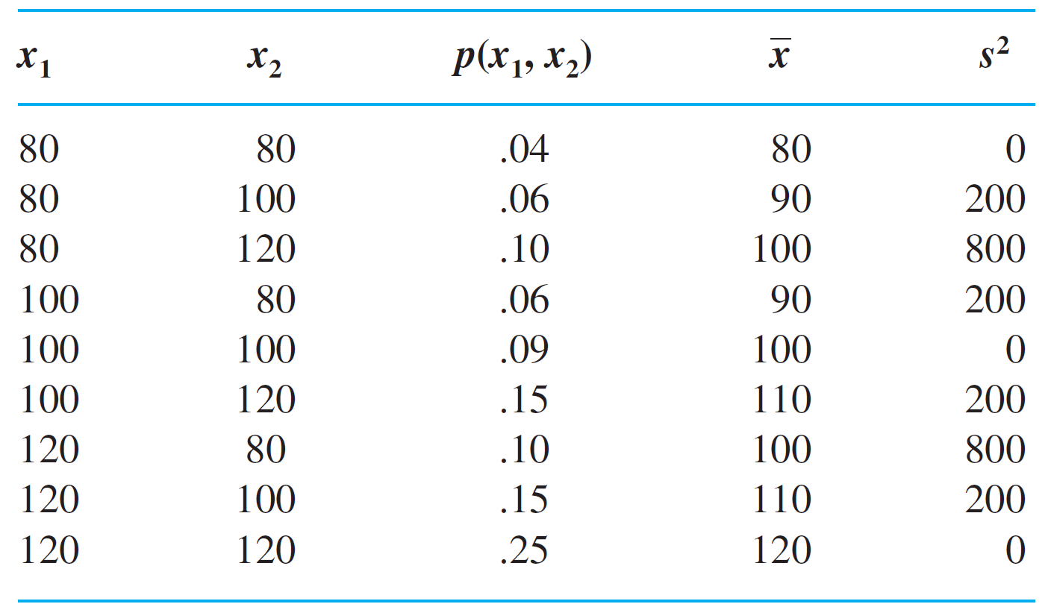
Sampling Distribution – Ex 5.20 (cont)
Outcomes, Probabilities, and Values of x and s² for Example 20
Table 5.2

Slide 36
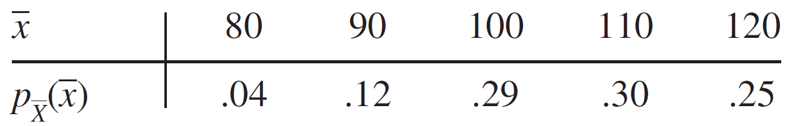
Sampling Distribution – Ex 5.20 (cont)

Slide 37
Sampling Distribution – Ex 5.20 (cont)

Slide 38
Sampling Distribution – Ex 5.20 (cont)

Slide 39
Example 5.22: Simulations Exps

Slide 40
Example 5.23: Simulations Exps

Slide 41
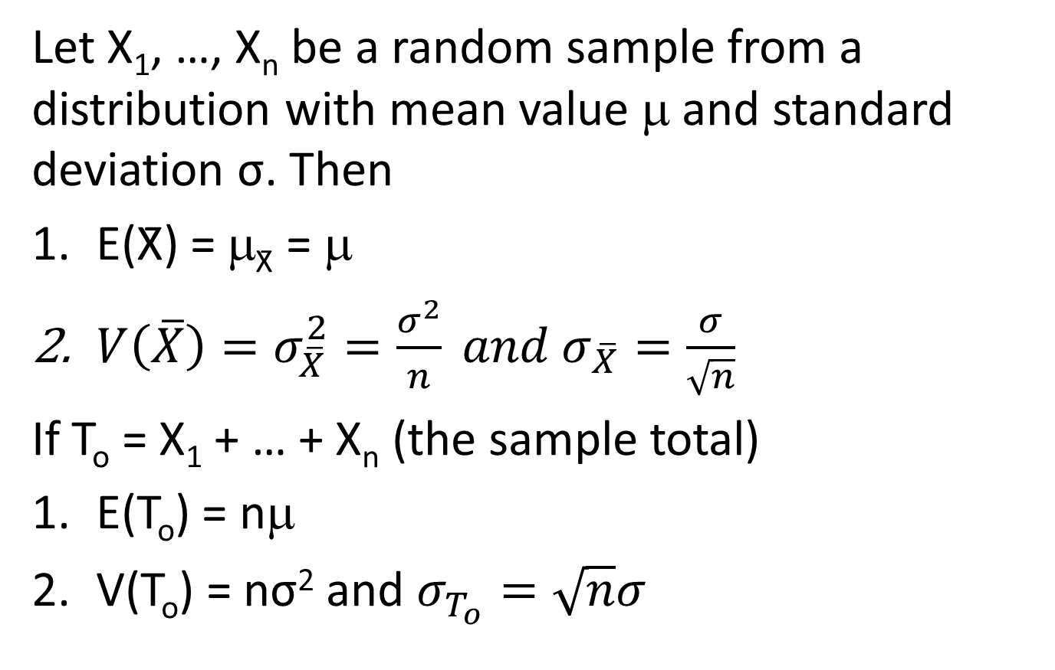
Distribution of the Sample Mean
Let X₁, …, X_{n} be a random sample from a distribution with mean value μ and standard deviation σ. Then
E(X̄) = μ_{X̄} = μ
$V\left(\overline{X}\right)=σ_{\overline{X}}^{2}=\frac{σ^{2}}{n} and σ_{\overline{X}}=\frac{σ}{\sqrt{n}}$
If T_{o} = X₁ + … + X_{n} (the sample total)
E(T_{o}) = nμ
V(T_{o}) = nσ² and $σ_{T_{o}}=\sqrt{n}σ$

Slide 42
Distribution
A normal population distribution and sampling distributions
Figure 5.14

Slide 43
Sample Mean – Normal
The time that it takes a randomly selected rat of a certain subspecies to find its way through a maze has a distribution of N(μ = 1.5 min, σ = 0.35 min). Suppose five rats are random selected. Let X₁, …, X₅ denote their times in the maze. T_{o} = X₁ + ∙∙∙ + X₅ be
the total time and be the average time.
What is the probability that the total time of the 5 rats is between 6 and 8 minutes?
What is the probability that the average time is at most 2.0 minutes?

Slide 44
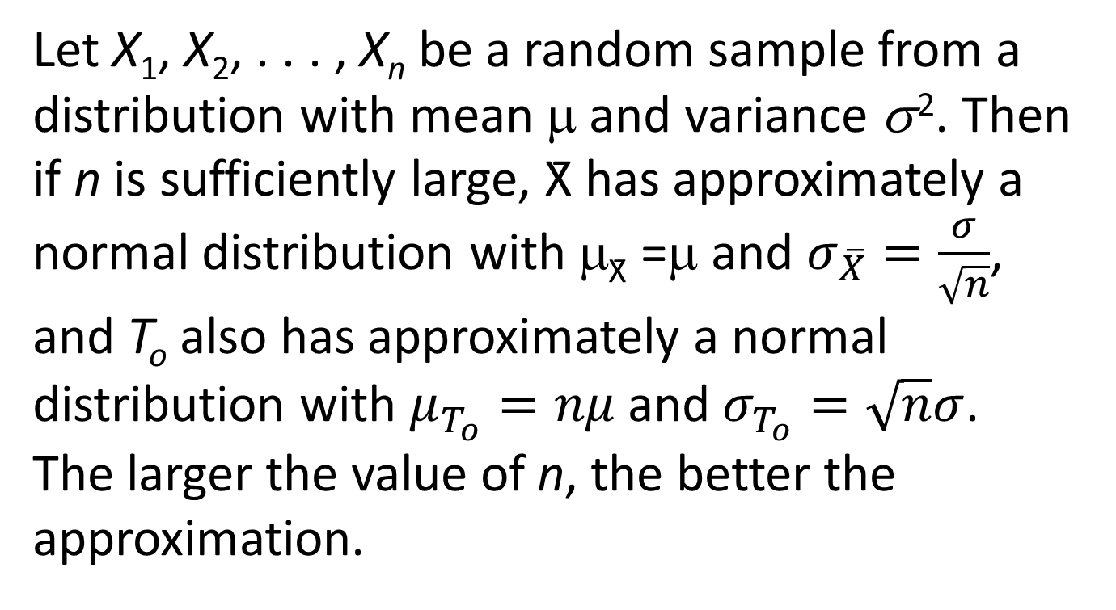
Central Limit Theorem (CLT)
Let X₁, X₂, . . . , X_{n} be a random sample from a distribution with mean μ and variance σ ². Then if n is sufficiently large, X̄ has approximately a normal distribution with μ_{X̄} =μ and $σ_{\overline{X}}=\frac{σ}{\sqrt{n}}$,
and T_{o} also has approximately a normal distribution with $μ_{T_{o}}=nμ$ and $σ_{T_{o}}=\sqrt{n}σ$. The larger the value of n, the better the approximation.

Slide 45
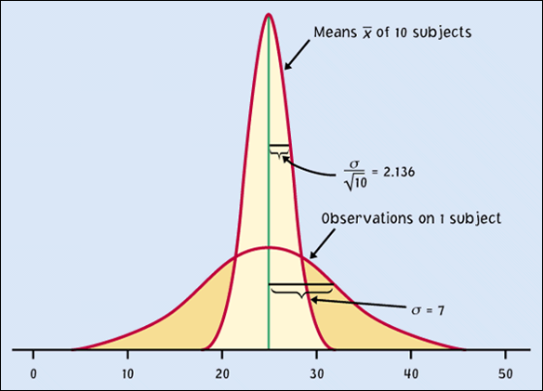
CLT
The Central Limit Theorem illustrated
Figure 5.15

Slide 46
CLT: Example 5.26
The amount of a particular impurity in a batch of a certain chemical product is a random variable with mean value 4.0 g and standard deviation 1.5 g. If 50 batches are independently prepared, what is the (approximate) probability that the sample average amount of impurity is between 3.5 and 3.8 g?

Slide 47
CLT: Example 5.27
The number of major defects for a certain model of automobile is a random variable with mean 3.2 and standard deviation 2.4.
Among 100 randomly selected cars of this model, how likely is it that the average number of major defects exceeds 4?
How likely is it that the number of major defects of all 100 cars exceeds 250?

Slide 48
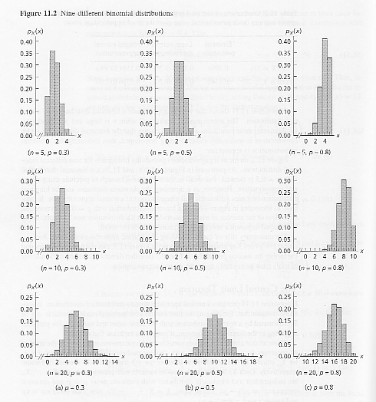
9 Binomial distributions

Slide 49
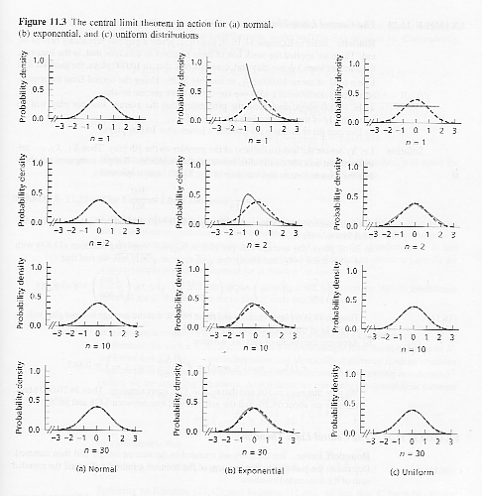
Central Limit Theorem

Slide 50
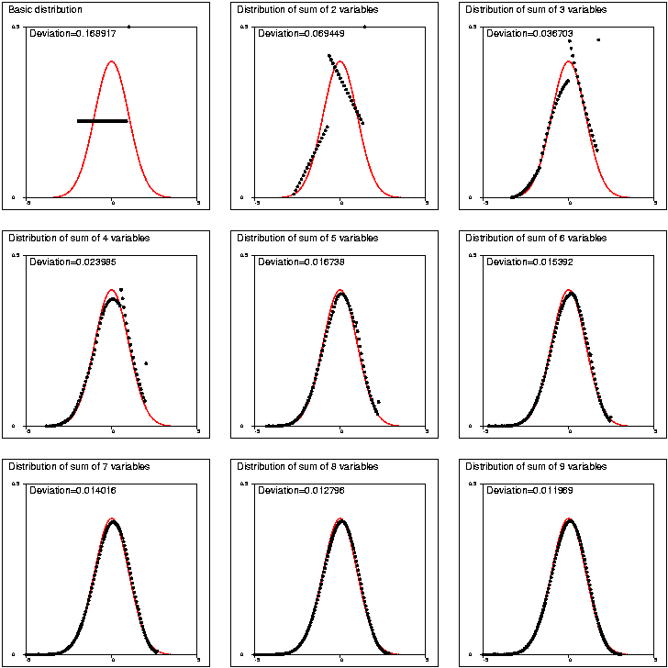
Central Limit Theorem
S.Mustonen (2003)
http://www.survo.fi/gallery/072.html

Slide 51
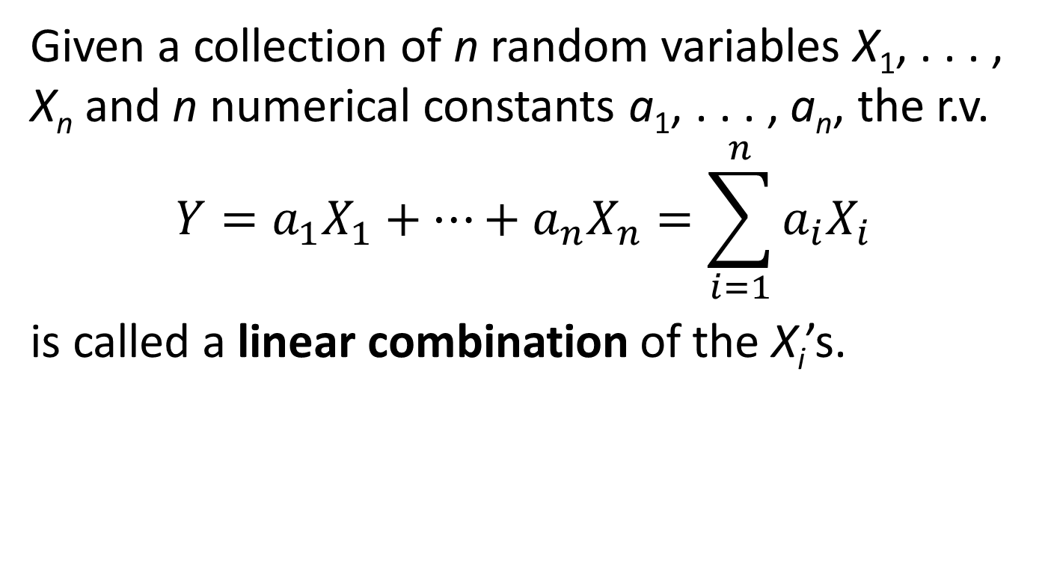
Linear Combination
Given a collection of n random variables X₁, . . . , X_{n} and n numerical constants a₁, . . . , a_{n}, the r.v.
$$Y=a_{1}X_{1}+⋯+a_{n}X_{n}=\sum_{i=1}^{n}{a_{i}X_{i}}$$
is called a linear combination of the X_{i}’s.

Slide 52

The Distribution of a Linear Combination
Proposition
Let X₁, X₂, . . . , X_{n} have mean values μ₁, . . . , μ_{n}, respectively, and variances respectively.
1. Whether or not the X_{i}’s are independent,
E(a₁X₁ + a₂X₂ + . . . + a_{n}X_{n}) = a₁E(X₁) + a₂E(X₂) . . .+a_{n}E(X_{n})
= a₁μ₁ + . . . + a_{n}μ_{n}
(5.8)

Slide 53
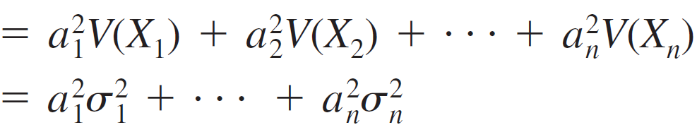
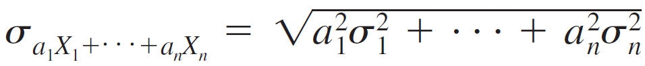
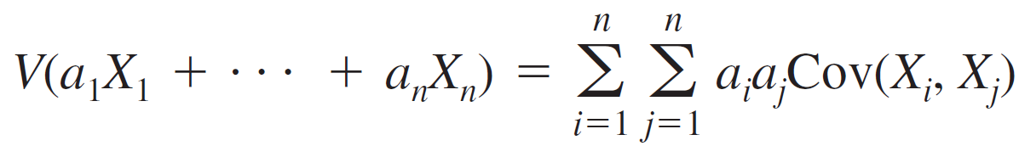
The Distribution of a Linear Combination (cont)
2. If X₁, . . . , X_{n} are independent,
V(a₁X₁ + a₂X₂ + . . . + a_{n}X_{n})
and
3. For any X₁, . . . , X_{n},
(5.9)
(5.10)
(5.11)

Slide 54
Example 5.29*: Linear Combination
A gas station sells three grades of gasoline: regular, extra, and super. These are priced at $3.43, $3.53 and $3.63 per gallon respectively. Let X₁, X₂ and X₃ denote the amounts of these grades purchased (gallons) on a particular day. Suppose X_{i}’s are independent and normally distributed with μ₁ = 1000, μ₂ = 500, μ₃ = 300, σ₁ = 100, σ₂ = 80 and σ₃ = 50.
a) What is the expected revenue and standard deviation from sales?

Slide 55
Example: Linear Combination - Difference
A gas station sells three grades of gasoline: regular, extra, and super. These are priced at $3.43, $3.53 and $3.63 per gallon respectively. Let X₁, X₂ and X₃ denote the amounts of these grades purchased (gallons) on a particular day. Suppose X_{i}’s are independent and normally distributed with μ₁ = 1000, μ₂ = 500, μ₃ = 300, σ₁ = 300, σ₂ = 80 and σ₃ = 50.
b) What are the expectation and standard deviation of the difference between the amount of extra and super grades of gasoline sold?

Slide 56
Example 5.31*: Linear Combination - Normal
A gas station sells three grades of gasoline: regular, extra, and super. These are priced at $3.43, $3.53 and $3.63 per gallon respectively. Let X₁, X₂ and X₃ denote the amounts of these grades purchased (gallons) on a particular day. Suppose X_{i}’s are independent and normally distributed with μ₁ = 1000, μ₂ = 500, μ₃ = 300, σ₁ = 100, σ₂ = 80 and σ₃ = 50.
E(Y) = $6284.00, σ_{Y} = $479.94
c) Find the probability that the total revenue exceeds $6000.

