Slide 1

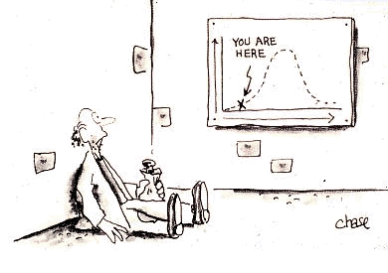
4
Continuous Random Variables and
Probability Distributions
Copyright © Cengage Learning. All rights reserved.
https://onlinecourses.science.psu.edu/
stat414/node/307

Slide 2
Example: Continuous r.v.
In a computer repair shop, select computers that are brought in at random. Let X = the time that a computer functions before breaking down.
Select runners at random in a certain park. Let X = the distance run between seeing two people while running in the park.
Make depth measurements at a randomly selected location in a specific lake. Let X = the depth at this location.
A chemical compound is randomly selected. Let X = the pH value of the compound measured in a solvent.

Slide 3
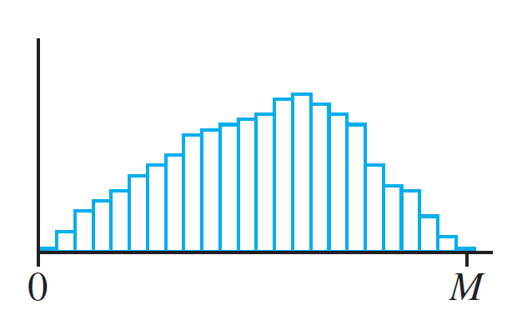
Development of pdf
(a)
(b)
(c)

Slide 4
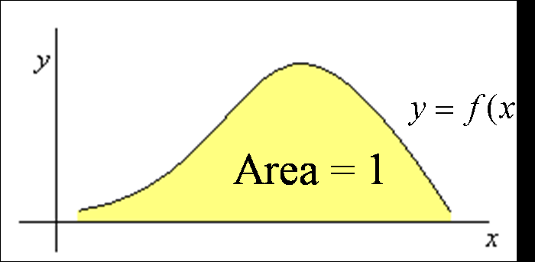
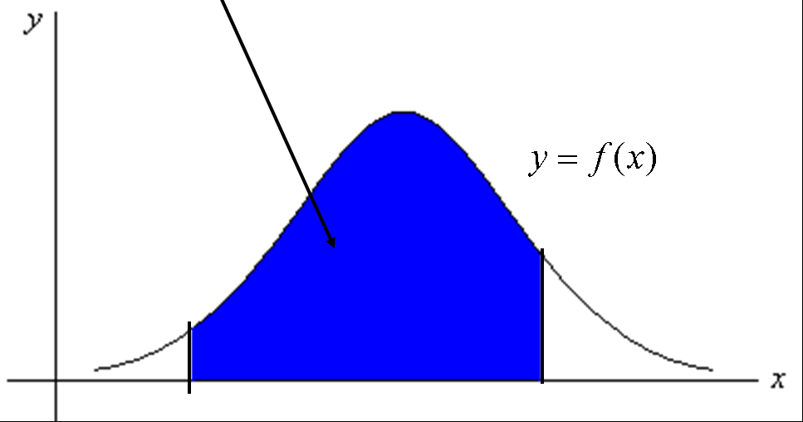
pdf
P(a ≤ X ≤ b)

Slide 5
Example 1: pdf Uniform
A person casually walks to the bus stop when the bus comes every 30 minutes.
What is the pdf for the wait time?
What is the probability that the person has to wait between 5 and 10 minutes?
What is the probability that the person has to wait longer than 5 minutes?

Slide 6
Example 2: pdf
Let X = the life span of some bacteria (in hours), X is a continuous r.v. with pdf
What is the probability that the bacteria lives over 2 hours?
What is the probability that the bacteria dies within one hour?

Slide 7
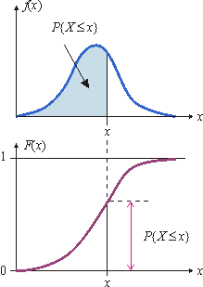
pdf/cdf
A pdf and associated cdf
http://daad.wb.tu-harburg.de/?id=271

Slide 8
Example cdf: Uniform
A person casually walks to the bus stop when the bus comes every 30 minutes has a pdf of
What is the cdf of X?

Slide 9
F(x): Uniform

Slide 10
F(x): Uniform (general case)
B

Slide 11
Example cdf: Uniform (cont)
A person casually walks to the bus stop when the bus comes every 30 minutes. Use F(x) to make the following calculations.
What is the probability that the person has to wait between 5 and 10 minutes?
What is the probability that the person has to wait longer than 5 minutes?

Slide 12
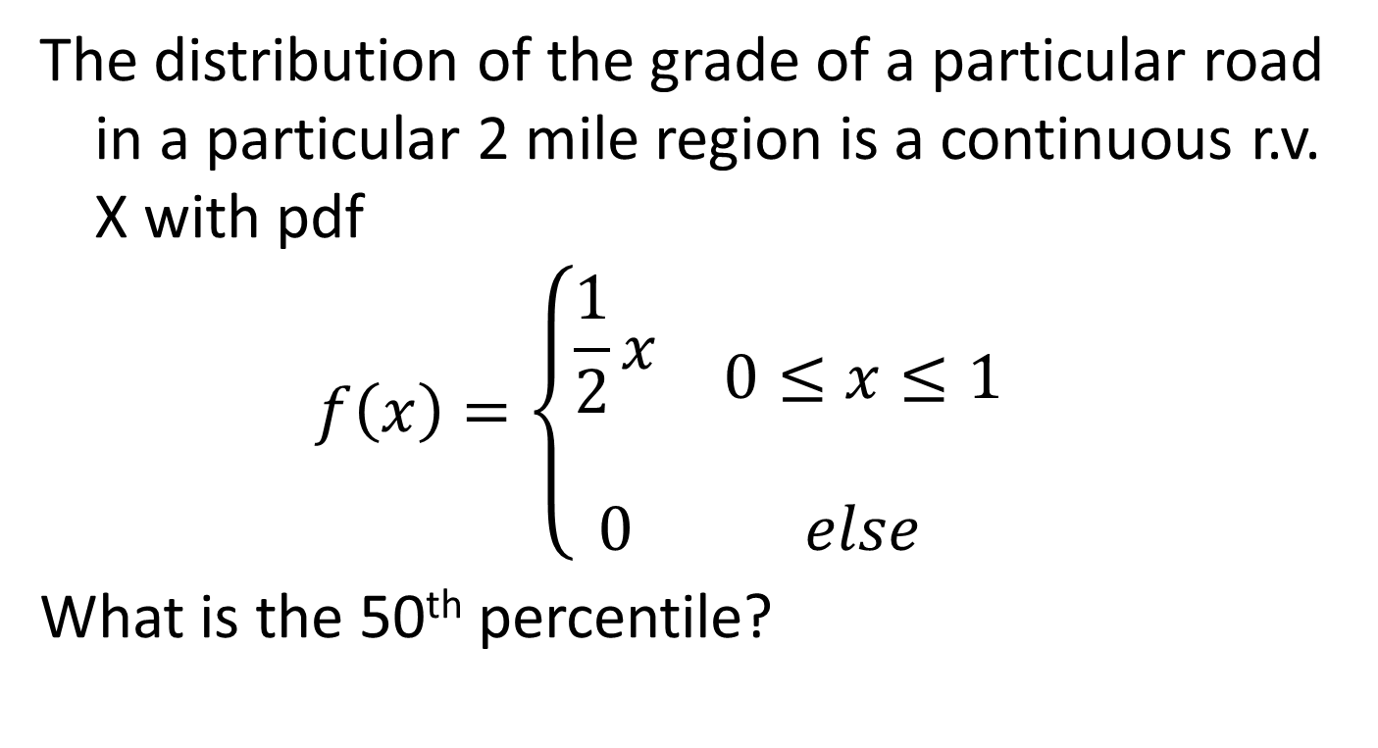
Example: Percentile
The distribution of the grade of a particular road in a particular 2 mile region is a continuous r.v. X with pdf
$$f\left(x\right)=\left\{\begin{matrix}\begin{aligned}\frac{1}{2}x \\ \end{aligned} & 0≤x≤1 \\ 0 & else\end{matrix}\right.$$
What is the 50th percentile?

Slide 13
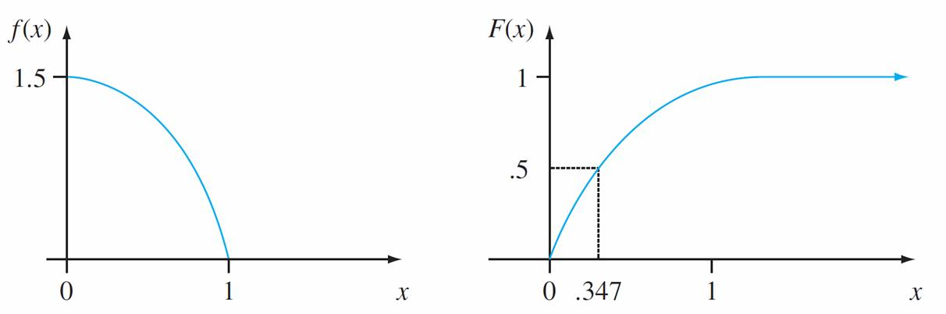
Example 4.9: Percentile (cont)
The pdf and cdf for Example 4.9
Figure 4.11
X

Slide 14
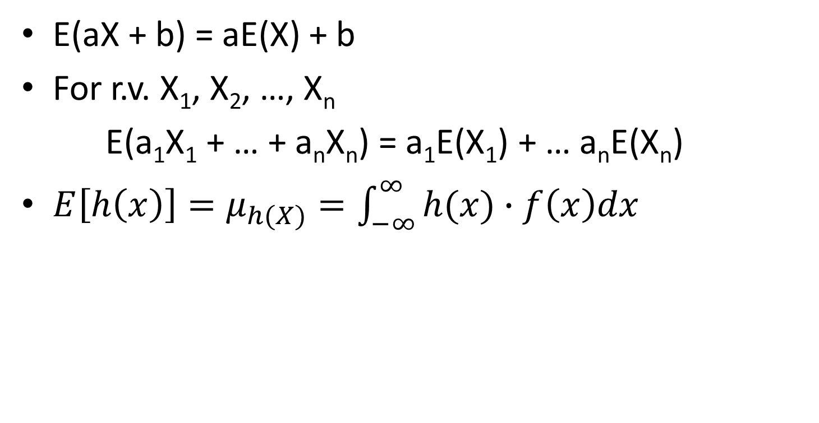
Rules of Expected Values
E(aX + b) = aE(X) + b
For r.v. X₁, X₂, …, X_{n}
E(a₁X₁ + … + a_{n}X_{n}) = a₁E(X₁) + … a_{n}E(X_{n})
$E\left[h\left(x\right)\right]=μ_{h(X)}=\int_{−∞}^{∞}{h(x)∙f\left(x\right)dx}$

Slide 15
Example: Expectations
The uniform distribution has a pdf of
What are E(X) and E(X²)?

Slide 16
Variance
Var(X) = E(X²) – (E(X))²
Rules: Given two real numbers a and b and a function h
Var(aX + b) = a²Var(X)
σ_{aX+b} = |a|σ_{X}
Var[h(X)] = E[h²(X)] – [E(h(X))]²

Slide 17
Example: Expectations
The uniform distribution has a pdf of
What are E(X) and E(X²)?
What is the Var(X)?

Slide 18
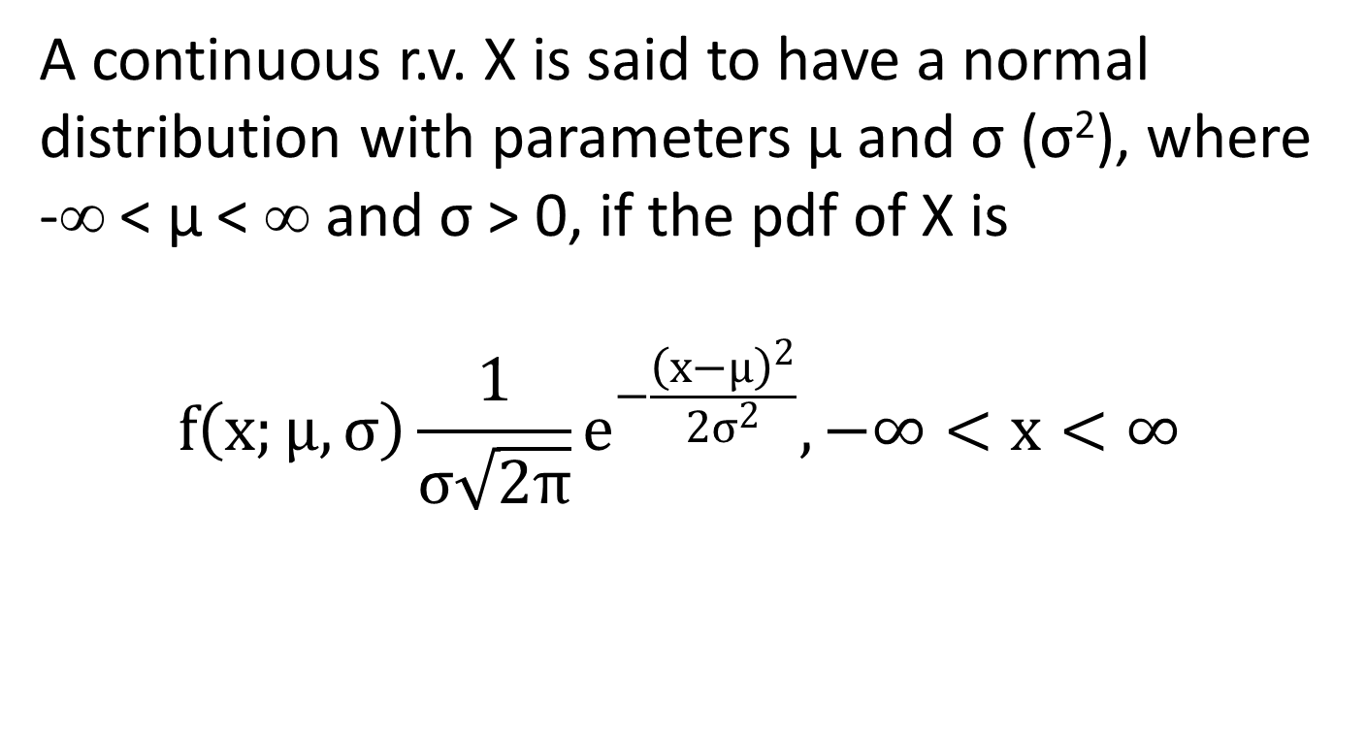
Normal Distribution
      A continuous r.v. X is said to have a normal distribution with parameters μ and σ (σ²), where -∞ < μ < ∞ and σ > 0, if the pdf of X is
        $$f\left(x;μ,σ\right)\frac{1}{σ\sqrt{2π}}e^{−\frac{{\left(x−μ\right)}^{2}}{2σ^{2}}}, −∞<x<∞$$

Slide 19
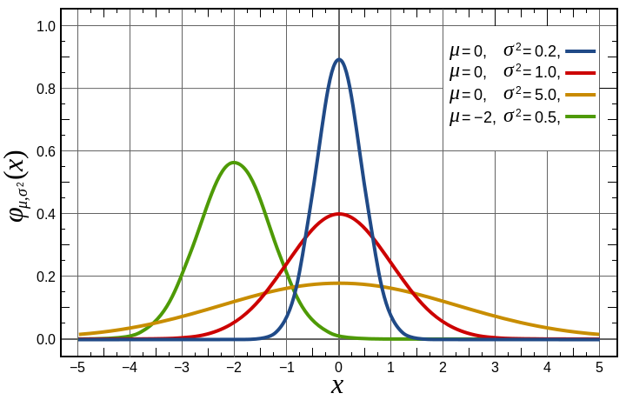
Shapes of Normal Curves
https://en.wikipedia.org/wiki/File:Normal_Distribution_PDF.svg

Slide 20
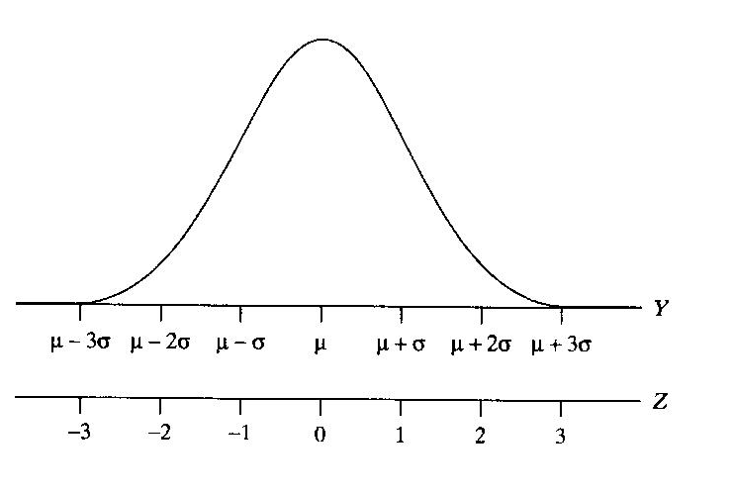
Shape of z curve

Slide 21
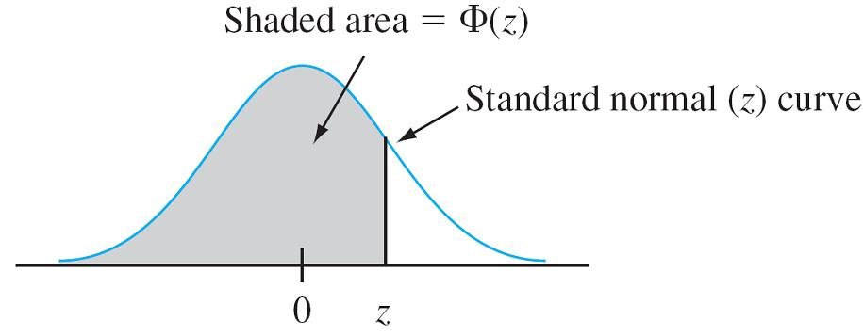
Φ(z)

Slide 24
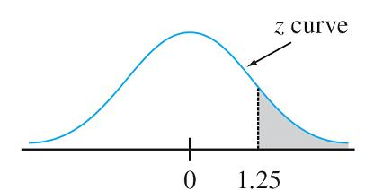
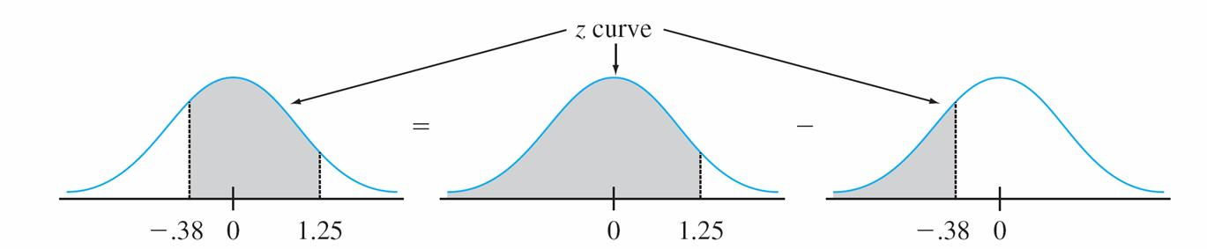
Using the Z table

Slide 25
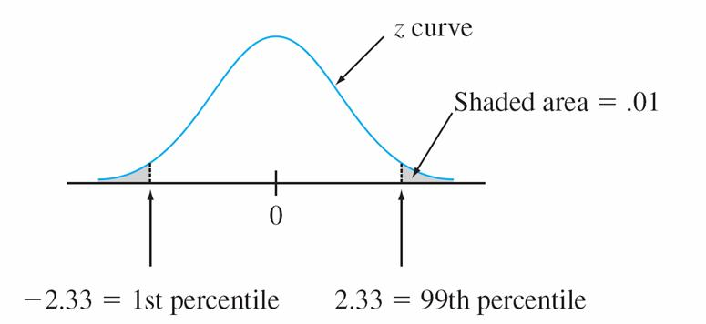
Symmetry of z-curve

Slide 26
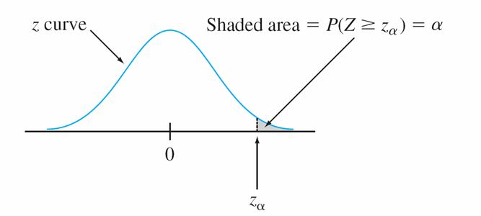
z_{α}

Slide 27
Example: Nonstandard Normal Distribution
Suppose the current measurements in a strip of wire are assumed to follow a normal distribution with a mean of 10 mA (milliamperes) and a standard deviation of 2.1 mA.
What is the probability that a current measurement will be between 9 mA and 13 mA?
What is the probability that a current measurement will exceed 13 mA.

Slide 28
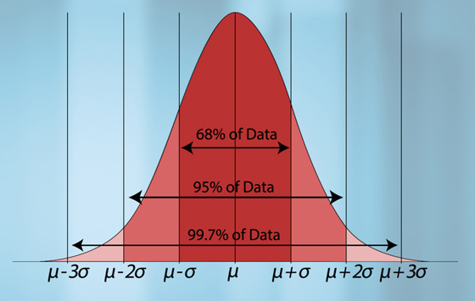
Empirical Rule
http://www.learner.org/courses/againstallodds/about/glossary.html

Slide 29
Example: Nonstandard Normal Distribution
Suppose the current measurements in a strip of wire are assumed to follow a normal distribution with a mean of 10 mA (milliamperes) and a standard deviation of 2.1 mA.
What is the probability that a current measurement will be between 9 mA and 13 mA?
What is the probability that a current measurement will exceed 13 mA.
Determine the 95th percentile of the current measurements?

Slide 30
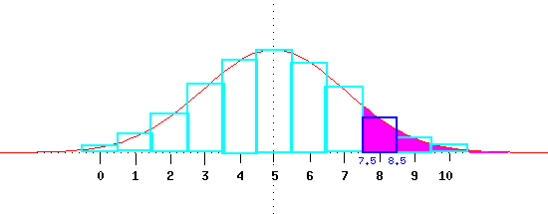
Continuity Correction
http://faculty.cns.uni.edu/~campbell/stat/prob9.html

Slide 31
Continuity Correction - Procedure
Actual Value | Approximate Value
P(X = a) | P(a – 0.5 < X < a +0.5)
P(a < X) | P(a + 0.5 < X)
P(a ≤ X) | P(a – 0.5 < X)
P(X < b) | P(X < b – 0.5)
P(X ≤ b) | P(X < b + 0.5)

Slide 32
Example: Approximating a Binomial
72% of women marry before 35 years old. For 500 women, what is the probability that at least 375 get married before they are 35 years old?

Slide 33
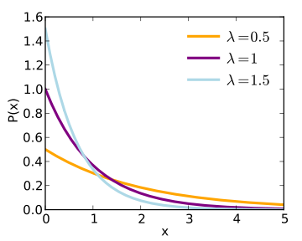
Shape of Exponential
http://en.wikipedia.org/wiki/File:Exponential_pdf.svg

Slide 34
Example: Exponential Distribution
The time, in hours, during which an electrical generator is operational is a r.v. that follows the exponential distribution with expected time of operation of 160 hours. What is the probability that the generator of this type will be operational for
less than 40 hours?
between 60 and 160 hours?
more than 200 hours?

Slide 35
Gamma Distribution: uses
Interval or time to failure (Exponential)
Queuing models
Flow of items through manufacturing and distribution processes
Load on web servers
Telecom exchange
Climatology – model for rainfall
Financial services – insurance claims, size of load defaults, probability of ruin, value of risk

Slide 36
Gamma Function
For α > 0,
Properties:
For α > 1, Γ(α) = (α – 1) ⋅ Γ(α – 1)
For any positive integer n, Γ(n) = (n – 1)!

Slide 37
Gamma Distribution
Standard: β =1
Exponential: α = 1, β = 1/λ

Slide 38
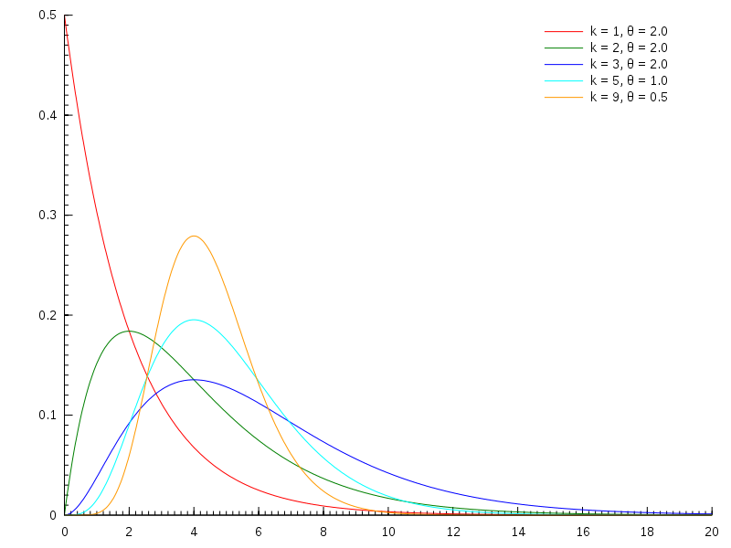
Shapes of Gamma Distribution
k = α
θ = 1/β
http://en.wikipedia.org/wiki/File:Gamma_distribution_pdf.svg

Slide 39
Gamma Distribution
E(X) = αβ
Var(X) = αβ²
cdf of standard gamma
  Incomplete gamma function
  Tabulated in Appendix A.4

Slide 40
χ² distribution

Slide 41
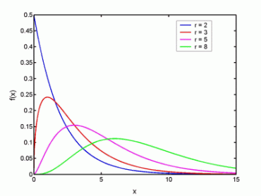
Shapes of χ² Distribution
r = ν
http://cnx.org/content/m13129/latest/chi_sq.gif

Slide 42
Weibull – pdf

Slide 43
Weibull – Uses
Used in material science as ‘time to failure’
If α < 1, the failure rate decreases over time.
Defective items fail early.
If α = 1, the failure rate is constant over time.
Exponential distribution.
3) If α > 1, the failure rate increases over time.
items are more likely to fail as time goes on.
In Material Science, α is known as the Weibull modulus

Slide 44
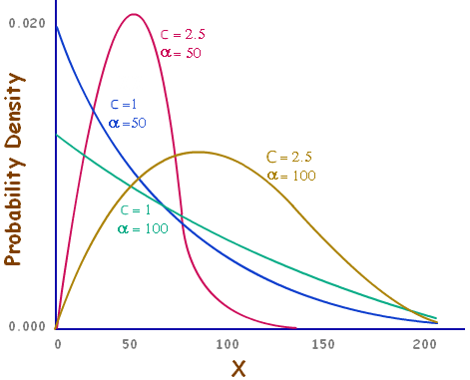
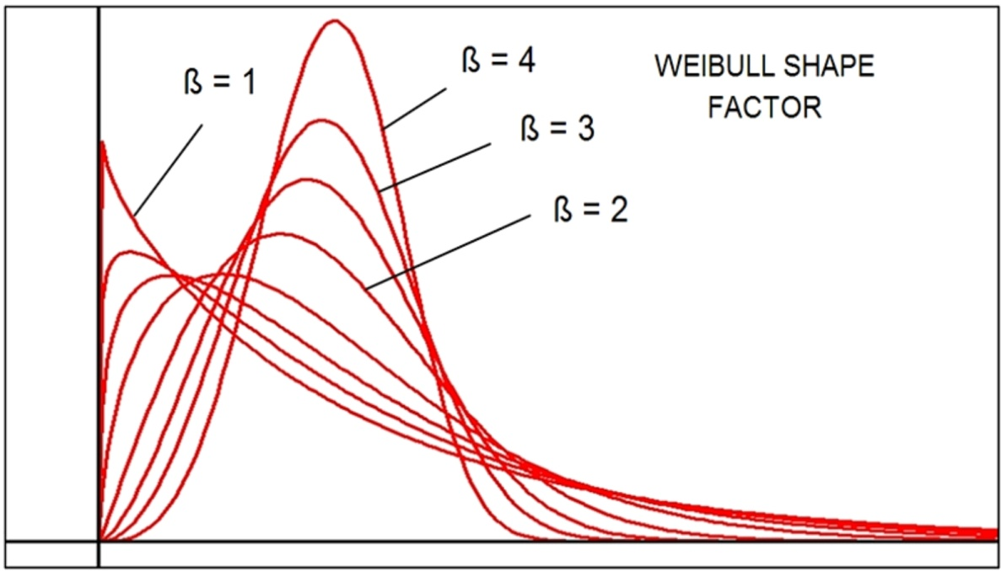
Weibull Distribution: Shapes
β = α
c = α
α = β
http://www.mathcaptain.com/probability/weibull-distribution.html
http://www.applicationsresearch.com/WeibullEase.htm

Slide 45
Weibull – Expectation/Variance
Γ: the Gamma Function

Slide 46
Weibull – cdf

Slide 47
Lognormal – Uses
A product of many independent r.v.
Wireless communication: The attenuation caused by shadowing or slow fading from random objects
Electronic (semiconductor) failure mechanism: failure degradation
Personal incomes
Tolerance of poison in animals

Slide 48
Lognormal – pdf

Slide 49
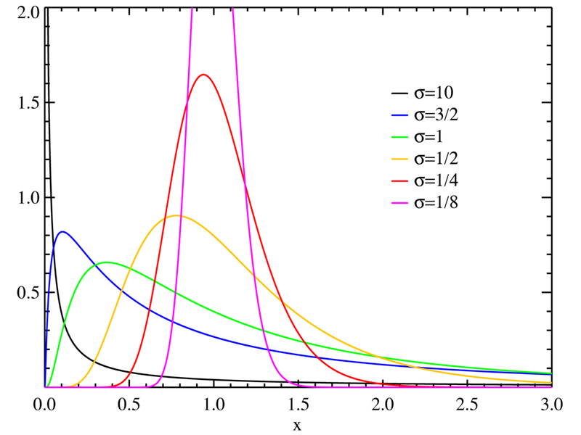
Lognormal Distribution: Shapes
http://commons.wikimedia.org/wiki/
File:Lognormal_distribution_PDF.png

Slide 50
Lognormal – Expectation/Variance

Slide 51
Lognormal – cdf

Slide 52
Beta – uses
Only has a positive density for values in a finite interval.
The uniform distribution is a member of this family.
Model proportions, probabilities.
e.g. proportion of a day that a person sleeps.
2) Any situation where the distribution is over a finite range.

Slide 53
Beta – pdf
When A = 0, B = 1, this is the standard beta
Distribution.

Slide 54
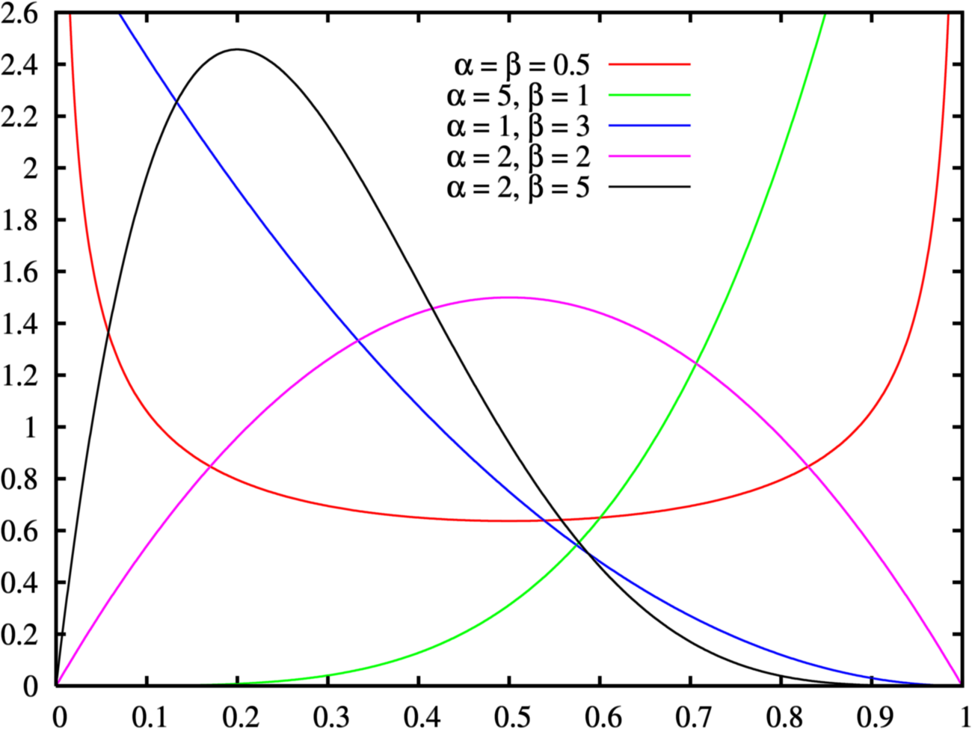
Beta Distribution:Shapes (Standard)
http://upload.wikimedia.org/wikipedia/commons/9/9a/Beta_distribution_pdf.png

Slide 55
Beta – Expectation/Variance

Slide 56

QQ Plot: Percentiles
$\left[100\frac{i−0.5}{n}\right]$
$\left[100\frac{i}{n+1}\right]$
$\left[100\frac{i−1/3}{n+1/3}\right]$

Slide 57
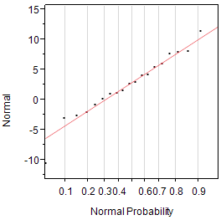
QQ-plot - normal

Slide 58
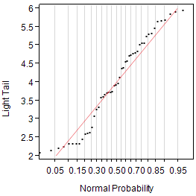
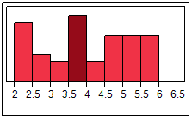
QQ-plot – light tails

Slide 59
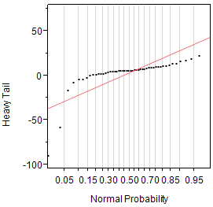
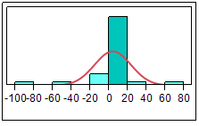
QQ-plot: heavy tailed

Slide 60
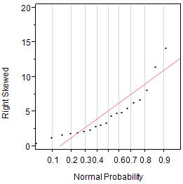
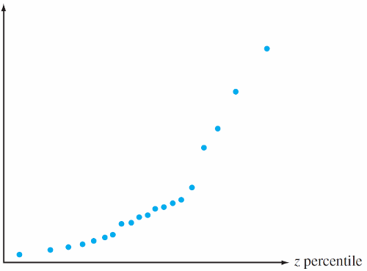
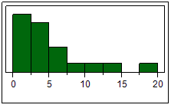
QQ-plot: right skewed

Slide 61
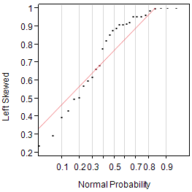
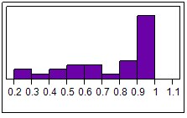
QQ Plot – Left Skewed

