Slide 1

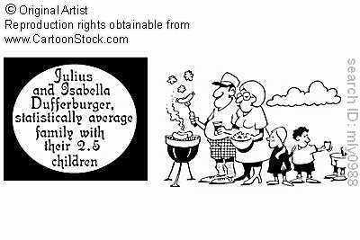
3
Discrete Random
Variables and
Probability Distributions
Copyright © Cengage Learning. All rights reserved.
http://www.cartoonstock.com/directory/a/average_family_gifts.asp

Slide 2
Example: Random Variables
The number that is rolled on a die
The sum of numbers rolled on two dice
The total number of failed components in a month

Slide 3
Example (cont): Random Variables
What are all of the possible random variables in the following:
Toss an n-sided die and determine if the number is even or odd.
Check if a manufactured bolt has a defect.
Determine the lifetime of a light bulb.
Roll 3 dice. Let I_{i} be the Bernoulli variable (even:1/odd: 0) for the i^{th} roll. Let X be the total number of even rolls.

Slide 4
Example: Discrete/Continuous
Are the following discrete or continuous r.v.?
X = number of tosses needed before getting a head
Y = lifetime of a light bulb
W = altitude of a specific location.
Z = number of calls a receptionist gets in an hour

Slide 5
Example: Probability Distributions
a) Calculate the pmf of rolling a 4-sided die where X = the outcome of the die.
Use the pmf above to determine the following:
b) What is the probability that the roll is at most a 2?
c) What is the probability that the roll is at least a 2?
d) What is the probability that the roll is between a 2 and a 4 inclusive?
e) What is the probability that the roll is between a 2 and a 4 exclusive?

Slide 6
Example: pmf
roll # | 1 | 2 | 3 | 4 | 5
x | 2 | 4 | 1 | 2 | 2
roll # | 6 | 7 | 8 | 9 | 10
x | 3 | 1 | 2 | 4 | 2

Slide 7
Example: pmf line graph
x |  | 1 | 2 | 3 | 4 | else
p(x) |  | 0.2 | 0.5 | 0.1 | 0.2 | 0

Slide 8
Definition: Parameter
Suppose that p(x) depends on a quantity that can be assigned any one of a number of possible values, with each different value determining a different probability distribution. Such a quantity is called a parameter of the distribution.
The collection of all probability distributions for different values of the parameter is called a family of probability distributions.

Slide 9
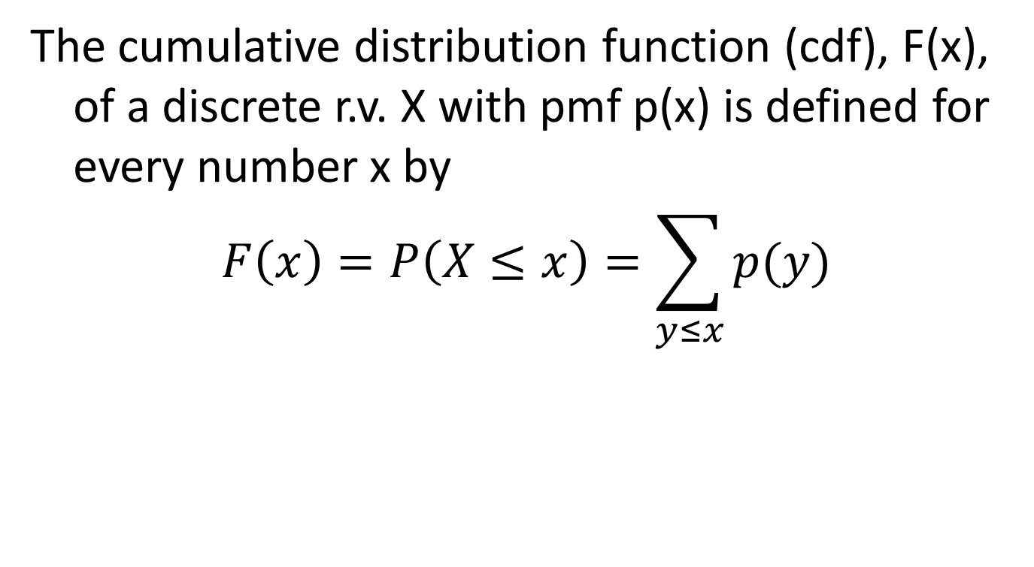
Definition: Cumulative Distribution Function (cdf)
The cumulative distribution function (cdf), F(x), of a discrete r.v. X with pmf p(x) is defined for every number x by
$$F\left(x\right)=P\left(X≤x\right)=\sum_{y≤x}{p(y)}$$

Slide 10
Example: pmf line graph
x |  | 1 | 2 | 3 | 4 | else
p(x) |  | 0.2 | 0.5 | 0.1 | 0.2 | 0

Slide 11
Example: cdf graph
F(x)
x

Slide 12
CDF
What is the cdf for the following pmf?

Slide 13
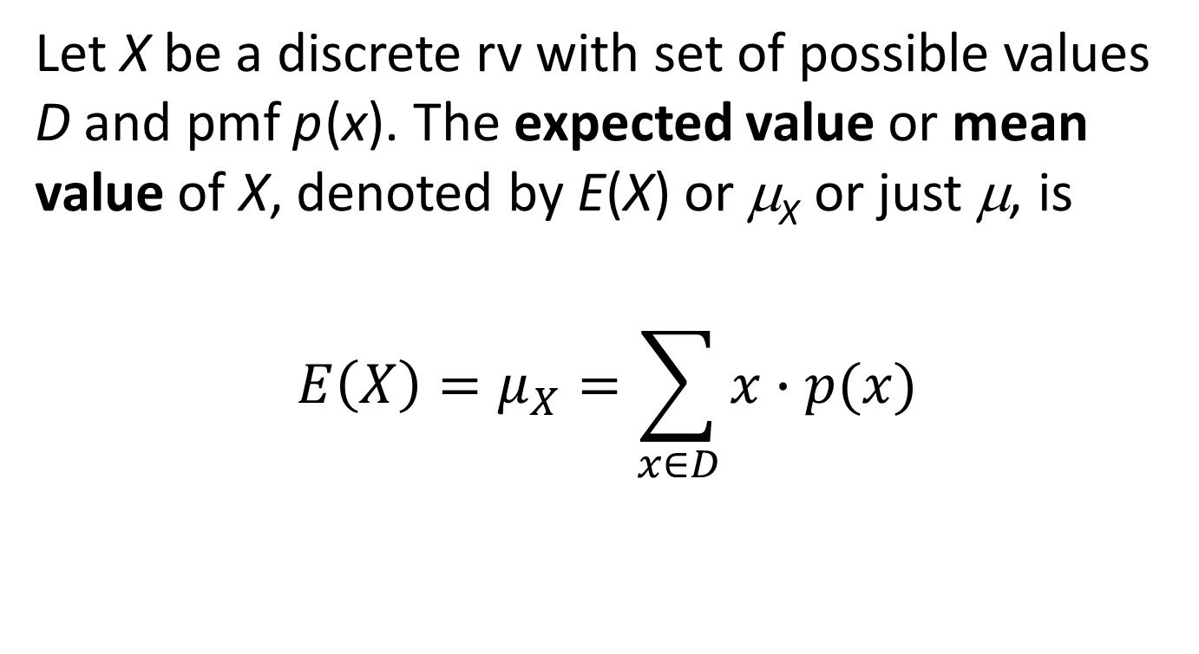
Expected Value: Definition
Let X be a discrete rv with set of possible values D and pmf p (x). The expected value or mean value of X, denoted by E(X) or μ_{X} or just μ, is
$$E\left(X\right)=μ_{X}=\sum_{x∈D}{x∙p(x)}$$

Slide 14
Expected Value
What is the expected value of the outcome on a 4-sided die?
What is the expected value for the following pmf?
Example 3.18: What is the expected value of a Bernoulli r.v. with X(1) = p?
x | 1 | 2 | 3 | 4 | else
p(x) | 0.2 | 0.5 | 0.1 | 0.2 | 0

Slide 15
Example: Expected Value of h(X)
Let X be the number of components in a circuit. If the circuit fails, h(X) = 30 – 3X is the cost of repair of the circuit.
What is the expected value of the cost?
What is the expected value of X²?
x | 1 | 2 | 3 | 4 | else
p(x) | 0.2 | 0.5 | 0.1 | 0.2 | 0

Slide 16
Rules of Expected Values
E(aX + b) = aE(X) + b
For r.v. X₁, X₂, …, X_{n}
E(a₁X₁ + … + a_{n}X_{n}) = a₁E(X₁) + … a_{n}E(X_{n})

Slide 17
Example: Expected Value of h(X)
Let X be the number of components in a circuit. If the circuit fails, h(X) = 30 – 3X is the cost of repair of the circuit.
What is the expected value of the cost?
x | 1 | 2 | 3 | 4 | else
p(x) | 0.2 | 0.5 | 0.1 | 0.2 | 0

Slide 18
Variance: Example
What is the variance of the outcome on a 4-sided die?
What is the variance for the following pmf?
What is the variance of a Bernoulli r.v. with X(1) = p?
x | 1 | 2 | 3 | 4 | else
p(x) | 0.2 | 0.5 | 0.1 | 0.2 | 0

Slide 19
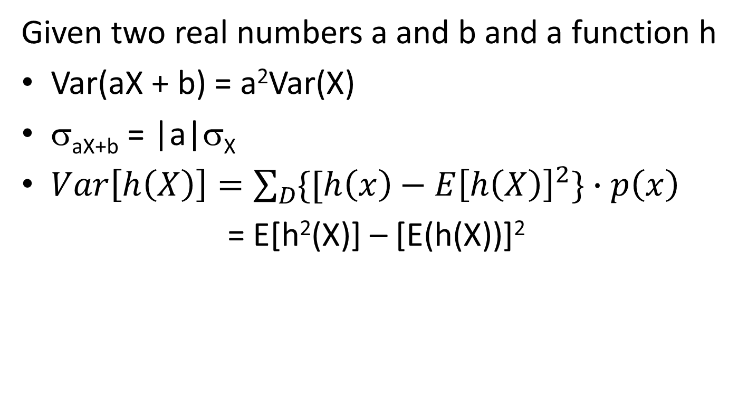
Rules for Variance
Given two real numbers a and b and a function h
Var(aX + b) = a²Var(X)
σ_{aX+b} = |a|σ_{X}
$Var\left[h\left(X\right)\right]=\sum_{D}{{\{[h\left(x\right)−E\left[h\left(X\right)\right]}^{2}\}∙p\left(x\right)}$
  = E[h²(X)] – [E(h(X))]²

Slide 20
Binomial Experiment: Conditions (BInS)
Binary: Each trial is dichotomous, two results
Independent: The trials are independent
n: The number of trials is fixed.
Success: The probability of a success is constant.

Slide 21
Binomial Experiment
Are the following Binomial Experiments?
Rolling a fair 4-sided die and observing whether the number showing is a 1 or not
The number of births of girls in a county hospital on any specific day.
In a drug trial, some patients with the same condition are given a drug and some are given a placebo to see if the drug is effective or not.
In quality control we want to see if a particular product is ‘good’. We take random samples from an assembly line that uses different machines to produce the product.

Slide 22
Binomial Experiment with 3 Trials
Roll a fair 3-sided die 3 times and observe if the roll is a 2. What is the pmf?
Outcome
x
Probability
Outcome
x
Probability
SSS
3
p
FSS
2
p
(1
3
2
–
p)
SSF
2
p
(1
–
p)
FSF
1
p(1
2
–
p)
2
SFS
2
p
(1
–
p)
FFS
1
p(1
2
–
p)
2
SFF
1
p(1
–
p)
FFF
0
(1
2
–
p)
3
x
0
1
2
3
else
p(x)
(
1
-
p)
3p(1
-
p)
3p
(1
-
3
2
2
p)
p
0
3

Slide 23
Binomial Experiment with 4 Trials
Roll a fair 3-sided die 4 times and observe if the roll is a 2. What is the pmf?
x | 0 | 1 | 2 | 3 | 4 | else
p(x) | (1-p)⁴ | 4p(1-p)³ | 6p²(1-p)² | 4p³(1-p) | p⁴ | 0

Slide 24
Binomial Distribution: Example 1
A card is drawn from a standard 52-card deck. If drawing a club is considered a success, find the probability of
1. exactly one success in 4 draws (with replacement)
2. no successes in 5 draws (with replacement)

Slide 25
Binomial Distribution: Example 2
20% of all telephones of a certain type are submitted for service while under warranty. Of these 60% can be repaired, whereas the other 40% must be replaced with new units. If a company purchases ten of these telephones,
1. what is the probability that exactly two will end up being replaced under warranty?
2. what is the probability that between two and four (inclusive) will end up being replaced under warranty?

Slide 26
Cumulative Binomial Probabilities
X

Slide 27
Binomial Distribution Mean/Variance: Example 2
20% of all telephones of a certain type are submitted for service while under warranty. Of these 60% can be repaired, whereas the other 40% must be replaced with new units. If a company purchases ten of these telephones,
3. what is the expected number of phones that will be replaced under warranty?
4. what is the variance and standard deviation of the number of phones that will be replaced under warranty?

Slide 28
Hypergeometric: Assumptions
There is a finite population, N.
There are two outcomes for each member of the population (S or F) with M total successes.
A sample of n objects is selected without replacement.
X = the number of successes in the sample

Slide 29
Example: Hypergeometric
A carton contains 24 bolts, eight of which are defective. What is the probability that if a sample of ten is chosen at random from the carton that exactly three of the bolts is defective?

Slide 30
Example: Hypergeometric
A bag with 10 dice, 3 of them are white and 7 are red, take 6 dice from the bag. Let X = the number white dice.
What are the possible values of X?
What is the probability that you draw one white ball?
What are the mean and variance of X?

Slide 31
Geometric Distribution: Locations in the book
The following are the examples (locations) that explain the geometric distribution (geometric r.v.) in the book:
Example 3.12 (p. 100)
Example 3.14 (p. 102)
Example 3.19 (p. 108)

Slide 32
Example: Geometric r.v.
(similar to example 3.12)
Suppose that we roll a k-sided die until a '1' is rolled. Let X be the number of rolls it takes to roll the '1'.
What is the PMF of X?
X

Slide 33
Negative Binomial Experiment: Conditions (BInS)
Binary: Each trial is dichotomous, two results
Independent: The trials are independent
n: The number of trials is fixed.
Success: The probability of a success is constant.
X = The number of failures until the r^{th} success.

Slide 34
Example: Negative Binomial r.v.
Suppose that we roll an 4-sided die until five '1‘s are rolled. Let X be the number of failures that it takes to perform this experiment.
What is the PMF of X?

Slide 35
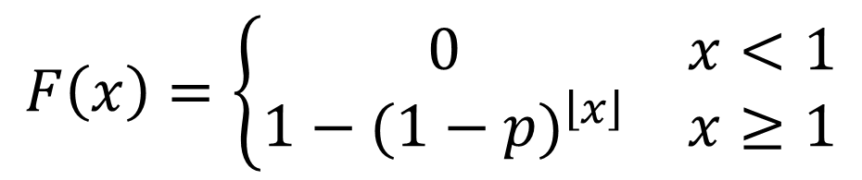
cdf of geometric distribution
F(x)
p=0.4
x
$$F\left(x\right)=\left\{\begin{matrix}0 & x<1 \\ 1−{(1−p)}^{\left\lfloor x\right\rfloor } & x≥1\end{matrix}\right.$$

Slide 36
Example: Negative Binomial r.v.
Suppose that we roll an 4-sided die until five '1‘s are rolled. Let X be the number of failures that it takes to perform this experiment.
What is the PMF of X?
What are the expectation and variance of X?

Slide 37
Poisson Distribution: Applications
The number of wrong telephone numbers that are dialed in a day.
The number of packages of cat food sold in a WalMart each day.
The number of customers entering the post office on a particular day.
The number of vacancies occurring during a year in the Supreme Court
The number of α-particles discharged in a fixed time period from Uranium-238.
The number of misprints on a page of a book.
The number of people in the Lafayette metropolitan area that are older than 100 years old.

Slide 38
Table A.2: Cumulative Poisson Probabilities
X

Slide 39
Poisson Distribution: Example
Let X = the number of calls an IT consultant receives each hour. X follows a Poisson distribution with mean of 2 calls/hr.
a) What is the probability that the consultant receives at least one call from 1 pm – 2 pm on a certain day?

Slide 40
Poisson Process: Assumptions
        The probability of 2 or more events in a very short time period is practically impossible.
        The probability of n events in any two intervals, Δt₁ and Δt₂, of the same length is the same.
        The number of events received during any time interval, Δt is independent of the number of events received prior to the time interval.

Slide 41
Poisson Distribution: Example
Let X = the number of calls an IT consultant receives each hour. X follows a Poisson distribution with mean of 2 calls/hr.
What is the probability that the consultant receives at least one call from 1 pm – 2 pm on a certain day?
What is the probability that the consultant receives at least one call from 1 pm – 3 pm on a certain day?

Slide 42
Poisson Distribution: Applications
The number of wrong telephone numbers that are dialed in a day.
The number of packages of cat food sold in a WalMart each day.
The number of customers entering the post office on a particular day.
The number of vacancies occurring during a year in the Supreme Court
The number of α-particles discharged in a fixed time period from Uranium-238.
The number of misprints on a page of a book.
The number of people in the Lafayette metropolitan area that are older than 100 years old.

Slide 43
Poisson Approx to Binomial: Example
0.2% of feral cats are infected with feline aids (FIV) in a region. What is the probability that there are exactly 10 cats infected with FIV among 1000 cats?

Slide 44
Poisson Process: Example
Every second, 2 cosmic rays hit a specific spot on earth. What is the probability that there are exactly 20 cosmic rays hitting the spot within 5 seconds?
X

Slide 45
Poisson Process: Example
Trees are distributed in a forest according to a 2-dimensional Poisson process with parameter α = the expected number of trees per acre = 80. What is the probability that in a certain quarter acre plot, there will be at most 16 trees?
X

Slide 46
Example: Uniform Distribution
Suppose that we roll an k-sided die. Let X = the number on the die.
What is the PMF of X?
What are the expectation and variance of X?
X

