Slide 1

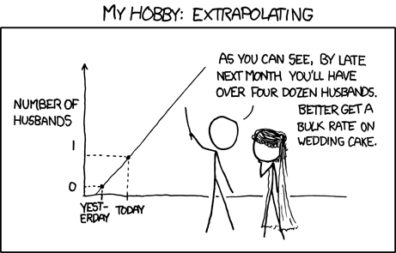
Simple Linear Regression and Correlation
12
Copyright © Cengage Learning. All rights reserved.
http://stats.stackexchange.com/questions/423/what-is-your-favorite-data-analysis-cartoon

Slide 2
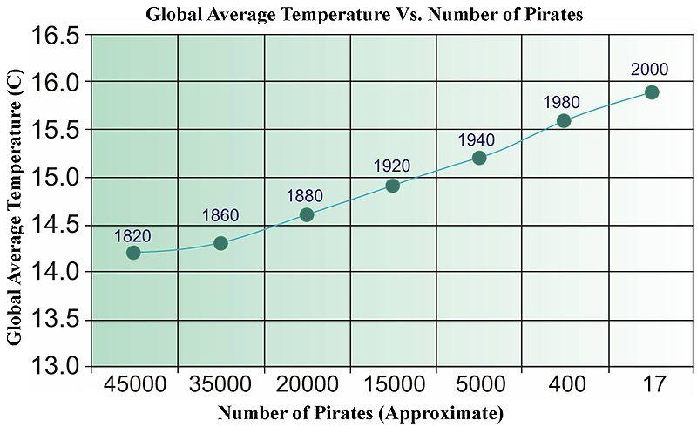
Regression and Causality
http://stats.stackexchange.com/questions/10687/does-simple-linear-regression-imply-causation

Slide 3
Linear Regression: Definitions
X: predictor, explanatory, independent variable
Y: response, dependent variable

Slide 4
Example: Scatterplot
The following data is to determine the relationship between age and change in systolic blood pressure (BP, mm Hg) after 24 hours in response to a particular treatment.
a) Draw a scatterplot of this data.
Obs | 1 | 2 | 3 | 4 | 5 | 6 | 7 | 8 | 9 | 10 | 11
Age | 70 | 51 | 65 | 70 | 48 | 70 | 45 | 48 | 35 | 48 | 30
BP | -28 | -10 | -8 | -15 | -8 | -10 | -12 | 3 | 1 | -5 | 8

Slide 5
Example: Scatterplot (cont)
Age
Age

Slide 6
Error in the Regression Line

Slide 7
Distribution of Y

Slide 8
Linear Regression: Assumptions
There is a linear relationship between X and Y.
Each (X,Y) pair is random and independent of the other pairs.
Variance of the residuals is constant.

Slide 9
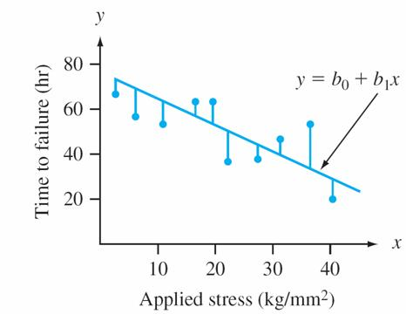
Principle of Least Squares

Slide 10
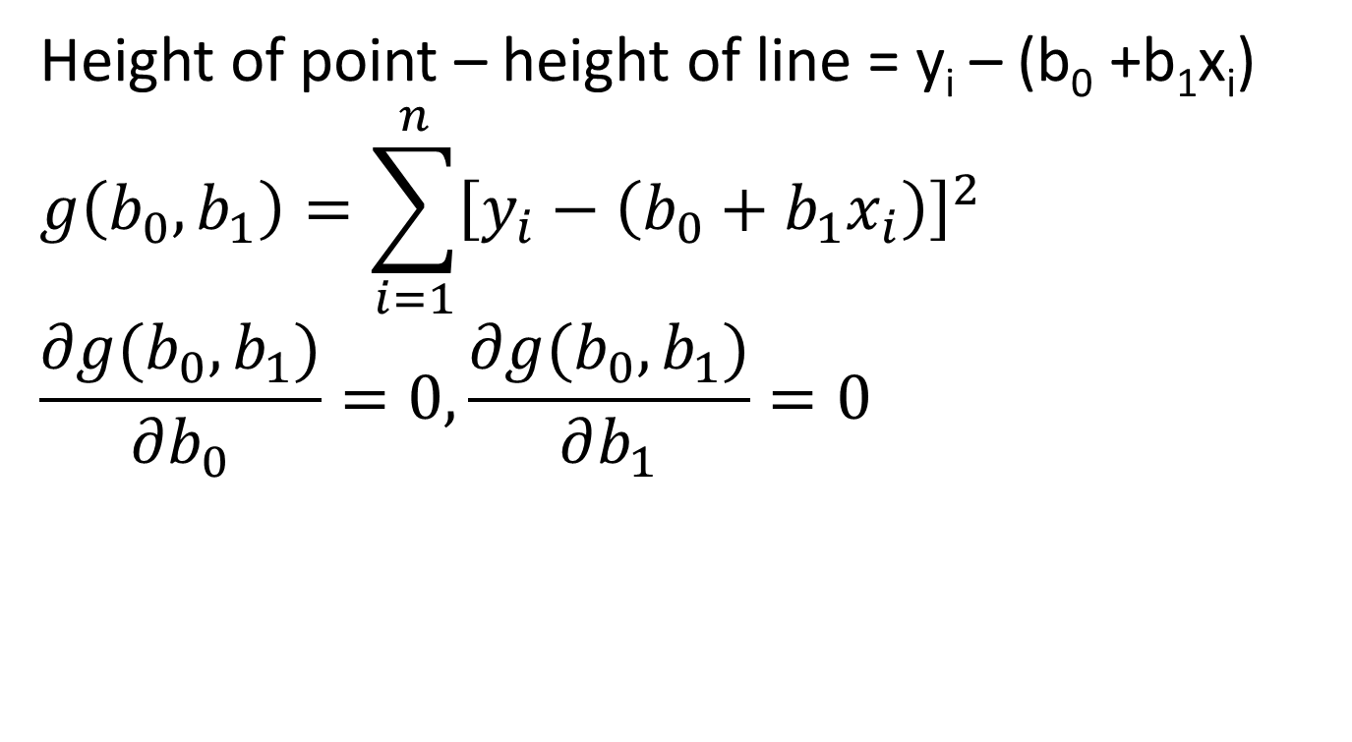
Principle of Least Squares
Height of point – height of line = y_{i} – (b₀ +b₁x_{i})
$$g\left(b_{0},b_{1}\right)=\sum_{i=1}^{n}{{\left[y_{i}−\left(b_{0}+b_{1}x_{i}\right)\right]}^{2}}$$
$$\frac{∂g(b_{0},b_{1})}{∂b_{0}}=0, \frac{∂g(b_{0},b_{1})}{∂b_{1}}=0$$

Slide 11

Point Estimations
$$b_{1}={\hat{β}}_{1}=\frac{\sum{\left(x_{i}−\overline{x}\right)\left(y_{i}−\overline{y}\right)}}{\sum{{\left(x_{i}−\overline{x}\right)}^{2}}}=\frac{S_{xy}}{S_{xx}}$$
$$b_{0}={\hat{β}}_{0}=\frac{\sum{y_{i}}−b_{1}\sum{x_{i}}}{n}=\overline{y}−b_{1}\overline{x}$$

Slide 12
Point Estimations
X

Slide 13
Example: Least Squares
The following data is to determine the relationship between age and change in systolic blood pressure (BP, mm Hg) after 24 hours in response to a particular treatment.
What is the regression line for this data?
x̄ = 52.727, ȳ = -7.636, S_{xy} = -1055.909,
S_{xx} = 2006.182

Slide 14
Example: Least Squares (cont)

Slide 15
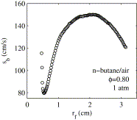
Extrapolation
http://www.sciencedirect.com/science/article/pii/S001021800900114X

Slide 16
Example: Least Squares point estimate
The following data is to determine the relationship between age and change in systolic blood pressure (BP, mm Hg) after 24 hours in response to a particular treatment.
c) What is the point estimate for the change in BP for someone who is 56 years old? 51 years old?
d) What is the residual at this age 51? The actual data point is (51, -10).

Slide 17
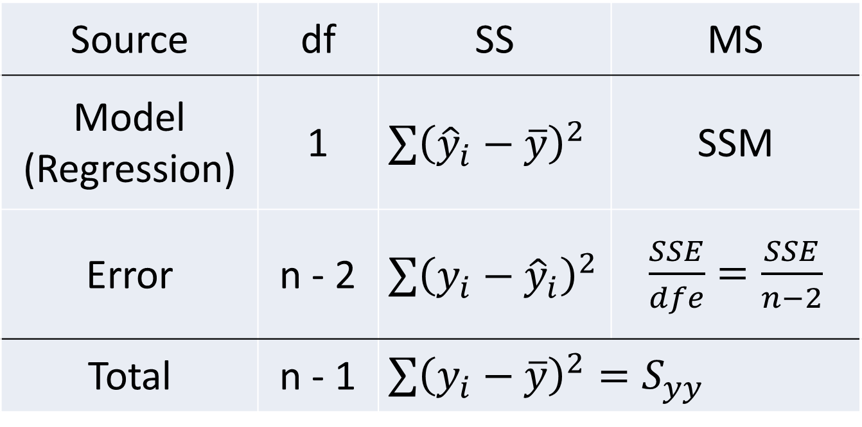
ANOVA Table
Source | df | SS | MS
Model (Regression) | 1 | $\sum{{\left({\hat{y}}_{i}−\overline{y}\right)}^{2}}$ | SSM
Error | n - 2 | $\sum{{\left(y_{i}−{\hat{y}}_{i}\right)}^{2}}$ | $\frac{SSE}{dfe}=\frac{SSE}{n−2}$
Total | n - 1 | $\sum{{\left(y_{i}−\overline{y}\right)}^{2}=S_{yy}}$

Slide 18
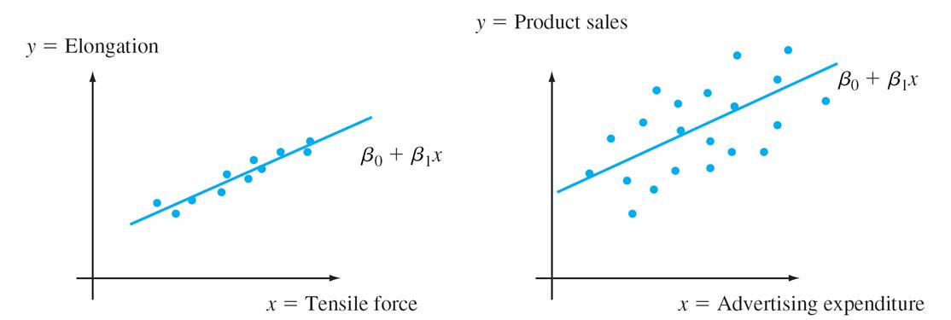
Meaning of σ²

Slide 19
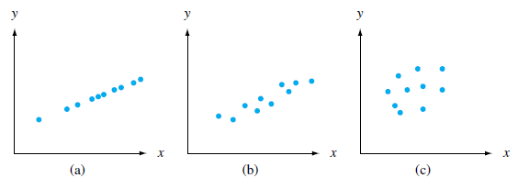
Meaning of R²

Slide 20
Cautions about R²
Linearity
Association
Outliers
Prediction

Slide 21
Example: Least Squares point estimate
The following data is to determine the relationship between age and change in systolic blood pressure (BP, mm Hg) after 24 hours in response to a particular treatment.
e) What proportion of the observed variation in y can be attributed to the simple linear regression relationship between x and y?

Slide 22
Example: Least Squares (cont)
outlier?

Slide 23
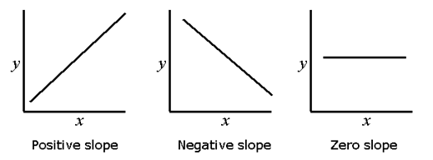
Inference on the slope
http://www.biomedware.com/files/documentation/spacestat/interface/Views/
Regression_line.htm

Slide 24
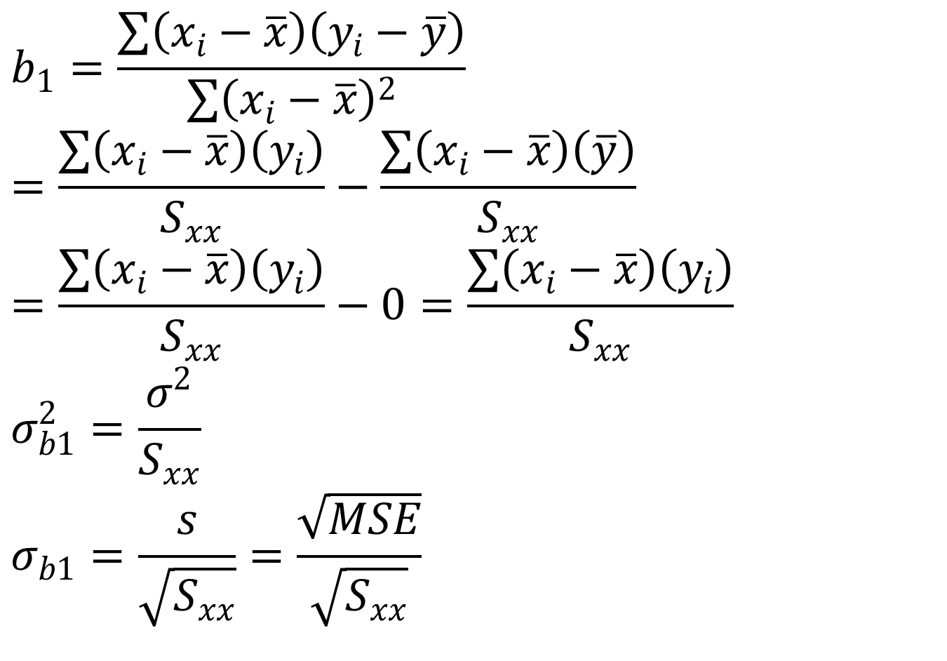
Normality of Y
$$b_{1}=\frac{\sum{\left(x_{i}−\overline{x}\right)\left(y_{i}−\overline{y}\right)}}{\sum{{\left(x_{i}−\overline{x}\right)}^{2}}}=\frac{\sum{\left(x_{i}−\overline{x}\right)\left(y_{i}\right)}}{S_{xx}}−\frac{\sum{\left(x_{i}−\overline{x}\right)\left(\overline{y}\right)}}{S_{xx}}=\frac{\sum{\left(x_{i}−\overline{x}\right)\left(y_{i}\right)}}{S_{xx}}−0=\frac{\sum{\left(x_{i}−\overline{x}\right)\left(y_{i}\right)}}{S_{xx}}$$
$$σ_{b1}^{2}=\frac{σ^{2}}{S_{xx}}$$
$$σ_{b1}=\frac{s}{\sqrt{S_{xx}}}=\frac{\sqrt{MSE}}{\sqrt{S_{xx}}}$$

Slide 25
Example: Regression
Suppose the mean daily peak load (MW) for a power plant and the maximum outdoor temperature (ºF) for a sample of 10 days is given below.
What is the estimated regression line (besides the equation of the line, include R²)?
S_{xx} = 6502.7693, S_{xy} = -1424.41429,
x̄ = 52.727, ȳ = -0.5263
SSE = 2093.72878, SST = 19264
x_{i} (ºF) | 95 | 82 | 90 | 81 | 99 | 100 | 93 | 95 | 93 | 97
y_{i} (MW) | 214 | 152 | 156 | 129 | 254 | 266 | 210 | 204 | 213 | 150

Slide 26
Example: Regression (cont)
Analysis of Variance
Sum of Mean
Source DF Squares Square F Value Pr > F
Model 1 17170 17170 65.60 <.0001
Error 8 2093.72878 261.71610
Corrected Total 9 19264
Root MSE 16.17764 R-Square 0.8913
Dependent Mean 194.80000 Adj R-Sq 0.8777
Coeff Var 8.30474
Parameter Estimates
Parameter Standard
Variable DF Estimate Error t Value Pr > |t|
Intercept 1 -419.84915 76.05778 -5.52 0.0006
temp 1 6.71748 0.82935 8.10 <.0001
X

Slide 27
Example: Regression (cont)
X

Slide 28
Example: Regression
The cetane number is a critical property in specifying the ignition quality of a fuel used in a diesel engine. Determination of this number for a biodiesel fuel is expensive and time-consuming. Therefore a way of predicting this number is wanted. The data on the next slide is x = iodine value (g) and y = cetane number for a sample of 14 biofuels. The iodine value is the amount of iodine necessary to saturate a sample of 100g of oil.
S_{xx} = 6802.7693, S_{xy} = -1424.41429, x̄ = 93.393, ȳ = 55.657, SSE = 78.920, SST = 377.174
What is the estimated regression line (besides the equation of the line, include R²)?

Slide 29
Example: Scatterplot

Slide 30
Example (Example 12.4): CI
The cetane number is a critical property in specifying the ignition quality of a fuel used in a diesel engine. Determination of this number for a biodiesel fuel is expensive and time-consuming. Therefore a way of predicting this number is wanted. The data on the next slide is x = iodine value (g) and y = cetane number for a sample of 14 biofuels. The iodine value is the amount of iodine necessary to saturate a sample of 100g of oil.
S_{xx} = 6802.7693, S_{xy} = -1424.41429, x̄ = 93.393, ȳ = 55.657, SSE = 78.920, SST = 377.174
b) What is the 95% CI for the true slope?

Slide 31
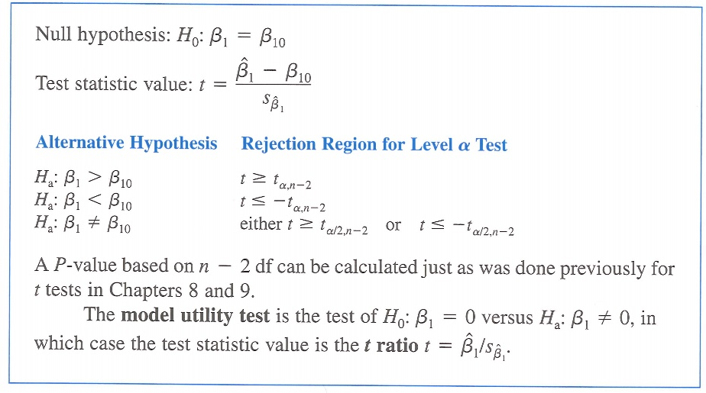
β₁ Hypothesis test: Summary

Slide 32
Example (Example 12.4): Hypothesis test
The cetane number is a critical property in specifying the ignition quality of a fuel used in a diesel engine. Determination of this number for a biodiesel fuel is expensive and time-consuming. Therefore a way of predicting this number is wanted. The data on the next slide is x = iodine value (g) and y = cetane number for a sample of 14 biofuels. The iodine value is the amount of iodine necessary to saturate a sample of 100g of oil.
c) Is the model useful (that is, is there a useful linear relationship between x and y)?

Slide 33
ANOVA Table
Source | df | SS | MS
Model (Regression) | 1 | $\sum{{\left({\hat{y}}_{i}−\overline{y}\right)}^{2}}$ | SSM
Error | n - 2 | $\sum{{\left(y_{i}−{\hat{y}}_{i}\right)}^{2}}$ | $\frac{SSE}{dfe}=\frac{SSE}{n−2}$
Total | n - 1 | $\sum{{\left(y_{i}−\overline{y}\right)}^{2}=S_{yy}}$

Slide 34
12.4
Inferences Concerning μ_{Y } _{x∗} and the Prediction of Future Y Values
Copyright © Cengage Learning. All rights reserved.

Slide 35
ρ Hypothesis test: Summary

Slide 36
Example (12.4): Hypothesis test for ρ
The cetane number is a critical property in specifying the ignition quality of a fuel used in a diesel engine. Determination of this number for a biodiesel fuel is expensive and time-consuming. Therefore a way of predicting this number is wanted. The data on the next slide is x = iodine value (g) and y = cetane number for a sample of 14 biofuels. The iodine value is the amount of iodine necessary to saturate a sample of 100g of oil.
d) Is the model useful (that is, is there a useful linear relationship between x and y) using the population correlation coefficient?
SSE = 78.9192, SST = S_{yy} = 377.1743
S_{xx} = 6502.7693, S_{xy} = -1424.41429

Slide 37
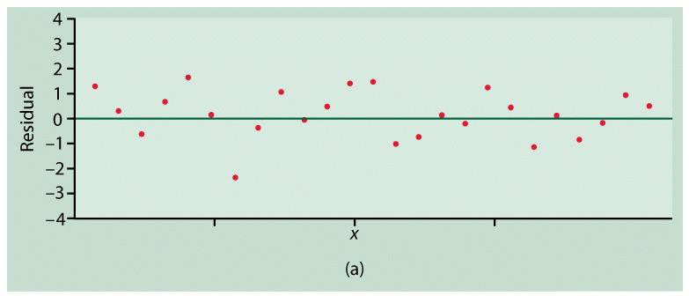
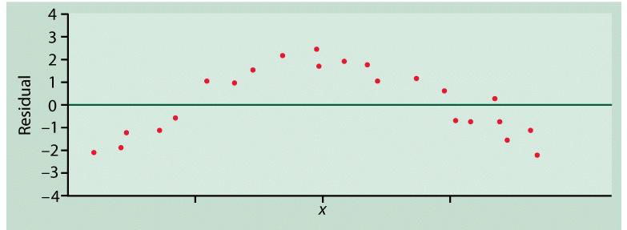
Residual Plots
Good
Linearity Violation

Slide 38
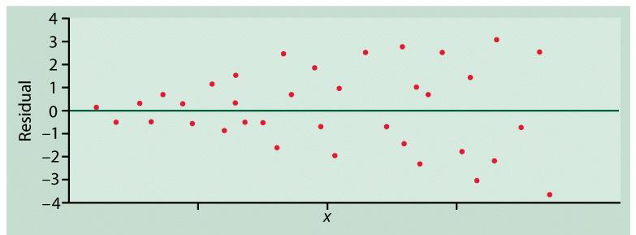
Residual Plots
Good
Constant variance violation

Slide 39
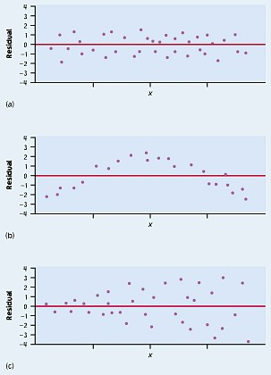
Residual Plots

Slide 40
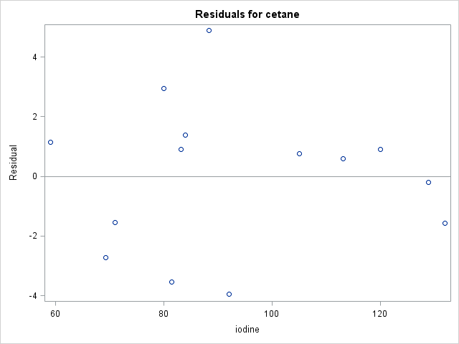
Example: SLR 1 – Residual Plot

Slide 41
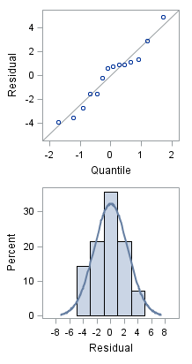
Example: SLR 1 – Normality

Slide 42
Residual Plots
X

