Slide 1
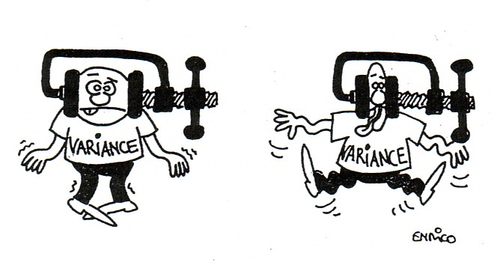
10
The Analysis of Variance
Copyright © Cengage Learning. All rights reserved.
http://www.luchsinger-mathematics.ch/Var_Reduction.jpg

Slide 2
ANOVA: Examples
Do four different types of steel have the same structural strength?
Does the major of the student (math, engineering, life sciences, economics, computer science) have an effect on the student’s grade in STAT 511?
Does the percentage of alcohol in gasoline has an effect on the mpg?
Does the heat retention in a house depending on the thickness or of insulation in the attic?

Slide 3
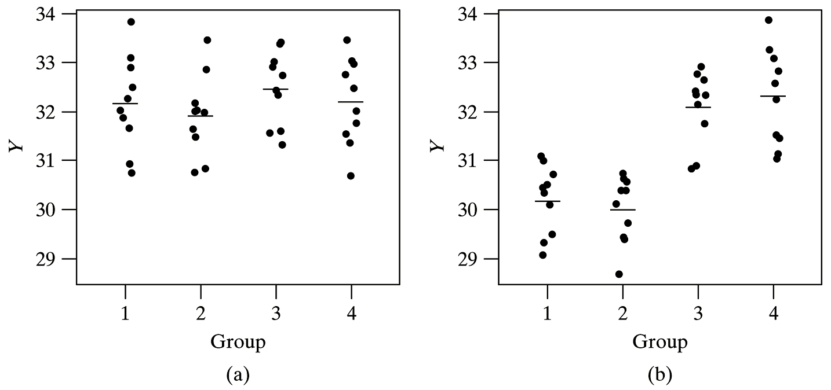
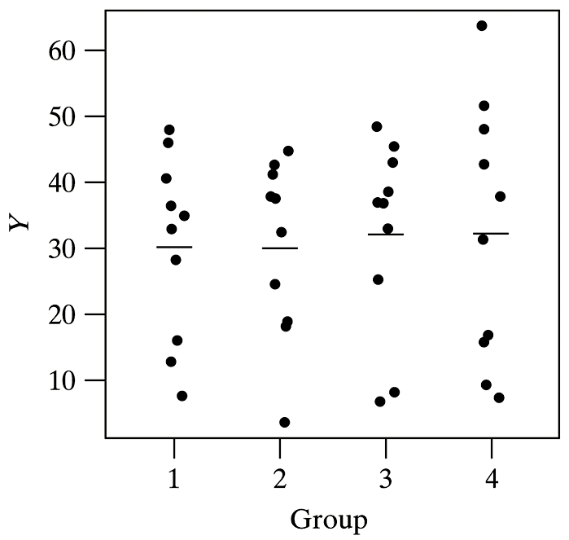
ANOVA: Graphical

Slide 4
ANOVA: notation
X_{ij}: j^{th} measurement taken from the i^{th} population
sample sizes: n_{1,} …, n_{I}
$${\overline{X}}_{i.}=\frac{\sum_{j=1}^{n_{i}}{X_{ij}}}{n_{i}}$$
$$S_{i}^{2}=\frac{\sum_{j=1}^{n_{i}}{{\left(X_{ij}−\overline{X}\right)}^{2}}}{n−1}=\frac{S_{XX}}{n−1}$$
n_{T} = n₁ + … + n_{I}
$${\overline{X}}_{..}=\frac{\sum_{i=1}^{I}{\sum_{j=1}^{n_{i}}{X_{ij}}}}{n_{T}}$$

Slide 5
ANOVA: Assumptions
All samples are independent of each other.
Each population or treatment distributions are normal with E(X_{ij}) = μ_{I.}
Each population has the same variance (pooled), Var(X_{ij}) = σ².

Slide 6
ANOVA test statistic

Slide 7
ANOVA test

Slide 8
F Distribution
http://www.vosesoftware.com/ModelRiskHelp/index.htm#Distributions/
Continuous_distributions/F_distribution.htm

Slide 9
F curve and critical value
http://controls.engin.umich.edu/wiki/index.php/Factor_analysis_and_ANOVA

Slide 10
Table A.9 Critical Values for F Distribution (first page)

Slide 11
ANOVA Table: Formulas
Source | df | SS | MS (Mean Square) | F
Model (Between) | I – 1
Error (Within) | n_{T} – I
Total | n_{T} – 1

Slide 12
ANOVA Hypothesis test: Summary
H₀: μ₁ = μ₂ = ⋅⋅⋅ = μ_{I}
H_{a}: At least one μ_{i} is different
Test statistic: $F=\frac{MSM}{MSE}$
Rejection Region: F ≥ F_{α,dfm,dfe}

Slide 13
ANOVA: Example
An experiment was carried out to compare five different brands of automobile oil filters with respect to their ability to capture foreign material. A sample of nine filters of each brand was used. Do the filters capture the same amount of foreign material at a 0.05 significance level?

Slide 14
ANOVA: Example (cont)
H₀: μ₁ = μ₂ = μ₃ = μ₄ = μ₅
The true mean amount of foreign material is the same for all of the filters
H_{A}: at least one of the μ_{i} is different
The true mean amount of foreign material caught is not the same for all of the filters

Slide 15
ANOVA: Example (cont)
Source | df | SS | MS | F
Model | 4 | 13.32 | 3.33 | 37.84
Error | 40 | 3.53 | 0.088
Total | 44 | 16.85

Slide 16
Example: ANOVA (cont)
The data does provide strong support to the claim that the mean amount of foreign material caught is not the same for all of the filters.

Slide 17
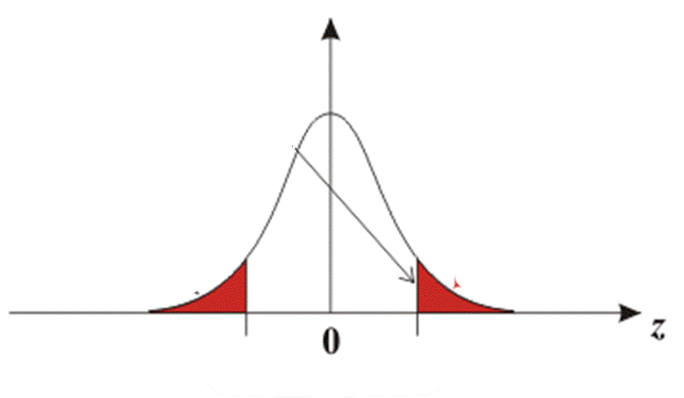
Problem with Multiple t tests

Slide 18
Overall Risk of Type I Error in Using Repeated t Tests at α = 0.05

Slide 19
Table A.10: Studentized Range

Slide 20
ANOVA: Example (Tukey)
An experiment was carried out to compare five different brands of automobile oil filters with respect to their ability to capture foreign material. A sample of nine filters of each brand was used. Do the filters capture the same amount of foreign material at a 0.05 significance level?
Which one(s) of the filters is best?
x̅_{1.} = 14.5 x̅_{2.} = 13.8 x̅_{3.} = 13.3 x̅_{4.} = 14.3 x̅_{5.} = 13.1

Slide 21
ANOVA: Example (cont)
Source | df | SS | MS | F
Model | 4 | 13.32 | 3.33 | 37.84
Error | 40 | 3.53 | 0.088
Total | 44 | 16.85

Slide 22
Example: Tukey (cont)
i – j | x̅_{i} - x̅_{j} | CI | Same?
1 – 2 | 0.7 | (0.3, 1.1)
1 – 3 | 1.2 | (0.8, 1.6)
1 – 4 | 0.2 | (-0.2, 0.6)
1 – 5 | 1.4 | (1.0, 1.8)
2 – 3 | 0.5 | (0.1, 0.9)
2 – 4 | -0.5 | (-0.9, -0.1)
2 – 5 | 0.7 | (0.3, 1.1)
3 – 4 | -1.0 | (-1.4, -0.6)
3 – 5 | 0.2 | (-0.2, 0.2)
4 – 5 | 1.2 | (0.8, 1.6)
yes
yes

Slide 23
Example: Tukey (cont)
x̅_{5.} | x̅_{3.} | x̅_{2.} | x̅_{4.} | x̅_{1.}
13.1 | 13.3 | 13.8 | 14.3 | 14.5
x̅_{5.} | x̅_{3.} | x̅_{2.} | x̅_{4.} | x̅_{1.}
13.1 | 13.3 | 13.8 | 14.3 | 14.5

