Slide 1

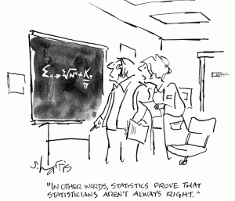
1
Overview and Descriptive Statistics
Copyright © Cengage Learning. All rights reserved.
http://www.widerfunnel.com/conversion-rate-optimization
/are-your-conversion-test-results-accurate-enough

Slide 2
Definitions: Data, Statistics, Population, Sample
Data
  Collections of facts
Statistics
  Methods for organizing and summarizing data
  Drawing conclusions based on the data
Population
  Well-defined collection of objects that we are interested in
Sample
  Subset of the population

Slide 3
Probability vs. Inferential Statistics
Probability
  The properties of the population are assumed to be known and question regarding the sample are posed and answered.
Inferential Statistics
  Characteristics of the sample are obtained experimentally and questions regarding the underlying populations are proposed.

Slide 4
Example: Probability vs. Inferential Statistics
Consider drivers’ use of manual lap belts in cars equipped with automatic shoulder belt systems (“Automobile seat Belts: Usage patterns in Automatic Belt Systems,” Human Factors, 1998: 126-135.)
Probability:
Assume that 50% of all drivers of cars with this type of seatbelt use their lap belt (population).
Q1: How likely that in a sample of 50 drivers, 35 will use their lap belt?
Q2: On average, how many drivers in the sample of 50 will use their lap belt?

Slide 5
Example: Probability vs. Inferential Statistics (cont)
Consider drivers’ use of manual lap belts in cars equipped with automatic shoulder belt systems (“Automobile seat Belts: Usage patterns in Automatic Belt Systems,” Human Factors, 1998: 126-135.)
Inferential Statistics:
Observe that 32 out of 50 drivers use their lap belt (sample).
Q1: Does this provide evidence to conclude that more than 50% of all the drivers in this area regularly use their lap belt?

Slide 6
Collecting Data
Methods of Collection
  Simple random sampling (SRS)
  Stratified Sampling
Type of Study
  Observational Study
  Experiment

Slide 7
Stem-and-Leaf Display
Methodology
Select one or more leading digits for the stem values. The trailing digits become the leaves.
List possible stem values in a vertical column.
Record the leaf for each observation beside the corresponding stem value. On WebAssign, you will need to order these values.
Indicate the units for stems and leaves someplace in the display.

Slide 8
Example 1: Stem-and-Leaf
The number of touchdown passes thrown by each of the 31 teams in the National Football league in 2000 is given below
14, 29, 22, 18, 20, 15, 6, 9, 18, 19, 18, 23, 28, 37, 21, 14, 19, 21, 20, 16, 22, 33, 28, 12, 18, 22, 14, 33, 21, 12
Reduced data set:
14, 18, 15, 6, 9, 18, 19, 18, 14, 19, 16, 12, 18, 14, 12

Slide 9
Stem-and-Leaf Displays
Typical Value
Spread
Gaps
Symmetry of distribution
Number and location of peaks
Outliers

Slide 10
Example 2: Comparison Stem-and-Leaf
The number of touchdown passes thrown by each of the 31 teams in the National Football league in 1998 is given below
26, 12, 17, 23, 21, 13, 24, 21, 41, 28, 18, 33, 17, 16, 7, 32, 15, 17, 24, 23, 11, 16, 21, 41, 20, 16, 28, 19, 25, 33
Reduced data set:
12, 17, 13, 18, 17, 16, 7, 15, 17, 11, 16, 16

Slide 11
Dotplots
Methodology
Represent each observation by a dot above the corresponding location on a measurement scale.
Stack dots vertically when a value occurs more than once.

Slide 12
Example 3: Dotplots
The number of touchdown passes thrown by each of the 31 teams in the National Football league in 2000 is given below
Reduced data set:
14, 18, 15, 6, 9, 18, 19, 18, 14, 19, 16, 12, 18, 14, 12

Slide 13
Dotplots
Typical Value
Spread
Gaps
Symmetry of distribution
Number and location of peaks
Outliers

Slide 14
Histogram - discrete
Methodology
Calculate the frequency and/or relative frequency of each x value.
Mark the possible x values on the x-axis.
Above each value, draw a rectangle whose height is the frequency (or relative frequency) of that value.

Slide 15
Example 4: Histogram - Discrete
100 married couples between 30 and 40 years of age are studied to see how many children each couple have. The table below is the frequency table of this data set.
Kids | # of Couples | Rel. Freq
0 | 11 | 0.11
1 | 22 | 0.22
2 | 24 | 0.24
3 | 30 | 0.30
4 | 11 | 0.11
5 | 1 | 0.01
6 | 0 | 0.00
7 | 1 | 0.01
 | 100 | 1.00

Slide 16
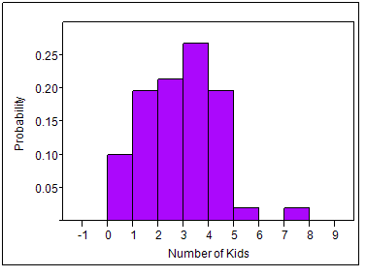
Kids | # of Couples | Rel. Freq
0 | 11 | 0.11
1 | 22 | 0.22
2 | 24 | 0.24
3 | 30 | 0.30
4 | 11 | 0.11
5 | 1 | 0.01
6 | 0 | 0.00
7 | 1 | 0.01
 | 100 | 1.00

Slide 17
Histogram - continuous
Methodology
Divide the x-axis into a number of class intervals or classes such that each observation falls into exactly one interval.
Calculate the frequency or relative frequency for each interval.
Above each value, draw a rectangle whose height is the frequency (or relative frequency) of that value.

Slide 18
Example 5: Histogram - Continuous
The following data give the lifetime of 30 incandescent light bulbs rounded to the nearest hour of a particular type
872 | 931 | 1146 | 1079 | 915 | 879 | 863 | 1112 | 979 | 1120
1150 | 987 | 958 | 1149 | 1057 | 1082 | 1053 | 1048 | 1118 | 1088
868 | 996 | 1102 | 1130 | 1002 | 990 | 1052 | 1116 | 1119 | 1028

Slide 19
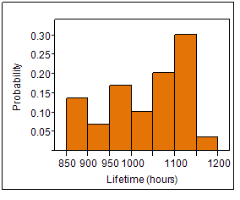
Example 5 (cont)
Class | Freq | Rel. Freq.
850 – 900 | 4 | 0.133
900 – 950 | 2 | 0.067
950 – 1000 | 5 | 0.167
1000 – 1050 | 3 | 0.100
1050 – 1100 | 6 | 0.200
1100 - 1150 | 9 | 0.300
1150 – 1200 | 1 | 0.033

Slide 20
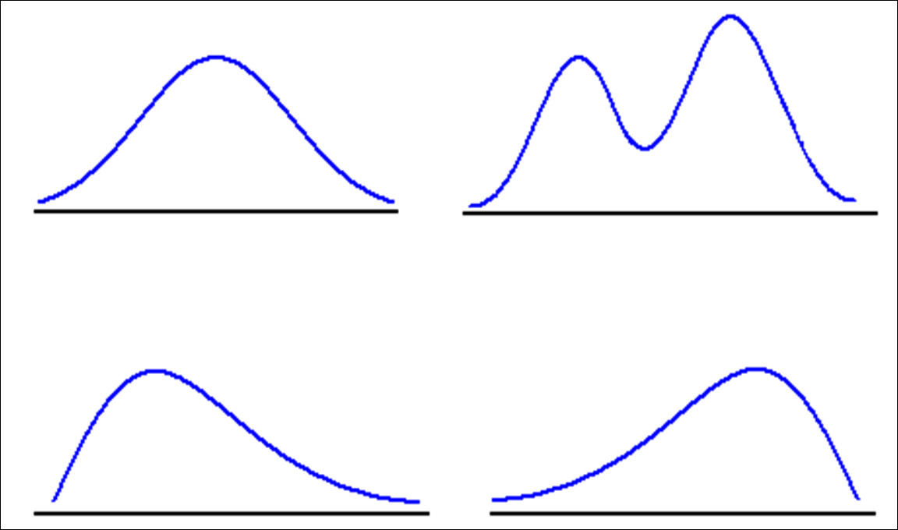
Shapes of Histograms

Slide 21
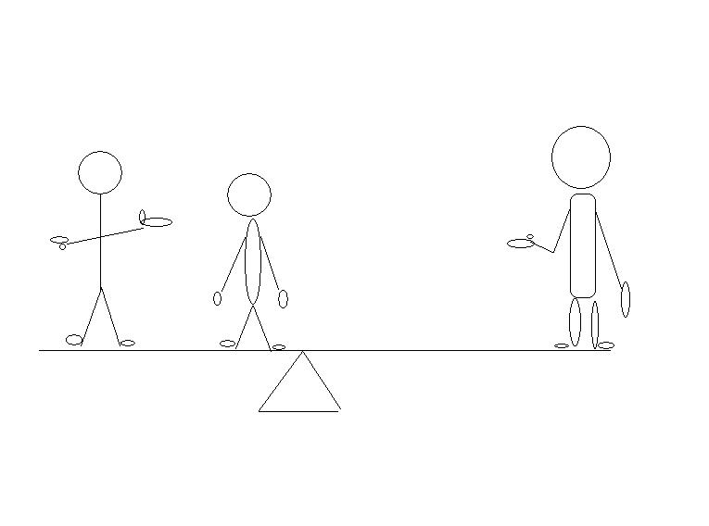
Mean
http://isc.temple.edu/economics/notes/descprob/descprob.htm

Slide 22
Example 6: Mean
The following data give the time in months from hire to promotion to manager for a random sample of 20 software engineers from all software engineers employed by a large telecommunications firm. What is the mean time for this sample?
Suppose that instead of x₂₀ = 69, we had chosen another engineer that took 483 months to be promoted. what is the mean time for this new sample?
5 | 7 | 12 | 14 | 18 | 14 | 14 | 22 | 21 | 25
23 | 24 | 34 | 37 | 34 | 49 | 64 | 47 | 67 | 69

Slide 23
Example 6: Mean

Slide 24
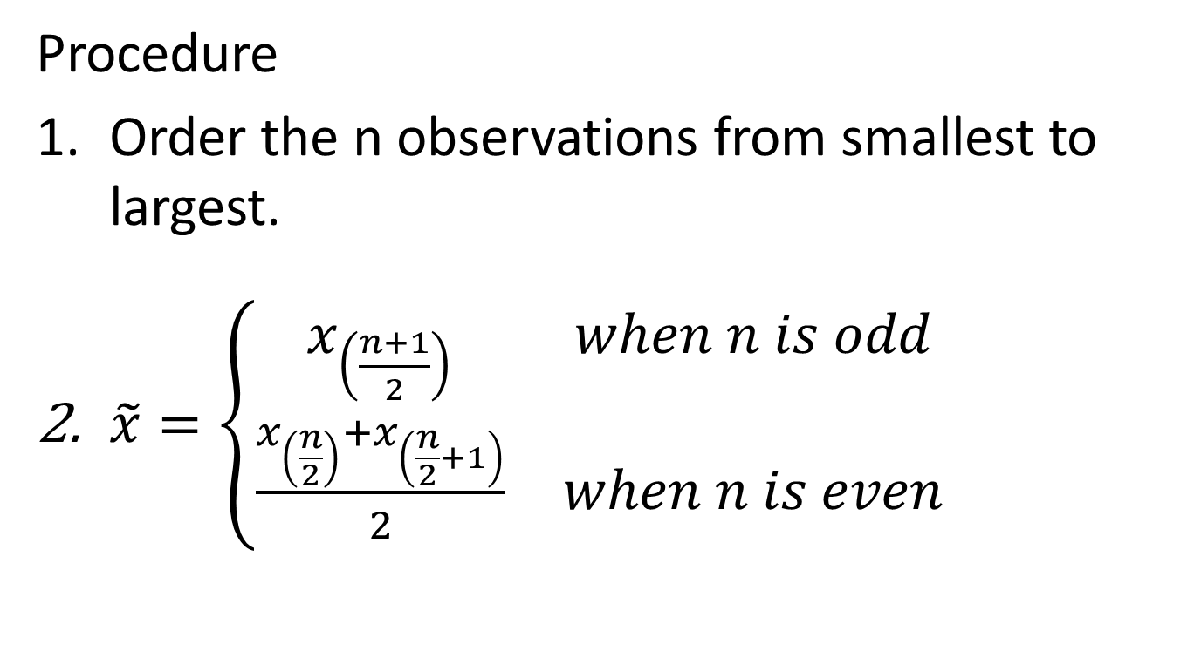
Median
Procedure
Order the n observations from smallest to largest.
$\tilde{x}=\left\{\begin{matrix}x_{\left(\frac{n+1}{2}\right)} & when n is odd \\ \frac{x_{\left(\frac{n}{2}\right)}+x_{\left(\frac{n}{2}+1\right)}}{2} & when n is even\end{matrix}\right.$

Slide 25
Example 6: Median
The following data give the time in months from hire to promotion to manager for a random sample of 20 software engineers from all software engineers employed by a large telecommunications firm. What is the median time for this sample?
Suppose that instead of x₂₀ = 69, we had chosen another engineer that took 483 months to be promoted. what is the median time for this new sample?
5 | 7 | 12 | 14 | 18 | 14 | 14 | 22 | 21 | 25
23 | 24 | 34 | 37 | 34 | 49 | 64 | 47 | 67 | 69

Slide 26
Example 6: Median
The following are the two data sets in Example 6 sorted from lowest to highest.
Original
Modified:
5 | 7 | 12 | 14 | 14 | 14 | 18 | 21 | 22 | 23
24 | 25 | 34 | 34 | 37 | 47 | 49 | 64 | 67 | 69
5 | 7 | 12 | 14 | 14 | 14 | 18 | 21 | 22 | 23
24 | 25 | 34 | 34 | 37 | 47 | 49 | 64 | 67 | 483

Slide 27
Example 6: Mean and Median

Slide 28
Comparison of Mean and Median
(a) Negative skew
(b) Symmetric
(c) Positive skew

Slide 29
Example 6: Quartiles
The following are the two data sets in Example 6 sorted from lowest to highest.
Original
Modified:
5 | 7 | 12 | 14 | 14 | 14 | 18 | 21 | 22 | 23
24 | 25 | 34 | 34 | 37 | 47 | 49 | 64 | 67 | 69
5 | 7 | 12 | 14 | 14 | 14 | 18 | 21 | 22 | 23
24 | 25 | 34 | 34 | 37 | 47 | 49 | 64 | 67 | 483

Slide 30
Trimmed Mean - 100α%
Methodology
Given a number α where 0 < α < 1.
Remove the 100α% lowest and highest values. (Sorting is required.)
Calculate the mean of the remaining values.

Slide 31
Example 6: Trimmed Mean
Calculated the 5% trimmed mean of the modified data set and compare to the mean of the original data set.
Original:
Modified:
5 | 7 | 12 | 14 | 14 | 14 | 18 | 21 | 22 | 23
24 | 25 | 34 | 34 | 37 | 47 | 49 | 64 | 67 | 69
5 | 7 | 12 | 14 | 14 | 14 | 18 | 21 | 22 | 23
24 | 25 | 34 | 34 | 37 | 47 | 49 | 64 | 67 | 483

Slide 32
Variation of Data
Set 1 | -15 | -10 | -5 | 0 | 5 | 10 | 15
Set 2 | -15 | -5 | -1 | 0 | 1 | 5 | 15
Set 3 | -3 | -2 | -1 | 0 | 1 | 2 | 3

Slide 33
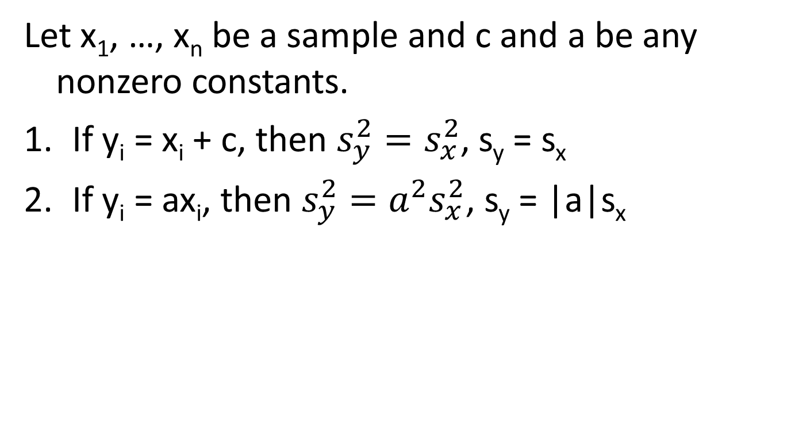
Properties of Variance
Let x₁, …, x_{n} be a sample and c and a be any nonzero constants.
If y_{i} = x_{i} + c, then $s_{y}^{2}=s_{x}^{2}$, s_{y} = s_{x}
If y_{i} = ax_{i}, then $s_{y}^{2}=a^{2}s_{x}^{2}$, s_{y} = |a|s_{x}

Slide 34
Boxplot
Methodology
Calculate the minimum, Q₁, median, Q₃, and the maximum.
Mark these values on the horizontal (vertical) axis.
Draw a rectangle with one edge at Q₁ and the other edge at Q₃.
Place a vertical (horizontal) line inside the rectangle at the median.
Draw whiskers from Q₁ to the minimum and Q₃ to the maximum.

Slide 35
Boxplot - outliers
Methodology
Calculate the minimum, Q₁, median, Q₃, and the maximum.
Mark these values on the horizontal (vertical) axis.
Draw a rectangle with one edge at Q₁ and the other edge at Q₃.
Place a vertical (horizontal) line inside the rectangle at the median.
Determine if there any outliers
Draw a whisker out from the rectangle to the smallest and largest observations that are not outliers.
Plot mild outliers by solid dots, plot extreme outliers with circles.

Slide 36
Example 7: Boxplot
The following (ordered) data give the time in months from hire to promotion to manager for a random sample of 25 software engineers from all software engineers employed by a large telecommunications firm.
5 | 7 | 12 | 14 | 14 | 14 | 18 | 21 | 22 | 23
24 | 25 | 34 | 34 | 37 | 47 | 49 | 64 | 67 | 69
125 | 192 | 229 | 453 | 483

Slide 37
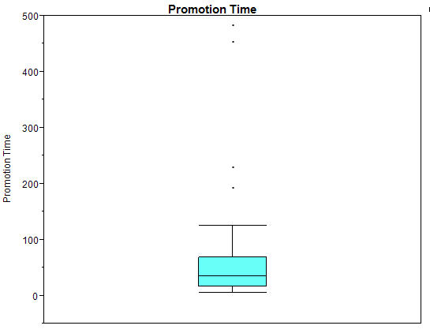
Example 7: Boxplot (cont)

Slide 38
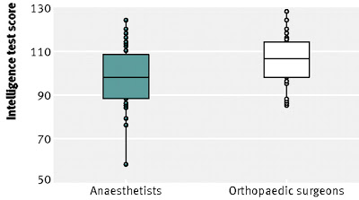
Comparative Boxplots
http://neurocritic.blogspot.com/2011/12/orthopedic-surgeons-vs.html

Slide 39
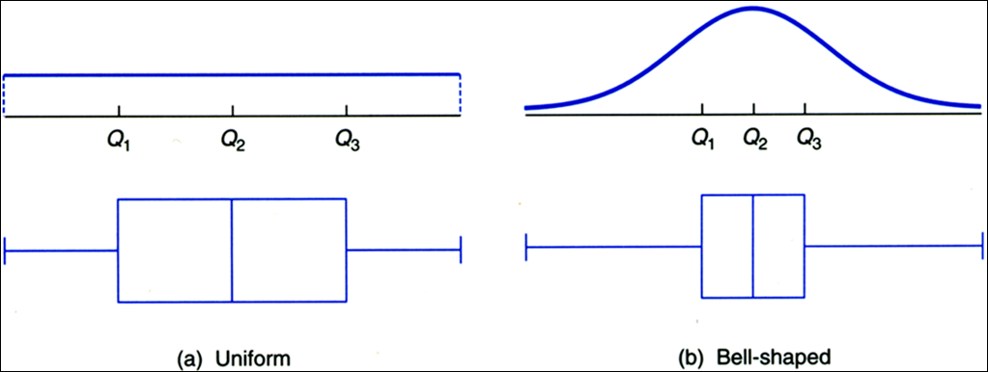
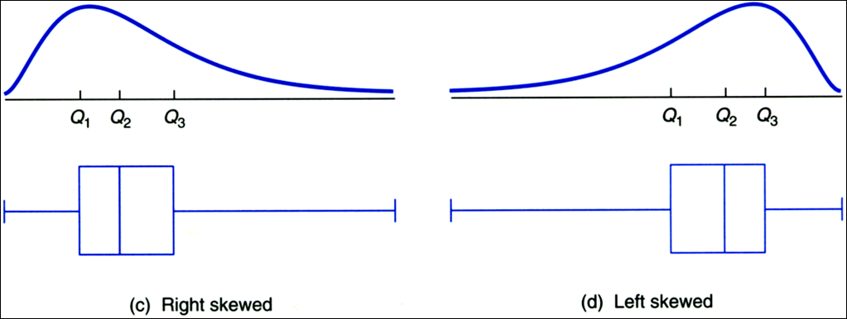
Distributions and Boxplots

