Slide 1
Example: Sampling distributions
The manufacturer admits that St. John’s Wort capsules have a 5% probability of being defective (containing the wrong amount of active ingredient). We have vials of 40 capsules.
 | Y | Probability
0.045 | 0 | 0.129
0.068 | 1 | 0.271
0.091 | 2 | 0.278
0.114 | 3 | 0.185
0.136 | 4 | 0.090
0.159 | 5 | 0.034
0.182 | 6 | 0.010
0.205 | 7 | 0.003
0.227 | 8 | 0.001

Slide 2
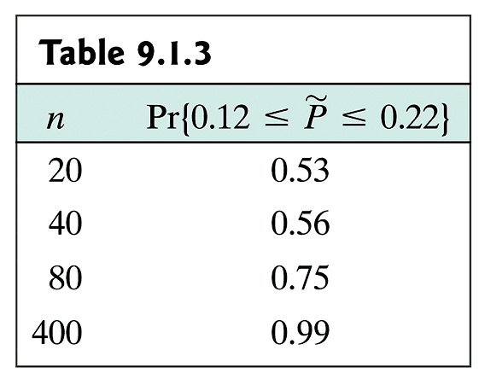
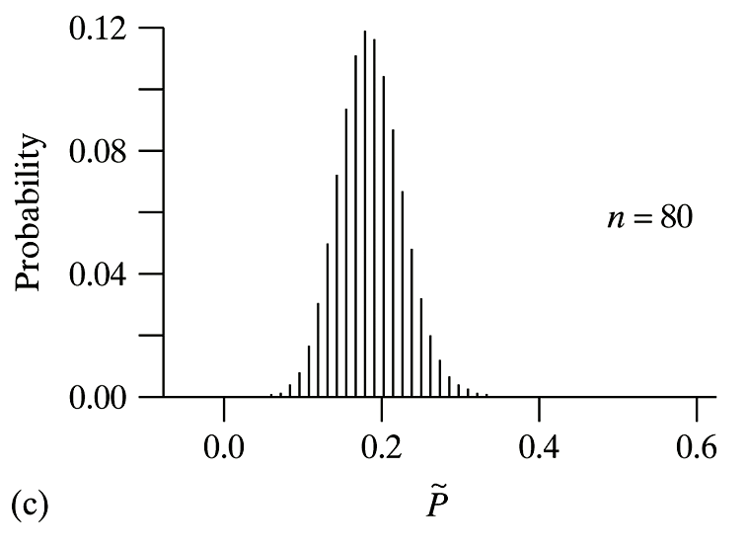
Dependence on Sample Size

Slide 3
Example: C.I. for p̃
To evaluate the policy of routine vaccination for whooping cough, adverse reactions were monitored for 339 infants who received their first injection of the vaccine. Reactions were noted in 69 of the infants.
a) Construct a 95% C.I. for the probability of an adverse reaction and interpret it.
b) Suppose that we wanted to extend our vaccination study to estimate p to within 0.01 with a 95% confidence. How many infants would we need to look at?

Slide 4
Example: C.I. for p̃
To evaluate the policy of routine vaccination for whooping cough, adverse reactions were monitored for 339 infants who received their first injection of the vaccine. Reactions were noted in 69 of the infants.
c) Suppose that we wanted to study the adverse reactions to infants in another country where we had no prior knowledge of the number of adverse reactions. How many infants would we need to look at to estimate p to within 0.01 with a 95% confidence?

Slide 5
Table 4 – t-distribution

Slide 6
Example: C.I. for p̃
To evaluate the policy of routine vaccination for whooping cough, adverse reactions were monitored for 339 infants who received their first injection of the vaccine. Reactions were noted in 69 of the infants.
Construct a 95% C.I. for the probability of an adverse reaction and interpret it.
Suppose that we wanted to extend our vaccination study to estimate p to within 0.05 with a 95% confidence. How many infants would we need to look at?
Construct a 99% C.I. for the probability of an adverse reaction and interpret it.

Slide 7
χ² distribution
http://cnx.org/content/m13129/latest/chi_sq.gif

Slide 8
Critical value for χ² Distribution

Slide 9
Table 9:χ² Distribution

Slide 10
Details for χ² Goodness-of-Fit
State the scientific question to be answered.
Define p_{i}’s for each category
State the H₀ and H_{A}.
In H₀: provide the theoretical values for the p_{i}’s
These may be explicit or implied (e.g., 9:3:3:1 ratio) in the question.
The sum of the p_{i}’s must be 1.
If only two categories, state H_{A} with symbols as well as words
can be both directional and nondirectional
If more than two categories, state H_{A} in words only
cannot be directional.

Slide 11
Details for χ² Goodness-of-Fit (cont)
State the significance level a.
Calculate E_{i} = np_{i} for each category.
Verify that all the E_{i} are at least 5
If not, stop; cannot use this test.
Calculate by summing over all categories.
State the rejection region.
Compare with χ²_{df} critical value with
df = number of categories -1
Reject H₀ if test statistic is greater than the critical value

Slide 12
Details for χ² Goodness-of-Fit (cont)
Compare the test statistic to the rejection region or compare the P-value to α.
Make a decision about the null hypothesis.
State the conclusion in the terms of the context of the problem.

Slide 13
Example 1: χ² distribution
In the sweet pea, the allele for purple flower color (P) is dominant to the allele for red flowers (p), and the allele for long pollen grains (L) is dominant to the allele for round pollen grains (l).
The first group (of grandparents) will be homozygous for the dominant alleles (PPLL) and the second group (of grandparents) will be homozygous for the recessive alleles (ppll). We are interested in the F2 population.
Are the two traits 25.5 cM apart?
Observations: 381 F2 offspring
284 purple/long, 21 purple/round, 21 red/long, 55 red/round

Slide 14
Example 2: χ² distribution
There are two homozygous lines of Drosophlia, one with red eyes and one with purple eyes. It has been suggested that there is a single gene responsible for this phenotype, with the red eye trait dominant over the purple eye trait. If that is true we expect these two lines to produce F2 progeny in the ratio 3 red: 1 purple. We want to test the hypothesis that red is (autosomal) dominant.
To do this we perform the cross of red-eyed and purple-eyed flies with several parents from the two lines and obtain 43 flies in the F2 generation, with 29 red-eyed flies and 14 purple-eyed flies.

Slide 15
Summary (1)

Slide 16
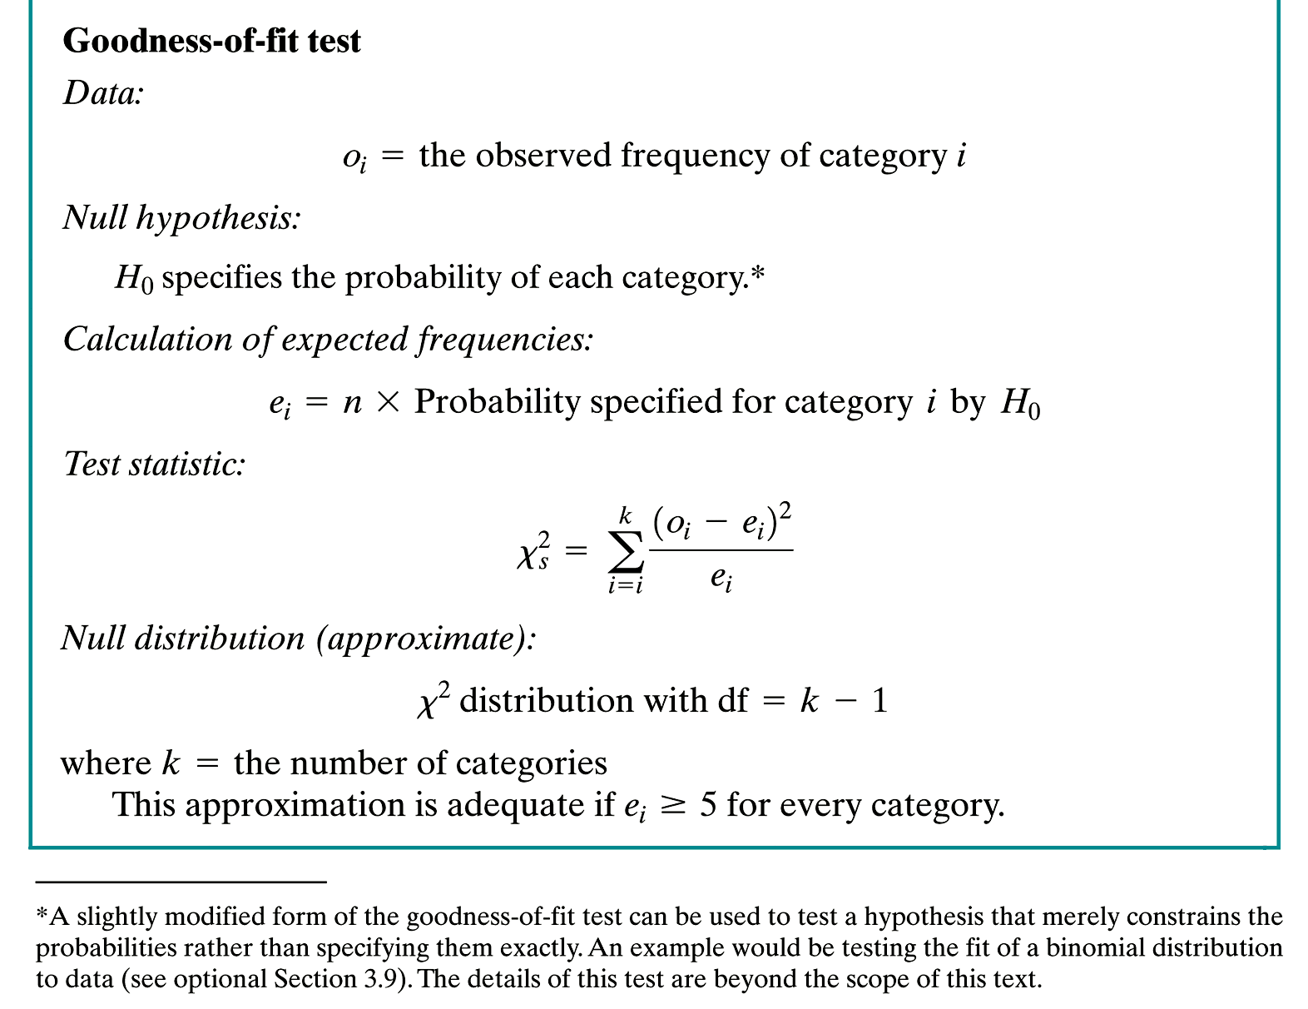
Summary (2)

