Slide 1
Example: Statistical Estimation
Consider taking a sample of size n from a large population of seeds of the princess bean (Phaseotus vulgaris) and record the seed weights.
If our sample size is 20 and found the mean = 475 mg and s = 75 mg. What is SE?

Slide 2
Difference between SE and SD

Slide 3
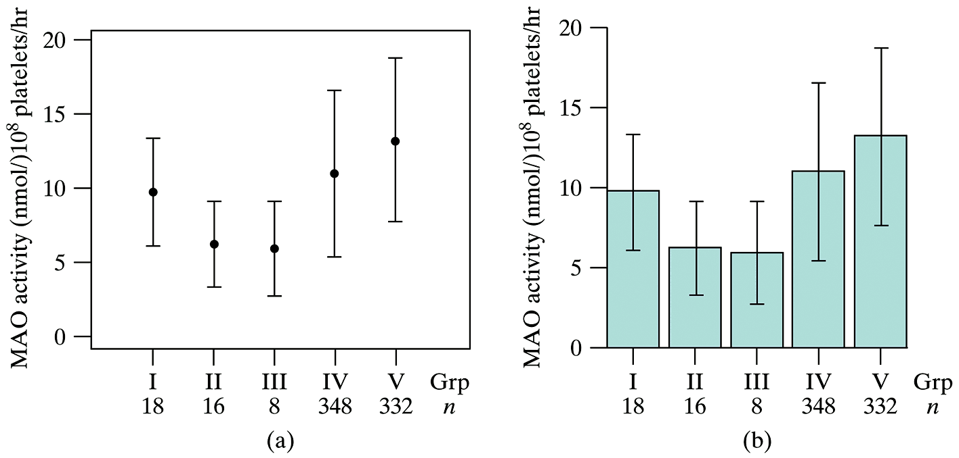
Graphical Presentation of SE and SD

Slide 4
CI: Idea
http://www.123rf.com/photo_8756272_lovely-little-toy-poodle-dog-running-on-the-lawn.html

Slide 5
Student’s t Distribution

Slide 6
Critical value of t_{α}

Slide 7
Table 4: t-distribution

Slide 8
Example: Statistical Estimation
Consider taking a sample of size n from a large population of seeds of the princess bean (Phaseotus vulgaris) and record the seed weights.
If our sample size is 20 with mean = 475 mg and s = 75 mg. What is SE?
What is the 95% confidence interval?
What is the 90% confidence interval?

Slide 9
Confidence Interval and Randomness

Slide 10
Example: Interpretation of C.I.
Researchers weighed the thymus gland of 5 chick embryos after 14 days of incubation and obtained a sample mean = 31.7 mg and s = 8.7 mg. Construct a 90% C.I. for the true population mean (μ).

Slide 11
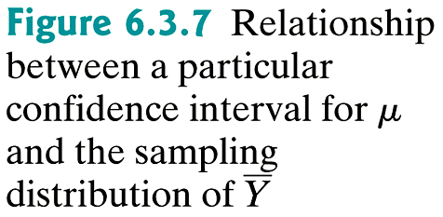
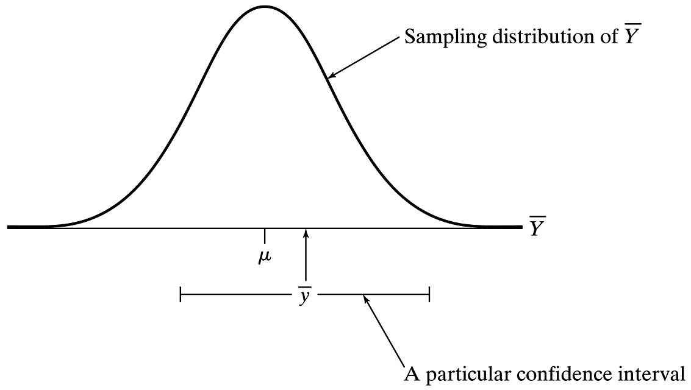
Relationship of C.I. to Sampling Distribution of

Slide 12
Example: One-sided C.I.
Researchers weighed the thymus gland of 5 chick embryos after 14 days of incubation and obtained sample mean = 31.7 mg and s = 8.7 mg.
Determine the 90% (lower bound) for the true population (μ).
Determine the 95% (upper bound) for the true population (μ).

Slide 13
Example: Determining n
Researchers weighed the thymus gland of 5 chick embryos after 14 days of incubation and obtained sample mean = 31.7 mg and s = 8.7 mg. Construct a 90% C.I. for the true population mean (μ).
Suppose that we plan a larger study on the thymus gland weights in chick embryos. We want to estimate μ with a margin of error of 1.5 mg for 95% confidence. How large of a sample should we take?

Slide 14
Example: Two-Sample Comparisons
1) Postmortem serotonin levels in patients who died of heart disease vs. those who died from other causes (control group)
2) To evaluate a new dietary supplement for beef cattle, one group gets a standard diet and a second group gets the standard diet plus a supplement. Observe weight gains.

Slide 15
“unpooled” SE of .

Slide 16
Example: Postmortem Serotonin Study
Suppose we observe the following data for our postmortem serotonin level study
a) What is the (unpooled) standard error?
b) What is the (pooled) standard error?
c) What is the 95% C.I.?
 | Serotonin (ng/g)
 | Heart Disease | Control
n | 8 | 12
 | 3840 | 5310
s | 2404 | 2217

Slide 17
Example: Postmortem Serotonin Study (cont)
We are 95% confident that the mean postmortem serotonin levels in patients who die from heart disease is from 3752 ng/g lower to 812 ng/g higher than the mean for patients who die of other causes.

Slide 18
Example: Calculation of C.I.
Seedlings were germinated under two different lighting conditions. Their lengths (in cm) were measured after a specified time period. The data are as follows:
What is the 95% C.I. for the difference of the means?
 | Dark | Light
n | 22 | 21
 | 1.76 | 2.46
SE | 0.125 | 0.175

Slide 19
Example: Calculation of C.I. (cont)
We are 95% confident that the mean lengths of plants grown in the dark is between 1.14 cm shorter to 0.26 cm shorter than mean lengths of plants grown in light.

Slide 20
Summary of Estimation Techniques

