Slide 1
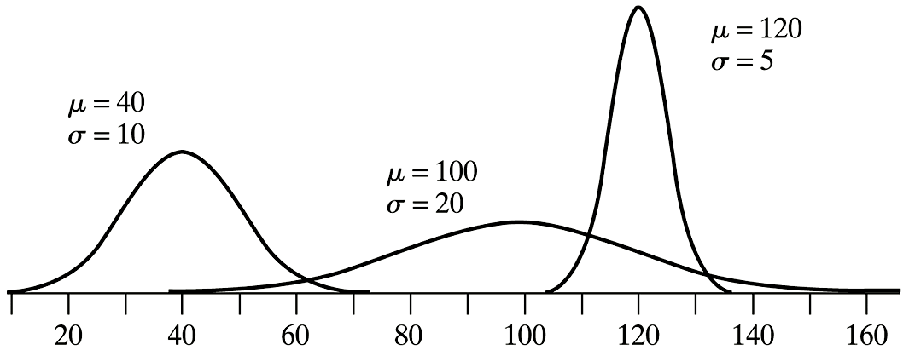
Shape of Normal Curves

Slide 2
Shape of Normal Curves

Slide 3
68%-95%-99.7% Rule

Slide 4
Areas under Normal Curve

Slide 5
Areas under Normal Curve(cont)

Slide 6
Example: Normal Distribution
The brain weights of adult Swedish males are approximately normally distributed with mean μ = 1,400 g and standard deviation σ = 100 g. (No real life population follows a normal distribution exactly!)
a) What is the probability that an adult Swedish male has a brain weight of less then 1,500 g?
b) What is the probability that an adult Swedish male has a brain weight between 1,475 g and 1,600 g?

Slide 7
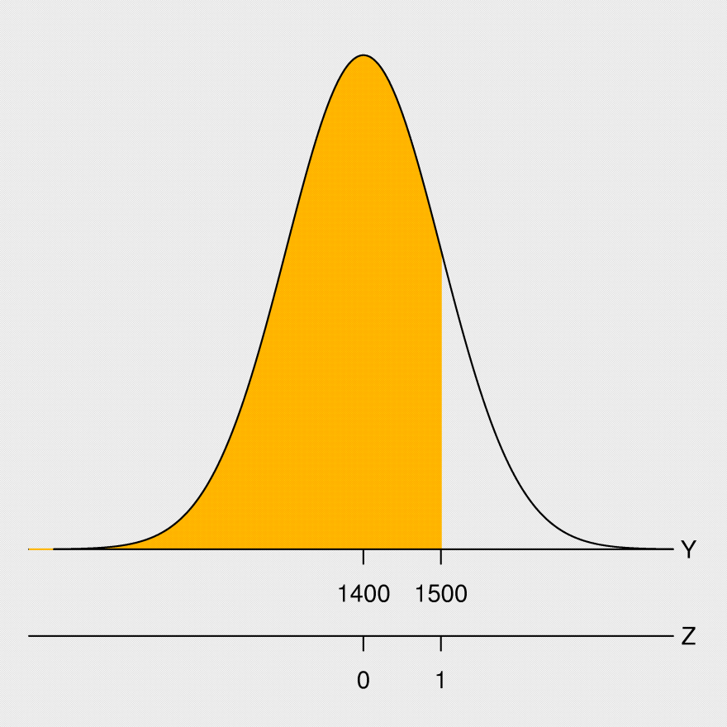
Example: Normal Distribution (cont)
μ = 1,400 g and σ = 100 g
a) What is the probability that an adult Swedish male has a brain weight of less then 1,500 g?

Slide 8
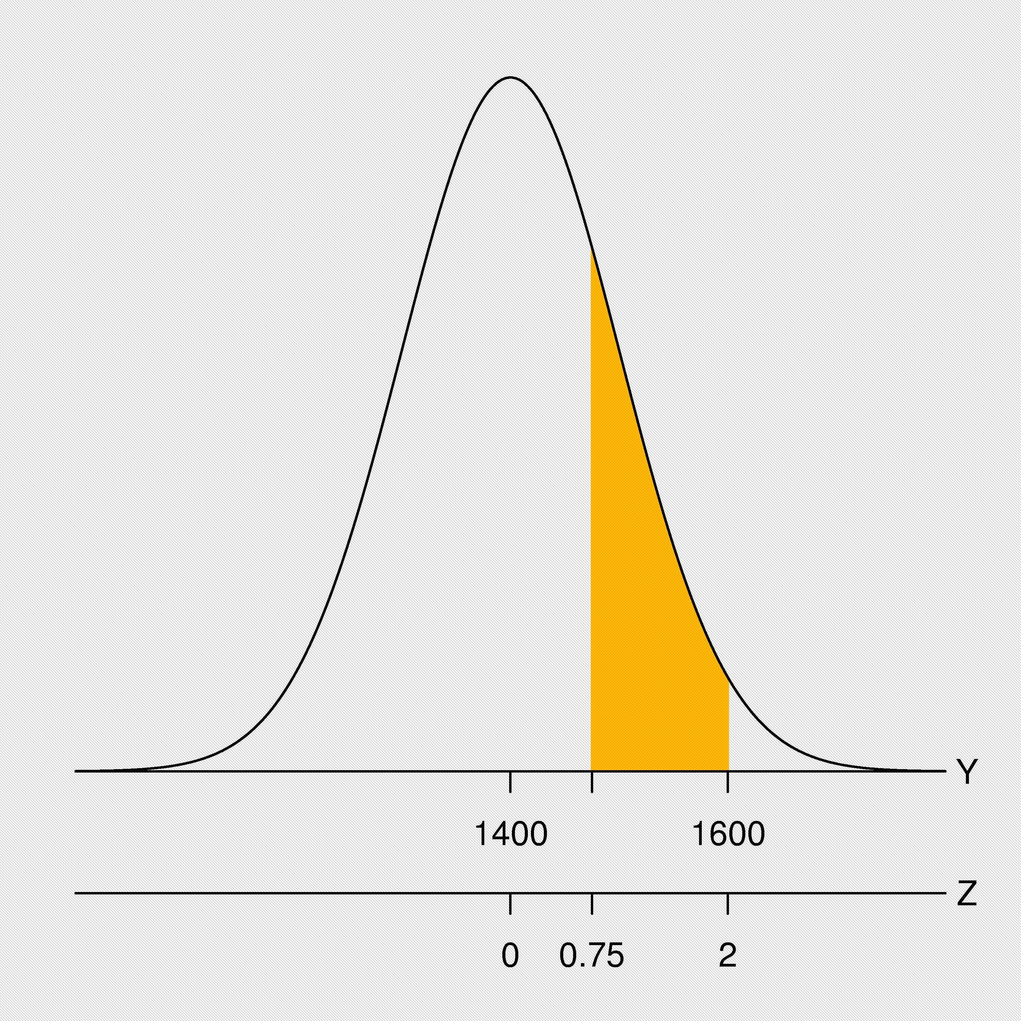
Example: Normal Distribution (cont)
μ = 1,400 g and σ = 100 g
b) What is the probability that an adult Swedish male has a brain weight between 1,475 g and 1,600 g?

Slide 9
Area under the normal curve above α

Slide 10
Example: Normal Distribution
The brain weights of adult Swedish males are approximately normally distributed with mean μ = 1,400 g and standard deviation σ = 100 g. (No real life population follows a normal distribution exactly!)
c) What is the 55th percentile for the distribution of brain weights?

Slide 11
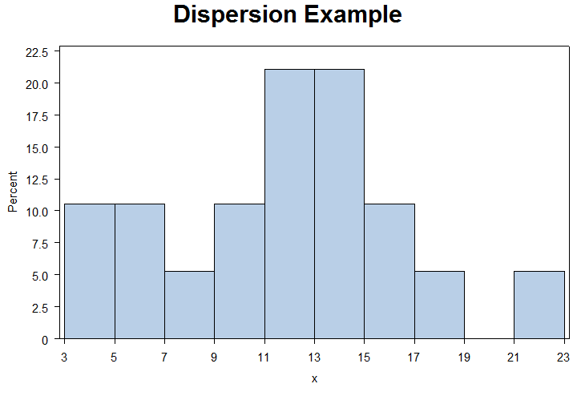
Example (ExDispersion.sas)
7 | 21 | 12 | 4 | 16 | 12 | 10 | 13 | 6 | 13
13 | 13 | 12 | 18 | 15 | 16 | 3 | 6 | 9 | 11
Determine the percentage of data points within 1 SD? 2 SD?

Slide 12
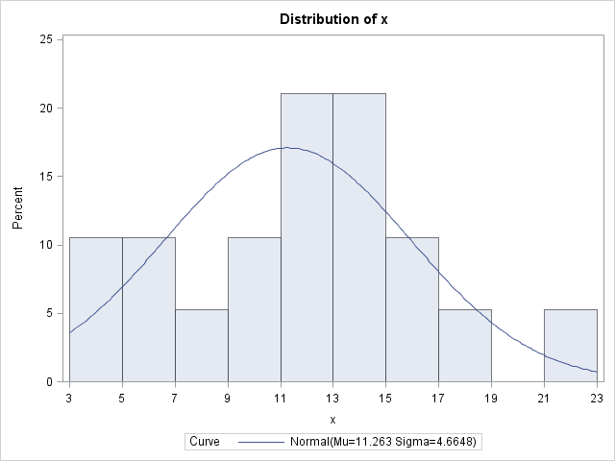
Example: Normality (ExNormal.sas)
7 | 21 | 12 | 4 | 16 | 12 | 10 | 13 | 6 | 13
13 | 13 | 12 | 18 | 15 | 16 | 3 | 6 | 9 | 11

Slide 13
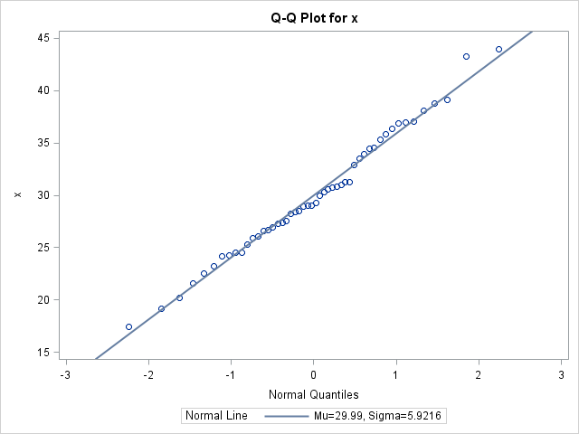
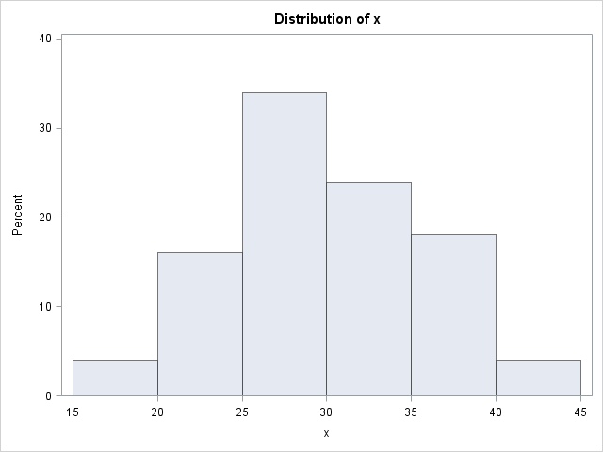
Example: QQPlots – Normal (ExQQplot.sas)

Slide 14
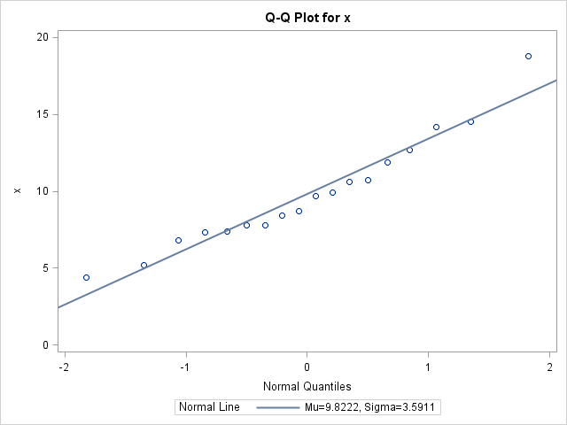
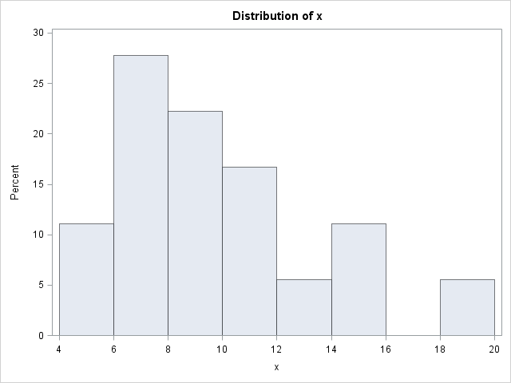
Example: QQPlots – Right Skewed

Slide 15
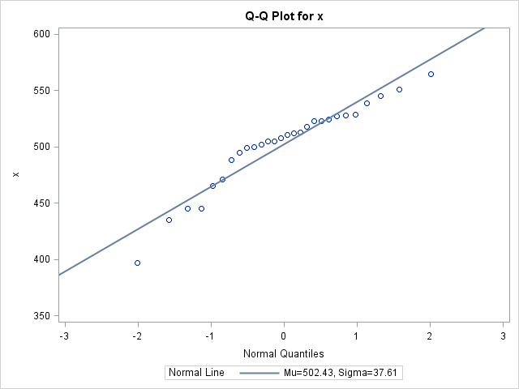
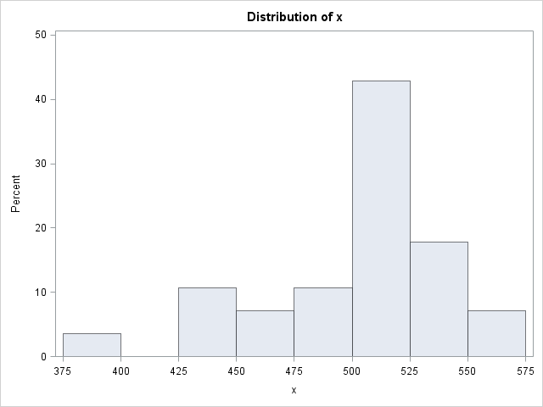
Example: QQPlots – Left Skewed

Slide 16
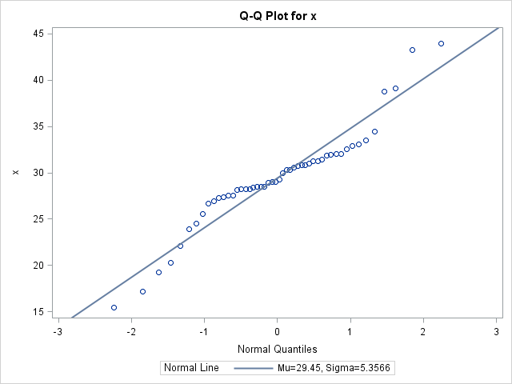
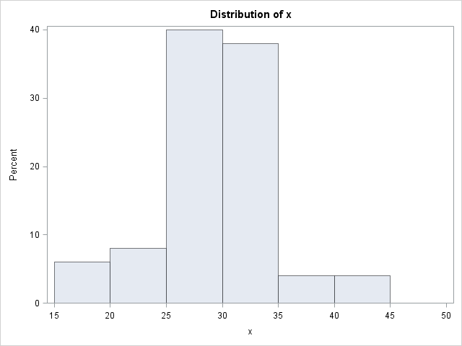
Example: QQPlots – Long Tail

Slide 17
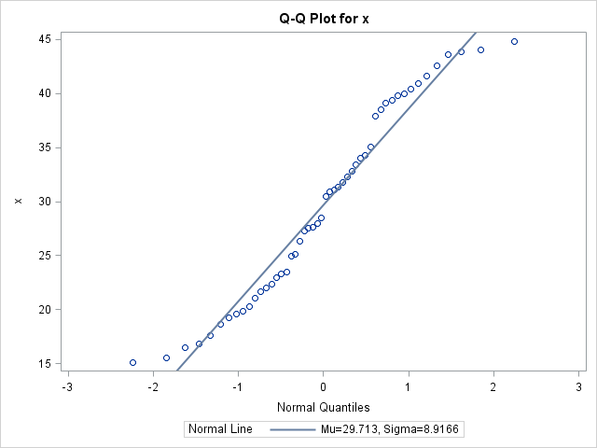
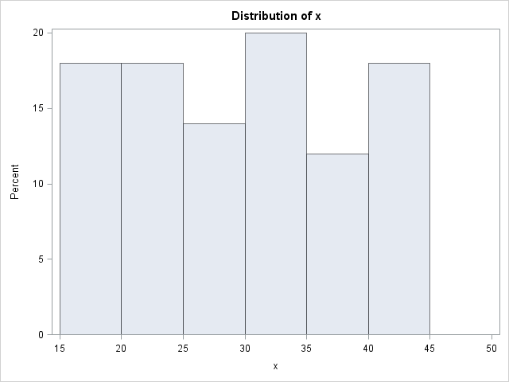
Example: QQPlots – Tails?

Slide 18
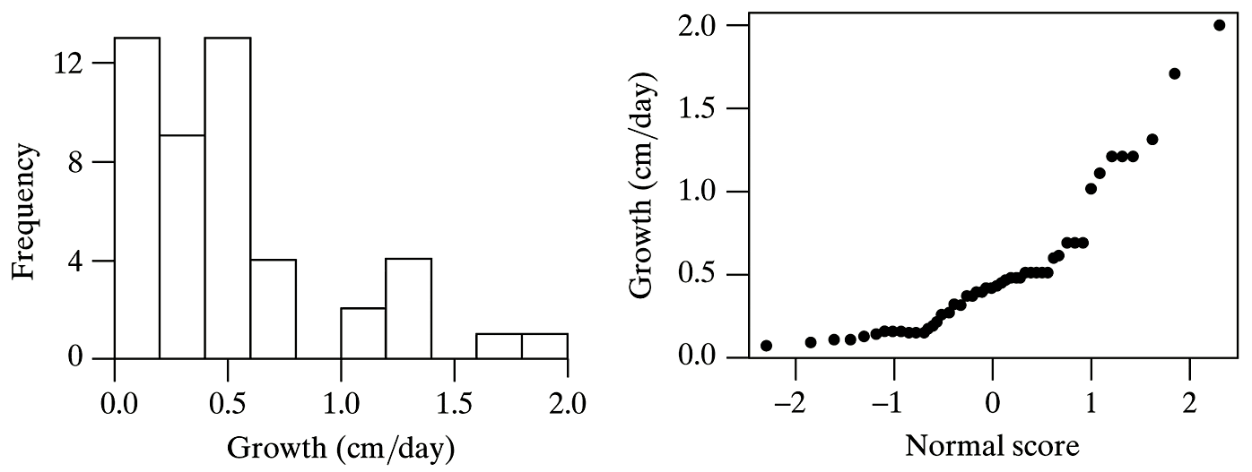
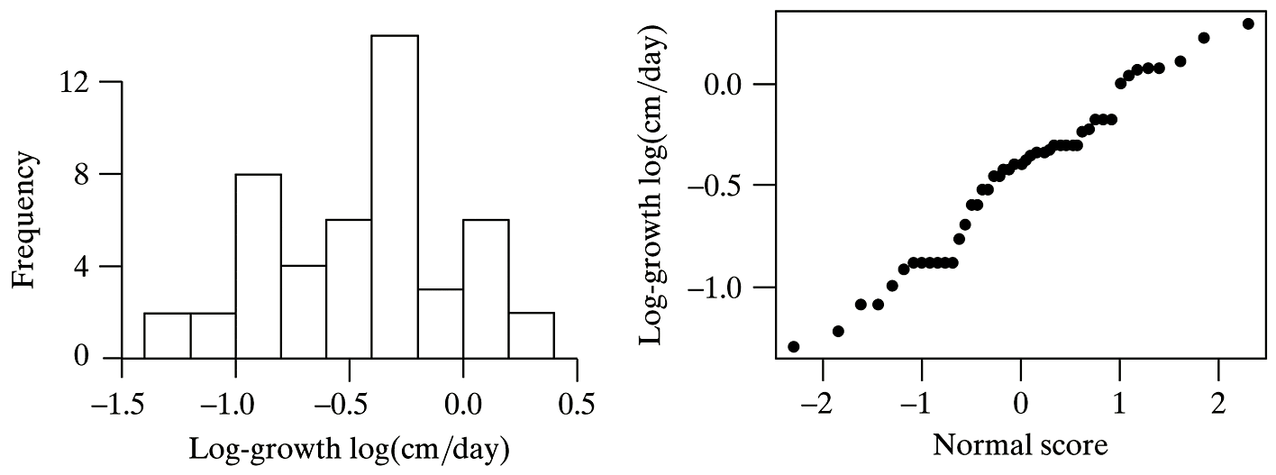
Example 4.4.5: Nonnormal Data

Slide 19
Interpretation of Shapiro-Wilk Test
P-Value | Interpretation
< 0.001 | Very strong evidence for nonnormality
< 0.01 | Strong evidence for nonnormality
< 0.05 | Moderate evidence for nonnormality
< 0.10 | Mild or weak evidence for nonnormality
≥ 0.10 | No compelling evidence for nonnormality

Slide 20
Objective Measure: SAS
Tests for Normality
Test | Statistic |  | p Value
Shapiro-Wilk | W | 0.98762 | Pr < W | 0.8757
Kolmogorov-Smirnov | D | 0.092489 | Pr > D | >0.1500
Cramer-von Mises | W-Sq | 0.042289 | Pr > W-Sq | >0.2500
Anderson-Darling | A-Sq | 0.233462 | Pr > A-Sq | >0.2500

Slide 21
Objective Measure: SAS
Tests for Normality
Test | Statistic |  | p Value
Normal | W | 0.98762 | Pr < W | 0.8757
Right Skewed | W | 0.949844 | Pr > W | 0.4226
Left Skewed | W | 0.925624 | Pr > W | 0.0479
Long Tailed | W | 0.927118 | Pr > W | 0.0043
Short Tailed | W | 0.949227 | Pr > W | 0.0317

Slide 22
Example: QQPlots
x

Slide 23
Example 4.10: Continuity Correction
Table 4.1 shows the distribution of litter size for a population of female mice with population mean 7.8 and SD 2.3.
x

Slide 24
Example 4.10: Continuity Correction(cont)
Table 4.1 shows the distribution of litter size for a population of female mice with population mean 7.8 and SD 2.3.
x

