Slide 1
Example 3.2.6: Sampling Fruitflies
In a Drosophila population, 30% of the flies are black and 70% are gray. Suppose that two flies are randomly chosen from the population. What is the probability that they are the same color?

Slide 2
Example 3.2.6: Sampling Fruitflies (cont)
In a Drosophila population, 30% of the flies are black and 70% are gray. Suppose that two flies are randomly chosen from the population. What is the probability that they are the same color?

Slide 3
Example 3.2.6: Sampling Fruitflies (cont)
In a Drosophila population, 30% of the flies are black and 70% are gray. Suppose that two flies are randomly chosen from the population. What is the probability that they are the same color?
 | Color - Homogeneous | Deviation from 58%
First 100 samples | 54 or 54% | -4 or -4%
First 1000 samples | 596 or 59.6% | +16 or +1.6%

Slide 4
Combination of Probabilities
What is the probability that I roll less than a 2 on my die?
What is the probability that I roll at most a 2 on my die?
What is the probability that I roll no more than a 2 on my die?
What is the probability that I roll more than a 3 on my die?
What is the probability that roll at least a 3 on my die?

Slide 5
Example 3.2.6: Sampling Fruitflies
In a Drosophila population, 30% of the flies are black and 70% are gray. Suppose that two flies are randomly chosen from the population. What is the probability that they are the same color?

Slide 6
Example: Medical Testing
The prevalence of HIV in a population is 2%. A certain test for HIV has a sensitivity (power) of 99.7% and a specificity of 98.5%.
What is the probability that a person at random will test positive?
What is the probability that if someone tests positive, that they have the disease?

Slide 7
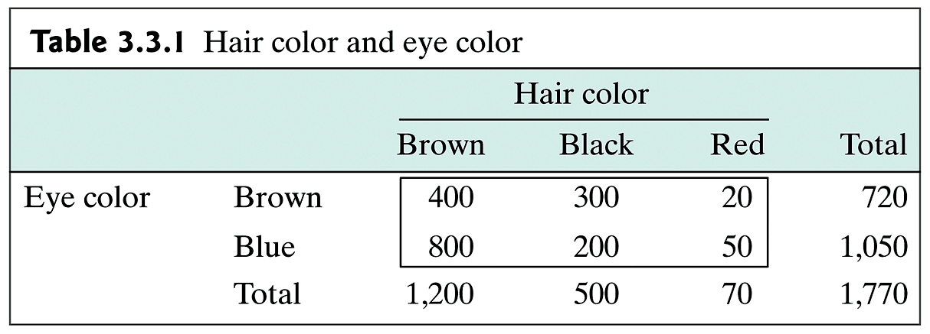
Example 3.3.2: Probability Rules
Table 3.3.1 shows the relationship between hair color and eye color for a group of 1,770 German men.

Slide 8
Example: Probability Rules (cont)
What is the probability that a man has either brown or red hair?
What is the probability that a man has either brown hair or brown eyes?

Slide 9
Example: Probability Rules (cont)
What is the probability that a man has brown eyes given that he has brown hair?
Is having brown hair independent of having brown eyes?
What is the probability that a man will have brown hair and brown eyes?

Slide 10
Probability Rules: Dice
We are rolling two 4-sided dice.
Let
E = the event that the white die is 1
F = the event that the sum of the dice is 3
Are E and F independent?

Slide 11
Density Curve

Slide 12
Interpretation of Density Curve

Slide 13
Interpolation of Density Curves (cont)

Slide 14
Example 3.5.11: mean/SD
You are using two balances to measure the mass of a 10 mL graduated cylinder. On any particular balance, your measurements will vary each time you weigh it. Let X be the value from one balance and Y the value from the other. Suppose that μ_{X} = 25.12 g, σ_{X} = 0.03 g, μ_{Y} = 25.13 g, σ_{Y} = 0.04 g.
What is the mean and standard deviation of X – Y?

Slide 15
Example 3.2.6: Binomial Distribution
In a Drosophila population, 30% of the flies are black and 70% are gray. Suppose that two flies are randomly chosen from the population.
What is the probability that one is grey and one is black?

Slide 16
Example: Binomial Distribution - 1
Suppose that 20% of the population experience nausea after taking a certain drug. A doctor prescribes the drug to 4 new patients. Let Y be the number of these that experience nausea, determine
the probability distribution of Y
E(Y) c) σ_{Y}
d) Pr(at least 1 experience nausea)
e) Pr(at most 2 experience nausea)
f) If the patient is taking 2 drugs with this distribution, what are E(X + Y) and σ_{X+Y}?

Slide 17
Example: Binomial Distribution - 2
Suppose you read that for the state of Indiana, 1 child in 16 has a high blood level of lead (defined as 30 μg/dL or more). You suspect that, in your community, the rate is higher. In order to test this, you select 30 children from your community and measure their blood lead levels. You find that 5 of them have high blood lead levels.
Is your hypothesis correct?

Slide 18
Histograms of Binomial Distributions

