Slide 1
Example: Samples and Variables
For each of the following, identify the variable(s) of interest, the type of variable, the observational unit (or case) and the sample size.
Number of petals of 20 rose flowers
Survey question about whether to have more student apartments in West Lafayette received from 100 households of residents in West Lafayette.
Gender and weight of 10 babies born at St. Elizabeth East.

Slide 2
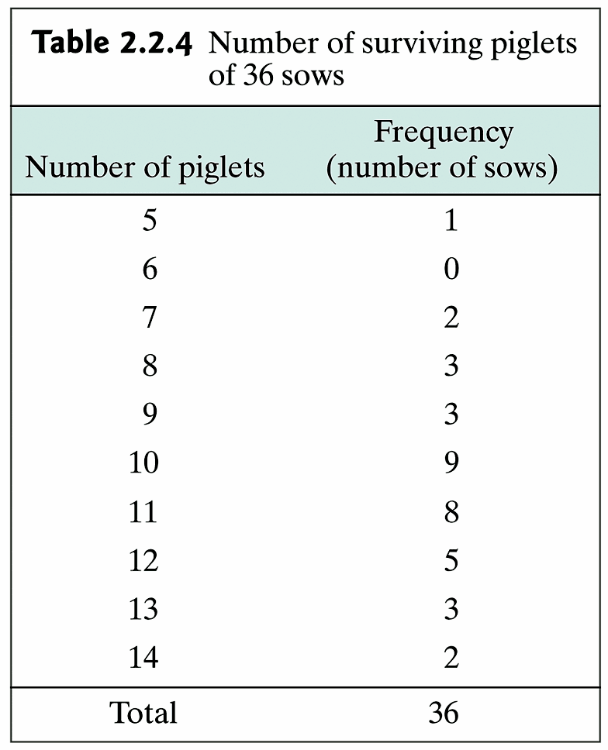
Example 2.2.4: Liter Size of Sows
A group of 36 2-year-old sows of the same breed were bred. the number of piglets surviving to 21 days of age were recorded for each sow.
What type of variable is this?

Slide 3
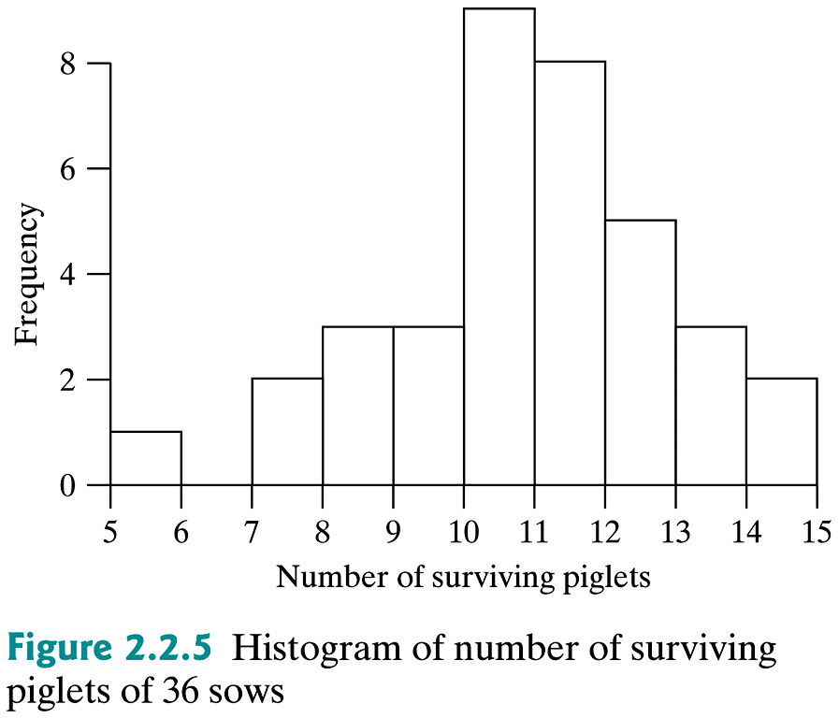
Example 2.2.4: Liter Size of Sows (cont)

Slide 4
Example: Bar Graph

Slide 5
Example 2.2.4: Liter Size of Sows
(Ex.2.2.4.sas)
data sow;
infile 'I:\My Documents\Stat 503\Ex.2.2.4.dat';
input piglets;
run;
proc print data=piglets;
run;
title1 'Surviving Piglets';
proc univariate data=sow noprint;
histogram piglets / endpoints = 5 to 15 by 1;
run;
quit;
X

Slide 6
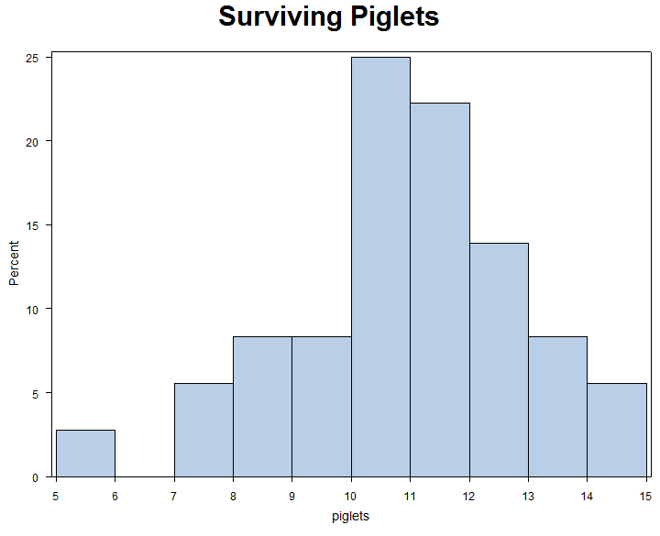
Example 2.2.4: Liter Size of Sows (cont)
X

Slide 7
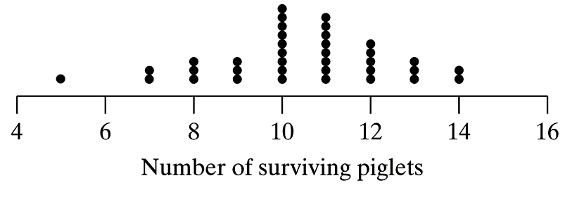
Example 2.2.4: Liter Size of Sows (cont)

Slide 8
Example 2.2.4: Liter Size of Sows (cont)

Slide 9
Example 2.2.4: Liter Size of Sows (cont)
Rel. Frequency
0.028
0
0.056
0.083
0.083
0.25
0.222
0.139
0.083
0.056

Slide 10
Example 2.2.4: Liter Size of Sows (cont)

Slide 11
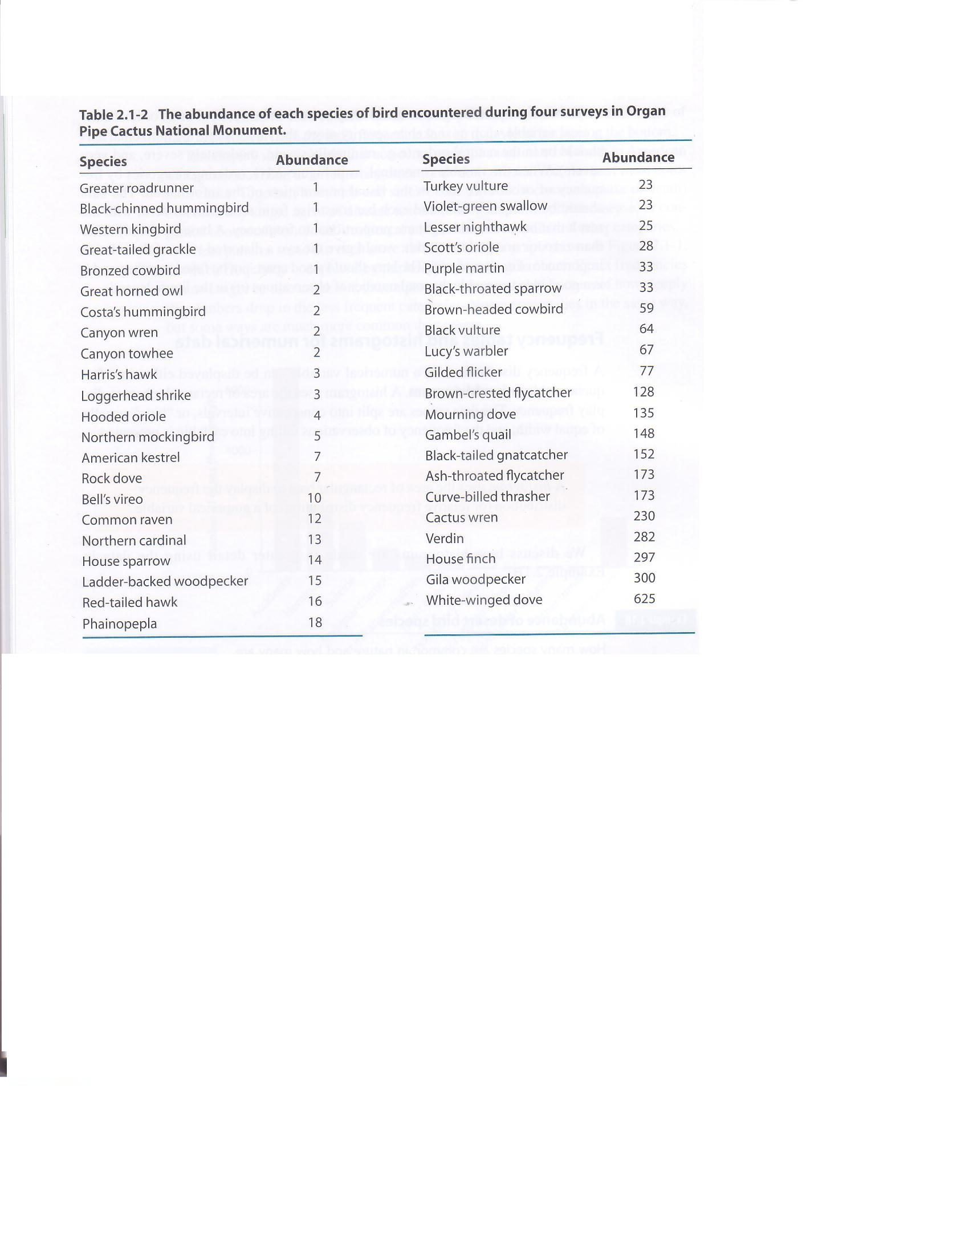
Example: Abundance of desert bird species
How many species are common in nature and how many are rare? The following frequency distribution is the number of breeding birds of different species in the Organ Pipe Cactus National
Monument
in
southern
Arizona.
The Analysis of Biological Data, Whitlock, Schluter, 2009, Roberts and Company, pp. 27-29

Slide 12
Example: Abundance of desert bird species
(Exhistogram.sas)
Table CODE:
data abundance;
infile 'I:\My Documents\Stat 503\Exhistogram.dat';
input species $ abundance;
run;
proc print data=abundance;
run;
title1 'Relative Percentage of Species';
proc univariate data=abundance noprint;
histogram abundance / endpoints = 0 to 650 by 50;
run;
quit;
X

Slide 13
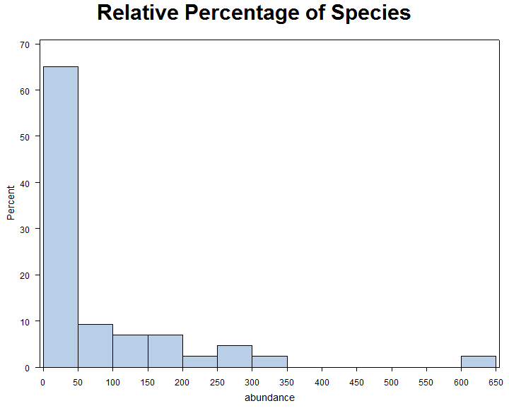
Example: Abundance of desert bird species
Table Histogram

Slide 14
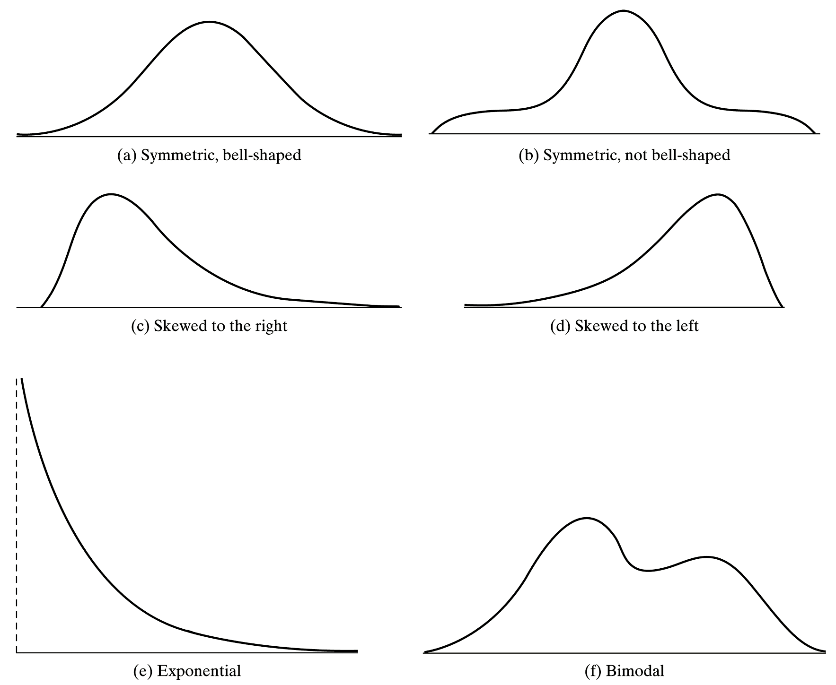
Shapes of Histograms

Slide 15
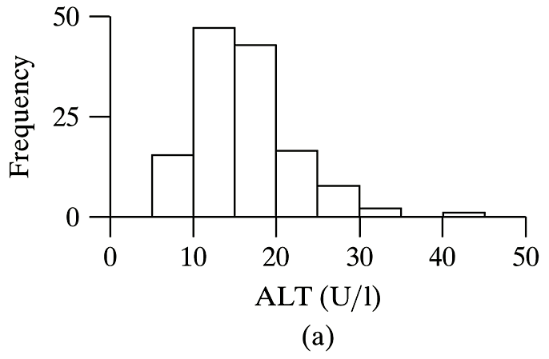
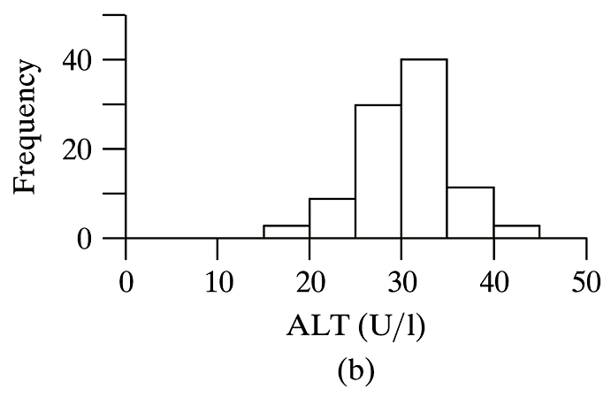
Sources of Error: Serum ALT
Alanine aminotransferase (ALT) is an enzyme found in most human tissues. A study was performed to determine the concentration of serum ALT (U/L) in 129 adult volunteers.

Slide 16
Example: Median and Mean
Calculate the median and mean for the following:
Example 2.3.1/3: Weight Gain of Lambs
11 13 19 2 10 1
Example 1:
2.45 2.57 2.81 2.37 2.01
Example 2:
2.86 2.65 2.75 2.60 2.30 2.49

Slide 17
Example: Median and Mean
Calculate the median and mean for the following:
Example 2.3.1/2/3: Weight Gain of Lambs
11 13 19 2 10 1
Example 1:
2.45 2.57 2.81 2.37 2.01
Example 1a:
2.45 2.57 2.81 2.37 2.31
Example 2:
2.86 2.65 2.75 2.60 2.30 2.49

Slide 18
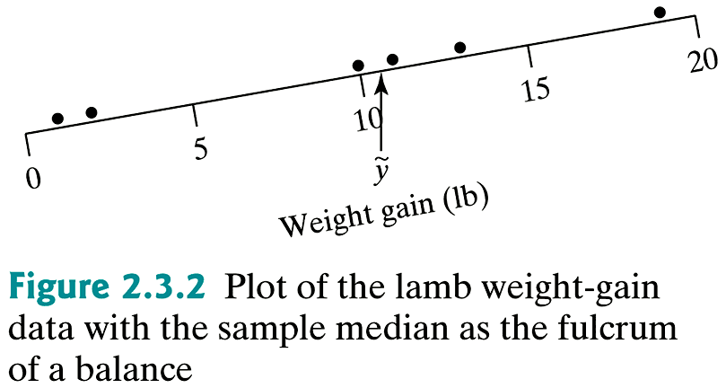
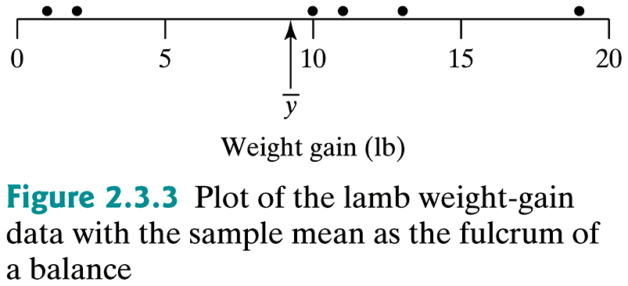
Example 2.3.1/3: (cont)

Slide 19
Mean vs. Median
ỹ
y̅
ỹ
y̅
y̅
ỹ

Slide 20
Example: Menarche
As part of a larger study of the effects of strenuous exercise on human fertility and fecundity, the ages (in years) of menarche (the beginning of menstruation) for 10 Olympic female endurance athletes (runners and swimmers) who had vigorously trained for at least 18 months prior to menarche were recorded.
What are median, Q₁, Q₃, IQR?
13.6 | 13.9 | 14.0 | 14.2 | 14.9 | 15.0 | 15.0 | 15.1 | 15.4 | 16.4

Slide 21
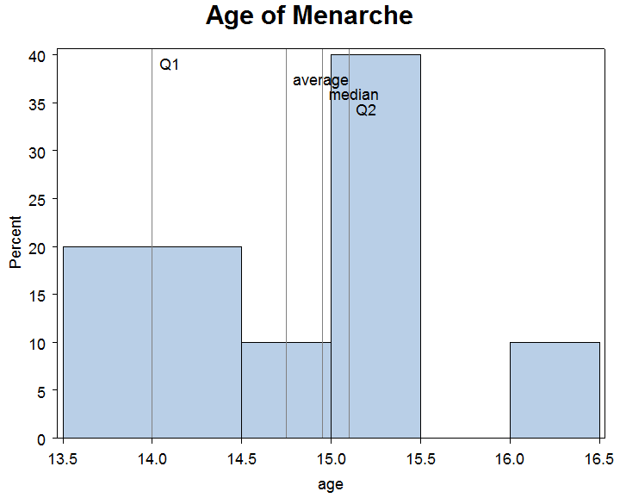
Example: Menarche (ExHistogramM.sas)
13.6 | 13.9 | 14.0 | 14.2 | 14.9 | 15.0 | 15.0 | 15.1 | 15.4 | 16.4
mean
Q₃
Q₁
Q3

Slide 22
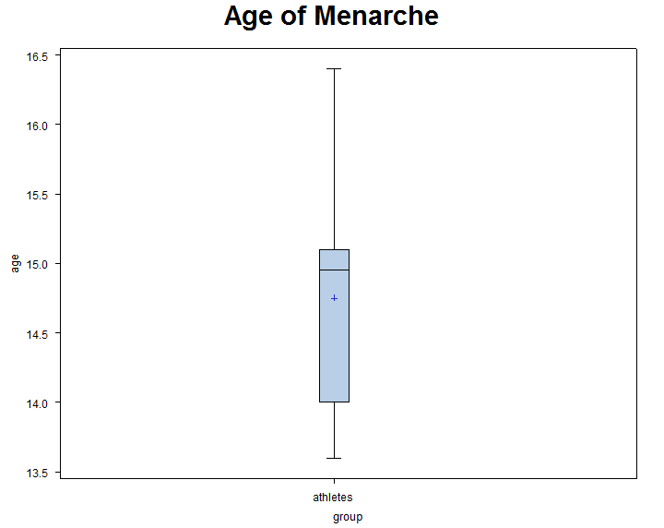
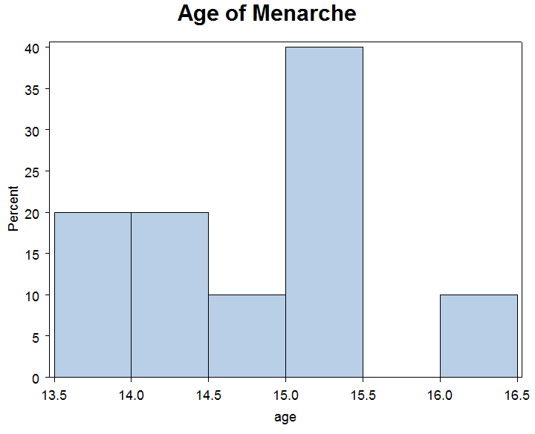
Example: Menarche (ExHistogramM.sas)

Slide 23
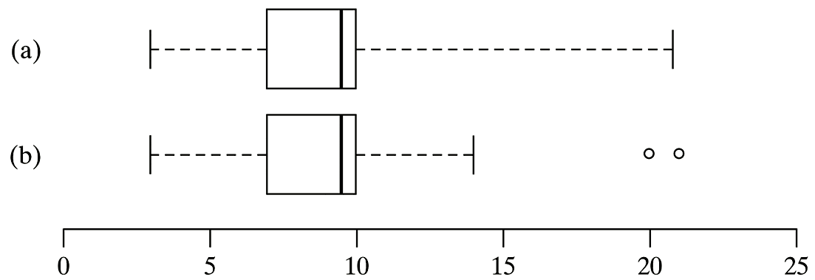
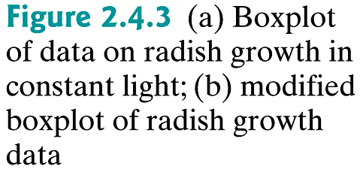
Example: Modified Boxplot

Slide 24
Example 2.5.1/2: Categorical-Categorical Relationships
In an effort to determine if there are difference in primary sources of fecal contamination at different locations in the Morro Bay watershed, n = 623 water specimens were collected at three primary locations that feed into Morro Bay: Chorro Creek (n₁ = 241), Los Osos Creek (n₂ = 256), and Baywood Seeps (n₃ = 126). The type of E. Coli strain was identified as Bird, Domestic Pet, Farm animal, Human, or Terrestrial mammal.

Slide 25
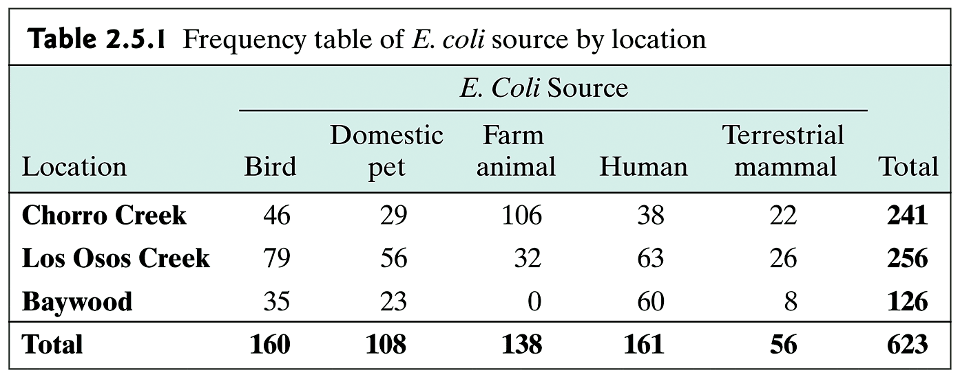
Example 2.5.1: (cont)

Slide 26
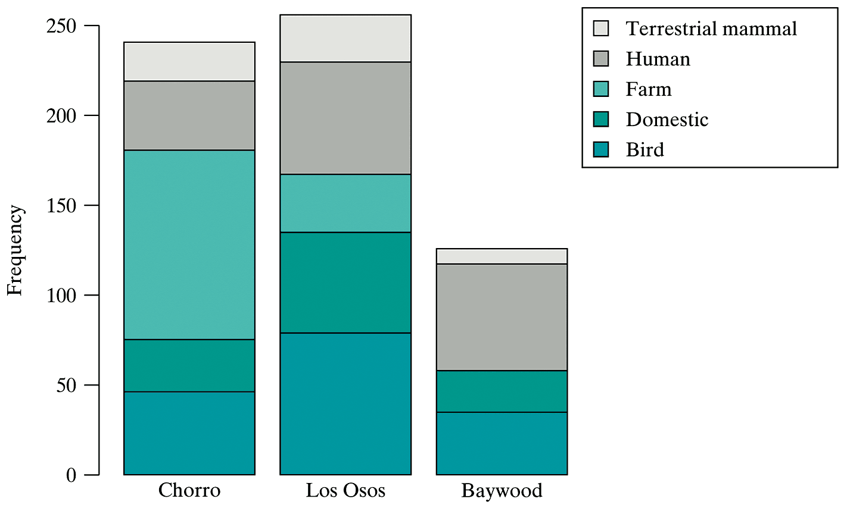
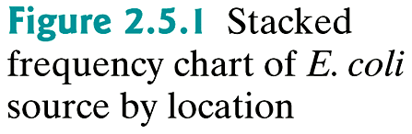
Example 2.5.1: (cont)

Slide 27
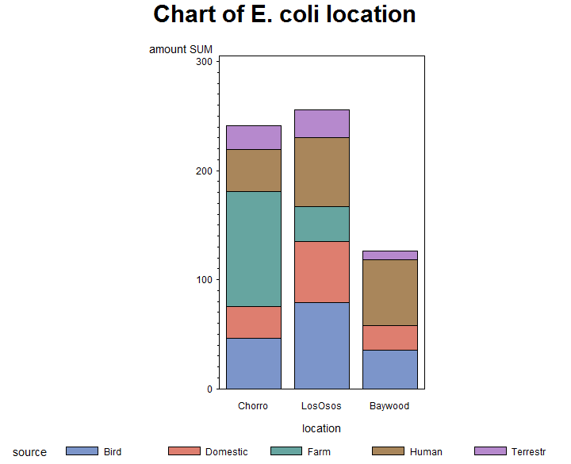
Example 2.5.1: (ExHistogramRel.sas)
X

Slide 28
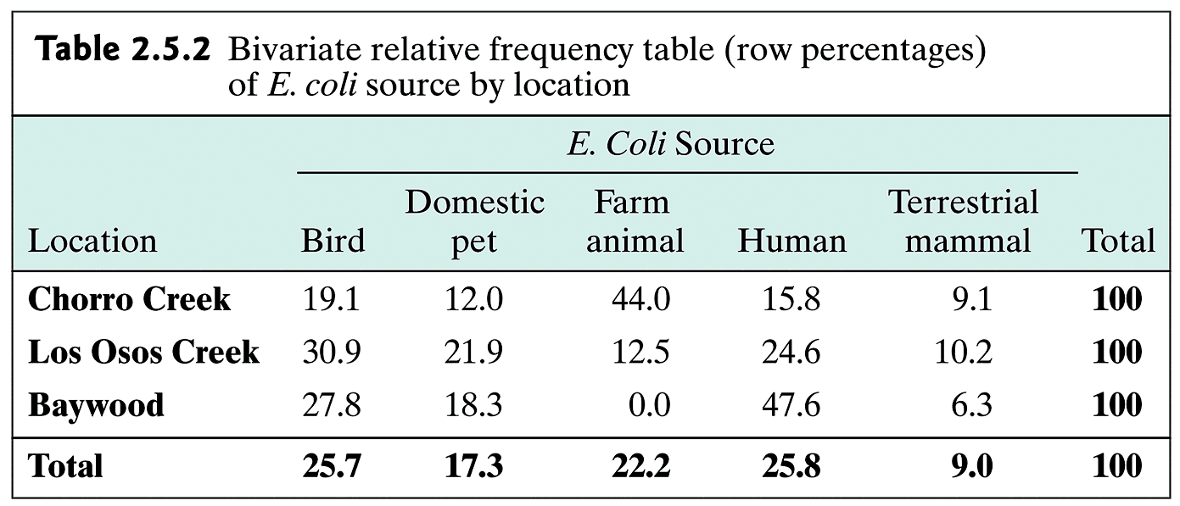
Example 2.5.2

Slide 29
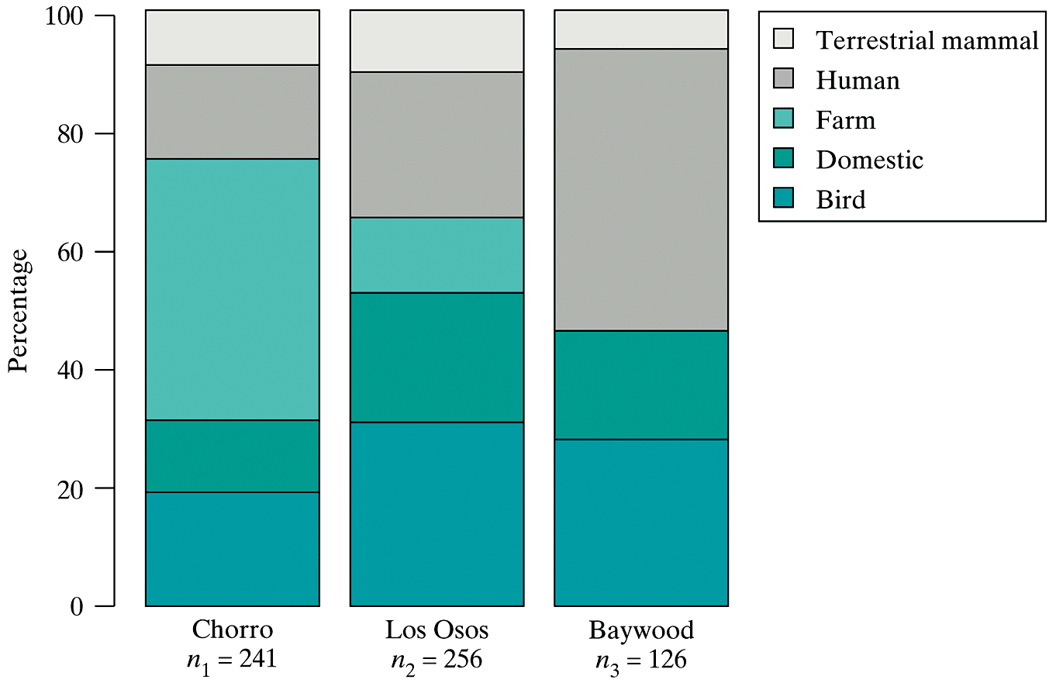
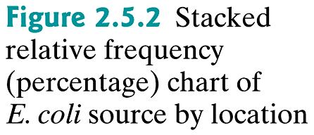
Example: 2.5.2: (cont)

Slide 30
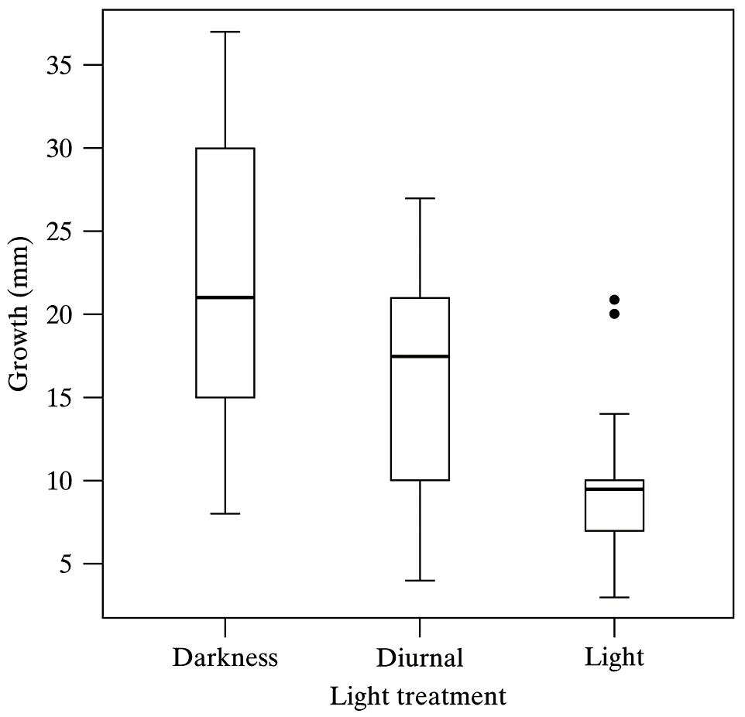
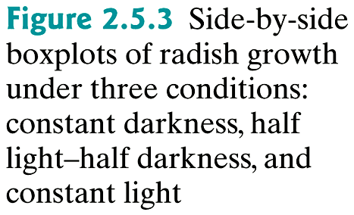
Example 2.5.3: Numeric-Categorical Relationships
The effect of different lighting conditions on radish shoot growth.

Slide 31
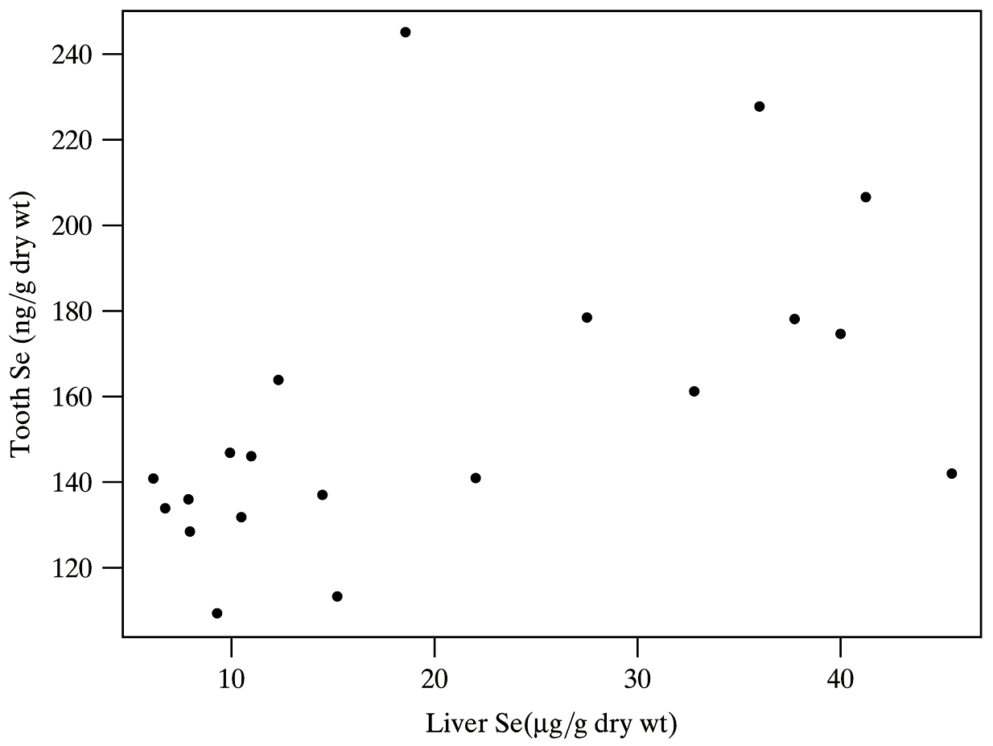
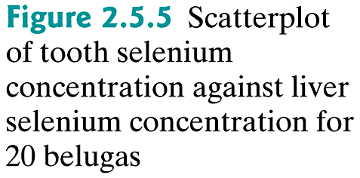
Example 2.5.4: Numeric-Numeric Relationships
The relationship between the concentrations of Selenium in tooth and liver for 10 beluga whales.

Slide 32
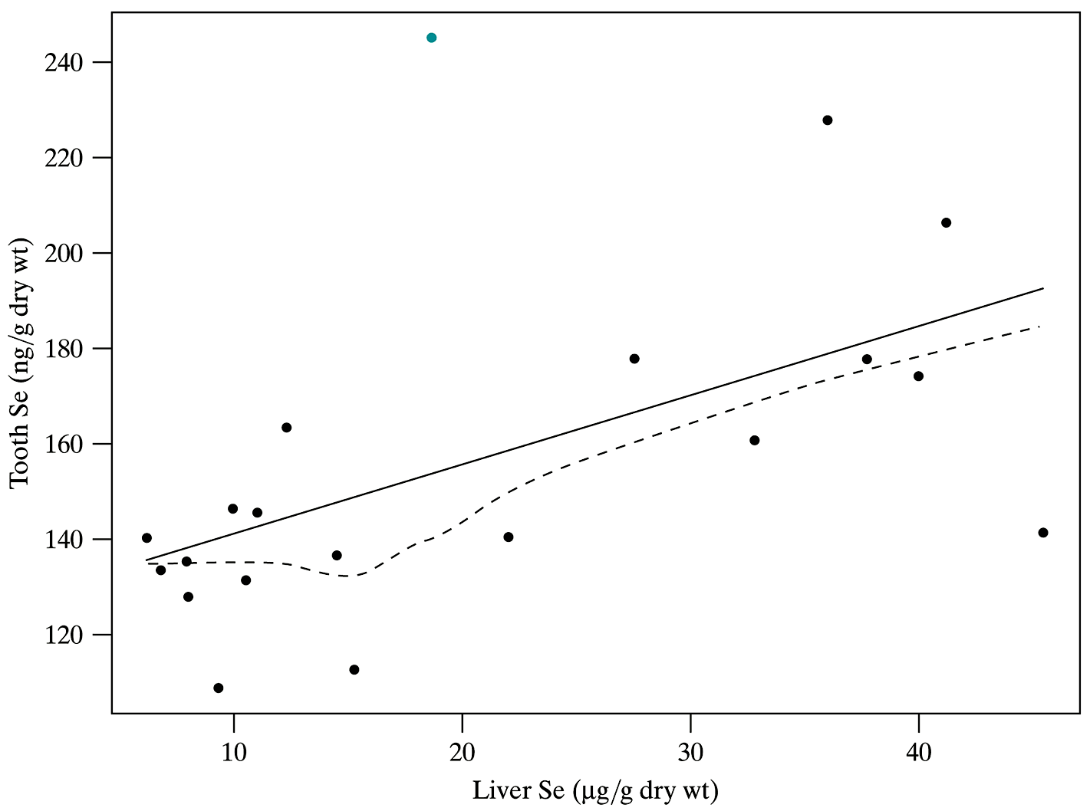
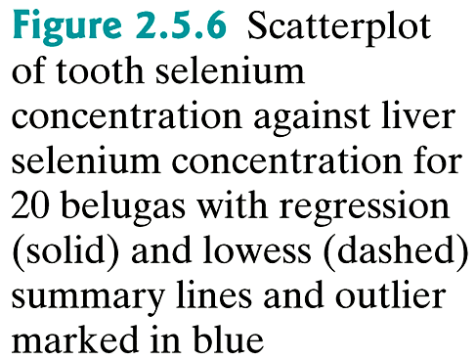
Example 2.5.4: (cont)

Slide 33
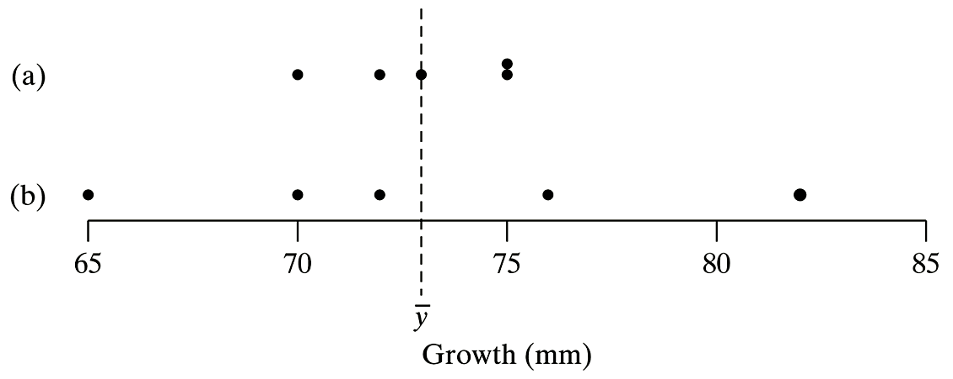
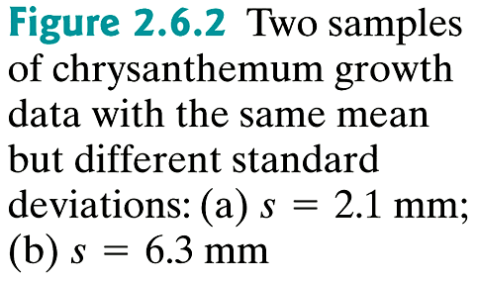
Interpretation of s

Slide 34
Example: Measures of Dispersion
Example 1:
2.45 2.57, 2.81 2.37 2.01
Calculate: range, IQR, s, variance, coefficient of variation

Slide 35
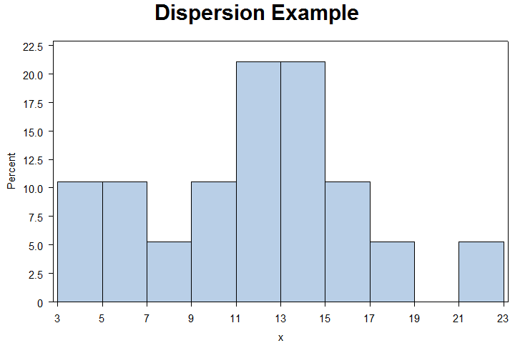
Example (ExDispersion.sas)
7 | 21 | 12 | 4 | 16 | 12 | 10 | 13 | 6 | 13
13 | 13 | 12 | 18 | 15 | 16 | 3 | 6 | 9 | 11
Determine the percentage of data points within 1 SD? 2 SD?

Slide 36
Example: Linear Transformation
After taking the temperature of a large number of healthy adults, it has been determined that the average temperature is = 98.6 F with a SD of s = 0.9 F, and variance of s² = 0.81 F²
What are the mean, SD and variance in Celsius?
What are the mean, SD and variance of the ‘standardized’ temperature,

Slide 37
Example: Populations
Given the following samples, what would possible populations be?
1) fallen cats brought to one veterinary clinic in NYC.
2) 50 children in Vancouver, Canada, suffering from asthma
3) a bar in West Lafayette full of voters
4) fruit flies trapped at a garbage dump

Slide 38
Example: Menarche
As part of a larger study of the effects of strenuous exercise on human fertility and fecundity, the ages (in years) of menarche (the beginning of menstruation) for 10 Olympic female endurance athletes (runners and swimmers) who had vigorously trained for at least 18 months prior to menarche were recorded.
13.6, 13.9, 14.0, 14.2, 14.9, 15.0, 15.0, 15.1, 15.4, 16.4
Draw the stem-and-leaf diagram of this data.
x

Slide 39
Example: Menarche
13.6, 13.9, 14.0, 14.2, 14.9, 15.0, 15.0, 15.1, 15.4, 16.4
x

Slide 40
Example 2.46: Sucrose Consumption
The following are the histograms, means and SD for the amount of sucrose that the black blowfly can drink in 30 mins for different samples sizes.
x

Slide 41
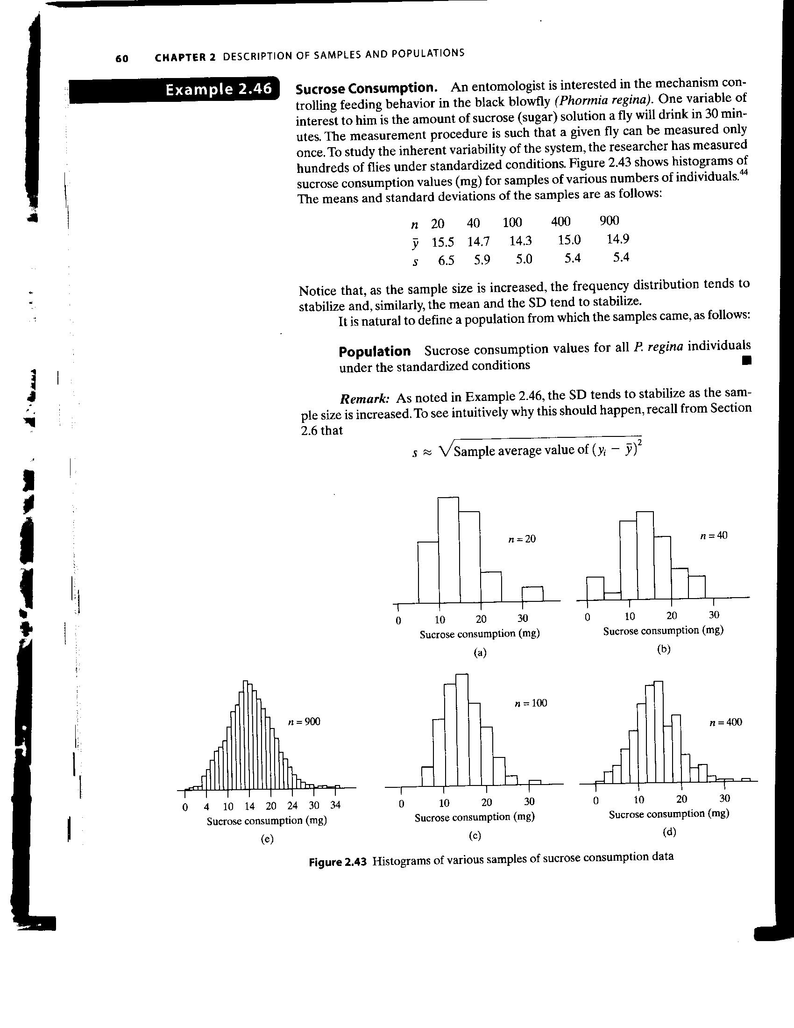
Example 2.46: Sucrose Consumption
n | 20 | 40 | 100 | 400 | 900
 | 15.5 | 14.7 | 14.3 | 15.0 | 14.9
s | 6.5 | 5.9 | 5.0 | 5.4 | 5.4
x

