Slide 1
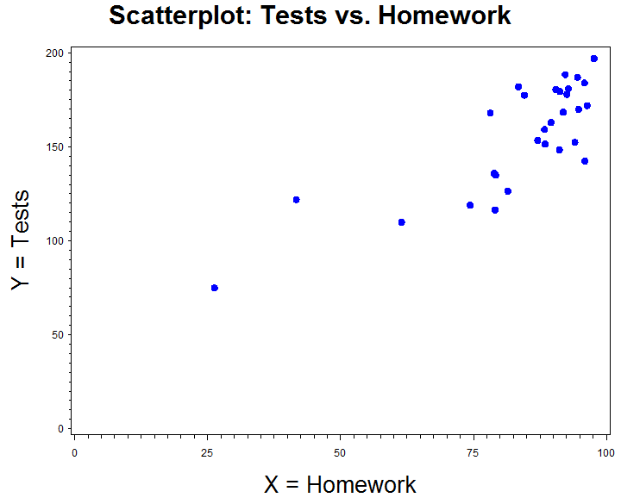
Linear Regression: Test scores vs. HW scores

Slide 2
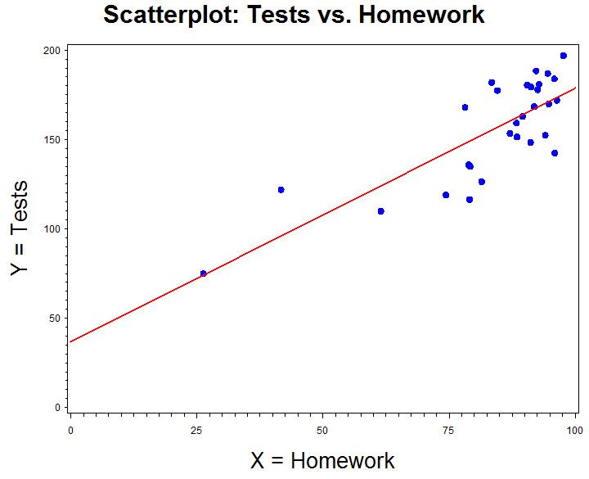
Linear Regression: Test scores vs. HW scores

Slide 3
Positive/Negative Correlation

Slide 4
Variety of Correlation Values

Slide 5
Example (Tests vs. HW): Correlation
 | HW | Tests | Std HW | Std tests | Product of std
 | X | Y |  |  | z_{x}z_{y}
 | 26.3 | 75 | -3.66 | -2.83 | 10.36
 | 94.1 | 152.4 | 0.56 | -0.19 | -0.11
Sum | 2632 | 4902 | 0.00 | 0.00 | 23.79
Mean | 84.89 | 158.12 | 0.00 | 0.00
SD | 16.02 | 29.34 | 1.00 | 1.00

Slide 6
Example: Hypothesis Testing - Correlation
Is there a correlation between test scores and homework scores within the linear model
H₀: ρ = 0 : there is no linear correlation between test scores and homework scores
H_{A}: ρ ≠ 0 : there is a linear correlation between test scores and homework scores
This study does provide evidence (P < 0.0001) at the 0.05 significance level that that there is a linear correlation between Homework scores and test scores.

Slide 7
Example: Confidence Interval - Correlation
We are 95% confident that the correlation between test scores and homework scores is between 0.658 and 0.896.
X
X

Slide 8
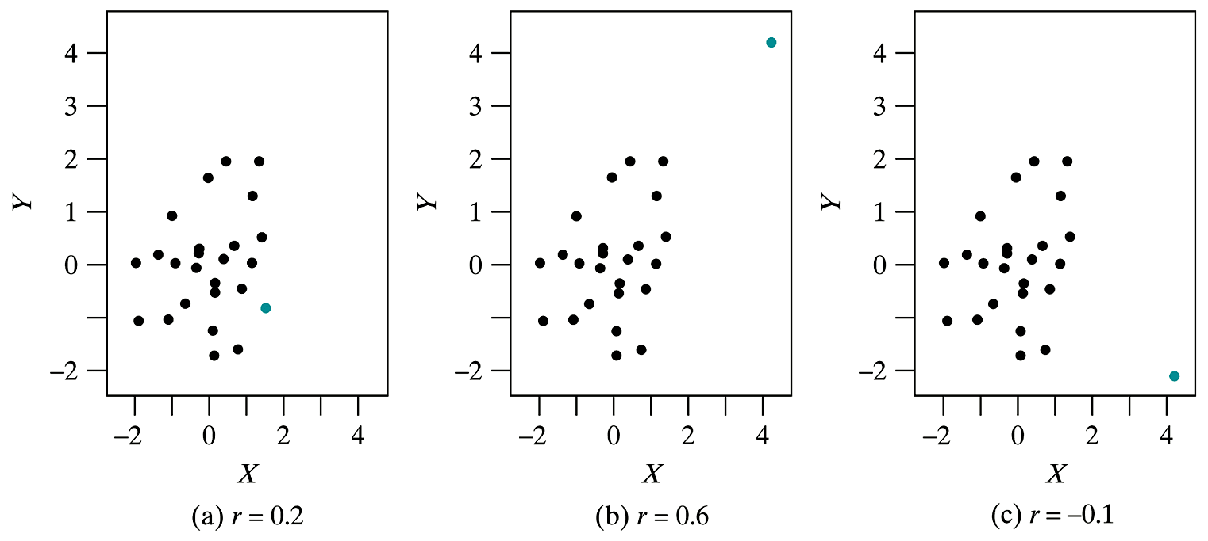
Effect of Outliers on r

Slide 9
Example: Fitted Regression Line
Let X be the total score on the Homework (in points) and Y be the total score on Tests (in points). The following summary statistics were obtained:
What is the equation of the fitted regression line?
n = 31 | r = 0.7930
x̄= 84.89 | ȳ = 158.12
s_{x} = 16.02 | s_{y} = 29.34

Slide 10
Example: Fitted Regression Line (cont)
Tests = 34.84 + 1.45 Homework
R² = 0.6288

Slide 11
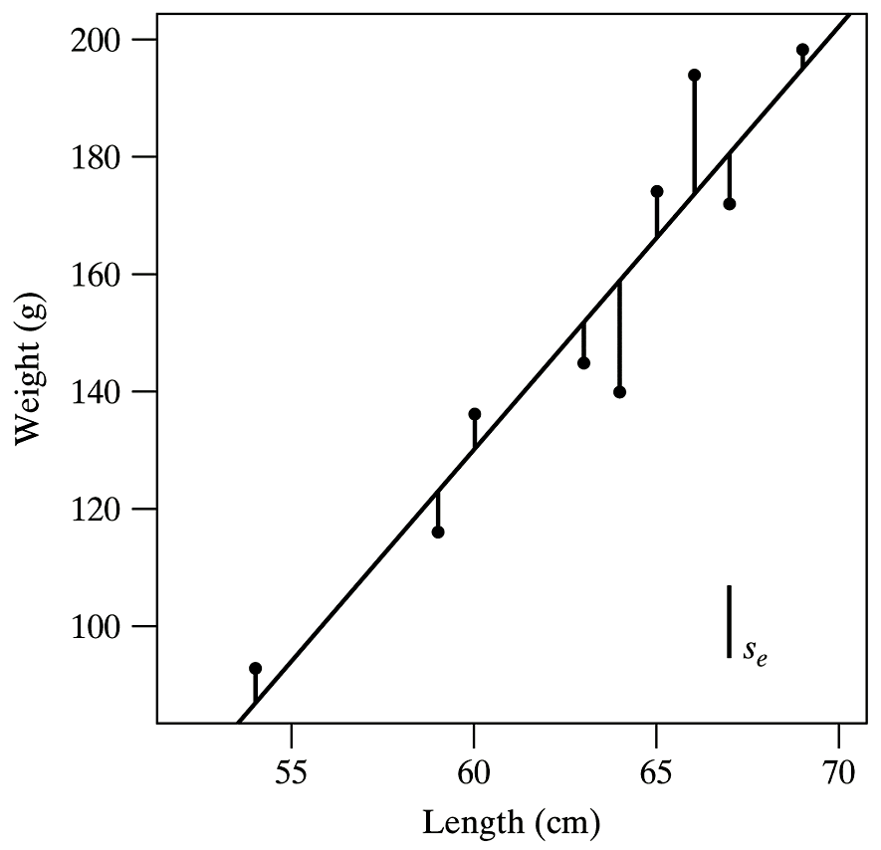
Residual SD

Slide 12
Residual SD

Slide 13
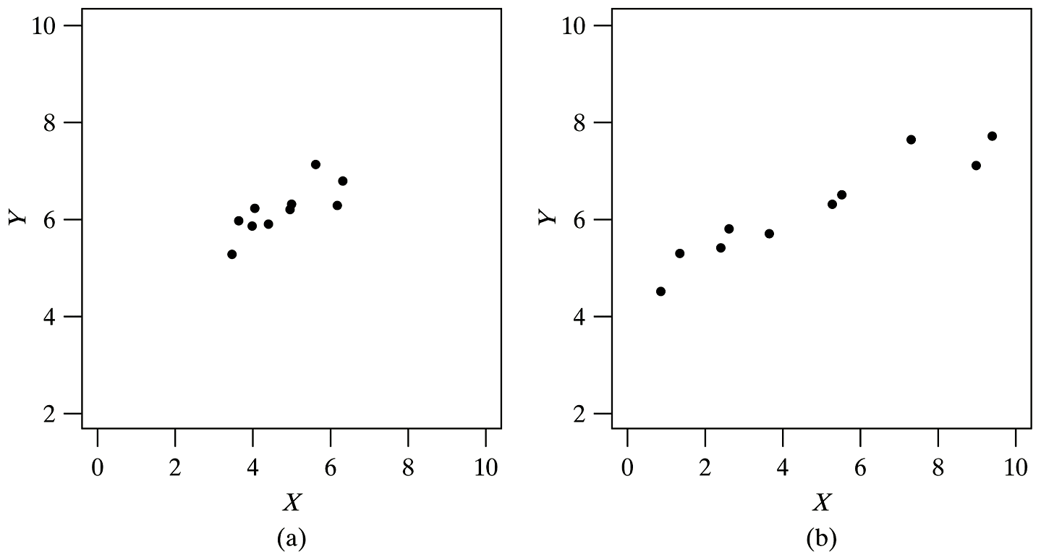
Size of SE_{b1}

Slide 14
Hypothesis testing
Step 1: Does X influence Y within the linear model ?
Step 2: Let β₁ be the slope of the linear regression of Y on X.
Step 3: H₀: β₁ = 0; there is no linear influence of X on Y.
H_{A}: β₁ ≠ 0; there is a linear influence of X on Y.
Step 9: This study does [not] provide evidence (P = ?) at the α significance level that that there is a linear association of X on Y.

Slide 15
Example: Hypothesis Testing
Does homework scores influence test scores within the linear model
Is there a nonzero linear influence of Homework scores on Test scores?
Let β₁ be the slope of the linear regression of Tests on Homework.

Slide 16
Example: Hypothesis Testing (cont)
H₀: β₁ = 0 : there is zero linear influence of Homework on tests
H_{A}: β₁ ≠ 0 : there is a nonzero linear influence of homework on test
This study does provide evidence (P < 0.0001) at the 0.05 significance level that that there is a (positive) linear influence of Homework score on test scores.

Slide 17
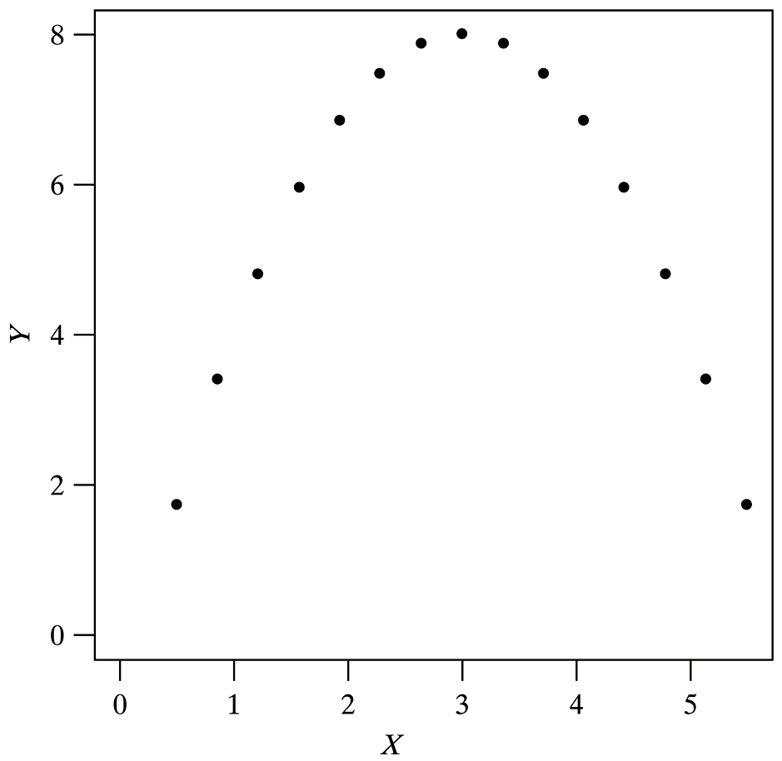
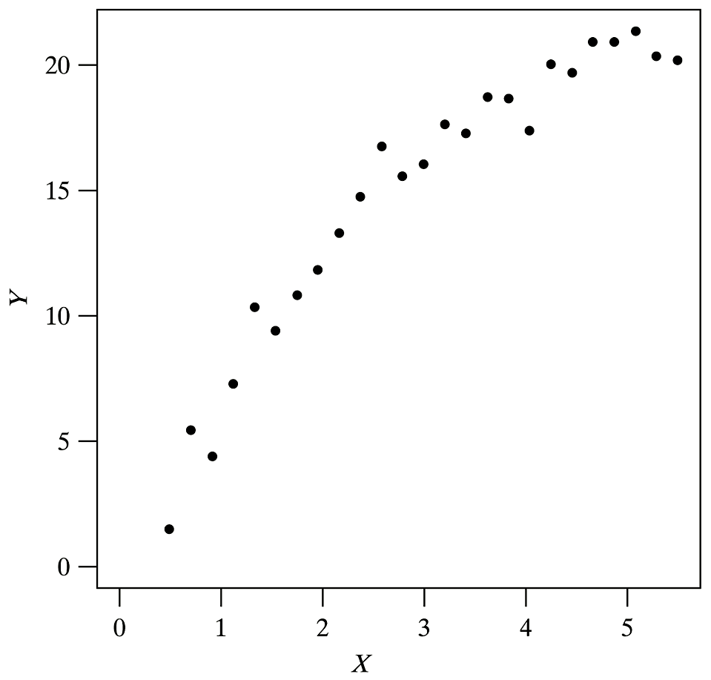
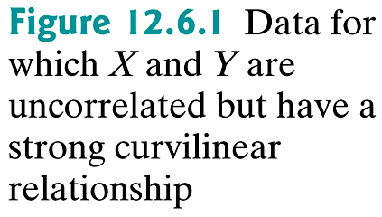
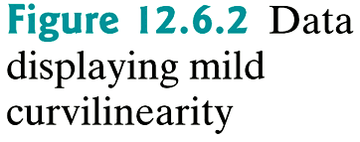
Curvilinear

Slide 18
Outlier

Slide 19
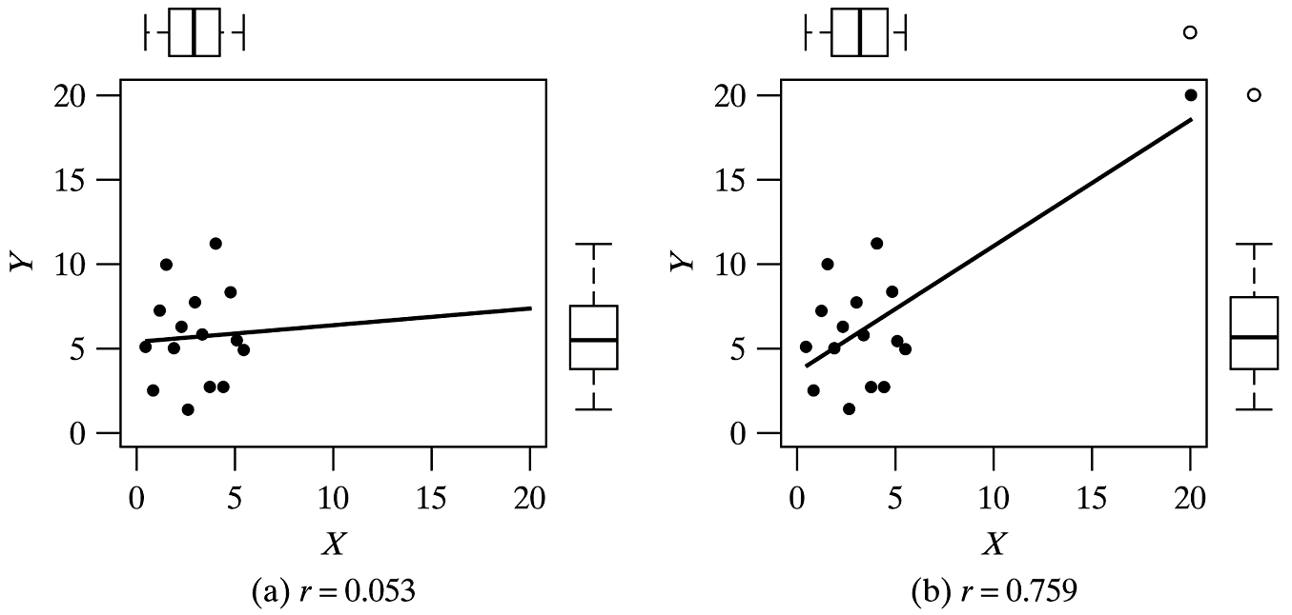
Influential Point

Slide 20
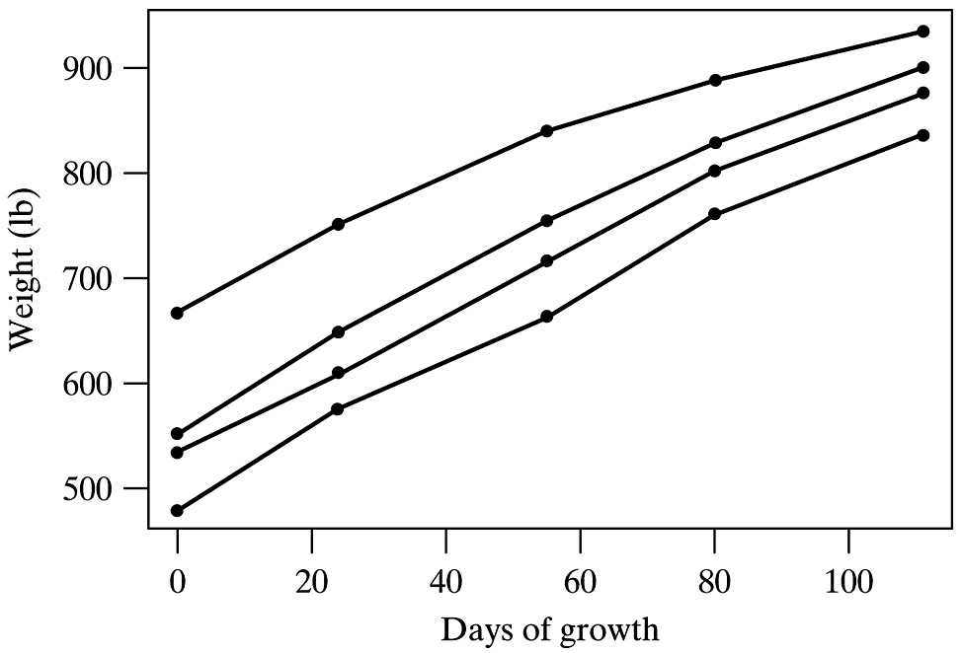
Dependency

Slide 21
Distribution of R

Slide 22
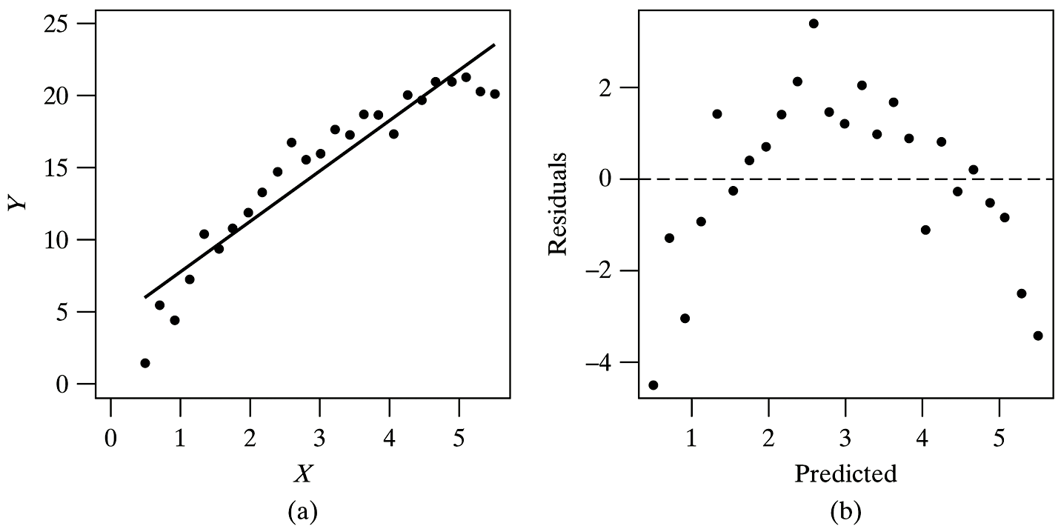
Residual Plot

Slide 23
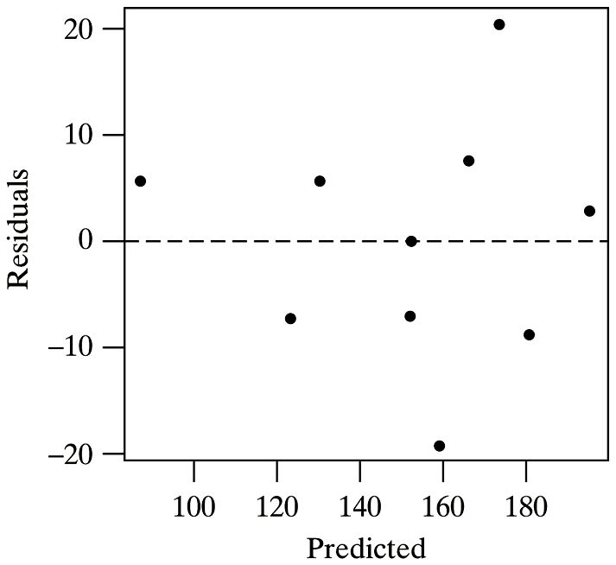
Residual Plot

Slide 24
Residual Plot

Slide 25
Summary of Formulas (1)

Slide 26
Summary of Formulas (2)

Slide 27
Summary of Formulas (3)

Slide 28
Chapter 13
1. What question were the researchers attempting to answer when they collected these data?
2. What is the response variable in the study?
3. What predictor variables, if any, were involved?

Slide 29
Chapter 13

Slide 30
Case Studies
For each of the 4 research question in the following cases, propose the appropriate statistical methods, what assumptions need to be checked for the method and how to check those assumptions.

Slide 31
Case 1: Consumer opinions on the effectiveness of energy drink
The consumer opinions on the effectiveness of energy drink.
Background: The popularity of energy drinks has risen constantly since the introduction of the first major energy drink in 1997, Red Bull. An energy drink, by definition, is a drink aimed to increase the consumer’s mental alertness and physical performance. A serving of energy drink can contain the same amount of caffeine as 5 ounces of coffee, which is the same as two cans of popular caffeinated soft drinks.
The typical college students’ day consists of strenuous and demanding schedule. One can often strike the need to get an extra boost of energy or alertness during the day in order to accomplish. The point of the study is to indentify if energy drinks are an effective tool for a typical college student, and what factors influence students’ rating of effectiveness. In total there are five variables measured: age, gender, average sleeping hour, stress level and effectiveness.

Slide 32
Case 1 (Cont)
Data: A 6-question survey was given to 33 randomly and independently chosen college students. A sample data is shown below.
Research question 1: the effectiveness is related with the resting situation. So the time spent on sleeping impacts students’ rating of effectiveness.
Research question2: The stress level is affected by the sleeping time.
ID | Age | Gender | Hr_sleep | stress | effectiveness
1 | y21 | F | 7to9 | high | 4.8
2 | n21 | M | 7to9 | low | 1.9
3 | n21 | F | 4to6 | high | 2.2

Slide 33
Case 2: Can you hear these words?
Background: To test whether a hearing aid is right for a patient, audiologists play a tape on which words are pronounced at low volume. The patient tries to repeat the words. There are several different lists of words that are supposed to be equally difficult. Are the lists equally difficult when there is background noise? To find out, an experimenter had subjects with normal hearing listen to four lists with a noisy background.

Slide 34
Case 2 (cont)
Data: The data set contains 96 responses. The experimenter assigns 96 subjects to 4 groups at random. Each group of 24 subjects listens to one of the lists. All individual listen and respond separately.
Research question: Are the four lists are equally difficult?
percent | level
23.4 | 1
42.4 | 4
29.0 | 3
31.7 | 2

Slide 35
Case 3: Plant density and cob weight
Background: Twenty plots, each 10 x 4 meters, were randomly chosen in a large field of corn. For each plot, the plant density (number of plants in the plot) and the mean cob weight (gm of grain per cob) were observed.

Slide 36
Case 3 (cont)
Data: a sample of size 20 was collected, as demonstrated below.
Research question: Does plant density have an effect on cob weight?
density | weight
137 | 212
107 | 214
132 | 215
135 | 225

Slide 37
Linear Regression: Test scores vs. HW scores
x

Slide 38
R vs. Shape of Scatterplots
x

Slide 39
Example: Fitted Regression Line (cont)
x

Slide 40
Outlier
x

