Slide 1
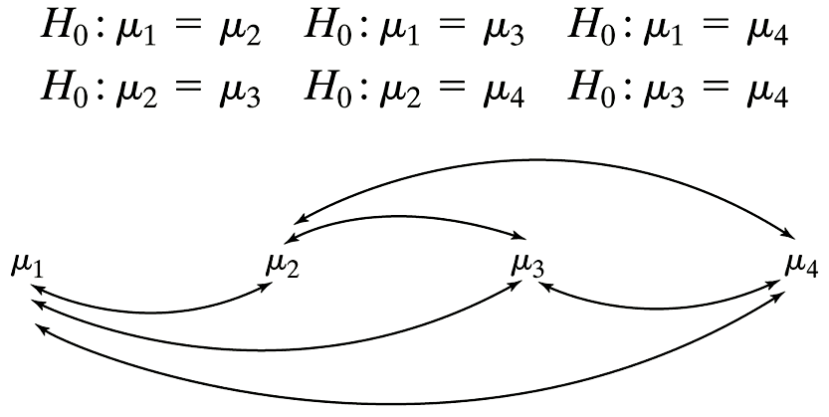
Multiple Comparisons

Slide 2
Overall Risk of Type I Error in Using Repeated t Tests at α = 0.05

Slide 3
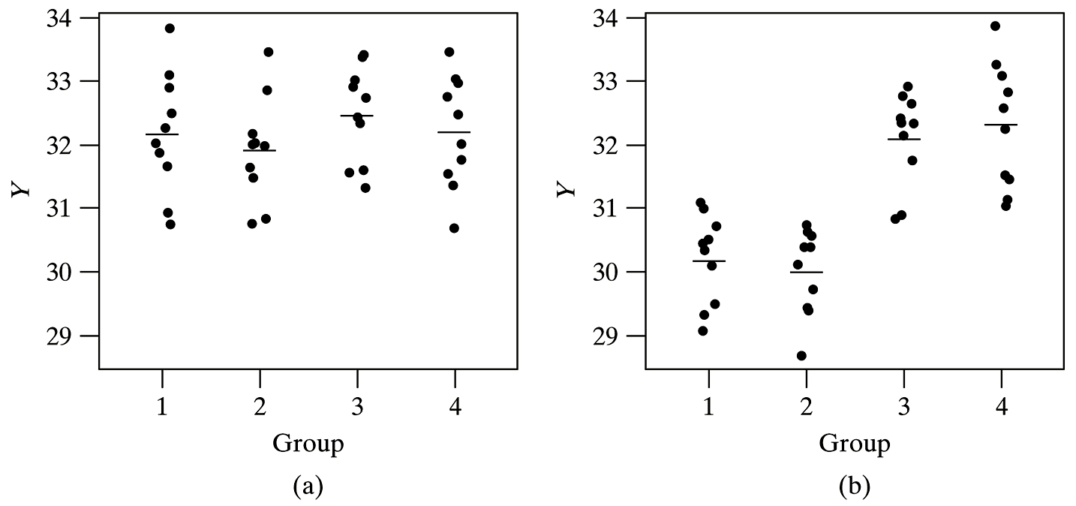
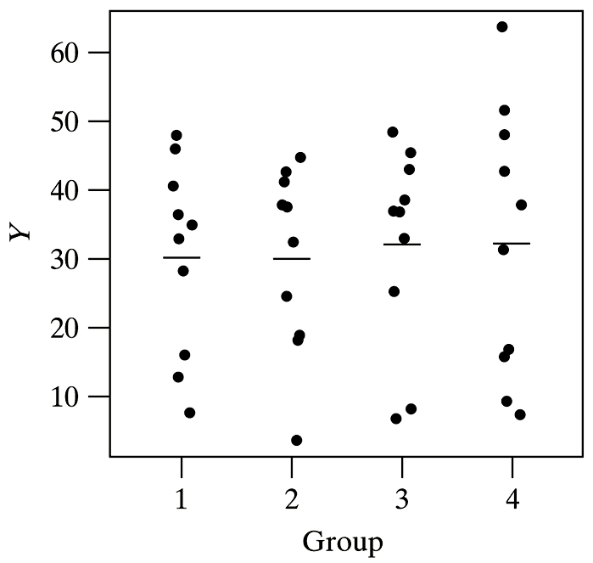
ANOVA: Graphical

Slide 4
Example: ANOVA terms
 | Treatment 1 | Treatment 2 | Treatment 3
1 | y₁₁ = 48 | y₂₁ = 40 | y₃₁ = 39
2 | y₁₂ = 39 | y₂₂ = 48 | y₃₂ = 30
3 | y₁₃ = 42 | y₂₃ = 44 | y₃₃ = 32
4 | y₁₄ = 43 |  | y₃₄ = 35 | Overall
 | n₁ = 4 | n₂ = 3 | n₃ = 4
11
 | ȳ₁ = 43 | ȳ₂ = 44 | ȳ₃ = 34
40
 | s₁ = 3.74 | s₂ = 4 | s₃ = 3.92

Slide 5
ANOVA Table
Source | df | SS | MS
Between | 2 | 228 | 114
Within | 8 | 120 | 15
Total | 10 | 348

Slide 6
ANOVA Table: Formulas
Source | df | SS (Sum of Squares) | MS (Mean Square)
Between | I – 1 |  | SS/df
Within | n• – I
Total | n• – 1

Slide 7
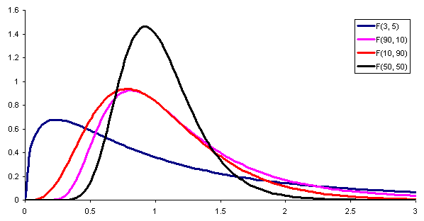
F distribution
http://www.vosesoftware.com/ModelRiskHelp/index.htm#Distributions/Continuous_distributions/F_distribution.htm

Slide 8
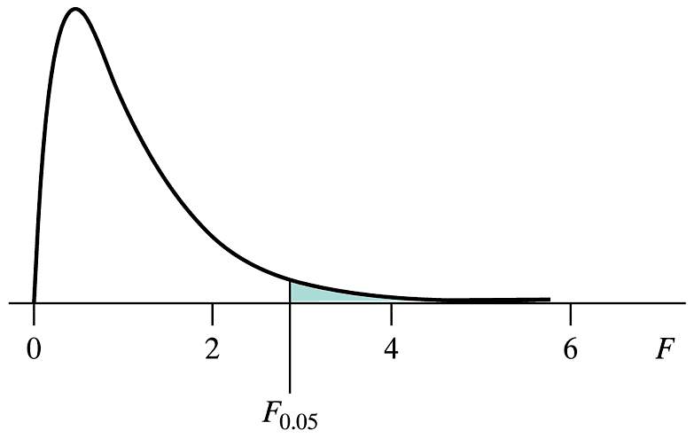
F Table

Slide 9
Scientific Conclusion for F test
This study (does not) provide(s) evidence [(P = )] at the α significance level that there is a difference in ____ among the ____ groups.

Slide 10
Example: ANOVA
A random sample of 15 healthy young men are split randomly into 3 groups of 5. They receive 0, 20, and 40 mg of the drug Paxil for one week. Then their serotonin levels are measured to determine whether Paxil affects serotonin levels.

Slide 11
Example: ANOVA (cont).
Dose | 0 mg | 20 mg | 40 mg
 | 48.62 | 58.60 | 68.59
 | 49.85 | 72.52 | 78.28
 | 64.22 | 66.72 | 82.77
 | 62.81 | 80.12 | 76.53
 | 62.51 | 68.44 | 72.33 | overall
n_{i} | 5 | 5 | 5 | 15
ȳ_{i} | 57.60 | 69.28 | 75.70 | 67.53
s_{i} | 7.678 | 7.895 | 5.460
(n_{i}-1)s_{i}² | 235.78 | 249.32 | 119.24 | 604.34
n_{i}(ȳ_{i} - y̅̅)² | 492.56 | 15.36 | 333.96 | 841.88

Slide 12
Example: ANOVA (cont)
Source | df | SS | MS
Between | 2 | 841.88 | 420.94
Within | 12 | 604.34 | 50.36
Total | 14 | 1446.23

Slide 13
Example: ANOVA (cont)
Does Paxil affect serotonin levels in healthy young men?
Let μ₁ be the mean serotonin level for men receiving 0 mg of Paxil.
Let μ₂ be the mean serotonin level for men receiving 20 mg of Paxil.
Let μ₃ be the mean serotonin level for men receiving 40 mg of Paxil.

Slide 14
Example: ANOVA (cont)
H₀: μ₁ = μ₂ = μ₃; mean serotonin levels are the same at all 3 dosage levels [or, mean serotonin levels are unaffected by Paxil dose]
H_{A}: The mean serotonin levels of the three groups are not all equal. [or, serotonin levels are affected by Paxil does]

Slide 15
Example: ANOVA (cont)
Source | df | SS | MS
Between | 2 | 841.88 | 420.94
Within | 12 | 604.34 | 50.36
Total | 14 | 1446.23

Slide 16
Example: ANOVA (cont)
Source | df | SS | MS | F-Ratio | P-Value
Between | 2 | 841.88 | 420.94 | 8.36 | 0.0053
Within | 12 | 604.34 | 50.36
Total | 14 | 1446.23
This study provides evidence (P = 0.0053) at the 0.05 significance level that there is a difference in serotonin levels among the groups of men taking 0, 20, and 40 mg of Paxil.
This study provides evidence (P = 0.0053) at the 0.05 significance level that Paxil intake affects serotonin levels in young men.

Slide 17
Verification of Conditions

Slide 18
Example 11.6.1: Randomized Block Procedure
Researchers are interested in the effect that acid has on growth rate of alfalfa plants. To control sunlight, the randomized block procedure is used.

Slide 19
Example 11.6.9: F test

Slide 20
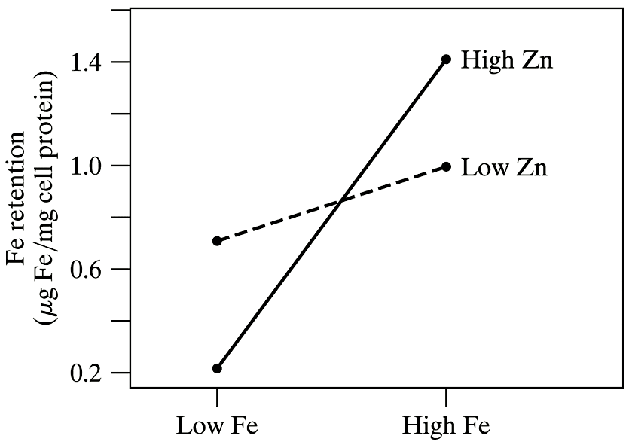
Example 11.7.3: Two-Way ANOVA

Slide 21
Example 11.7.4: Two-Way ANOVA

Slide 22
Bonferroni t Table

Slide 23
Example: ANOVA
A random sample of 15 healthy young men are split randomly into 3 groups of 5. They receive 0, 20, and 40 mg of the drug Paxil for one week. Then their serotonin levels are measured to determine whether Paxil affects serotonin levels.

Slide 24
Example: Bonferroni Adjustment
Dose | 0 mg | 20 mg | 40 mg | overall
n_{i} | 5 | 5 | 5 | 15
y̅_{i•} | 57.60 | 69.28 | 75.70 | 67.53
SS_{i} | 235.78 | 249.32 | 119.24 | 604.34
Source | df | SS | MS | F-Ratio | P-Value
Between | 2 | 841.88 | 420.94 | 8.36 | 0.0053
Within | 12 | 604.34 | 50.36
Total | 14 | 1446.23

Slide 25
Example: Paxil, Graphical Representation
0 mg 20 mg 40 mg

Slide 26
Exercise 11.4.1 (MultComp.sas)
data MAO;
infile ‘H:\Ex.11.4.1.dat';
input MAO diagnosis $;
*I: Chronic, II: UndParanoid, III: ParanoidShiz;
run;
proc print data=MAO; run;
Title 'Example of mulitple comparisons';
proc glm data=MAO alpha=0.05;
class diagnosis;
model MAO = diagnosis;
means diagnosis / bon cldiff lines; ← Bonferroni
means diagnosis / tukey cldiff lines; ← Tukey
run;
quit;
X

Slide 27
Exercise 11.4.1 (Bonferroni cldiff)
Bonferroni (Dunn) t Tests for MAO
NOTE: This test controls the Type I experimentwise error rate, but it generally has a higher
Type II error rate than Tukey's for all pairwise comparisons.
Alpha 0.05
Error Degrees of Freedom 39
Error Mean Square 10.72442
Critical Value of t 2.50166
Comparisons significant at the 0.05 level are indicated by ***.
Difference Simultaneous
diagnosis Between 95% Confidence
Comparison Means Limits
Chronic - UndParan 3.524 0.709 6.339 ***
Chronic - ParnoidS 3.843 0.362 7.324 ***
UndParan - Chronic -3.524 -6.339 -0.709 ***
UndParan - ParnoidS 0.319 -3.229 3.866
ParnoidS - Chronic -3.843 -7.324 -0.362 ***
ParnoidS - UndParan -0.319 -3.866 3.229
X

Slide 28
Exercise 11.4.1 (Bonferroni lines)
The GLM Procedure
Bonferroni (Dunn) t Tests for MAO
NOTE: This test controls the Type I experimentwise error rate, but it generally has a higher
Type II error rate than REGWQ.
Alpha 0.05
Error Degrees of Freedom 39
Error Mean Square 10.72442
Critical Value of t 2.50166
Minimum Significant Difference 3.2978
Harmonic Mean of Cell Sizes 12.34286
NOTE: Cell sizes are not equal.
Means with the same letter are not significantly different.
Bon Grouping Mean N diagnosis
A 9.806 18 Chronic
B 6.281 16 UndParan
B
B 5.963 8 ParnoidS
X

Slide 29
Exercise 11.4.1 (Tukey cldiff)
The GLM Procedure
Tukey's Studentized Range (HSD) Test for MAO
NOTE: This test controls the Type I experimentwise error rate.
Alpha 0.05
Error Degrees of Freedom 39
Error Mean Square 10.72442
Critical Value of Studentized Range 3.44546
Comparisons significant at the 0.05 level are indicated by ***.
Difference Simultaneous
diagnosis Between 95% Confidence
Comparison Means Limits
Chronic - UndParan 3.524 0.783 6.266 ***
Chronic - ParnoidS 3.843 0.453 7.233 ***
UndParan - Chronic -3.524 -6.266 -0.783 ***
UndParan - ParnoidS 0.319 -3.136 3.774
ParnoidS - Chronic -3.843 -7.233 -0.453 ***
ParnoidS - UndParan -0.319 -3.774 3.136
X

Slide 30
Exercise 11.4.1 (Tukey lines)
The GLM Procedure
Tukey's Studentized Range (HSD) Test for MAO
NOTE: This test controls the Type I experimentwise error rate, but it generally has a higher
Type II error rate than REGWQ.
Alpha 0.05
Error Degrees of Freedom 39
Error Mean Square 10.72442
Critical Value of Studentized Range 3.44546
Minimum Significant Difference 3.2116
Harmonic Mean of Cell Sizes 12.34286
NOTE: Cell sizes are not equal.
Means with the same letter are not significantly different.
Tukey Grouping Mean N diagnosis
A 9.806 18 Chronic
B 6.281 16 UndParan
B
B 5.963 8 ParnoidS
X

