Slide 1
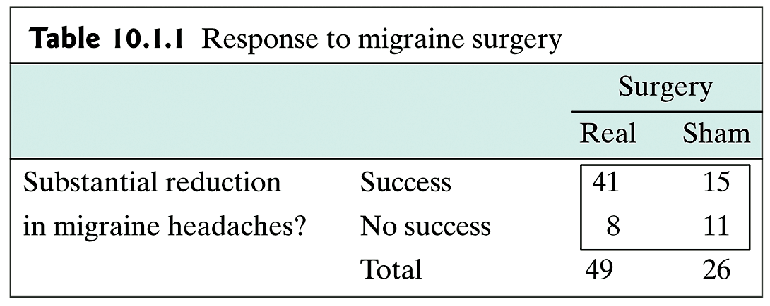
Example: Contingency Table

Slide 2
Contingency Tables: Context 1
Samples are “drug” and “placebo” ; observed variable “improve” or “don’t improve”
Observed | Treatment
 | Drug | Placebo | Total
Improve | 15 | 4 | 19
Don’t Improve | 11 | 17 | 28
Total | 26 | 21 | 47

Slide 3
Contingency Tables: Context 2
Observe eye color( red/purple) and wing shape (normal/vestigial)
 |  | eye color
 |  | red | purple
wing shape | normal | 39 | 11
 | vestigial | 18 | 32

Slide 4
Example: Context 1 (cont)
Are patients who take the drug more likely to improve than those who take the placebo at a significance level of 0.01?
p₁ = probability that a patient will improve if they take the drug
p₂ = probability that a patient will improve if they take the placebo

Slide 5
Example: Context 1 (cont)
H₀: p₁ = p₂; the probability of improving is the same whether drug or placebo is taken
H_{A}: p₁ > p₂; the probability if improving is greater if the drug is taken than if the placebo is taken

Slide 6
Contingency Tables: Context 1 (cont)
Observed | Treatment
 | Drug | Placebo | Total
Improve | 15 | 4 | 19
Don’t Improve | 11 | 17 | 28
Total | 26 | 21 | 47
Observed (Expected) | Treatment
 | Drug | Placebo | Total
Improve | 15 (10.5) | 4 (8.5) | 19
Don’t Improve | 11(15.5) | 17 (12.5) | 28
Total | 26 | 21 | 47

Slide 7
Example: Context 1(cont)
This study provides evidence at the 0.01 significance level that the probability of improving is greater if the drug is taken than if the placebo is taken.

Slide 8
Example: Context 2
Are eye color and wing shape independent in this back-cross population?
p₁ = probability that a fly has red eyes if it has normal wings
p₂ = probability that a fly has red eyes if it has vestigial wings

Slide 9
Example: Context 2 (cont)
H₀: p₁ = p₂; eye color and wing shape are independent
H_{A}: p₁ ≠ p₂: eye color and wing shape are associated

Slide 10
Example: Context 2 (cont)
 |  | eye color
 |  | red | purple | Total
wing shape | normal | 39 | 11 | 50
 | vestigial | 18 | 32 | 50
total |  | 57 | 43 | 100
 |  | eye color
 |  | red | purple | Total
wing shape | normal | 39 (28.5) | 11 (21.5) | 50
 | vestigial | 18 (28.5) | 32 (21.5) | 50
total |  | 57 | 43 | 100

Slide 11
Example: Context 2 (cont)
This study provides evidence at the 0.05 significance level that eye color and wing shape are associated.

Slide 12
Example: r x k Contingency Table
This table shows the relationship between hair color and eye color for 6800 German men. Is there an association between hair color and eye color for German men to a significance level of 0.01.
Hair Color | eye color
 | Brown | Grey/Green | Blue | Total
Brown | 438 | 1387 | 807 | 2632
Black | 288 | 746 | 189 | 1223
Fair | 115 | 946 | 1768 | 2829
Red | 16 | 53 | 47 | 116
Total | 857 | 3132 | 2811 | 6800

Slide 13
Example: r x k Contingency Table (cont)
Hair Color | eye color
 | Brown | Grey/Green | Blue | Total
Brown | 438 (331.7) | 1387 (1212.3) | 807 (1088.0) | 2632
Black | 288 (154.1) | 746 (563.3) | 189 (505.6) | 1223
Fair | 115 (356.5) | 946 (1303.0) | 1768 (1169.5) | 2829
Red | 16 (14.6) | 53(53.4) | 47 (48.0) | 116
Total | 857 | 3132 | 2811 | 6800

Slide 14
Example: Confidence Interval
What is the 95% Confidence Interval for the study of the treatment of a drug vs. a placebo below?
Observed | Treatment
 | Drug | Placebo | Total
Improve | 15 | 4 | 19
Don’t Improve | 11 | 17 | 28
Total | 26 | 21 | 47

Slide 15
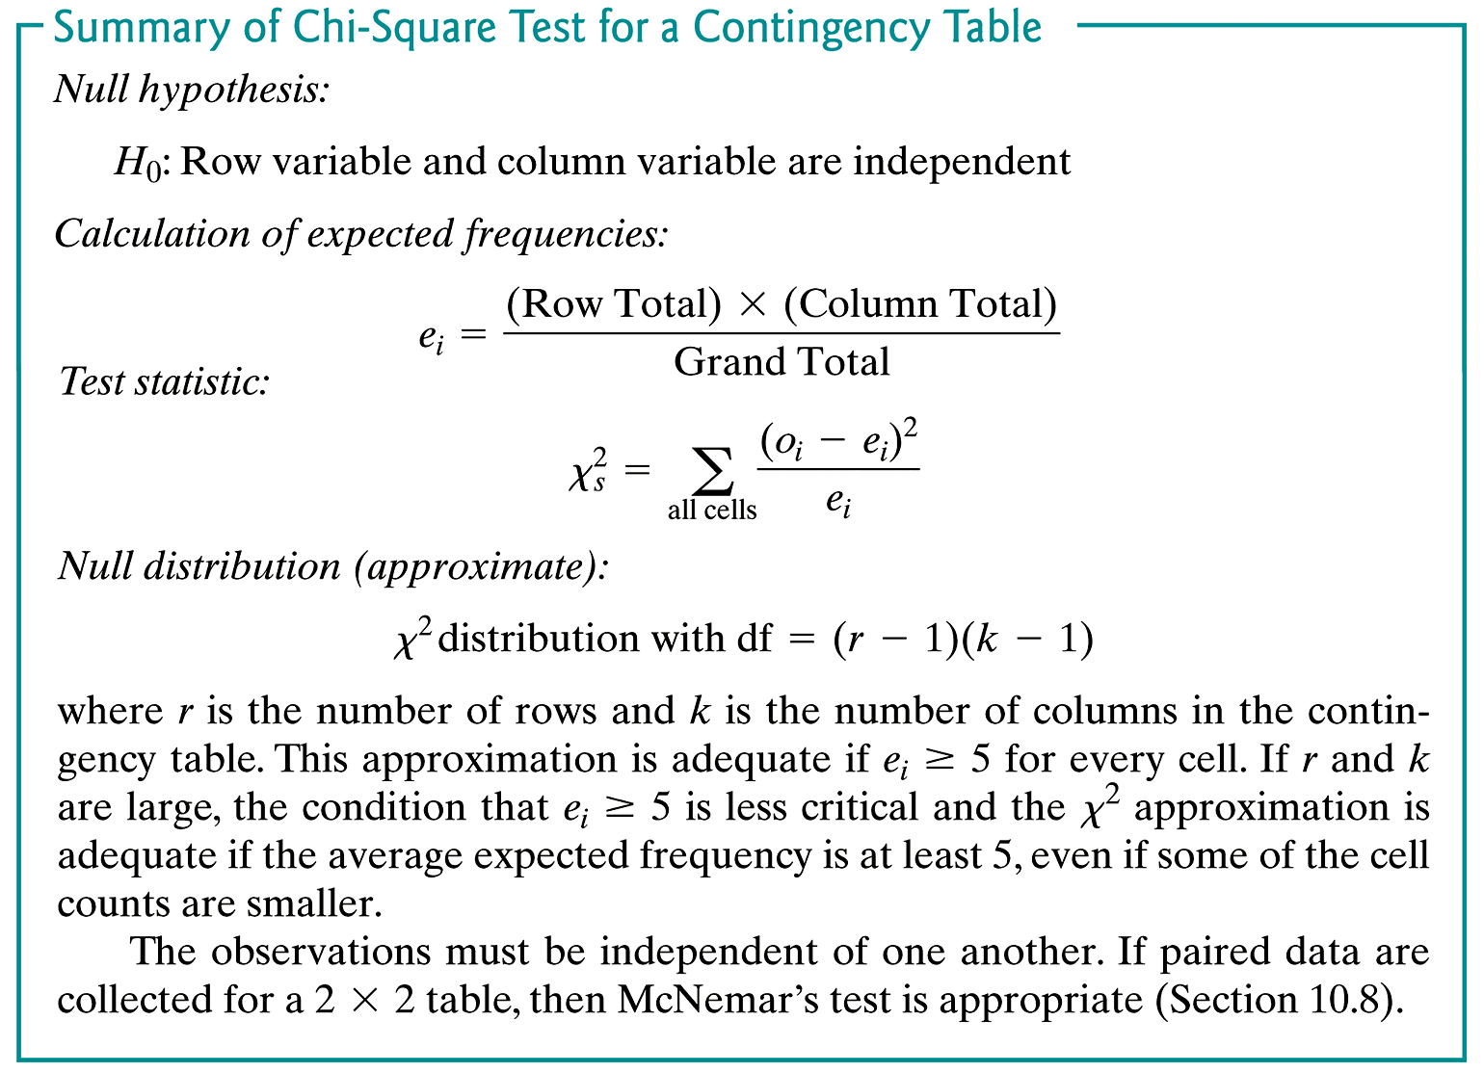
Summary

