Slide 1
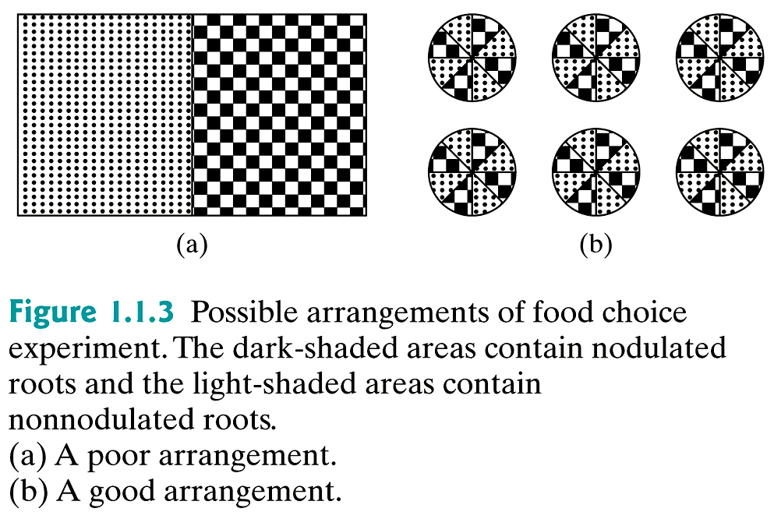
Example 1.1.5: Food Choice

Slide 2
Example 1.2.1: Lightning and Deafness
On July 15, 1911, 65 year old Mrs. Jane Decker was struck by lightning while in her house. She had been deaf since birth, but after being struck, she recovered her hearing, which led to a headline in the New York Times, “Lightning Cures Deafness.”
Is this compelling evidence that lightning is a cure for deafness?

Slide 3
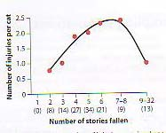
Example: Raining Cats
In an article published in the Journal of the American Veterinary Medical Association, Whitney and Mehlaff (1987) presented results on the injury rates of cats that had plummeted from buildings in New Your City according to the number of floors that they had fallen. The researches merely recorded the number of injuries from the cats that were brought into the vet. No cats were thrown from the windows – the cats did it to themselves!
The Analysis of Biological Data, Whitlock, Schluter, 2009, Roberts and Company, p. 3

Slide 4
Example 1.2.4: Toxicity in Dogs
A new investigational drug was given to 4 male and 4 female dogs, at two doses 8 mg/kg and 25 mg/kg (8 male and 8 female dogs in total). To determine the toxicity in the dogs, the endpoint from the blood samples of alkaline phosphatase level (in U/L) was measured.

Slide 5
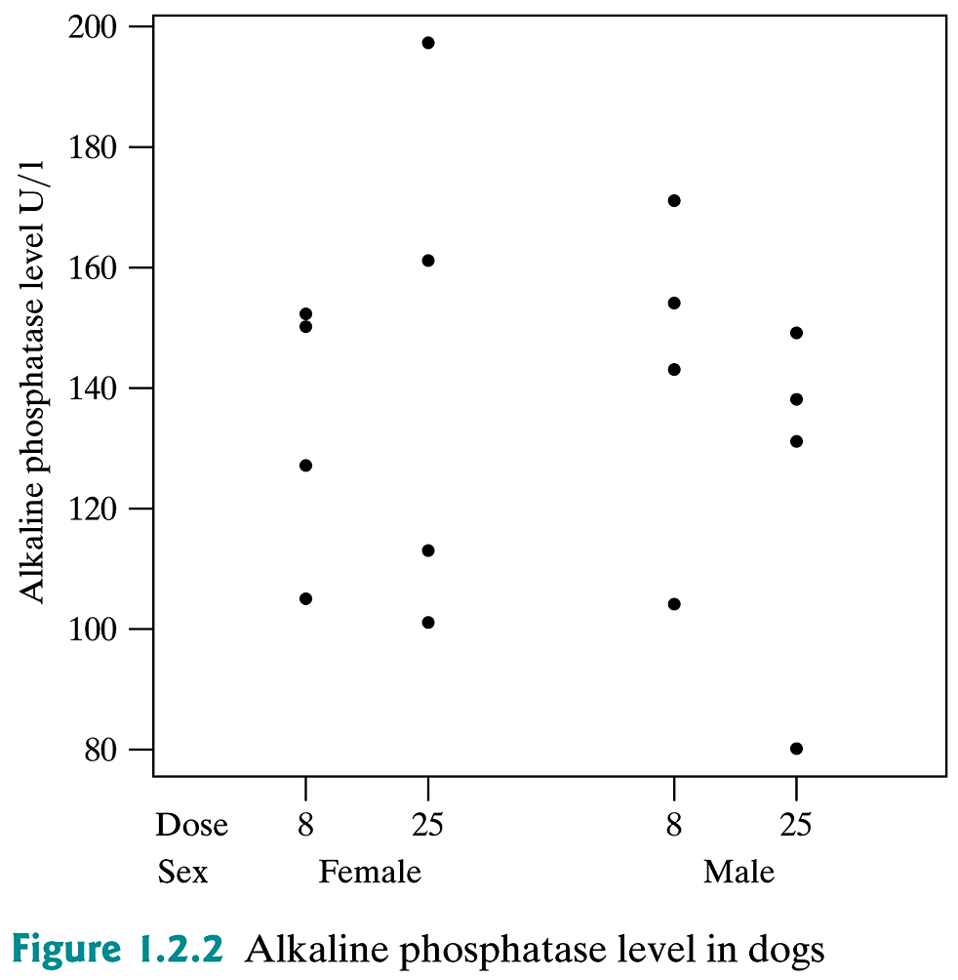
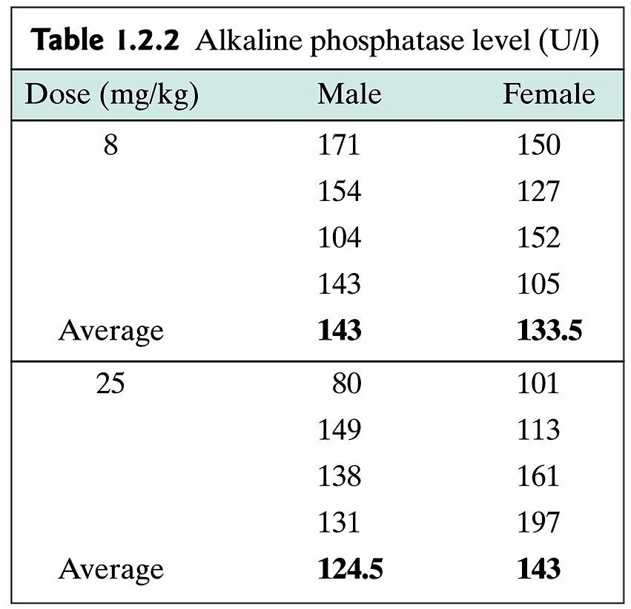
Example 1.2.4: Toxicity in Dogs (cont)

Slide 6
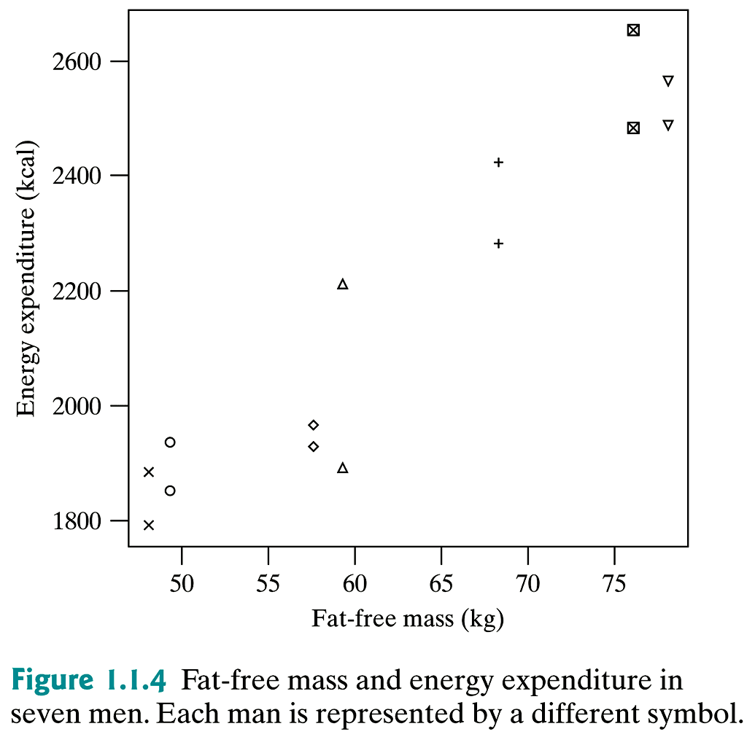
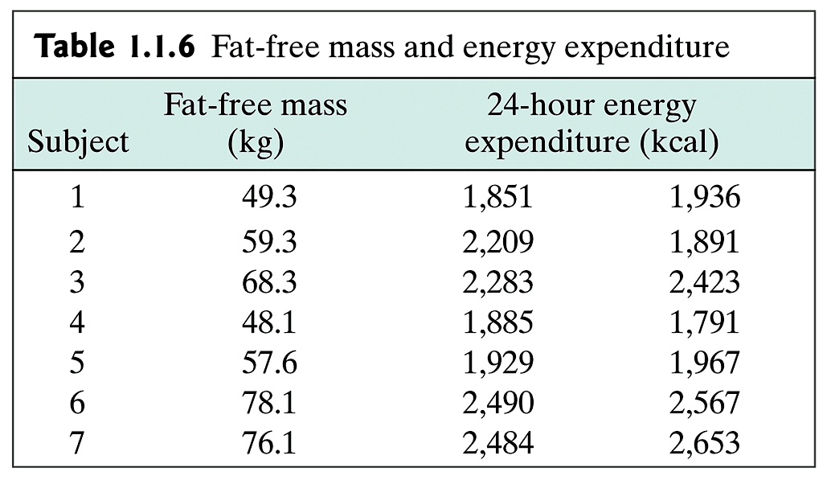
Example 1.1.6: Body Size and Energy Expenditure.
How much food does a person need? The researchers used underwater weighing techniques to determine the fat-free body mass for each of seven men. They also measured the total 24-hour energy expenditure during conditions of quiet sedentary activity; repeated twice.

Slide 7
Population and Sample
Population | Sample
All sycamore trees in Indiana | 8 sycamore trees in Happy Hollow Park (n=8)
All 100 mL water samples from the Wabash near Lafayette | 10 100 mL samples taken in 10 different locations in one day (n=10)
All squirrels in West Lafayette | 13 squirrels caught in traps in WL

Slide 8
Table 1

Slide 9
Example: Random Sampling
Are the following samples representative of the whole population? If not, how would you correct the sampling technique?
a) For studying of two therapies, you choose patients that come into free clinics.
b) Capture-recapture studies
c) US census

