Slide 1
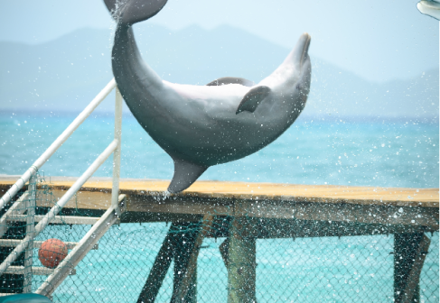
Flipped Classes
Desiree doing a flip
http://projectltl.com/2013/06/06/swim-with-and-ride-a-dolphin/

Slide 2
Comparison Between Flipped and Traditional Classes
 | Traditional | Flipped
Preparation Time |  | Lecture
Class Time | Lecture | Work on problems
Reinforcement Time | Work on problems

Slide 3
Schedule
Mondays
I strongly recommend that you attend, but it is not required.
I will be running discussion sessions with optional worksheets.
Labs
The same as the rest of the sections.
If there is no lab, the class will be like Friday.
Fridays
Required that you attend.
I will be leading group discussions and worksheets

Slide 4
Online Quizzes
Because you are required to read the book, watch videos and/or read the required material BEFORE class, there will be online quizzes posted on Blackboard.
They are due by 9 am on the class day.
They will be graded on completion only.
If you receive 80% on the quiz, you will be given credit
You may take the quiz as many times as you want before the due date.
Each time you take the quiz, it will be different.
This counts toward your participation points.

Slide 5
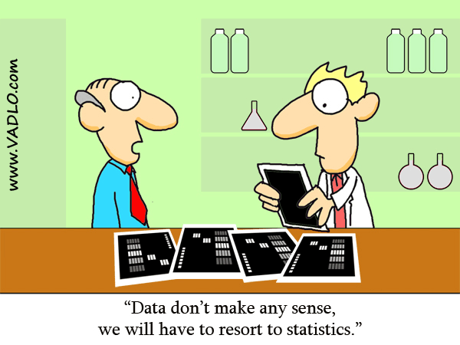
Discussion Topics
What is statistics?
Why is statistics important?
http://vadlo.com/cartoons.php?id=71

Slide 6
What is statistics?

Slide 7
Why is statistics important?

