Slide 1
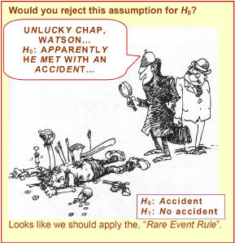
Chapter 9: Hypothesis Tests Based on a Single Sample
http://www.rmower.com/statistics/Stat_HW/0801HW_sol.htm

Slide 2
Assumptions for Inference
We have an SRS from the population of interest.
The variable we measure has a Normal distribution (or approximately normal distribution) with mean μ and standard deviation σ.
We don’t know μ
but we do know σ (Section 9.3)
We do not know σ (Section 9.5)
σ

Slide 3
9.1: The Parts of a Hypothesis Test - Goals
State the steps that are required to perform a hypothesis test.
Be able to state the null and alternative hypothesis.

Slide 4
Hypothesis
In statistics, a hypothesis is a declaration, or claim, in the form of a mathematical statement, about the value of a specific population parameter (or about the values of several population characteristics).
A Hypothesis Test is a formal procedure for comparing observed data with a claim (also called a hypothesis) whose truth we want to assess.

Slide 5
Example: Hypothesis Test
You are in charge of quality control in your food company. You sample randomly four packs of cherry tomatoes, each labeled 1/2 lb. (227 g). The average weight from your four boxes is 222 g.
Is the somewhat smaller weight simply due to chance variation?
Is there evidence that the calibrating machine that sorts cherry tomatoes into packs needs revision?

Slide 6
Parts of a Hypothesis Tests
A. The claim assumed to be true.
B. Alternative claim.
C. How to test the claim.
D. What to use to make the decision.

Slide 7
Statistical Hypotheses
A. Null Hypothesis: H₀:
Initially assumed to be true.
B. Alternative Hypothesis: H_{a}
Contradictory to H₀

Slide 8
Example: Significance Test
You are in charge of quality control in your food company. You sample randomly four packs of cherry tomatoes, each labeled 1/2 lb. (227 g). The average weight from your four boxes is 222 g.
What are some examples of hypotheses in this situation?

Slide 9
Example: Hypothesis
Translate each of the following research questions into appropriate hypothesis.
1. The census bureau data show that the mean household income in the area served by a shopping mall is $62,500 per year. A market research firm questions shoppers at the mall to find out whether the mean household income of mall shoppers is higher than that of the general population.
2. Last year, your company’s service technicians took an average of 2.6 hours to respond to trouble calls from business customers who had purchased service contracts. Do this year’s data show a different average response time?

Slide 10
Example: Hypothesis (cont)
Translate each of the following research questions into appropriate hypothesis.
3. The drying time of paint under a specified test conditions is known to be normally distributed with mean value 75 min and standard deviation 9 min. Chemists have proposed a new additive designed to decrease average drying time. It is believed that the new drying time will still be normally distributed with the same σ = 9 min. Should the company change to the new additive?

Slide 11
Parts of a Hypothesis Tests
A. The claim assumed to be true.
B. Alternative claim.
C. How to test the claim.
A test statistic, TS calculated from the sample data measures how far the data diverge from what we would expect if the null hypothesis H₀ were true.
D. What to use to make the decision.

Slide 12
Parts of a Hypothesis Tests
A. The claim assumed to be true.
B. Alternative claim.
C. How to test the claim.
D. What to use to make the decision.
The p-value for a hypothesis test is the smallest significance level for which the null hypothesis, H₀, can be rejected.

Slide 13
9.2: Hypothesis Test Errors and Power - Goals
Describe the two types of possible errors and the relationship between them.
Define the power of a test and what affects it.

Slide 14
Error Probabilities
 |  | Decision
 |  | Reject H₀ | Fail to reject H₀
Truth | H₀ is true
 | H₀ is false (H_{a} is true)
If we reject H₀ when H₀ is true, we have committed a Type I error.
P(Type I error) = α
If we fail to reject H₀ when H₀ is false, we have committed a Type II error.
P(Type II error) = β, Power = 1 - β

Slide 15
Types of Error
http://www.rmower.com/statistics/Stat_HW/0801HW_sol.htm

Slide 16
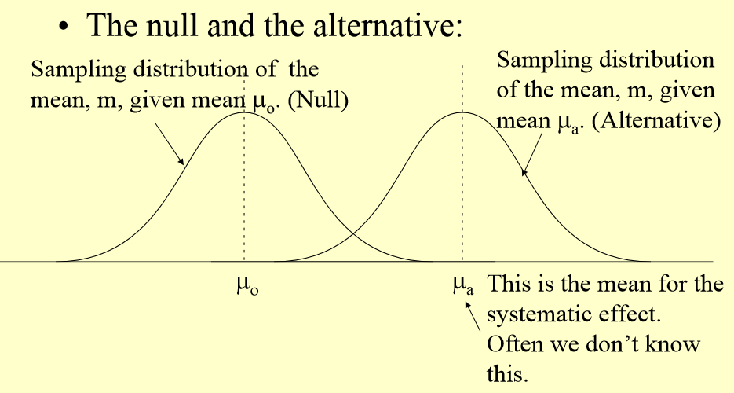
Type I vs. Type II errors (1)

Slide 17
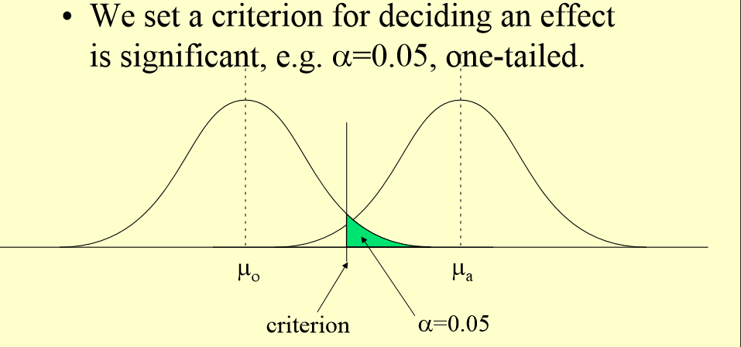
Type I vs. Type II errors (2)

Slide 18
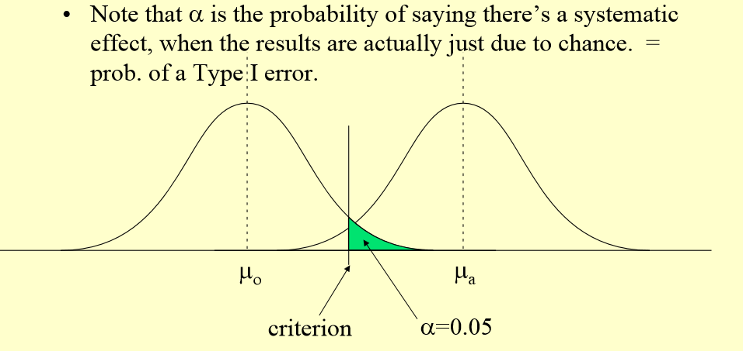
Type I vs. Type II errors (3)

Slide 19
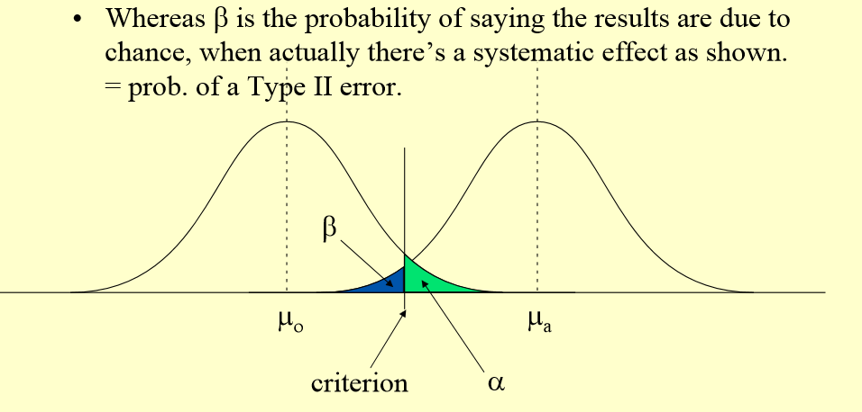
Type I vs. Type II errors (4)

Slide 20
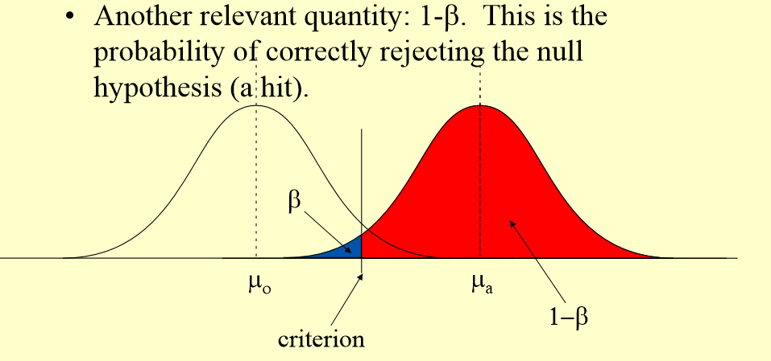
Type I vs. Type II errors (5)

Slide 21
Errors
α measures the strength of the sample evidence against H₀.
The power measures the sensitivity (true negative) of the test.

Slide 22
Increase the power
α
μ_{a}
σ
n

Slide 23
Type I vs. Type II errors (4)
• α • μ_{a} • σ • n

Slide 24
9.3/9.4 Hypothesis tests concerning a population mean when σ is known- Goals
Be able to state the test statistic.
Be able to define, interpret and calculate the P value.
Determine the conclusion of the significance test from the P value and state it in English.
Be able to calculate the power by hand.
Describe the relationships between confidence intervals and hypothesis tests.

Slide 25
Assumptions for Inference
We have an SRS from the population of interest.
The variable we measure has a Normal distribution (or approximately normal distribution) with mean μ and standard deviation σ.
We don’t know μ
but we do know σ (Section 9.3)
We do not know σ (Section 9.5)
σ

Slide 26
Test Statistic
A test statistic, TS, calculated from the sample data measures how far the data diverge from what we would expect if the null hypothesis H₀ were true.

Slide 27
Hypotheses
H₀: μ = μ₀
H_{a}: μ ≠ μ₀ μ > μ₀ μ < μ₀

Slide 28
Test Statistic
$$z_{ts}=\frac{estimate−hypothesized value}{standard deviation of the estimate}=\frac{\overline{x}−μ_{0}}{σ/{\sqrt{n}}}$$
Large values of the statistic show that the data are not consistent with H₀.

Slide 29
Example: Significance Test (con)
You are in charge of quality control in your food company. You sample randomly four packs of cherry tomatoes, each labeled 1/2 lb. (227 g). The average weight from your four boxes is 222 g. The packaging process has a known standard deviation of 5 g.
c) What is the test statistic?
d) What is the probability that 222 is consistent with the null hypothesis?

Slide 30
Example: Significance Test (con)
You are in charge of quality control in your food company. You sample randomly four packs of cherry tomatoes, each labeled 1/2 lb. (227 g). The average weight from your four boxes is 222 g. The packaging process has a known standard deviation of 5 g.
c) What is the test statistic?
d) What is the probability that 222 is consistent with the null hypothesis?

Slide 31
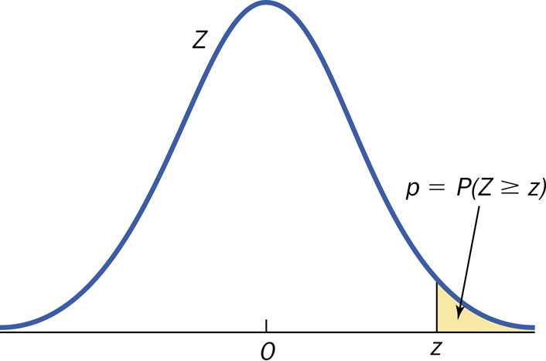
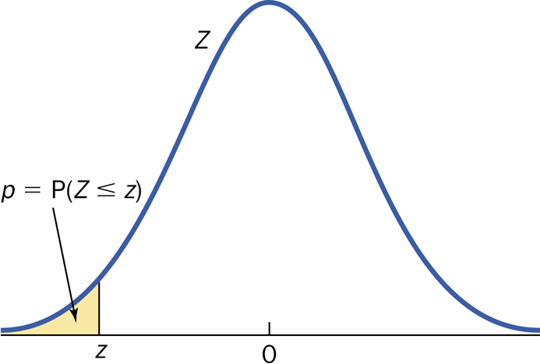
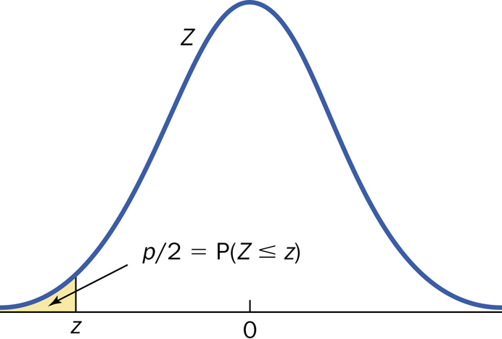
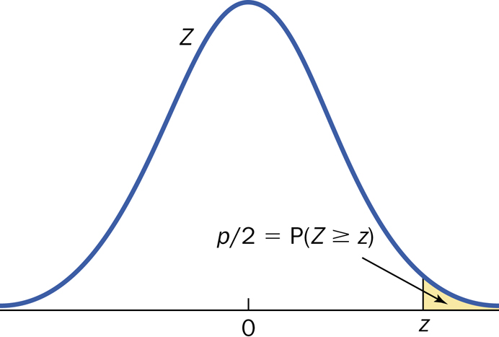
P-value
Right Tailed
Left Tailed
Two Tailed
z_{ts} < 0
z_{ts} > 0

Slide 32
P-value (cont)
The p-value for a hypothesis test is the smallest significance level for which the null hypothesis, H₀, can be rejected.
The probability, computed assuming H₀ is true, that the statistic would take a value as or more extreme than the one actually observed is called the p-value of the test. The smaller the P-value, the stronger the evidence against H₀.

Slide 33
P-value (cont.)
Small P-values are evidence against H₀ because they say that the observed result is unlikely to occur when H₀ is true.
Large P-values fail to give convincing evidence against H₀ because they say that the observed result is likely to occur by chance when H₀ is true.

Slide 34
P-value
Right Tailed
Left Tailed
Two Tailed
z_{ts} < 0
z_{ts} > 0

Slide 35
Decision
Reject H₀ or Fail to Reject H₀
Note: A fail-to-reject H₀ decision in a significance test does not mean that H₀ is true. For that reason, you should never “accept H₀” or use language implying that you believe H₀ is true.
In a nutshell, our conclusion in a significance test comes down to:
P-value small --> reject H₀ --> conclude H_{a} (in context)
P-value large --> fail to reject H₀ --> cannot conclude H_{a} (in context)

Slide 36
Significance
α measures the strength of the sample evidence against H₀.
The power measures the sensitivity (true negative) of the test.

Slide 37
Statistically Significant
α measures the strength of the sample evidence against H₀
If the P-value is smaller than α, we say that the data are statistically significant at level α. The quantity α is called the significance level or the level of significance.
When we use a fixed level of significance to draw a conclusion in a significance test,
P-value ≤ α --> reject H₀ --> conclude H_{a} (in context)
P-value > α --> fail to reject H₀ --> cannot conclude H_{a} (in context)

Slide 38
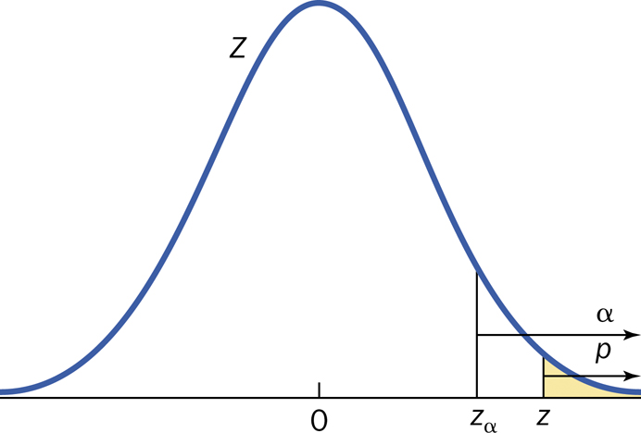
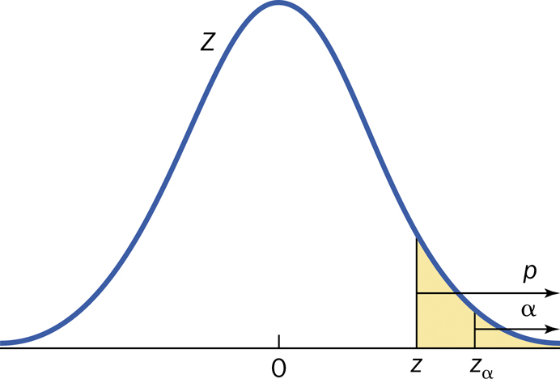
P-value
Reject H₀
Fail to reject H₀

Slide 39
P-value decisions
P-Value | α | Reject?
0.02 | 0.1
0.02 | 0.001
0.02 | 0.02
0.9 | Any value
0.00001 | Any value
0.0456 | 0.05

Slide 40
Statistically Significant - Comments
Significance is a technical term
Determine what significance level (α) you want BEFORE the data is analyzed.
Conclusion
P-value ≤ α --> reject H₀
P-value > α --> fail to reject H₀

Slide 41
Rejection Regions:

Slide 42
P-value interpretation
The probability, computed assuming H₀ is true, that the statistic would take a value as or more extreme than the one actually observed is called the P-value of the test.
The P-value (or observed significance level) is the smallest level of significance at which H₀ would be rejected when a specified test procedure is used on a given data set.
The P-value is NOT the probability that H₀ is true.

Slide 43
P-Value Interpretation

Slide 44
Procedure for Hypothesis Testing
1. Identify the parameter(s) of interest and describe it (them) in the context of the problem.
2. State the Hypotheses.
3. Calculate the appropriate test statistic and find the P-value.
4. Make the decision (with reason) and state the conclusion in the problem context.
Reject H₀ or fail to reject H₀ and why.
The data [does or might] [not] give [strong] support (P-value = [value]) to the claim that the [statement of H_{a} in words].

Slide 45
Example: Significance Test (cont)
You are in charge of quality control in your food company. You sample randomly four packs of cherry tomatoes, each labeled 1/2 lb. (227 g). The average weight from your four boxes is 222 g. The packaging process has a known standard deviation of 5 g.
d) Perform the appropriate significance test at a 0.05 significance level to determine if the calibrating machine that sorts cherry tomatoes needs to be recalibrated.

Slide 46
Single mean test: Summary
Null hypothesis: H₀: μ = μ₀
Test statistic:
 | Alternative Hypothesis | P-Value
One-sided: upper-tailed | H_{a}: μ > μ₀ | P(Z ≥ z)
One-sided: lower-tailed | H_{a}: μ < μ₀ | P(Z ≤ z)
two-sided | H_{a}: μ ≠ μ₀ | 2P(Z ≥ |z|)

Slide 47
Calculation of α and Power
A SRS of 300 Indiana high school students’ SAT scores are taken. A teacher believes that the mean will be no more than 1497 because that was the national average in 2013. Assume that the population standard deviation is 200.
Assuming that the test is at a 1% significance level, determine whether this test is sufficiently sensitive (has enough power) to be able to detect an increase of 20 points in this population.

Slide 48
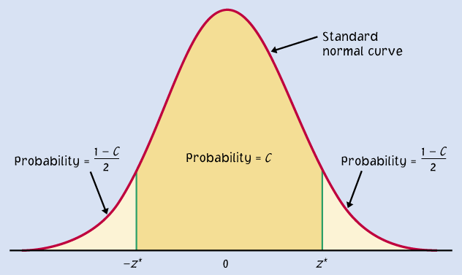
CI and HT

Slide 49
Example: HT vs. CI
You are in charge of quality control in your food company. You sample randomly four packs of cherry tomatoes, each labeled 1/2 lb. (227 g). The average weight from your four boxes is 222 g. The packaging process has a known standard deviation of 5 g.
e) Determine the 95% CI.
f) How do the results of part d) and e) compare?

Slide 50
Example: HT vs. CI (2)
Suppose we are interested in how many credit cards that people own. Let’s obtain a SRS of 100 people who own credit cards. In this sample, the sample mean is 4 and the sample standard deviation is 2. If someone claims that he thinks that μ > 2, is that person correct?
a) Construct a 99% lower bound for μ.
b) Perform an appropriate hypothesis test with significance level of 0.01.
c) How would the conclusion have changed if H_{a}: µ < 2?

Slide 51
Example: HT vs. CI (2)
b) The data does give strong support (P = 0) to the claim that the population average number of credit cards is greater than 2.

Slide 52
Example: HT vs. CI (2)
Suppose we are interested in how many credit cards that people own. Let’s obtain a SRS of 100 people who own credit cards. In this sample, the sample mean is 4 and the sample standard deviation is 2. If someone claims that he thinks that μ > 2, is that person correct?
a) Construct a 99% lower bound for μ.
b) Perform an appropriate hypothesis test with significance level of 0.01.
c) How would the conclusion have changed if H_{a}: µ < 2?

Slide 53
P-value
Right Tailed
Left Tailed
Two Tailed
z_{ts} < 0
z_{ts} > 0

Slide 54
Example: HT vs. CI (2)
c) The data does not give strong support (P > 0.5) to the claim that the population average number of credit cards is less than 2.

Slide 55
Example 1: Extra Practice
A group of 15 male executives in the age group 35 – 44 have a mean systolic blood pressure of 126.07 and population standard deviation of 15.
Is this career group’s mean pressure different from that of the general population of males in this age group which have a mean systolic blood pressure of 128 at a significance level of 0.01?
Calculate and interpret the appropriate confidence interval.
Are the answers to part a) and b) the same or different? Explain your answer.

Slide 56
Example 2: Extra Practice
A new billing system will be cost effective only if the mean monthly account is more than $170. Accounts have a population standard deviation of $65. A survey of 41 monthly accounts gave a mean of $187.
Will the new system be cost effective at a significance of 0.05?
Calculate the appropriate confidence bound.
Are the answers to part a) and b) the same or different? Explain your answer.
What would the conclusion in part a) be if the monthly accounts gave a mean of $160? Please perform the hypothesis tests.

Slide 57
Confidence interval vs. Hypothesis Test
Confidence Interval | Hypothesis Test
Range of values at one confidence level. | Yes or no with a measure of how close you are to the cutoff.

Slide 58
9.5: Hypothesis tests concerning a population mean when σ is unknown- Goals
Perform a one-sample t significance and summarize the results.

Slide 59
Single mean test: Summary
Null hypothesis: H₀: μ = μ₀
Test statistic:
 | Alternative Hypothesis | P-Value
One-sided: upper-tailed | H_{a}: μ > μ₀ | P(T ≥ t)
One-sided: lower-tailed | H_{a}: μ < μ₀ | P(T ≤ t)
two-sided | H_{a}: μ ≠ μ₀ | 2P(T ≥ |t|)

Slide 60
Inferences for Non-Normal Distributions
If you know what the distribution is, use the appropriate model.
If the data is skewed, you can transform the variable.
Use a nonparametric procedure.

Slide 61
Comments about Inference - Goals
Be able to describe the factors involved in determining an appropriate significance level.
Be able to differentiate between practical (or scientific) significance and statistical significance.
Be able to determine when statistical inference can be used.
State the problems involved with searching for statistical significance.
Be able to determine when to use z vs. t procedure.

Slide 62
More on P-values
When you report a significance test, always report the P-value.
The P-value is the smallest level of α at which the data is significant.
P-value is calculated from the data, α is chosen by each individual.

Slide 63
How small a P is convincing? (factors involved in choosing α)
How plausible is H₀?
What are the consequences of your conclusion?
Are you conducting a preliminary study?

Slide 64
Notes for choosing the significance level
Use the cut-off that is standard in your field
There is no sharp border between “significant” and “not significant”
It is the order of magnitude of the P-value that matters.
Do not use α = 0.05 as the default value!
Sir R.A. Fisher said, “A scientific fact should be regarded as experimentally established only if a properly designed experiment rarely fails to give this level of significance.”

Slide 65
Statistical vs. Practical Significance
Statistical significance: the effect observed is not likely to be due to chance alone.
Practical significance: the effect has some practical consequence.

Slide 66
Statistical vs. Practical Significance
H₀: μ = 100
An Illustration of the Effect of Sample Size on P-values

Slide 67
Example: Practical Significance
A drug is found to lower patient temperature an average of 0.4º C (P-value < 0.01). But clinical benefits of temperature reduction only appear for a 1ºC or large decrease.
It is found that a certain process works better with a P-value < 0.01. However, the cost to implement this improvement is more than can be expected to be returned by the better procedure.

Slide 68
Lack of Evidence
Consider this provocative title from the British Medical Journal: “Absence of evidence is not evidence of absence.”

Slide 69
Beware of Searching for Significance
Decide the experiment BEFORE you look at the data.
All of our tests involve errors.
The previous two points do not imply that exploratory data analysis is a bad thing. Exploratory analysis often leads to interesting discoveries. However, if the data at hand suggest an interesting theory, then test that theory on a new set of data!

Slide 70
z-test vs. t-test
Z-test | t-test
Population standard deviation | Sample standard deviation
σ | s

