Slide 1
Chapter 8: Confidence Intervals based on a Single Sample
http://pballew.blogspot.com/2011/03/100-confidence-interval.html

Slide 2
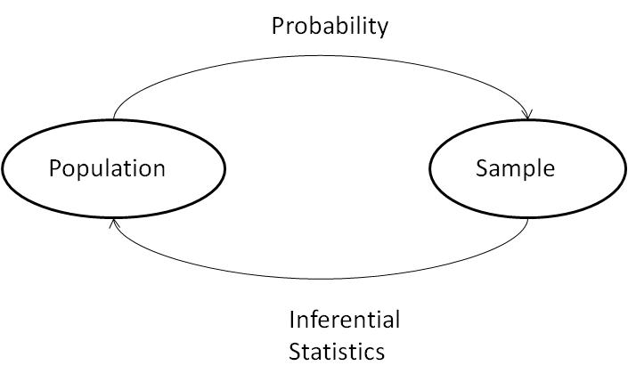
Statistical Inference
Sampling

Slide 3
Sampling Variability
What would happen if we took many samples?
Population
Sample
Sample
Sample
?
Sample
Sample
Sample
Sample
Sample

Slide 4
8.1: Point Estimation - Goals
Be able to differentiate between an estimator and an estimate.
Be able to define what is meant by a unbiased or biased estimator and state which is better in general.
Be able to determine from the pdf of a distribution, which estimator is better.
Be able to define MVUE (minimum-variance unbiased estimator).
Be able to state what estimator we will be using for the rest of the book and why we are using the estimator.

Slide 5
Definition: Point Estimate
A point estimate of a population parameter, θ, is a single number computed from a sample, which serves as a best guess for the parameter.

Slide 6
Definition: Estimator and Estimate
An estimator is a statistic of interest, and is therefore a random variable. An estimator has a distribution, a mean, a variance, and a standard deviation.
An estimate is a specific value of an estimator.

Slide 7
What Statistic to Use?
Fig. 8.1

Slide 8
Biased/Unbiased Estimator
A statistic $\hat{θ}$ is an unbiased estimator of a population parameter θ if $E\left(\hat{θ}\right)=θ$.
If $E\left(\hat{θ}\right)≠θ$, the then statistic $\hat{θ}$ is a biased estimator.

Slide 9
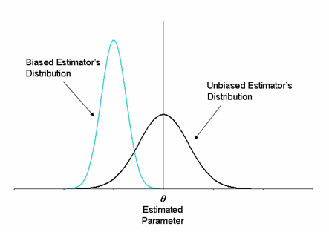
Unbiased Estimators
http://www.weibull.com/DOEWeb/unbiased_and_biased_estimators.htm

Slide 10
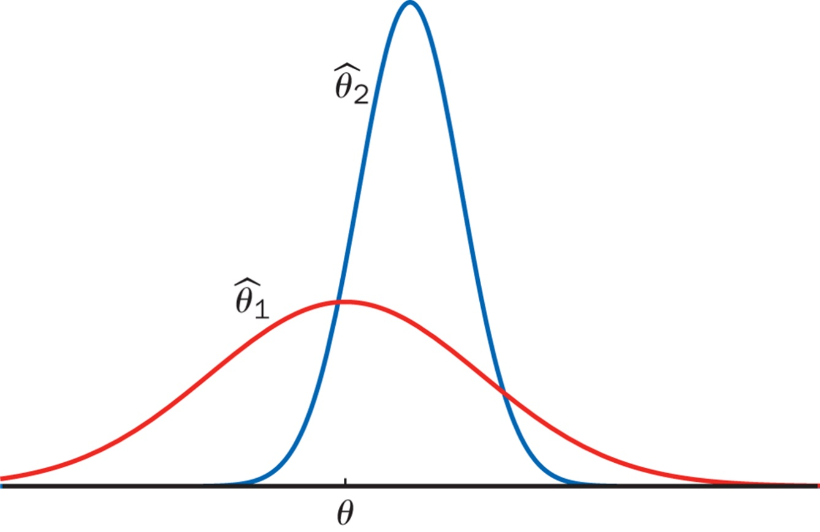
Estimators with Minimum Variance

Slide 11
Minimum Variance Unbiased Estimator
Among all estimators of θ that are unbiased, choose the one that has minimum variance. The resulting $\hat{θ}$ is called the minimum variance unbiased estimator (MVUE) of θ.

Slide 12
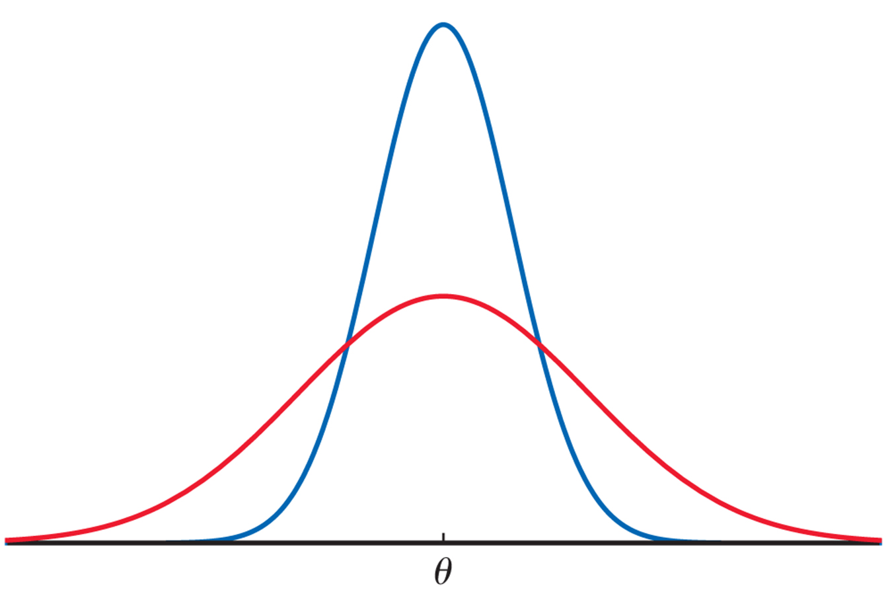
Estimators with Minimum Variance

Slide 13
8.2: A confidence interval (CI) for a population mean when σ is known- Goals
State the assumptions that are necessary for a confidence interval to be valid.
Be able to construct a confidence level C CI for μ for a sample size of n with known σ (critical value).
Explain how the width changes with confidence level, sample size and sample average.
Determine the sample size required to obtain a specified width and confidence level C.
Be able to construct a confidence level C confidence bound for μ for a sample size of n with known σ (critical value).
Determine when it is proper to use the CI.

Slide 14
Assumptions for Inference
We have an SRS from the population of interest.
The variable we measure has a Normal distribution (or approximately normal distribution) with mean μ and standard deviation σ.
We don’t know μ
but we do know σ (Section 8.2)
We do not know σ (Section 8.3)
σ

Slide 15
Definition of CI
A confidence interval (CI) for a population parameter is an interval of values constructed so that, with a specified degree of confidence, the value of the population parameter lies in this interval.
The confidence coefficient, C, is the probability the CI encloses the population parameter in repeated samplings.
The confidence level is the confidence coefficient expressed as a percentage.

Slide 16
z_{α/2}
z_{α/2} is a value on the measurement axis in a standard normal distribution such that
P(Z ≥ z_{α/2}) = α/2.
P(Z ≤ -z_{α/2}) = α/2
P(Z ≤ z_{α/2}) = 1- α/2

Slide 17
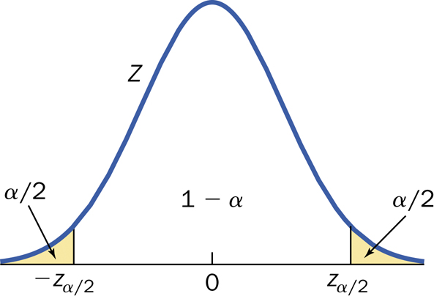
Confidence Interval: Definition

Slide 18
Example: Confidence Interval 1
Suppose we obtain a SRS of 100 plots of corn which have a mean yield (in bushels) of x̅ = 123.8 and a standard deviation of σ = 12.3.
What are the plausible values for the (population) mean yield of this variety of corn with a 95% confidence level?

Slide 19
Confidence Interval: Definition

Slide 20
Confidence Interval
$$\left(\overline{x}−z_{α/2}\frac{σ}{\sqrt{n}},\overline{x}+z_{α/2}\frac{σ}{\sqrt{n}}\right)$$
$$\overline{x}±z_{α/2}\frac{σ}{\sqrt{n}}$$
ME $=z_{α/2}\frac{σ}{\sqrt{n}}$

Slide 21
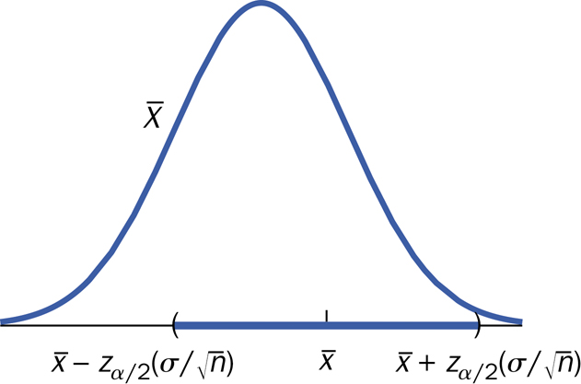
Confidence Interval

Slide 22
Interpretation of CI
The population parameter, µ, is fixed.
The confidence interval varies from sample to sample.
It is correct to say “We are 95% confident that the interval captures the true mean µ.”
It is incorrect to say “We are 95% confident µ lies in the interval.”

Slide 23
Interpretation of CI
The confidence coefficient, a probability, is a long-run limiting relative frequency.
In repeated samples, the proportion of confidence intervals that capture the true value of µ approaches the confidence coefficient.

Slide 24
Interpretation of CI
x

Slide 25
CI conclusion
We are 95% (C%) confident that the population (true) mean of […] falls in the interval (a,b) [or is between a and b].
We are 95% confident that the population (true) mean yield of this type of corn falls in the interval (121.4, 126.2) [or is between 121.4 and 126.2 bushels].

Slide 26
Table III (end of table)

Slide 27
Confidence Interval: Definition

Slide 28
Table III (end of table)

Slide 29
Example: Confidence Interval 2
An experimenter is measuring the lifetime of a battery. The distribution of the lifetimes is positively skewed similar to an exponential distribution. A sample of size 196 produces x̅ = 2.268. The population standard deviation is known to be 1.935 for this population.
a) Find and interpret the 95% Confidence Interval.
b) Find and interpret the 90% Confidence Interval.
c) Find and interpret the 99% Confidence Interval.

Slide 30
Example: Confidence Interval 2 (cont)
We are 95% confident that the population mean lifetime of this battery falls in the interval (1.997, 2.539).
We are 90% confident that the population mean lifetime of this battery falls in the interval (2.041, 2.495).
We are 99% confident that the population mean lifetime of this battery falls in the interval (1.912, 2.624).

Slide 31
How Confidence Intervals Behave
We would like high confidence and a small margin of error
$ME=z_{α/2}\frac{σ}{\sqrt{n}}$
lower C
reduce σ
increase n
C | z_{α/2} | CI
0.90 | 1.6449 | (2.041, 2.495)
0.95 | 1.96 | (1.997, 2.539)
0.99 | 2.5758 | (1.912. 2.624

Slide 32
Example: Confidence Level & Precision
The following are two CI’s having a confidence level of 90% and the other has a level of 95% level: (-0.30, 6.30) and (-0.82,6.82).
Which one has a confidence level of 95%?

Slide 33
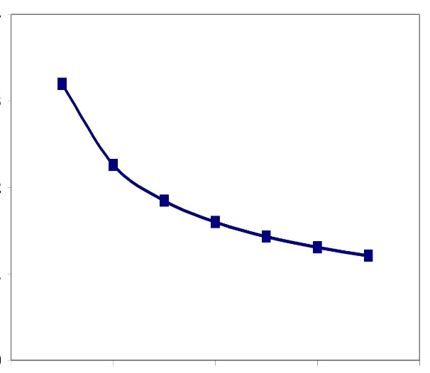
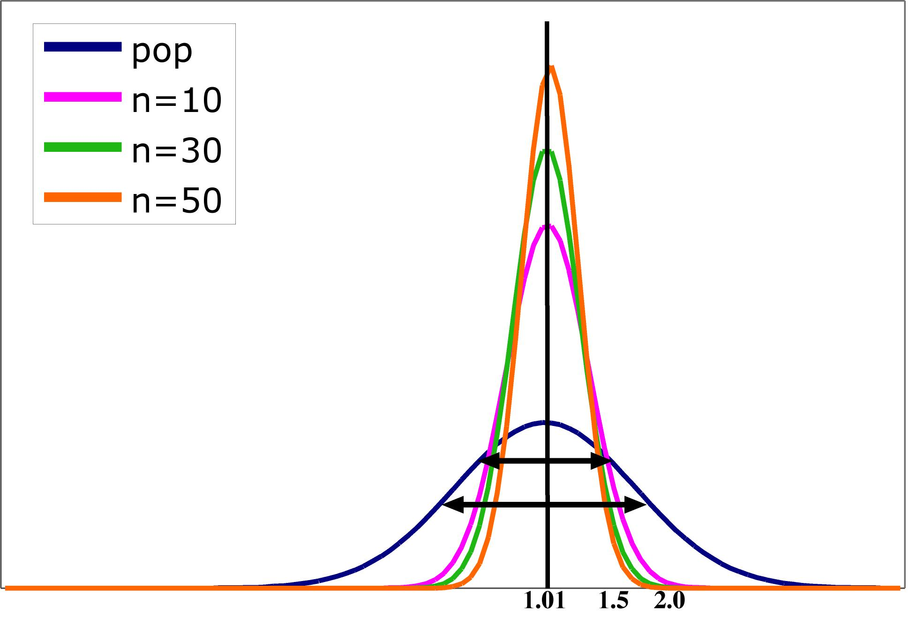
Impact of Sample Size
Standard error σ ⁄ √n
Sample size n

Slide 34
Example: Confidence Interval 2 (cont.)
An experimenter is measuring the lifetime of a battery. The distribution of the lifetimes is positively skewed similar to an exponential distribution. A sample of size 196 produces x̅ = 2.268 and s = 1.935.
a) Find the Confidence Interval for a 95% confidence level.
b) Find the Confidence Interval for the 90% confidence level.
c) Find the Confidence Interval for the 99% confidence level.
d) What sample size would be necessary to obtain a margin of error of 0.2 at a 99% confidence level?

Slide 35
Practical Procedure
Plan your experiment to obtain the lowest σ possible.
Determine the confidence level that you want.
Determine the largest possible width that is acceptable.
Calculate what n is required.
Perform the experiment.

Slide 36
Confidence Bound
Upper confidence bound
$$μ<\overline{x}+z_{α}\frac{σ}{\sqrt{n}}$$
Lower confidence bound
$$μ>\overline{x}−z_{α}\frac{σ}{\sqrt{n}}$$
z_{α} critical values
C | $$z_{α}$$
0.90 | 1.2816
0.95 | 1.6449
0.99 | 2.3263

Slide 37
Example: Confidence Bound
The following is summary data on shear strength (kip) for a sample of 3/8-in. anchor bolts: n = 78, x̅ = 4.25, σ = 1.30.
Calculate a lower confidence bound using a confidence level of 90% for the true average shear strength.
We are 90% confident that the true average shear strength is greater than ….

Slide 38
Summary CI
Confidence Interval $\overline{x}±z_{α/2}\frac{σ}{\sqrt{n}}$
Upper Confidence Bound $μ<\overline{x}+z_{α}\frac{σ}{\sqrt{n}}$
Lower Confidence Bound $μ>\overline{x}−z_{α}\frac{σ}{\sqrt{n}}$
Confidence Level | 95% | 99%
Two – sided z critical value | 1.96 | 2.5758
One-sided z critical value | 1.6449 | 2.3263

Slide 39
Cautions
The data must be an SRS from the population.
Be careful about outliers.
You need to know the sample size.
You are assuming that you know σ.
The margin of error covers only random sampling errors!

Slide 40
Conceptual Question
One month the actual unemployment rate in the US was 8.7%. If during that month you took an SRS of 250 people and constructed a 95% CI to estimate the unemployment rate, which of the following would be true:
1) The center of the interval would be 0.087
2) A 95% confidence interval estimate contains 0.087.
3) If you took 100 SRS of 250 people each, 95% of the intervals would contain 0.087.

Slide 41
8.3: Inference for the Mean of a Population - Goals
Be able to construct a level C confidence interval (without knowing σ) and interpret the results.
Be able to determine when the t procedure is valid.

Slide 42
Assumptions for Inference
We have an SRS from the population of interest.
The variable we measure has a Normal distribution (or approximately normal distribution) with mean μ and standard deviation σ.
We don’t know μ
but we do know σ (Section 8.2)
We do not know σ (Section 8.3)
σ

Slide 43
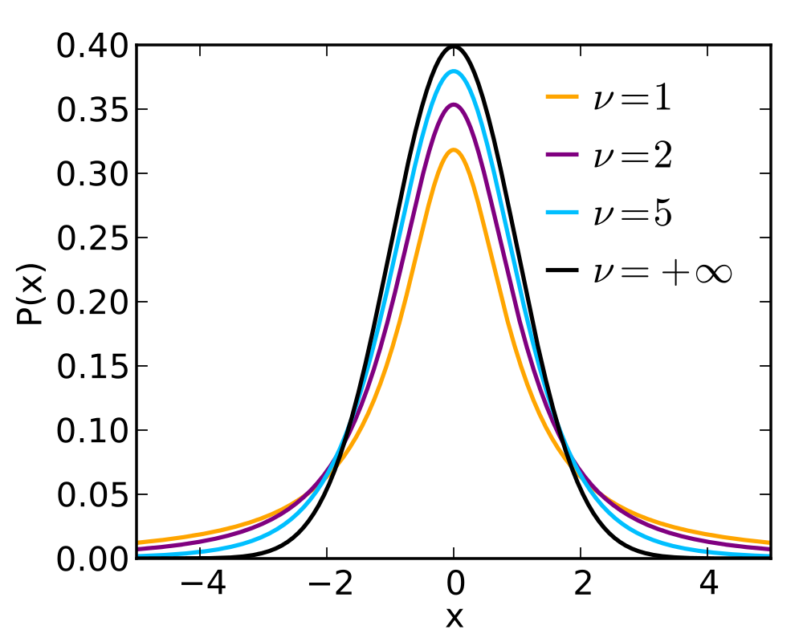
Shape of t-distribution
http://upload.wikimedia.org/wikipedia/commons/thumb/4/41/Student_t_pdf.svg/1000px-Student_t_pdf.svg.png

Slide 44
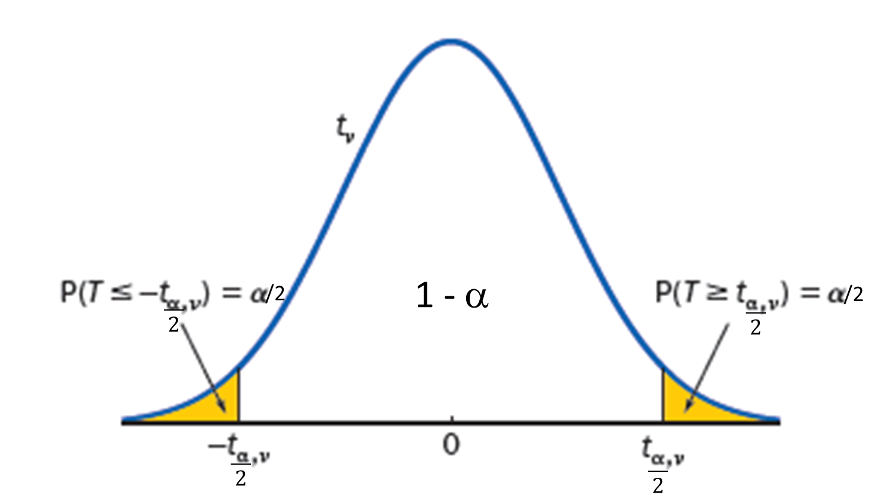
t Critical Values
t_{α,ν} is a critical value for a t distribution with ν degrees of freedom
P(T ≥ t_{α,ν}) = α

Slide 45
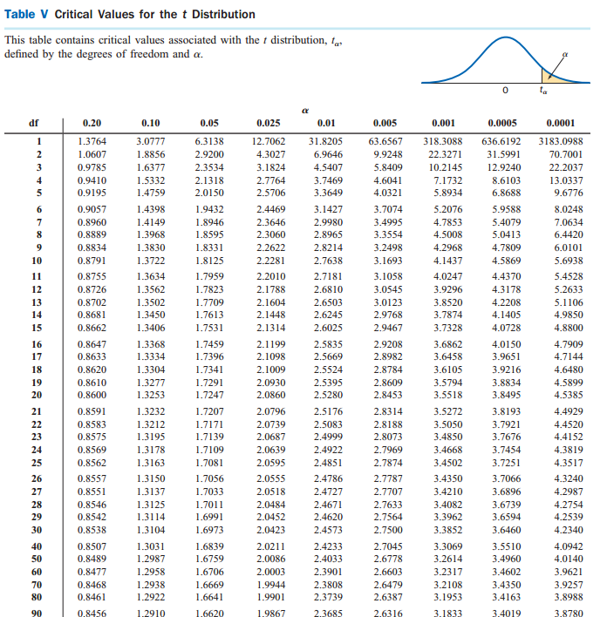
t-Table (Table V)

Slide 46
Table III vs. Table V
Table III | Table V
Standard normal (z) | t-distribution
P(Z ≤ z) | P(T > t*)
df not required | df required
Require: z_{α} Answer: probability | Require: probability Answer: t_{α}

Slide 47
Example: t critical values
What is the t critical value for the following:
Central area = 0.95, df = 10
Central area = 0.95, df = 60
Central area = 0.95, df = 100
Central area = 0.95, z curve
Upper area = 0.99, df = 10
Lower area = 0.99, df = 10

Slide 48
Summary CI – t distribution
Confidence Interval $\overline{x}±t_{α/{2,n−1}}\frac{s}{\sqrt{n}}$
Upper Confidence Bound $μ<\overline{x}+t_{α.n−1}\frac{s}{\sqrt{n}}$
Lower Confidence Bound $μ>\overline{x}−t_{α,n−1}\frac{s}{\sqrt{n}}$
Sample size $n={\left(\frac{t_{α/2}^{′}s}{ME}\right)}^{2}$

Slide 49
Example: t-distribution
We were curious about what the average time (hours per month) that students spent watching videos on cell phones month U.S. College students. We took an SRS of size 41 and determined a sample mean of 7.16 and a sample standard deviation of 3.56.
a) Determine the 95% CI.
b) What sample size is required to obtain a half width of 0.9 hours/month at a 95% confidence level?

Slide 50
Robustness of the t-procedure
A statistical value or procedure is robust if the calculations required are insensitive to violations of the condition.
The t-procedure is robust against normality.
n < 15 : population distribution should be close to normal.
15 < n < 40: mild skewedness is acceptable
n > 40: procedure is usually valid.

