Slide 1
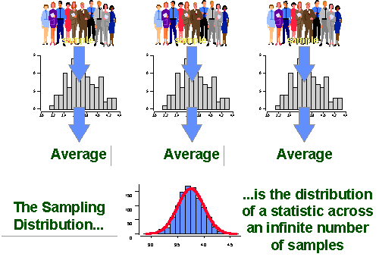
Chapter 7: Sampling Distributions
http://www.socialresearchmethods.net/kb/sampstat.php

Slide 2
7.1/7.2: Statistics, Parameters, Sampling Distribution of a Sample Mean - Goals
Be able to differentiate between parameters and statistics.
Explain the difference between the sampling distribution of x̄ and the population distribution of μ.
Determine the mean and standard deviation of x̄ for an SRS of size n from a population with mean μ and standard deviation σ.
Use the central limit theorem (CLT) to approximate the shape of the sampling distribution of x̄ and use it to perform probability calculations.

Slide 3
Probability vs. Statistics

Slide 4
Parameter and statistic
A parameter is a numerical descriptive measure of a population.
A statistic is any quantity computed from values in a sample.

Slide 5
Statistics

Slide 6
Sampling Variability
What would happen if we took many samples?
Population
Sample
Sample
Sample
?
Sample
Sample
Sample
Sample
Sample
A statistic is a random variable.

Slide 7
Sampling Distribution
The sampling distribution of a statistic is the probability distribution of the statistic.

Slide 8
Sampling Distributions
The sampling distribution of a statistic is the distribution of values taken by the statistic in all possible samples of the same size from the same population.
The population distribution of a variable is the distribution of values of the variable among all individuals in the population.

Slide 9
Mean and Standard Deviation
$μ_{\overline{X}}=μ_{X}$
$σ_{\overline{X}}=\frac{σ_{X}}{\sqrt{n}}$

Slide 10
Spread as a function of n
Therefore, sample means are less variable than
individual observations

Slide 11
Example: mean and SD of Sampling Distribution
The time that it takes a randomly selected rat of a certain subspecies to find its way through a maze has a normal distribution with μ = 1.5 min and σ = 0.35 min. Suppose five rats are randomly selected.
What is the mean of the average time?
What is the standard deviation of the average time?

Slide 12
Shape of Sampling Distributions
If a population X ~ N(μ, σ²) then the sample distribution of X̄ ~ N$\left(μ,\frac{σ^{2}}{n}\right)$.
Let X̄ be the mean of observations in a random sample of size n drawn from a population with mean μ and finite variance σ². As the sample size n is large enough, then X̄ $\dot{\sim }$ N$\left(μ,\frac{σ^{2}}{n}\right)$.

Slide 13
Example – Sampling Distribution: Normal
The time that it takes a randomly selected rat of a certain subspecies to find its way through a maze has a normal distribution with μ = 1.5 min and σ = 0.35 min. Suppose five rats are randomly selected.
What is the probability that the average time is at most 2.0 minutes?
What is the probability that the average time will be within 0.3 minutes of the mean?

Slide 14
Shape of Sampling Distributions
If a population X ~ N(μ, σ) then the sample distribution of X̄ ~ N$\left(μ,\frac{σ^{2}}{n}\right)$.
Let X̄ be the mean of observations in a random sample of size n drawn from a population with mean μ and finite variance σ². As the sample size n is large enough, then X̄ $\dot{\sim }$ N$\left(μ,\frac{σ^{2}}{n}\right)$.

Slide 15
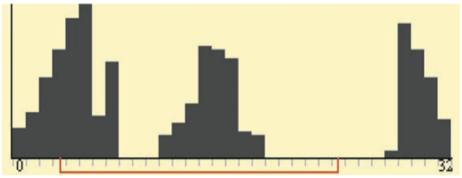
A Few More Facts
Any linear combination of independent Normal random variables is also Normal.
More generally, the distribution of a sum or average of many small random quantities is close to Normal whether independent or not.
CLT also applies to discrete random variables.

Slide 16
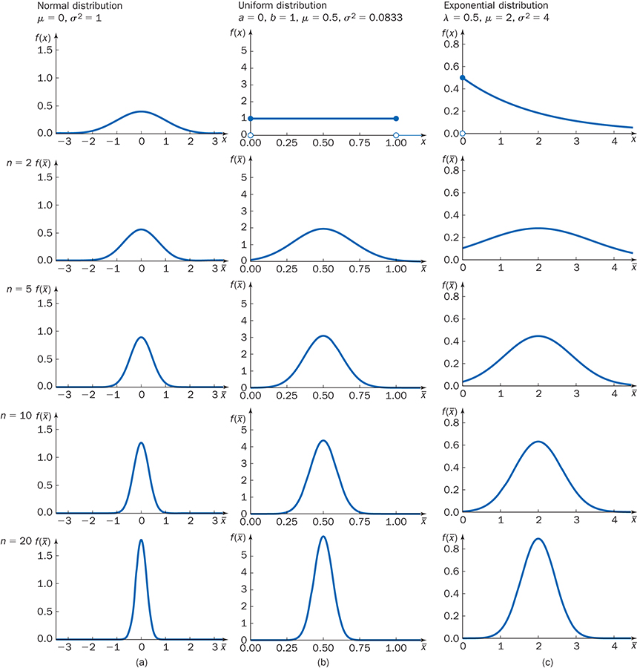
CLT (Fig. 7.5)

Slide 17
9 Binomial distributions

Slide 18
CLT: Example 1 (in class)
An electronics company manufactures resistors that have a mean resistance of 100 ohms and a standard deviation of 10 ohms. Assume that the distribution of resistance is normal.
a) Find the probability that one resistor will have a resistance less than 95 ohms. (0.3085)
b) Find the probability that a random sample of 25 resistors will have an average resistance less than 95 ohms. (0.0062)

Slide 19
CLT: Example 2 (in class)
Without checking the city bus web site, a student walks at random times to the Beering Hall bus stop to wait for the Ross Ade bus which is supposed to arrive every 10 minutes. This will be a Uniform distribution with 0 ≤ x ≤ 10.
a) If one student walks to the bus stop to catch this bus, what is the probability that the wait time will be more than 6 minutes? (0.4)
b) If 40 students walk to the bus stop to catch this bus, what is the probability that the average wait time will be more than 6 minutes? (0.0143)

