Slide 1
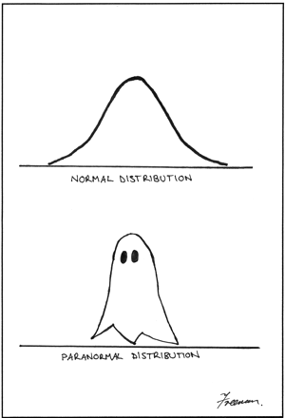
Chapter 6: Continuous Probability Distributions
A visual comparison of
normal and paranormal
distribution
Lower caption says
'Paranormal Distribution' - no
idea why the graphical artifact
is occurring.
http://stats.stackexchange.com/questions/423/what-is-your-favorite-data-analysis-cartoon

Slide 2
6.1: Probability Distributions for a Continuous Random Variable - Goals
Describe the basis of the probability density function (pdf).
Use the probability density function (pdf) and cumulative distribution function (cdf) of a continuous random variable to calculate probabilities and percentiles (median) of events.
Be able to use a pdf to find the mean of a continuous random variable.
Be able to use a pdf to find the variance of a continuous random variable.

Slide 3
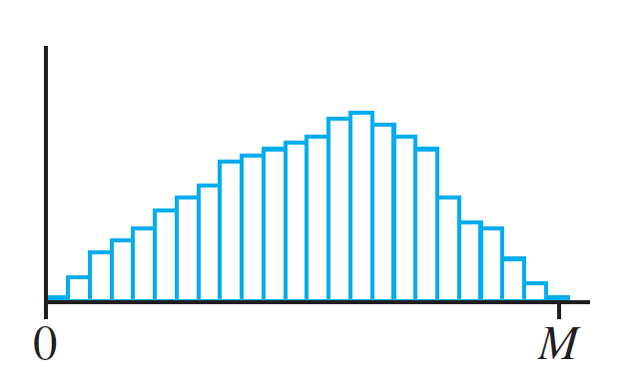
Density Curve
(a)
(b)
(c)

Slide 4
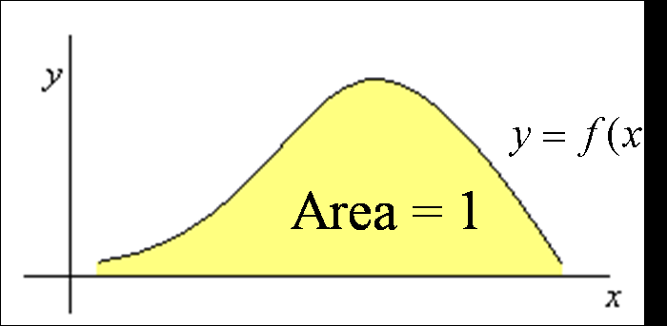
Probability Distribution for Continuous Random Variable
A probability distribution for a continuous random variable X is given by a smooth curve called a density curve, or probability density function (pdf).
y = f(x)
Area = 1

Slide 5
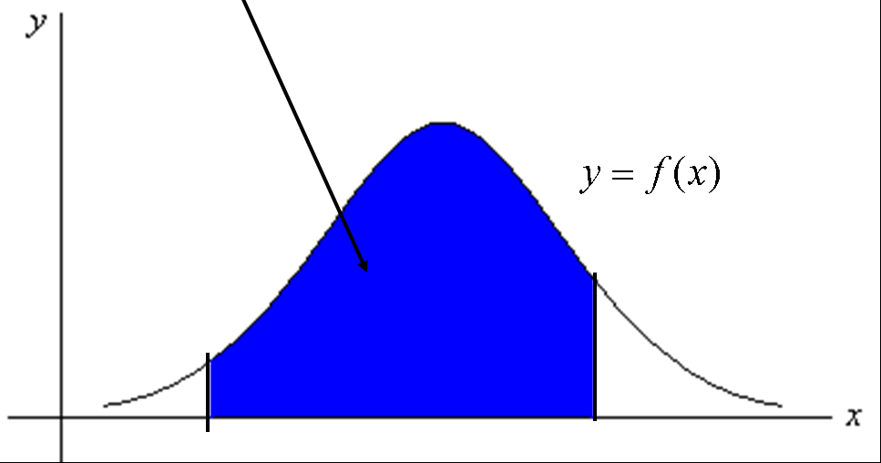
Probabilities Continuous Random Variable
The curve is defined so that the probability that X takes on a value between a and b (a < b) is the area under the curve between a and b.

Slide 6

Properties of pdf
f(x) ≥ 0
$\int_{−∞}^{∞}{f\left(x\right)dx}=1$

Slide 7
Example: Continuous Random Variable
We know that the distribution of the grade of a particular road in a particular 2 mile region is a continuous r.v. X with a functional form which is proportional to x². What is f(x)?

Slide 8
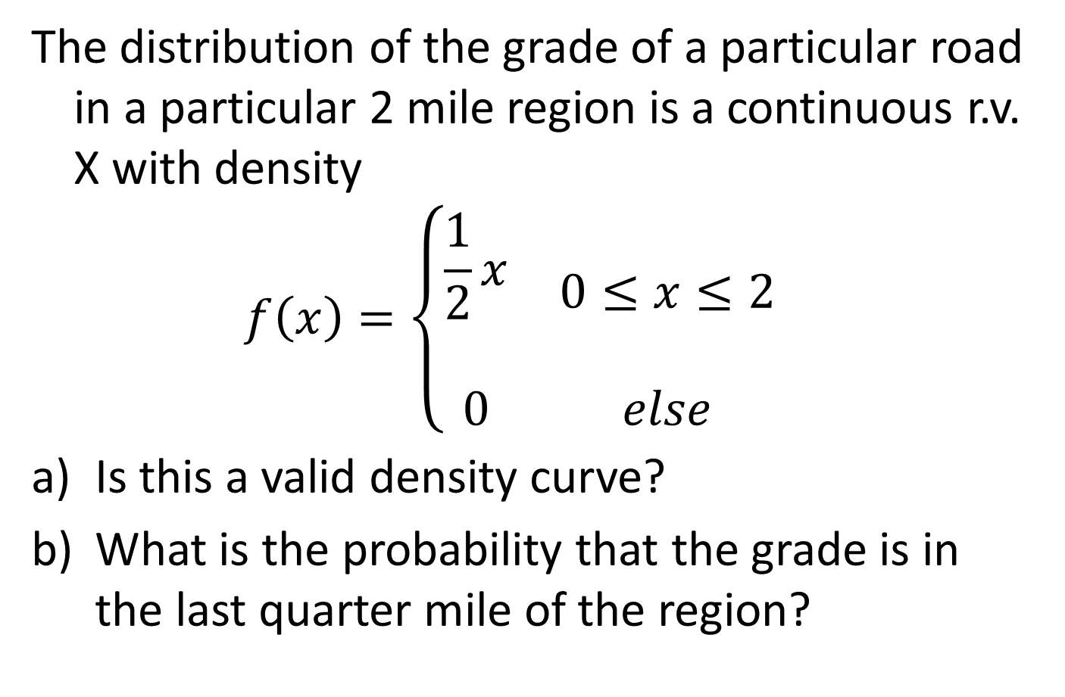
Example: Continuous Random Variable
The distribution of the grade of a particular road in a particular 2 mile region is a continuous r.v. X with density
$$f\left(x\right)=\left\{\begin{matrix}\begin{aligned}\frac{1}{2}x \\ \end{aligned} & 0≤x≤2 \\ 0 & else\end{matrix}\right.$$
Is this a valid density curve?
What is the probability that the grade is in the last quarter mile of the region?

Slide 9
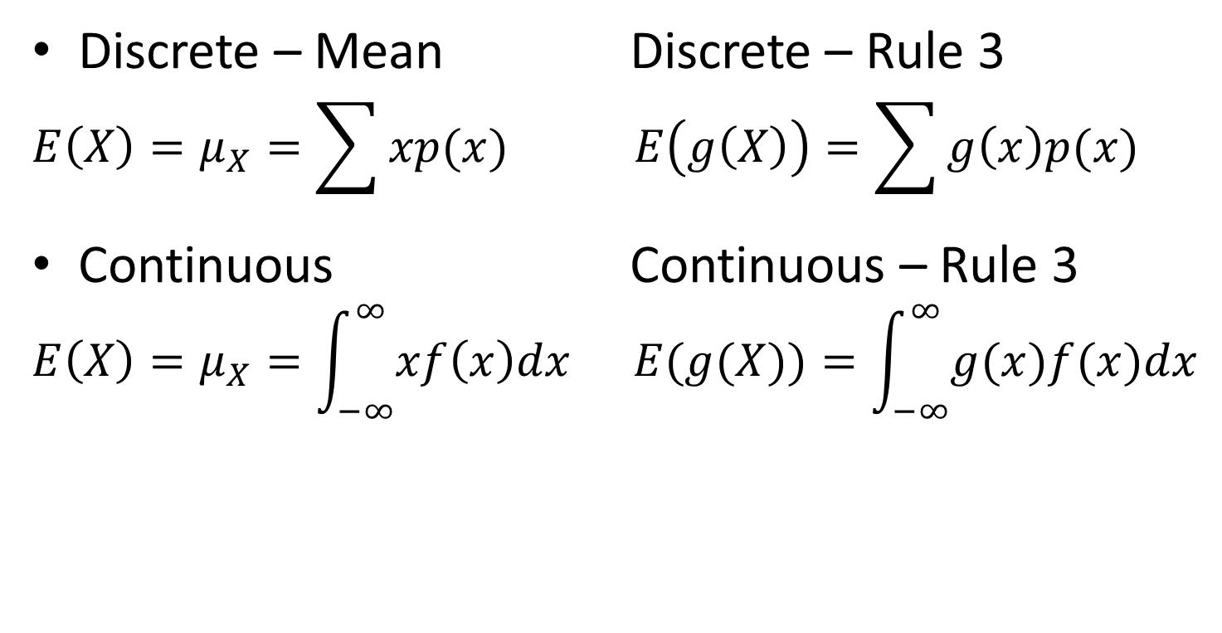
Formulas for the Mean of a Random Variable
Discrete – Mean Discrete – Rule 3
$$E\left(X\right)=μ_{X}=\sum{xp(x)} E\left(g\left(X\right)\right)=\sum{g\left(x\right)p(x) }$$
Continuous Continuous – Rule 3
$$E\left(X\right)=μ_{X}=\int_{−∞}^{∞}{xf\left(x\right)dx} E(g(X))=\int_{−∞}^{∞}{g(x)f(x)dx}$$

Slide 10
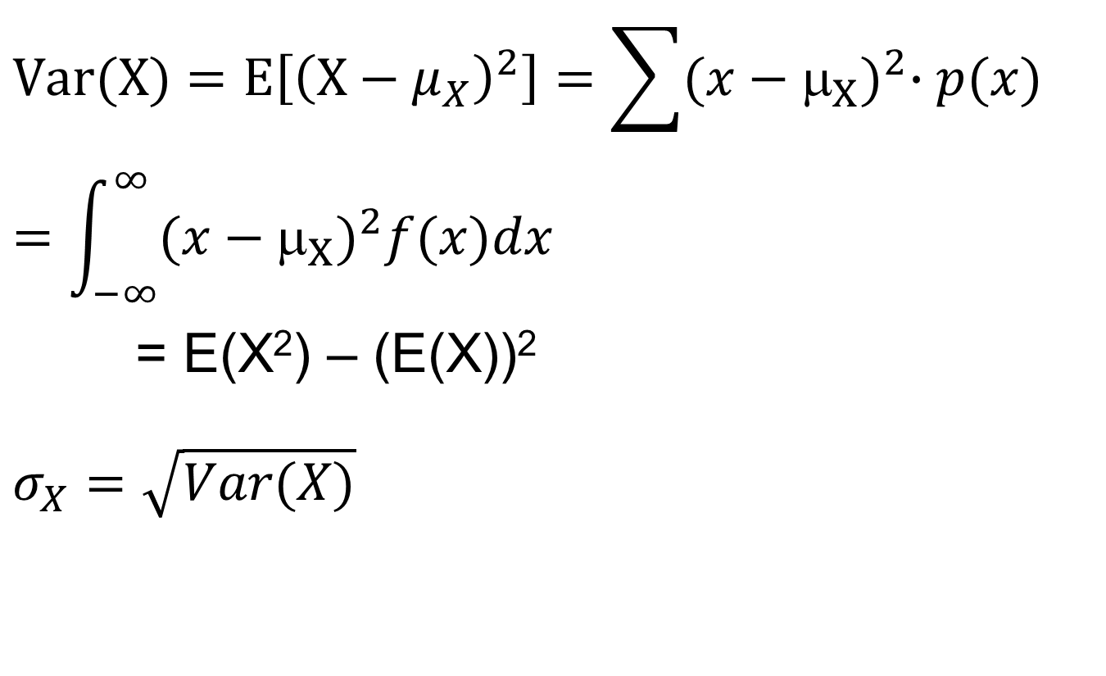
Variance of a Random Variable
$$Var(X)=E\left[{\left(X−μ_{X}\right)}^{2}\right]=\sum{{(x−μ_{X})}^{2}∙p(x)}=\int_{−∞}^{∞}{{(x−μ_{X})}^{2}f(x)dx}$$
= E(X²) – (E(X))²
$$σ_{X}=\sqrt{Var(X)}$$

Slide 11
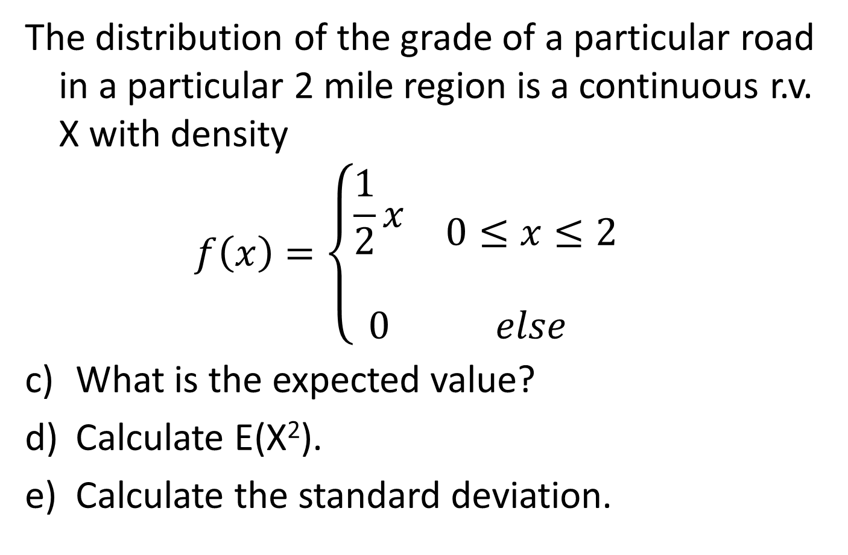
Example: Continuous Random Variable
The distribution of the grade of a particular road in a particular 2 mile region is a continuous r.v. X with density
$$f\left(x\right)=\left\{\begin{matrix}\begin{aligned}\frac{1}{2}x \\ \end{aligned} & 0≤x≤2 \\ 0 & else\end{matrix}\right.$$
What is the expected value?
Calculate E(X²).
Calculate the standard deviation.

Slide 12
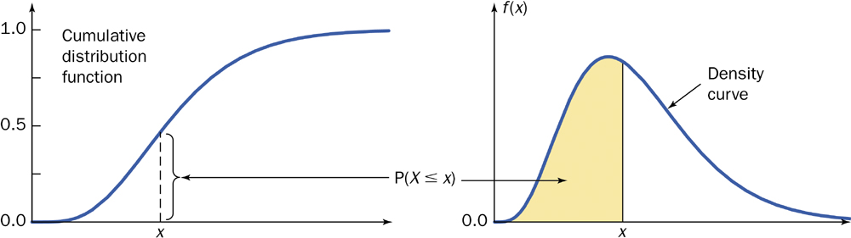

Cumulative Distribution Function (cdf)
F(x) = P(X ≤ x) = $\int_{−∞}^{x}{f\left(s\right)ds}$

Slide 13
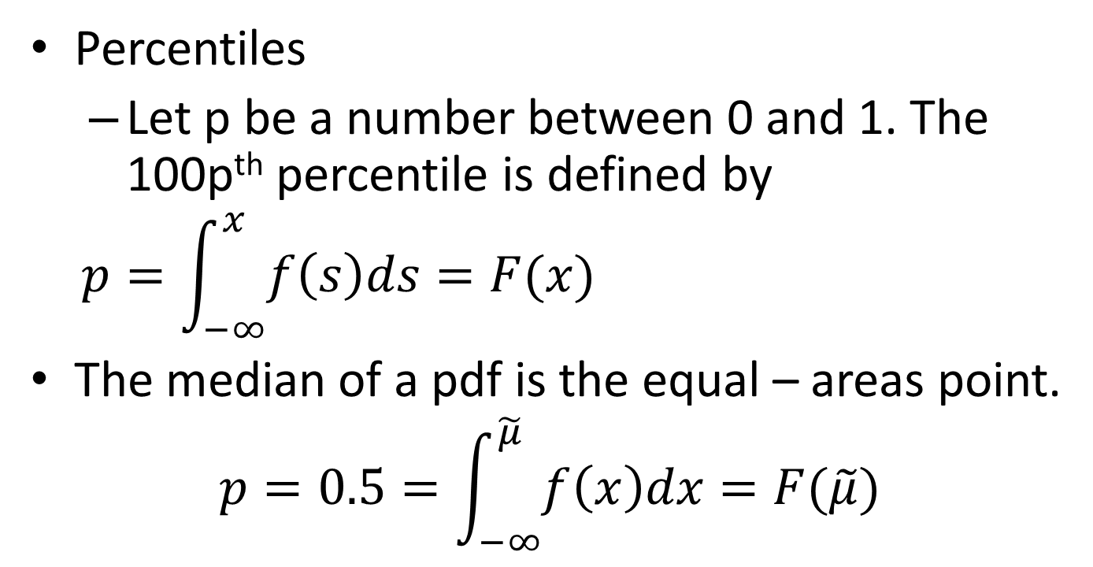
pdf – Percentiles
Percentiles
  Let p be a number between 0 and 1. The 100p^{th} percentile is defined by
$$p=\int_{−∞}^{x}{f\left(s\right)ds}=F(x)$$
The median of a pdf is the equal – areas point.
$$p=0.5=\int_{−∞}^{\tilde{μ}}{f\left(x\right)dx}=F(\tilde{μ})$$

Slide 14
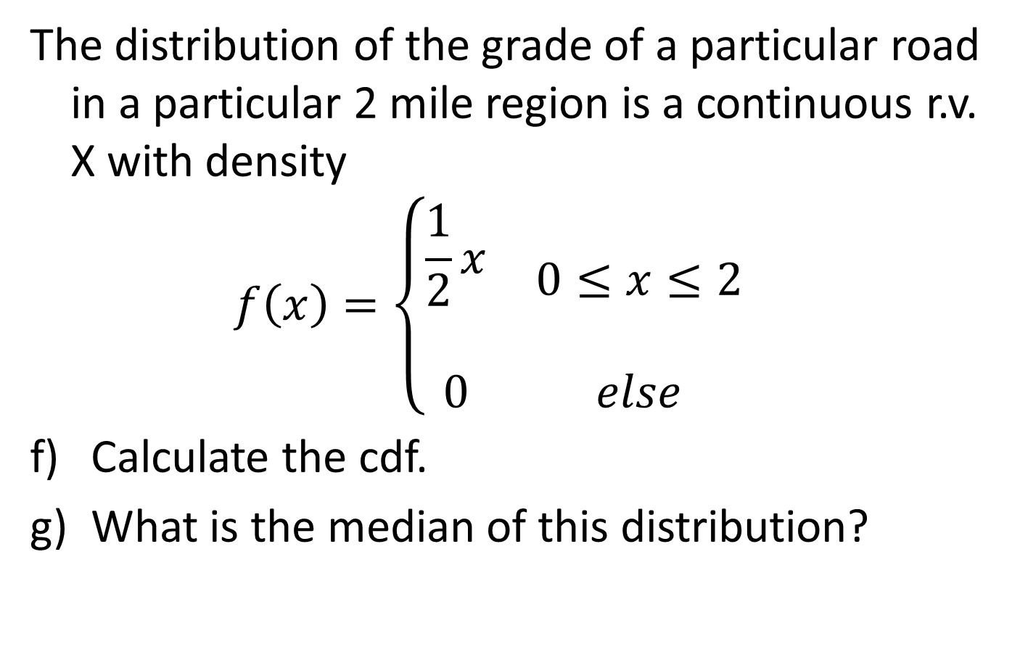
Example: Continuous Random Variable
The distribution of the grade of a particular road in a particular 2 mile region is a continuous r.v. X with density
$$f\left(x\right)=\left\{\begin{matrix}\begin{aligned}\frac{1}{2}x \\ \end{aligned} & 0≤x≤2 \\ 0 & else\end{matrix}\right.$$
Calculate the cdf.
What is the median of this distribution?

Slide 15
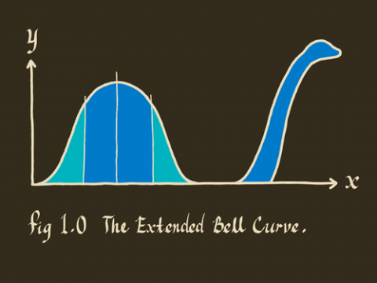
6.2 Normal Distribution
http://delfe.tumblr.com/

Slide 16
6.2/6.5: The Normal Distribution
The Normal Approximation to the Binomial Distribution - Goals
Be able to sketch the normal distribution.
Be able to standardize a value.
Be able to use the Z-table.
Be able to calculate probabilities.
Be able to calculate percentiles (Inverse calculations).
Determine when you can use the normal approximation to the binomial and perform calculations using this approximation.

Slide 17

Normal Distribution
$$f\left(x\right)=\frac{1}{σ\sqrt{2π}}e^{−\frac{{(x−μ)}^{2}}{2σ^{2}}}$$
where -∞ < μ < ∞, σ > 0
X ~ N(μ,σ²)

Slide 18
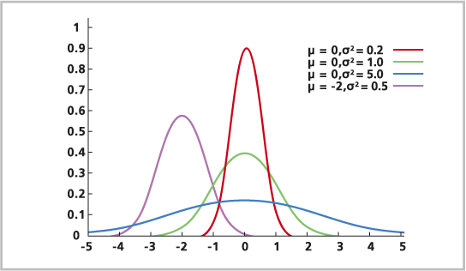
Shapes of Normal Density Curve
http://resources.esri.com/help/9.3/arcgisdesktop/com/gp_toolref
/process_simulations_sensitivity_analysis_and_error_analysis_modeling
/distributions_for_assigning_random_values.htm

Slide 19
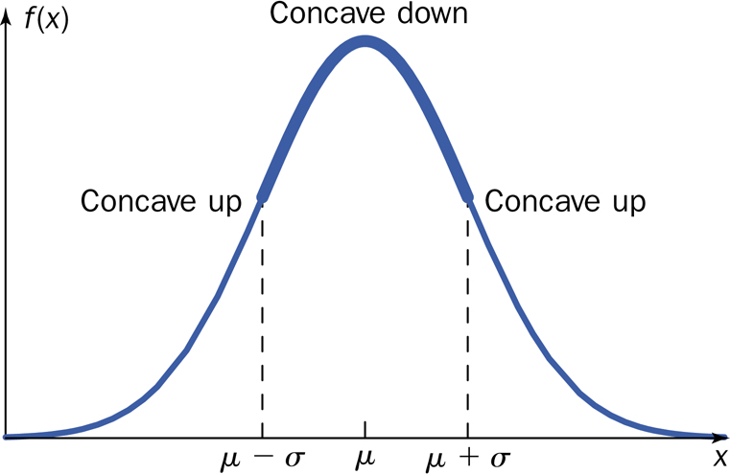
Graph of Normal Distribution

Slide 20

Normal Distribution
$$f\left(x\right)=\frac{1}{σ\sqrt{2π}}e^{−\frac{{(x−μ)}^{2}}{2σ^{2}}}$$
where -∞ < μ < ∞, σ > 0

Slide 21
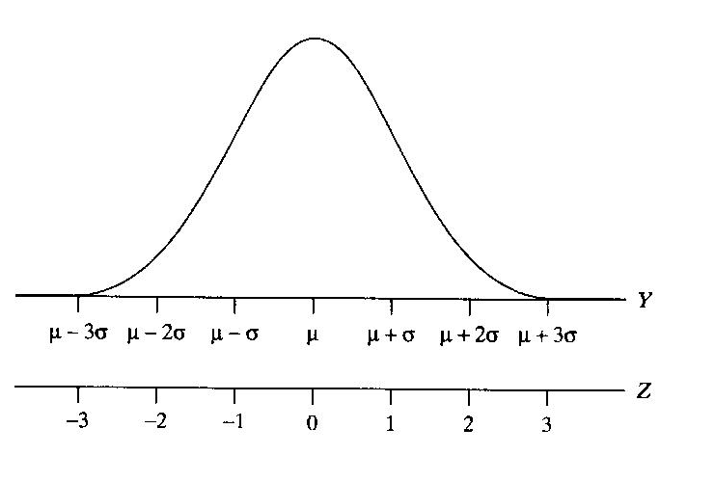
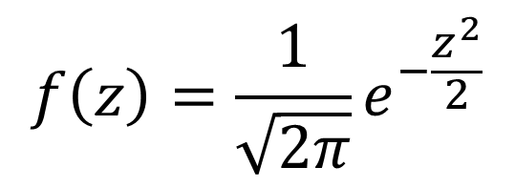
Standard Normal or z curve
$$f\left(z\right)=\frac{1}{\sqrt{2π}}e^{−\frac{z^{2}}{2}}$$

Slide 22
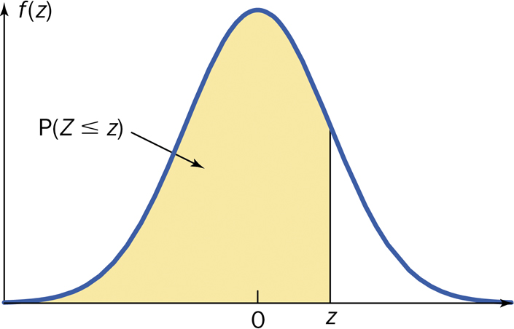
Cumulative z curve area

Slide 23
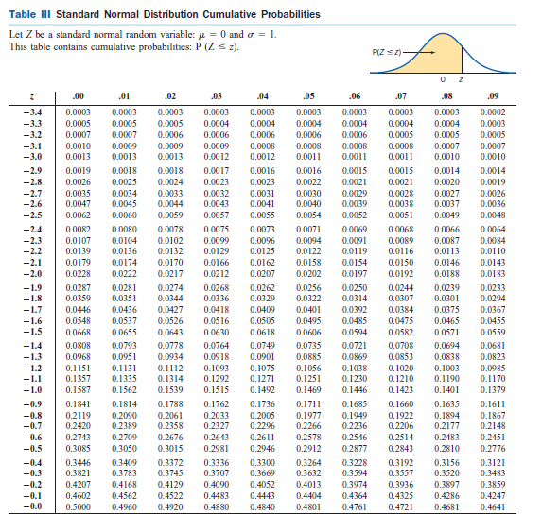
Z-table

Slide 24
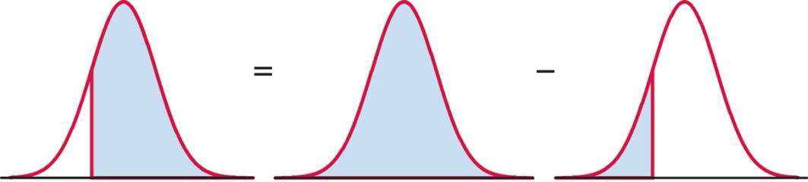
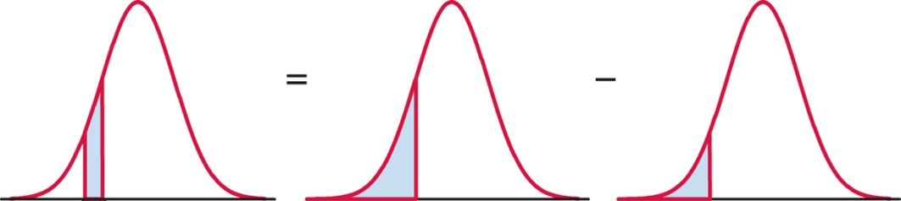
Using the Z table
area right of z = 1 − area left of z
area between z₁ and z₂ = area left of z₁ – area left of z₂

Slide 25
Procedure for Normal Distribution Problems
Sketch the situation and shade the area to be found. Optional but extremely useful.
Standardize X to state the problem in terms of Z.
Use Table III to find the area to the left of z.
Calculate the final answer.
Write your conclusion in the context of the problem.

Slide 26
Normal Distribution: Example
A particular rash has shown up in an elementary school. It has been determined that the length of time that the rash will last is normally distributed with mean 6 days and standard deviation 1.5 days.
What is the percentage of students that have the rash for longer than 8 days?
What is the percentage of students that the rash will last between 3.7 and 8 days?

Slide 27
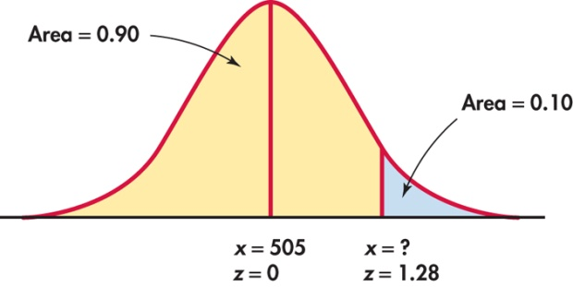
Percentiles

Slide 28
Normal Distribution: Example
A particular rash has shown up in an elementary school. It has been determined that the length of time that the rash will last is normally distributed with mean 6 days and standard deviation 1.5 days.
How long would the student’s rash have to have lasted to be in the top 10% of the number of days that the students have the rash?

Slide 29
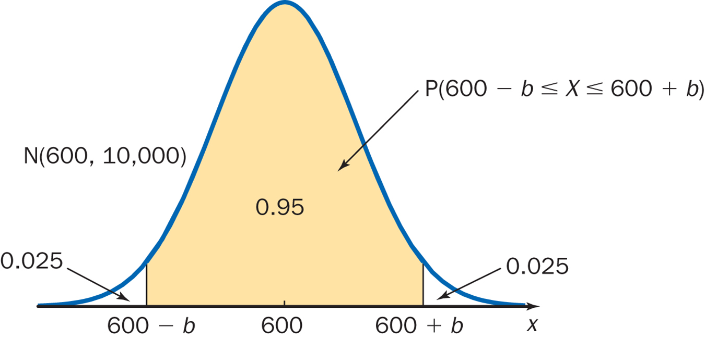
Symmetrically Located Areas

Slide 30
Normal Distribution: Example
A particular rash has shown up in an elementary school. It has been determined that the length of time that the rash will last is normally distributed with mean 6 days and standard deviation 1.5 days.
What interval symmetrically placed about the mean will capture 95% of the times for the student’s rashes to have lasted.

Slide 31
Why Approximate the Binomial Distribution?
Intervals
Computation (n large)
Inference

Slide 32
Difficulties with the Normal Approximation to the Binomial
Skewedness of the Binomial Distribution.
The Binomial Distribution is discrete.

Slide 33
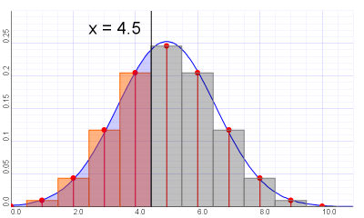
Continuity Correction
http://wiki.axlesoft.com/index.php?title=Continuity_correction

Slide 34
Continuity Correction – Extra
Actual Value | Approximate Value
P(X = a) | P(a – 0.5 < X < a +0.5)
P(a < X) | P(a + 0.5 < X)
P(a ≤ X) | P(a – 0.5 < X)
P(X < b) | P(X < b – 0.5)
P(X ≤ b) | P(X < b + 0.5)

Slide 35
Example: Normal Approximation to the Binomial
      The ideal size of a first-year class at a particular college is 150 students. The college, knowing from past experience that on the average only 30 percent of those accepted for admission will actually attend, uses a policy of approving the applications of 450 students.
        Compute the probability that more than 150 students attend this college.

Slide 36
6.3: Checking the Normality Assumption- Goals
Be able to state why it is important to be able to check to see whether a data set is normal or not.
Be able to determine if a distribution is normal (normal quantile plots)

Slide 37
Methods for Checking Normality
Graphs
Backward Empirical Rule
IQR/s
Normal Probability Plot

Slide 38
Procedure: Normal Quantile Plot
Arrange the data from smallest to largest.
Record the corresponding percentiles (quantiles).
Find the z value corresponding to the quantile calculated in part 2.
Plot the original data points (from 1) vs. the z values (from 3).

Slide 39
6.4: The Exponential Distribution (and Uniform Distribution) - Goals
Be able to recognize situations that may be described by uniform or exponential distributions.
Be able to recognize the sketches of the pdfs for uniform and exponential distribution.
Calculate the probability, mean and standard deviation when X has a uniform or exponential distribution.

Slide 40
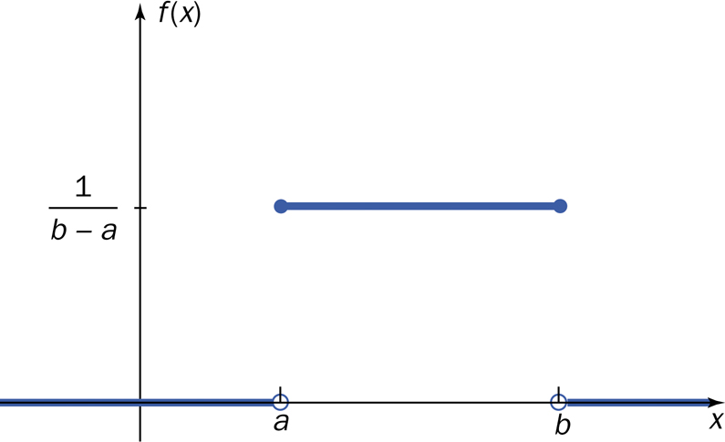
Uniform Distribution
In a (continuous) uniform distribution, the probability density is distributed evenly between two points.

Slide 41
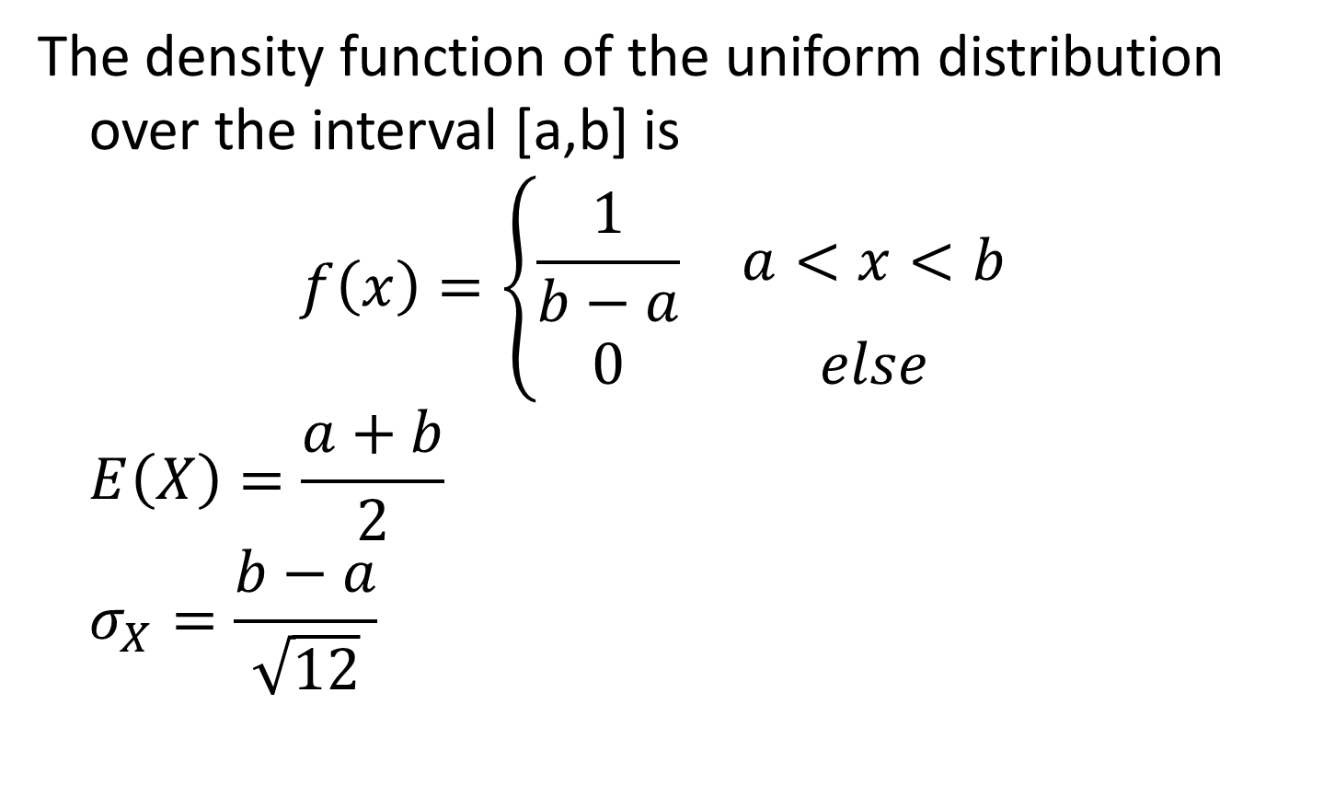
Uniform Distribution
The density function of the uniform distribution over the interval [a,b] is
$$f\left(x\right)=\left\{\begin{matrix}\frac{1}{b−a} & a<x<b \\ 0 & else\end{matrix}\right.$$
$$E\left(X\right)=\frac{a+b}{2}$$
$$σ_{X}=\frac{b−a}{\sqrt{12}}$$

Slide 42
Example: Uniform
A packaging line constantly packages 200 cartons per hour. After weighing every package variation the distribution of the weights was found to be uniform with weights ranging from 18.2 lbs. – 20.4 lbs., measured to the nearest tenths. The customer requires less than 20.0 lbs. for ergonomic reasons.
What is the probability that the package weights less than 20 lbs.?
What are the mean and the standard deviation of the package weights?

Slide 43
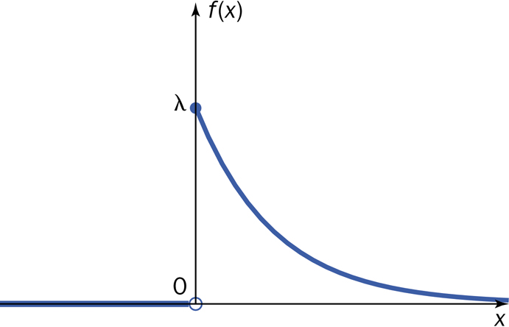

Exponential Distribution
Uses: amount of time until some specific event occurs (the amount of time between successive events)
$f\left(x\right)=\left\{\begin{matrix}λe^{−λx} & x≥0 \\ 0 & else\end{matrix}\right.$

Slide 44

Exponential Distribution
$F\left(x\right)=\left\{\begin{matrix}0 & x<0 \\ 1−e^{−λx} & x≥0\end{matrix}\right.$
$E\left(X\right)=\frac{1}{λ}$
Var$\left(X\right)=\frac{1}{λ^{2}}$
$σ_{X}=\frac{1}{λ}$

Slide 45
Example: Exponential
The time that it takes to repair a machine takes on average 2 hours. Assume that that the repair time has an exponential distribution.
What is the probability that the repair time will take at most 1 hour?
What is the probability that the repair time will be more than 1.5 hours?
What is the standard deviation of the distribution of these bacteria?

Slide 46
Gamma Distribution
Generalization of the exponential function
Uses
  probability theory
  theoretical statistics
  actuarial science
  operations research
  engineering

Slide 47
Beta Distribution
This distribution is only defined on an interval
  standard beta is on the interval [0,1]
uses
  modeling proportions
  percentages
  Probabilities
Uniform distribution is a member of this family.

Slide 48
Other Continuous Random Variables
Weibull
  exponential is a member of family
  uses: lifetimes
lognormal
  log of the normal distribution
  uses: products of distributions
Cauchy
  symmetrical, long straggly tails

