Slide 1
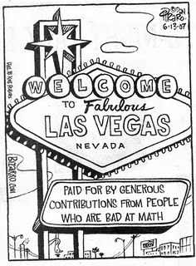
Chapter 4. Probability
http://mikeess-trip.blogspot.com/2011/06/gambling.html

Slide 2
Uses of Probability
Gambling
Business
Product preferences of consumers
Rate of returns on investments
Engineering
Defective parts
Physical Sciences
Locations of electrons in an atom
Computer Science
Flow of traffic or communications

Slide 3
4.1: Experiments, Sample Spaces, and Events - Goals
Be able to determine if an activity is an (random) experiment.
Be able to determine the outcomes and sample space for a specific experiment.
Be able to draw a tree diagram.
Be able to define and event and simple event.
Given a sample space, be able to determine the complement, union (or), intersection (and) of event(s).
Be able to determine if two events are disjoint.

Slide 4
Experiment
A (random) experiment is an activity in which there are at least two possible outcomes and the result of the activity cannot be predicted with absolute certainty.
An outcome is the result of an experiment.
A trial is when you do the experiment one time.

Slide 5
Examples of Experiments
Roll a 4-sided die.
The number of wins that the Women’s Volleyball team will make this season.
Select two Keurig Home Brewers and determine if either of them have flaws in materials and/or workmanship.
Does an 18-wheeler use the I65 detour (S) or make a right turn on S. River Road (R)

Slide 6
Total Number of Outcomes
How many possible outcomes are there for 3 18-wheelers at the US 231 S. River Road intersection?
S
SSS
SS
S
R
SSR
S
SRS
S
S
R
SR
R
SRR
S
RSS
S
RS
R
R
RSR
R
S
RRS
R
RR
R
RRR

Slide 7
Asymmetric Tree Diagram
No more than 2 18-wheelers are allowed to make the right turn.
S
SSS
SS
S
R
SSR
S
SRS
S
S
R
SR
R
SRR
S
RSS
S
RS
R
R
RSR
R
S
RRS
R
RR

Slide 8
Sample Space
The sample space associated with an experiment is a listing of all the possible outcomes.
It is indicated by a S or Ω.

Slide 9
Event
An event is any collection of outcomes from an experiment.
A simple event is an event consisting of exactly one outcome.
An event has occurred if the resulting outcome is contained in the event.
Events are indicated by capital Latin letters.
An empty event is indicated by {} or ∅

Slide 10
Sample Space, Event: Example
What is the sample space in the following situations? What are the outcomes in the listed event? Is the event simple?
I roll one 4-sided die. A = {roll is even}
I roll two 4-sided dice. A = {sum is even}
I toss a coin until the first head appears. A = {it takes 3 rolls}

Slide 11
Set Theory Terms
The event A complement, denoted A’, consists of all outcomes in the sample space S, not in A.
The event A union B, denoted A ∪ B, consists of all outcomes in A or B or both.
The event A intersection B, denoted by A ∩ B, consists of all outcomes in both A and B.
If A and B have no elements in common, they are disjoint or mutually exclusive events, written A ∩ B = { }.

Slide 12
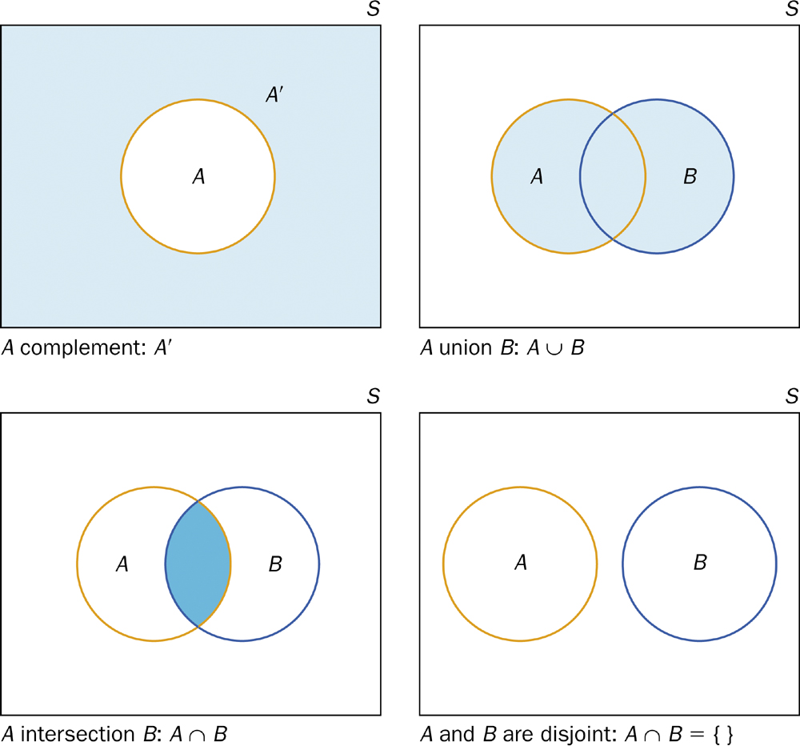
Set Theory Visualization

Slide 13
4.2: An Introduction to Probability - Goals
Be able to state what probability is in layman’s terms.
Be able to state and apply the properties and rules of probability.
Be able to determine what type of probability is given in a certain situation.
Be able to assign probabilities assuming an equally likelihood assumption.

Slide 14
Introduction to Probability
Given an experiment, some events are more likely to occur than others.
For an event A, assign a number that conveys the likelihood of occurrence. This is called the probability of A or P(A)
When an experiment is conducted, only one outcome can occur.

Slide 15
Probability
The probability of any outcome of a chance process is the proportion of times the outcome would occur in a very long series of repetitions.
This can be written as (frequentist interpretation)
$$P\left(A\right)≈\lim_{N→∞}{\frac{n}{N}}$$

Slide 16
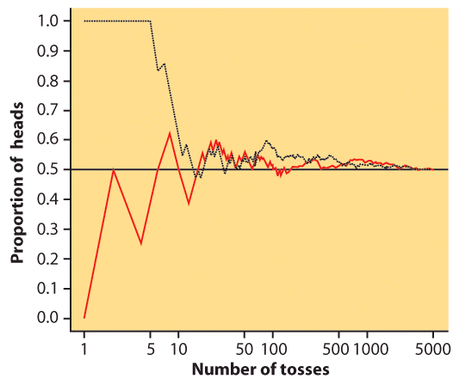
Frequentist Interpretation

Slide 17
Bayesian Statistics
Bayesian probability belongs to the category of evidential probabilities; to evaluate the probability of a hypothesis, the Bayesian probabilist specifies some prior probability, which is then updated in the light of new, relevant data (evidence). – Wikipedia
https://en.wikipedia.org/wiki/Bayesian_probability#Bayesian_methodology

Slide 18
Properties of Probability
1. For any event A, 0 ≤ P(A) ≤ 1.
2. If ω is an outcome in event A, then
$$P\left(A\right)=\sum_{i}{ω_{i}}$$
3. P(S) = 1.
4: P({}) = 0

Slide 19
Example: Examples: Properties of Probability
An individual who has automobile insurance from a certain company is randomly selected. The following table shows the probability number of moving violations for which the individual was cited during the last 3 years.
Consider the following events: A = {0}, B = {0,1}, C = {3},
D = {0,1,2,3}
Calculate the following:
P(A’) b) P(B) c) P(A ∩ C) d) P(D)
Simple event | 0 | 1 | 2 | 3
probability | 0.60 | 0.25 | 0.10 | 0.05

Slide 20
Types of Probabilities
Subjective
Empirical
$$P\left(A\right)=\frac{number of times that A occurs}{total number of times}$$
Theoretical (equally likely)
$$P\left(A\right)=\frac{number of outcomes in A}{number ofoutcomes in S}$$

Slide 21
Example: Types of Probabilities
For each of the following, determine the type of probability and then answer the question.
What is the probability of rolling a 2 on a fair 4-sided die?
What is the probability of having a girl in the following community?
What is the probability that Purdue Men’s football team will it’s season opener?
Girl | 0.52
Boy | 0.48

Slide 22
Probability Rules
Complement Rule
For any event A, P(A’) = 1 – P(A)
General addition rule
For any two events A and B,
P(A U B) = P(A) + P(B) – P(A ∩ B)
Additional rule – Disjoint
For any two disjoint events A and B,
P(A U B) = P(A) + P(B)

Slide 23
Example: Probability Rules
Marketing research by The Coffee Beanery in Detroit, Michigan, indicates that 70% of all customers put sugar in their coffee, 35% add milk, and 25% use both. Suppose a Coffee Beanery customer is selected at random.
What is the probability that the customer uses at least one of these two items?
What is the probability that the customer uses neither?

Slide 24
Example: Venn Diagrams
At a certain University, the probability that a student is a math major is 0.25 and the probability that a student is a computer science major is 0.31. In addition, the probability that a student is a math major and a student science major is 0.15.
a) What is the probability that a student is a math major or a computer science major?
b) What is the probability that a student is a computer science major but is NOT a math major?

Slide 25
4.4/4.5: Conditional Probability and Independence - Goals
Be able to calculate conditional probabilities.
Apply the general multiplication rule.
Use Bayes rule (or tree diagrams) to find probabilities.
Determine if two events with positive probability are independent.
Understand the difference between independence and disjoint.

Slide 26
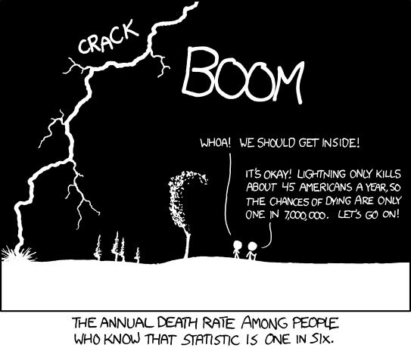
Conditional Probability
http://stats.stackexchange.com/questions/
423/what-is-your-favorite-data-analysis-cartoon

Slide 27
Conditional Probability: Example
A news magazine publishes three columns entitled "Art" (A), "Books" (B) and "Cinema" (C). Reading habits of a randomly selected reader with respect to these columns are
a) What is the probability that a reader reads the Art column given that they also read the Books column?
b) What is the probability that a reader reads the Books column given that they also read the Art column?
Read Regularly | A | B | C | both A and B | both A and C | both B and C
Probability | 0.14 | 0.23 | 0.37 | 0.08 | 0.09 | 0.13

Slide 28
Example: General Multiplication Rule
Suppose that 8 good and 2 defective fuses have been mixed up. To find the defective fuses we need to test them one-by-one, at random. Once we test a fuse, we set it aside.
a) What is the probability that we find both of the defective fuses in the first two tests?
b) What is the probability that when testing 3 of the fuses, the first tested fuse is good and the last two tested are defective?

Slide 29
Example: Tree Diagram/Bayes’s Rule
A diagnostic test for a certain disease has a 99% sensitivity and a 95% specificity. Only 1% of the population has the disease in question. If the diagnostic test reports that a person chosen at random from the population tests positive, what is the probability that the person does, in fact, have the disease?
Sensitivity (true positive): the probability that if the test is positive, the person has the disease.
Specificity (true negative): the probability that if the test is negative, the person does NOT have the disease.

Slide 30
Law of Total Probability
5
1
4
6
3
B and 4
B and 6
B and 3
B and 7
2
7
B

Slide 31
Bayes’s Rule
Suppose that a sample space is decomposed into k disjoint events A₁, A₂, … , A_{k} — none of which has a 0 probability — such that
$$\sum_{i=1}^{k}{P(A_{i})}=1$$
Let B be any other event such that P(B) is not 0. Then
$$P\left(A_{j} | B\right)=\frac{P\left(B | A_{j}\right)P(A_{j})}{\sum_{i=1}^{k}{P(B|A_{i})P(A_{i})}}$$

Slide 32
Bayes’s Rule (2 variables)
For two variables:
$$P\left(A | B\right)=\frac{P\left(B | A\right)P(A)}{P\left(B | A\right)P\left(A\right)+P\left(B | A^{′}\right)P(A^{′})}$$

Slide 33
Independence
Two events are independent if knowing that one occurs does not change the probability that the other occurs.
If A and B are independent:
P(B|A) = P(B)

Slide 34
Example: Independence
Are the following events independent or dependent?
Winning at the Hoosier (or any other) lottery.
The marching band is holding a raffle at a football game with two prizes. After the first ticket is pulled out and the winner determined, the ticket is taped to the prize. The next ticket is pulled out to determine the winner of the second prize.

Slide 35
Independence
If A and B are independent:
P(B|A) = P(B)
General multiplication rule:
P(A ∩ B) = P(A) P(B|A)
Therefore, if A and B are independent:
P(A ∩ B) = P(A) × P(B)

Slide 36
Example: Independence
Deal two cards without replacement
A = 1st card is a heart B = 2nd card is a heart
C = 2nd card is a club.
Are A and B independent?
Are A and C independent?
2. Repeat 1) with replacement.

Slide 37
Disjoint vs. Independent
In each situation, are the following two events
a) disjoint and/or b) independent?
Draw 1 card from a deck
A = card is a heart B = card is not a heart
Toss 2 coins
A = Coin 1 is a head B = Coin 2 is a head
Roll two 4-sided dice.
A = red die is 2 B = sum of the dice is 3

Slide 38
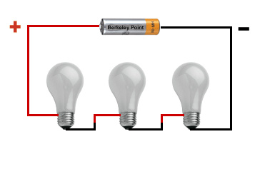
Example: Complex Multiplication Rule (1)
The following circuit is in a series. The current will flow only if all of the lights work. Whether a light works is independent of all of the other lights. If the probability that A will work is 0.8, P(B) = 0.85 and P(C) = 0.95, what is the probability that the current will flow?
A
B
C
http://www.berkeleypoint.com/learning/parallel_circuit.html

Slide 39
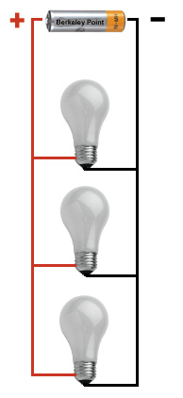
Example: Complex Multiplication Rule (2)
The following circuit to the right is parallel. The current will flow if at least one of the lights work. Whether a light works is independent of all of the other lights. If the probability that A will work is 0.8, P(B) = 0.85 and P(C) = 0.95, what is the probability that the current will flow?
A
B
C
http://www.berkeleypoint.com/learning/parallel_circuit.html

