Slide 1
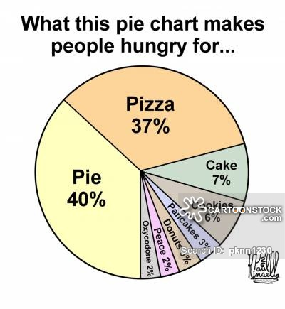
Chapter 2: Tables and Graphs for Summarizing Data
https://www.cartoonstock.com/cartoonview.asp?catref=pknn1230

Slide 2
Types of Data, Graphing: Goals
Section 2.1 Classify variables as
Number of characteristics
Categorical or numerical
Section 2.2 (very brief) Analyze the distribution of categorical variable:
Bar Graphs
Pie Charts
Section 2.3: Skip
Section 2.4 Analyze the distribution of quantitative variable:
Histogram
Identify the shape, center, and spread
Identify and describe any outliers

Slide 3
What to Look for in Graphs
Shape
Center
Variability

Slide 4
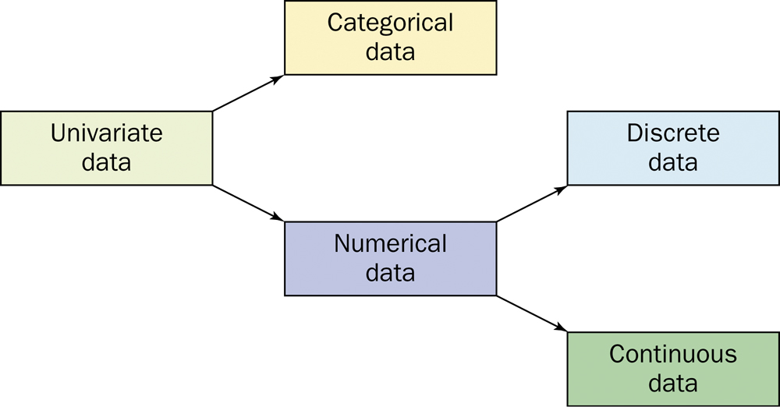
Types of Variables
Number
univariate
bivariate
multivariate
Type
Categorical
Numerical

Slide 5
To better understand a data set, ask:
Who?
What cases do the data describe?
How many cases?
What?
How many variables?
What is the exact definition of each variable?
What is the unit of measurement for each variable?
Why?
What is the purpose of the data?
What questions are being asked?
Are the variables suitable?

Slide 6
Frequency Distribution
The possible values and how often that it takes these values.
The label or class is the category of the data.
The frequency is the count.
$\text{Relative} \text{Frequency}\text{=}\frac{\text{frequency}}{\text{total} \text{count}}$

Slide 7
Categorical Variables - Display
The distribution of a categorical variable lists the categories and gives the count or percent or frequency of individuals who fall into each category.
Pie charts show the distribution of a categorical variable as a “pie” whose slices are sized by the counts or percents for the categories.
Bar graphs represent categories as bars whose heights show the category counts or percents.

Slide 8
Categorical Variables – Display (STAT 311)

Slide 9
Quantitative Variable: Histograms
Histograms show the distribution of a quantitative variable by using bars. Remember to always include the summary table.
Procedure – discrete (small number of values)
Calculate the frequency distribution and/or relative frequency of each x value.
Mark the possible x values on the x-axis.
Above each value, draw a rectangle whose height is the frequency (or relative frequency) of that value.

Slide 10
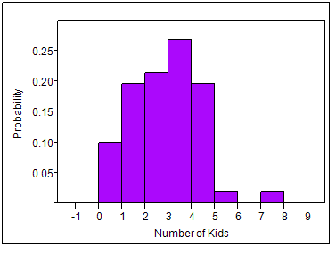
Histogram - Discrete
100 married couples between 30 and 40 years of age are studied to see how many children each couple have. The table below is the frequency table of this data set.
Kids | # of Couples | Rel. Freq
0 | 11 | 0.11
1 | 22 | 0.22
2 | 24 | 0.24
3 | 30 | 0.30
4 | 11 | 0.11
5 | 1 | 0.01
6 | 0 | 0.00
7 | 1 | 0.01
 | 100 | 1.00

Slide 11
Quantitative Variable: Histograms - continuous
Procedure - continuous
Divide the x-axis into a number of (equal) class intervals or classes such that each observation falls into exactly one interval.
Calculate the frequency or relative frequency for each interval.
Above each value, draw a rectangle whose height is the frequency (or relative frequency) of that value.

Slide 12
Visual Display: Continuous Histogram
Power companies need information about customer usage to obtain accurate forecasts of demand. Investigators from Wisconsin Power and Light determined the energy consumption (BTUs) during a particular period for a sample of 90 gas-heated homes. An adjusted consumption value was calculated via
The data is listed under furnace.txt under extra files on the computer web page.

Slide 13
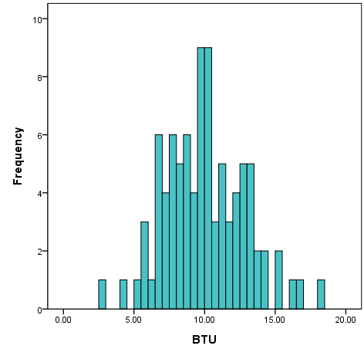
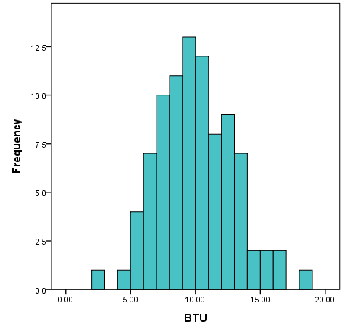
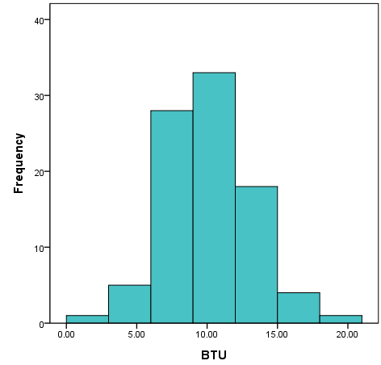
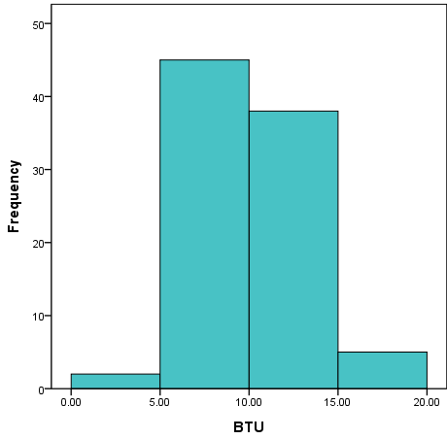
Example (cont)
Bin = 0.25
63 classes
Bin = 0.5
32 classes
Bin = 1
17 classes
Bin = 3
7 classes
Bin = 5
4 classes

Slide 14
Examining Distributions
In any graph of data, look for the overall pattern and for striking deviations from that pattern.
You can describe the overall pattern by its shape, center, and spread.
An important kind of deviation is an outlier, an individual that falls outside the overall pattern.

Slide 15
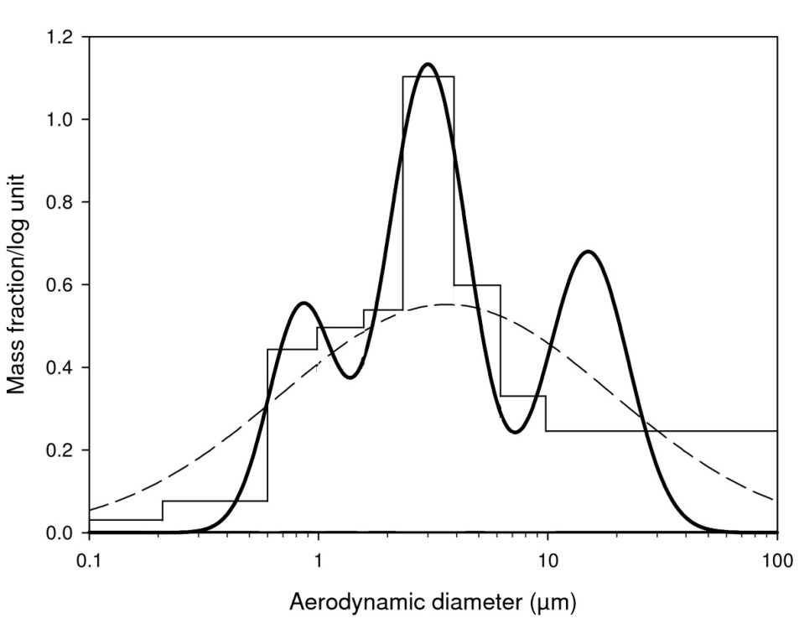
Shapes of Histograms - Number
Symmetric
unimodal
bimodal
multimodal
http://www.particleandfibretoxicology.com/content/6/1/6/figure/F1?highres=y

Slide 16
Shapes of Histograms (cont)
Symmetric
Positively skewed
Negatively skewed

Slide 17
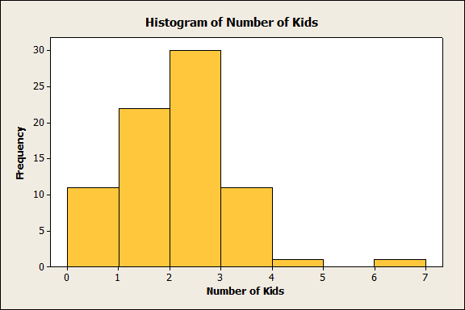
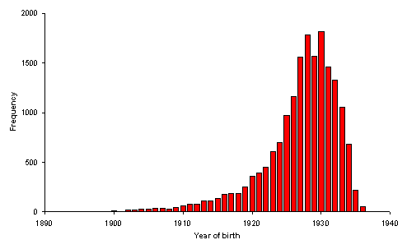
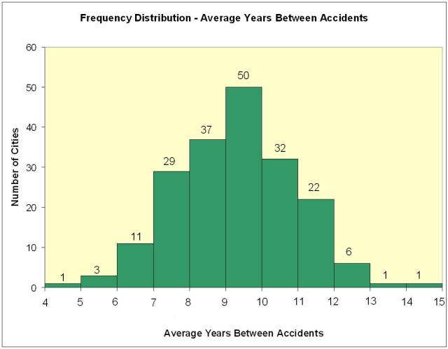
Shapes of Histograms (cont)

Slide 18
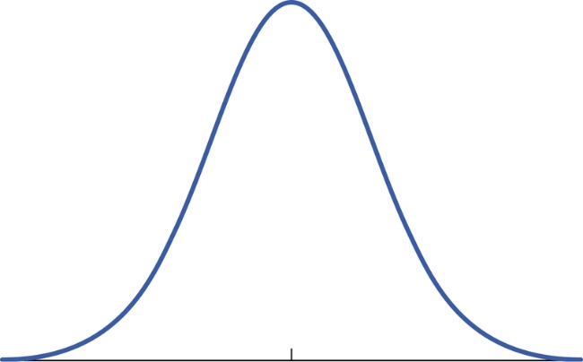
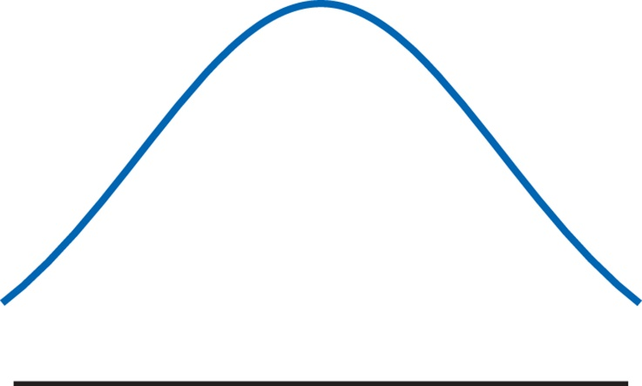
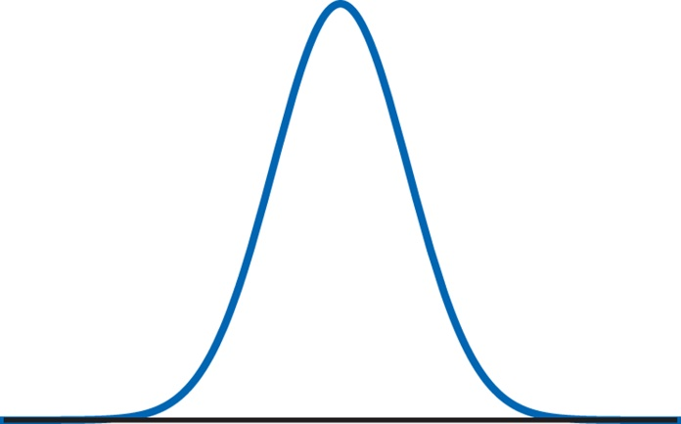
Shapes of Histograms (cont)
Normal distribution
Heavy Tails
Light Tails

Slide 19
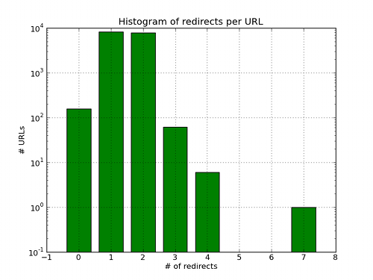
Outliers
http://ewencp.org/blog/url-reshorteners/

Slide 20
Time Plots
A time plot shows behavior over time.
Time is always on the x-axis; the other variable is on the y-axis
Look for a trend and deviations from the trend. Connecting the data points by lines may emphasize this trend.
Look for patterns that repeat at known regular intervals.

Slide 21
Example: Time Plots
We are interested in the temperature (ºF) of effluent at a sewage treatment plant.
Plot a histogram of the data.
Plot a time plot of the data.
47 | 54 | 53 | 50 | 46 | 46 | 47 | 50 | 51 | 50 | 51 | 50 | 46
52 | 50 | 50

Slide 22
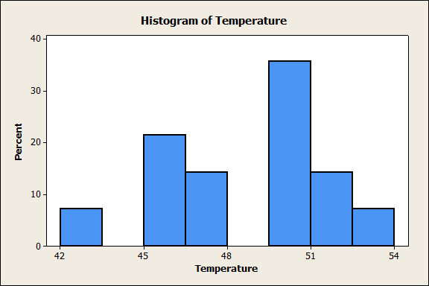
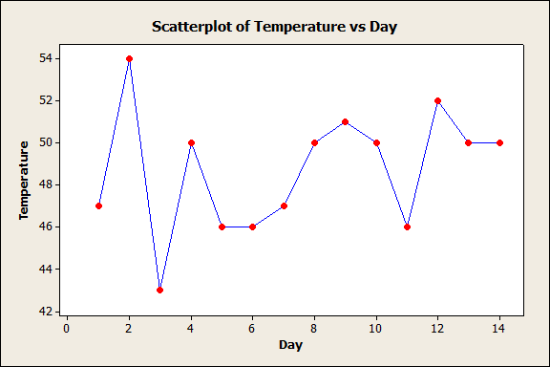
Example: Time Plots (cont)

