Slide 1
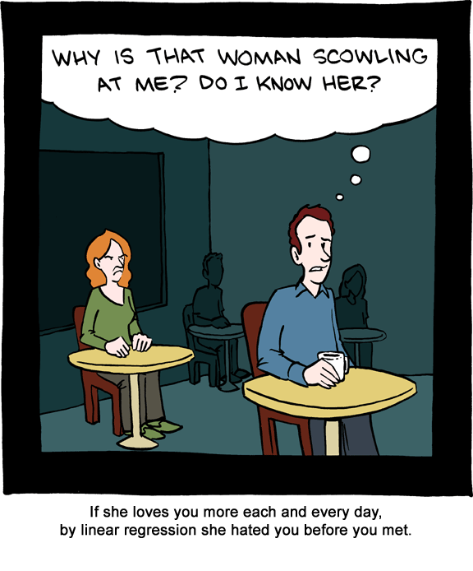
Chapter 12: Correlation and Linear Regression
http://jonfwilkins.blogspot.com/2011_08_01_archive.html

Slide 2
12.1: Simple Linear Regression - Goals
Be able to categorize whether a variable is a response variable or a explanatory variable.
Be able to interpret a scatterplot
Pattern
Outliers
Form, direction and strength of a relationship
Be able to generally describe the method of ‘Least Squares Regression’ including the model.
Be able to calculate and interpret the regression line.
Using the least square regression line, be able to predict the value of y for any appropriate value of x.
Be able to generate the ANOVA table for linear regression.
Be able to calculate r².
Be able to explain the meaning of r².
Be able to discern what r² does NOT explain.

Slide 3
Association
Two variables are associated if knowing the values of one of the variables tells you something about the values of the other variable.
Do you want to explore the association?
Do you want to show causality?

Slide 4
Variable Types
Response variable (Y): outcome of the study
Explanatory variable (X): explains or causes changes in the response variable
Y = g(X)

Slide 5
Scatterplot - Procedure
Decide which variable is the explanatory variable and put on X axis. The response variable goes on the Y axis.
Label and scale your axes.
Plot the (x,y) pairs.

Slide 6
Example: Scatterplot
The following data is to determine the relationship between age and change in systolic blood pressure (BP, mm Hg) after 24 hours in response to a particular treatment.
a) Draw a scatterplot of this data.
Obs | 1 | 2 | 3 | 4 | 5 | 6 | 7 | 8 | 9 | 10 | 11
Age | 70 | 51 | 65 | 70 | 48 | 70 | 45 | 48 | 35 | 48 | 30
BP | -28 | -10 | -8 | -15 | -8 | -10 | -12 | 3 | 1 | -5 | 8

Slide 7
Example: Scatterplot (cont)
Age
Age

Slide 8
Pattern
Form
Direction
Strength
Outliers

Slide 9
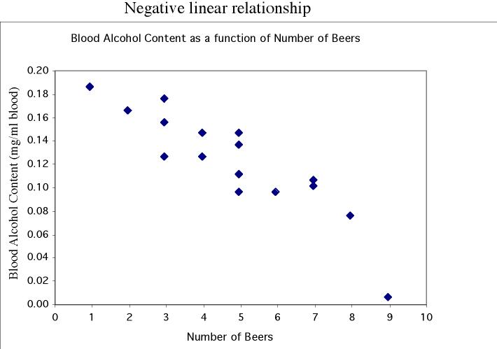
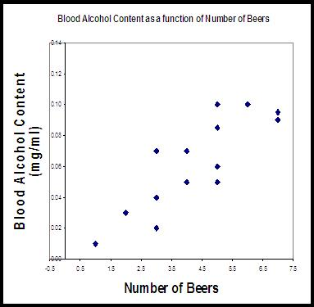
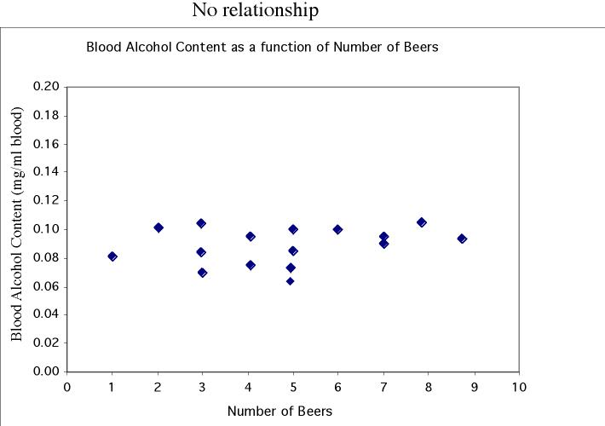
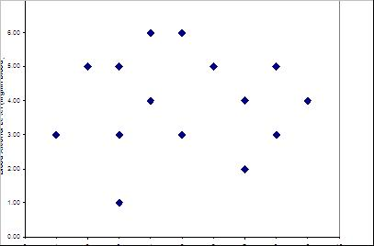
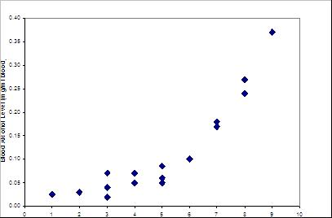
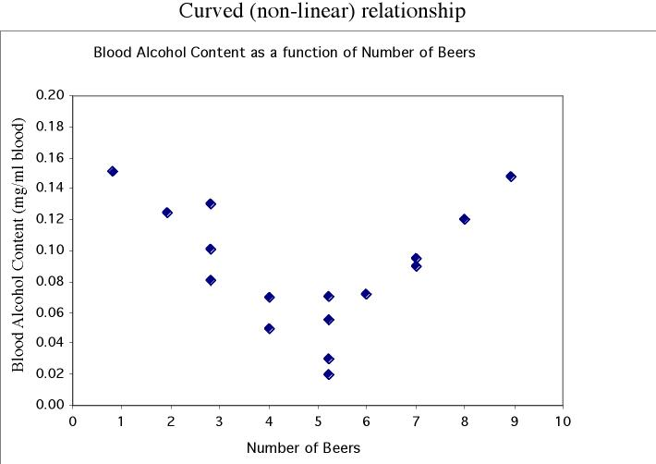
Pattern
Linear
No relationship
Nonlinear

Slide 10
Outliers

Slide 11
Example: Scatterplot (cont)
Age

Slide 12
Regression Line
A regression line is a straight line that describes how a response variable y changes as an explanatory variable x changes.
We can use a regression line to predict the value of y for a given value of x.
Y = β₀ + β₁X
Y = β₀ + β₁X + ε

Slide 13
Notation
n independent observations
x_{i} are the explanatory observations
y_{i} are the observed response variable observations
Therefore, we have n ordered pairs (x_{i}, y_{i})

Slide 14
Simple Linear Regression Model
Let (x_{i}, y_{i}) be pairs of observations. We assume that there exists constants β₀ and β₁ such that
Y_{i} = β₀ + β₁X_{i} + ε_{i}
where ε_{I} ~ N(0, σ²) (iid)

Slide 15
Idea of Linear Regression

Slide 16
Assumptions for Linear Regression
SRS with the observations independent of each other.
The relationship is linear in the population.
The response, y, is normally distribution around the population regression line.
The standard deviation of the response is constant.

Slide 17
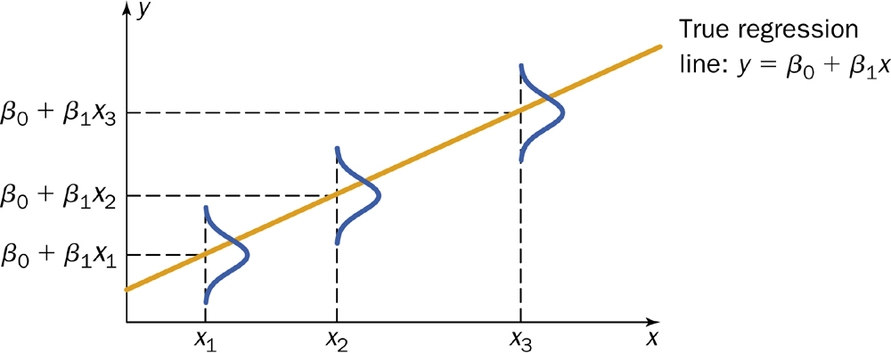
Normality of Y

Slide 18
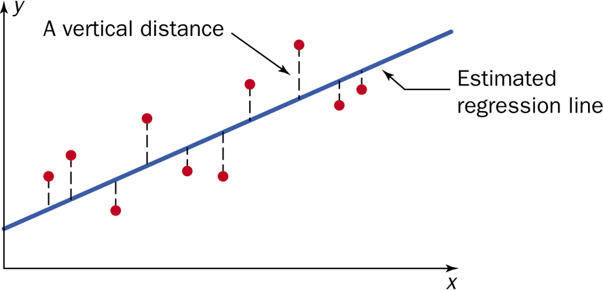
Linear Regression Model

Slide 19
Linear Regression Results
$$\hat{y}={\hat{β}}_{0}+{\hat{β}}_{1}x=b_{0}+b_{1}x$$
$${\hat{β}}_{1}=b_{1}=\frac{\sum{\left[\left(x_{i}−\overline{x}\right)\left(y_{i}−\overline{y}\right)\right]}}{\sum{{\left(x_{i}−\overline{x}\right)}^{2}}}=\frac{S_{XY}}{S_{XX}}$$
$${\hat{β}}_{0}=\overline{y}−{\hat{β}}_{1}\overline{x}$$
$$b_{0}=\overline{y}−b_{1}\overline{x}$$

Slide 20
Example: Regression Line
The following data is to determine the relationship between age and change in systolic blood pressure (BP, mm Hg) after 24 hours in response to a particular treatment.
x̄ = 52.727, ȳ = -7.636, S_{XY} = -1055.91, S_{XX} = 2006.18
b) What is the regression line for this data?
c) What would the predicted value be for someone who is 51 years old?
Obs | 1 | 2 | 3 | 4 | 5 | 6 | 7 | 8 | 9 | 10 | 11
Age | 70 | 51 | 65 | 70 | 48 | 70 | 45 | 48 | 35 | 48 | 30
BP | -28 | -10 | -8 | -15 | -8 | -10 | -12 | 3 | 1 | -5 | 8

Slide 21
Example: Regression Line
ŷ = 20.11 - 0.526x
Age

Slide 22
Simple Linear Regression Model
Let (x_{i}, y_{i}) be pairs of observations. We assume that there exists constants β₀ and β₁ such that
Y_{i} = β₀ + β₁X_{i} + ε_{i}
where ε_{I} ~ N(0, σ²) (iid)

Slide 23
Linear Regression - variance
e_{i} = y_{i} - ŷ_{i}
$$s^{2}=\frac{\sum{e_{i}^{2}}}{n−2}=\frac{\sum{{\left(y_{i}−{\hat{y}}_{i}\right)}^{2}}}{n−2}=\frac{SSE}{dfe}$$

Slide 24
Other SS and df
Total
$$SST=S_{yy}=\sum{{\left(y_{i}−\overline{y}\right)}^{2}}$$
dft = n - 1
Regression
$$SSR=\sum{{\left({\hat{y}}_{i}−\overline{y}\right)}^{2}}=b_{1}S_{XY}$$
dfr= 1

Slide 25
ANOVA table for Linear Regression
Source | df | SS | MS | F
Regression | 1 | Σ(ŷ_{i} - ȳ)²
Error | n – 2 | Σ(y_{i} - ŷ_{i})²
Total | n – 1 | Σ(y_{i} - ȳ)²

Slide 26
Facts about Least Square Regression
Slope: A change of y with one unit change in x.
$$b_{1}=\frac{rise}{run}$$
Intercept: the value of y when x = 0.
The line passes through the point (x̄,ȳ).
There is an inherent difference between x and y.

Slide 27
r²
Coefficient of determination.
Fraction of the variation of the values of y that is explained by the least-squares regression of y on x.
$$r^{2}=\frac{\sum{{(\hat{y}−\overline{y})}^{2}}}{\sum{{(y_{i}−\overline{y})}^{2}}}=\frac{SSR}{SST}$$

Slide 28
Example: Regression Line
The following data is to determine the relationship between age and change in systolic blood pressure (BP, mm Hg) after 24 hours in response to a particular treatment.
d) What percent of variation of Y is due to the regression line?
Obs | 1 | 2 | 3 | 4 | 5 | 6 | 7 | 8 | 9 | 10 | 11
Age | 70 | 51 | 65 | 70 | 48 | 70 | 45 | 48 | 35 | 48 | 30
BP | -28 | -10 | -8 | -15 | -8 | -10 | -12 | 3 | 1 | -5 | 8

Slide 29
ANOVA table bp Example
Source | df | SS | MS
Regression
Error
Total

Slide 30
ANOVA table bp Example
Source | df | SS | MS
Regression | 1 | 555.75
Error | 9 | 382.79
Total | 10 | 938.54

Slide 31
ANOVA table bp Example
Source | df | SS | MS
Regression | 1 | 555.75 | 555.75
Error | 9 | 382.79 | 42.53
Total | 10 | 938.54

Slide 32
Beware of interpretation of r²
Linearity
Outliers
Good prediction

Slide 33
12.2 (Part A) Hypothesis Tests Goals
Be able to determine if there is an association between the response and explanatory variables using the F test.
Be able to perform inference on the slope (Confidence interval and hypothesis test).

Slide 34
Simple Linear Regression Model
Let (x_{i}, y_{i}) be pairs of observations. We assume that there exists constants β₀ and β₁ such that
Y_{i} = β₀ + β₁X_{i} + ε_{i}
where ε_{I} ~ N(0, σ²) (iid)

Slide 35
Linear Regression Results
$${\hat{β}}_{1}=b_{1}=\frac{\sum{\left[\left(x_{i}−\overline{x}\right)\left(y_{i}−\overline{y}\right)\right]}}{\sum{{\left(x_{i}−\overline{x}\right)}^{2}}}=\frac{S_{XY}}{S_{X}}$$
$${\hat{β}}_{0}=\overline{y}−{\hat{β}}_{1}\overline{x}=b_{0}=\overline{y}−b_{1}\overline{x}$$
s² = MSE

Slide 36
Example: Linear Regression 1
The cetane number is a critical property in specifying the ignition quality of a fuel used in a diesel engine. Determination of this number for a biodiesel fuel is expensive and time-consuming. Therefore a way of predicting this number is wanted. The data on the next slide is x = iodine value (g) and y = cetane number for a sample of 14 biofuels. The iodine value is the amount of iodine necessary to saturate a sample of 100g of oil.
Graph the scatterplot.
Determine the equation of the fitted line.
What is a point estimate of the true average cetane number whose iodine value is 100?
Estimate the value of σ.
What proportion of the observed variation in cetane number that can be attributed to the iodine value?

Slide 37
Example: Linear Regression 1 (cont.)
x: | 132.0 | 129.0 | 120.0 | 113.2 | 105.0 | 92.0 | 84.0
y: | 46.0 | 48.0 | 51.0 | 52.1 | 54.0 | 52.0 | 59.0
x: | 83.2 | 88.4 | 59.0 | 80.0 | 81.5 | 71.0 | 69.2
y: | 58.7 | 61.6 | 64.0 | 61.4 | 54.6 | 58.8 | 58.0

Slide 38
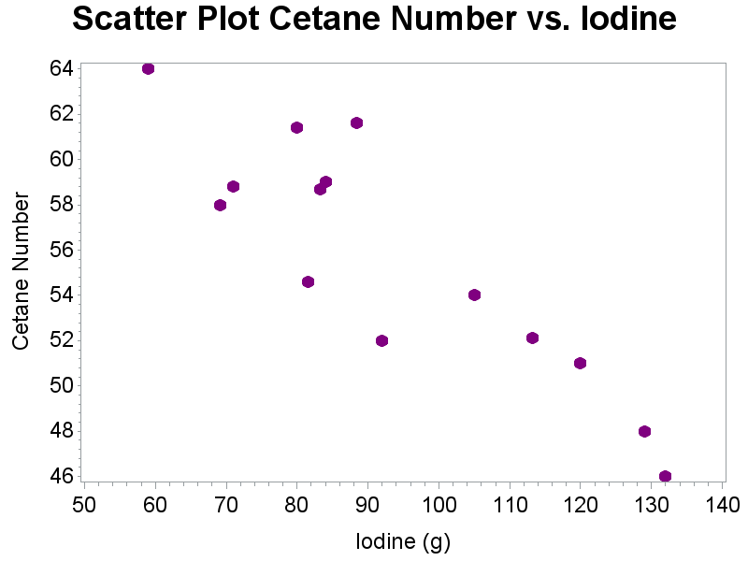
Example: SLR 1 - Scatterplot

Slide 39
Example: Linear Regression 1
The cetane number is a critical property in specifying the ignition quality of a fuel used in a diesel engine. Determination of this number for a biodiesel fuel is expensive and time-consuming. Therefore a way of predicting this number is wanted. The data on the next slide is x = iodine value (g) and y = cetane number for a sample of 14 biofuels. The iodine value is the amount of iodine necessary to saturate a sample of 100g of oil.
Verify the assumptions required for linear regression.
Determine the equation of the fitted line.
What is a point estimate of the true average cetane number whose iodine value is 100?
Estimate the value of σ.
What proportion of the observed variation in cetane number that can be attributed to the iodine value?

Slide 40
Example: SLR 1 – Fitted Line
x: | 132.0 | 129.0 | 120.0 | 113.2 | 105.0 | 92.0 | 84.0
y: | 46.0 | 48.0 | 51.0 | 52.1 | 54.0 | 52.0 | 59.0
x: | 83.2 | 88.4 | 59.0 | 80.0 | 81.5 | 71.0 | 69.2
y: | 58.7 | 61.6 | 64.0 | 61.4 | 54.6 | 58.8 | 58.0
S_{XX} = 6802.769 S_{XY} = -1424.41
y̅ = 55.657 x̅ = 93.393

Slide 41
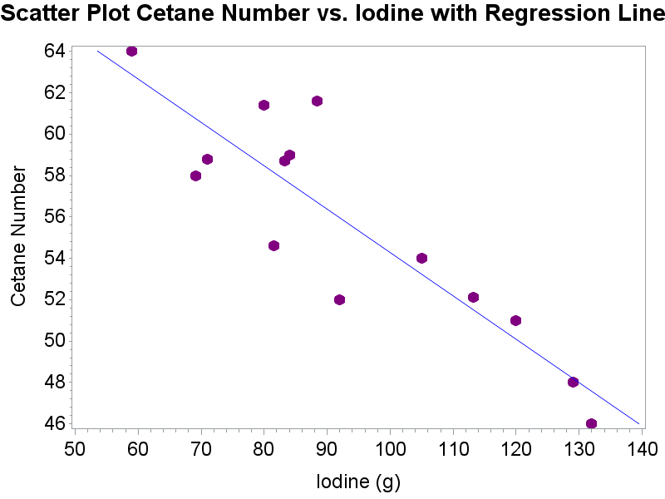
Example: SLR – fitted line

Slide 42
Example: Linear Regression 1
The cetane number is a critical property in specifying the ignition quality of a fuel used in a diesel engine. Determination of this number for a biodiesel fuel is expensive and time-consuming. Therefore a way of predicting this number is wanted. The data on the next slide is x = iodine value (g) and y = cetane number for a sample of 14 biofuels. The iodine value is the amount of iodine necessary to saturate a sample of 100g of oil.
Verify the assumptions required for linear regression.
Determine the equation of the fitted line.
What is a point estimate of the true average cetane number whose iodine value is 100?
Estimate the value of σ.
What proportion of the observed variation in cetane number that can be attributed to the iodine value?

Slide 43
Example: Linear Regression 1
The cetane number is a critical property in specifying the ignition quality of a fuel used in a diesel engine. Determination of this number for a biodiesel fuel is expensive and time-consuming. Therefore a way of predicting this number is wanted. The data on the next slide is x = iodine value (g) and y = cetane number for a sample of 14 biofuels. The iodine value is the amount of iodine necessary to saturate a sample of 100g of oil.
Verify the assumptions required for linear regression.
Determine the equation of the fitted line.
What is a point estimate of the true average cetane number whose iodine value is 100?
Estimate the value of σ.
What proportion of the observed variation in cetane number that can be attributed to the iodine value?

Slide 44
Example: SLR - 1
x: | 132.0 | 129.0 | 120.0 | 113.2 | 105.0 | 92.0 | 84.0
y: | 46.0 | 48.0 | 51.0 | 52.1 | 54.0 | 52.0 | 59.0
x: | 83.2 | 88.4 | 59.0 | 80.0 | 81.5 | 71.0 | 69.2
y: | 58.7 | 61.6 | 64.0 | 61.4 | 54.6 | 58.8 | 58.0
Analysis of Variance
Source | DF | Sum of Squares | Mean Square | F Value | Pr > F
Regression | 1 | 298.25443 | 298.25443 | 45.35 | <.0001
Error | 12 | 78.91986 | 6.57665
Corrected Total | 13 | 377.17429

Slide 45
Example: Linear Regression 1
The cetane number is a critical property in specifying the ignition quality of a fuel used in a diesel engine. Determination of this number for a biodiesel fuel is expensive and time-consuming. Therefore a way of predicting this number is wanted. The data on the next slide is x = iodine value (g) and y = cetane number for a sample of 14 biofuels. The iodine value is the amount of iodine necessary to saturate a sample of 100g of oil.
Verify the assumptions required for linear regression.
Determine the equation of the fitted line.
What is a point estimate of the true average cetane number whose iodine value is 100?
Estimate the value of σ.
What proportion of the observed variation in cetane number that can be attributed to the iodine value?

Slide 46
Example: SLR - 1
x: | 132.0 | 129.0 | 120.0 | 113.2 | 105.0 | 92.0 | 84.0
y: | 46.0 | 48.0 | 51.0 | 52.1 | 54.0 | 52.0 | 59.0
x: | 83.2 | 88.4 | 59.0 | 80.0 | 81.5 | 71.0 | 69.2
y: | 58.7 | 61.6 | 64.0 | 61.4 | 54.6 | 58.8 | 58.0
Analysis of Variance
Source | DF | Sum of Squares | Mean Square | F Value | Pr > F
Regression | 1 | 298.25443 | 298.25443 | 45.35 | <.0001
Error | 12 | 78.91986 | 6.57665
Corrected Total | 13 | 377.17429

Slide 47
Inference
Association
Intercept
b₀ is an unbiased estimator for β₀
slope
b₁ is an unbiased estimator for β₁

Slide 48
Assumptions
SRS
linearity
Constant standard deviation of residuals
Normality
If y is normal, then both b₀ and b₁ are normal
If y is not normal, there is still CLT

Slide 49
ANOVA table for Linear Regression
Source | df | SS | MS | F
Regression | 1 | Σ(ŷ_{i} - ȳ)²
Error | n – 2 | Σ(y_{i} - ŷ_{i})²
Total | n – 1 | Σ(y_{i} - ȳ)²

Slide 50
LR Hypothesis Test: Summary
H₀: there is no association between X and Y
H_{a}: there is an association between X and Y
Test statistic: F_{ts} $=\frac{MSR}{MSE}$
P-value: P = P(F > F_{ts}), df1 = dfr = 1, df2 = dfe = n - 2

Slide 51
Example: LR - Inference
The cetane number is a critical property in specifying the ignition quality of a fuel used in a diesel engine. Determination of this number for a biodiesel fuel is expensive and time-consuming. Therefore a way of predicting this number is wanted. The data on the next slide is x = iodine value (g) and y = cetane number for a sample of 14 biofuels. The iodine value is the amount of iodine necessary to saturate a sample of 100g of oil.
Perform the hypothesis test using the F test statistic (the model utility test)

Slide 52
Example: LR – Inference - ANOVA
Analysis of Variance
Source | DF | Sum of Squares | Mean Square | F Value | Pr > F
Model | 1 | 298.25443 | 298.25443 | 45.35 | <.0001
Error | 12 | 78.91986 | 6.57665
Corrected Total | 13 | 377.17429
Parameter Estimates
Variable | DF | Parameter Estimate | Standard Error | t Value | Pr > |t|
Intercept | 1 | 75.21243 | 2.98363 | 25.21 | <.0001
iodine | 1 | -0.20939 | 0.03109 | -6.73 | <.0001

Slide 53
Example: LR – Inference (cont)
The data does provide strong support (P = 2.09 x 10⁻⁵) to the claim that there is a linear relationship between iodine value and cetane number.

Slide 54
Standard deviation for b₁
$$b_{1}=\frac{\sum{\left[\left(x_{i}−\overline{x}\right)\left(y_{i}−\overline{y}\right)\right]}}{\sum{{\left(x_{i}−\overline{x}\right)}^{2}}}=\sum{a_{i}y_{i}}$$
$$σ_{b_{1}}=σ\sqrt{\sum{a_{i}^{2}}}=\frac{σ}{\sqrt{\sum{{(x_{i}−\overline{x})}^{2}}}}=\frac{σ}{\sqrt{S_{xx}}}$$
(Bonus on HW)
$${SE}_{b_{1}}=s_{b_{1}}=\frac{s}{\sqrt{\sum{{(x_{i}−\overline{x})}^{2}}}}=\frac{s}{\sqrt{S_{xx}}}=\sqrt{\frac{MSE}{S_{xx}}}$$

Slide 55
Confidence Interval for β₁
$b_{1}±t_{α/{2,df}}^{}{SE}_{b1}$ =
$$b_{1}±t_{α/{2,n−2}}^{}\sqrt{\frac{MSE}{S_{xx}}}$$

Slide 56
Example: SLR 1 - Inference
The cetane number is a critical property in specifying the ignition quality of a fuel used in a diesel engine. Determination of this number for a biodiesel fuel is expensive and time-consuming. Therefore a way of predicting this number is wanted. The data on the next slide is x = iodine value (g) and y = cetane number for a sample of 14 biofuels. The iodine value is the amount of iodine necessary to saturate a sample of 100g of oil.
What is the 95% Confidence Interval for the population slope?
Is there a useful linear relationship between iodine value and cetane number at a 5% significance level?

Slide 57
Example: SLR 1
x: | 132.0 | 129.0 | 120.0 | 113.2 | 105.0 | 92.0 | 84.0
y: | 46.0 | 48.0 | 51.0 | 52.1 | 54.0 | 52.0 | 59.0
x: | 83.2 | 88.4 | 59.0 | 80.0 | 81.5 | 71.0 | 69.2
y: | 58.7 | 61.6 | 64.0 | 61.4 | 54.6 | 58.8 | 58.0
Analysis of Variance
Source | DF | Sum of Squares | Mean Square | F Value | Pr > F
Model | 1 | 298.25443 | 298.25443 | 45.35 | <.0001
Error | 12 | 78.91986 | 6.57665
Corrected Total | 13 | 377.17429
b₁ = -0.209 S_{xx} = 6802.77

Slide 58
Example: SLR 1 – CI.
We are 95% confident that the population slope is between -0.277 and -0.141.

Slide 59
Example: SLR – fitted line

Slide 60
LR Hypothesis Test: Summary
Null hypothesis: H₀: β₁ = β₁₀
Test statistic: $\frac{b_{1}−β_{10}}{\sqrt{\frac{MSE}{S_{xx}}}}$
Note: A two-sided test with β₁₀ = 0 is the F test
 | Alternative Hypothesis | P-Value
Upper-tailed | H_{a}: β₁ > β₁₀ | P(T ≥ t)
Lower-tailed | H_{a}: β₁ < β₁₀ | P(T ≤ t)
two-sided | H_{a}: β₁ ≠ β₁₀ | 2P(T ≥ |t|)

Slide 61
Example: SLR 1 - Inference
The cetane number is a critical property in specifying the ignition quality of a fuel used in a diesel engine. Determination of this number for a biodiesel fuel is expensive and time-consuming. Therefore a way of predicting this number is wanted. The data on the next slide is x = iodine value (g) and y = cetane number for a sample of 14 biofuels. The iodine value is the amount of iodine necessary to saturate a sample of 100g of oil.
What is the 95% Confidence Interval for the population slope?
Is there a useful linear relationship between iodine value and cetane number at a 5% significance level?

Slide 62
Example: SLR 1
x: | 132.0 | 129.0 | 120.0 | 113.2 | 105.0 | 92.0 | 84.0
y: | 46.0 | 48.0 | 51.0 | 52.1 | 54.0 | 52.0 | 59.0
x: | 83.2 | 88.4 | 59.0 | 80.0 | 81.5 | 71.0 | 69.2
y: | 58.7 | 61.6 | 64.0 | 61.4 | 54.6 | 58.8 | 58.0
Analysis of Variance
Source | DF | Sum of Squares | Mean Square | F Value | Pr > F
Model | 1 | 298.25443 | 298.25443 | 45.35 | <.0001
Error | 12 | 78.91986 | 6.57665
Corrected Total | 13 | 377.17429
b₁ = -0.209 S_{xx} = 6802.77

Slide 63
Example: SLR 1 - HT
The data does provide strong support
(P = 2.13 x 10⁻⁵) to the claim that there is a linear relationship between iodine value and cetane number.

Slide 64
12.2 (Part B): Correlation - Goals
Be able to use (and calculate) the correlation to describe the direction and strength of a linear relationship.
Be able to recognize the properties of the correlation.
Be able to determine when (and when not) you can use correlation to measure the association.

Slide 65
Sample Correlation
The sample correlation, r, is measure of the strength of a linear relationship between two continuous variables.

Slide 66
Sample correlation, r (Pearson’s Sample Correlation Coefficient)
$$r=\frac{\sum{\left[\left(x_{i}−\overline{x}\right)\left(y_{i}−\overline{y}\right)\right]}}{\sqrt{\sum{{\left(x_{i}−\overline{x}\right)}^{2}}}\sqrt{\sum{{\left(y_{i}−\overline{y}\right)}^{2}}}}=\frac{S_{xy}}{\sqrt{S_{xx}S_{yy}}}=\frac{\sum{\left[\left(x_{i}−\overline{x}\right)\left(y_{i}−\overline{y}\right)\right]}}{(n−1)s_{x}s_{y}}=\frac{1}{n−1}\sum{\left[\left(\frac{x_{i}−\overline{x}}{s_{x}}\right)\left(\frac{y_{i}−\overline{y}}{s_{y}}\right)\right]}$$

Slide 67
Comments about Correlation
Correlation makes no distinction between explanatory and response variables.
$$r=\frac{\sum{\left[\left(x_{i}−\overline{x}\right)\left(y_{i}−\overline{y}\right)\right]}}{\sqrt{\sum{{\left(x_{i}−\overline{x}\right)}^{2}}}\sqrt{\sum{{\left(y_{i}−\overline{y}\right)}^{2}}}}=\frac{{SS}_{xy}}{\sqrt{SS_{xx}}\sqrt{{SS}_{yy}}}=\frac{\sum{\left[\left(x_{i}−\overline{x}\right)\left(y_{i}−\overline{y}\right)\right]}}{(n−1)s_{x}s_{y}}=\frac{1}{n−1}\sum{\left[\left(\frac{x_{i}−\overline{x}}{s_{x}}\right)\left(\frac{y_{i}−\overline{y}}{s_{y}}\right)\right]}$$
r has no units and does not change when the units of x and y change.

Slide 68
Properties of Correlation
r > 0 ==> positive association
r < 0 ==> negative association
r is always a number between -1 and 1.
The strength of the linear relationship increases as |r| moves to 1.
|r| = 1 only occurs if there is a perfect linear relationship
r = 0 ==> x and y are uncorrelated.

Slide 69
Positive/Negative Correlation

Slide 70
Example: Positive/Negative Correlation
1) Would the correlation between the age of a used car and its price be positive or negative? Why?
2) Would the correlation between the weight of a vehicle and miles per gallon be positive or negative? Why?

Slide 71
Properties of Correlation
r > 0 ==> positive association
r < 0 ==> negative association
r is always a number between -1 and 1.
The strength of the linear relationship increases as |r| moves to 1.
|r| = 1 only occurs if there is a perfect linear relationship
r = 0 ==> x and y are uncorrelated.

Slide 72
Variety of Correlation Values

Slide 73
Value of r

Slide 74
Properties of Correlation
r > 0 ==> positive association
r < 0 ==> negative association
r is always a number between -1 and 1.
The strength of the linear relationship increases as |r| moves to 1.
|r| = 1 only occurs if there is a perfect linear relationship
r = 0 ==> x and y are uncorrelated.

Slide 75
Variety of Correlation Values

Slide 76
Cautions about Correlation
Correlation requires that both variables be quantitative.
Correlation measures the strength of LINEAR relationships only.
The correlation is not resistant to outliers.
Correlation is not a complete summary of bivariate data.

Slide 77
Datasets with r = 0.816

Slide 78
Questions about Correlation
Does a small r indicate that x and y are NOT associated?
Does a large r indicate that x and y are linearly associated?

Slide 79
12.4: Regression Diagnostics - Goals
Be able to state which assumptions can be validated by which graphs.
Using the graphs, be able to determine if the assumptions are valid or not.
If the assumptions are not valid, use the graphs to determine what the problem is.
Using the graphs, be able to determine if there are outliers and/or influential points.
Be able to determine when (and when not) you can use linear regression and what you can use it for.

Slide 80
Assumptions for Linear Regression
SRS with the observations independent of each other.
The relationship is linear in the population.
The standard deviation of the response is constant.
The response, y, is normally distribution around the population regression line.

Slide 81
Scatterplot

Slide 82
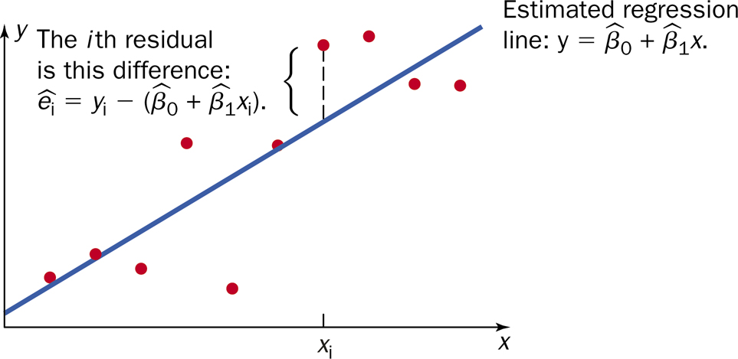
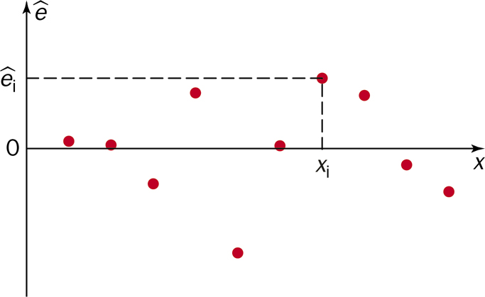
Concept of Residual Plot

Slide 83
Why a residual plot is useful?
It is easier to look at points relative to a horizontal line vs. a slanted line.
The scale is larger

Slide 84
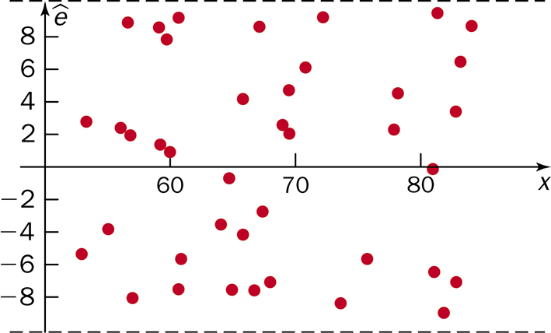
No Violations
If there are no violations in assumptions, scatterplot should look like a horizontal band around zero with randomly distributed points and no discernible pattern.

Slide 85
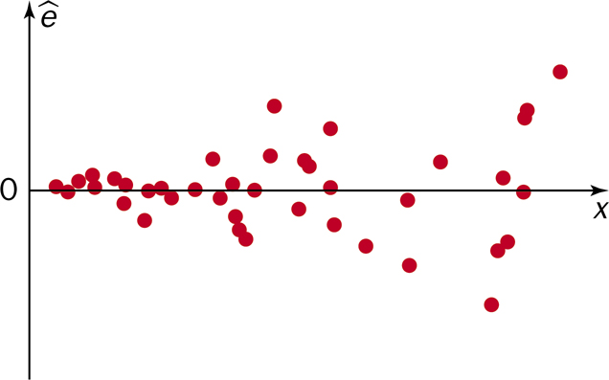
Non-constant variance

Slide 86
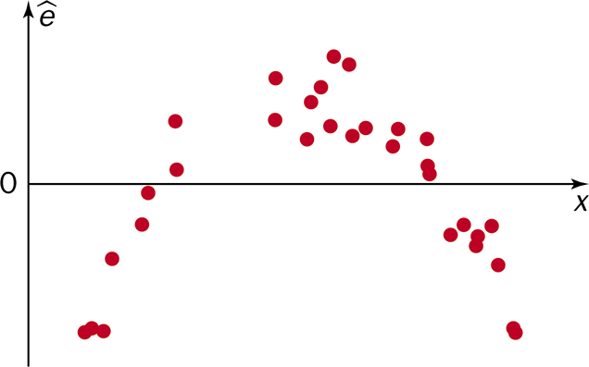
Non-linearity

Slide 87
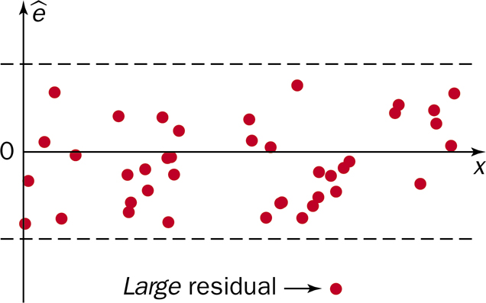
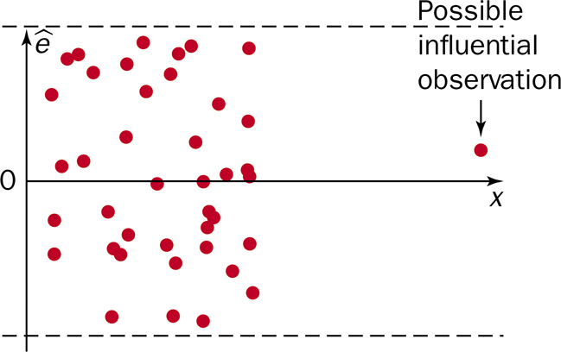
Outliers

Slide 88
Example: SLR 1 Scatterplot

Slide 89
Example: SLR 1 – Residual Plot

Slide 90
Example: SLR 1 – Normality

Slide 91
Assumptions/Diagnostics for Linear Regression
Assumption | Plots used for diagnostics
SRS | None
linear | Scatterplot, residual plot
Constant variance | Scatterplot, residual plot
Normality of residuals | QQ-plot, histogram of residuals

Slide 92
Cautions about Correlation and Regression:
Both describe linear relationship.
Both are affected by outliers.
Always PLOT the data.
Beware of extrapolation.
Beware of lurking variables
Correlation (association) does NOT imply causation!

Slide 93
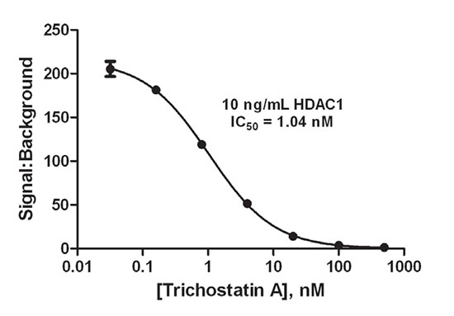
Cautions about Correlation and Regression: Extrapolation

Slide 94
Cautions about Correlation and Regression:
Both describe linear relationship.
Both are affected by outliers.
Always PLOT the data.
Beware of extrapolation.
Beware of lurking variables
Correlation (association) does NOT imply causation!

Slide 95
12.3: Inferences Concerning the Mean Value and an Observed Value of Y for x = x* - Goals
Be able to calculate the confidence interval for the mean value of Y for x = x*.
Be able to calculate the confidence interval for the observed value of Y for x = x* (prediction interval)
Be able to differentiate these two confidence intervals from each other and the confidence interval of the slope.

Slide 96
SE_{µ̂*}
$${SE}_{{\hat{μ}}^{∗}}=\sqrt{MSE\left[\frac{1}{n}+\frac{{\left(x^{∗}−\overline{x}\right)}^{2}}{S_{XX}}\right]}$$

Slide 97
Example: LR - Inference
The cetane number is a critical property in specifying the ignition quality of a fuel used in a diesel engine. Determination of this number for a biodiesel fuel is expensive and time-consuming. Therefore a way of predicting this number is wanted. The data on the next slide is x = iodine value (g) and y = cetane number for a sample of 14 biofuels. The iodine value is the amount of iodine necessary to saturate a sample of 100g of oil.
What is the 95% confidence interval for the cetane number with a iodine value of 100.
Predict the cetane number for the next sample of biofuel that contains an iodine value of 100 to a 95% confidence. (Find the 95% prediction interval with an iodine value of 100.)

Slide 98
Example: LR – Inference
Analysis of Variance
Source | DF | Sum of Squares | Mean Square | F Value | Pr > F
Model | 1 | 298.25443 | 298.25443 | 45.35 | <.0001
Error | 12 | 78.91986 | 6.57665
Corrected Total | 13 | 377.17429
μ̂ = 54.313
S_{xx} = 6802.77 x̅ = 93.393

Slide 99
Example: SLR (cont)
We are 95% confident that the population mean cetane number is between 52.754 and 55.872 with a iodine value of 100.

Slide 100
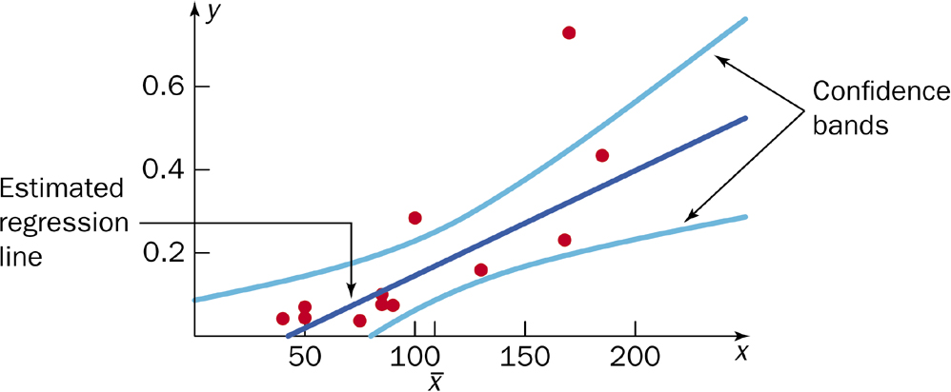
Confidence Bands

Slide 101
SE_{ŷ}
Variance Components of prediction value
Variance associate with the mean response
$${SE}_{\hat{μ}∗}=\sqrt{MSE\left[\frac{1}{n}+\frac{{\left(x^{∗}−\overline{x}\right)}^{2}}{S_{XX}}\right]}$$
Variance associated with the observation
$${SE}_{\hat{y}∗}=\sqrt{MSE\left[1+\frac{1}{n}+\frac{{\left(x^{∗}−\overline{x}\right)}^{2}}{S_{XX}}\right]}$$

Slide 102
Example: LR - Inference
The cetane number is a critical property in specifying the ignition quality of a fuel used in a diesel engine. Determination of this number for a biodiesel fuel is expensive and time-consuming. Therefore a way of predicting this number is wanted. The data on the next slide is x = iodine value (g) and y = cetane number for a sample of 14 biofuels. The iodine value is the amount of iodine necessary to saturate a sample of 100g of oil.
What is the 95% confidence interval for the cetane number with a iodine value of 100.
Predict the cetane number for the next sample of biofuel that contains an iodine value of 100 to a 95% confidence. (Find the 95% prediction interval with an iodine value of 100.)

Slide 103
Example: LR – Inference
Analysis of Variance
Source | DF | Sum of Squares | Mean Square | F Value | Pr > F
Model | 1 | 298.25443 | 298.25443 | 45.35 | <.0001
Error | 12 | 78.91986 | 6.57665
Corrected Total | 13 | 377.17429
μ̂ = 54.313
S_{xx} = 6802.77 x̅ = 93.393

Slide 104
Example: SLR (cont)
We are 95% confident that the next cetane number is between 48.512 and 60.114 when the iodine value is 100.
Mean response: (52.754, 55.872)
Prediction interval: (48.512. 60.114)

Slide 105
Example: Confidence/Prediction Band

Slide 106
Multiple Regression: Examples 1
A portrait studio operates in cities of medium size and specializes in portraits of children. They want to open a store in a other similar community, but want to be able to predict sales.
So that only students that succeed are accepted into college, the registrar’s office wants to be able to predict GPA from entering high school students.
A researcher studied the effects of the charge rate and the temperature on the life of a new type of power cell in a preliminary small-scale experiment.

Slide 107
Multiple Regression: Examples 2
An experiment was run to investigate the yield of tomato plants as a function of the amount of water levels. A series of plots were randomized to different water levels and at the end of the season, the yield of the plants was determined.
Fernandez-Juricic et al. (2003) examined the effect of human disturbance on the nesting of house sparrows (Passer domesticus). They counted breeding sparrows per hectare in 18 parks in Madrid, Spain, and also counted the number of people per minute walking through each park (both measurement variables).

