Slide 1
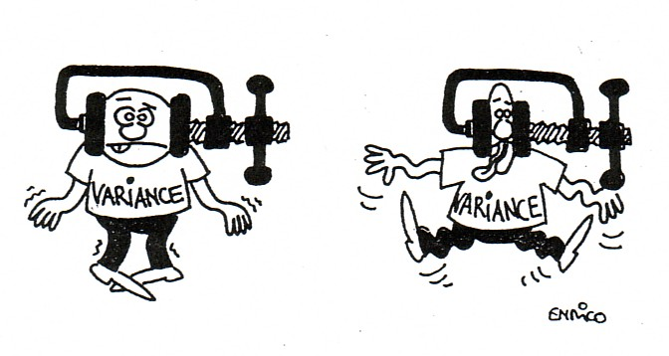
Chapter 11: The ANalysis Of Variance (ANOVA)
http://www.luchsinger-mathematics.ch/Var_Reduction.jpg

Slide 2
11.1: One-Way ANOVA - Goals
Provide a description of the underlying idea of ANOVA (how we use variance to determine if means are different)
Be able to construct the ANOVA table.
Be able to perform the significance test for ANOVA and interpret the results.
Be able to state the assumptions for ANOVA and use diagnostics plots to determine when they are valid or not.

Slide 3
ANOVA: Terms
Factor: What differentiates the populations
Level or group: the number of different populations, k
One-way ANOVA is used for situations in which there is only one factor, or only one way to classify the populations of interest.
Two-way ANOVA is used to analyze the effect of two factors.

Slide 4
Examples: ANOVA
In each of the following situations, what is the factor and how many levels are there?
Do five different brands of gasoline have an effect on automobile efficiency?
Does the type of sugar solution (glucose, sucrose, fructose, mixture) have an effect on bacterial growth?
Does the hardwood concentration in pulp (%) have an effect on tensile strength of bags made from the pulp?
Does the resulting color density of a fabric depend on the amount of dye used?

Slide 5
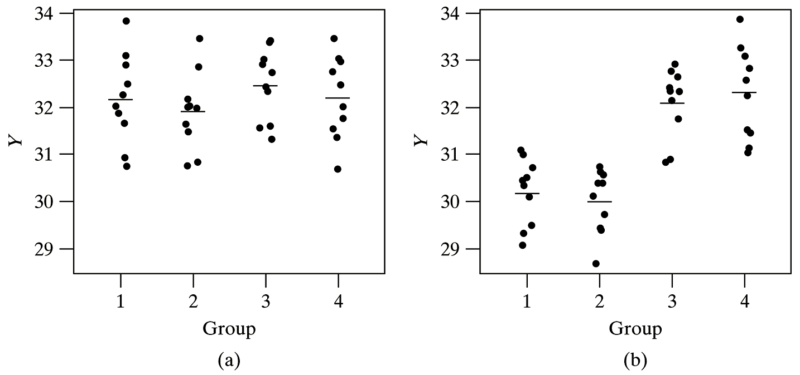
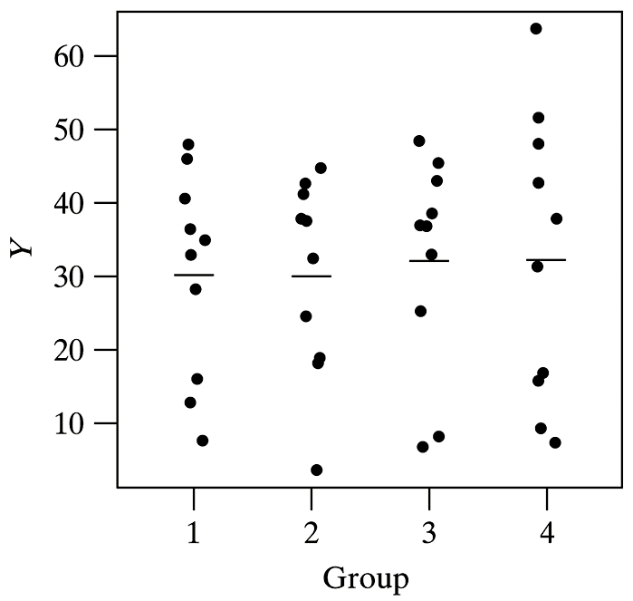
ANOVA: Graphical
c)

Slide 6
Notation

Slide 7
Examples: ANOVA
What are H₀ and H_{a} in each case?
Do five different brands of gasoline have an effect on automobile efficiency?
Does the type of sugar solution (glucose, sucrose, fructose, mixture) have an effect on bacterial growth?

Slide 8
Assumptions for ANOVA
We have k independent SRSs, one from each population. We measure the same response variable for each sample.
The ith population has a Normal distribution with unknown mean μ_{i}.
All the populations have the same variance σ², whose value is unknown.

Slide 9
ANOVA: model
x_{ij}
i: group or level
k: the total number of levels
j: object number in the group
n_{i}: total number of objects in group i
μ_{i}
X_{ij} = μ_{I} + ε_{ij}
DATA = FIT + RESIDUAL
ε_{ij} ~ N(0,σ²)

Slide 10
ANOVA: model (cont)
$${\overline{x}}_{i}.=\frac{\sum_{j=1}^{n_{i}}{x_{ij}}}{n_{i}}$$
$$s_{i}^{2}=\frac{\sum_{j=1}^{n_{i}}{{\left(x_{ij}−{\overline{x}}_{i}\right)}^{2}}}{n_{i}−1}=\frac{{SS}_{x}}{df}$$
$$n=\sum_{i=1}^{k}{n_{i}}$$
$$\overline{x}..=\frac{\sum_{i=1}^{k}{\sum_{j=1}^{n_{i}}{x_{ij}}}}{n}$$

Slide 11
ANOVA test statistic

Slide 12
ANOVA test

Slide 13
ANOVA test
Analysis of variance compares the variation due to specific sources with the variation among individuals who should be similar. In particular, ANOVA tests whether several populations have the same means by comparing how far apart the sample means are with how much variation there is within a sample.

Slide 14
Formulas for Variances
$$Var=\frac{{SS}_{X}}{n−1}=\frac{SS}{df}=MS$$
SS: Sum of squares
MS: mean square

Slide 15
Model or Between Sample Variance
SSM (SS for model) or SSG (SS for group) or
SSA (SS for factor A): between samples
$$SSA=\sum_{i=1}^{k}{\sum_{j=1}^{n_{i}}{{({\overline{x}}_{i.}−\overline{x}..)}^{2}}}=\sum_{i=1}^{k}{n_{i}{({\overline{x}}_{i.}−\overline{x}..)}^{2}}$$
dfa = k – 1
$$MSA=\frac{SSA}{dfa}=\frac{\sum_{i=1}^{I}{n_{i}{({\overline{x}}_{i.}−\overline{x}..)}^{2}}}{k−1}$$

Slide 16
Within Sample Variance
SSE (SS for error) or SSR (SS for residuals): within groups
$$SSE=\sum_{i=1}^{k}{\sum_{j=1}^{n_{i}}{{\left(x_{ij}−{\overline{x}}_{i}.\right)}^{2}}=\sum_{i=1}^{k}{\left(n_{i}−1\right)s_{i}^{2}}}$$
dfe = n – k
$$MSE=\frac{SSE}{dfe}=\frac{\sum_{i=1}^{I}{\left(n_{i}−1\right)s_{i}^{2}}}{n−k}$$

Slide 17
Total Variance
SST (SS for total)
$$SST=\sum_{i=1}^{k}{\sum_{j=1}^{n_{i}}{{(x_{ij}−\overline{x}..)}^{2}}}$$
dft = n – 1
SST = SSE + SSA (HW Bonus)
dft = dfe + dfa

Slide 18
F Distribution
http://www.vosesoftware.com/ModelRiskHelp/index.htm#Distributions/
Continuous_distributions/F_distribution.htm

Slide 19
P-value for an upper-tailed F test
shaded area=P-value = 0.05

Slide 20
ANOVA Table: Formulas
Source | df | SS | MS (Mean Square) | F
Factor A (between) | k – 1
Error (within) | n – k
Total | n – 1
$$s=\sqrt{MSE}$$

Slide 21
ANOVA Hypothesis test: Summary
H₀: μ₁ = μ₂ = ⋅⋅⋅ = μ_{k}
H_{a}: At least two μ_{i}’s are different
Test statistic:
P-value: P(F ≥ F_{ts}) has a F_{α,dfa,dfe} distribution

Slide 22
t test vs. F test
$$t_{ts}^{2}=F_{ts}$$
2-sample independent | ANOVA
Same or different σ² | Same σ²
1 or 2 tailed | Only 2 tailed
Δ₀ ∈ real number | Δ₀ = 0
Only 2 levels | More than 2 levels

Slide 23
ANOVA: Example
A random sample of 15 healthy young men are split randomly into 3 groups of 5. They receive 0, 20, and 40 mg of the drug Paxil for one week. Then their serotonin levels are measured to determine whether Paxil affects serotonin levels. The data is on the next slide.
Does Paxil affect serotonin levels in healthy young men at a significance level of 0.05?

Slide 24
ANOVA: Example (cont).
Dose | 0 mg | 20 mg | 40 mg
 | 48.62 | 58.60 | 68.59
 | 49.85 | 72.52 | 78.28
 | 64.22 | 66.72 | 82.77
 | 62.81 | 80.12 | 76.53
 | 62.51 | 68.44 | 72.33

Slide 25
ANOVA: Example (cont).
Dose | 0 mg | 20 mg | 40 mg
 | 48.62 | 58.60 | 68.59
 | 49.85 | 72.52 | 78.28
 | 64.22 | 66.72 | 82.77
 | 62.81 | 80.12 | 76.53
 | 62.51 | 68.44 | 72.33 | overall
n_{i} | 5 | 5 | 5 | 15
x̅_{i} | 57.60 | 69.28 | 75.70 | 67.53
s_{i} | 7.678 | 7.895 | 5.460

Slide 26
ANOVA: Example (cont)
1. Let μ₁ be the population mean serotonin level for men receiving 0 mg of Paxil.
Let μ₂ be the population mean serotonin level for men receiving 20 mg of Paxil.
Let μ₃ be the population mean serotonin level for men receiving 40 mg of Paxil.

Slide 27
ANOVA: Example (cont)
2. H₀: μ₁ = μ₂ = μ₃
The mean serotonin levels are the same at all 3 dosage levels [or, The mean serotonin levels are unaffected by Paxil dose]
H_{A}: at least two μ_{i}’s are different
The mean serotonin levels of the three groups are not all equal. [or, The mean serotonin levels are affected by Paxil dose]

Slide 28
ANOVA: Example (cont). (NOT USED)
Dose | 0 mg | 20 mg | 40 mg
 | 48.62 | 58.60 | 68.59
 | 49.85 | 72.52 | 78.28
 | 64.22 | 66.72 | 82.77
 | 62.81 | 80.12 | 76.53
 | 62.51 | 68.44 | 72.33 | overall
n_{i} | 5 | 5 | 5 | 15
x̅_{i} | 57.60 | 69.28 | 75.70 | 67.53
s_{i} | 7.678 | 7.895 | 5.460
(n_{i}-1)s_{i}² | 235.78 | 249.32 | 119.24 | 604.34
n_{i}(x̅_{i} - x̅̅)² | 492.56 | 15.36 | 333.96 | 841.88
X

Slide 29
ANOVA: Example (cont)
Source
df
SS
MS
F
P
-
Value
A
2
841.88
420.94
8.36
0.005321
Error
12
604.34
50.36
Total
14
1446.23

Slide 30
Example: ANOVA (cont)
This data does give strong support (P = 0.005321) to the claim that there is a difference in serotonin levels among the groups of men taking 0, 20, and 40 mg of Paxil.
This data does give strong support (P = 0.005321) to the claim that Paxil intake affects serotonin levels in young men.

Slide 31
11.2: Comparing the Means - Goals
State why you have to use multi-comparison methods vs. 2-sample t procedures.
Be able to state when the Bonferroni method should be done and generally state the method.
Be able to state when the Tukey method should be done and perform the method.
Be able to state when the Dunnett method should be done.
Be able to draw conclusions from the results of the multi-comparison method.

Slide 32
Advantages/Problems of ANOVA (more than 2 samples)
Advantages
Single test
Better estimation of error
Disadvantages
Which groups are different?

Slide 33
Which mean(s) is different?
Graphics
Multiple comparisons
No prior knowledge

Slide 34
Problems with multiple pairwise t-tests
Type I error
Estimation of the standard deviation
Structure in the groups

Slide 35
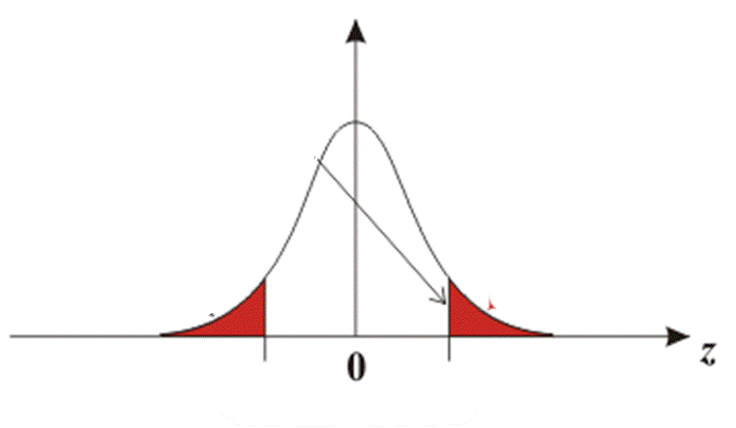
Problem with Multiple t tests

Slide 36
Overall Risk of Type I Error in Using Repeated t Tests at α = 0.05

Slide 37
Problems with multiple pairwise t-tests
Type I error
Estimation of the standard deviation
Structure in the groups

Slide 38
Simultaneous Confidence Intervals
$${\overline{x}}_{i.}−{\overline{x}}_{j.}±t_{column,df}^{}∙SE$$
$${\overline{x}}_{i.}−{\overline{x}}_{j.}±t_{column,df}^{∗∗}∙\sqrt{MSE\left(\frac{1}{n_{i}}+\frac{1}{n_{j}}\right)}$$
$${\overline{x}}_{i.}−{\overline{x}}_{j.}±t_{column,df}^{∗∗}∙\sqrt{\frac{2MSE}{n_{i}}}$$

Slide 39
Multiple Comparison Methods
LSD (Fishers)
Bonferroni
Tukey
Dunnet

Slide 40
Bonferroni Method
$$t_{column,dfe}^{∗∗}= t_{∝/{2c,n−k}}^{}$$
Problems
Type I error is usually much less than expected.
If c is large, every difference becomes significant.
If we repeated this experiment many times, in 95% of these repetitions each and every of the c confidence intervals would capture the corresponding difference.

Slide 41
I am a Turkey, not Tukey!
Thank you for not eating
me!

Slide 42
Other Methods
Tukey
$$t_{column,df}^{∗∗}=\frac{Q_{α,k,n−k}}{\sqrt{2}}$$
Used if all pairwise comparisons are used.
Dunnett
Only used if there is a control
$$t_{column,df}^{∗∗}=d_{α,k,n−k}^{}$$

Slide 43
Procedure: Multiple Comparison
Perform the ANOVA test (obtain the ANOVA table); only continue if the results are statistically significant.
Select a family significance level, α.
Select the multiple comparison methodology.
Calculate t**.
Calculate all of the confidence intervals required by the procedure.
Determine which ones are statistically significant.
Visually display the results.
Write a conclusion in the context of the problem.

Slide 44
Example: Multiple Comparison
A random sample of 15 healthy young men are split randomly into 3 groups of 5. They receive 0, 20, and 40 mg of the drug Paxil for one week. Then their serotonin levels are measured to determine whether Paxil affects serotonin levels.
Which dosage would provide the largest change in serotonin levels?

Slide 45
Example: Multiple Comparison (cont)
Dose | 0 mg | 20 mg | 40 mg
 | 48.62 | 58.60 | 68.59
 | 49.85 | 72.52 | 78.28
 | 64.22 | 66.72 | 82.77
 | 62.81 | 80.12 | 76.53
 | 62.51 | 68.44 | 72.33
x̅_{i} | 57.60 | 69.28 | 75.70
Source | df | SS | MS | F | P-Value
Model | 2 | 841.88 | 420.94 | 8.36 | 0.005321
Error | 12 | 604.34 | 50.36
Total | 14 | 1446.23

Slide 46
Example: Multiple Comparison: Dunnett
t** = 2.50
Therefore, dosages of both 20 mg and 40 mg of Paxil do raise serotonin levels.
i - j | x̅_{i.} - x̅_{j.} | interval
2 – 1 | 69.28 – 57.60 = 11.68 | (0.46, 22.9)
3 - 1 | 75.70 – 57.60 = 18.1 | (6.88, 29.32)
0 mg (control) | 20 mg | 40 mg
57.60 | 69.28 | 75.70
 | different from control | different from control

Slide 47
Example: Multiple Comparison (cont)
Dose | 0 mg | 20 mg | 40 mg
 | 48.62 | 58.60 | 68.59
 | 49.85 | 72.52 | 78.28
 | 64.22 | 66.72 | 82.77
 | 62.81 | 80.12 | 76.53
 | 62.51 | 68.44 | 72.33
x̅_{i} | 57.60 | 69.28 | 75.70
Source | df | SS | MS | F | P-Value
Model | 2 | 841.88 | 420.94 | 8.36 | 0.005321
Error | 12 | 604.34 | 50.36
Total | 14 | 1446.23

Slide 48
Example: Multiple Comparison: Tukey
i - j | x̅_{i.} - x̅_{j.} | interval
2 – 1 | 69.28 – 57.60 = 11.68 | (-0.285, 23.645)
3 - 1 | 75.70 – 57.60 = 18.1 | (6.135, 30.065)
3 – 2 | 75.70 – 69.28 = 6.42 | (-5.545, 18.385)
Therefore, 40 mg dosage of Paxil does raise serotonin levels, but a 20 mg dosage of Paxil does not raise serotonin levels.
0 mg (control) | 20 mg | 40 mg
57.60 | 69.28 | 75.70

