Slide 1
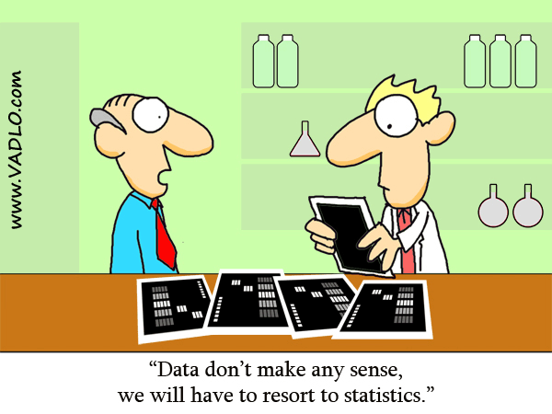
Chapter 0: Why Study Statistics? Chapter 1: An Introduction to Statistics and Statistical Inference
http://vadlo.com/cartoons.php?id=71

Slide 2
0,1: Introduction: Goals
Create your own definition of statistics.
State some applications of Statistics for your field.
State the branches of statistics and briefly describe each one.
Define: Population, sample, variable
Differentiate between probability and statistics.
Be able to solve word problems in statistics.

Slide 3
What is Statistics
Statistics is the science of collecting and interpreting data.
Components
Collection
Organization
Analysis
Interpretation

Slide 4
Applications of Statistics
Computer Science
client-server performance image processing
Chemistry/Physics
determining outliers in your data
linear regression propagation of error
dealing with large populations and approximations
Engineering
is one process/technique better than another one?
Business
Making good decisions
Everyday life
Medical information
Average cell phone usage of Purdue students

Slide 5
Branches of Statistics
Collection of data
Descriptive Statistics
Graphical and numerical methods used to describe, organize, and summarize data.
Inferential Statistics
Techniques and methods used to analyze a small, specific set of data in order to draw a conclusion about a large, more general collection of data.

Slide 6
Inferential Statistics
Claim
Status Quo
Experiment
Check claim
Likelihood
How likely is the experimental result consistent with the claim?
Conclusion
The outcome is reasonable
The outcome is rare.

Slide 7
Definitions
A population is the entire collection of individuals or objects to be considered or studied.
A sample is a subset of the entire population, a small selection of individuals or objects taken from the entire collection.
A variable is a characteristic of an individual or object in a population of interest.
Qualitative (categorical)
Quantitative (numerical)

Slide 8
Probability vs. Statistics

Slide 9
Solution Trail
Find the keywords.
Correctly translate these words in statistics.
Determine the applicable concepts.
Develop a vision, or strategy, for the solution.
Solve the problem.

