Slide 1
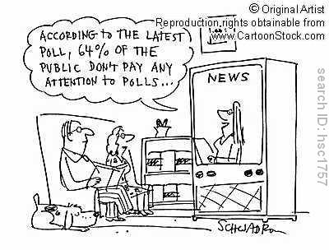
Producing Data
http://www.cartoonstock.com/directory/d/data_gathering.asp

Slide 2
Sources of Data - Goals
Identify anecdotal data in a specific situation and explain why we should not use this type of data.
Define what is meant by available data.
Distinguish between experiments and observational studies.

Slide 3
Anecdotal Data
Anecdotal data represent individual cases that often come to our attention because they are striking in some way.
A woman who was deaf from birth was hit by lightning and regained her hearing. Does this mean that lightning is a cure for deafness?

Slide 4
Available Data
Available data are data that were produced in the past for some other purpose but that may help answer a present question inexpensively. The library and the Internet are sources of available data.

Slide 5
Observational Studies and Experiments
In an experimental study, we investigate the effects of certain conditions on individuals or objects in the sample.
In an observational study, we observe the response for a specific variable for each individual or object.

Slide 6
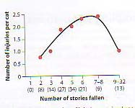
Observational Data
In an article published in the Journal of the American Veterinary Medical Association, Whitney and Mehlaff (1987) presented results on the injury rates of cats that had plummeted from buildings in New Your City according to the number of floors that they had fallen. The researches merely recorded the number of injuries from the cats that were brought into the vet. No cats were thrown from the windows – the cats did it to themselves!
The Analysis of Biological Data, Whitlock, Schluter, 2009, Roberts and Company, p. 3

Slide 7
Designing Experiments and Observational Studies - Goals
In experiments, identify the units or subjects, treatments or factors and outcomes.
Identify a comparative experiment and explain why they are used.
Be able to apply the basic principles of experimental design: compare, randomize and repeat.
Be able to identify common problems in design:
Bias
Over generalization
Be able to identify matched pairs design and block design and explain why they are used.

Slide 8
Terms used in experiments
Experimental units
Treatment or factor
Level
Outcome
Statistically significant
An observed effect so large that it would rarely occur by chance.

Slide 9
Example: Terminology of Experimental Design
For each of the following, define the experimental unit, factor, levels, response variable and what would be statistically significant.
In a study of cell phone usage by college students, we want to know how much time is being spent on different types of apps on the phones.
In a study of sickle cell anemia, 150 patients were given the drug hydroxyurea, and 150 were given a placebo (dummy pill). The researchers counted the episodes of pain in each subject.

Slide 10
Principles of Experimental Design
Control: Compare two or more treatments.
Randomize: use chance to assign experimental units to treatments.
Replication: Use enough experimental units in each group to reduce chance variation in the results.

Slide 11
Comparative Experiments
Experimental units
Treatment
Measure response
Control
Measure response
Compare results
Experimental units
Treatment
Measure response

Slide 12
Bias
The design of a study is biased if it systematically favors certain outcomes.
An investigator is interested if the size of fish versus the size of the lake that they are in. A number of lakes are chosen in a particular area and the investigator uses nets to catch the fish.

Slide 13
Principles of Experimental Design
Control: Compare two or more treatments,
Randomize: use chance to assign experimental units to treatments.
Replication: Use enough experimental units in each group to reduce chance variation in the results.

Slide 14
Randomized Experiments
In a completely randomized design, the treatments are assigned to all the experimental units completely by chance.
Group 1
Treatment 1
Compare results
Experimental units
Random assignment
Group 2
Treatment 2

Slide 15
Randomization
Label each of the N individuals.
Put the N numbers into a hat.
Draw the numbers one at a time until you have n individuals.

Slide 16
Principles of Experimental Design
Control: Compare two or more treatments,
Randomize: use chance to assign experimental units to treatments.
Replication: Use enough experimental units in each group to reduce chance variation in the results.

Slide 17
Cautions about Experimentation
Bias
Generalization

Slide 18
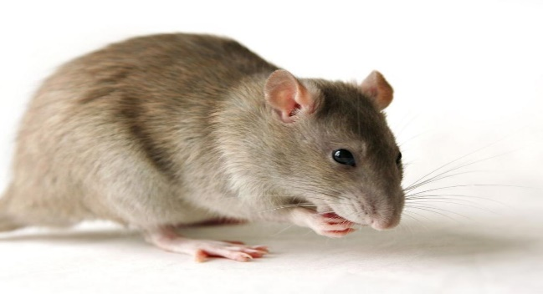
Lack of Realism
Is studying the effects of eating red meat on cholesterol values in a group of middle aged men a realistic way to study factors affecting heart disease problems in humans?
Is studying the effects of hair spray on rats a realistic way to determine what will happen to women with large amounts of hair?

Slide 19
Other Designs
A matched pair design is when each experimental unit is matched with another one.
A block is a group of experimental units that are similar.
In a block design, the random assignment of experimental units to treatments is carried out within each block.
Control what you can, block what you can’t control, and randomize to create comparable groups.

Slide 20
Sampling Design - Goals
Be able to determine and explain when a probability sample, simple random sample or a stratified random sample is the preferred method.
Be able to state when there is a response bias with obtaining a sample: convenience sample, nonresponse

Slide 21
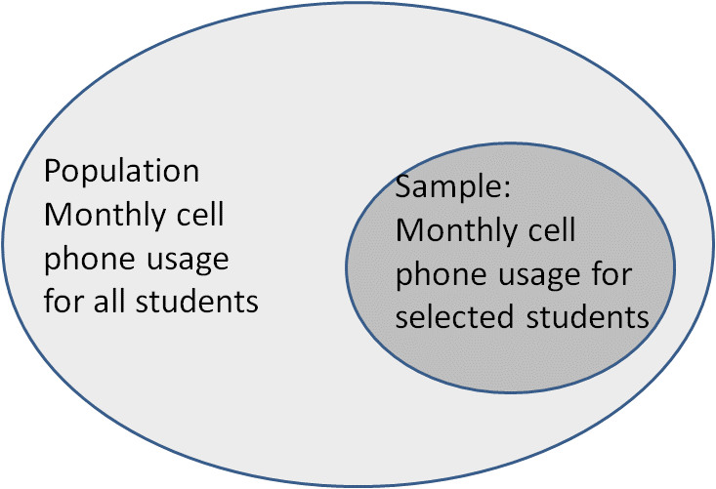
Population and Sample
Population: the entire group of objects that we want information about.
Sample: the part (subset) of the population that we actual examine.

Slide 22
Sampling Methods
Probability Sample
Simple Random Sample (SRS)
Stratified Random Sample

Slide 23
SRS
A (simple) random sample (SRS) of size n is a sample selected in such a way that every possible sample of size n has the same chance of being selected.
Method
Label every object from 1 to n.
Generate random numbers to select the objects.
You are done when you have selected n different objects.

Slide 24
Stratified Random Samples
Procedure
Divide the population into groups into strata.
Choose a SRS fro each group.

Slide 25
Response Bias
Convenience sample
Undercoverage
Nonresponse
Your random sample needs to be representative of the population.

Slide 26
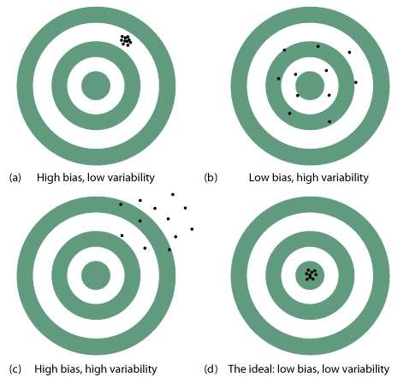
Bias vs. Variability

Slide 27
Managing Bias and Variability
To reduce bias, use random sampling.
To reduce variability of a statistic from an SRS, use a larger sample

Slide 28
Statistical Inference
Sample has to be representative of the population
Randomize
The experiment has to be performed in such a way that you can obtain the data that you are interested in.
Perform the correct analysis.

Slide 29
Causality
http://www.forbes.com/sites/erikaandersen/2012/03/23
/true-fact-the-lack-of-pirates-is-causing-global-warming/

Slide 30
Causality - Goals
Be able to determine if a variable is lurking or confounding.
Be able to explain an association in terms of
Causation
Common response
Confounding variables
Apply the criteria for establishing causation.
Association and causation are NOT the same thing.
Interpret examples in terms of Simpson’s paradox.

Slide 31
Causality
A lurking variable is a variable that is not among the explanatory or response variables in a study but that may influence the variables in the study.
Confounding occurs when two variables are associated in such a way that their effects on a response variable cannot be distinguished from each other.

Slide 32
Lurking Variables
In each case, what is the lurking variable?
1. For children, there is an extremely strong correlation between shoe size and math scores.
2. There is a very strong correlation between ice cream sales and number of deaths by drowning.
3. There is very strong correlation between number of churches in a town and number of bars in a town.

Slide 33
Lurking Variable?
http://www.forbes.com/sites/erikaandersen/2012/03/23
/true-fact-the-lack-of-pirates-is-causing-global-warming/

Slide 34
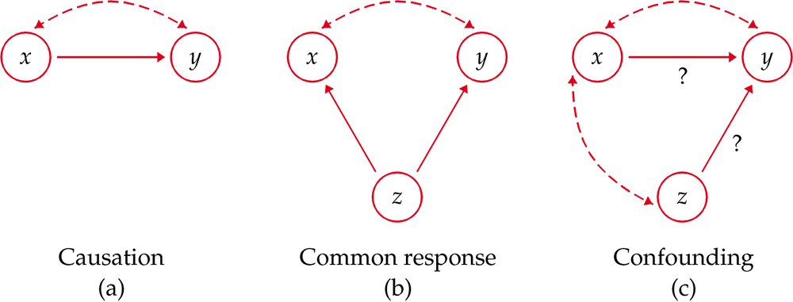
Causation
Association does not mean causation!

Slide 35
Establishing Causation
Perform an experiment!
What do we need for causation?
The association is strong.
The association is consistent.
The connection happens in repeated trials
The same connection happens under varying conditions
Alleged cause precedes the effect.
The alleged cause is plausible.

Slide 36
Simpson’s Paradox
An association or comparison that holds for all of several groups can reverse direction when the data are combined to form a single group. This reversal is called Simpson’s paradox.

Slide 37
Simpson’s Paradox
Consider the acceptance rates for the following groups of men and women who applied to college.
Counts | Accepted | Not accepted | Total
Men | 198 | 162 | 360
Women | 88 | 112 | 200
Total | 286 | 274 | 560
Percents | Accepted | Not accepted
Men | 55% | 45%
Women | 44% | 56%

Slide 38
Simpson’s Paradox
Business School
Art School
Counts | Accepted | Not accepted | Total
Men | 18 | 102 | 120
Women | 24 | 96 | 120
Total | 42 | 198 | 240
Percents | Accepted | Not accepted
Men | 15% | 85%
Women | 20% | 80%
Counts | Accepted | Not accepted | Total
Men | 180 | 60 | 240
Women | 64 | 16 | 80
Total | 244 | 76 | 320
Percents | Accepted | Not accepted
Men | 75% | 25%
Women | 80% | 20%

Slide 39
Provide All the Critical Information
Papers reporting scientific research are supposed to be short, with no extra baggage. Brevity, however, can allow researchers to avoid complete honesty about their data. Did they choose their subjects in a biased way? Did they report data on only some of their subjects? Did they try several statistical analyses and report only the ones that looked best? The statistician John Bailar screened more than 4000 medical papers in more than a decade as consultant to the New England Journal of Medicine. He says, “When it came to the statistical review, it was often clear that critical information was lacking, and the gaps nearly always had the practical effect of making the authors’ conclusions look stronger than they should have.” The situation is no doubt worse in fields that screen published work less carefully.

Slide 40
In-class discussion on Data Ethics Should we allow this personal information to be collected?
A government agency takes a random sample of income tax returns to obtain information on the average income of people in different occupations. Only the incomes and occupations are recorded from the returns, not the names.
A social psychologist attends public meetings of a religious group to study the behavior patterns of members,
A social psychologist pretends to be converted to membership in a religious group and attends private meetings to study the behavior patterns of members.

