Slide 1
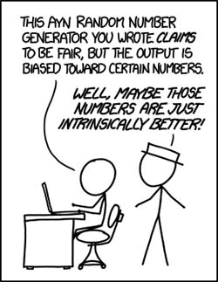
Part II: Discrete Random Variables
http://neveryetmelted.com/categories/mathematics/

Slide 2
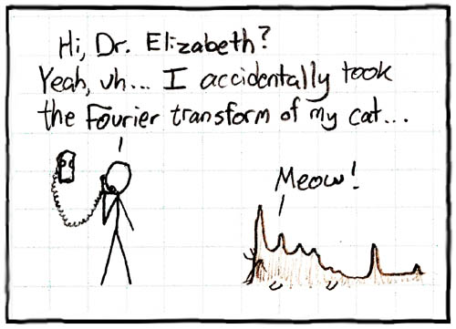
Chapter 7: Random Variables; Discrete Versus Continuous
http://math.sfsu.edu/beck/quotes.html

Slide 3
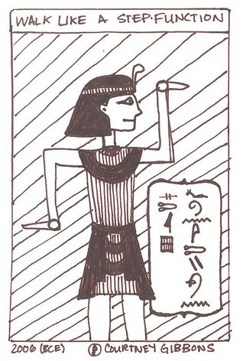
Chapter 8: Probability Mass Functions and Cumulative Distribution Functions
The 50-50-90 rule: Anytime
You have a 50-50 chance of
getting something right,
there’s a 90% probability
you’ll get it wrong.
Andy Rooney
http://brownsharpie.courtneygibbons.org/?p=161

Slide 4
Chapter 8: Jointly Distributed Random Variables; Independence and Conditioning
The most misleading assumptions are the ones you don’t even know you’re making.
Douglas Adams and Mark Carwardine
http://math.stackexchange.com/questions/314072/joint-probability-mass-function
X

Slide 5
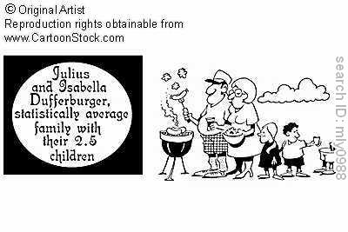
Chapters 9: Expected Values of Discrete Random Variables
http://www.cartoonstock.com/directory/a/average_family_gifts.asp
X

Slide 6
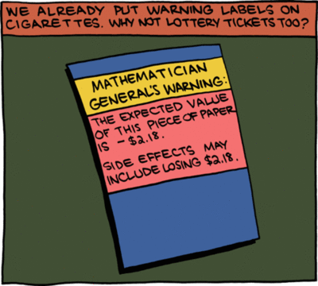
Chapter 10: Expected Values of Sums of Random Variables
http://faculty.wiu.edu/JR-Olsen/wiu/stu/m206/front.htm
X

Slide 7
Theorem 11.3: Expected value of an indicator random variable
If X is an indicator random variable for event A, i.e., X = 1 if event A occurs and X = 0 otherwise, then the expected value of X is equal to the probability that event A occurs:
$𝔼$(X) = P(A)

Slide 8
Chapter 11: Expected Values of Functions of Discrete Random Variables; Variance of Discrete Random Variables
http://fightingdarwin.blogspot.com/2011_12_01_archive.html
X

