Slide 1
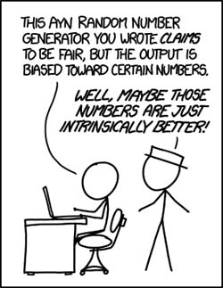
Part II: Discrete Random Variables
http://neveryetmelted.com/categories/mathematics/

Slide 2
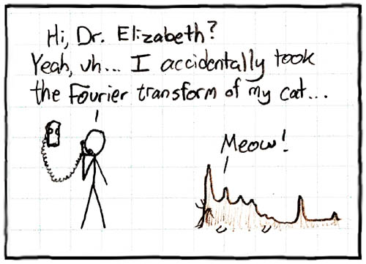
Chapter 7: Random Variables; Discrete Versus Continuous
http://math.sfsu.edu/beck/quotes.html

Slide 3
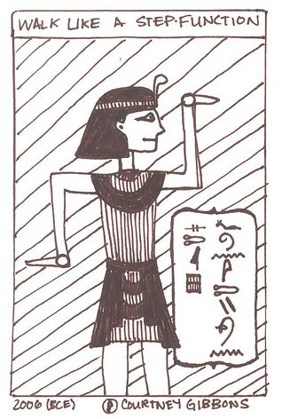
Chapter 8: Probability Mass Functions and Cumulative Distribution Functions
The 50-50-90 rule: Anytime
You have a 50-50 chance of
getting something right,
there’s a 90% probability
you’ll get it wrong.
Andy Rooney
http://brownsharpie.courtneygibbons.org/?p=161

Slide 4
Probability Mass Density Cumulative Density Function
Def. 8.1: If X is a random variable, the probability that X is exactly equal to X is called the PMF
p_{X}(x) = P(X = x)
Def. 8.2: If X is a random variable, the probability that X does not exceed x is called the CDF
F_{X}(x) = P(X ≤ x)

Slide 5
Histogram: interpretation of PMF
Theoretical
Simulated
1000 times
Simulated
10,000 times

Slide 6
Example 8.4 (Fig. 8.3)
mass
CDF

Slide 7
More on CDFs
CDFs should always be written as piece-wise functions like the following
$$F_{X}\left(x\right)=\left\{\begin{matrix}0 & x≤0 \\ 0.369 & 0≤x<1 \\ \begin{matrix}0.584 \\ 0.816 \\ 1\end{matrix} & \begin{matrix} 1≤x<2 \\ 2≤x<3 \\ 3≤x\end{matrix}\end{matrix}\right.$$

Slide 8
More on CDFs (cont.)
Because CDFs are not right continuous,
P(X ≤ a) ≠ P(X < a)
F_{X}(a) = P(X ≤ a)
F_{X}(a-) = P(X < a)
To calculate a probability
P(a < X ≤ b) = F_{X}(b) – F_{X}(a)
P(a ≤ X < b) = F_{X}(b-) – F_{X}(a-)
a
b
a
b

Slide 9
Calculation of Probabilities from CDFs
Let X be a random variable. Then for all real numbers a,b where a < b
P(a < X ≤ b) = F_{X}(b) – F_{X}(a)
P(a ≤ X ≤ b) = F_{X}(b) – F_{X}(a-)
P(a < X < b) = F_{X}(b-) – F_{X}(a)
P(a ≤ X < b) = F_{X}(b-) – F_{X}(a-)
P(X = a) = F_{X}(a) – F_{X}(a-)

Slide 10
Chapter 8: Jointly Distributed Random Variables; Independence and Conditioning
The most misleading assumptions are the ones you don’t even know you’re making.
Douglas Adams and Mark Carwardine
http://math.stackexchange.com/questions/314072/joint-probability-mass-function
X

Slide 11
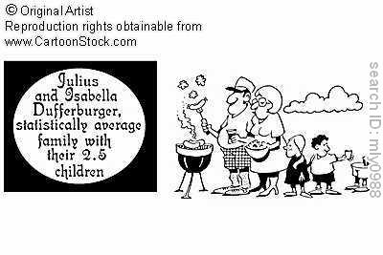
Chapters 9: Expected Values of Discrete Random Variables
http://www.cartoonstock.com/directory/a/average_family_gifts.asp
X

Slide 12
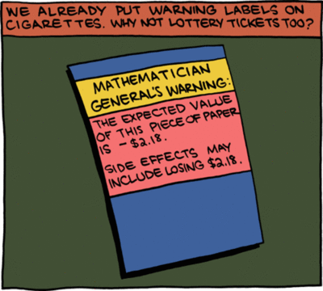
Chapter 10: Expected Values of Sums of Random Variables
http://faculty.wiu.edu/JR-Olsen/wiu/stu/m206/front.htm
X

Slide 13
Chapter 11: Expected Values of Functions of Discrete Random Variables; Variance of Discrete Random Variables
http://fightingdarwin.blogspot.com/2011_12_01_archive.html
X

