Slide 1
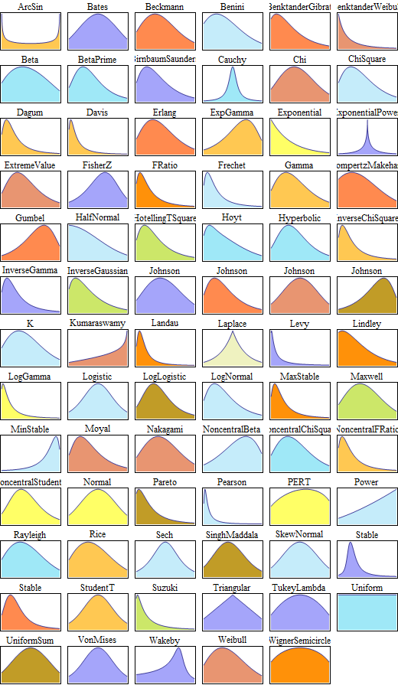
Chapter 38: Summary and Review of Named Continuous R.V.
http://www.wolfram.com/mathematica/new-in-8/parametric-probability-distributions
/univariate-continuous-distributions.html

Slide 2
Summary of Continuous Distributions
Name
Density, f_{X}(x)
Domain
CDF, F_{X}(x)
$𝔼$(X)
Var(X)
Parameters
What X is
When used

Slide 3
Summary of Continuous Distributions

Slide 4
Expected values and Variances for selected families of continuous random variables.
Family | Parameter(s) | Expectation | Variance
Uniform | a,b
Exponential | λ
Normal | μ,σ² | μ | σ²

