Slide 1
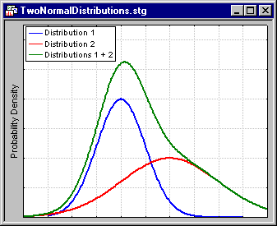
Chapter 36: Sums of Independent Normal Random Variables
https://www.statsoft.com/Textbook/Cluster-Analysis

Slide 2
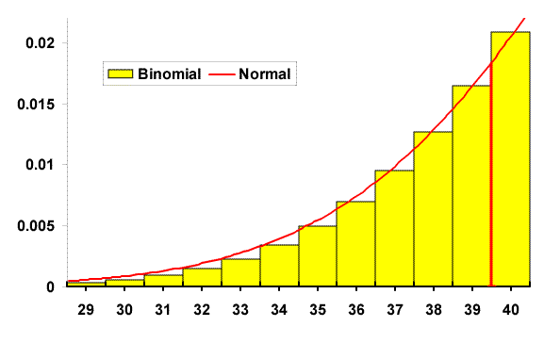
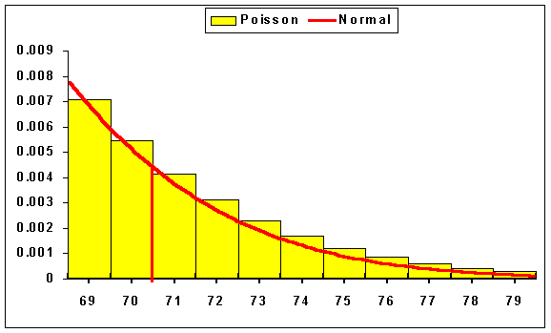
Chapter 37: Central Limit Theorem (Normal Approximations to Discrete Distributions – 36.4, 36.5)
http://nestor.coventry.ac.uk/~nhunt/binomial/normal.html
http://nestor.coventry.ac.uk/~nhunt/poisson
/normal.html

Slide 3
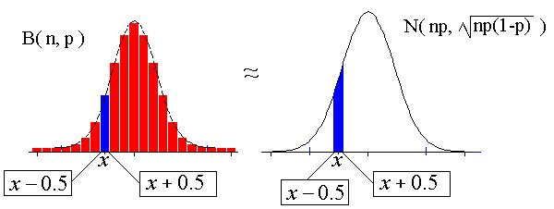
Continuity Correction - 1
http://www.marin.edu/~npsomas/Normal_Binomial.htm

Slide 4
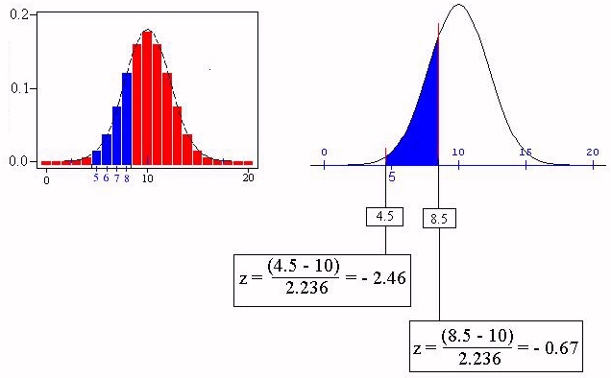
Continuity Correction - 2
W~N(10, 5)
X ~ Binomial(20, 0.5)

Slide 5
Continuity Correction - 3
Discrete | Continuous
a < X | a + 0.5 < X
a ≤ X | a – 0.5 < X
X < b | X < b – 0.5
X ≤ b | X < b + 0.5

Slide 6
Normal Approximation to Binomial

Slide 7
Example: Normal Approximation to Binomial (Class)
The ideal size of a first-year class at a particular college is 150 students. The college, knowing from past experience that on the average only 30 percent of these accepted for admission will actually attend, uses a policy of approving the applications of 450 students.
Compute the probability that more than 150 students attend this college.
Compute the probability that fewer than 130 students attend this college.

Slide 8
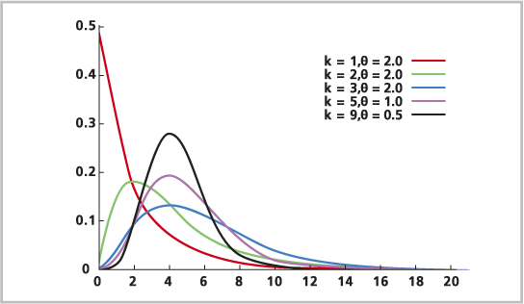
Chapter 33: Gamma R.V.
http://resources.esri.com/help/9.3/arcgisdesktop/com/gp_toolref
/process_simulations_sensitivity_analysis_and_error_analysis_modeling
/distributions_for_assigning_random_values.htm

Slide 9
Gamma Distribution
Generalization of the exponential function
Uses
probability theory
theoretical statistics
actuarial science
operations research
engineering

Slide 10
Gamma Function
Γ(t + 1) = t Γ(t), t > 0, t real
Γ(n + 1) = n!, n > 0, n integer

Slide 11
Gamma Distribution: Summary
Things to look for: waiting time until r^{th} event occurs
Variable: X = time until the rth event occurs, X ≥ 0
Parameters:
r: total number of arrivals/events that you are waiting for
λ: the average rate
Density:
$$f_{x}\left(x\right)=\left\{\begin{matrix}\frac{λ^{r}}{Γ(r)}x^{r−1}e^{−λx} & x>0 \\ 0 & else\end{matrix}\right. 𝔼\left(X\right)=\frac{r}{λ}, Var\left(X\right)=\frac{r}{λ^{2}}$$
$${CDF: F}_{X}\left(x\right)=\left\{\begin{matrix}1−e^{−λx}\sum_{j=0}^{r−1}{\frac{{(λx)}^{j}}{j!}} & x>0 \\ 0 & else\end{matrix}\right.$$

Slide 12
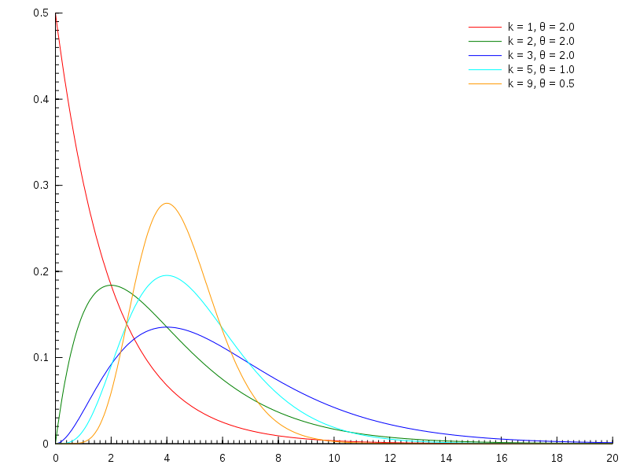
Gamma Random Variable
k = r
$$θ=\frac{1}{λ}$$
http://en.wikipedia.org/wiki/File:Gamma_distribution_pdf.svg

Slide 13
Chapter 34: Beta R.V.
http://mathworld.wolfram.com/BetaDistribution.html

Slide 14
Beta Distribution
This distribution is only defined on an interval
standard beta is on the interval [0,1]
The formula in the book is for the standard beta
uses
modeling proportions
percentages
probabilities

Slide 15
Beta Distribution: Summary
Things to look for: percentage, proportion, probability
Variable: X = percentage, proportion, probability of interest (standard Beta)
Parameters:
α, β
Density:
$$f_{x}\left(x\right)=\left\{\frac{1}{B−A}\begin{matrix}\frac{Γ(α+β)}{Γ(α)Γ(β)}{\left(\frac{x−A}{B−A}\right)}^{α−1}{\left(\frac{x−A}{B−A}\right)}^{β−1} & A≤x≤B \\ 0 & else\end{matrix}\right.$$
Density: no simple form
When A = 0, B = 1 (Standard Beta)
$$𝔼\left(X\right)=\frac{α}{α+β}, Var\left(X\right)=\frac{αβ}{{\left(α+β\right)}^{2}(α+β+1)}$$

Slide 16
Shapes of Beta Distribution
http://upload.wikimedia.org/wikipedia/commons/9/9a/Beta_distribution_pdf.png
X

Slide 17
Other Continuous Random Variables
Weibull
exponential is a member of family
uses: lifetimes
lognormal
log of the normal distribution
uses: products of distributions
Cauchy
symmetrical, flatter than normal

