Slide 1
Chapter 3: Normal R.V.
http://delfe.tumblr.com/

Slide 2
Normal Distribution: Summary
Things to look for: bell curve,
Variable:
X = the event
Parameters:
μ_{X} = the mean
$$σ_{X}^{2}=the variance$$
Density:
$$f_{x}\left(x\right)=\frac{e^{−{{(x−μ_{x})}^{2}}/{(2σ^{2})}}}{\sqrt{2πσ^{2}}}, x ε ℝ$$
$$𝔼\left(X\right)=\text{μ}\text{X}, Var\left(X\right)=σ_{X}^{2}$$

Slide 3
PDF of Normal Distribution (cont)
http://commons.wikimedia.org/wiki/File:Normal_distribution_pdf.svg

Slide 4
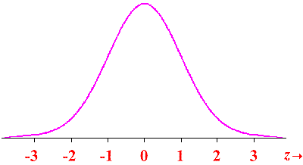
PDF of Normal Distribution
http://www.oswego.edu/~srp/stats/z.htm

Slide 6
PDF of Normal Distribution (cont)
http://commons.wikimedia.org/wiki/File:Normal_distribution_pdf.svg

Slide 7
Using the Z table
P(Z > z)
area right of z = 1 − area left of z
area between z₁ and z₂ = area left of z₁ – area left of z₂
P(z₁ < Z < z₂)

Slide 8
Procedure for doing Normal Calculations
Sketch the problem.
Write down the probability of interest in terms of the original problem.
Convert to standard normal.
Convert to CDFs.
Use the z-table to write down the values of the CDFs.
Calculate the answer.

Slide 9
Example: Normal r.v. (Class)
The gestation periods of women are normally distributed with μ = 266 days and σ = 16 days. Determine the probability that a gestation period is
less than 225 days.
between 265 and 295 days.
more than 276 days.
less than 300 days.
Among women with a longer than average gestation, what is the probability that they give birth longer than 300 days?

Slide 10
Example: “Backwards” Normal r.v. (Class)
The gestation periods of women are normally distributed with μ = 266 days and σ = 16 days. Find the gestation length for the following situations:
longest 6%.
shortest 13%.
middle 50%.

Slide 11
Example: Normal r.v. (class)
Suppose that a Scottish soldier's chest size is normally distributed with μ = 39.8 inches and σ = 2.05 inches.
a) What is the probability that a Scottish soldier has a chest size of less than 35 inches?
b) What is the probability that a Scottish soldier has a chest of at least 40 inches?
c) What is the probability that a Scottish soldier has a chest size between 35 and 40 inches?

