Slide 1
Part VI: Named Continuous Random Variables
http://www-users.york.ac.uk/~pml1/bayes/cartoons/cartoon08.jpg

Slide 2
Comparison of Named Distributions
discrete | continuous
Bernoulli, Binomial, Geometric, Negative Binomial, Poisson, Hypergeometric, Discrete Uniform | Continuous Uniform, Exponential, Gamma, Beta, Normal

Slide 3
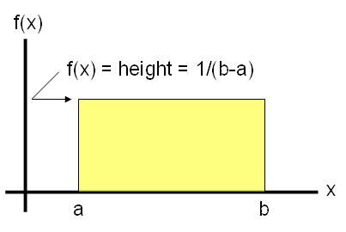
Chapter 31: Continuous Uniform R.V.
http://www.six-sigma-material.com/Uniform-Distribution.html

Slide 4
Uniform distribution: Summary
Things to look for: constant density on a line or area
Variable:
X = an exact position or arrival time
Parameter:
(a,b): the endpoints where the density is nonzero.
Density: CDF:
$$f_{x}\left(x\right)=\left\{\begin{matrix}\frac{1}{b−a} & a≤x≤b \\ 0 & else\end{matrix} \right.F_{X}\left(x\right)=\left\{\begin{matrix}0 & x<a \\ \frac{x−a}{b−a} & a≤x≤b \\ 1 & b<x\end{matrix}\right.$$
$$𝔼\left(X\right)=\frac{a+b}{2}, Var\left(X\right)=\frac{{(b−a)}^{2}}{12}$$

Slide 5
Example: Uniform Distribution (Class)
A bus arrives punctually at a bus stop every thirty minutes. Each morning, a bus rider leaves her house and casually strolls to the bus stop.
Why is this a Continuous Uniform distribution situation? What are the parameters? What is X?
What is the density for the wait time in minutes?
What is the CDF for the wait time in minutes?
Graph the density.
Graph the CDF.
What is the expected wait time?

Slide 6
Example: Uniform Distribution (Class)
A bus arrives punctually at a bus stop every thirty minutes. Each morning, a bus rider leaves her house and casually strolls to the bus stop.
What is the standard deviation for the wait time?
What is the probability that the person will wait between 20 and 40 minutes? (Do this via 3 different methods.)
Given that the person waits at least 15 minutes, what is the probability that the person will wait at least 20 minutes?

Slide 7
Example: Uniform Distribution

Slide 8
Example: Uniform Distribution (Class)
A bus arrives punctually at a bus stop every thirty minutes. Each morning, a bus rider leaves her house and casually strolls to the bus stop.
Let the cost of this waiting be $20 per minute plus an additional $5.
What are the parameters?
What is the density for the cost in minutes?
What is the CDF for the cost in minutes?
What is the expected cost to the rider?
What is the standard deviation of the cost to the rider?

Slide 9
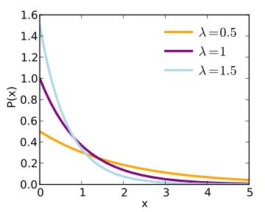
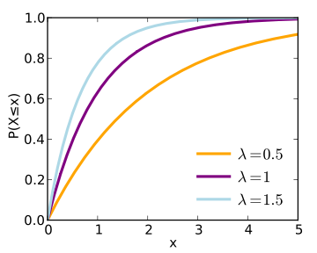
Chapter 32: Exponential R.V.
http://en.wikipedia.org/wiki/Exponential_distribution

Slide 10
Exponential Distribution: Summary
Things to look for: waiting time until first event occurs or time between events.
Variable:
X = time until the next event occurs, X ≥ 0
Parameter:
λ: the average rate
Density: CDF:
$$f_{x}\left(x\right)=\left\{\begin{matrix}λe^{−λx} & x>0 \\ 0 & else\end{matrix} \right.F_{X}\left(x\right)=\left\{\begin{matrix}1−e^{−λx} & x>0 \\ 0 & else\end{matrix}\right.$$
$$𝔼\left(X\right)=\frac{1}{λ}, Var\left(X\right)=\frac{1}{λ^{2}}$$

Slide 11
Example: Exponential R.V. (class)
Suppose that the arrival time (on average) of a large earthquake in Tokyo occurs with an exponential distribution with an average of 8.25 years.
What does X represent in this story? What values can X take?
Why is this an example of the Exponential distribution?
What is the parameter for this distribution?
What is the density?
What is the CDF?
What is the standard deviation for the next earthquake?

Slide 12
Example: Exponential R.V. (class, cont.)
Suppose that the arrival time (on average) of a large earthquake in Tokyo occurs with an exponential distribution with an average of 8.25 years.
What is the probability that the next earthquake occurs after three but before eight years?
What is the probability that the next earthquake occurs before 15 years?
What is the probability that the next earthquake occurs after 10 years?
How long would you have to wait until there is a 95% chance that the next earthquake will happen?

Slide 13
Example: Exponential R.V. (Class, cont.)
Suppose that the arrival time (on average) of a large earthquake in Tokyo occurs with an exponential distribution with an average of 8.25 years.
k) Given that there has been no large Earthquakes in Tokyo for more than 5 years, what is the chance that there will be a large Earthquake in Tokyo in more than 15 years? (Do this problem using the memoryless property and the definition of conditional probabilities.)

Slide 14
Minimum of Two (or More) Exponential Random Variables
Theorem 31.5
If X₁, …, X_{n} are independent exponential random variables with parameters λ₁, …, λ_{n} then Z = min(X₁, …, X_{n}) is an exponential random variable with parameter λ₁ + … + λ_{n}.

