Slide 1
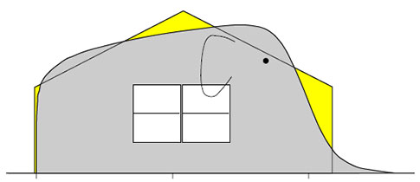
Chapter 28: Expected values
http://www.qualitydigest.com/inside/quality-insider-article
/problems-skewness-and-kurtosis-part-one.html#

Slide 2
Comparison of Expected Values
Discrete | Continuous
$$𝔼\left(X\right)=\sum_{x}{xp_{X}(x)}$$ | $$𝔼\left(X\right)=\int_{−∞}^{∞}{xf_{X}\left(x\right)dx}$$

Slide 3
Example: Expected Value (class)
What is the expected value in each of the following situations:
a) The following is the density of the magnitude X of a dynamic load on a bridge (in newtons)
b) The train to Chicago leaves Lafayette at a random time between 8 am and 8:30 am. Let X be the departure time.

Slide 4
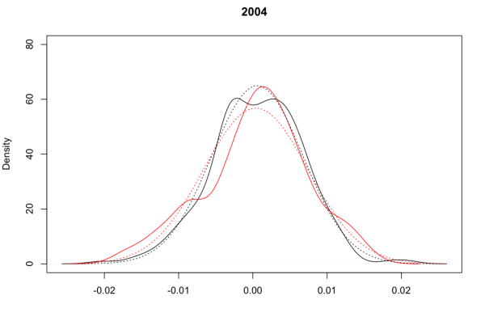
Chapter 29: Functions, Variance
http://quantivity.wordpress.com/2011/05/02/empirical-distribution-minimum-variance/

Slide 5
Comparison of Functions, Variances
 | Discrete | Continuous
Function (general) | $$𝔼\left(g(X)\right)=\sum_{x}{g(x)p_{X}(x)}$$ | $$𝔼\left(g(X)\right)=\int_{−∞}^{∞}{g(x)f_{X}\left(x\right)dx}$$
Function (X²) | $$𝔼\left(X^{2}\right)=\sum_{x}{x^{2}p_{X}(x)}$$ | $$𝔼\left(X^{2}\right)=\int_{−∞}^{∞}{x^{2}f_{X}\left(x\right)dx}$$
Variance | Var(X) = $𝔼$(X²) – ($𝔼$(X))² | Var(X) = $𝔼$(X²) – ($𝔼$(X))²
SD | $$σ_{X}=\sqrt{Var(X)}$$ | $$σ_{X}=\sqrt{Var(X)}$$

Slide 6
Example: Expected Value - function (class)
What is $𝔼$(X²) in each of the following situations:
a) The following is the density of the magnitude X of a dynamic load on a bridge (in newtons)
b) The train to Chicago leaves Lafayette at a random time between 8 am and 8:30 am. Let X be the departure time.

Slide 7
Example: Variance (class)
What is the variance in each of the following situations:
a) The following is the density of the magnitude X of a dynamic load on a bridge (in newtons)
b) The train to Chicago leaves Lafayette at a random time between 8 am and 8:30 am. Let X be the departure time.

Slide 8
Friendly Facts about Continuous Random Variables - 1
Theorem 28.18: Expected value of a linear sum of two or more continuous random variables:
$𝔼$(a₁X₁ + … + a_{n}X_{n}) = a₁$𝔼$(X₁) + … + a_{n}$𝔼$(X_{n})
Theorem 28.19: Expected value of the product of functions of independent continuous random variables:
$𝔼$(g(X)h(Y)) = $𝔼$(g(X))$𝔼$(h(Y))

Slide 9
Friendly Facts about Continuous Random Variables - 2
Theorem 28.21: Variances of a linear sum of two or more independent continuous random variables:
Var(a₁X₁ + … + a_{n}X_{n}) =$a_{1}^{2}$Var(X₁) + … + $a_{n}^{2}$Var(X_{n})
Corollary 28.22: Variance of a linear function of continuous random variables:
Var(aX + b) = a²Var(X)

