Slide 1
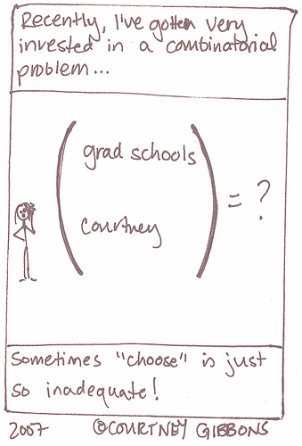
Part 4: Counting
High
http://brownsharpie.courtneygibbons.org/?cat=22

Slide 2
Ways of Counting
 | with Replacement | without Replacement
order matters
order does not matter
BCR (Tree diagram)
Permutation (nPr)
SB (Stars and Bars)
Combination (nCr)
n = # of objects to choose from
r = # of objects that we actually choose

Slide 3
Sampling with Replacement, order matters (BCR)
Suppose that a sample of size 2 is drawn with replacement from a population of size 5.
a) Use a direct listing to determine the number of possible ordered pairs.
b) Solve part (a) by using BCR.
c) Determine the number of possible ordered samples of size r with replacement from a population of size n.
aa | ab | ac | ad | ae | ba | bb | bc | bd | be
ca | cb | cc | cd | ce | da | db | dc | dd | de
ea | eb | ec | ed | ee

Slide 4
Sampling Without Replacement, order matters (Permutation)
Suppose that a sample of size 2 is drawn without replacement from a population of size 5.
a) Use a direct listing to determine the number of possible ordered pairs.
b) Solve part (a) by using BCR.
aa | ab | ac | ad | ae | ba | bb | bc | bd | be
ca | cb | cc | cd | ce | da | db | dc | dd | de
ea | eb | ec | ed | ee

Slide 5
Sampling Without Replacement , order does not matter(Combination)
Suppose that a sample of size 2 is drawn without replacement from a population of size 5.
Use a direct listing to determine the number of possible unordered pairs.
aa | ab | ac | ad | ae | ba | bb | bc | bd | be
ca | cb | cc | cd | ce | da | db | dc | dd | de
ea | eb | ec | ed | ee

Slide 6
Sampling With Replacement, order does not matter (SB)
Suppose that a sample of size 2 is drawn with replacement from a population of size 5.
a) Use a direct listing to determine the number of possible unordered pairs.
b) Determine the number of possible unordered samples of size r with replacement from a population of size n.
aa | ab | ac | ad | ae | ba | bb | bc | bd | be
ca | cb | cc | cd | ce | da | db | dc | dd | de
ea | eb | ec | ed | ee

Slide 7
SB: Examples
How many different sets of non-negative numbers x, y and z are solutions for the following equation: x + y + z = 136.
How many ways are there to buy 13 bagels from 17 types if you can repeat the types of bagels?

Slide 8
Example
An ordinary deck of 52 playing cards is shuffled and dealt. What is the probability that
a) the 7th card is an ace?
b) the 7th card is the first ace?

Slide 9
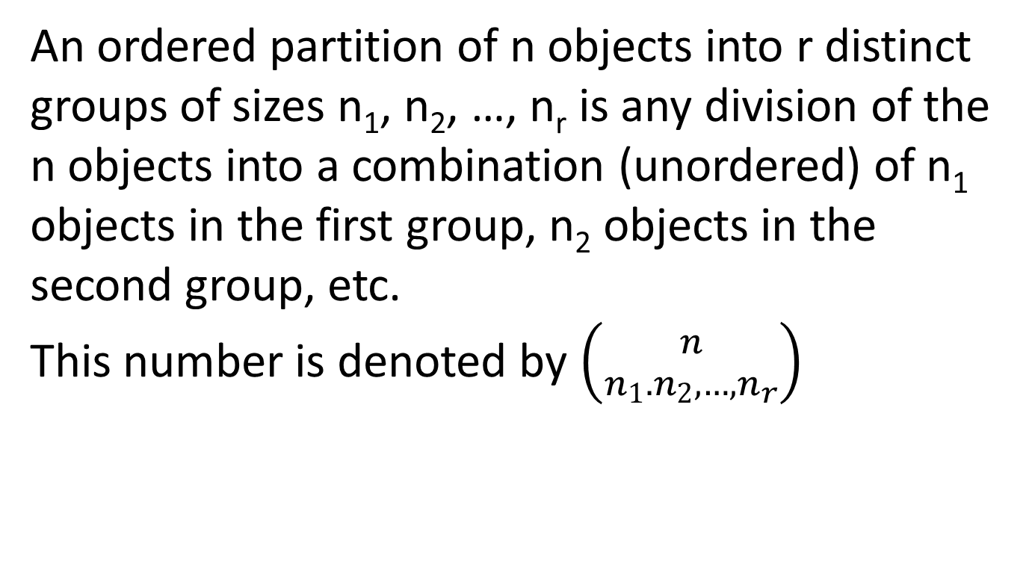
Ordered Partition - Definition
          An ordered partition of n objects into r distinct groups of sizes n₁, n₂, …, n_{r} is any division of the n objects into a combination (unordered) of n₁ objects in the first group, n₂ objects in the second group, etc.
            This number is denoted by $\left({n \atop n_{1}.n_{2},…, n_{r}}\right)$

Slide 10
Ordered Partition: Example
List all of the possible ordered partitions of these 5 letters into two distinct groups of sizes 3 and 2.
b) Use part (a) to determine the number of possible ordered partitions of the 5 letters into the two groups.
c) Use the combinations rule and BCR to determine the number of possible ordered partitions of the 5 letters into the 2 groups.
{abc},{de} | {abd},{ce} | {abe},{cd} | {acd},{be} | {ace},{bd}
{ade},{bc} | {bcd},{ae} | {bce},{ad} | {bde},{ac} | {cde},{ab}

Slide 11
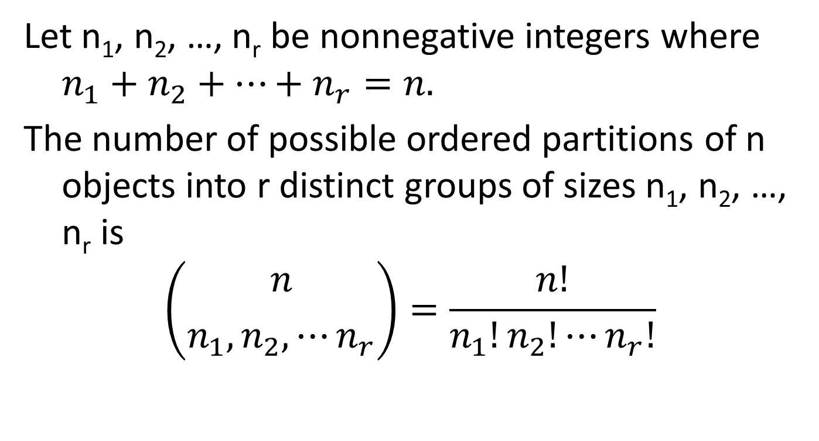
Ordered Partition - formula
Let n₁, n₂, …, n_{r} be nonnegative integers where $n_{1}+n_{2}+⋯+n_{r}=n.$
The number of possible ordered partitions of n objects into r distinct groups of sizes n₁, n₂, …, n_{r} is
$$\left({n \atop n_{1},n_{2},⋯n_{r}}\right)=\frac{n!}{n_{1}!n_{2}!⋯n_{r}!}$$

Slide 12
Birthday Problem
What is the probability that at least two students in this class, size = 21, have the same birthday?
What is the probability that at least two students in this class, size = 30, have the same birthday?

Slide 13
Coincidences
…Once we set aside coincidences having apparent causes, four principles account for large numbers of remaining coincidences: hidden cause; psychology, including memory and perception; multiplicity of endpoints, including the counting of "close" or nearly alike events as if they were identical; and the law of truly large numbers, which says that when enormous numbers of events and people and their interactions cumulate over time, almost any outrageous event is bound to occur. These sources account for much of the force of synchronicity. (Abstract)
….. The probability problems discussed in Section 7 make the point that in many problems our intuitive grasp of the odds is far off. We are often surprised by things that turn out to be fairly likely occurrences. (Introduction)
Diaconis, P. and Mosteller, F. "Methods for Studying Coincidences." J. Amer. Statist. Assoc. 84, 853-861, 1989

