Slide 1
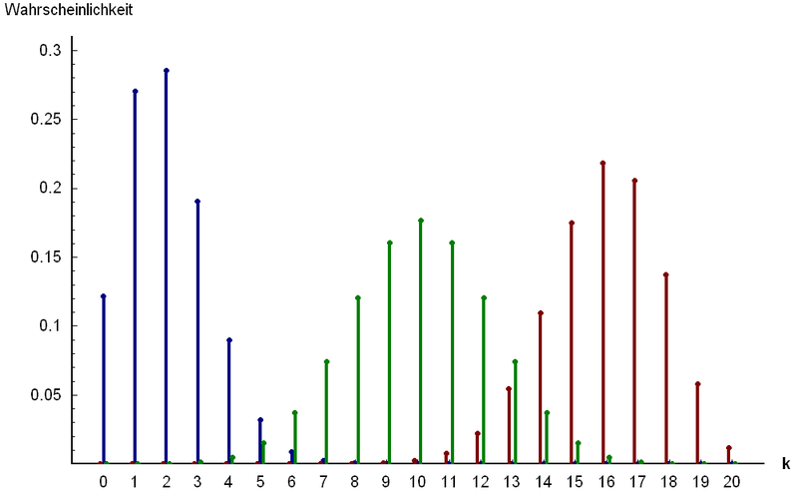
Part 2: Named Discrete Random Variables
http://www.answers.com/topic/binomial-distribution

Slide 2
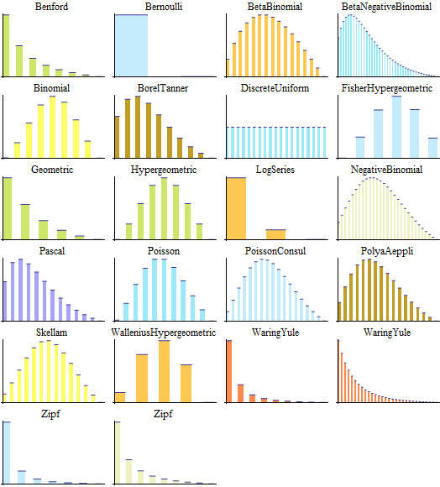
Chapter 21: Summary of Part III
http://www.wolfram.com/mathematica/new-in-8/parametric-probability-distributions
/univariate-discrete-distributions.html

Slide 3
Summary of Discrete Distributions

Slide 4
Expected values and Variances for selected families of discrete random variables.
Family | Param(s) | Expected Value | Variance
Bernoulli | p | p | q
Binomial | n,p | np | npq
Geometric | p | 1/p | q/p²
Neg. Binomial | r,p | r/p | qr/p²
Poisson | λ | λ | λ
Hypergeometric | N,n,p | $$n\frac{M}{N}$$ | $$n\frac{M}{N}\left(1−\frac{M}{N}\right)\frac{N−n}{N−1}$$
Discrete Uniform | N | $$\frac{N+1}{2}$$ | $$\frac{N^{2}−1}{12}$$

Slide 5
Example: Determine the Distribution (class)
For each of the following situations, state which distribution (and approximation distribution if applicable) would be appropriate and why. Also please state all parameters. Note: A possible answer is ‘none’.
Exercises 20.1 – 20.9 (pp. 271 – 272)
Typo is 20.6 Let X be the number of broken ice cream cones….
20.a: Let X be the number of ice cream cones that you need to sample to find the 2nd waffle cone and the 3rd regular cone if they come from a large, independent population and 10% of the waffle cones are broken and 15% of the regular cones are broken.
20.b: Let X be the number of ice cream cones in your sample which are broken if you sample 50 of them from 2 boxes, one of which was roughly handled and the other was handled normally. Assume that 12% of the cones from the plant are broken and handling the box roughly breaks an additional 2%.
20.c: Let X be the number of broken ice cream cones that you give to your class of 20 if originally 12 of the 100 ice cream cones in the box are broken. To avoid jealousy, you give one ice cream cone per person whether they are broken or not.

