Slide 1
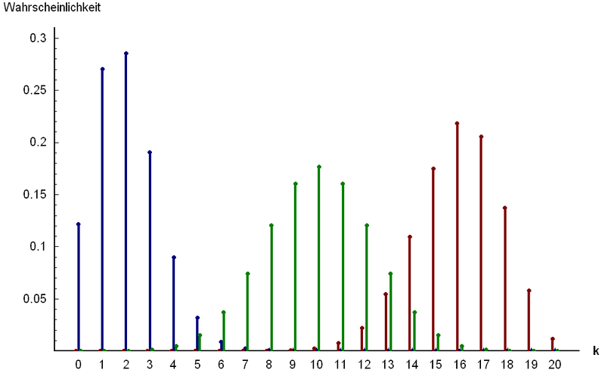
Part 2: Named Discrete Random Variables
http://www.answers.com/topic/binomial-distribution

Slide 2
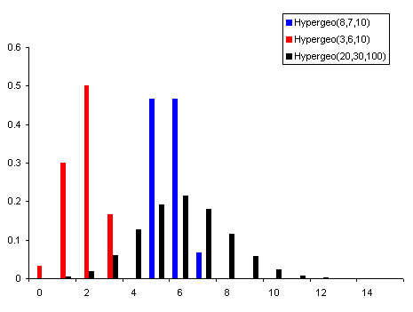
Chapter 19: Hypergeometric Random Variables
http://www.vosesoftware.com/ModelRiskHelp/index.htm#Distributions
/Discrete_distributions/Hypergeometric_distribution.htm

Slide 3
Hypergeometric distribution: Summary
Things to look for: Bn, without Replacement
Variable: X = # of successes
Parameters:
N = total number of items in population
M = total number of successes in population
N – M = total number of failures in population
n = items selected
Mass:
$P\left(X = x\right)=\frac{\left({M \atop x}\right)\left({N−M \atop n−x}\right)}{\left({N \atop n}\right)}$
$$𝔼\left(X\right)=n\frac{M}{N}$$
$$Var\left(X\right)=n\frac{M}{N}\left(1−\frac{M}{N}\right)\frac{N−n}{N−1}$$

Slide 4
Example: Hypergeometric Distribution
A quality assurance engineer of a company that manufactures TV sets inspects finished products in lots of 100. He selects 5 of the 100 TV’s at random and inspects them thoroughly. Let X denote the number of defective TV’s obtained. If, in fact 6 of the 100 TVs in the current lot are actually defective, find the mass of the random variable X.

Slide 5
Example: Hypergeometric Distribution (2) - class
A textbook author is preparing an answer key for the answers in a book. In 500 problems, the author has made 25 errors. A second person checks seven of these calculations randomly. Assume that the second person will definitely find the error in an incorrect answer.
Explain in words what X is in this story. What values can it take?
Why is this a Hypergeometric distribution? What are the parameters?
What is the probability that the second person finds exactly 1 error?
What is the probability that the second person finds at least 2 errors?
What is the expected number of errors that the second person will find?
What is the standard deviation of the number or errors that the second person will find?

Slide 6
Example: Capture-Recapture Sampling
Estimating the Size of a Population. Suppose that an unknown number, N, of bluegills inhabit a small lake and that we want to estimate that number. One procedure for doing so, often referred to as the capture-recapture method, is to proceed as follows:
Capture and tag some of the fish, say 250 and then release the fish back into the lake and give them time to disperse.
Capture some more of the animals, say 150, and determine the number that are tagged, say 16. These are the recaptures.
Use the data to estimate N.

Slide 7
Example: Hoosier Lotto (class)
The Lotto. In the Hoosier lotto, a player specifies six numbers of her choice from the numbers 1 – 48. In the lottery drawing, six winning numbers are chosen at random without replacement from the numbers 1 – 48. To win a prize, a lotto ticket must contain two or more of the winning numbers.
Confirm the mass of X from the Hoosier lottery web site which is on the next page. (Homework)
If the player buys one Lotto ticket, determine the probability that she wins a prize (at least 2 numbers correct).
If the player buys one Lotto ticket per week for a year, determine the probability that she wins a prize at least once in the 52 tries. (Hint: What is this distribution?)

Slide 8
Example: Hoosier Lotto (cont)
These are the odds from the Hoosier lottery (https://www.hoosierlottery.com/games/hoosier-lotto)
6 OF 6 1:12,271,512 5 OF 6 1:48,696
4 OF 6 1:950 3 OF 6 1:53
2 OF 6 1:7

Slide 9
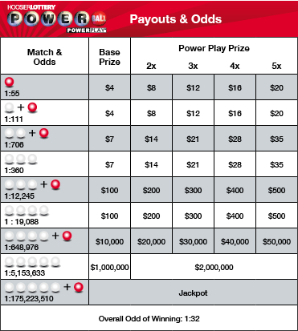
Example: Powerball (BONUS)
When playing Powerball, you receive a ticket with five (5) numbers from 1 – 59 and one (1) Powerball number from 1 – 35. Confirm the following odds (including the overall odds of winning):

Slide 10
Binomial Approximation to the Hypergeometric
M = 200

